Slide 1


Computer Science Tutors Wanted for 2014
Why Tutor?
Consolidate your Computer Science knowledge
Network with fellow students and staff
Be a role model and help less experienced students
Develop skills and experience for your CV
Earn some money
Eligibility
Those doing CS2, CS3 or Honours in 2014
Application
Online form: http://dl.cs.uct.ac.za/cs/tutors2014
Queries
Contact Gary Stewart <gstewart@cs.uct.ac.za>

Slide 2
Ethics & Professionalism
Outcomes and Review

Slide 3
Learning outcomes
Be aware of and sensitive to ethical dilemmas, legal restrictions and professional codes in computing
Understand what it means to be a profession and a professional, and the associated benefits and responsibilities
Know and understand why computing is regarded by some as different/special with regard to ethics, professionalism, copyright, trade secrecy and patenting
On reading about a possible computing scenario, be able to identify and discuss the ethical & professional issues it raises and know how to address them

Slide 4
What is examinable in Ethics
Everything that is on the 2012 slides i.e. the Vula powerpoint on Resources for “Ethics”
Some slides have notes below

Slide 5
What you should know (1)
New terminology in all parts of this module – be able to explain terms and concepts in your own words to show you understand them
What is meant by ethics
The difference between ethical and legal
Arguments for & against “computer ethics is special, different from ethics in other fields”

Slide 6
What you should know (2)
How to analyse a given scenario/ethical dilemma
List relevant facts & stakeholders
Outline at least 3 possible courses of action
2 extremes and 1 comprise
Analyse possible courses of action using
Philosophical ethics / ethical theories (e.g. utilitarianism)
Formal guidelines / codes of conduct / codes of practice
Informal guidelines (e.g. TV test)
[a 4th analysis is from a legal viewpoint, but not in exams]

Slide 7
What you should know (3)
what is a profession
what are the advantages and disadvantages of becoming a profession
arguments for & against: “is computing a profession”
the 5 professional relationships
(employer/employee, client, professional society, the public, fellow professionals)

Slide 8
What you should know (4)
what is the benefit of a professional society
and the CSSA disciplinary procedure & its benefits
and the ACM and what it offers its members
what it meant by a code of conduct & a code of practice
Understand the CSSA and BCS codes
be able to give the gist (general idea) of some typical guidelines in computing codes like the ACM, CSSA and BCS

Slide 9
What you should know (5)
what is privacy and why is it valuable
why computer/internet data is different from other forms of record keeping and surveillance
what is the EFF and what does it do
what we should do to protect our online privacy
privacy (e.g. communication privacy) is in the SA Bill of Rights
how SA’s protection of personal information (POPI) bill limits data processing to enforce our rights as regards unsolicited mail and automated decision-making

Slide 10
What you should know (6)
copyright protects the expression of an idea from being copied without permission
trade secrecy laws allow companies to keep information secret through licensing and non-disclosure agreements
patents grant a monopoly on a (new, useful & non-obvious) invention to its inventor while promoting its disclosure (so as to foster further inventions)
covers ideas not their expression as code
but there are 100s of patents software products could infringe, a minefield for developers who aren’t huge corporations
computer programs cannot be patented in SA

Slide 11
What you should know (7)
what is the digital divide
we can bridge this through appropriate studies, on-the-ground designs and implementations, policy reforms
technologies like wireless networks, mobiles, open source and VOIP are useful in ICT4D
but human factors are most important (design, acceptance, usability, training, affordability)

Slide 12
What you should know (8)
what is meant by open source, open standards, open content, FOSS, copyleft, and sampling licences, and their advantages & disadvantages
which are the commonly used open source operating systems, office suites, web servers, databases and programming languages (1 or 2 examples of each)

Slide 13
Exam structure (120 minutes)
Q1 Audrey 13
Q2 Sonia 13
Q3 Ethics 13
Q4 Stephan 13
Q5 Combo 13
20 – 25 minutes each

Slide 14
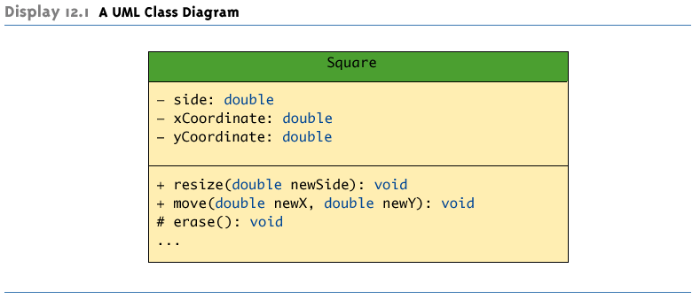
Data members: visibility name : type = default-value
Operation members: visibility name (parameter-list) : return-type
Ellipsis: some operations are not shown (. . .)

Slide 15
Relationship
1-way relationship
Inheritance
Parts destroyed when composite destroyed
Parts can exist on their own outside of the whole

Slide 16
The South African government has decided that all citizens should have access to their medical records, in keeping with the Promotion of Access to Information Act.
Information about a citizen includes: Name, Gender, Age, ID number, Address.
Each citizen can view his or her information but update only their address.
Medical records include: ID number, date, doctor; along with illness, notes and medicine (this is if the record is from a doctor) or injection, date, weight and pulse (this is if the record is from a clinic).
Each medical record belongs to a particular citizen who can be identified by ID number and a citizen can have any number of records.
The system can store and retrieve all information about the citizen. It can create a new medical record corresponding to each citizen. The medical record could either be a record from a doctor or a record from a clinic.
Given a correct ID number, a citizen can print their medical records.
Assume that all data is stored in a suitable data structure in memory while the program is running and then answer the following questions on this data structure.
Hint: Read ALL the questions in this section before you begin to answer any of them as the design of your solution must address all the issues noted.
(a) Draw a UML class diagram to illustrate all classes of the system and the relationships among them. In particular,
i.Identify the classes (there are 3 classes).[1]
ii.Draw a full class diagram for only one class.[2]
iii.Draw the relationship among the 3 classes.[2]

Slide 17
Information about a citizen includes: Name, Gender, Age, ID number, Address.
Each citizen can view his or her information but update only their address.
Medical records include: ID number, date, doctor; along with illness, notes and medicine (this is if the record is from a doctor) or injection, date, weight and pulse (this is if the record is from a clinic).
Each medical record belongs to a particular citizen who can be identified by ID number and a citizen can have any number of records.
The system can store and retrieve all information about the citizen. It can create a new medical record corresponding to each citizen. The medical record could either be a record from a doctor or a record from a clinic.
Given a correct ID number, a citizen can print their medical records.
(a) Draw a UML class diagram to illustrate all classes of the system and the relationships among them. In particular,
i.Identify the classes (there are 3 classes).[1]
ii.Draw a full class diagram for only one class.[2]
iii.Draw the relationship among the 3 classes.[2]

Slide 18
The SRC has asked you to create an online “dashboard” for UCT students. This will enable students to quickly and easily see their academic situation anywhere, any time. In addition, if the student has outstanding fees (not yet paid), then it will also show information about this.
The system will show to a student, for each course they are registered in, their current mark for this course and also the class average and highest mark in that course. If a student owes the university money, then the system will also show the amount of money owed, the date it is (or was) due, and the address to which the bills are being sent (res or home or bursar, for example).
(a) Assume that the system will have two classes: Student to manage a student's information and finances and Course to manage a course and marks. Draw a class diagram to represent the system. You may assume other variables/methods that you think are necessary to complete your class diagram. [5]
(b) Suppose your friend had built this system using a class Student and its subclass OwingStudent (to represent a student with unpaid fees) instead of integrating all information into one class. There is no fee amount, date or address variable in Student (these are only in OwingStudent).
Write a method that, given a Student as parameter, prints "Possible Grad Problem" if that student may be unable to graduate -either because your friend's boolean method passing() in Student returns false, or because of unpaid fees (or both). [5]
(c) Draw a diagram of a doubly linked list that contains nodes with data items of type String that contains the name, surname, and number of a student, as well as of type double that contains the outstanding fees of a student. Include an instance variable named head to indicate the beginning of the list. Insert the following nodes, in sorted order into the linked list: Marco, Bossi, MARBOS002, 0.0; Chika, Chika, CHICHI001, 12000.0; Bertina, Vusani, BERVUS001, 0.0. [2]
(d) Redraw the diagram created in Question (c) above after inserting a node containing Paul, Chaka, PAUCHA001, 0.0 in a sorted version of the linked list obtained in Question (c). Clearly show all the changes you make during the insertion AND state, in Java or pseudo-code, what instructions you would use to implement this insertion. [3]
(e) Give 3 major professional issues that arise in designing this application, and discuss how any one of these could be handled. [5]

Slide 19
The SRC has asked you to create an online “dashboard” for UCT students. This will enable students to quickly and easily see their academic situation anywhere, any time. In addition, if the student has outstanding fees (not yet paid), then it will also show information about this.
The system will show to a student, for each course they are registered in, their current mark for this course and also the class average and highest mark in that course. If a student owes the university money, then the system will also show the amount of money owed, the date it is (or was) due, and the address to which the bills are being sent (res or home or bursar, for example).
Assume that the system will have two classes: Student to manage a student's information and finances and Course to manage a course and marks. Draw a class diagram to represent the system. You may assume other variables/methods that you think are necessary to complete your class diagram. [5]

Slide 20
The SRC has asked you to create an online “dashboard” for UCT students. This will enable students to quickly and easily see their academic situation anywhere, any time. In addition, if the student has outstanding fees (not yet paid), then it will also show information about this.
The system will show to a student, for each course they are registered in, their current mark for this course and also the class average and highest mark in that course. If a student owes the university money, then the system will also show the amount of money owed, the date it is (or was) due, and the address to which the bills are being sent (res or home or bursar, for example).
(b) Suppose your friend had built this system using a class Student and its subclass OwingStudent (to represent a student with unpaid fees) instead of integrating all information into one class. There is no fee amount, date or address variable in Student (these are only in OwingStudent).
Write a method that, given a Student as parameter, prints "Possible Grad Problem" if that student may be unable to graduate -either because your friend's boolean method passing() in Student returns false, or because of unpaid fees (or both). [5]

Slide 21
The SRC has asked you to create an online “dashboard” for UCT students. This will enable students to quickly and easily see their academic situation anywhere, any time. In addition, if the student has outstanding fees (not yet paid), then it will also show information about this.
The system will show to a student, for each course they are registered in, their current mark for this course and also the class average and highest mark in that course. If a student owes the university money, then the system will also show the amount of money owed, the date it is (or was) due, and the address to which the bills are being sent (res or home or bursar, for example).
(c) Draw a diagram of a doubly linked list that contains nodes with data items of type String that contains the name, surname, and number of a student, as well as of type double that contains the outstanding fees of a student. Include an instance variable named head to indicate the beginning of the list. Insert the following nodes, in sorted order into the linked list: MARBOS002, 0.0; CHICHI001; BERVUS001, 0.0. [2]
(d) Redraw the diagram in (c) after inserting a node for PAUCHA001, 0.0 in a sorted version of the linked list obtained in Question (c). Clearly show all changes you make during the insertion AND state, in Java or pseudo-code, what instructions you would use to implement this insertion. [3]

Slide 22
Computer Science senior UG (typical class size in brackets)
CSC2001F = data structures & databases (150)
CSC2002S = mobile & multicore programming (150)
CSC2003S = game design, 2D game programming (50)
CSC3002F = networks, operating systems, func.prog.
CSC3003S = s/w eng, compilers, algorithms (100)
CSC3022H = C++, machine learning (50)
CSC3020H = 3D & distributed games (25)

Slide 23
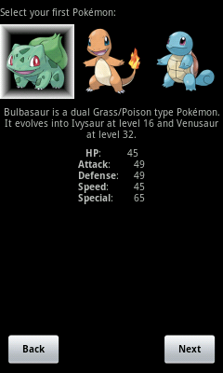
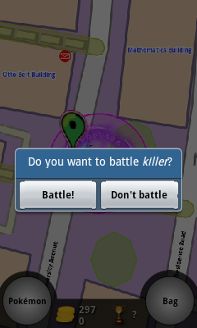
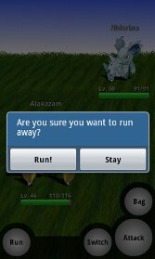
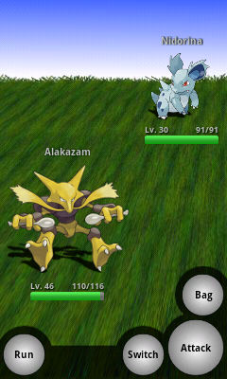
Notes:
CS Honours project using GPS on cellphones in a Pokemon game

Slide 24
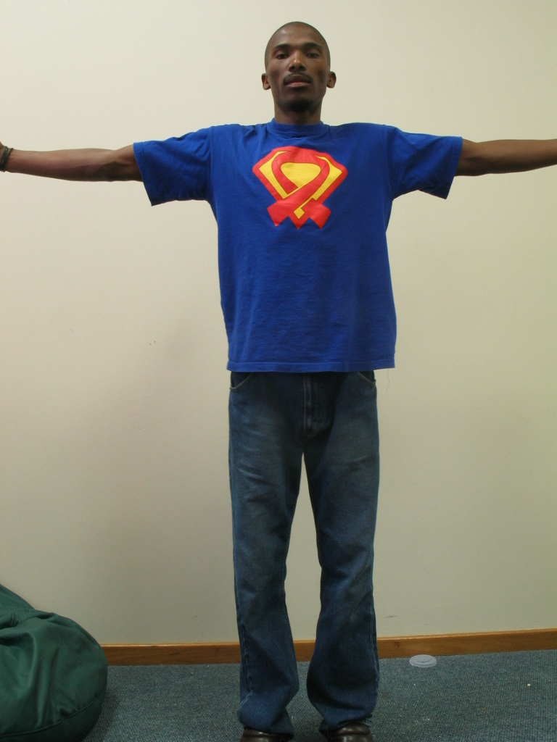
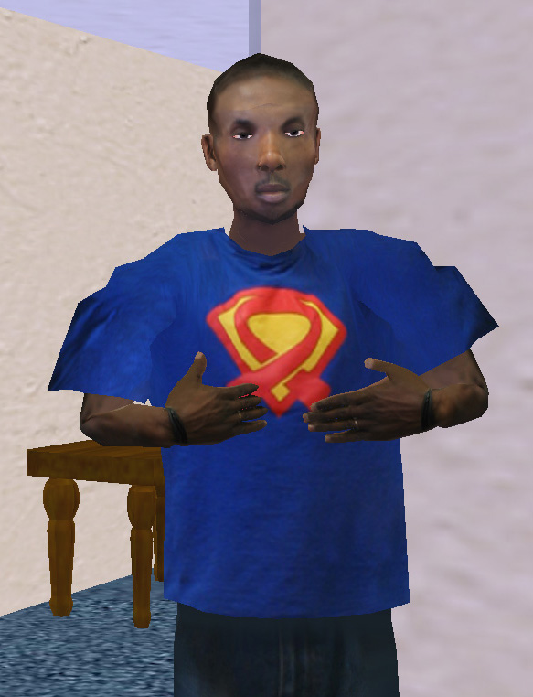
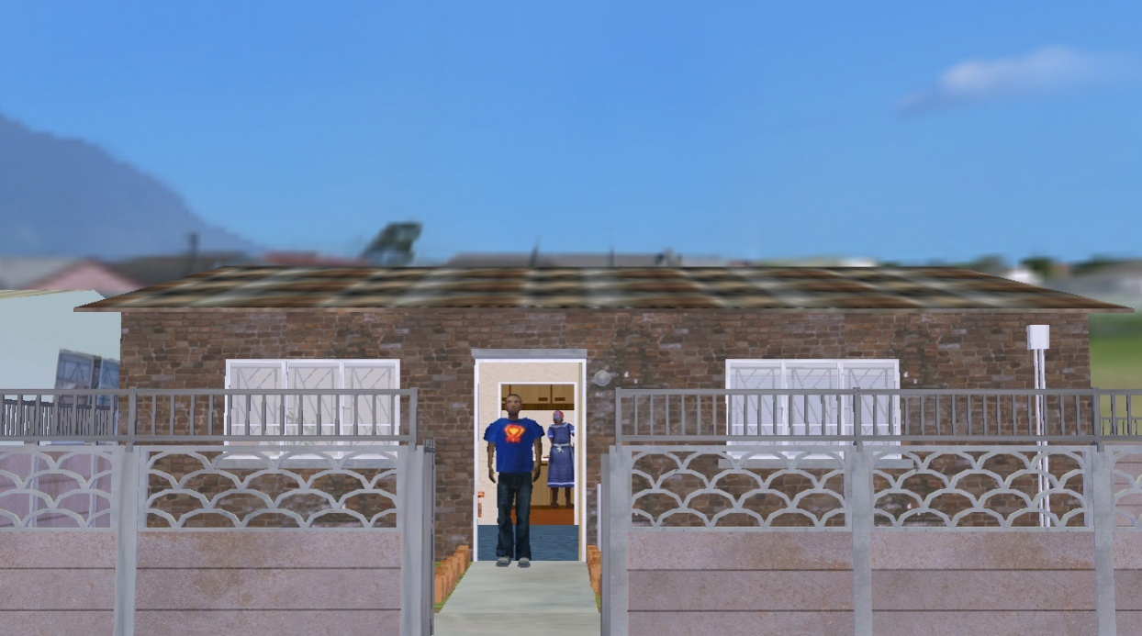
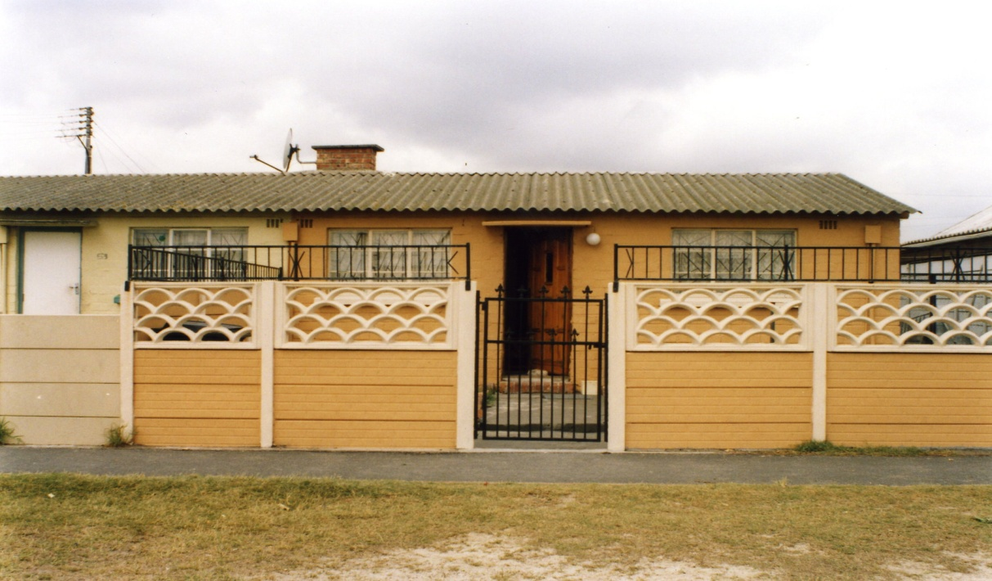
Virtual Environment
Council house in Mannenberg
Notes:
CS Honours project using virtual reality for AIDS education

Slide 25
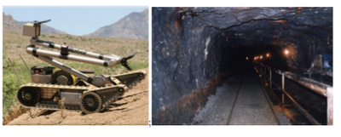
Notes:
AI project to guide robots in mines

Slide 26
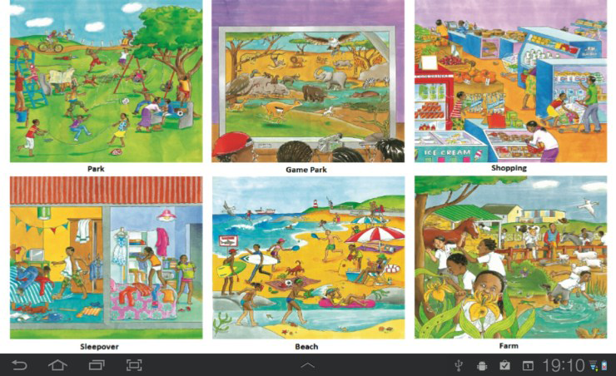
Notes:
CS Honours project for children learning 2nd language (with Oxford University Press – their material here)

Slide 27
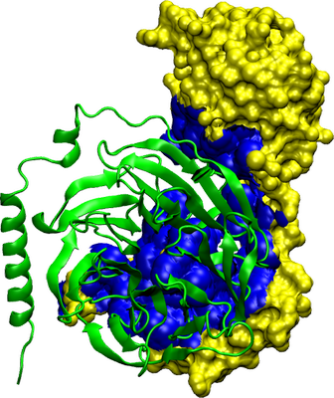
Notes:
project for visualisation of chemical structures

Slide 28
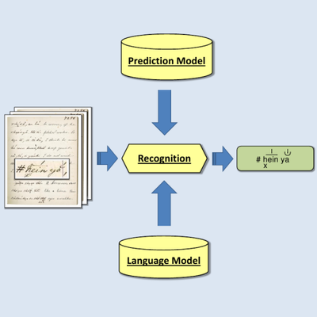
Notes:
digital heritage project for recognising and digitising San texts

