Slide 1



EEE4084F
Digital Systems
Lecture 5:
Review of paper: Temporal Partitioning Algorithm for a Coarse-grained Reconfigurable Computing Architecture by
Chongyong Yin, Shouyi Yin, Leibo Liu, Shaojun Wei
Blocking and Non-blocking comms
Lecturer:
Simon Winberg
Attribution-ShareAlike 4.0 International (CC BY-SA 4.0)

Slide 2

PechaKucha or Pecha Kucha (Japanese: ペチャクチャ, IPA: [petɕa ku͍̥tɕa], chit-chat) is a presentation style in which 20 slides are shown for 20 seconds each (6 minutes and 40 seconds in total). The format, which keeps presentations concise and fast-paced, powers multiple-speaker events called PechaKucha Nights (PKNs)-Wikipedia
Creating a Pecha Kucha Presentation Using PowerPoint.mp4
https://www.youtube.com/watch?v=l9zxNTpNMLo
A Pecha Kucha about Pecha Kucha
https://www.youtube.com/watch?v=jJ2yepIaAtE
http://www.nssa.us/tech_journal/volume_1-1/vol1-1_article2.htm
Pecha Kucha: Get to the PowerPoint in 20 Slides - https://www.youtube.com/watch?v=9NZOt6BkhUg
How to Make a Pecha Kucha - https://www.youtube.com/watch?v=32WEzM3LFhw
Pecha Kucha examples - http://www.pechakucha.org/
Pecha Kucha in Cape Town - http://www.pechakucha-capetown.com/
Pecha Kucha topic: How to manage an academic course as a project
Pecha Kucha presentation to your tutor group
Pecha Kucha presentation converted to a video with a voice over and uploaded to Your Tube

Slide 3

Algorithm broadly described
Want to partition the processing in a way so that it is executed optimally on the available RCA
CPU has lots of program space but programs are comprised of a small set of instructions run sequentially
FPGA has (comparatively) very limited program space, but can have very complex instructions that could run in parallel
Task / computation
Task / computation
Task / computation
Task / computation
Task / computation
uProcessor
Cant fit? Try alternate
FPGA
RCA
platform

Slide 4
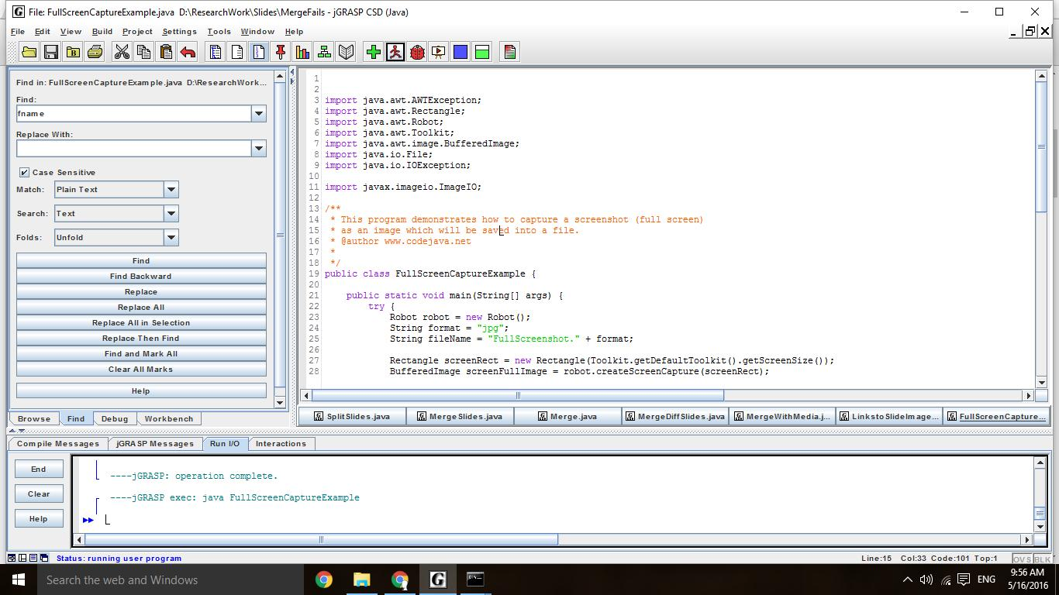

Slide 5
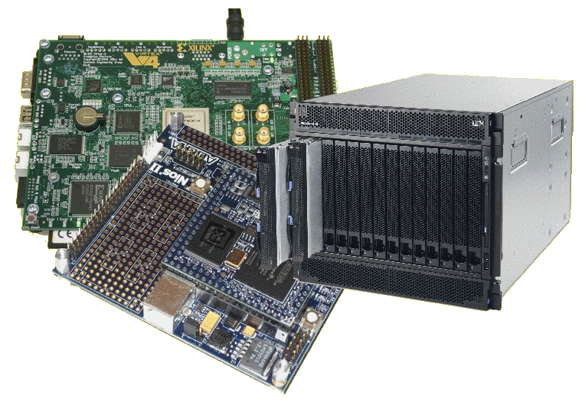
Lecture Overview
The problem
Terms
Approach
Licensing details last slide

