Slide 1



EEE4084F
Digital Systems
Lecture 5:
Review of paper: Temporal Partitioning Algorithm for a Coarse-grained Reconfigurable Computing Architecture by
Chongyong Yin, Shouyi Yin, Leibo Liu, Shaojun Wei
Blocking and Non-blocking comms
Lecturer:
Simon Winberg
Attribution-ShareAlike 4.0 International (CC BY-SA 4.0)

Slide 2
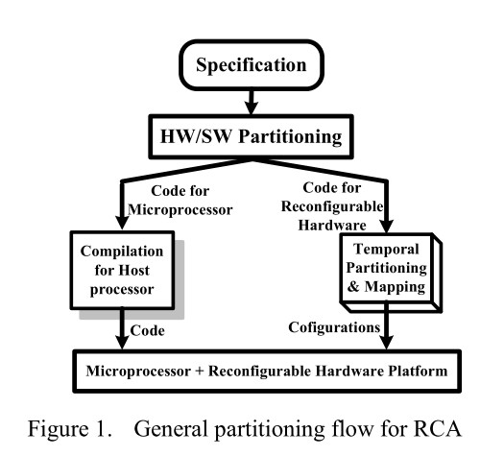
Approach to using a RCA

Slide 3
