Slide 1



EEE4084F
Digital Systems
Lecture 5:
Review of paper: Temporal Partitioning Algorithm for a Coarse-grained Reconfigurable Computing Architecture by
Chongyong Yin, Shouyi Yin, Leibo Liu, Shaojun Wei
Blocking and Non-blocking comms
Lecturer:
Simon Winberg
Attribution-ShareAlike 4.0 International (CC BY-SA 4.0)

Slide 2
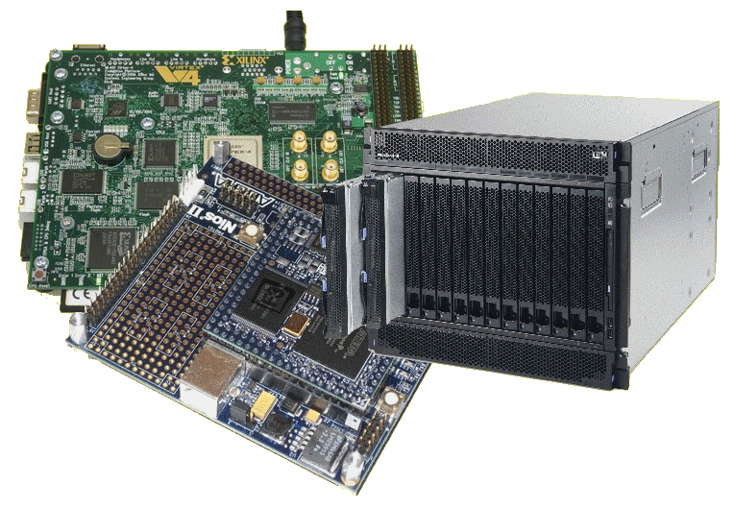
Lecture Overview
The problem
Terms
Approach
Licensing details last slide

Slide 3
Context
“Reconfigurable computing architecture (RCA) [1] is intended to fill the gap between application specific integrated circuits (ASICs) and instruction set processors”
Achieving potentially much higher performance than processors, while maintaining a higher level of flexibility than ASICs. A typically RCA consists of reconfigurable hardware along with microprocessors.

Slide 4
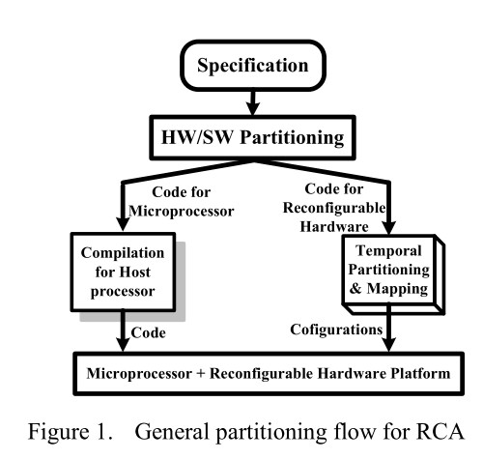
Approach to using a RCA

Slide 5
Yin et al.’s Purpose
A temporal partitioning algorithm for a coarse grained reconfigurable computing architecture is presented to improve system’s performance for satisfying the constraints of application parts executed on the reconfigurable hardware

Slide 6

Algorithm broadly described
Want to partition the processing in a way so that it is executed optimally on the available RCA
CPU has lots of program space but programs are comprised of a small set of instructions run sequentially
FPGA has (comparatively) very limited program space, but can have very complex instructions that could run in parallel
Task / computation
Task / computation
Task / computation
Task / computation
Task / computation
uProcessor
Cant fit? Try alternate
FPGA
RCA
platform

Slide 7
Partitioning Algorithms with different objectives
BUT these algorithms focus on the a single partitioning objective, so they aren’t suitable for multi-objective optimization.
…
So, they looked at other know approaches such as…
The level based algorithm:
tries to achieve maximum possible parallelism in each module.
The clustering based algorithm
tries to minimize the communication overhead between modules

Slide 8
Reviewed existing techniques
Network flow-based algorithm to find Dynamically reconfigurable computing (DRC) multiple temporal partition stages
But that approach isn’t an optimal one when the goal is to minimize communications costs.
Modified network flow-based partitioning algorithm with added scheduling technique to minimize comms cost
Doesn’t consider the prospective parallelism and the number of modules

Slide 9
Problem formulation
PROBLEM FORMULATION
Given a directed acyclic graph G=(V,E), to ensure proper precedence constraints, each node must be scheduled in a partition or module no later than its successor. For multi-objective optimization
Necessary to build ready partition list to avoid deadlock partition.

Slide 10
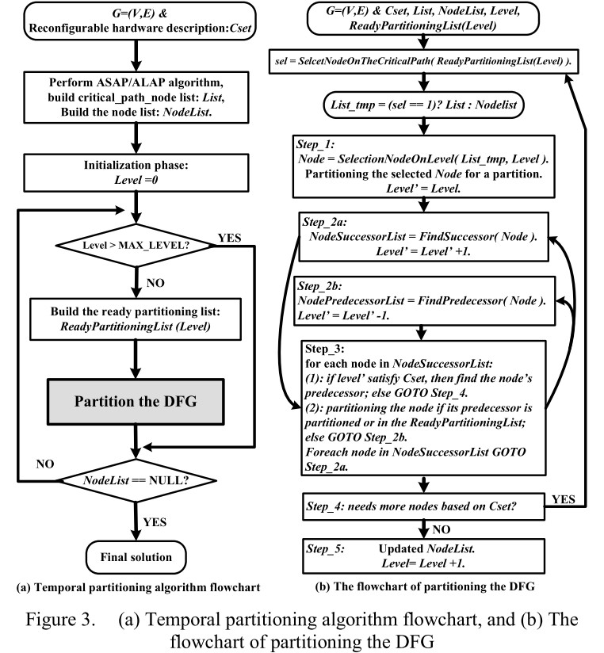
Algorithm solution

Slide 11
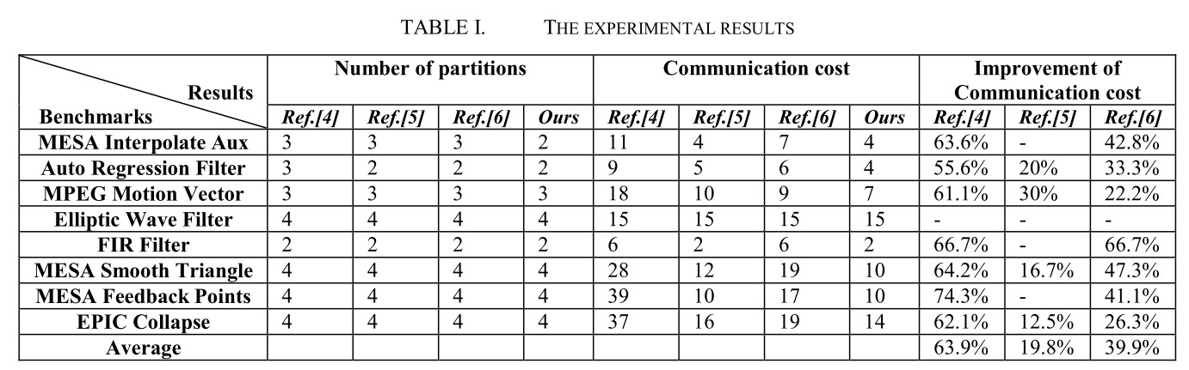
Experimental results
Good improvements
Using a selection of benchmarking applications.
Comparing the performance of the various standard partitioning algorithms that were reviewed in the introduction to the prototyped approach…

Slide 12
Communications & Costs of Communication
EEE4084F

Slide 13
Communication concerns in related to solution partitioning
The communications needs between tasks depends on your solution:
Communications not needed for
Minimal or no shared data or results.
E.g., an image processing routine where each pixel is dimmed (e.g., 50% dim). Here, the image can easily be separated between many tasks that act entirely independently of one other.
Usually the case for embarrassingly parallel solutions

Slide 14
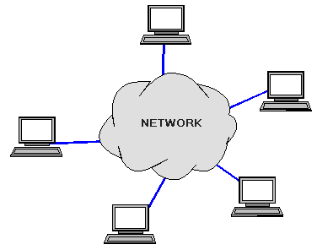
Communications
The communications needs between tasks depends on your solution:
Communications is needed for…
Parallel applications that need to share results or boundary information. E.g.,
E.g., modeling 2D heat diffusion over time – this could divide into multiple parts, but boundary results need to be shared. Changes to an elements in the middle of the partition only has an effect on the boundary after some time.

Slide 15
Factors related to Communication
Cost of communications
Latency vs. Bandwidth
Visibility of communications
Synchronous vs. asynchronous communications
Scope of communications
Efficiency of communications
Overhead and Complexity

Slide 16
Cost of communications
Communication between tasks has some kind of overheads, such as:
CPU cycles, memory and other resources that could be used for computation are instead used to package and transmit data.
Also needs synchronization between tasks, which may result in tasks spending time waiting instead of working.
Competing communication traffic could also saturate the network bandwidth, causing performance loss.

Slide 17
Visibility of Communications
Communications is usually both explicit and highly visible when using the message passing programming model.
Communications may be poorly visible when using the data parallel programming model.
For data parallel design on a distributed system, communications may be entirely invisible, in that the programmer may have no understanding (and no easily obtainable means) to accurately determine what inter-task communications is happening.

Slide 18

Synchronous vs. asynchronous
Synchronous communications
Require some kind of handshaking between tasks that share data / results.
May be explicitly structured in the code, under control of the programmer – or it may happen at a lower level, not under control of the programmer.
Synchronous communications are also referred to as blocking communications because other work must wait until the communications has finished.

Slide 19

Synchronous vs. asynchronous
Asynchronous communications
Allow tasks to transfer data between one another independently. E.g.: task A sends a message to task B, and task A immediately begin continues with other work. The point when task B actually receives, and starts working on, the sent data doesn't matter.
Asynchronous communications are often referred to as non-blocking communications.
Allows for interleaving of computation and communication, potentially providing less overhead compared to the synchronous case

Slide 20
Scope of communications
Scope of communications:
Knowing which tasks must communicate with each other
Can be crucial to an effective design of a parallel program.
Two general types of scope:
Point-to-point (P2P)
Collective / broadcasting

Slide 21
Scope of communications
Point-to-point (P2P)
Involves only two tasks, one task is the sender/producer of data, and the other acting as the receiver/consumer.
Collective
Data sharing between more than two tasks (sometimes specified as a common group or collective).
Both P2P and collective communications can be synchronous or asynchronous.

Slide 22
Collective communications
Typical techniques used for collective communications:
BROADCAST
SCATTER
Task
Task
Task
Task
Task
Task
Same message sent to all tasks
Different message sent to each tasks
Initiator
Initiator
REDUCING
GATHER
Task
Task
Task
Task
Task
Task
Only parts, or reduced form, of the messages are worked on
Messages from tasks are combined together
Task
Task

Slide 23

Efficiency of communications
There may be a choice of different communication techniques
In terms of hardware (e.g., fiberoptics, wireless, bus system), and
In terms of software / protocol used
Programmer may need to use a combination of techniques and technology to establish the most efficient choice (in terms of speed, power, size, etc).

Slide 25
Disclaimers and copyright/licensing details
I have tried to follow the correct practices concerning copyright and licensing of material, particularly image sources that have been used in this presentation. I have put much effort into trying to make this material open access so that it can be of benefit to others in their teaching and learning practice. Any mistakes or omissions with regards to these issues I will correct when notified. To the best of my understanding the material in these slides can be shared according to the Creative Commons “Attribution-ShareAlike 4.0 International (CC BY-SA 4.0)” license, and that is why I selected that license to apply to this presentation (it’s not because I particulate want my slides referenced but more to acknowledge the sources and generosity of others who have provided free material such as the images I have used).
Image sources:
Gold bar: Wikipedia (open commons)
IBM Blade (CC by 2.0) ref: http://www.flickr.com/photos/hongiiv/407481199/
Takeaway, Clock, Factory and smoke – public domain CC0 (http://pixabay.com/)
Forrest of trees: Wikipedia (open commons)
Moore’s Law graph, processor families per supercomputer over years – all these creative commons, commons.wikimedia.org

