Slide 1
Effect of immigration on host countries:
The curious case of Canada
HSO201 Research Paper presentation

Slide 2
Our Team
(Leader)
Sanskar Sanjay Shah
Sparsh Sihotiya
Aryash Pateriya
Ayush Gupta
Roushan Prakash
Abhinav Raj Singh
Mohammad Imad Khan
Srajan Jain
Ishit Manojkumar Darania
Ansh Saxena

Slide 3
Overview
Introduction
Objectives
Hypothesis
Finding order of Integration
VAR model
Impulse response
Model Equations
Analysis
The outcome of our Research
Policy suggestions
Conclusion
References

Slide 4
Introduction
The question of the economic impact on immigration has been addressed widely in Economics.
The economic impact of immigration varies by time and place, and it can be beneficial or harmful as well.
Immigration has short-term and long-term impacts.
In the short-term, immigration affects employment/unemployment
In the long term, imigration affects the structure of the economy (e.g., capital/labor ratio)
As Canada's immigration history is concerned, its population increased from 0.65 million in 1800 to currently 37.7 million, thus clearly indicating the rich immigration history of Canada.
There are about 300,000 immigrants in Canada each year and many temporary immigrants every year. The policies of Canada prefer incoming skilled immigrants. Their immigration policy had a significant impact on the economy and employment.
The purpose of our paper is to explore the complexities of unemployment and immigration in host countries using the immigration and unemployment statistics of Canada.

Slide 5
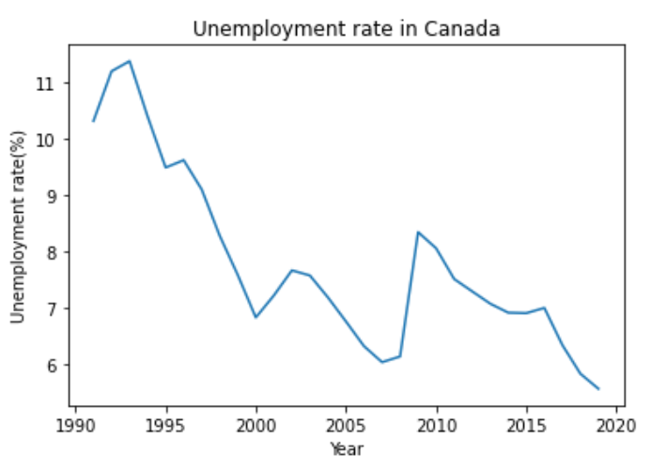
Introduction
The purpose of our paper is to explore the complexities of unemployment and immigration in host countries using the immigration and unemployment statistics of Canada.
The aim of this study is to produce reliable results that enhance our understanding of the casual relationship and the impact of immigration on the labour market in Canada through an econometric analysis based on a general macroeconomic model framework.
For this purpose, we adopt the use of a Vector AutoRegression Model(VAR) and Impulse Response to examine the dynamic interaction the selected variables used in the study.

Slide 6



Objectives
The Initial Scenario
Canada, one of the highest immigrant friendly countries witnesses a high influx and outflux of population every year which affects various factors related to the living conditions of the nation.
The 3 major areas of impact are
Minimum Wages
Unemployment
Per Capita GDP

Slide 7
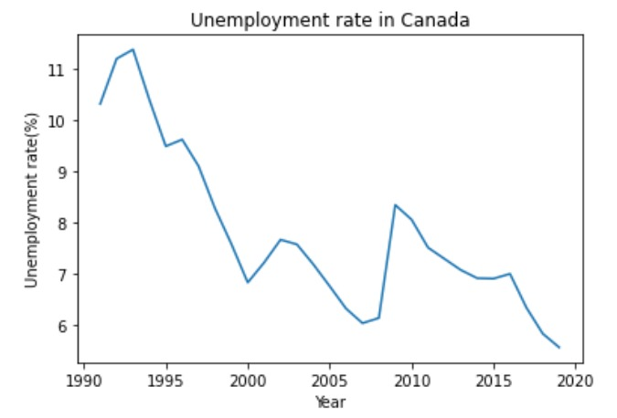
Objectives
Unemployment Rate
It is a measure of the fraction of population left unemployed and does not have a fixed amount of income.
The amount of population unemployed acts as a liability for the country and it is desired to eradicate unemployment as much as possible.
Due to less population and high literacy rate, unemployment in Canada always remained in control till now, but it is threatened to get affected by the high inflation rate.

Slide 8
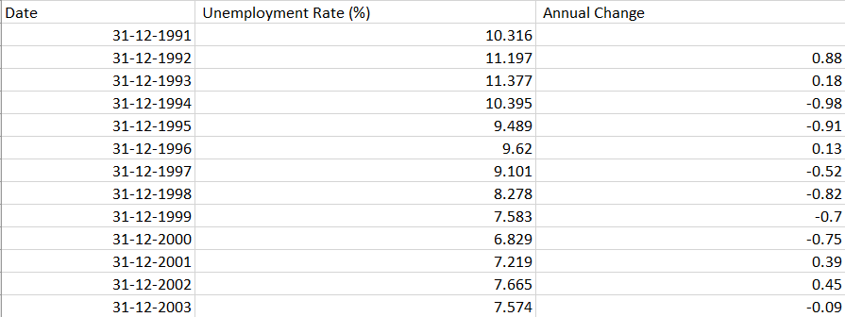

Objectives
Unemployment Rate – The dataset
Provides the percentage of Canadian population left unemployed after end of one year along with the annual rate of change compared to previous year.
We will represent it with the variable $UN$.
Courtesy - World Bank Report - Unemployment rate
https://datatopics.worldbank.org/world-development-indicators/

Slide 9
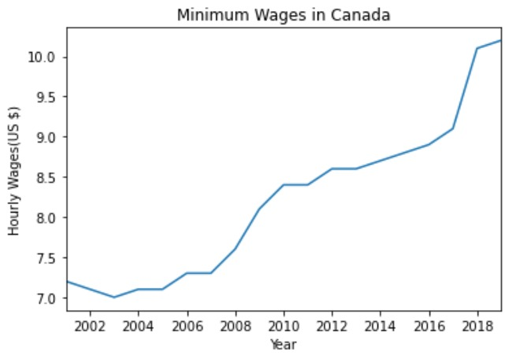
Objectives
Minimum Wages
It is a measure of the minimum amount of average wage Canadians received in a particular year.
It depends upon the number of industries setup across the nation and the competitions among them and the amount of manpower they utilize.
Minimum wages in Canada always remained adequate due to large land area and uniform distribution of wealth among individuals.

Slide 10
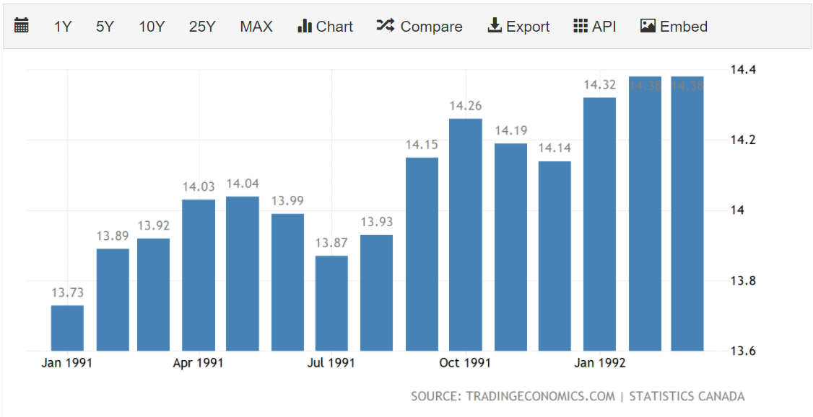

Objectives
Minimum Wages – The Dataset
Provides the average hourly wage received by Canadian population in Canadian Dollars every year.
We will represent it with the variable$HW$.
Courtesy – Trading economics - Hourly Minimum wage rate -
https://tradingeconomics.com/canada/wages

Slide 11
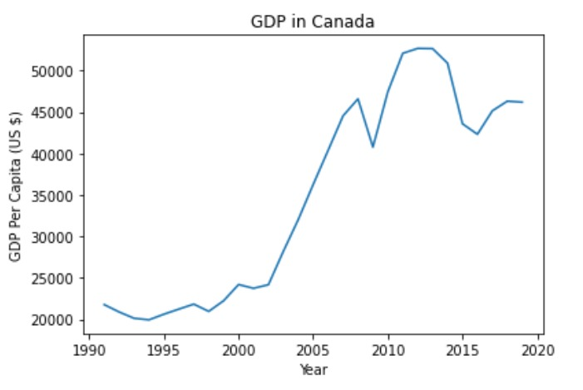
Objectives
Per Capita GDP
It is a measure of a country's economic output per person and is calculated by dividing the GDP of a country by its population.
It is used by economists, along with GDP, to analyze the prosperity of a country based on its economic growth.
Canada is one of the least corrupt countries in the world, and is one of the world's top ten trading nations, with a highly globalized economy.

Slide 12
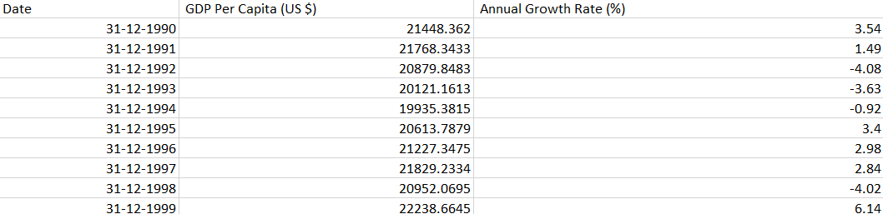

Objectives
Per Capita GDP – The Dataset
Provides the Yearly Per Capita GDP of Canada along with the annual growth rate compared to previous year.
We will represent it with the variable$PGDP$.
Courtesy - World Bank Report - Per Capita GDP –
https://datatopics.worldbank.org/world-development-indicators/

Slide 13
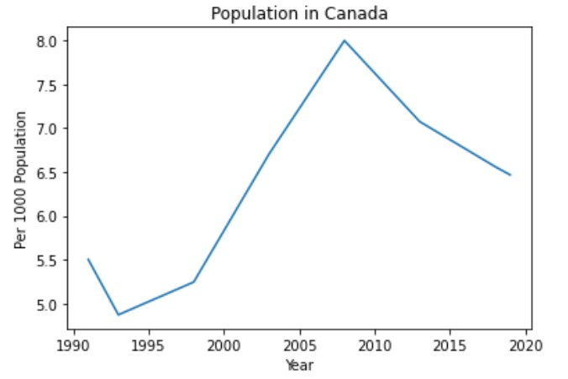
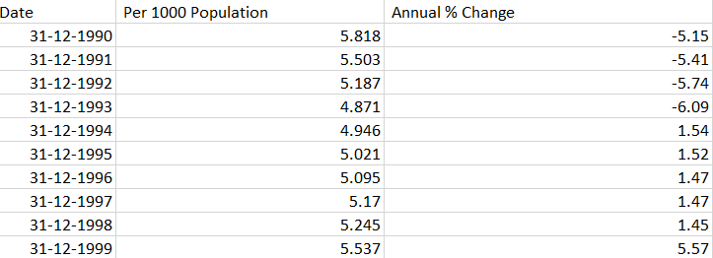

Objectives
The Dataset of Net Migration Rate
Net Migration Rate - Trend
Provides the net overseas migration rate in the form of number of people migrated into Canada per 1000 population.
We will represent it with the variable $NOM$.
Courtesy – Canada net migration rate
https://population.un.org/wpp/

Slide 14
Objectives
What are our goals?
We will function on the datasets to generate the ideas in a mathematical fashion, filter out the parts which are less relevant and arrange our dataset in resonance with the compatibility between various factors.
We will try to develop a suitable mathematical relation which will link the variables. This will act as the core dependence relation for the model.
Our mathematical model will basically be a relation among various factors we induced by analysing their correlations and producing a suitable relationship among them.
We will run the Vector Autoregression Model and draw conclusions in tabular and graphical forms to clearly represent the relevant results. We will then draw upon the conclusions based on this

Slide 15
Hypothesis
Predicting the economic outcome of immigration is quite challenging to determine a priori of complete research and analysis because it depends on lots of variables and varies with time and place.
Net immigration negatively affects unemployment in case of Canada as evident from the data of World Bank report from 1990 to 1992, and 2002-2007.
Unemployment negatively impacts per capita real GDP; thus, immigration should positively impact it as per above statement.
Immigration must negatively impact the hourly wage rate as immigration might increase the need for jobs leading to a decrease in the hourly wage rate.

Slide 16
Finding Order of Integration
Considering the test for order of integration we had the following
possibilities for our model:
If all variables were I(1) then we would have directly done
cointegration
If some variables were I(0) and some were I(1) we would have used
the Autoregressive Distributed Lag (ARDL) approach to cointegration.
If some variables were I(0), some were I(1) and some were I(2) then we would have end up using VAR approach with Impulse Response and Variance Decomposition.
After implementing unit root test on the first difference of the data we found that UN, HW and PGDP are integrated of order 1; but NOM is Integrated of order 2. So we will use the Vector Autoregressive model with Impulse Response and Variance decomposition.

Slide 17
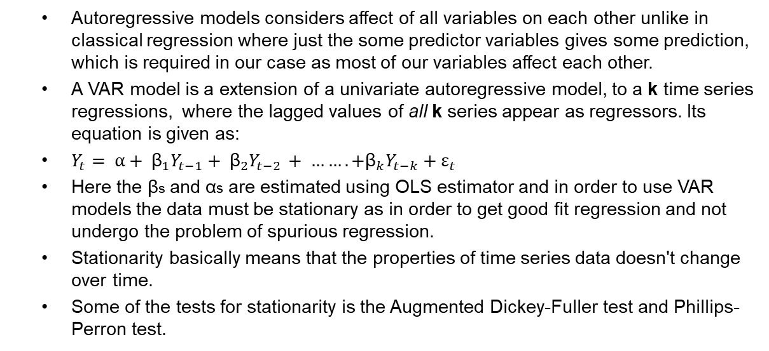
Vector Autoregression Model
Autoregressive models considers affect of all variables on each other unlike in classical regression where just the some predictor variables gives some prediction, which is required in our case as most of our variables affect each other.
A VAR model is a extension of a univariate autoregressive model, to a k time series regressions, where the lagged values of all k series appear as regressors. Its equation is given as:
$Y_{t}= α+ {\text{β}}_{1}Y_{t−1}+ {\text{β}}_{2}Y_{t−2 }+ ……. +{\text{β}}_{k}Y_{t−k}+ε_{t}$
Here the βs and αs are estimated using OLS estimator and in order to use VAR models the data must be stationary as in order to get good fit regression and not undergo the problem of spurious regression.
Stationarity basically means that the properties of time series data doesn't change over time.
Some of the tests for stationarity is the Augmented Dickey-Fuller test and Phillips-Perron test.

Slide 18
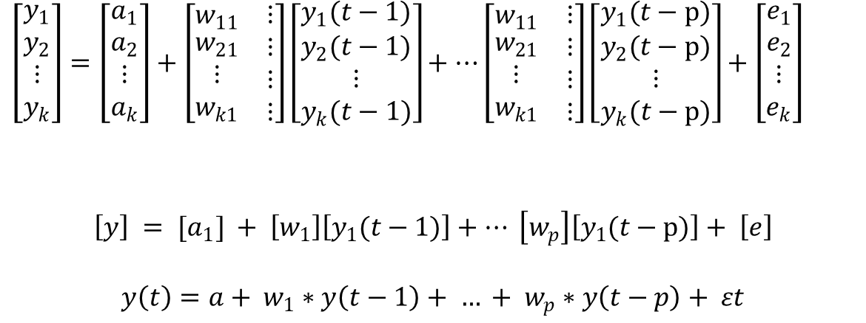
Model Equations :
Basic VAR equations:
$\left[\begin{matrix}y_{1} \\ y_{2} \\ \begin{matrix}⋮ \\ y_{k}\end{matrix}\end{matrix}\right]=\left[\begin{matrix}a_{1} \\ a_{2} \\ \begin{matrix}⋮ \\ a_{k}\end{matrix}\end{matrix}\right]+\left[\begin{matrix}w_{11} & ⋮ \\ \begin{matrix}w_{21} \\ ⋮ \\ w_{k1}\end{matrix} & \begin{matrix}⋮ \\ ⋮ \\ ⋮\end{matrix}\end{matrix}\right]\left[\begin{matrix}y_{1}(t−1) \\ y_{2}(t−1) \\ \begin{matrix}⋮ \\ y_{k}(t−1)\end{matrix}\end{matrix}\right]+…\left[\begin{matrix}w_{11} & ⋮ \\ \begin{matrix}w_{21} \\ ⋮ \\ w_{k1}\end{matrix} & \begin{matrix}⋮ \\ ⋮ \\ ⋮\end{matrix}\end{matrix}\right]\left[\begin{matrix}y_{1}(t−p) \\ y_{2}(t−p) \\ \begin{matrix}⋮ \\ y_{k}(t−p)\end{matrix}\end{matrix}\right]+\left[\begin{matrix}e_{1} \\ e_{2} \\ \begin{matrix}⋮ \\ e_{k}\end{matrix}\end{matrix}\right]$
$$\left[y\right] = [a_{1}] + \left[w_{1}\right]\left[y_{1}(t−1)\right]+… \left[w_{p}\right]\left[y_{1}(t−p)\right]+ \left[e\right]$$
$$y\left(t\right)=a+ w_{1}∗y\left(t−1\right)+ … + w_{p}∗y\left(t−p\right)+ εt$$

Slide 19
Analysis
Correlation matrix of residuals showing dependence of one variable on another.
 | NOM | HW | UN | GDP
NOM | 1.000000 | 0.116917 | -0.809114 | 0.724953
HW | 0.116917 | 1.000000 | -0.385461 | 0.639119
UN | -0.809114 | -0.385461 | 1.000000 | -0.911902
GDP | 0.724953 | 0.639119 | -0.911902 | 1.000000
*Analysis has been performed on log scale data to get more accurate results.

Slide 20
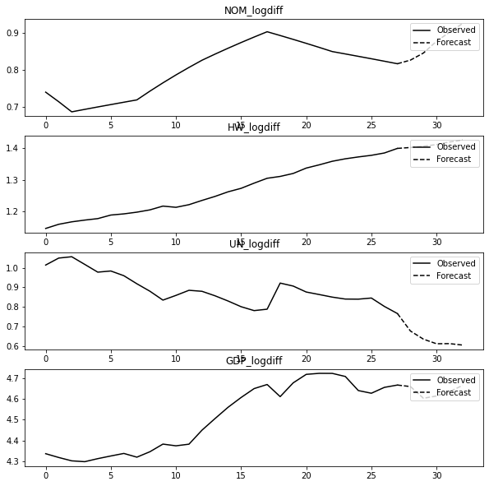
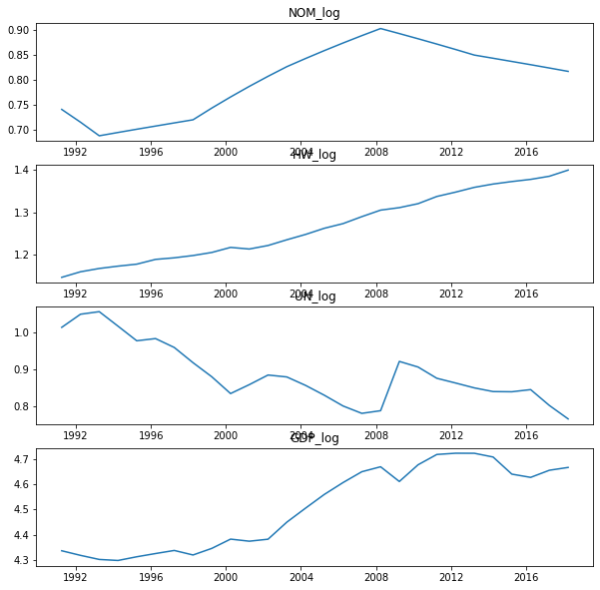
The outcome of our research
Unemployment Rate
The Unemployment Rate is supposed to decrease in Canada for upcoming years (positive effect).
Possible reason – More skilled migrants come to Canada in search of work from Asia, Africa and South America in search of opportunity as compared to just liabilities.

Slide 21
The outcome of our research
Minimum Wages
Minimum Wages
As per the forecast, minimum wage rate will keep on increasing for upcoming years in Canada.
Inferences–
This is concrete evidence in support of immigration as despite ever increasing population in Canada, HW increases which means skilled immigrants get good income in the country which makes Canada a good choice to settle if you think you can contribute to the country’s skilled workforce.

Slide 22
The outcome of our research
Per Capita GDP
The Per Capita GDP rate is supposed to go down a bit and will then start to increase again.

Slide 23
Impulse Response
Impulse response functions show the effects of shocks on the adjustment path of the variables.
Forecast error variance decompositions measure the contribution of each type of shock to the forecast error variance.
Both computations are useful in assessing how shocks to economic variables reverberate through a system.

Slide 24
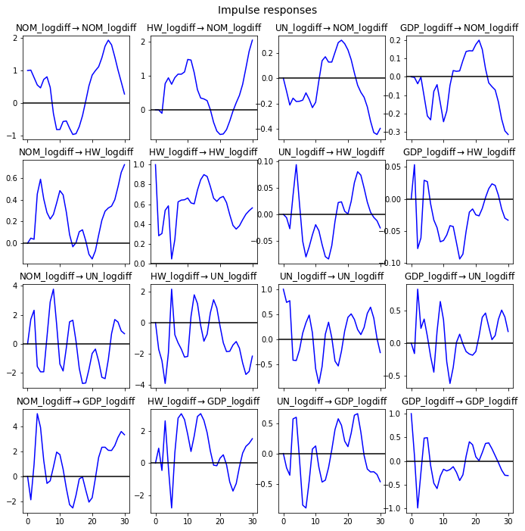
The outcome of our research
Plots of Impulse Response
Hourly Wage Rate
For
Per Capita GDP
Unemployment
Code

Slide 25
Policy Suggestions
The Canadian Government can increase the influx of skilled immigrants who can work as entrepreneurs, investors, and innovators.
With a diversified population, they can promote non-native sports.
They can provide a portal for businesses to provide information about their requirement of labor and emigrants to display their skills. Such a portal will help the Government in accepting visas as per the requirement of employers.
They can develop regional immigration offices with support for different languages apart from English and French.
Canadian Government can upgrade its health and education infrastructure to support the influx of immigrants.

Slide 26
Conclusion
We used the VAR model with an Impulse response to study the relationship between Immigration, Unemployment, per capita GDP, and Hourly wage rate.
According to our prediction, Unemployment will decrease in the upcoming years, while Per Capita GDP and Hourly Wage Rate will increase as Net Overseas Migration increases.
Our hypothesis was right in predicting the relationship amongst Unemployment, Immigration and Per Capita GDP but we got a reverse relationship between Immigration and Hourly wage rate.
Based on our research we suggested few policies for the Canadian Government for the near future so that they can maximize their economic growth.

Slide 27
References
Applied Econometric Time Series by Walter Enders
Base Paper - Does a change in immigration affect the unemployment rate in host countries? Evidence from Australia (2020) - Mostafa E. AboElsoud , Anas AlQudah & Eman Elish
United Nations - World Population Prospects Minimum Wages
World Bank Report - Unemployment rate
OCED - Hourly Minimum wage rate
World Bank Report - Per Capita GDP
Canada Population 1800s to 2020
Error Correction Model

Slide 28
Thank You!

