Slide 1
Welcome !
Keyword Driven
Automation Framework

Slide 2
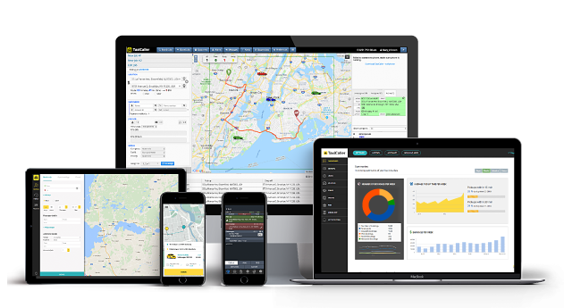

User/ QA
Product or Service
Third Party
Internal Module 1
Front End
Ext Module 1
….
User/ QA
API
Internal Module n
Ext Module n
DB
….
QA

Slide 3
GUI Testing Automation

Slide 4



GUI Testing Needs
Web Browser
Desktop
Stock Market Trading
Whatsapp

Slide 5
Database Test Automation

Slide 6
Non-Functional Needs
Database Testing

Slide 7
Automation Framework

Slide 8
Framework
Introduction
What is a Framework?
Why we need a Framework?
Attributes and Offerings from Keyword Driven Framework
Design, Enhance, Maintain Framework

Slide 9
Framework
A Framework is an Organized way To Perform One or Multiple Tasks.
A mechanism to write and maintain Software code in a certain manner.
It provides a way to execute automation code.
A place for implementation of desired concepts with Coding.
It is needed to address automation needs for one or multiple business purpose e.g. GUI, API, Database etc
It is assumed to have basic understanding of Core Java, Junit/ TestNG and Maven

Slide 10
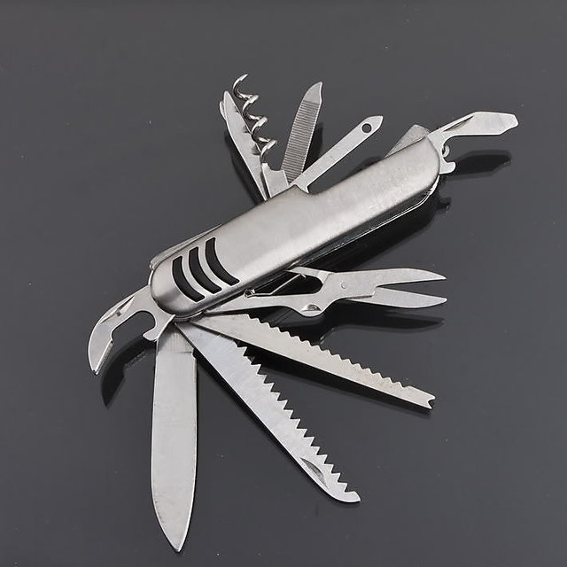
Framework Attributes, Offering, Expectations

Slide 11
Framework Attributes, Offering, Expectations
Selenium Support
Desktop Automation
File Handling
(xlsx, pdf, xml, json)
Browser (Screenshot)
Logging
Database Automation
Code Reusability
Assertions
Error handling
Exception recovery
The
“Framework”
Report email
Robust
Modular
Loosely coupled
Rerun Failed Tests
Easy to Understand
Reporting
Scalable
Page Object Model
Selenium Grid Support
Devops Support
Simplicity and Reusability

Slide 12
Framework Types with Layers
Keyword Driven
Popular in QA
Community
Data Driven
Behavior Driven (Cucumber)
Unit Testing
Framework
Junit
TestNG
Build, Dependency
Management
Maven

Slide 13
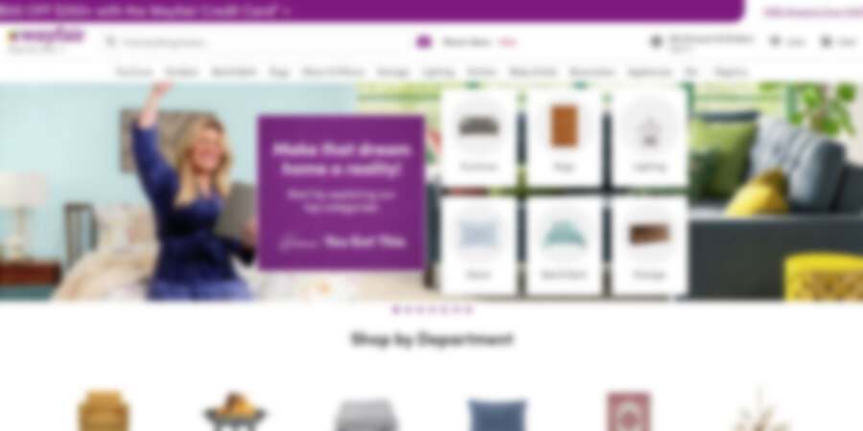




Non-Selenium Automation
Robot + AWT

Slide 14
Keyword Driven Framework
Keyword/ User Action (Variety)
A
U
T
Excel File
(Apache POI, xlrd/ xlwt)
TestScenario Execution control
(TestNG/ Junit, Pytest)
Application Under Test

Slide 15
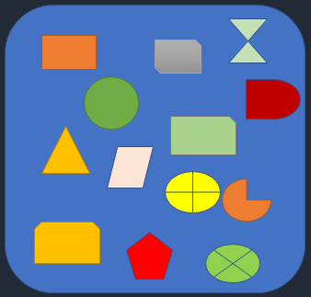
Keywords / User Actions (Repository)
GUI/ Browser related:
Click
Double Click
Right Click
Type Text
Select Down
Hover
Wait
Get Attribute
Navigate
GUI/ Browser related:
Pop up Interaction
Alert Interaction
Drag n Drop
Close Tab/ Window
Window Resize
Verify Web Element
Count Element
JavaScript Run
Other:
Test Reporting Preparation
Test Report Emailing
Logging
Environment Setup
Test Data Preparation
Database related:
Db Connect
Db Disconnect
Raise CRUD SQL query
Parse SQL Response
Desktop related:
Move mouse
Press Key
Click on Desktop

Slide 16
Keyword Driven Framework
Keyword/ User Action (Variety)
FRAMEWORK
A
U
T
Test Scenario Execution control
(TestNG/ Junit, Pytest)
Excel File
(Apache POI, xlrd/ xlwt)
Build management using Maven
Application Under Test

Slide 17
Keyword Driven Framework
Keyword/ User Action (Variety)
FRAMEWORK
A
U
T
Test Scenario Execution control
(TestNG/ Junit, Pytest)
Application
Under
Test
Excel File
(Apache POI, xlrd/ xlwt)
Build management using Maven

Slide 18
Basic Programming
Java/ Python

Slide 19
Excel Processing
Java – Apache POI
Python – xlrd, xlwt

Slide 20
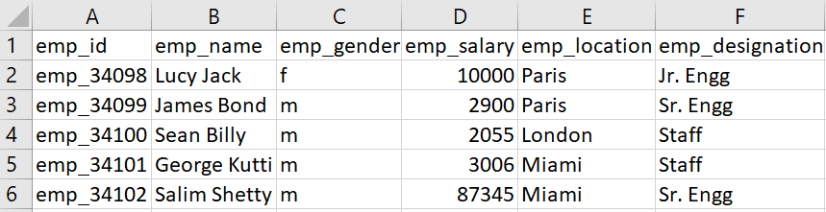
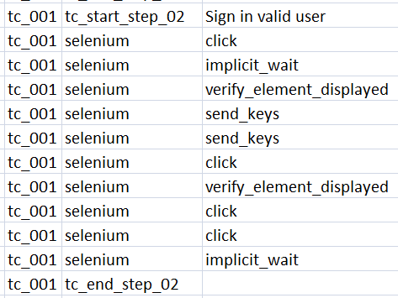
Excel (.xlsx)
Read Cell value (Cell Type is important)
Set Cell value (Existing Cell, New Cell (create cell) )
Read Excel Sheet(s) line by line
Read Keywords => Read Actions => (Perform Operation)

Slide 21
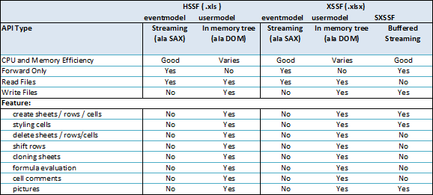
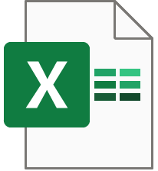
Excel (.xlsx)
Spreadsheet, Workbook, Cell, Row, Column, Cell Type
Excel file format :
HSSF (Excel '97) / XSSF (Excel 2007) (XML Spreadsheet Format)

Slide 22
The Selenium

Slide 23
The Maven

Slide 24
KDD Basic

Slide 25
Keywords as Utility
GUI/ Browser related:
Click
Double Click
Right Click
Type Text
Select Down
Hover
Wait
Get Attribute
Navigate
GUI/ Browser related:
Pop up Interaction
Alert Interaction
Drag n Drop
Close Tab/ Window
Window Resize
Verify Web Element
Count Element
JavaScript Run
Other:
Test Reporting Preparation
Test Report Emailing
Logging
Environment Setup
Test Data Preparation
Database related:
Db Connect
Db Disconnect
Raise CRUD SQL query
Parse SQL Response
Desktop related:
Move mouse
Press Key
Click on Desktop

Slide 26
Keyword as Utility
Designing re-usable methods (e.g. for Selenium)
Excel handling – Acts as input to the Framework, Excel utility
What? – A unique action by user
Steps related to Selenium
Steps related to Robot class
Steps related to Database

Slide 27
The Not So Cool
KDD

Slide 28
Not So Cool KDD
Keyword Driven Parser
Limitations
Scalability
Stability
Reporting
Effective Segregation of Steps
Poor Exception handling
Config / specific parameter setting
Page Object Model

Slide 29
Keyword Driven Framework
A Modern Approach

Slide 30
Framework Fixtures
What? – A set of actions needed to be performed repeatedly
Why? – To save time, resources
How? – By implementing sub-routine or reusable method
Example –
Launch/ Close browser
Test report pre/ post processing
Db connect/ disconnect
Test report emailing
Any specific repetitive activity
Sequencing – BeforeAll, AfterAll, BeforeTest, AfterTest (inspired by Junit)
How to set up and use them and call using excel?

Slide 31
Framework Fixtures
Prepare Report Sheet
Read Command line param
Db connection (optional)
Page Object Init
Before All
Before
TC
Before
TC
Before
TC
Launch Browser
Use Specific config
TC 1
TC 2
TC 3
After
TC
After
TC
After
TC
Close Browser
Update Report Sheet
After All
Db dis-connection (optional)
Send Report email

Slide 32
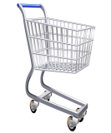
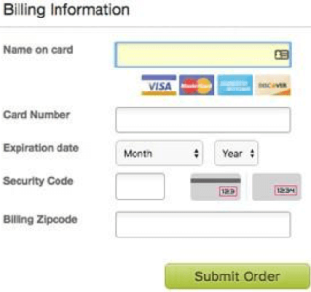

Page Object via Excel
What? – Grouping of WebElements, User Actions for a web page
Why? – Simplicity, Traceability, Organized approach
How? – Example in actual Excel file
Login.html
Login Page
Search.html
Search Page
Checkout.html
Checkout Page
Payment.html
Payment Page
User
Enter text …
Search
Password
Login

Slide 33
Other
Config setup (inspired by .properties file)

Slide 34
How To Write KDD Test Case
tc_create (mandatory to indentify start of a TC)
tc_enable
tc_start_step_xx
tc_end_stop_xx
Core Activity
Selenium
JavaScript
Robot
Database
Using Elements defined in Page Objects
Using config variables

Slide 35
Interesting !
Lets see Demo

Slide 36
Revisiting - Framework Attributes, Offering, Expectations
Selenium Support
Desktop Automation
File Handling
(xlsx, pdf, xml, json)
Browser (Screenshot)
Logging
Database Automation
Code Reusability
Assertions
The
KDD
“Framework”
Error handling
Exception recovery
Report email
Robust
Modular
Loosely coupled
Rerun Failed Tests
Easy to Understand
Reporting
Scalable
Page Object Model
Selenium Grid Support
Devops Support
Simplicity and Reusability

Slide 37
Misc..
Further scope of expansion :
API testing
Mobile testing
Conditional execution
Custom Subroutine calling
Intermediate step data passing
awesome dude

