Slide 1
Welcome !
Keyword Driven
Automation Framework

Slide 2
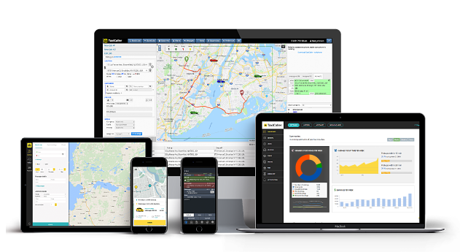

User/ QA
Product or Service
Third Party
Internal Module 1
Front End
Ext Module 1
….
User/ QA
API
Internal Module n
Ext Module n
DB
….
QA

Slide 3
GUI Testing Automation

Slide 4



GUI Testing Needs
Web Browser
Desktop
Stock Market Trading
Whatsapp

Slide 5
Database Test Automation

Slide 6
Non-Functional Needs
Database Testing

Slide 7
Automation Framework

Slide 8
Framework
Introduction
What is a Framework?
Why we need a Framework?
Attributes and Offerings from Keyword Driven Framework
Design, Enhance, Maintain Framework
Allow manual QA to use this Framework
for test case writing
for test execution
Without any programming knowledge

Slide 9
Framework Types with Layers
Keyword Driven
Popular in QA
Community
Data Driven
Behavior Driven (Cucumber)
Unit Testing
Framework
Junit
TestNG
Build, Dependency
Management
Maven

Slide 10
Framework Attributes, Offering, Expectations
Selenium Support
Desktop Automation
File Handling
(xlsx, pdf, xml, json)
Browser (Screenshot)
Logging
Database Automation
Code Reusability
Assertions
Error handling
Exception recovery
The
“Framework”
Report email
Robust
Modular
Loosely coupled
Rerun Failed Tests
Easy to Understand
Reporting
Scalable
Page Object Model
Selenium Grid Support
Devops Support
Simplicity and Reusability

Slide 11
Keyword Driven Framework
Keyword/ User Action (Variety)
A
U
T
Apache POI for Excel
TestNG/ Junit
Application Under Test

Slide 12
Selenium Related Features Automated
Selenium Basic
WebDriver
ChromeOptions
WebElement (Xpath and CSS)
DOM concept
Browser profile
Page Factory
Page Objects
Selenium Advanced
Actions
JavaScript
Exception handling
Wait condition
Fluent wait
Iframe
Multi Window
Popup/ Alert
Selenium Grid
Take screenshot
Desktop Automation
Robot library
Sikuli library (WIP)

Slide 13
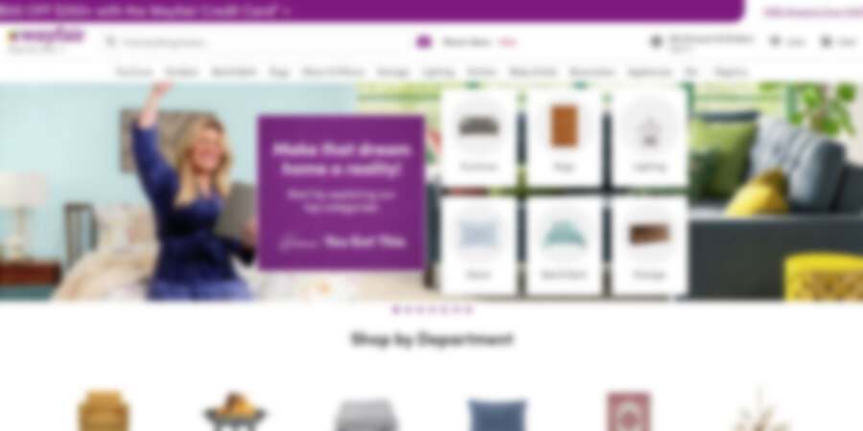




Non-Selenium Automation
Robot + AWT

Slide 14
Database Testing
Why, How?
Testing using programming
Database Driver, Making connection
Raising SQL queries and Response data parsing
Sqlite
MySQL
Postgres DB

Slide 15
Different Fixtures
Why, How?
How to set up and use them from Excel
Types :
Reporting
Db config
Parameter passing
Page Object creation
Browser setting

Slide 16
Demo !
Sample Web Application Automation
Sample Database Automation
Input Excel
Output Excel with Report
Report email

