Slide 1
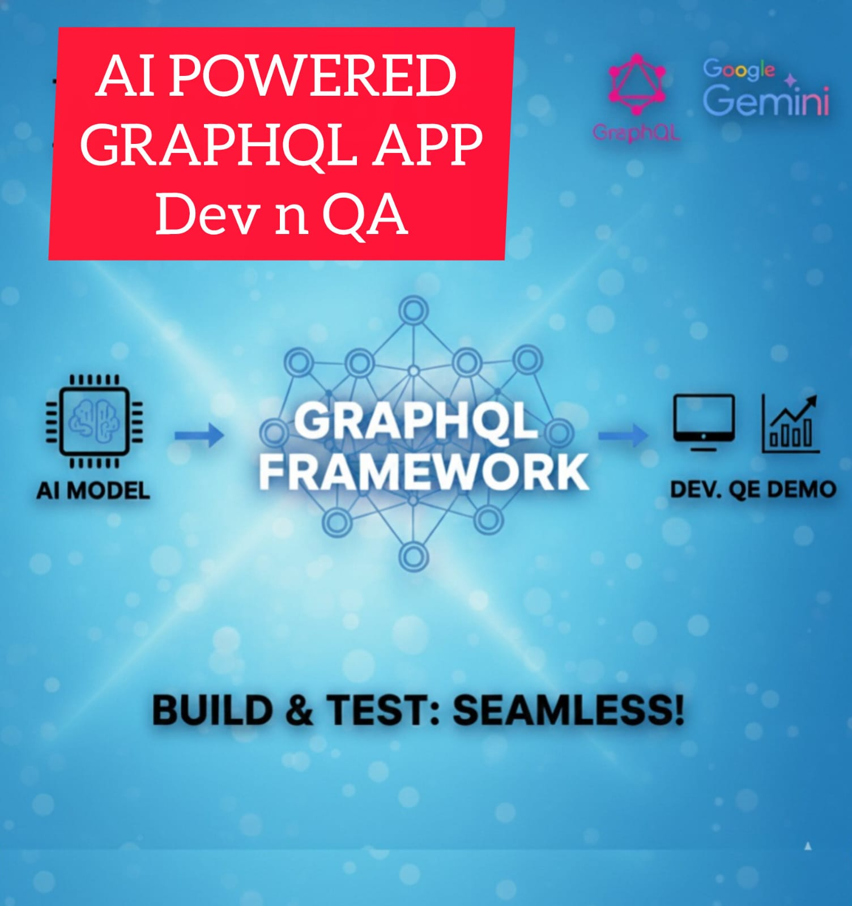



Slide 2

GraphQL
An open-source query language for API
It lets clients ask for exactly the data they need
No Over-fetching
No Under-fetching

Slide 3
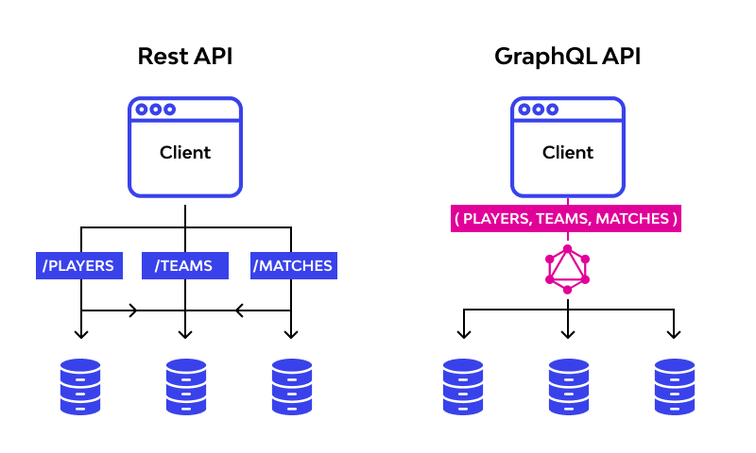
HTTP POST
by default

Slide 4
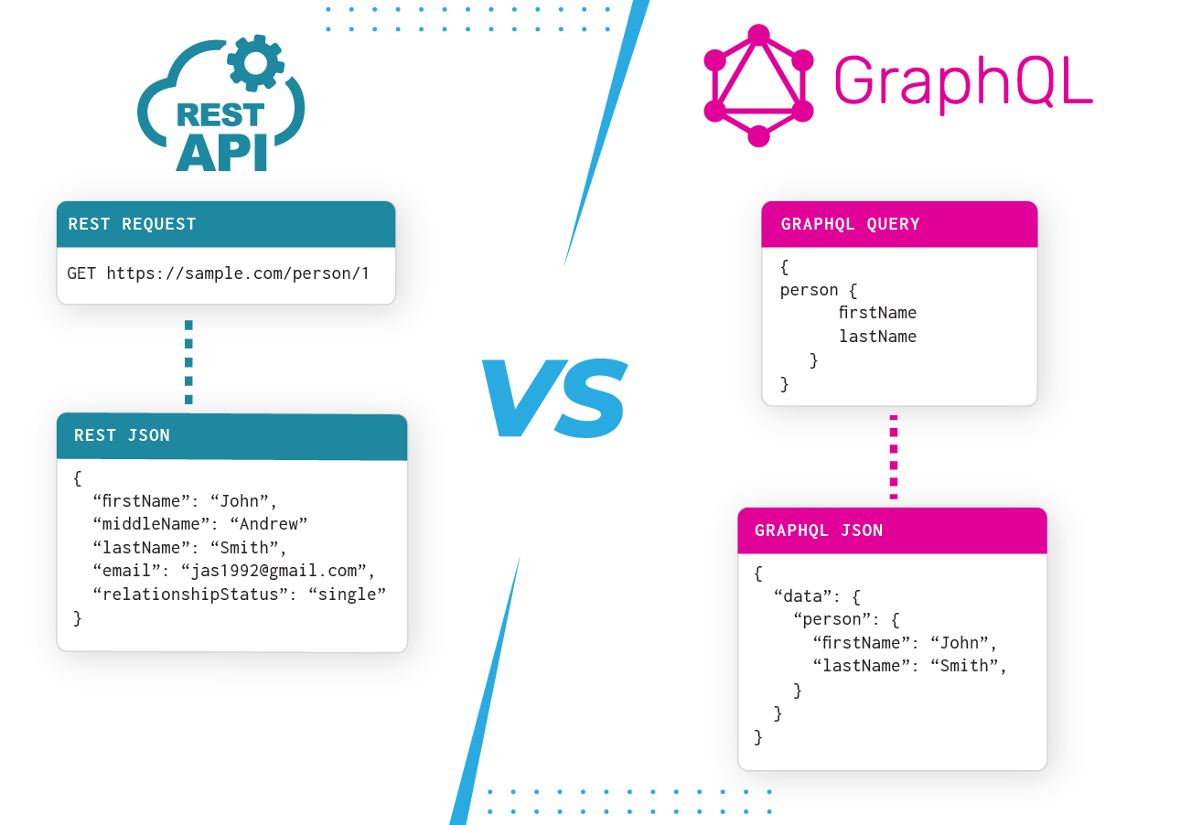

Slide 5
How It Works
GraphQL APIs are built on a Type System and a Schema
Schema: A "contract" defined by the server that lists all available data types (e.g., User, Project) and their relationships.
Resolvers: Functions on the server that fetch the actual data for each field from various sources like databases, other APIs, or microservices.
Operations: Clients interact with the API using three main types of operations:
  Queries: For fetching data (similar to a GET request).
  Mutations: For creating, updating, or deleting data (similar to POST, PUT, DELETE).
  Subscriptions: For receiving real-time updates over long-lived connections (typically via WebSockets).

Slide 6
Key Features
Single Endpoint: All operations usually go to a single URL (e.g., /graphql), regardless of what data is being requested.
Strongly Typed: Every field has a specific type, allowing for automatic validation and better developer tools.
Introspective: You can query the API for its own schema to see what data is available, making it self-documenting.
Version less: Instead of creating new versions (like /v1/, /v2/), APIs evolve by adding new fields and deprecating old ones without breaking existing queries.

Slide 7
Disadvantages
Complexity Overhead
Potential Over-fetching (for a poorly designed query)
Caching Challenges
Schema Design Overhead
Learning Curve

Slide 8
Demo
AI (Google Gemini) assisted backend development
Simple query (POST method)
Nested query (POST method)
Filtering / selective query
Selective query with limit keyword
Error scenario response code and body
GET method
.gql file or schema
Manual/ POSTMAN testing, Automation testing

