Slide 1
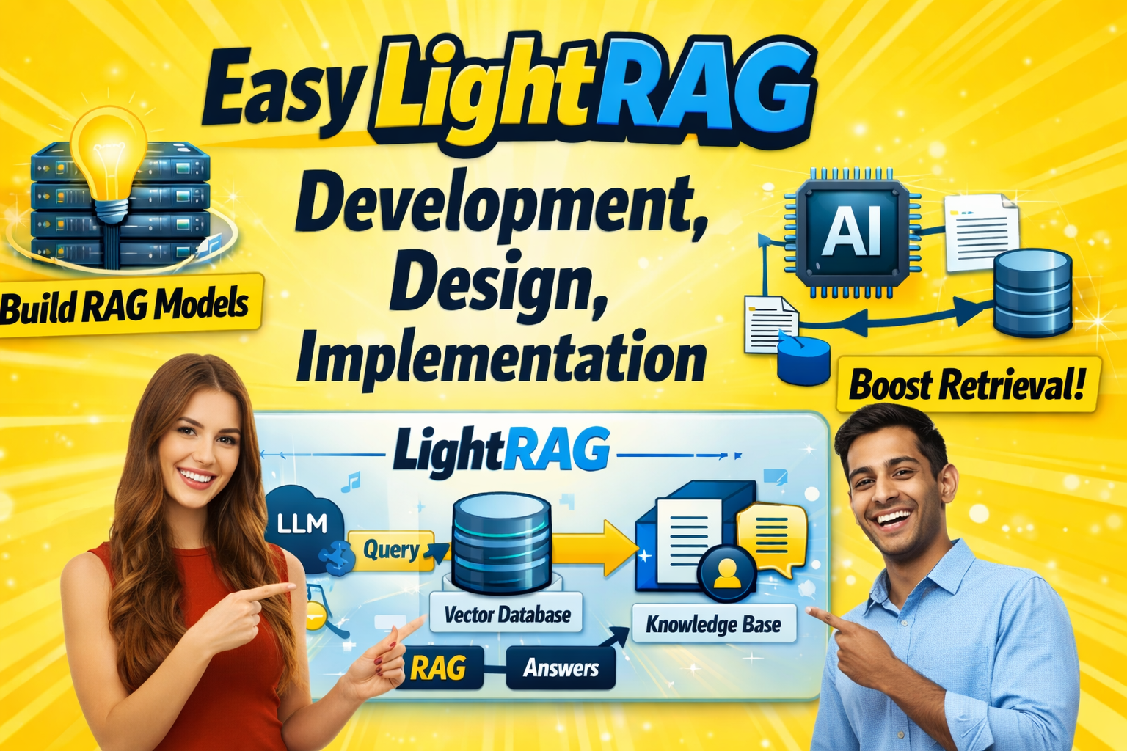

Slide 2

ollama LightRAG demo
Good alternative
for OpenAI / Gemini
LightRAG is a faster,
more context-aware
evolution of standard RAG

Slide 3
Light RAG demo
Retrieval-Augmented Generation
An advanced, graph-enhanced retrieval system
Designed for higher accuracy and faster response
Cost-effective performance compared to traditional, vector-based RAG
It bridges the gap between simple vector RAG and complex GraphRAG by mapping entity relationships

Slide 4
Light RAG demo
Retrieval-Augmented Generation
Retrieval Approach: Traditional RAG relies on semantic similarity (vector distance) of text chunks. LightRAG uses a hybrid approach, leveraging a lightweight graph structure to index entity relationships along with vectors.
Context & Accuracy: LightRAG excels at understanding complex connections, providing richer, context-aware, and more precise answers, particularly when comparing against traditional methods in testing.
Efficiency: LightRAG reduces query latency by approximately 30% compared to traditional RAG.
Updates: LightRAG is designed for efficient, incremental updates (appending data) without needing full re-indexing, which is often required in heavy graph systems.

Slide 5
Setup
Download and install Ollama local
AI model pulling on local – pros / cons
AI model on cloud ollama run gpt-oss:120b-cloud ollama run cogito-2.1:671b-cloud ollama run mistral-large-3:675b-cloud
Cloud model free credits
Sign in on web / local
Python 3.11
Links:
cogito
mistral

Slide 6
Light RAG demo – Gemini and Ollama prompt
Retrieval-Augmented Generation
https://gemini.google.com/share/e09c13ec1073
Ollama local window – with qwencode 3 model assisted coding

Slide 7
Use Cases
The "Needle in a Haystack" Test
Objective: specific entity retrieval from the middle of a long context.
Text Input: A 1800-word corporate policy document. Buried in paragraph 42 is a specific clause: "Remote work is only permitted on Tuesdays for Level 4 employees."
Query: "Which employees are allowed to work from home and when?"
Expected Output: "Level 4 employees are permitted to work remotely on Tuesdays."

Slide 8
Use Cases
List Aggregation
Objective: Verify the system can scan the entire window to collect scattered items.
Text Input: A 1500-word recipe book intro describing 15 different spices across various paragraphs.
Query: "List all spices mentioned in the text."
Expected Output: A comprehensive list of all 15 spices, with no hallucinations or omissions.

Slide 9
Use Cases
Negative Testing (Error Handling)
Verifying the system gracefully handles failure.
The "Absent Information" Trap
Objective: Test hallucination resistance.
Text Input: A 2000-word history of the Roman Empire.
Query: "What role did Napoleon play in the Battle of Cannae?"
Expected Output: "The provided text does not mention Napoleon or his role in the Battle of Cannae." (Must not invent a connection).

Slide 10
Use Cases
Irrelevant Query Filtering
Objective: Test context adherence.
Text Input: A 1700-word technical manual for a dishwasher.
Query: "What is the capital of France?"
Expected Output: "The provided text is a dishwasher manual and does not contain geographical information about France."

Slide 11
Use Cases
The "Noise" Stress Test
Objective: Test robustness against poor data quality (OCR errors, broken formatting).
Text Input: 1600 words of messy text: "Th$e p#roject wi|| launch on M@y 5th."
Query: "When is the launch date?"
Expected Output: "May 5th." (System should normalize the noise)

Slide 12
Use Cases
Distractor Entities
Objective: Test precision against similar entities.
Text Input: A 1700-word bio of "John A. Smith" and "John B. Smith".
Query: "Where was John Smith born?"
Expected Output: "The text mentions two individuals: John A. Smith (born in London) and John B. Smith (born in Ohio). Please specify."

Slide 13
Use Cases
Circular Reference Handling
Objective: Test graph-traversal loops.
Text Input: A 1500-word process doc. "Step 1 leads to Step 2. Step 2 refers back to Step 1 for verification."
Query: "What is the outcome of the process?"
Expected Output: "The process describes a loop between Step 1 and Step 2." (Should not crash or hang).

