Slide 1

ollama demo
Good alternative
for OpenAI / Gemini
Pilot IVRS for Banking domain
Interactive Voice Response System

Slide 2
Setup
Download and install Ollama local
AI model pulling on local – pros / cons
AI model on cloud (gpt-oss:120b-cloud) – pros / cons
Cloud model free credits
Sign in on web / local
Python 3.11

Slide 3
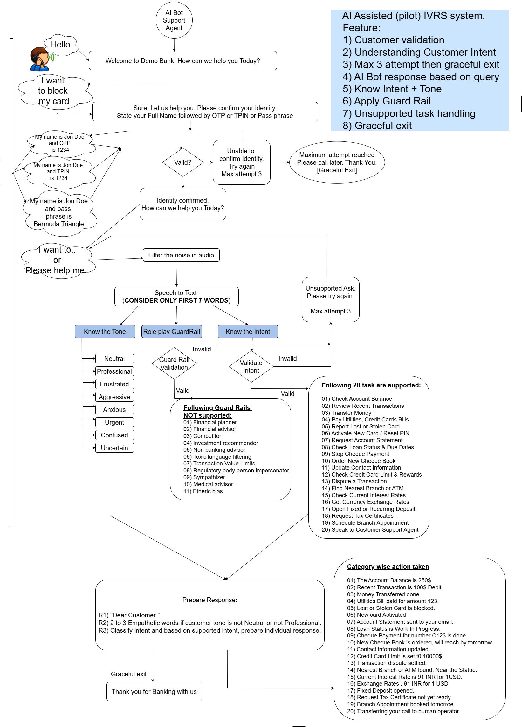

Slide 4
Simple RAG demo
Retrieval-Augmented Generation
AI Assisted (pilot) IVRS system.
Feature:
1) Customer validation
2) Understanding Customer Intent
3) Max 3 attempt then graceful exit
4) AI Bot response based on query
5) Know Intent + Tone
6) Apply Guard Rail
7) Unsupported task handling
8) Graceful exit

Slide 5
Prompt Design
Guardrails and Prompt for Guardrails
Supported tasks and Prompt for sentiment
Other
Test data design
Graceful exit
Error or exception handling, max attempt
Separate QE automation
Result discussion

