Slide 1
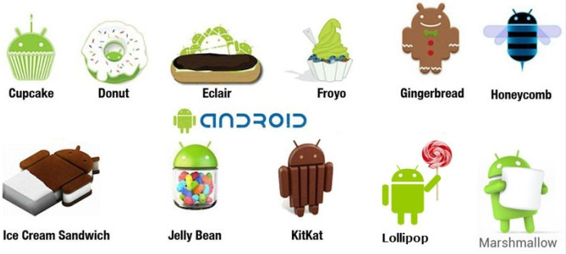

Welcome to imademethink
Android Automation using
ADB commands only

Slide 2

Agenda
ADB basics
ADB basic commands
Basic installation on Windows
ADB GUI tool install / run / examples
App Activity (MainActivity)
Automation for sample application :
https://www.realestate.com.au

Slide 3
ADB basics
Android Debug Bridge (adb) is a versatile tool lets you manage the state of an emulator instance or Android-powered device.
The adb command facilitates a variety of device actions, such as installing and debugging apps, and it provides access to a Unix shell that you can use to run a variety of commands on a device.
It is a client-server program that includes three components:
A client, which sends commands. The client runs on your development machine. You can invoke a client from a command-line terminal by issuing an adb command.
A daemon (adbd), which runs commands on a device. The daemon runs as a background process on each device.
A server, which manages communication between the client and the daemon. The server runs as a background process on your development machine.

Slide 4
ADB basic commands
adb devices
adb connect <host>[:<port>]
adb install -s test123.apk
adb uninstall com.test123.app
adb shell pm list packages
adb pull /sdcard/song.mp3
adb push test123.apk /sdcard
adb logcat
adb shell dumpsys
adb shell screencap /sdcard/screen.png

Slide 5
Basic installation on Windows
SDK tools - Google search for ADB minimal SDK and download it
ADB GUI tool - https://github.com/yapplications
Appium – NOT Required
Basic configurations on Android mobile
Enabling developer mode
Show point location/ X-Y location for user actions
App activity
An activity represents a single screen with a user interface just like window or frame of Java.Android activity is the subclass of ContextThemeWrapper class.
Activity Launcher App

Slide 6
ADB GUI tool
Windows based GUI tool to send commands with many utilities,
Tool demo for many utilities.

Slide 7
Automation Example
Realestate.com.au app
Automation scenario
Search and browse
Search result map swipe
Sign In

