Slide 1

CORE JAVA Programming Tutorial

Slide 2
Agenda
Java OOPS feature – Collection Interface.
Basic concept / theory.
How it works.
Examples with programs.
Interview questions.

Slide 3
Basic concept/ theory – Collection Interface
Java Collection simply means a single unit of objects.
A Collection is a group of individual objects represented as a single unit.
The Collection interface (java.util.Collection) and Map interface (java.util.Map) are two main root interfaces of Java collection classes.

Slide 4
Basic concept/ theory – Collection Interface
Collection Framework defines several classes and interfaces to represent a group of objects as a single unit. All collections frameworks contain the following:
Interfaces: These are abstract data types that represent collections. Interfaces allow collections to be manipulated independently of the details of their representation.
Classes: These are implementations of the collection interfaces.
Algorithms: These are the methods that perform useful computations, such as searching and sorting, on objects that implement collection interfaces. The algorithms are said to be polymorphic: that is, the same method can be used on many different implementations of the appropriate collection interface.

Slide 5
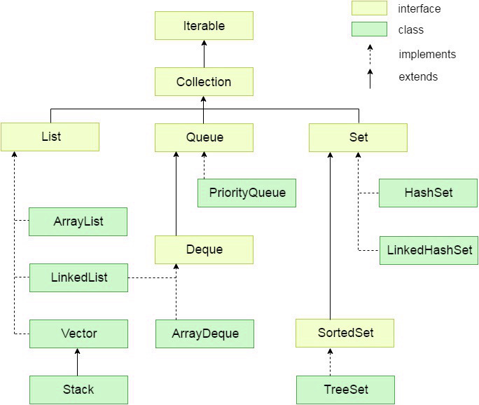

Slide 6
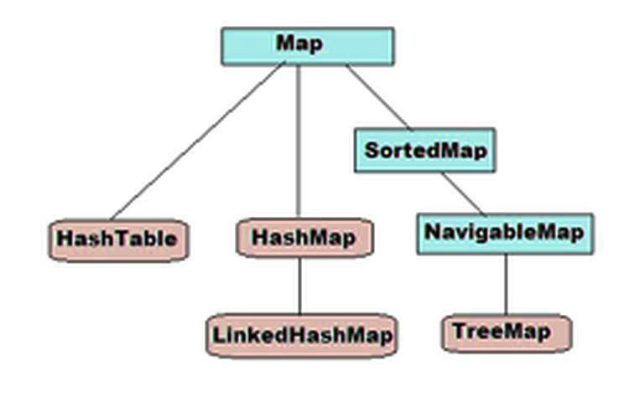

Slide 7
Collection interface methods
No. | Method | Description
1 | public boolean add(Object element) | Used to insert an element in this collection.
2 | public boolean addAll(Collection c) | Used to insert the specified collection elements in the invoking collection.
3 | public boolean remove(Object element) | Used to delete an element from this collection.
4 | public boolean removeAll(Collection c) | Used to delete all the elements of specified collection from the invoking collection.
5 | public boolean retainAll(Collection c) | Used to delete all the elements of invoking collection except the specified collection.
6 | public int size() | It return the total number of elements in the collection.

Slide 8
Collection interface methods
No. | Method | Description
7 | public void clear() | It removes the total no of element from the collection.
8 | public boolean contains(Object element) | It is used to search an element.
9 | public boolean containsAll(Collection c) | It is used to search the specified collection in this collection.
10 | public Iterator iterator() | It returns an iterator.
11 | public Object[] toArray() | It converts collection into array.
12 | public boolean isEmpty() | Checks if collection is empty.
13 | public boolean equals(Object element) | Matches two collection.
14 | public int hashCode() | It returns the hashcode number for collection.

Slide 9
Collection methods examples :
Example using ArrayList.
Example using PriorityQueue.
Example using HashMap.

Slide 10
Interview questions
Difference between Collection and Collections –
Difference between clear() and removeAll() method? – Clear will delete all members. Remove will delete given single member. RemoveAll will delete given multiple members (may not delete all members).
No. | Collection | Collections
1 | An interface. | A class.
2 | Used to represent group of individual objects as single entity. | A utility class which defines many utility methods e.g. sorting, searching.
3 | It is a root interface of Collection hierarchy. | It is not a root element.
4 | Declares all abstract methods. | Defines all static methods.

Slide 11
Interview questions
Difference between List, Set and Map:
 | List | Set | Map
Indexed/ Ordered | Yes | No | No
Duplicate | Yes | No | No duplicate key allowed, Value can be duplicate
Null elements | Yes | Only once | Only 1 key can be null, Only 1 value can be null
Insertion order | Yes, it can be accessed using index | No | No
Data structure | Array | Underlaying map implementation | Hashing technique

Slide 12
Interview questions
Difference between List, Set and Queue:
 | List | Set | Queue
Indexed/ Ordered | Yes | No | Yes
Duplicate | Yes | No | Yes
Null elements | Yes | Only once | It allows (but should be avoided)
Accessing order | Yes, it can be accessed using index | Traversing | First in is first out
Insertion order | At any index | Depends on implementation | At the last
Removal order | At any index | Depends on implementation | At the beginning

