Slide 1

INFO-H509 Geo-Spatial and web technologies
Urban Mobility Use case : Delay Visualization
Student : Imad SHAROF
Antonios Sisiaridis Noor ul Hassan
Murielle Tchamakam
Aziable Yawa
Professor : Mahmoud Sakr
Teacher Assistant : Gaspard Merten

Slide 2
Introduction and Objectives

Slide 3
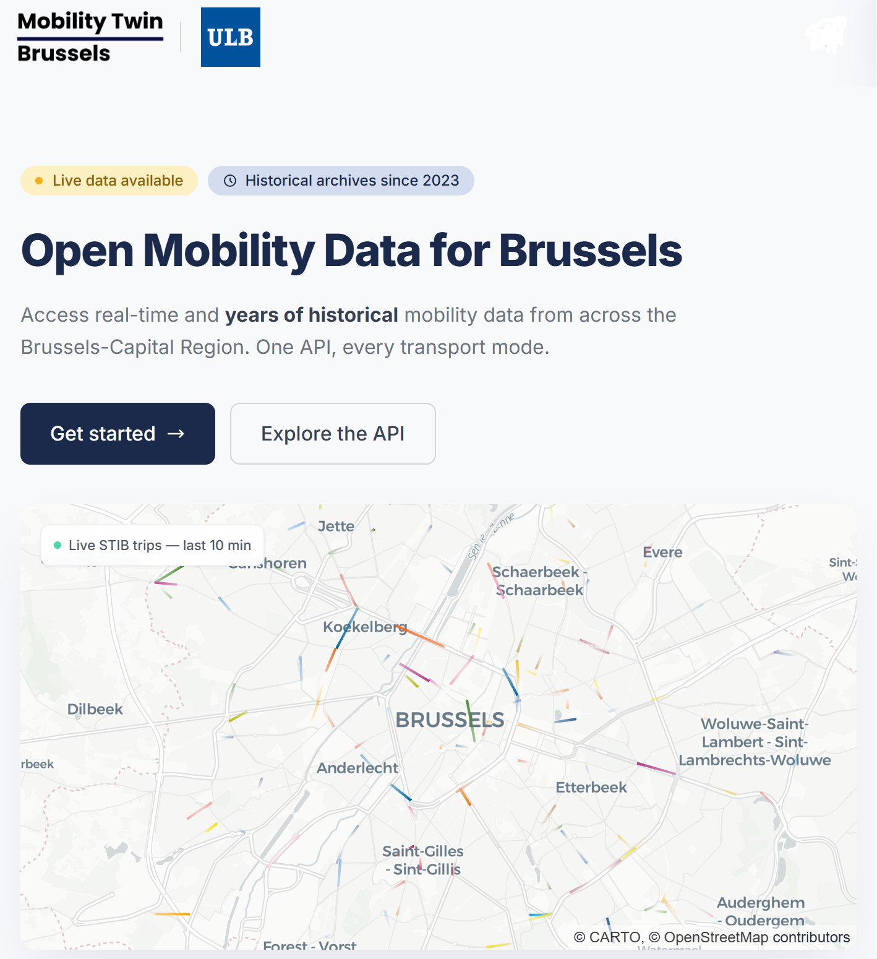
Introduction & Project Objectives
MobilityTwin.Brussels
ULB Research Platform
Aggregating mobility data for Brussels
+10 data sources: STIB, SNCB, Infrabel, Lime, Bolt, TEC...
+4 TB of data collected since 20233
Unified API: real-time + historical
Notes:
"This project is based on the MobilityTwin.Brussels platform, developed by the ULB. This platform brings together data from more than ten mobility operators in Brussels public transport, micromobility, traffic in a single place, representing over 4 terabytes of data since 2023. It is this infrastructure that has enabled us to access Infrabel’s data easily.

Slide 4
The problem identified
Daily report : Just one day: 8 May 2026
67,000 arrivals
Average delay: 1.69 mins
Unable to draw a conclusion
The problem :Why delay the display?
The Infrabel daily report offers a limited analytical value in isolation.
Our approach:
Aggregate 43 days of data to reveal invisible trends in everyday life.
A total of 43 days reveal:
🗺️ Beverlo: 8 mins late
🚆 Train 475: 72% late
🕐 Peak at 5 pm
Notes:
Infrabel publishes punctuality reports every day. The problem is that a daily report alone does not say much. However, by aggregating 43 days of data, we can start to see significant trends: which trains are chronically behind, which stations are problematic, and whether the delays follow regular patterns.

Slide 5
Goal of the Project
🗺️ Q1:
Which stations are the worst affected?
🕐️ Q2:
Which stations are the worst affected?
Our research questions ?
Four questions guided our analysis as a whole
+ 470000 arrived analyzed
447 stations
103 lines
43 days
🚆️ Q3:
Which trains are frequently delayed?
🗺️ Q4:
How do disturbances propagate?
Notes:
"To structure our analysis, we asked four specific questions. Firstly: which stations and lines are most affected? Secondly: are there any predictable daily or weekly patterns? Thirdly: are the same trains consistently running late? And fourthly: how does a disruption spread throughout the day? These four questions guided our entire study."

Slide 6
This visualisation might be helpful
👷
Infrabel :
Prioritise maintenance based on concrete evidence
🔬
Chercheurs:
Longitudinal analysis of mobility patterns
🚆
Voyageurs
Understanding why their journey has been disrupted
Notes:
Our dashboard is aimed at three types of users: the d'Infrabel, who can identify areas to prioritize for maintenance. MobilityTwin researchers, who have a longitudinal analysis tool. And finally the travelers, who can finally understand why their journey is exclusively disrupted

Slide 7
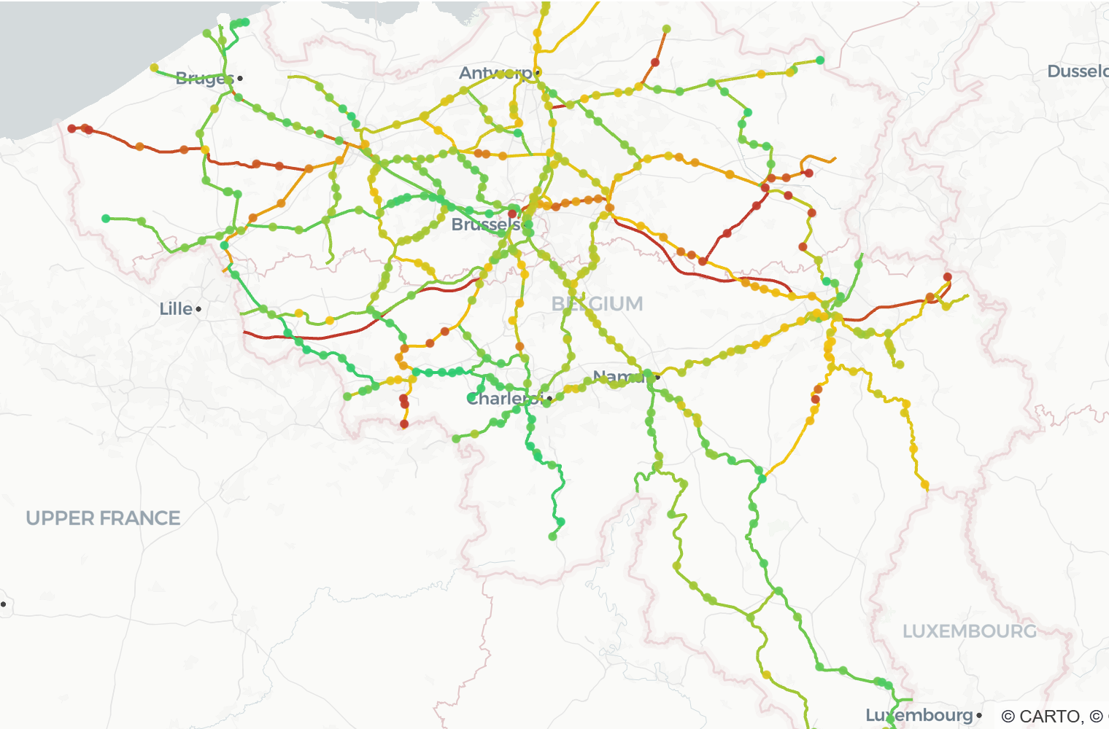
Data source
🗄️ Source principale
API MobilityTwin.Brussels
GET /infrabel/punctuality tu m'as montrée] ?timestamp=<iso>
1 recording = 1 stop, 1 train, 1 day
470000 arrivals / 43 days
447stations and 103 days
Geographical data
Operational_points.json GPS coordinates of the stations
Line_sections.json Line geometry
Notes:
Our data comes from the MobilityTwin.Brussels API via the Infrabel punctuality endpoint. Each record corresponds to a train stop at a station, with the scheduled time, the actual time and the delay in seconds. Over 43 days, this represents more than 470,000 arrivals at 447 stations and 103 lines. We also use two GeoJSON files for map visualization: station coordinates and railway line geometry.

Slide 8
Data Pipeline

Slide 9
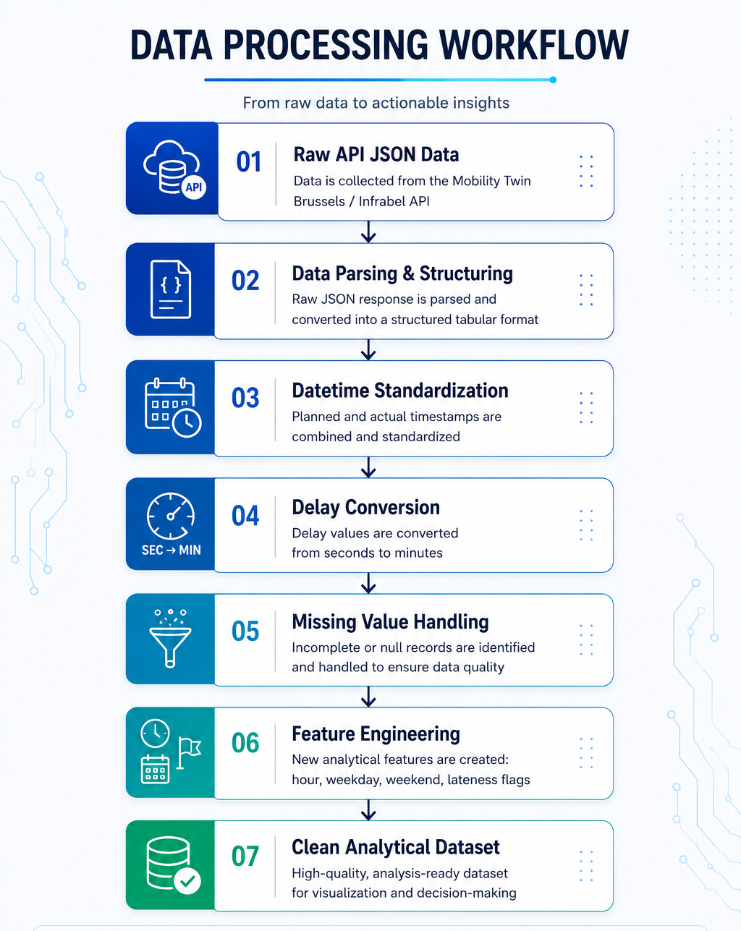
Data Cleaning
Transformed raw Mobility Twin / Infrabel API responses
Standardized temporal and delay-related features
Analysis-Ready Dataset
Notes:
Raw API data is not directly suitable for analysis because timestamps, delay fields, and categorical information are not structured for visualization. Therefore, the preprocessing pipeline converts raw JSON responses into a clean dataframe, standardizes datetime information, calculates delays in minutes, handles missing values, and creates analytical features such as weekdays, hours, and lateness indicators. This ensures the dataset is reliable for downstream visualization and delay pattern analysis.

Slide 10
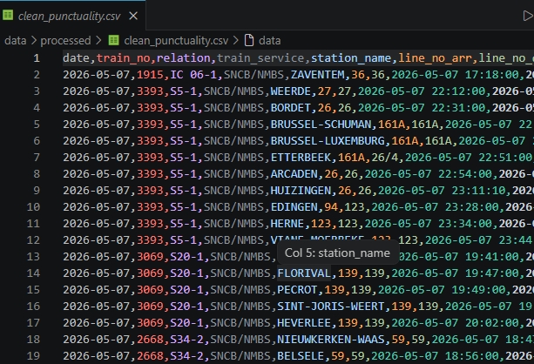
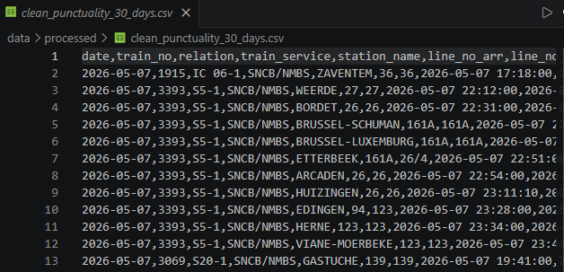
Cleaned Data

Slide 11
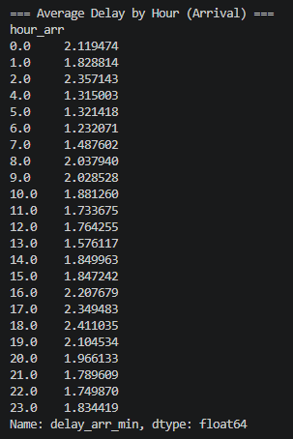
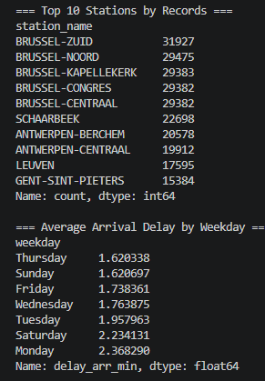

Data points used in analysis (the local version) and analysis

Slide 12
The Interactive Dashboard

Slide 13

Tool Selection: Why Streamlit?
Powered by Streamlit: An open-source Python library designed specifically for data scientists to quickly build and share interactive, data-driven web applications

Slide 14
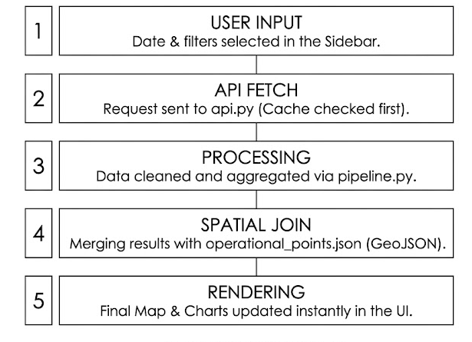

Technical Implementation & Data Flow

Slide 15
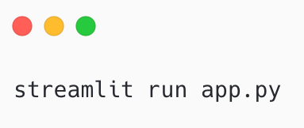
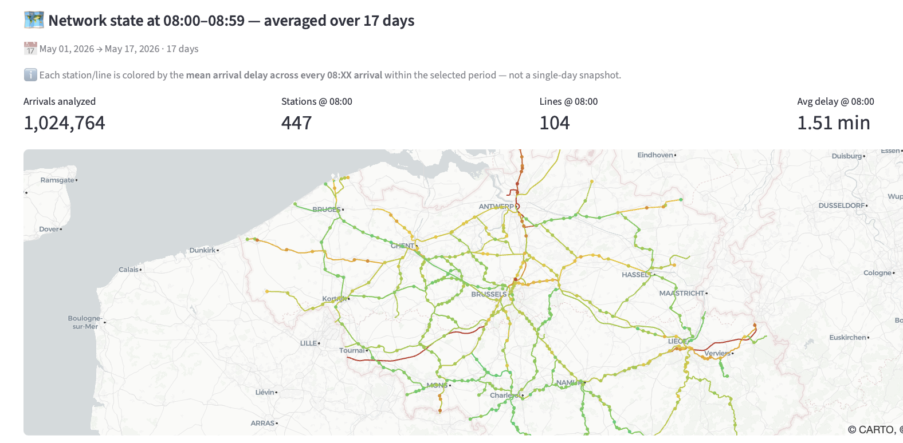
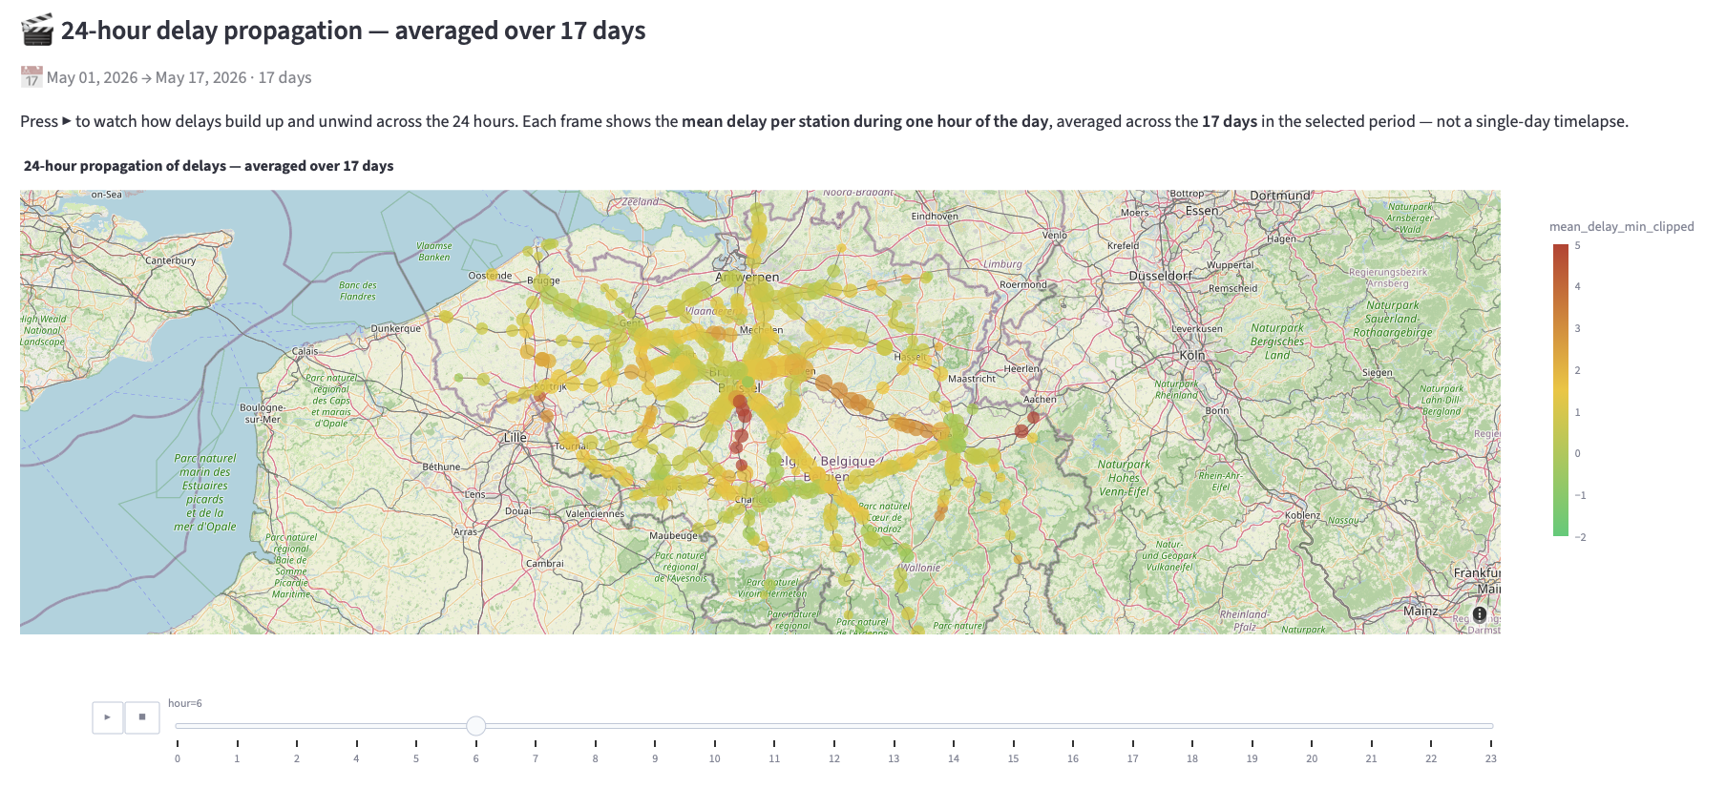
Live Demo & Data Analysis

