Slide 1
Presented by:
Ayaz Bahir
Imad Subhan
Muhammad Moiez

Slide 2

Student Interactive Career Counselling Assistant based RAG System
Empowering students with personalized, intelligent career guidance through advanced AI.

Slide 3

Understanding Retrieval-Augmented Generation (RAG)
What is RAG?
How it Works
RAG combines information retrieval with text generation for enhanced AI responses.
A retriever fetches relevant data, then a generator crafts precise answers.
Intelligent Assistants
RAG is ideal for building smart, context-aware conversational AI systems.

Slide 4
RAG vs. Traditional LLMs: A Key Difference
ChatGPT (Traditional LLM)
RAG System
Relies on pre-trained internal knowledge.
Accesses and uses external, up-to-date information.
Can "hallucinate" information not in its training data.
Reduces hallucinations by grounding responses in facts.
Less suitable for specialized, factual domains.
Perfect for accurate, domain-specific Q&A.

Slide 5




Addressing the Career Guidance Gap
Uncertain Choices
Students often struggle with complex career decisions and pathways.
Lack of Real-time Support
Existing guidance is generic, outdated, and lacks personalization.
Non-Interactive Systems
Current tools fail to offer engaging, dynamic interactions for users.

Slide 6

Our Solution: The Career Counselling Assistant
Our project develops a AI-powered career assistant using a RAG system.
It offers personalized, real-time guidance to students from all academic backgrounds.
The system leverages a comprehensive dataset for rich, accurate responses.

Slide 7
System Architecture and Workflow
Our RAG system processes queries through distinct stages:
1
Data Input
User queries enter the system.
2
Retriever Module
Identifies and retrieves relevant information from the knowledge base.
3
Generator Module
Synthesizes retrieved data into coherent answers.
4
Response Output
Delivers tailored career advice to the student.

Slide 8
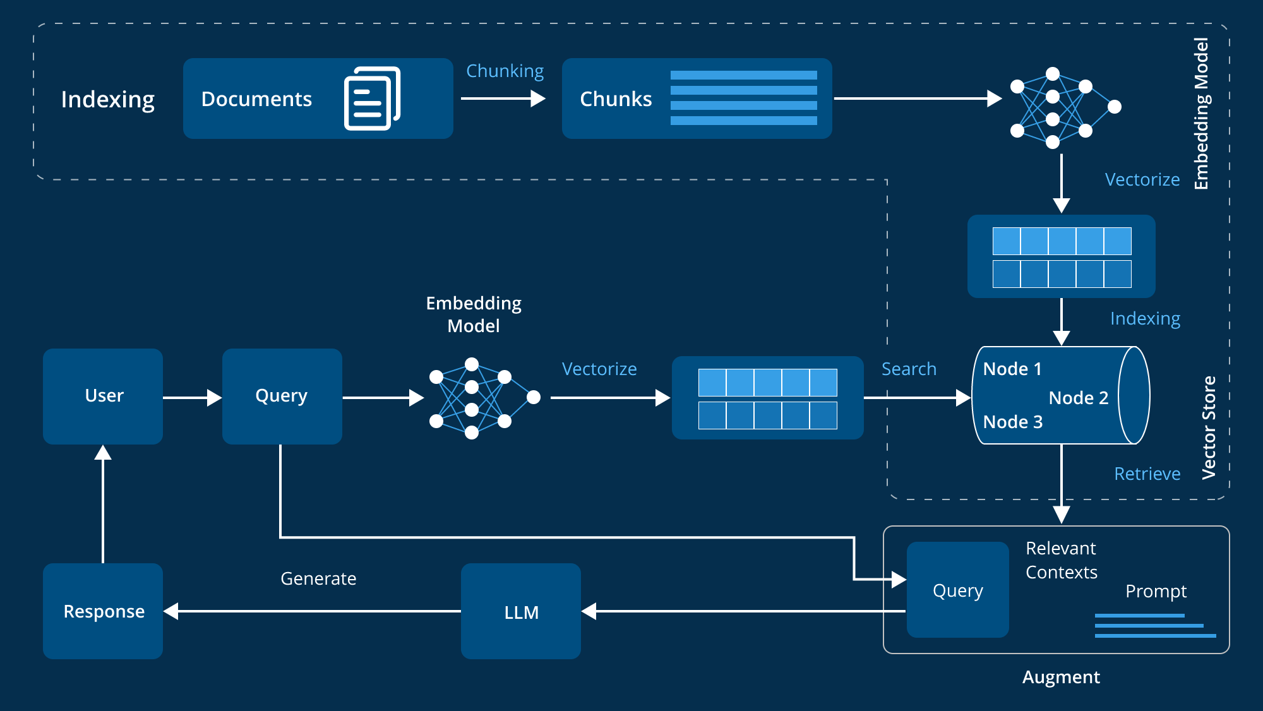

Slide 9


Core Modules: Retriever and Generator
Retriever Module
Generator Module
Built with Sentence-Transformer for semantic search.
Employs T5-base model for answer formulation.
Utilizes FAISS for efficient similarity search.
Generates responses based solely on retrieved data.
Finds top-k most relevant knowledge chunks.
Ensures factual accuracy and relevance.

Slide 10
Future Vision
Future Enhancements
We envision expanding the assistant's capabilities:
Intuitive Streamlit-based user interface.
Universities Scholarships.
Live chat.

Slide 11




Conclusion: Empowering Student Futures
Enhanced Guidance
Our RAG system significantly improves career guidance for students.
Informed Decisions
It provides personalized, accurate, and real-time career advice.
Educational Impact
This technology has immense potential to revolutionize educational support.

