Slide 1
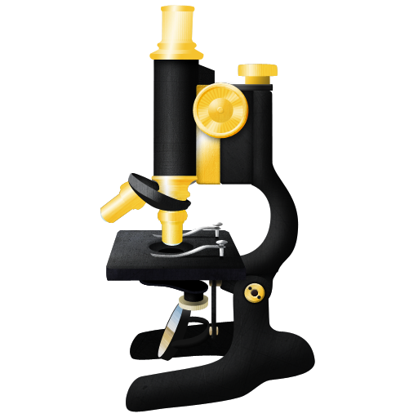
ImageJ2
Notes:
Thank you for the opportunity to speak to you all. My name is Curtis Rueden, and I am the project lead for ImageJ2.
For the past three years, we have been developing a new version of ImageJ for the next generation of scientific image data.
The project began in late 2009 with the funding of an NIH “Grand Opportunities” grant proposal. In this talk I'll discuss the project's goals, its current status, design philosophy and future directions.

Slide 2






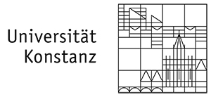

Who Develops ImageJ2?
And anyone who wants to contribute!
Notes:
ImageJ2 is a joint collaboration between several institutions.

Slide 3
Who Develops ImageJ2?
And anyone who wants to contribute!
Notes:
The primary development is happening at my lab, the Laboratory for Optical and Computational Instrumentation—or LOCI—at the University of Wisconsin-Madison, in the USA.

Slide 4
Who Develops ImageJ2?
And anyone who wants to contribute!
Notes:
But our initial funding included a developer at the Marine Biological Laboratory at Woods Hole, as well as a collaboration with the CellProfiler team at the Broad Institute of Harvard and MIT.

Slide 5
Who Develops ImageJ2?
And anyone who wants to contribute!
Notes:
We have also partnered with members of the Fiji team from MPI-CBG in Dresden and at Janelia Farm, who have developed the ImgLib library, as well as developers at the University of Konstanz, who have integrated ImageJ2 into KNIME's Image Processing nodes.

Slide 6
Who Develops ImageJ2?
And anyone who wants to contribute!
Notes:
And LOCI is a member of the Open Microscopy Environment consortium, which is working hard to create a common software platform for the life sciences and beyond.

Slide 7
Who Develops ImageJ2?
And anyone who wants to contribute!
Notes:
We make a serious effort to be as open as possible with the development, and additional collaboration on the project is very welcome. The more, the merrier!

Slide 8

Why ImageJ2?
Notes:
We often cite several motivations for ImageJ2:
To support the next generation of image data
To interoperate & collaborate with other projects
To broaden the ImageJ community
To provide a central online resource for ImageJ
But rather than dwell on the rationale now, I'll cover each aspect of the project in more detail, to give you a clearer idea of what ImageJ2 is trying to achieve.

Slide 9
ImageJ2 in a Nutshell
Compatible
N-dimensional
Headless
Extensible
Interoperable
Updatable
Openly developed
Notes:
These seven features represent ImageJ2's primary characteristics and design goals.

Slide 10
ImageJ2 in a Nutshell
Compatible
N-dimensional
Headless
Extensible
Interoperable
Updatable
Openly developed
Notes:
“Compatible” means providing support for existing macros and plugins from the current ImageJ 1.x.

Slide 11
ImageJ2 in a Nutshell
Compatible
N-dimensional
Headless
Extensible
Interoperable
Updatable
Openly developed
Notes:
“N-dimensional” means robust support for image data beyond space and time. A few examples include multispectral and hyperspectral images; fluorescence lifetime measured in the time or frequency domains; multi-angle data from acquisition modalities such as Selective Plane Illumination Microscopy; multi-position data from High Content Screens; and experiments using polarized light.

Slide 12
ImageJ2 in a Nutshell
Compatible
N-dimensional
Headless
Extensible
Interoperable
Updatable
Openly developed
Notes:
“Headless” means the software can run remotely on a server without a graphical user interface. In computer science terminology, ImageJ2 strives to have a proper separation of concerns between data model and display thereof, enabling headless operation and much more.

Slide 13
ImageJ2 in a Nutshell
Compatible
N-dimensional
Headless
Extensible
Interoperable
Updatable
Openly developed
Notes:
“Extensible” means the software can be modified and extended easily by others. We have put a lot of thought into ImageJ2's plugin framework to make all sorts of extensions possible, and common ones easy.

Slide 14
ImageJ2 in a Nutshell
Compatible
N-dimensional
Headless
Extensible
Interoperable
Updatable
Openly developed
Notes:
“Interoperable” means that the program plays well with others. We make every effort to enable usage of ImageJ code from within other applications; in fact, such usage is one of ImageJ2's primary motivations.

Slide 15
ImageJ2 in a Nutshell
Compatible
N-dimensional
Headless
Extensible
Interoperable
Updatable
Openly developed
Notes:
“Updatable” means having a built-in, configurable update mechanism to manage extensions and keep the software up-to-date.

Slide 16
ImageJ2 in a Nutshell
Compatible
N-dimensional
Headless
Extensible
Interoperable
Updatable
Openly developed
Notes:
“Openly developed” means making the project as accessible as possible to everyone. An openly developed project is not only open source, but has an open history, open discussion forums, open issue tracking system, open roadmap, and an open patch submission process. Perfecting these qualities allows a project to be truly driven by the community, and greatly magnifies its relevance and utility worldwide.

Slide 17
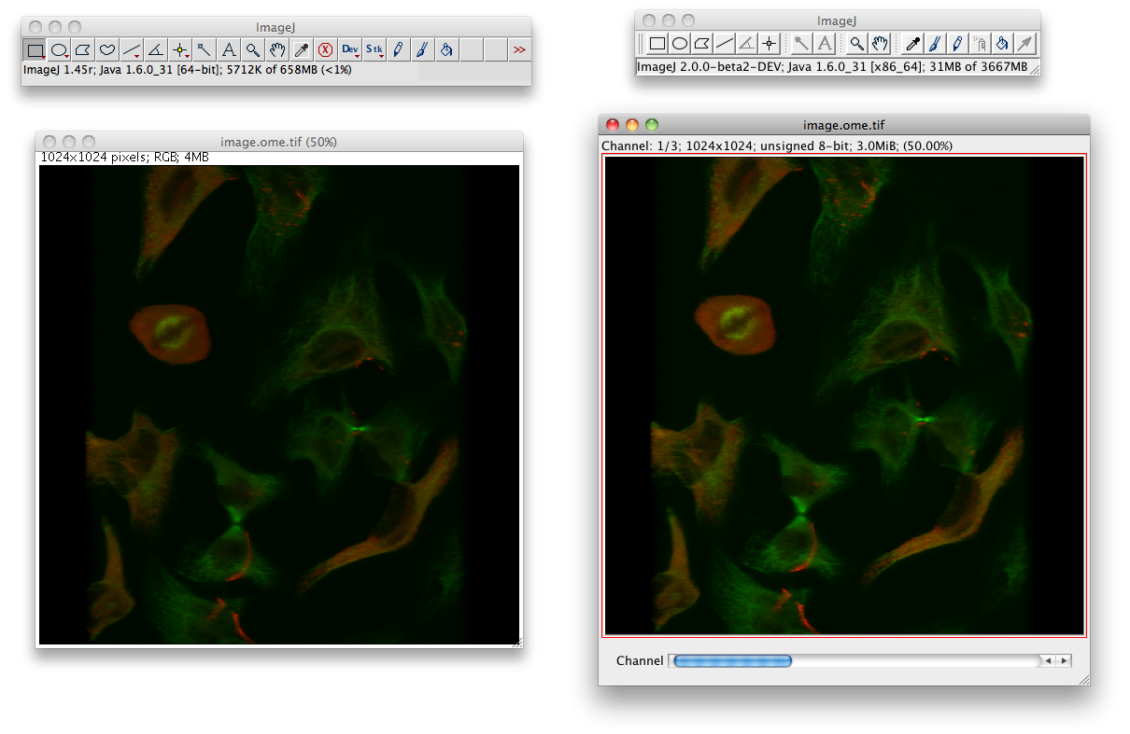
Compatibility
Invisible ImageJ1
Notes:
ImageJ2's data model is very different from that of ImageJ 1.x, so maintaining backwards compatibility has been a major undertaking.
ImageJ1 and ImageJ2 continue to develop in tandem. The ImageJ2 distribution includes a copy of the latest version of ImageJ1.
ImageJ2 provides backwards compatibility with ImageJ1 via a “legacy layer” which translates between “legacy” and “modern” data structures.
Our goals for backward compatibility include full support for non-interactive commands, and for ImageJ1's macro language. The current version of ImageJ2 supports many commands, although there are still some bugs and limitations.
Our strategy for interactive commands is to “port” them to the ImageJ2 platform.

Slide 18
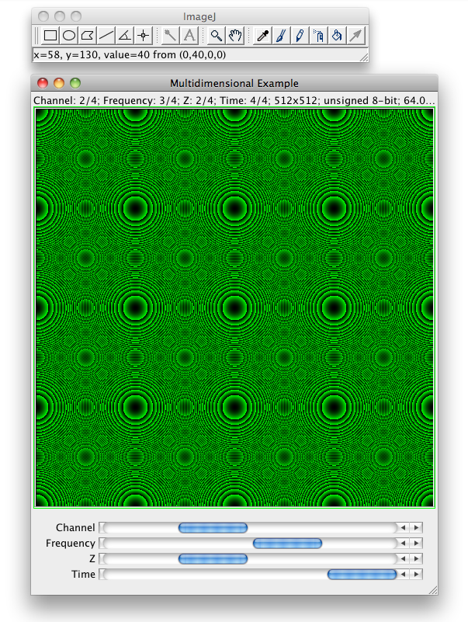
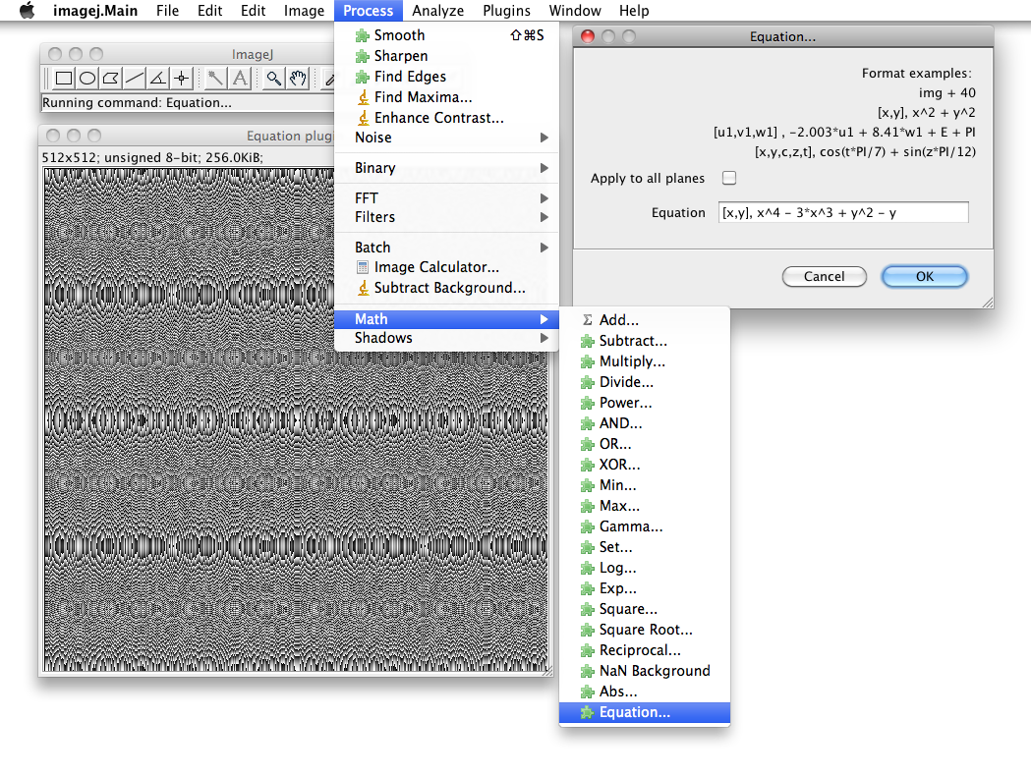
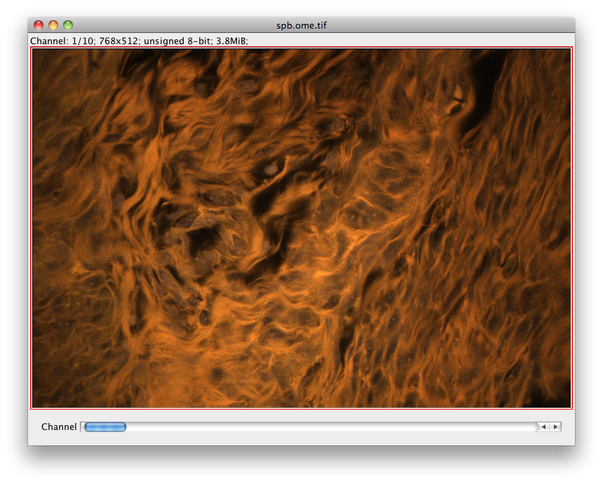
N-Dimensional
Support for more than five dimensions
Composite more than seven channels
Notes:
ImageJ2 has an N-dimensional data model, meaning it supports any number of dimensional axes. There are several presets, or you can define your own axis types.
When visualizing multi-channel data, each channel can have its own LUT, similar to ImageJ1's composite image feature. But in ImageJ2 there is no limit to the number of channels which can be composited together.

Slide 19
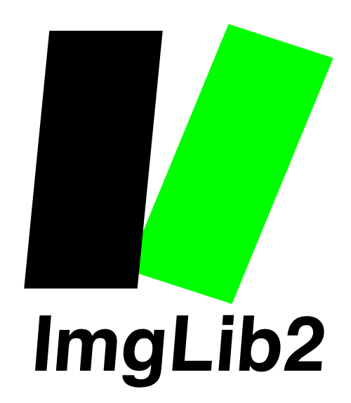
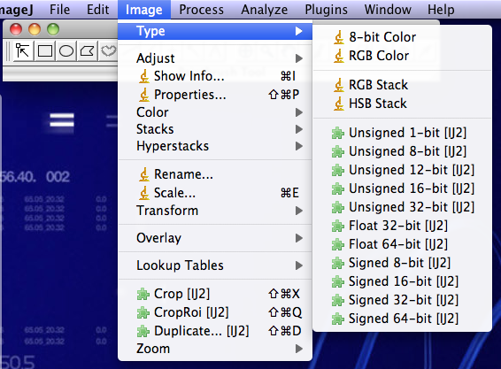
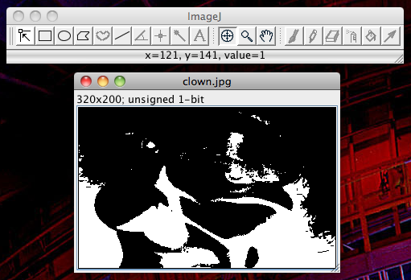
Data Model
Driven by powerful ImgLib2 library
Support for many new data types
Notes:
ImageJ2's data model is based on the ImgLib2 library, which you will hear more about later today and tomorrow.
ImgLib2 provides an extensible way of defining image pixel types, meaning that ImageJ2 can support, for example, 64-bit reals, 12-bit integers, 1-bit binary, or really any numerical data you can express computationally.
ImgLib2 also has an extensible container system, which enables data to be stored internally however you want: as files on disk, remote URLs, within a database.
As such, you can write an algorithm once and it will work with data in any pixel type, and stored internally using any storage container.

Slide 20
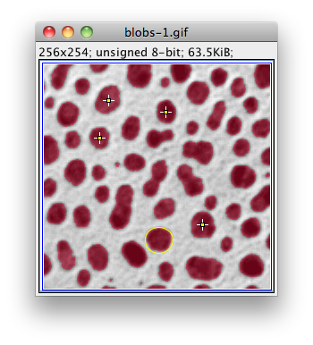
Regions of Interest
ROIs are functions
Overlays are visuals
Notes:
A region of interest, or ROI, is a function that identifies samples upon which to operate. In contrast, an overlay is a visual superimposed over a dataset, often (but not always) linked to a ROI.
ImageJ2's ROI model is part of ImgLib2, while the overlay logic lives in ImageJ2. ImageJ2 allows any number of simultaneous overlays.
There is still a lot of work to be done on ROIs, but we are collaborating with other members of the community, including the Icy, CellProfiler and OMERO teams, to define a common ROI specification that we can all use to ensure interoperability across our projects.

Slide 21



Data I/O
SCIFIO = SCientific Image Format Input & Output
Core library for reading and writing data
New formats added as SCIFIO plugins
Notes:
For reading and writing data, we are developing the SCIFIO library. It is a generalized version of Bio-Formats intended to support file format plugins for any scientific image format, not just those in the life sciences.
With the new SCIFIO library, Bio-Formats will simply be one collection of plugins, with others being possible for other scientific disciplines.
SCIFIO plugins will work automatically in ImageJ2, but also in many other tools such as MATLAB, ITK and OMERO.

Slide 22
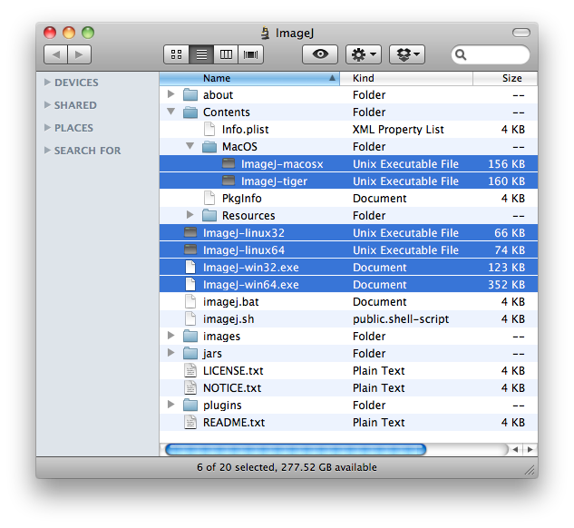
Launcher
Single, multi-platform distribution of ImageJ
Run scripts in batch mode
Run headless
Notes:
ImageJ2 features a cross-platform launcher, which was formerly part of Fiji. It has many features, with more to come. It will provide several different ways of launching ImageJ2, including in headless mode with no user interface.

Slide 23
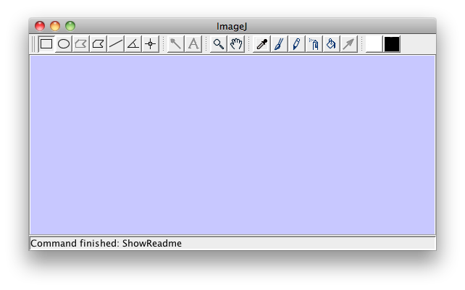
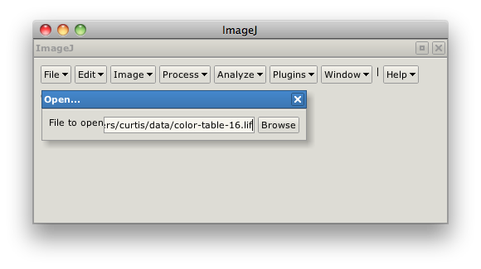
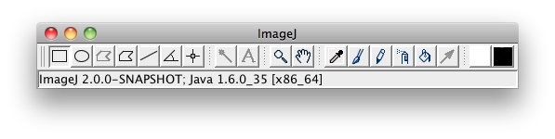
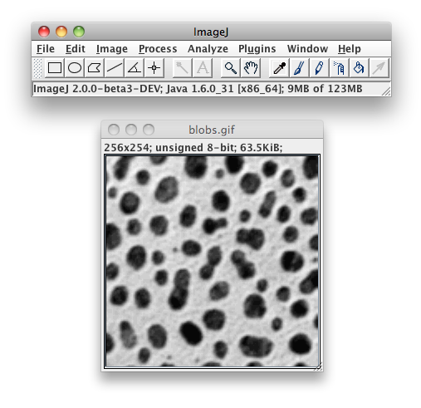
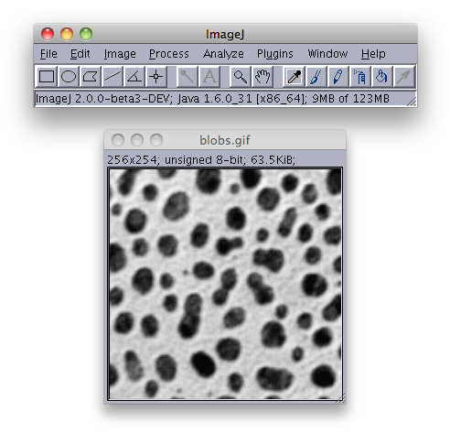
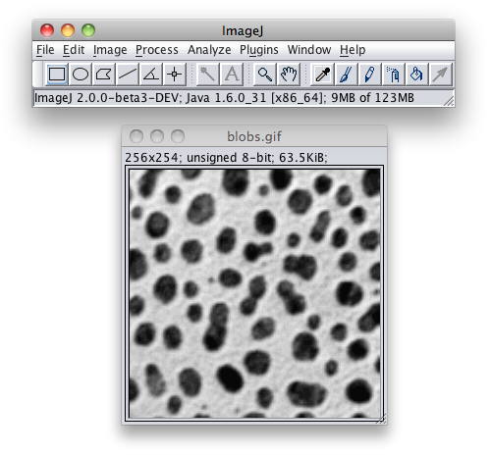
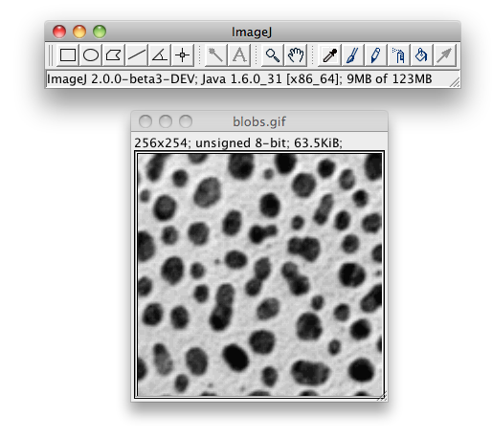
Customizable UIs
Support for Swing Look & Feels
  Metal, Motif, Nimbus, Aqua, Windows, GTK
Multiple UIs possible
  Swing, AWT, Apache Pivot, Eclipse SWT…
Notes:
Developing ImageJ2 to support multiple different user interfaces has been a challenge, but we believe it will be well worth it for many years to come. One very common question on the ImageJ mailing list is how to customize ImageJ, and doing so will be much easier now with ImageJ2. In particular, it will no longer be necessary to modify the existing source code—only to write a new user interface plugin for your needs.

Slide 24
Service Architecture
Core ImageJ2 Services
Plugins
Displays
UIs
Events
Overlays
ImageJ Context
Animation
Tools
I/O
Options
Platforms
Custom Service
Another Service
Notes:
A service is a collection of related functionality. For example, the animation service provides methods for animating: starting, stopping, setting frames per second, and so on. Each service may depend on other services, creating a hierarchy.
ImageJ2 is nothing more than a collection of these services. While the application comes with many services built-in, you can also write plugins that define their own, making ImageJ2 truly extensible.

Slide 25
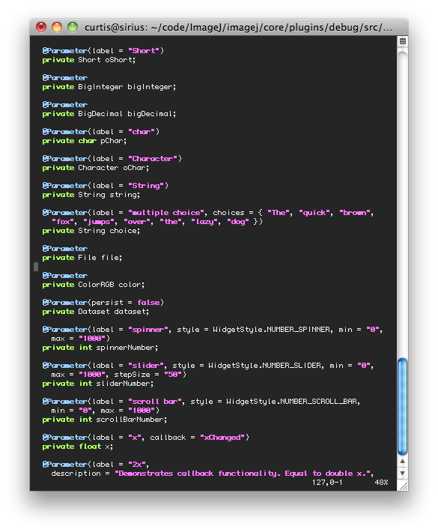
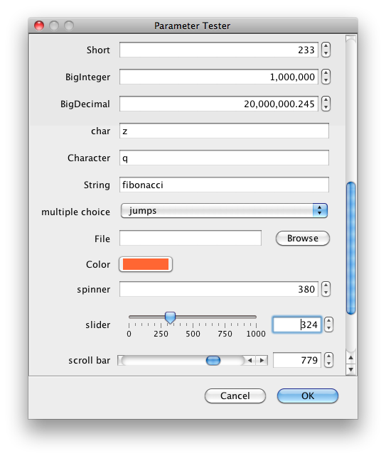
Plugin Framework
Notes:
The ImageJ2 plugin framework is a modular and extensible infrastructure for adding features.
Plugins can now take many forms, including image processing, new tools, and even completely new display viewers. It is even possible to define your own types of plugins.
One very useful type of plugin is called a command. Here we see the plugin framework in action defining a new command for exercising different sorts of input parameters. The ImageJ2 user interface takes care of creating a dialog box to harvest parameter values from the user, which will be used when the command runs.

Slide 26


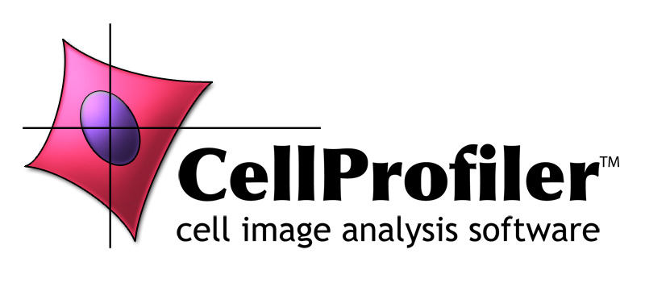
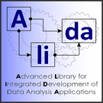


Interoperability
Notes:
There is no one-size-fits-all tool for scientific image processing, and there never will be. A diversity of tools is good for users—as long as they can interoperate with each other.
Our primary goal is for ImageJ2 to be reusable from other tools. Because the plugin framework is completely headless, many other tools already take advantage of ImageJ2.
Even tools in written in languages besides Java, such as CellProfiler which is written in Python, have successfully embedded ImageJ2.

Slide 27

Interoperability
http://scijava.org/
Notes:
Together with several other project teams, we have started an initiative called SciJava. The idea is to work together on a common software stack, reusing one another's work when practical, and defining common libraries when necessary for functionality such as ROIs.
See the SciJava web site for details.

Slide 28
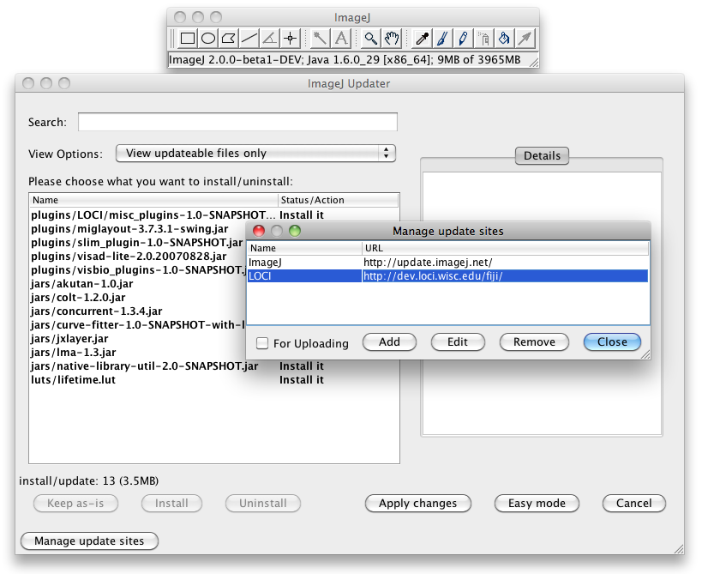
Updater
Central mechanism for installing new plugins
Compatible with Fiji update sites
Notes:
Another piece of Fiji that has made its way into ImageJ2 is the Updater. Johannes has done a ton of work to make the Updater a core, robust part of ImageJ2.
The Updater allows you to update what features are available within your ImageJ, and keeps them up to date as bugs are fixed, etc.

Slide 29
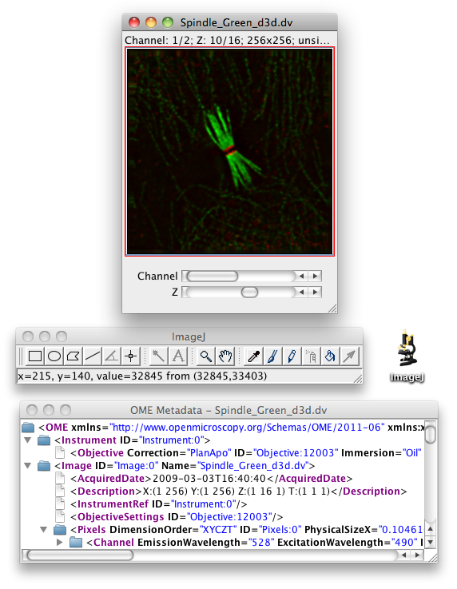
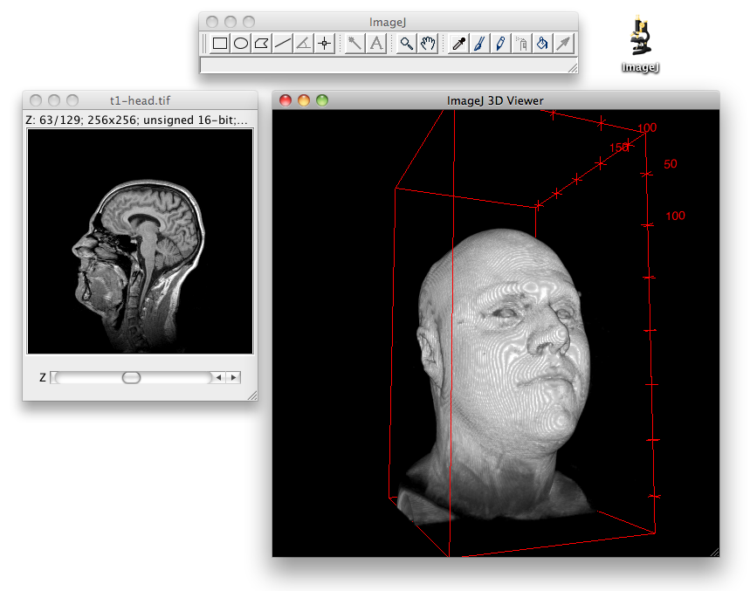
Updater
Install and use Fiji plugins
3D Viewer, Bio-Formats, more
Notes:
The Updater makes it easy to install additional plugins. It is compatible with existing Fiji update sites, so you can easily install all of Fiji into your ImageJ2 if you want to: more than 350 of them!
Here we see the 3D Viewer and Bio-Formats Importer plugins in action within ImageJ2.

Slide 30
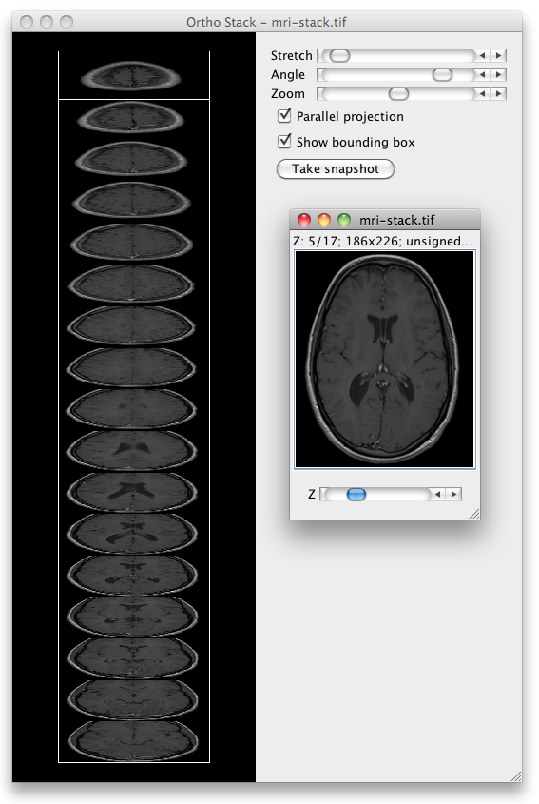
Updater
Works with third party update sites too
On right, VisBio Ortho Stack plugin from LOCI update site
Notes:
It is also easy to set up your own ImageJ update site to distribute your own plugins. This is much easier for most users than requiring them to download a JAR file and drop it into the plugins folder, although you can still do that with ImageJ2 if you want. Just remember that users will always have to update your plugins manually then, and you will have a much harder time managing your dependencies too.

Slide 31
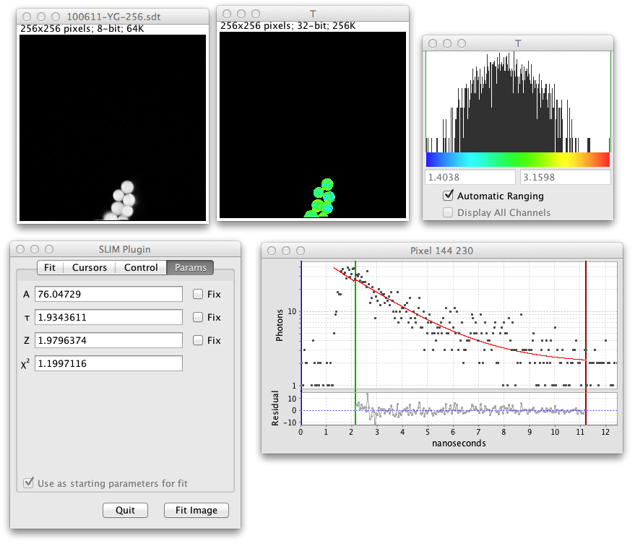
Spectral Lifetime Analysis
SLIM Plugin for visualizing and analyzing combined spectral lifetime image data
Works with data
in time domain
Available from
LOCI update site
Notes:
Here we see the Spectral Lifetime Analysis plugin, another example of a plugin available from a third party update site. LOCI is developing this plugin to better support fluorescence lifetime data within ImageJ. As the plugin matures, it will help to drive ImageJ2's display architecture.

Slide 32
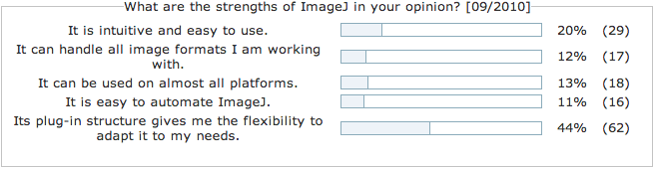
Design Philosophy
Extensibility
Modularity
Interoperability
Notes:
Next I would like to discuss a few issues relating to ImageJ2's design philosophy. For those at the conference two years ago, you may remember me discussing the ideas of extensibility, modularity and interoperability.
ImageJ's greatest strength is in its extensibility, which is its plugin and scripting mechanisms. Each plugin is a modular building block. Creating these reusable building blocks facilitates interoperability, as discussed earlier.

Slide 33
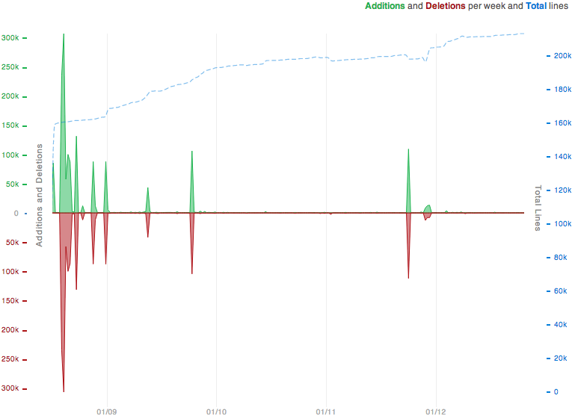
Complexity
ImageJ 1.x
Notes:
Here is a graph of changes in ImageJ1 over time. The green and red spikes represent lines of code added and removed, respectively. The dashed blue line represents total lines of code. As typical for a stable project, you can see the blue line slowly grows over time, as bugs are fixed and new features are introduced.

Slide 34
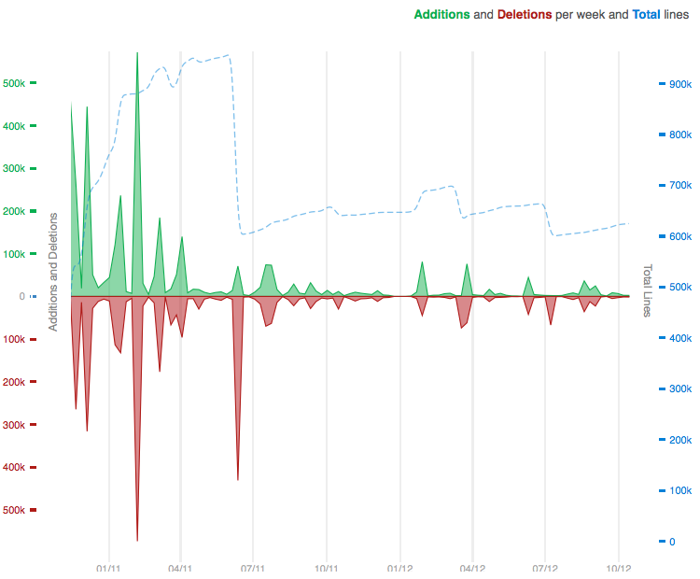
Complexity
ImageJ 1.x
ImageJ2
Notes:
Contrast that with the same graph of changes in ImageJ2, shown on the right. As you can probably guess from the blue line, development is more active and less stable.
You'll notice that at several junctures, we pruned the codebase to reduce total lines of code. Sometimes that meant moving non-essential features out of the core, and other times it meant refactoring to simplify and generalize the codebase.

Slide 35
Complexity
"Every line of code is a liability."
—Taka Muraoka
"Debugging is twice as hard as writing the code in the first place. Therefore, if you write the code as cleverly as possible, you are, by definition, not smart enough to debug it."
—Brian Kernighan
ImageJ 1.x
ImageJ2
Notes:
The complexity of a codebase is more than the number of lines of code. But each line of code does add complexity, making the project harder to understand and maintain.
Other vital considerations include modular code structure, careful management of dependencies, effective unit testing, and avoiding unnecessarily “clever” code.
By keeping a clean, well-organized codebase of modest size, we facilitate contributions from the entire ImageJ community, as well as make maintenance of ImageJ2 feasible far into the future.

Slide 36
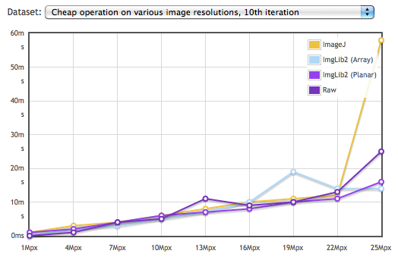
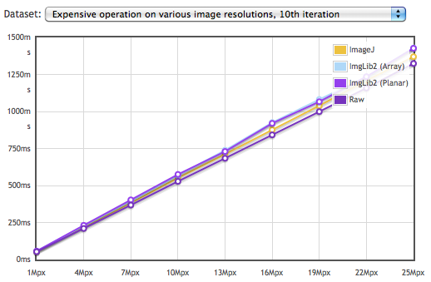
Performance
Performance is a design goal
http://developer.imagej.net/imglib-benchmarks
Notes:
Here we see a benchmark comparing the time performance of ImgLib2 with ImageJ1 as well as raw arrays. On the left is a cheap operation, which is largely dominated by loop overhead. On the right is an expensive operation dominated by the operation itself. Although there are some outliers due to vagaries of Java's Just-In-Time compiler, on average the performance of all methods is highly comparable.
Good performance in both time and space is one of ImageJ2's central goals. In some cases, such as with the ImageJ1 macro language, we actually hope to substantially improve time performance. And ImgLib2's flexible container model will allow us to often improve space performance in a transparent way, too.

Slide 37
Performance
“We should forget about small efficiencies, say about 97% of the time: premature optimization is the root of all evil. Yet we should not pass up our opportunities in that critical 3%.”
—Donald Knuth
Performance is a design goal
But optimize only as needed
http://developer.imagej.net/imglib-benchmarks
Notes:
However, since ImageJ2 is still in beta, performance has not been our primary focus yet. We believe that compromising early for the sake of performance often results in a long-term increase in complexity. There is no doubt that performance must be a design consideration, but we believe that aggressive performance optimization should only be done on an as-needed basis, once the software is mature.

Slide 38

Collaboration
Open development
Improve ImageJ as a community
Open access resources
Responsive, reliable maintainers
Powerful collaboration tools (GitHub!)
Notes:
With ImageJ2, we really want to push ImageJ development in a collaborative and community-driven direction. ImageJ2 is not only open source, but follows an open development process. This includes...

Slide 39
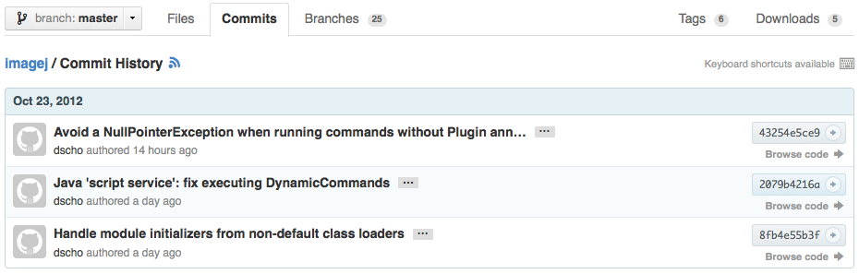
Collaboration
Notes:
...an open revision history...

Slide 40
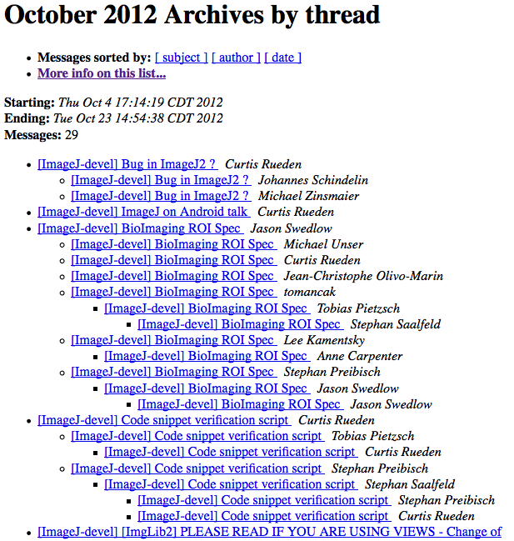
Collaboration
Notes:
...open mailing list...

Slide 41
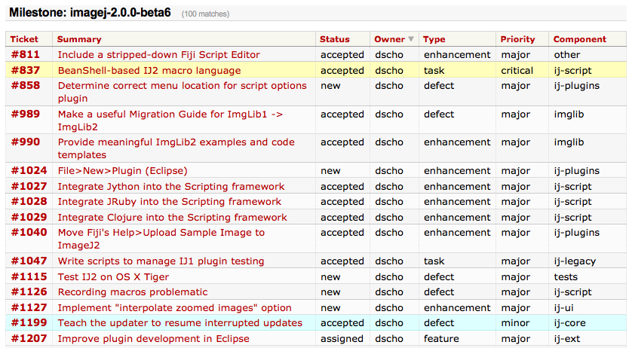
Collaboration
Notes:
...open issue tracking system...

Slide 42
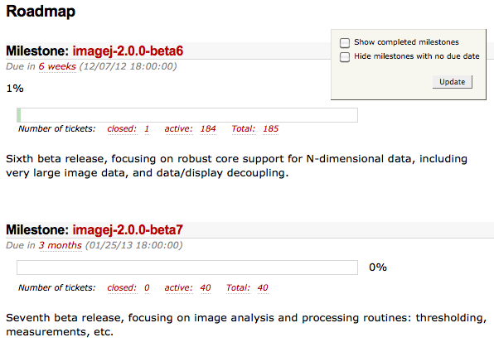
Collaboration
Notes:
...open roadmap...

Slide 43
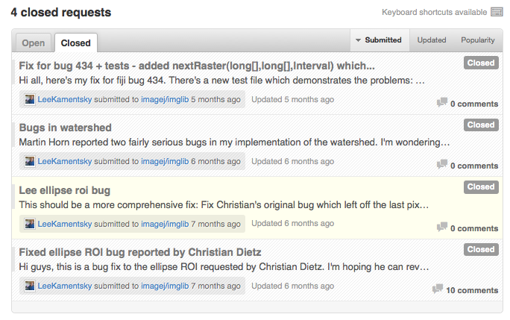
Collaboration
Notes:
... and open patch submission process.

Slide 44
Collaboration
Open development
Improve ImageJ as a community
Open access resources
Responsive, reliable maintainers
Powerful collaboration tools (GitHub!)
Notes:
We really want it to be easy for the community to not only use ImageJ2, but to contribute to it.
I want to show you one powerful tool called GitHub which is truly awesome for community-driven development. GitHub is so good, that any project which seriously wants to enable contributions from the community should be using it.

Slide 45
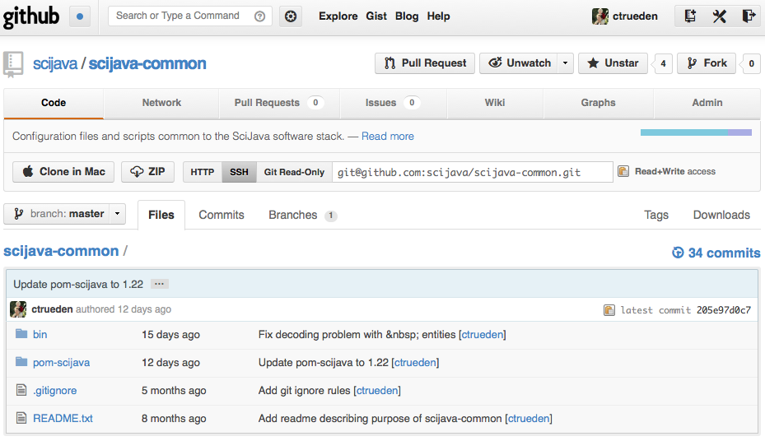
GitHub: A project of interest
Notes:
GitHub is a web site that hosts source code repositories in a social way. You can host any open source project there for free, and most of the GitHub infrastructure itself is also open source. Think of it as “Facebook for programmers”—but more productive. :-)
Let's suppose we find a project of interest on GitHub. We like this project, but it has one small flaw: it uses ImageJ version 1.45s, which is too old. We need to update it to use a newer version.

Slide 46
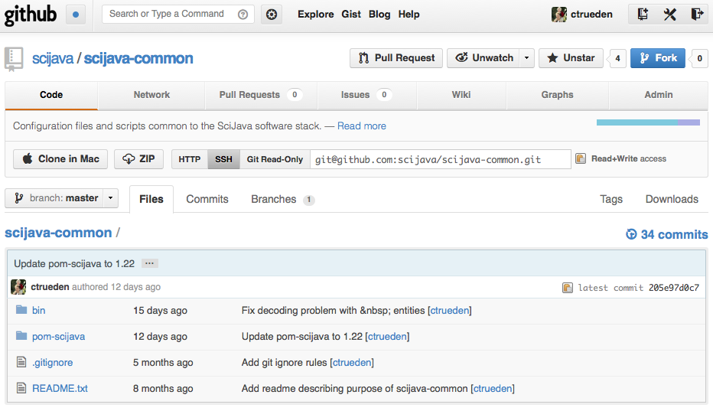
GitHub: Fork it!
Notes:
With GitHub, we can do this ourselves in our own copy of the code, automatically making it available to others.
First, we copy the project into our own project space by clicking the Fork button.

Slide 47
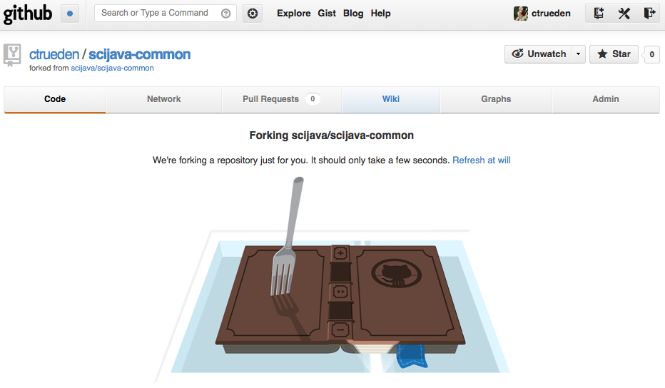
GitHub: Forking...
Notes:
GitHub forks the repository for us!

Slide 48
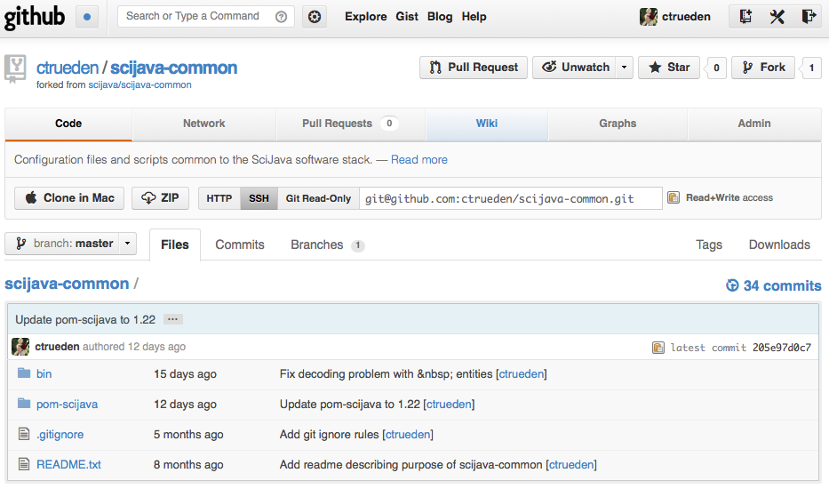
GitHub: New fork in your space
Notes:
We now have a copy of the code, and can get to work on it.

Slide 49
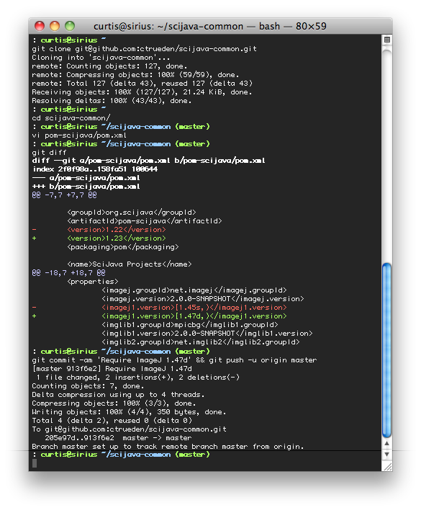
Clone the code
Make a change
Double check it
Commit and push!
Notes:
For those familiar with Git, this part is the business as usual. We clone the repository to our local computer, make our desired change to the source code, then push it back to the server.
Here, I use the command line because I like it, but GitHub also provides easy-to-use graphical tools called “GitHub for Windows” and “GitHub for Mac” which make it a breeze to clone, commit and push changes, if you like that better.

Slide 50
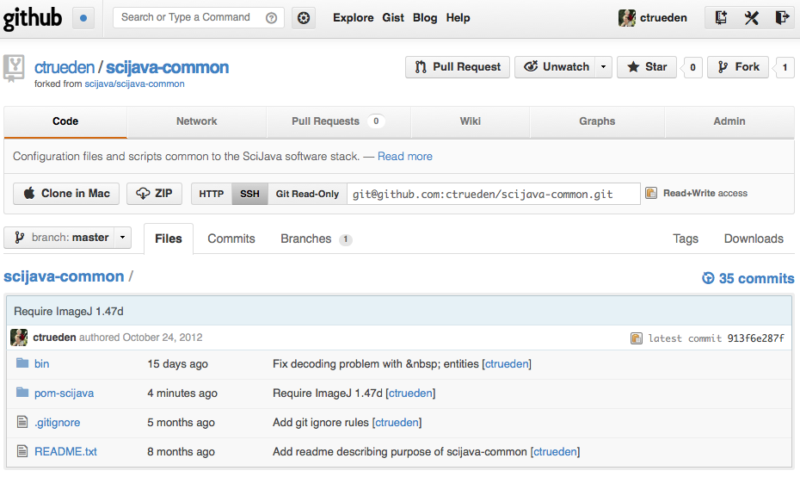
GitHub: Changes pushed!
Notes:
Returning to our GitHub page, we see that the changes have appeared!

Slide 51
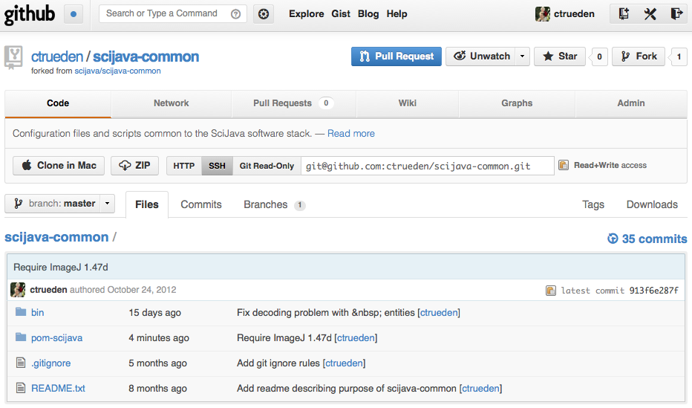
GitHub: Submit a Pull Request
Notes:
Now suppose we want these changes incorporated into the official version of the project. We can send a special request back upstream by clicking the “Pull Request” button. A “pull request” is just what it sounds like: a request for the project maintainers to “pull” your changes into the main project.

Slide 52
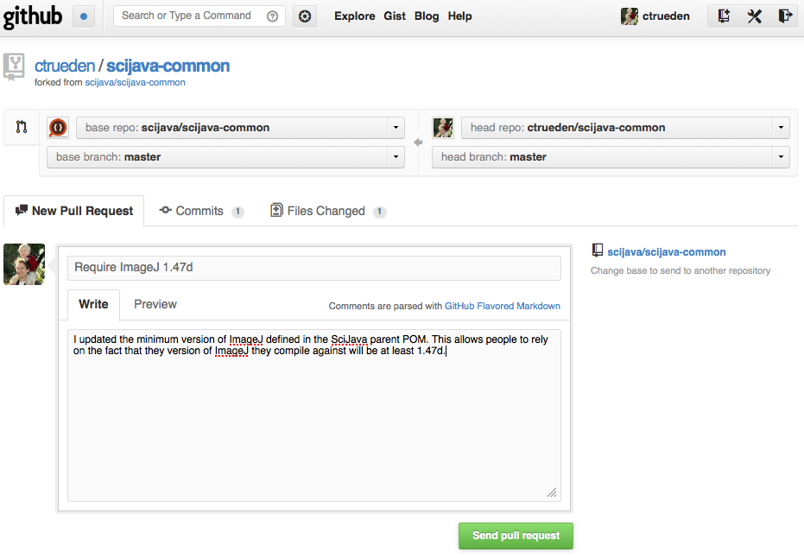
GitHub: Explain what you did
Notes:
We fill out the form explaining what changes we made and why.

Slide 53
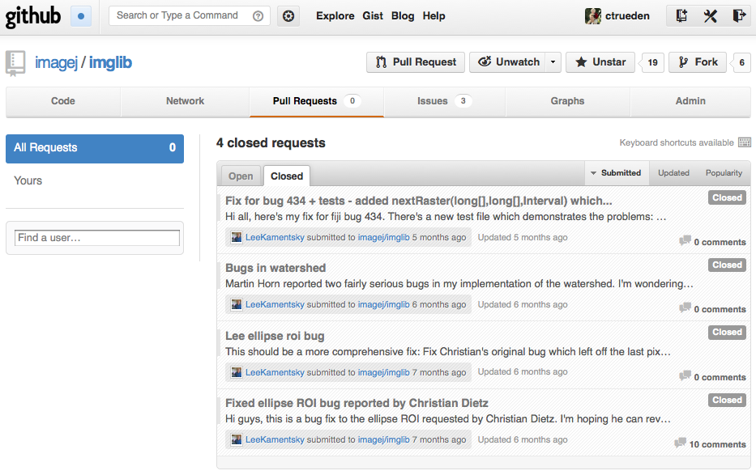
GitHub: Browsing PRs
Notes:
The Pull Request, or PR, will then appear on the official project's list of outstanding PRs, where the project maintainers can review it, comment, ask for clarification, and merge it into the main codebase as soon as it is ready.
Even if they do not accept your PR for some reason, you still have your changes available in your project fork for the community to use.
This is an extremely collaborative and effective way for everyone to work together.

Slide 54
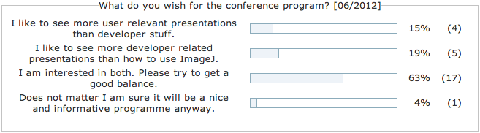
Users vs. Developers?
It's a balance... but moreover, it's a blend!
Many people are both, or want to learn both
Notes:
Many people think of “users” and “developers” as two different animals. But really, anyone can learn to be a developer, with some guidance. One of the great things about ImageJ is that it makes it easy to get started.
With ImageJ2, we want to make it even easier. The Script Editor has migrated from Fiji to ImageJ2, and is one big way we are helping people to bridge that gap. It's hard enough just learning how to program a simple macro or script, much less dealing with compilers, IDEs and the command line.
If you are interested in learning more, come to the ImageJ2 scripting workshop bright and early tomorrow morning!

Slide 55

Future Directions
New beta every 7 weeks
Big green button
Better integration with native code
Website: central plugins listing
Application-driven development
Notes:
(This is the last slide: freestyle!)

