Slide 1
Quantitative Characterization of Cellular Irregularities in Extruded Polystyrene Foam Using Digital Image Processing and Analysis
William A. Heeschen & Valentina Woodcraft
The Dow Chemical Company
Midland, Michigan
Motivation and Background
Image Analysis
Correlation of Human Rating with Image Analysis
Conclusions and Path Forward

Slide 2
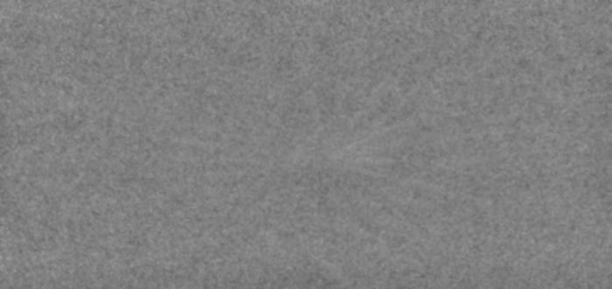
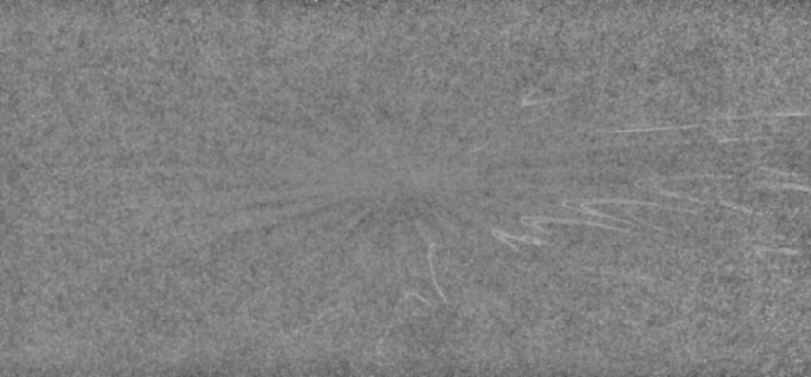
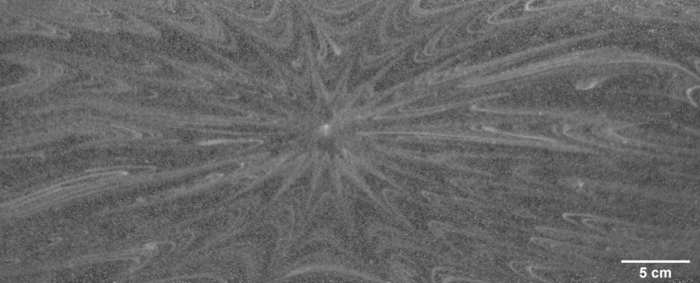
Motivation and Background
Minimal
Intermediate
Strong
Flow - induced cell size irregularities in extruded foam structure → foam pattern
Overall pattern strength
Magnitude of difference between “small” and “large” cells
Sharpness of boundaries between small-cell and large-cell domains
Cell size consistency within domains
Overall pattern shape due to extent of correlated sizes
Historic human panel rating is inconsistent.
Ubiquitous foam patterns + difficulty to quantify → need for robust analytical method

Slide 3
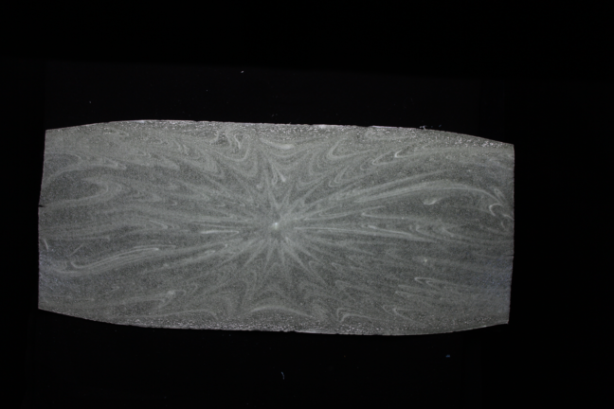
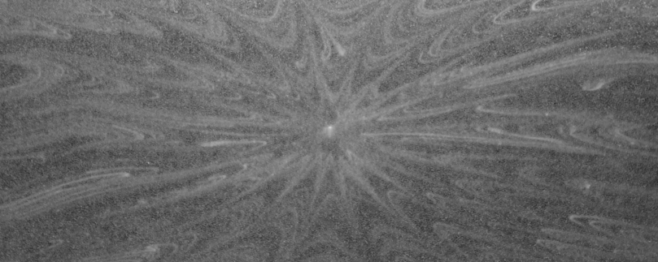
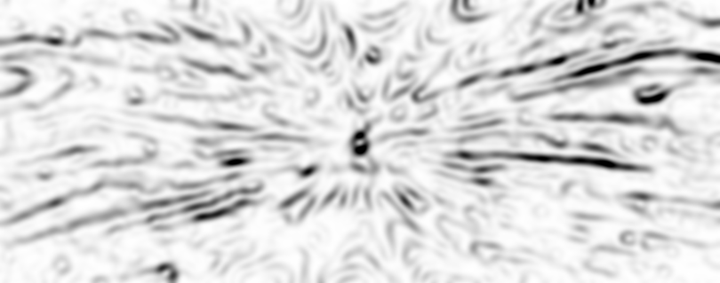
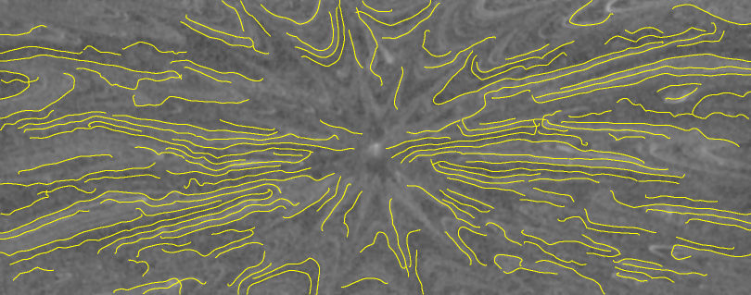
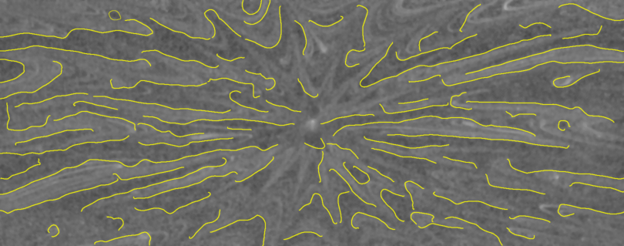
Image Analysis - Method
Crop
Straighten
Center
Grayscale
Background
correct
~10” x 24”
Variance Filter
Ridge isolation: Remove Outliers… “bright” and “dark”
Find Ridges (Variance, Brightest, Darkest)
Pattern–based feature acceptance/rejection
Quantitative pattern assessment
Line and Chevron count
Summed line length
Contrast-weighted line length (Ridge Factor)
Find Ridges (Variance example)
Add All
Ridges

Slide 4
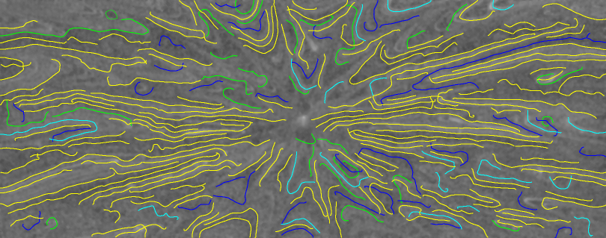
Image Analysis – Detail of Keep/Reject Results
KEEPERS
Green/Variance
Cyan/Bright
Blue/Dark

Slide 5

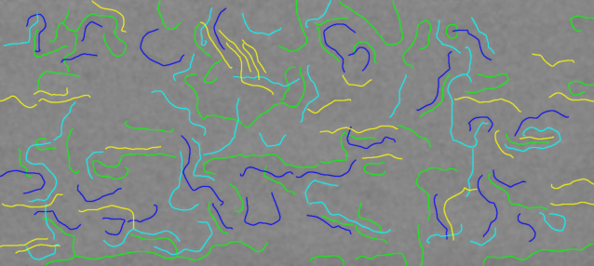
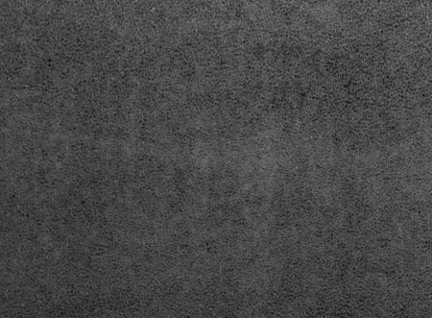
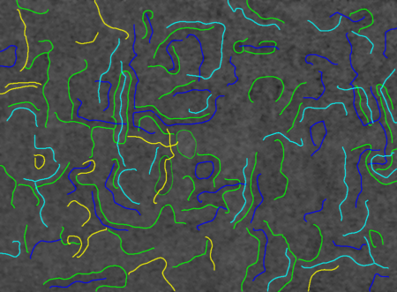

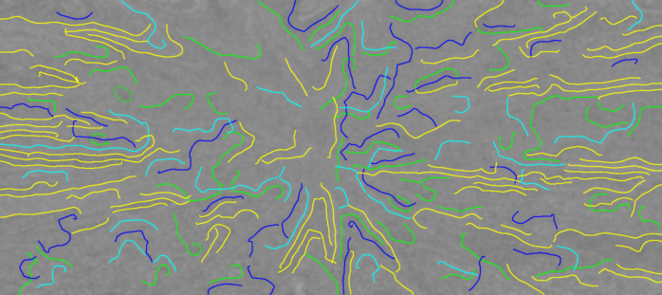
Image Analysis – Several Examples
Line: |  | 27
Chev: |  | 8
Sum: |  | 4,257
Ridge: |  | 9,636
KEEPERS
Green/Variance
Cyan/Bright
Blue/Dark
Line: |  | 10
Chev: |  | 15
Sum: |  | 2,969
Ridge: |  | 13,933
Line: |  | 87
Chev: |  | 15
Sum: |  | 17,179
Ridge: |  | 56,155
Line: |  | 116
Chev: |  | 29
Sum: |  | 30,642
Ridge: |  | 272,144

Slide 6
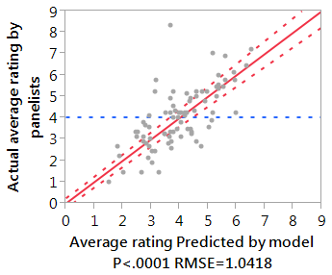
Correlation of Human Rating with Image Analysis
Criteria (broad descriptions)
Panelists ranked same images as image analysis algorithm
Lowest rating (1) = least pattern features (lines, chevrons)
Highest rating (10) = most pattern features
Averaged survey data compared to image analysis measures
Reasonable statistical correlation between human perception and image analysis data → model is useful!
Survey data
(9 panelists)
Image analysis data
(83 samples)
Correlation model
(JMP)

Slide 7
Key ImageJ functions, plugins, etc.
Remove Outliers… (built-in)
Bring locally-bright (dark) pixels in line with bulk in region
Consolidate ridge (valley)
Variance… (built-in) to find “slopes” between ridges and valleys.
Find_Ridges (plugin by Bob Dougherty, OptiNav, Inc., http://www.optinav.com/imagej.html )
Isolate gray-level ridges
Applied to “bright”, “dark” and variance images
BinaryConnectivity to isolate nodes/trunks/branches in skeleton (from Gabriel Landini’s Morphology Package: http://www.mecourse.com/landinig/software/software.html )
ROI Manager (built-in) to manage feature boundaries

Slide 8
Classifying Feature Outlines
Get XY coordinates of isolated-line skeletons (no nodes)
Find and assign ends, then eliminate the “other half” of the outline
“Line” vs “Chevron” from net curvature
Pointing direction (must point to center of pattern)
Lines (slope/intercept passes through center)
Chevron (use triangle to assess pointing direction)
Base = two ends
Vertex = point along curve at maximum distance from base
“Orientation” is line from mid-point of base to vertex

Slide 9
Conclusions and Path Forward
Current image analysis method generates reasonable agreement with panel results
Opportunities:
Auto-center analysis region (special case for radial pattern)
Better filtering for “crossing” ridges
Adaptive recognition of chevrons

Slide 10
Legal Disclaimer
Notice: No freedom from infringement of any patent owned by Dow or others is to be inferred. Because use conditions and applicable laws may differ from one location to another and may change with time, Customer is responsible for determining whether products and the information in this document are appropriate for Customer's use and for ensuring that Customer's workplace and disposal practices are in compliance with applicable laws and other government enactments. The product shown in this literature may not be available for sale and/or available in all geographies where Dow is represented. The claims made may not have been approved for use in all countries. Dow assumes no obligation or liability for the information in this document. References to “Dow” or the “Company” mean the Dow legal entity selling the products to Customer unless otherwise expressly noted. NO WARRANTIES ARE GIVEN; ALL IMPLIED WARRANTIES OF MERCHANTABILITY OR FITNESS FOR A PARTICULAR PURPOSE ARE EXPRESSLY EXCLUDED.

Slide 11

End Of Talk

