Slide 1
An n-dimensional Thin Plate Spline implementation in Java
John Bogovic
ImageJ Conference 2015
3 September 2015

Slide 2
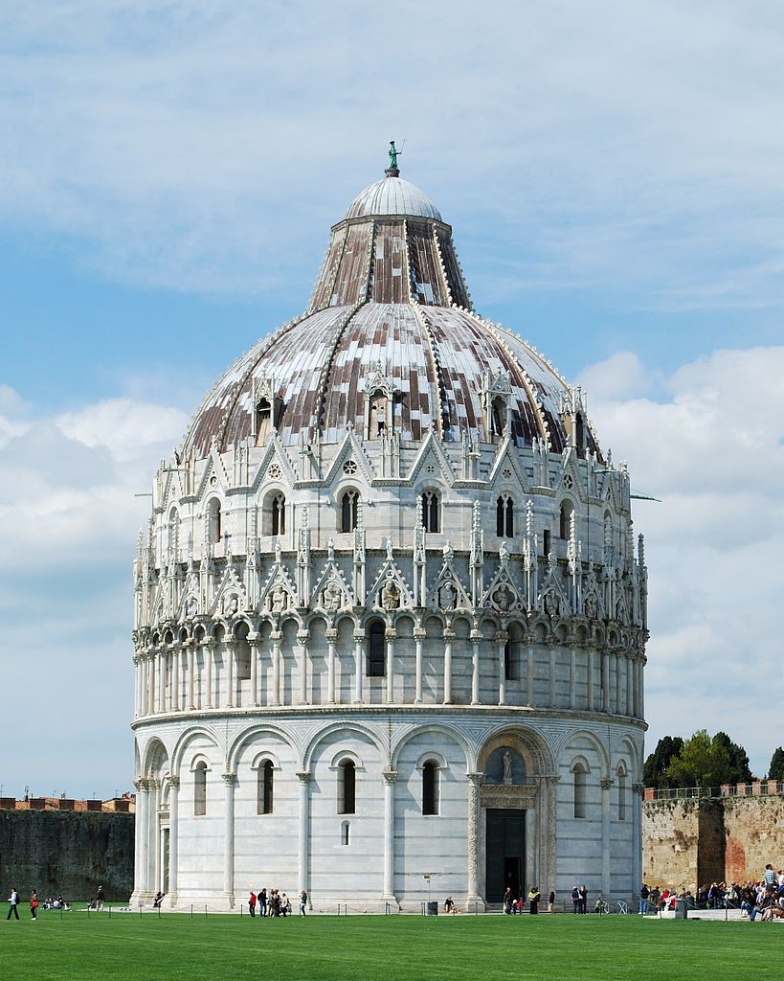

Transformations and Image alignment
Moving
Fixed / Target

Slide 3
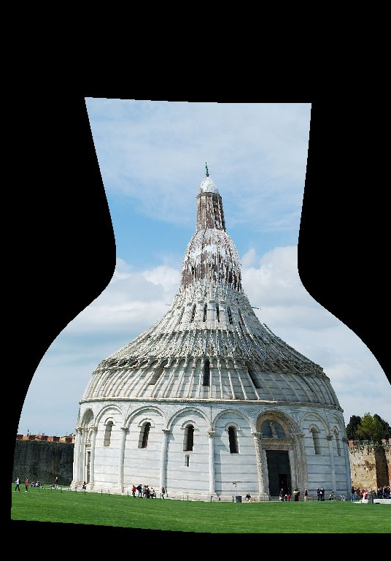
Transformations and Image alignment

Slide 4

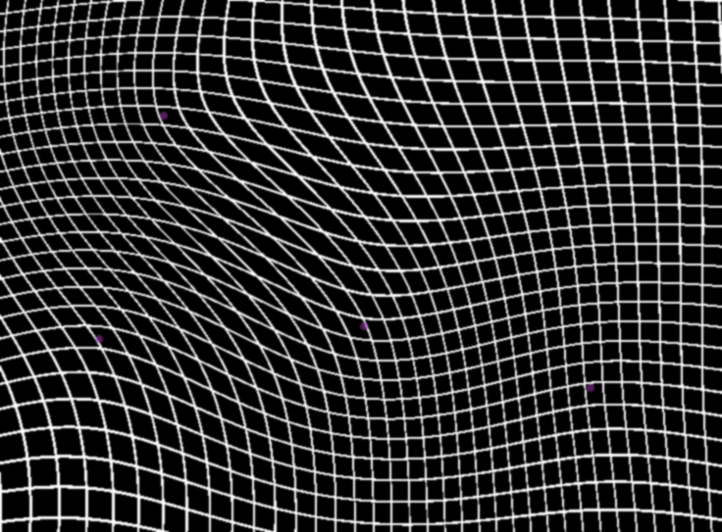
Thin Plate Spline
Landmark-based warp
Landmarks are aligned exactly
Warp has minimal bending energy
No parameters to tune
Closed-form solution
Our implementation:
Pure Java
N-dimensional
ported from ITK
Available as open-source library
github.com/saalfeldlab/jitk-tps
- Bookstein (1989).
Principal warps: Thin-plate splines and the decomposition of deformations. IEEE PAMI, 11(6), 567–585.
- Davis, Khotanzad, Flamig, & Harms. (1997).
A physics-based coordinate transformation for 3-D image matching. IEEE TMI, 16(3), 317–28.

Slide 5
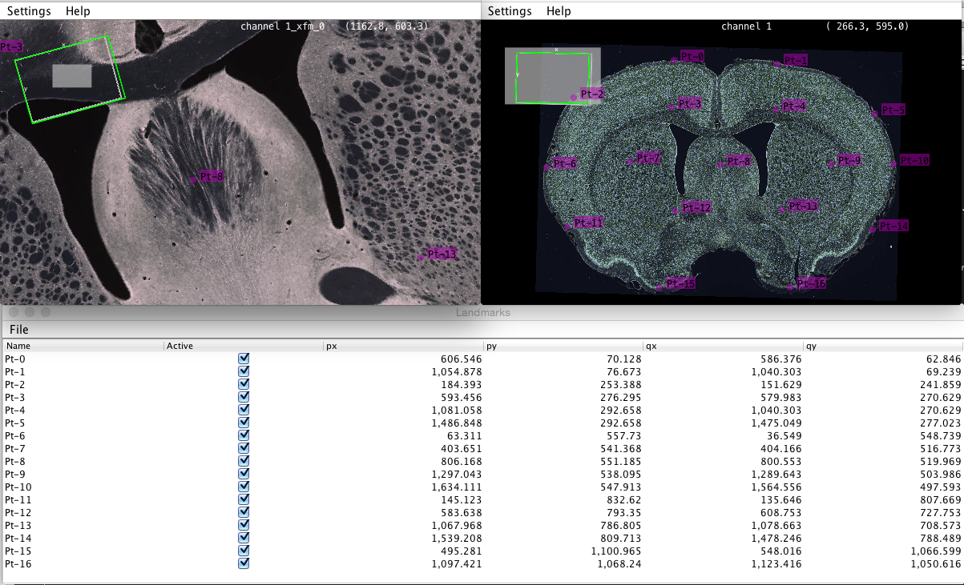
“bigwarp”
A tool for manual, interactive alignment
Based on bigdataviewer
Can handle Terabyte-sized datasets
github.com/saalfeldlab/bigwarp

Slide 6

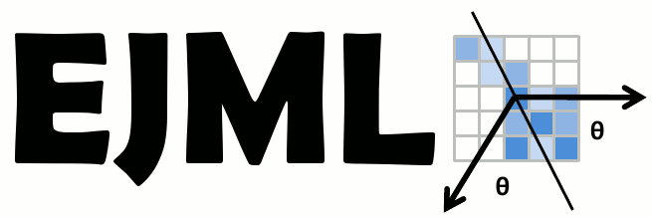




Related projects
itk.org
ejml.org
github.com/imglib/imglib2
github.com/bigdataviewer
github.com/fiji/MaMuT
github.com/axtimwalde/mpicbg
fiji.sc/TrakEM2
fiji.sc

Slide 7
Live demo

Slide 8






Acknowledgements
Stephan Saalfeld
Tobias Pietzsch
Philipp Hanslovsky
Allan Wong
Crystal Sullivan
Jean-Yves Tinevez

Slide 9


