Slide 1
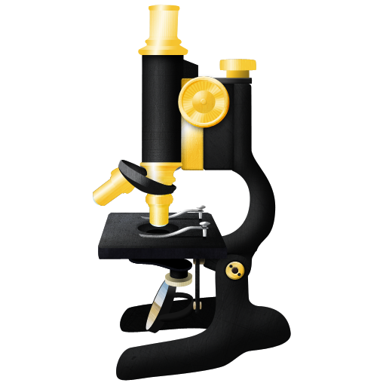
ImageJ2

Slide 2

Why ImageJ2?
Support the next generation of image data
Interoperate and collaborate with other projects
Broaden the ImageJ community
Reuse each others' work wherever practical
Provide a central online resource for ImageJ
  Program downloads, a plugin repository, developer resources and more

Slide 3








Who Develops ImageJ2?
And anyone who wants to contribute!

Slide 4
Guiding Principles
Preserve backwards compatibility
Maintain good performance
Support N-dimensional imaging
Use common input and output for data
Minimize complexity
Employ open source software dev. practices

Slide 5
ImageJ 2.0.0-beta2
Supports most ImageJ1 plugins and macros
Many new pixel types
Multidimensional data beyond 5D
Import and export of many file formats
Improved region of interest (ROI) tools
Truly headless
Automatic updates
Easily install additional plugins (e.g., Fiji >350 plugins!)
175 new/reimplemented core ImageJ2 plugins so far

Slide 6
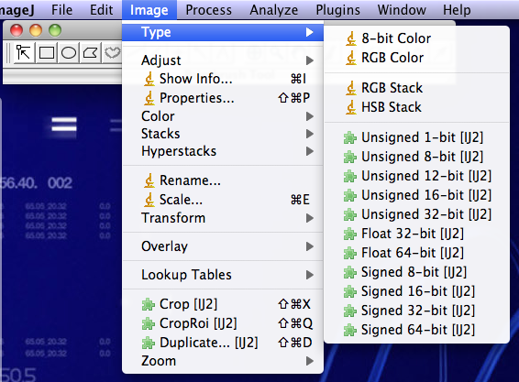

Data Model
Based on ImgLib2 library
Any data source (files, URLs, DBs...)
N-dimensional images
Unlimited pixel types
Write algorithms once

Slide 7
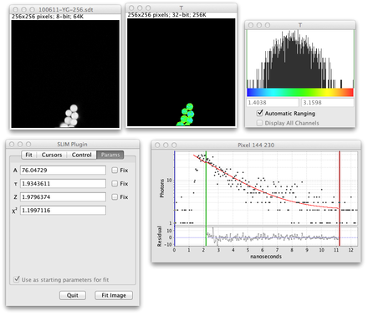
Displays and Visualization
The user interface provides views of the data
Show multiple datasets in one window
Or multiple windows showing the same dataset
Composite any # of channels
Fully pluggable

Slide 8
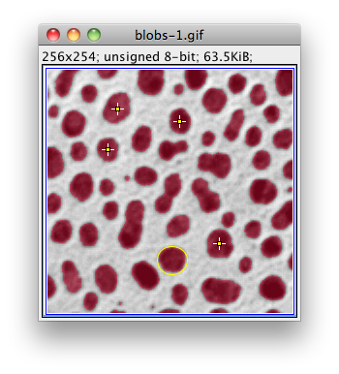
Regions of Interest
ROIs are functions that identify samples upon which to operate
Overlays are visuals superimposed over a dataset, often (but not always) linked to ROIs

Slide 9
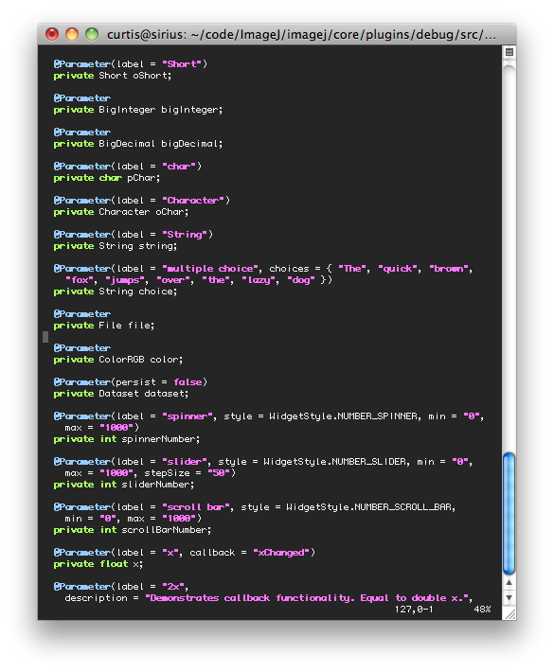
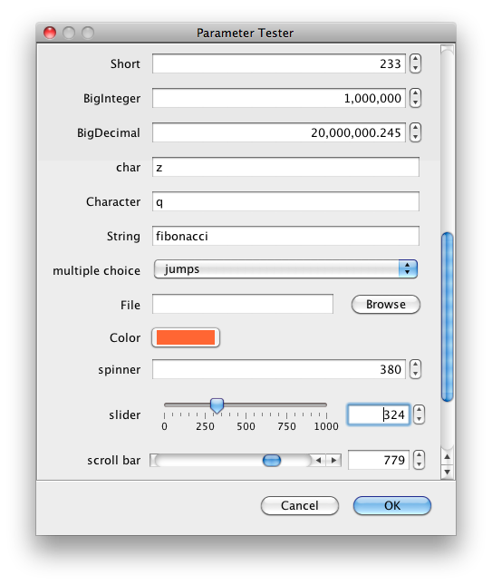
Plugin Framework

Slide 10
User Interface
Provides widgets for several UI styles:
  Swing
  “Pure” AWT
  Eclipse SWT
  Apache Pivot
Custom UIs possible
Can run headless
Use ImageJ2 as a library to execute plugins

Slide 11
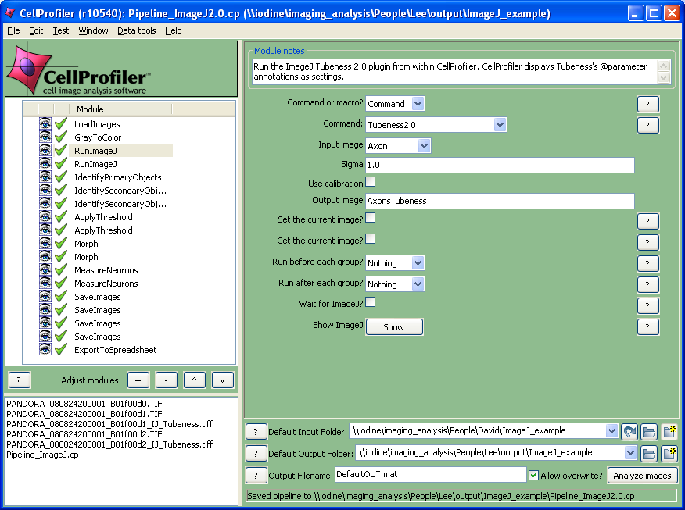
Interoperability

Slide 12
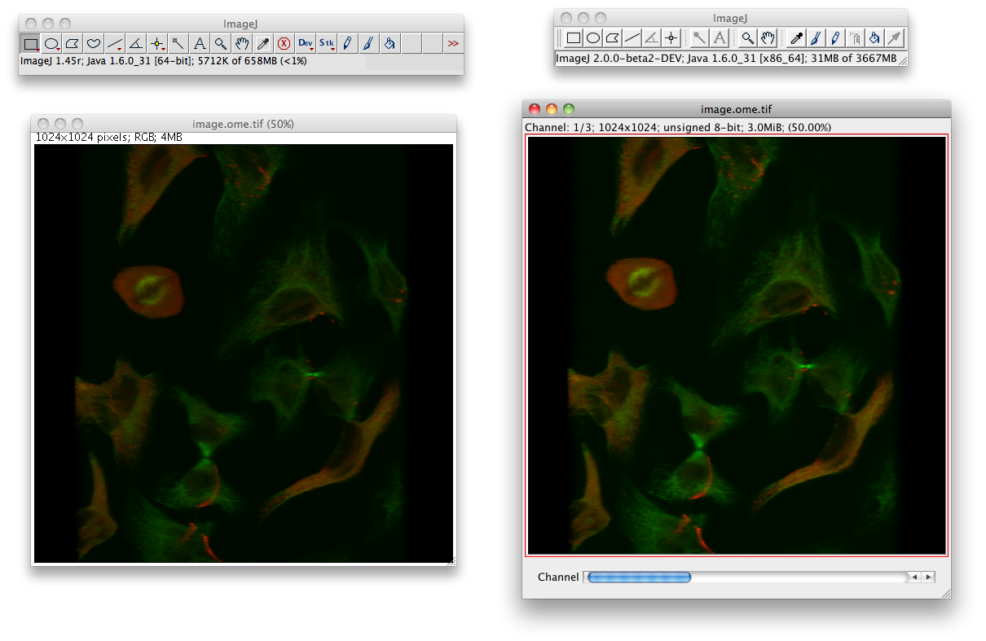
Compatibility
Invisible ImageJ1

Slide 13
Service Architecture
Core ImageJ2 Services
Plugins
Displays
UIs
Events
Overlays
ImageJ Context
Animation
Tools
I/O
Options
Platforms
Custom Service
Another Service

Slide 14
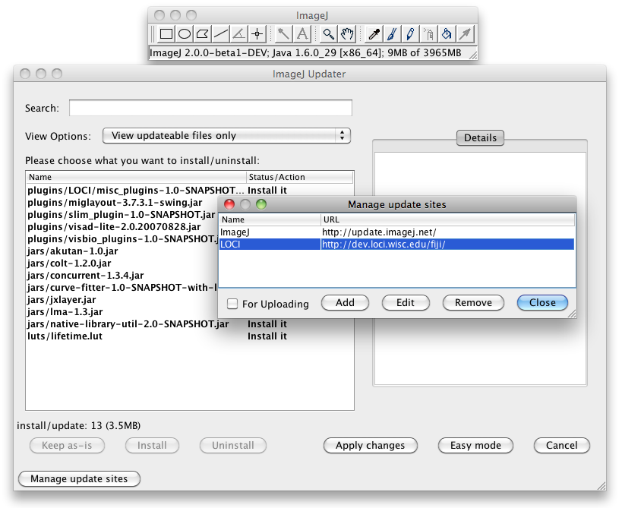
ImageJ Updater
Keeps ImageJ2 plugins up-to-date
Installs new plugins
Anyone can create an update site and upload their own plugins to it
Compatible with existing Fiji update sites (including fiji.sc)

Slide 15



Data I/O
Uses SCIFIO (SCientific Image Format Input & Output) library for reading and writing data
New formats can be added as SCIFIO plugins

Slide 16
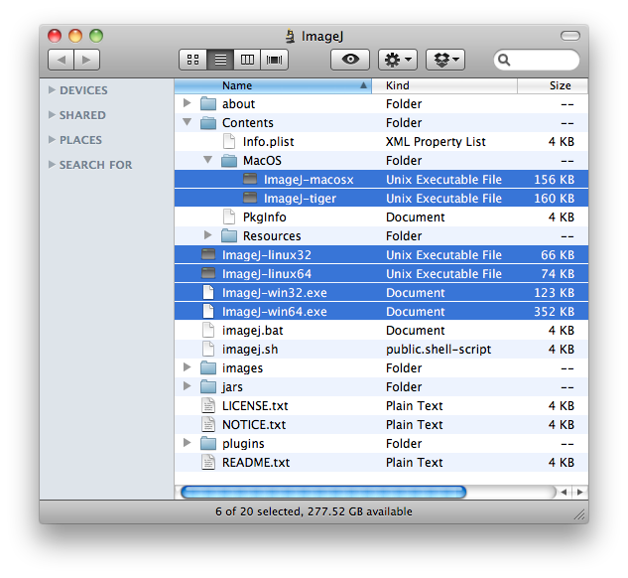
Launcher
Many options for launching ImageJ2
Run scripts in batch mode
Multiple platforms
Run headless

Slide 17

Future Directions
Release one beta per month
Big green button
Better integration with native code
Website: central plugins listing
Application-driven development

