Slide 1
Introduction to Ops: Usage and Development
Zach Petersen
Leon Yang
Nov 3rd, 2015

Slide 2
Warm Up: Tutorials
https://github.com/imagej/imagej-tutorials/tree/master/using-ops/src/main/java
UsingOps
Overview of ops
UsingOpTypes (later)
Overview of SpecialOps
CreateANewOp

Slide 3
How Images are Represented
IterableInterval
Uses cursors
RandomAccessibleInterval
Random access
Img
Implements both
From imglib2

Slide 4

SpecialOps: Four types
ComputerOp: Stores result into the specified output reference.
FunctionOp: Returns output as a new object
HybridOp: Can be used either as a function or computer op
InplaceOp: Mutates the given input reference

Slide 5
SpecialOps: Usage
Intended to be used repeatedly from other ops
They only look for ops of that type, so there is an improved search performance
Intuitive, can easily chain together

Slide 6

SpecialOps: Helper classes
Raw type if generics used as I/O and not parameterized
Unsafe, can lead to unseen errors
Avoid by using helper classes
Lets you parameterize input and output
Currently have RAIs, IIs, RTs
Could also pass in instances instead

Slide 7
SpecialOps: Methods
ops() – gateway to access other Ops
run() – default way to execute an Op
in() – gets the template input.
out() – gets the template output.
Both return null if class object was passed
initialize() – initialize the Op
compute() - execute the SpecialOp with given parameters

Slide 8
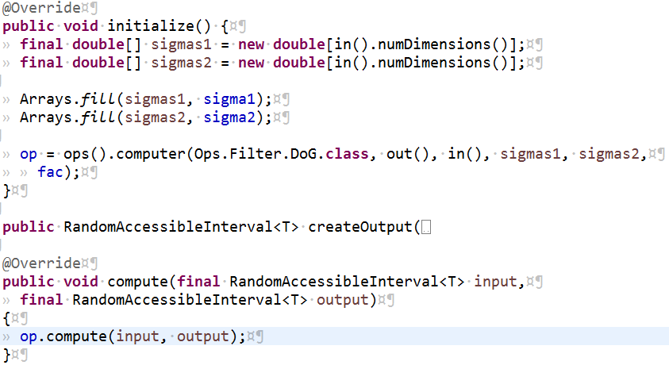
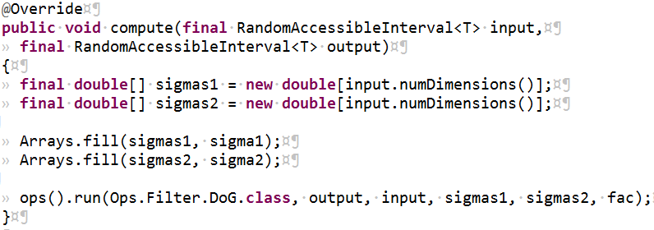
SpecialOps: Methods
Why use initialize()?

Slide 9
SpecialOps: Tutorial
UsingOpTypes
https://github.com/imagej/imagej-tutorials/tree/ops-tutorials/using-ops/src/main/java

Slide 10
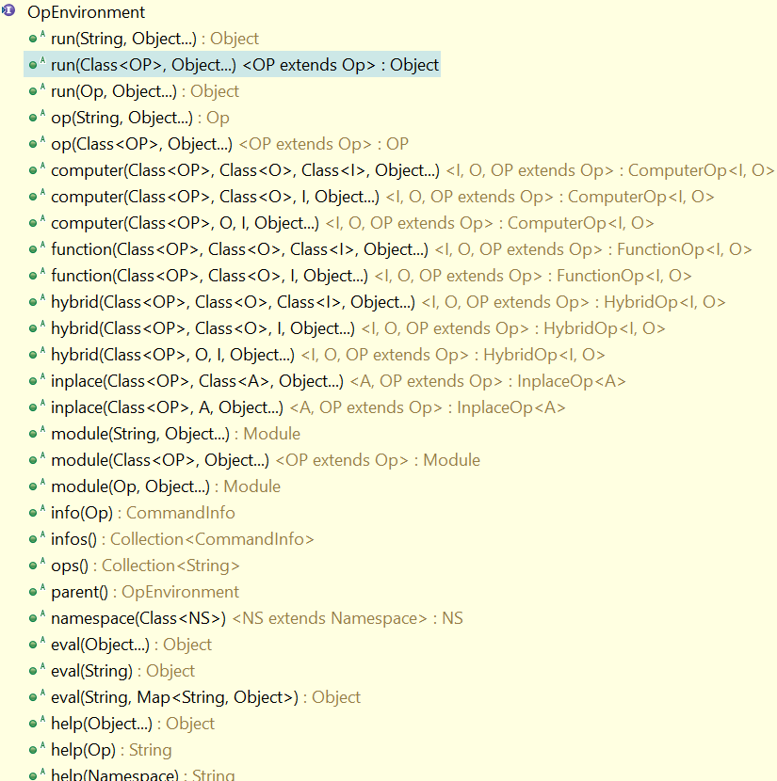
OpEnvironment - Methods
Notes:
1.op() matches all ops, lower performance. 2. module(): not frequently used, not exactly an Op but very similar

Slide 11
OpEnvironment - Methods
Get an Op
op()
matches all Ops
module()
not frequently used
not exactly an Op, but very similar
low-level, higher degrees of freedom
computer(), function(), hybrid(), inplace()
only match Ops of the specific type
higher performance
Notes:
1.op() matches all ops, lower performance. 2. module(): not frequently used, not exactly an Op but very similar

Slide 12
OpEnvironment - Methods
Execute an Op
run()
basically the same as op(SameParameters).run()
map(), join(), help(), ...
execute the Op of the specified type
math().add(), image().crop(), …
math() or image() returns the specified "Namespace"
Notes:
Namespace is a collection of Ops that share similar logic; can think of the OpEnvironment as a "default Namespace"

Slide 13
Matching Methods - Op Type
The first parameter in those matching methods
Accepts class object, or sometimes String as the name of the Op type
Marker interface
Contains nothing except its name
All of them live inside the class Ops
For example: Ops.Map, Ops.Join, Ops.Math.Add, Ops.Image.Crop
Notes:
Notice that class object does not necessarily come from a "class." "SomeInterface.class" is also a class object.
The name of the marker interface can be used as Op type indicator

Slide 14
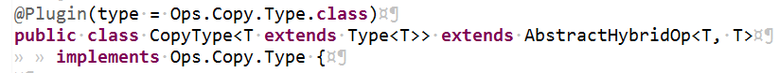
Matching Methods - Op Type
Actual (implemented) class
Not usually used
Can do more specific matching
Question:
what are the marker interface and the implemented class, respectively?

Slide 15

Matching Methods - I/O Types
Usually the parameters right after the Op type
In most cases, we can pass either a class object or an instance, of the type
for example: "Img.class" vs. "new Img()"
Three overloaded versions of the computer() methods
If we can pass a class object to get an Op, why do we bother passing a default/empty instance?

Slide 16
Matching Methods - I/O Types
Either to get an Op or execute an Op
First find the best matching Op class
Then initialize an instance of that Op class
To find the best matching Op class
Only cares about types
To initialize an Op
Use the instances if possible
Default values otherwise
Notes:
Whether the given ones can be converted to the required ones

Slide 17
Matching Methods - I/O Types
Not only "type indicators"
But also "template parameters“
Passing class objects as I/O type parameters could sometimes causes unexpected behaviors
Notes:
so that the returned Op can run() immediately without given any input/output objects.

Slide 18
Matching Methods - I/O Types
For example, to get the CopyIterableInterval Op, both statements seem to work
ops().hybrid(Ops.Copy.IterableInterval.class, null, img);
ops().hybrid(Ops.Copy.IterableInterval.class, null, img.getClass());
However, the second statement (the one uses class object) throws an exception
This is because when initializing the actual Op, the input parameter's method is called to get a helper Op

Slide 19
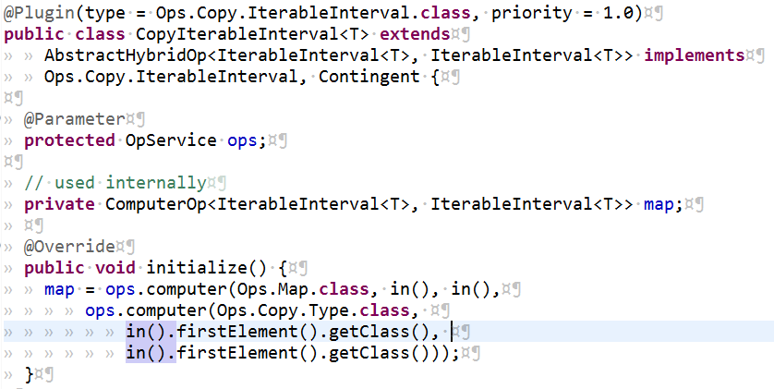
Matching Methods - I/O Types
Question: What Exception will be thrown?

Slide 20
Matching Ops
Done in DefaultOpMatchingService
First find candidates with matching name and type
Then narrow down candidates to exact matches
Find highest priority match and check that arguments match
Initialize the op

Slide 21
Converters
Can sometimes convert to match an op if parameters are not a perfect match
Done by ConvertService in SciJava

Slide 22
Plugin Annotation
@Plugin
Defines the ops type, name, priority, etc.
Used for matching ops
Type compared to first argument when calling op

Slide 23
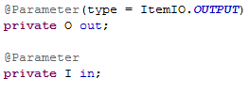

Parameter Annotation
@Parameter
Indicates field is input or output
Which type of SpecialOp are the parameter declarations for?
FunctionOp
HybridOp

Slide 24


Thank you for listening to our presentation!
Questions?

