Slide 1
CellProfiler 2.0
Lee Kamentsky
Broad Institute

Slide 2
What is CellProfiler?
Microscopy imaging software / primarily cells
Mechanism for chaining algorithms together to build customized processing pipelines
Produces high-dimensional measurements conducive to modern statistical analysis
Targeted to high-throughput screening

Slide 3
CellProfiler: goals
User friendly
Modern UI
More help / feedback
More accurate
Heavily tested / improved algorithms
Faster
2x speedup Matlab -> Python
Cross Platform
Mac / PC / Unix
Free / Open source

Slide 4
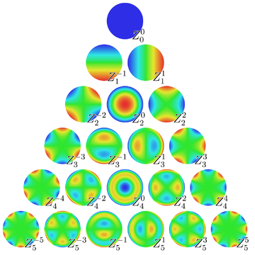
CellProfiler: why Python
Open source development
Numpy / Scipy are fast
Used for big problems, like CERN & astrophysics
Expressive – think about what, not how
R / Matlab / Python use similar notation to express powerful ideas
exp_terms[m] = np.exp(1j*m*phi)
s += lut[idx,k] * r**(n-2*k)
zf[:,idx] = s*exp_term
Cython – compiled python-like language
http://en.wikipedia.org/wiki/File:Zernike_polynomials2.png

Slide 5
CellProfiler: key data structures
Pipeline / module / setting
Tells how to analyze experiment
Image
Combination of pixel data, mask (=ROI), cropping info and history
Objects
A labels matrix + associated info
Measurements
Per object, per image

Slide 6
CellProfiler: Java
JavaBridge
1-1 mapping of the JNI
Support for conversion between Java & Python types
Jutil
Call Java methods
Wrap Java classes
Bioformats
Wrappers for image readers & writers

Slide 7
CellProfiler: testing and build environment
SVN repository
https://svn.broadinstitute.org/CellProfiler/trunk
1444 unit tests
Cruise control continuous integration server
Jira issue tracker

