Slide 1
Regions of Interest in ImageJ 2.0
Lee Kamentsky
Broad Institute

Slide 2
Overview
Imglib 2
  net.imglib2.roi.RegionOfInterest
    IterableRegionOfInterest
  net.imglib2.labeling.Labeling
    Algorithms for segmentation
ImageJ 2.0
  ij.data.roi.Overlay
  ij.display.OverlayView
    SwingOverlayView
  ij.ui.swing
    IJHotDrawOverlayAdapter
    JHotDrawAdapterFinder
    Other stuff
Display
Image
View
Overlay
View
Overlay
View
Overlay
Mgr
Overlay
Overlay
Roi
Roi
Notes:
RegionOfInterest – is a point in or out
IterableRegionOfInterest – give me every pixel that is in
Labeling – segmentation results: set of ROIs
Overlay – presentation metadata + optional imglib ROI + serialization
OverlayView – placeholder for an overlay in a display
IJHotDrawOverlayAdapter – translates between overlays and JHotDraw Figures
JHotDrawAdapterFinder – finds the adapter to use for a particular overlay using SezPos

Slide 3


Imglib2 RegionOfInterest
RegionOfInterest
  Extends RealRandomAccessible
  <BitType>
  Answers question, In or Out
IterableRegionOfInterest
  getIterableIntervalOverROI
  Give me the pixels that are inside.
Flavors
  Binary mask
  Ellipse
  Rectangle
  Polygon

Slide 4
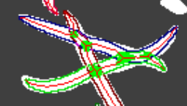
Imglib2 LabelingType
LabelingType
  A pixel can be doubly labeled
    Use case: crossing worms
  Labels can be any Comparable type
    Strings if drawn by user and named
    Integer if machine-generated

Slide 5
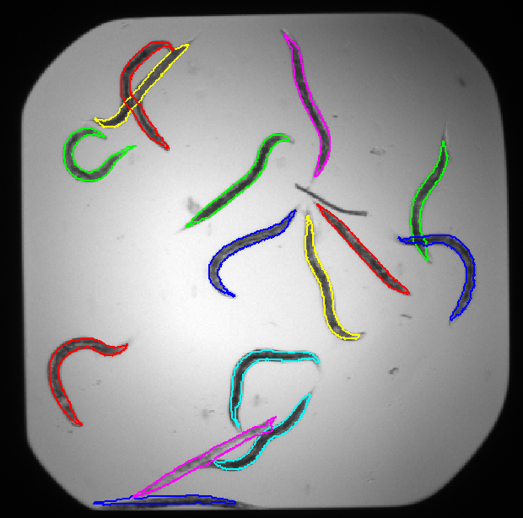
Imglib2 Labeling
Labeling
  Img<LabelingType>
  Per-label statistics
    area, extents, raster start
  Get ROI for label
NativeImgLabeling
  Labeling backed by a NativeImg
  Uses a pluggable ROIStrategy to control Labeling -> ROI
    Default optimized for “blobby” things.
    Need optimization for stringy things.

Slide 6

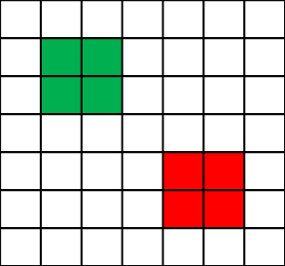
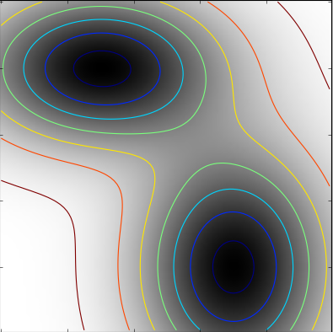
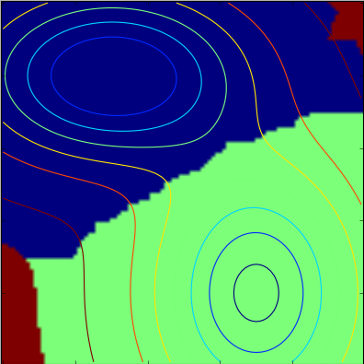
Imglib2 Algorithms: net.imglib2.algorithm.labeling
AllConnectedComponents
  Assigns labels to clumps of mutually touching pixels
Watershed
  Seeds + Image
  Finds each seed’s watershed in the image
Gradient watershed
  Carolina Wahlby’s method for segmentation of a fluorescently labeled image.

Slide 7
ImageJ: ij-data imagej.data.roi
Overlay
  Extends DataObject
  Presentation metadata
    Line color / width
    Fill color, alpha
  Optional RegionOfInterest
AbstractOverlay &ROIOverlay
  Overlay metadata
  Serialization
  Templated ROI container
Implementations
  EllipseOverlay, RectangleOverlay, PolygonOverlay

Slide 8
ImageJ: ij-display imagej.display
AbstractOverlayView
  Implements DataView
  Container for overlay
OverlayManager
  Manages overlay lifecycle
  Data model for overlay organization GUI
  Needs structural elements like folder hierarchy?
  How to represent a labeling’s ROIs?

Slide 9
Ij-ui-swing imagej.ui.swing.tools.roi
IJHotDrawOverlayAdapter
IJHotDrawOverlayAdapter
  @JHotDrawOverlayAdapter makes it sezpos discoverable
  Adapts a JHotDraw Figure to an ImageJ Overlay
    supports(overlay[, figure])
    createNewOverlay, createDefaultFigure
    updateOverlay, updateFigure
JHotDrawAdapterFinder
  Gets the adapter for an overlay / overlay + figure
IJCreationTool
  JHotDraw CreationTool handles figure creation lifecycle
EllipseAdapter, RectangleAdapter, PolygonAdapter

Slide 10
ij-ui-swing imagej.ui.swing.display
SwingOverlayView extends AbstractOverlayView
  Synchronizes JHotDrawFigure with Overlay
    Listens for figure and overlay change events
    Uses adapter to synchronize figure with overlay & vice-versa
JHotDrawImageCanvas
  Manages tool lifecycle via tool activation events
  Manages selection via DisplayView and figure selection events

Slide 11
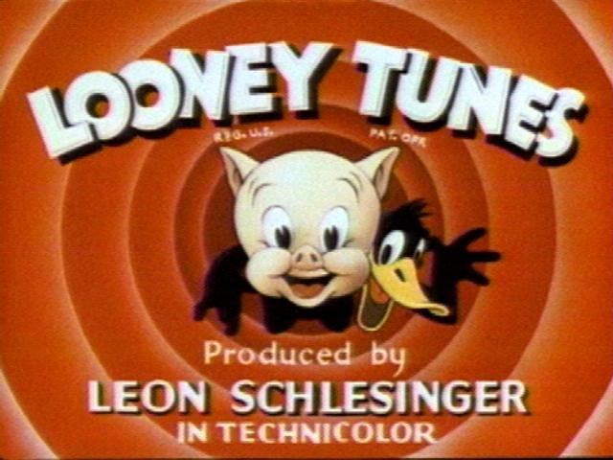
That’s all folks
Thanks
  Loci-Wisconsin
  Imglib team MPICBG
  Adam Fraser, Grant Harris and the WHOI squid tank and GFP jellyfish
Questions & Comments?

