Slide 1

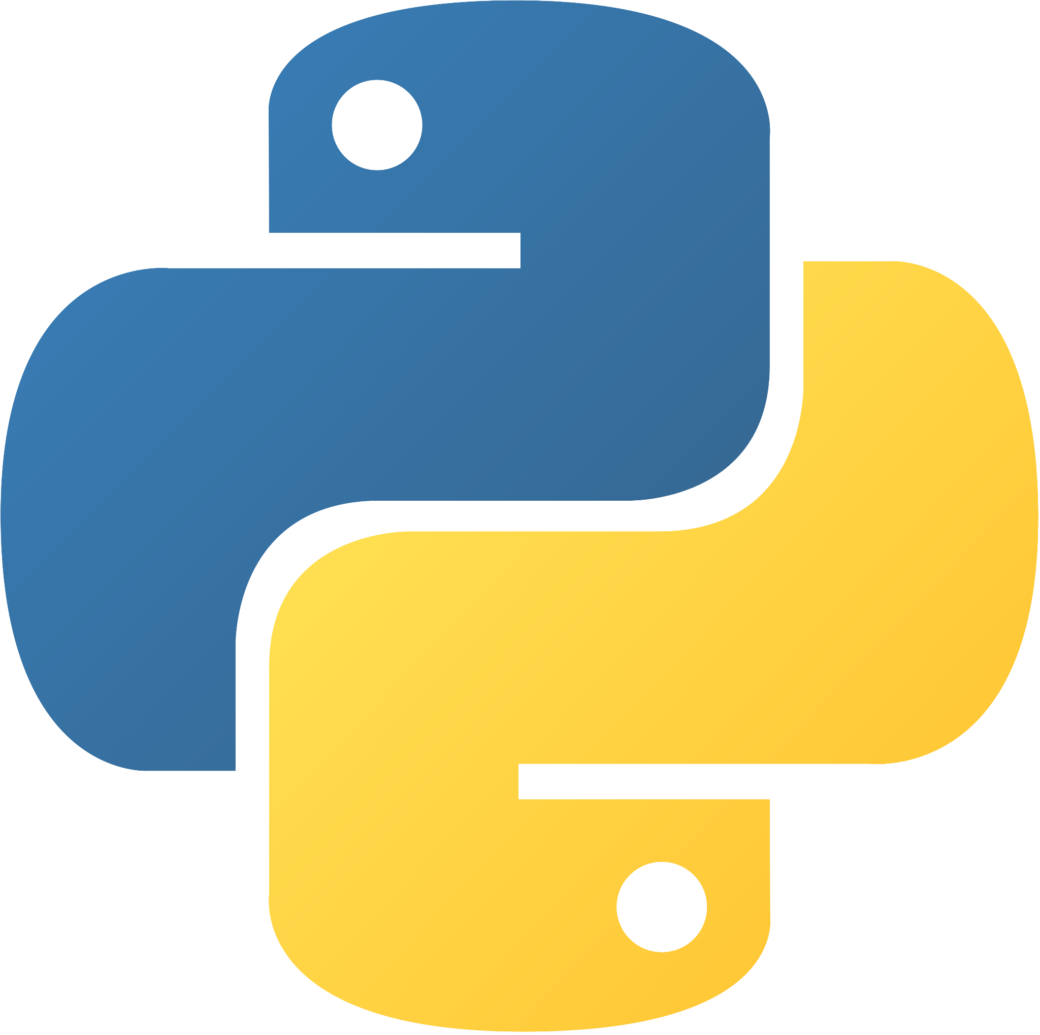


Gabriel Selzer
Eliceiri Lab/LOCI, UW-Madison

Slide 2
Agenda
Motivations
  “Why are we here?”
Hands On Usage
  Step 1: Environment
  Steps 2-4: PyImageJ
  Steps 5-7: napari-imagej

Slide 3



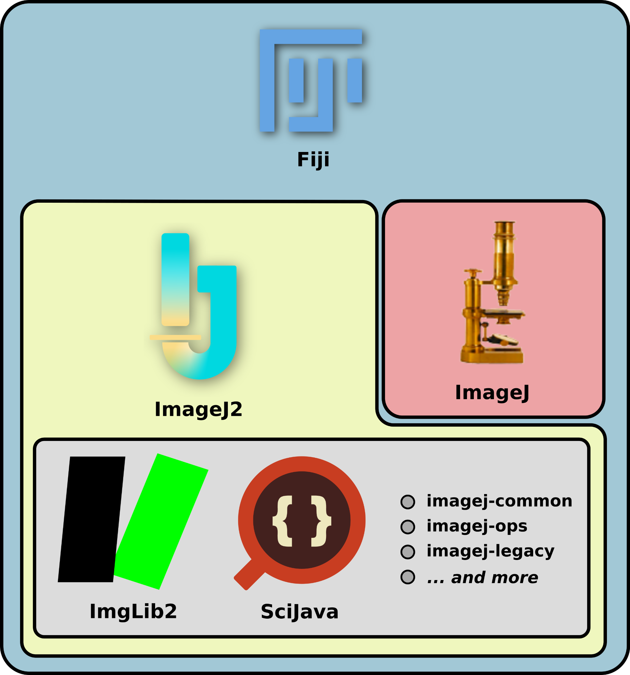
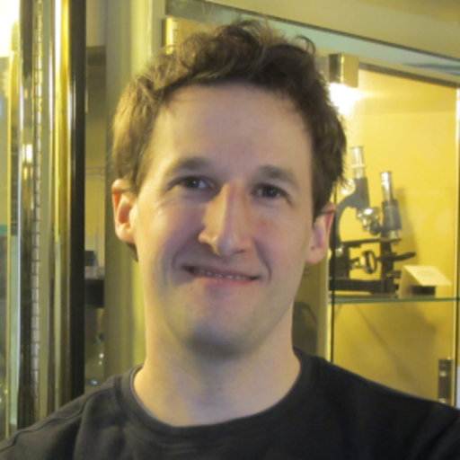
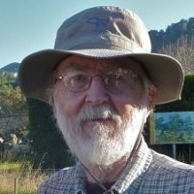
Overview: Fiji
ImageJ (1.x) maintained since 1997
ImageJ2 modernized, improved architecture
ImgLib2 modernized data structures
SciJava modernized plugins
ImageJ Legacy links ImageJ and ImageJ2
Fiji bundles:
ImageJ
ImageJ2
Lots of plugins
Curtis Rueden
Wayne Rasband

Slide 4





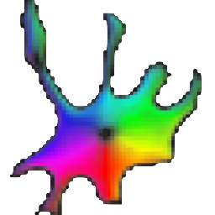



Overview: Python
Scientific Stack
ML Toolkits
Applications

Slide 5
Motivations
Fiji/ImageJ provides many unique features and toolkits
How can we access these things from Python?

Slide 6
Agenda
How do Python and Java talk?
Motivations
  “Why are we here?”
Hands On Usage
  Step 1: Environment
  Steps 2-4: PyImageJ
  Steps 5-7: napari-imagej
How do we use Fiji from Python?
How do we use Fiji from a Python UI?
Find the workshop document at:
https://workshops.imagej.net/

