Slide 1

Image Analysis with Fiji
http://imagej.net/Presentations

Slide 2
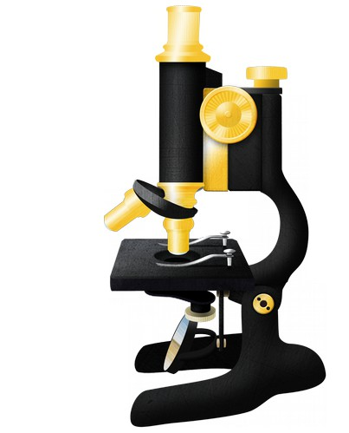
What is ImageJ?
A tool for scientific image analysis
Open source
    You wouldn't write:
    Added 500mg of unknown chemical.
    So don't put your data in a black box!
Rich ecosystem: thousands of plugins
Science = reproducibility
  Plugins>Utilities>Make Fiji Package
http://imagej.net/

Slide 3
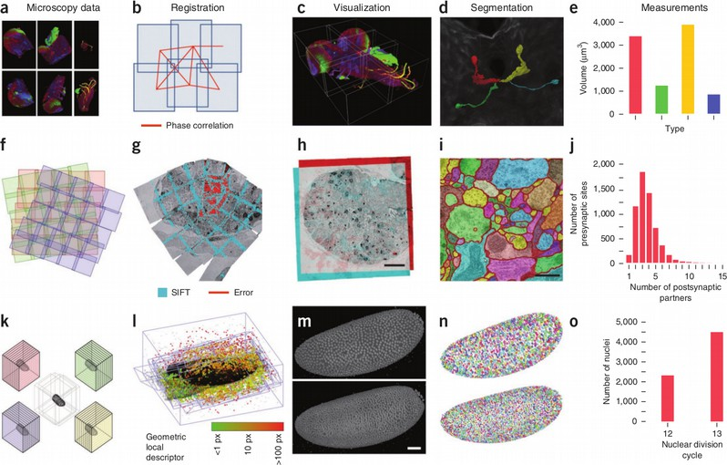
Fiji Is Just ImageJ
http://imagej.net/Introduction

Slide 4
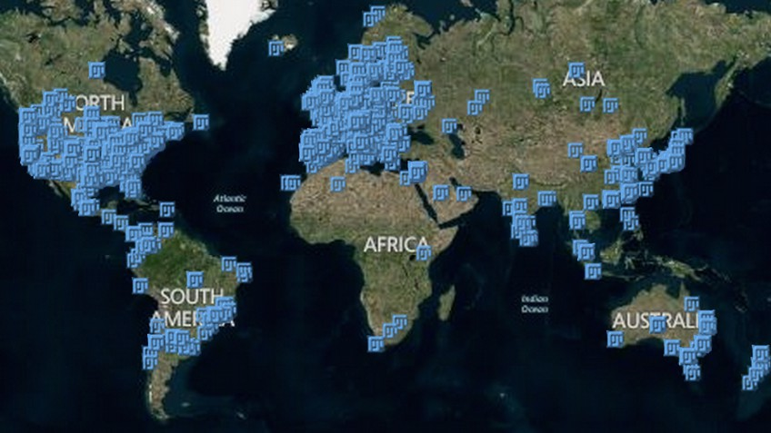
Who uses Fiji?
Resources for advice and collaboration

Slide 5
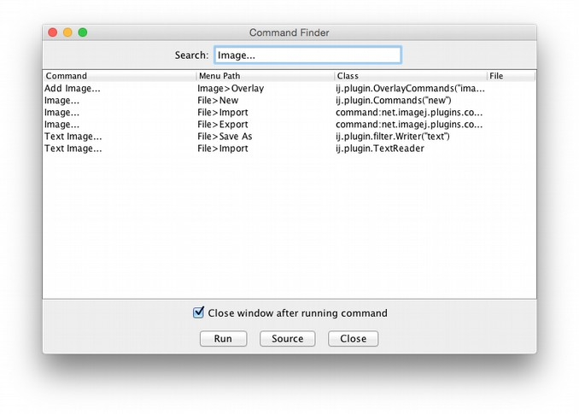
There's a lot of stuff!
Ctrl+L = Command Finder
http://imagej.net/Command_Finder

Slide 6
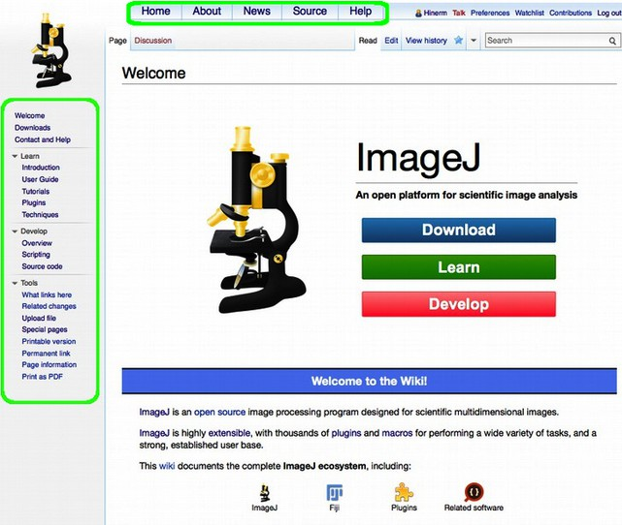
Learn how to fish:
http://imagej.net/

Slide 7
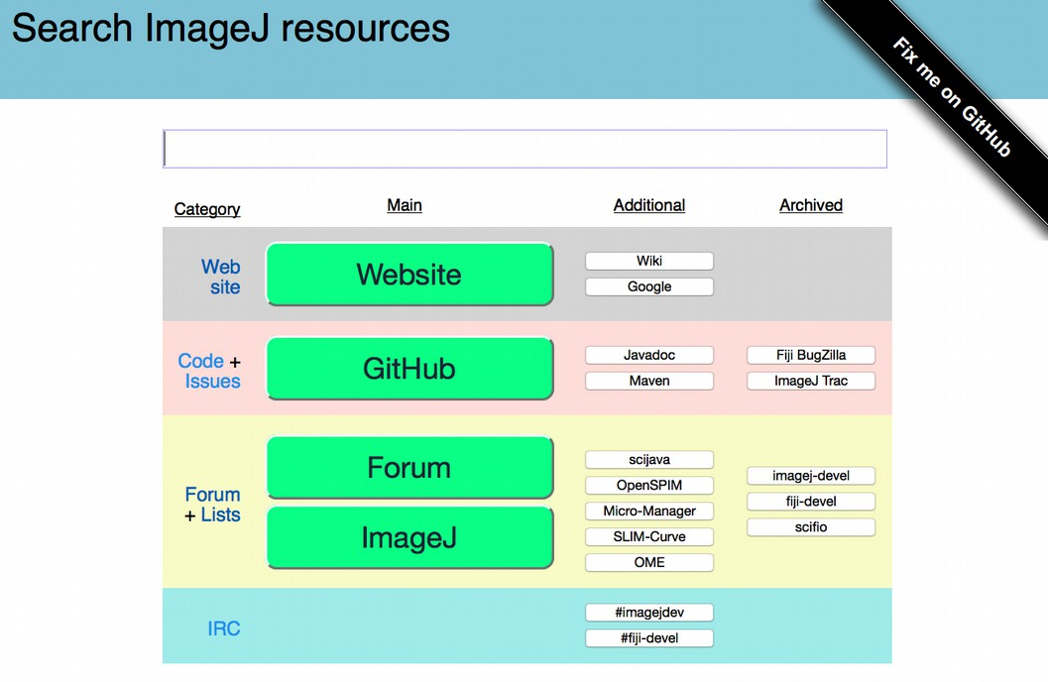
Learn how to fish:
http://search.imagej.net/

Slide 8
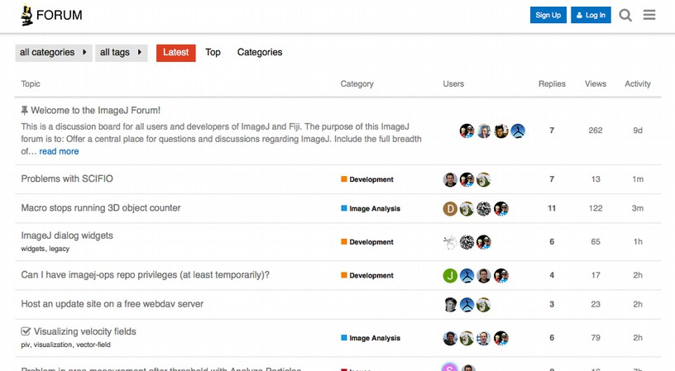
Teach me how to fish!
http://forum.imagej.net/

Slide 9
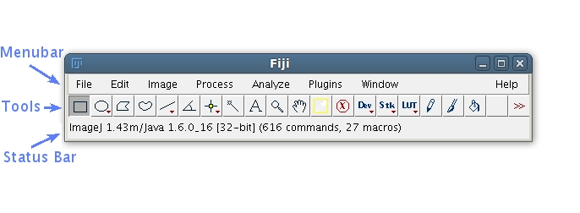
The main window
Tip: click on the status bar
Tip: right / double-click on Tools
http://imagej.net/Getting_started

Slide 10
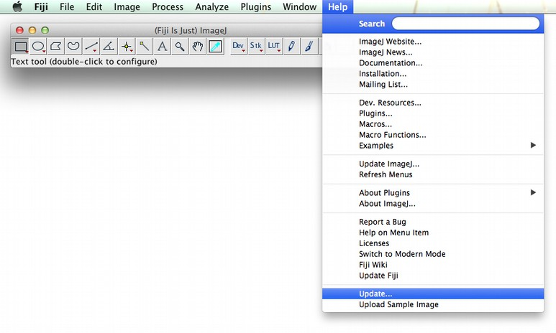
Staying up-to-date
http://imagej.net/Updater

Slide 11
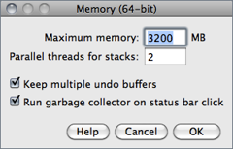

Memory management
Edit>Options>Memory & Threads
Plugins>Utilities>Monitor Memory
http://imagej.net/guide/146-27.html

Slide 12

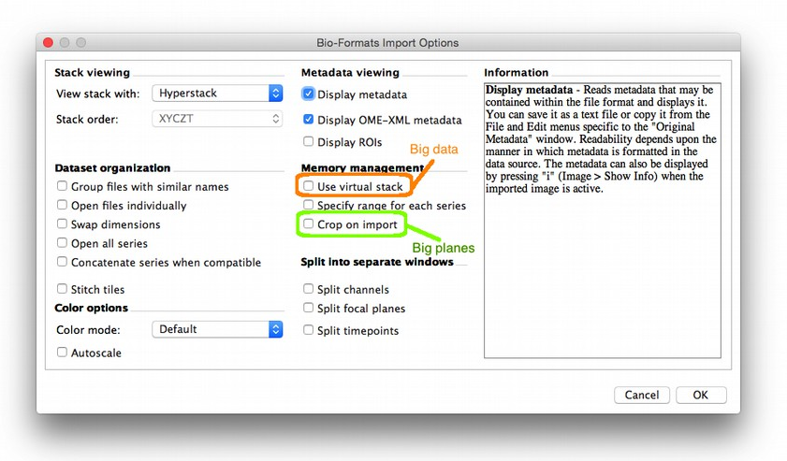
Opening images
Drag & Drop
File>Open
Plugins>Bio-Formats>
Bio-Formats Importer
http://imagej.net/Importing_Image_Files

Slide 13
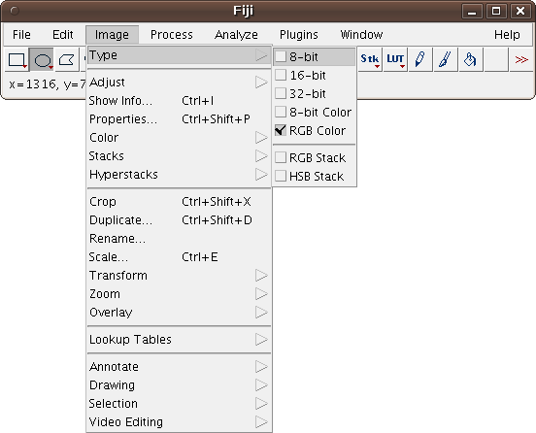
Pixel types
http://imagej.net/docs/guide/146-7.html

Slide 14
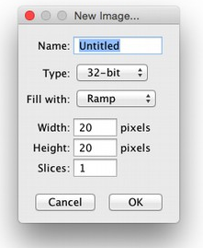
Pixel type pitfalls
Know the limitations of your data
    File>New>Image... (32-bit, ramp, 20x20)
Process>Math>Multiply... : 100,000,000
Probe values
Process>Math>Add... : 1
Probe values
Can you find any problems?
http://imagej.net/IP_Principles

Slide 15
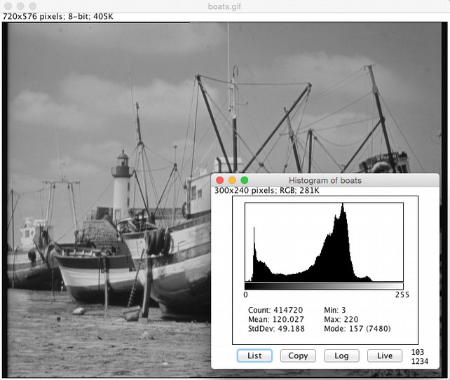
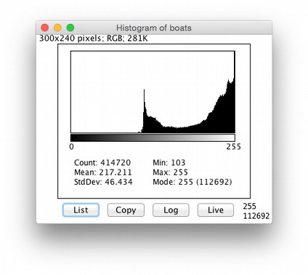
Get to know your data
File>Open Samples>Boats
Analyze>Histogram
Compare histograms:
File>Open Samples>Blobs
What would cause this histogram:
http://imagej.net/docs/guide/146-30.html

Slide 16
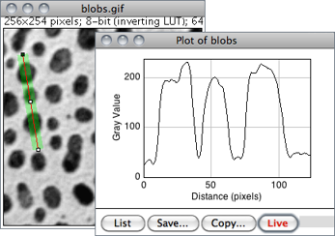
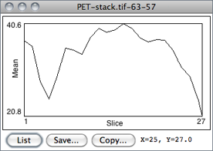
Profile Plots
Qualitative observations → Quantitative data
Open Blobs (Shift + B)
Use any Line tool
Analyze>Plot Profile
Image>Stacks>Plot Z-Axis Profile...
http://imagej.net/docs/guide/146-28.html

Slide 17
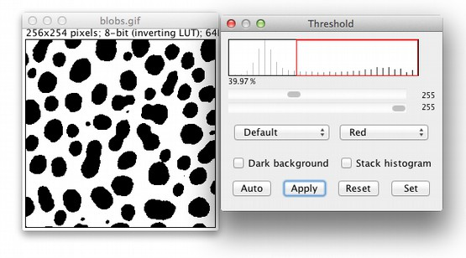
Thresholding
Isolate values of interest
Open Blobs (Shift + B)
Image>Adjust>Threshold…
Use Profile Plot to guide threshold
Which method is best?
Image>Adjust>Auto Threshold>Try All
http://imagej.net/docs/guide/

Slide 18
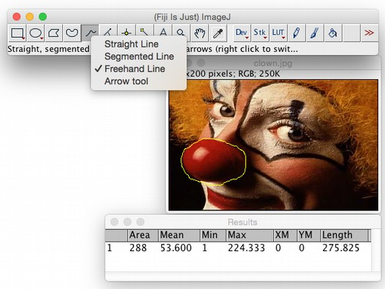
Regions of interest: ROIs
File>Open Samples>Clown
Freehand Line
Circle the clown nose
Analyze>Measure
Can you draw the same circle on a new clown?
http://imagej.net/docs/guide/146-10.html

Slide 19
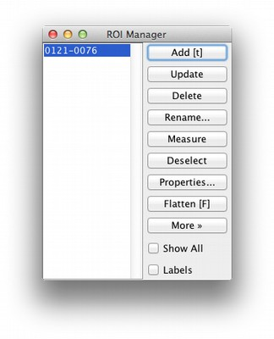
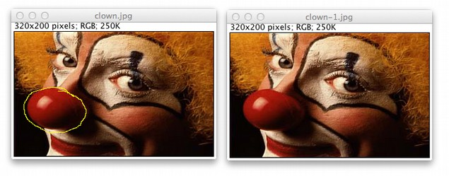
ROI Manager
Two clowns, one measurement
  Select a nose
  Press t – or Analyze>Tools>ROI Manager
  Select other clown
  Click ROI in manager – or Edit>Selection>Restore Selection
http://imagej.net/docs/guide/146-10.html

Slide 20
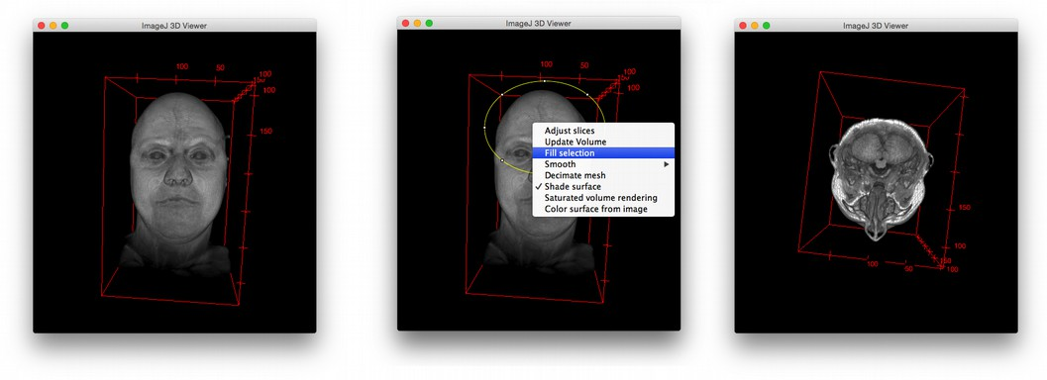
Qualitative Observations
File>Open Samples>T1 Head (2.4M, 16-bits)
Image>Type>8-bit
Plugins>3D Viewer (Resampling Factor: 1)
http://imagej.net/3D_Viewer

Slide 21

Information flow
Starts at image acquisition!
What does this image tell us
about the volume of this pipette?

Slide 22
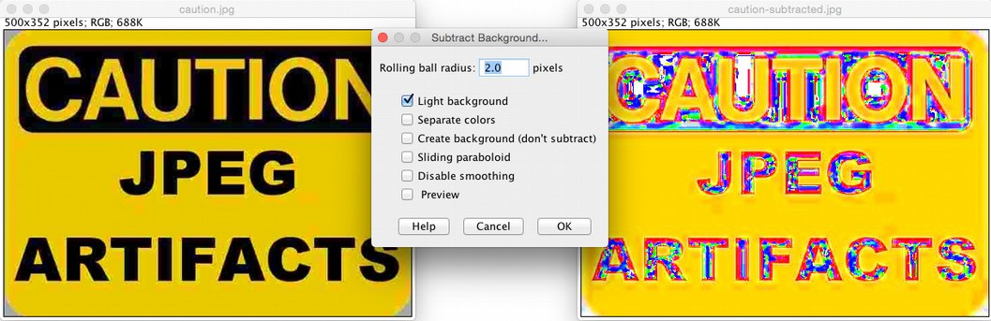
Information loss
Image formats are not created equal!

Slide 23
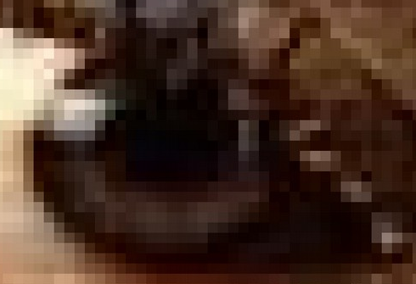
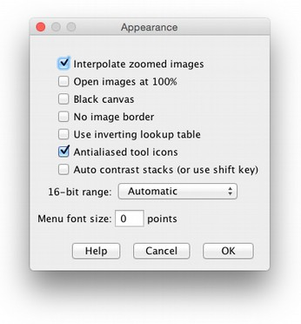
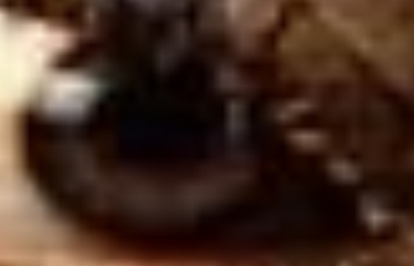
Pixel Problems
Pixels are not little squares
See Alvy Ray Smith's article for details:
http://alvyray.com/Memos/CG/Microsoft/6_pixel.pdf
Can think of detectors as sampling a Gaussian
    Edit>Options>Appearance...>
    Interpolate zoomed images
http://imagej.net/IP_Principles

Slide 24
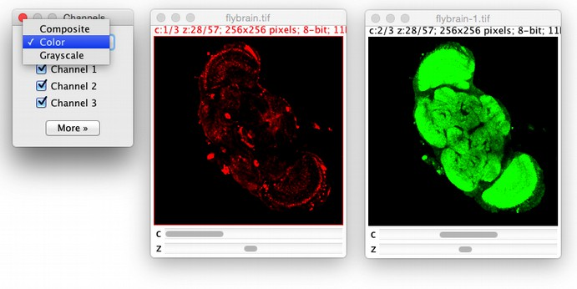
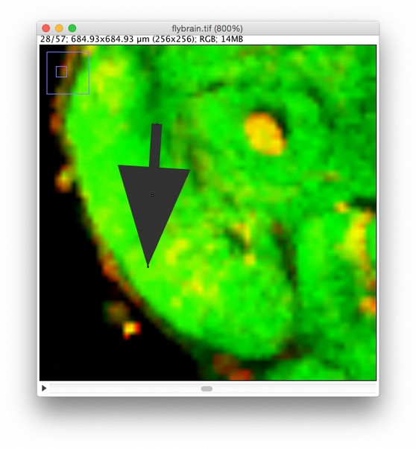
Eyes? More like LIES!
  File>Open Samples>Fly Brain
  Image>Color>Channels Tool…
Can “Composite” mode show colocalization?
http://imagej.net/docs/guide/146-28.html

Slide 25
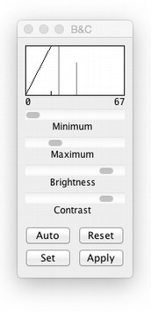
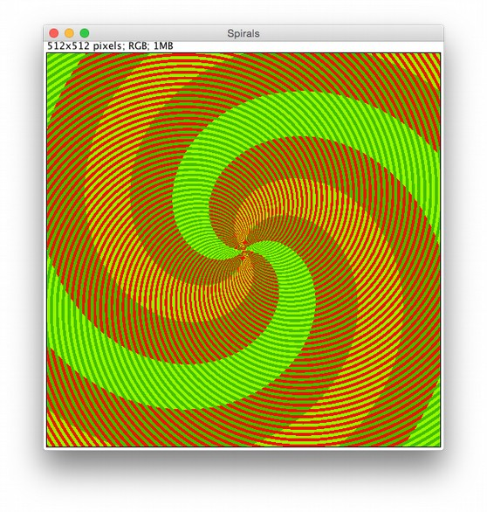
“Color” is not “signal”
File>Open Samples>Spirals
How many colors in the spiral below?
What if we:
Image>Adjust>Brightness/Contrast
… change colors?
Image>Type>8-bit color
Image>Lookup Tables>glasbey
… zoom in (+) and probe?

Slide 26
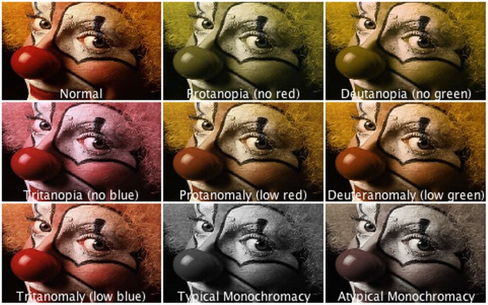
Eyes are not all equal
Image>Color>Simulate Color Blindness
https://nei.nih.gov/health/color_blindness

Slide 27
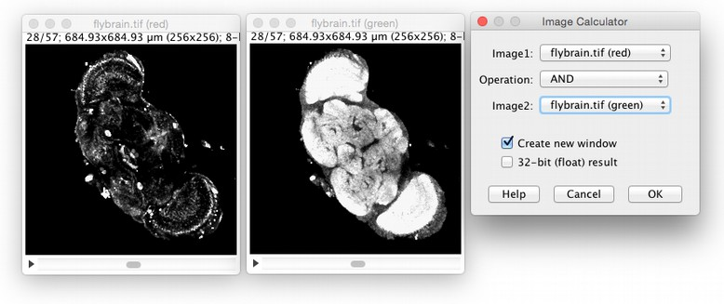
So what CAN we do?
  Image>Color>Split channels
  Process>Image calculator (AND)
But… what question have we answered?
http://imagej.net/docs/menus/process.html

Slide 28
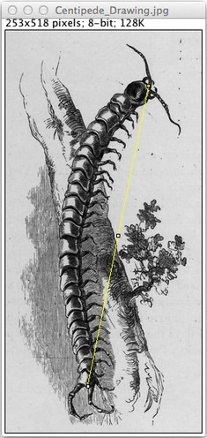
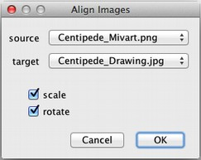
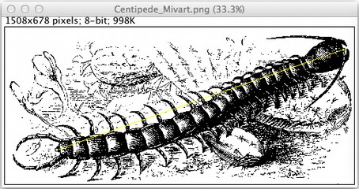
Registration
Unify coordinates of 2+ images
  File>Open Samples>Centipede Drawing
  File>Open Samples>Centipede Mivart
  Draw lines between equivalent points
  Plugins>Registration>Align Image by line ROI
http://imagej.net/Image_Stitching

Slide 29
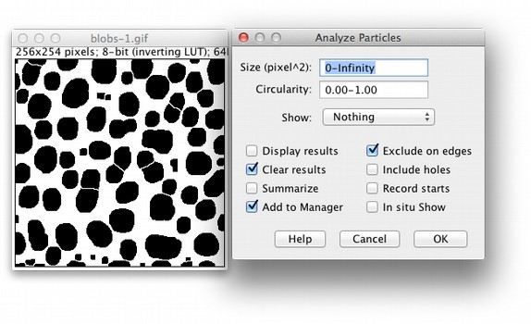
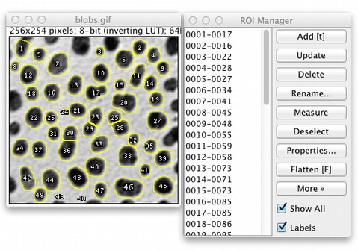
Segmentation
Identify blobs of interest
  File>Open Samples>Blobs (25k)
  Image>Duplicate…
  Image>Adjust>Auto Threshold
  Process>Binary>Dilate (x2)
  Process>Binary>Watershed
  Analyze>Analyze Particles...
http://imagej.net/Segmentation

Slide 30
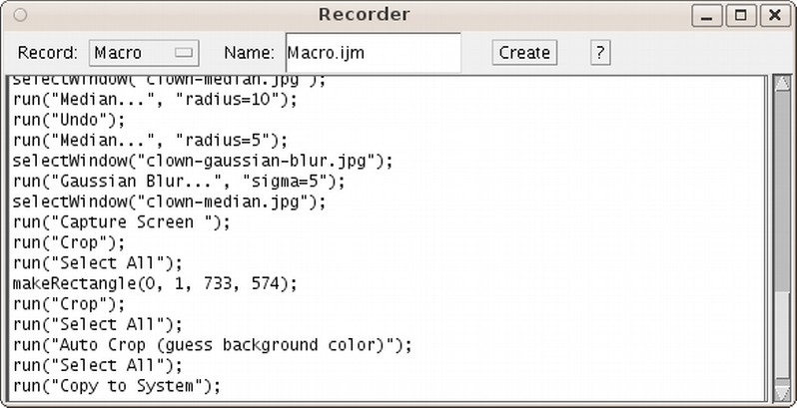
Macros: Never Forget
Plugins>Macros>Record...
http://imagej.net/Macros

Slide 31
Further reading
The community—forum and mailing list! ~2000 members:
http://imagej.net/Help
The ImageJ manual:
http://imagej.net/docs/guide/
The Cookbook, a collection of image analysis “recipes”:
http://imagej.net/Cookbook
A thorough Fiji tutorial for beginners:
http://nic.uni-hd.de/analysis.html
Additional workshops and presentations:
http://imagej.net/Presentations

