Slide 1

Writing Macros with Fiji
http://imagej.net/Presentations

Slide 2
Why are Macros useful?
Reproducible science
document your work
automate your analysis
    share with the world
identify plugins of interest
http://imagej.net/Macros

Slide 3
Recording Macros (1/3)
Exercise: Record a Macro
Many ways to start recording:
use the Command Finder! (Ctrl+L)
click the Dev icon, then Record…
Plugins>Macros>Record...
http://imagej.net/Macros

Slide 4
Recording Macros (2/3)
Exercise: Record a Macro
Suggested workflow:
open the Blobs sample image
apply a threshold
create a Mask
dilate
invert
watershed
analyze particles
Tip: when in doubt, use the Command Finder!
(ctrl + L)
http://imagej.net/Macros

Slide 5
Recording Macros (3/3)
Make your macro better:
  Batch mode
  Use Image IDs
  Store in plugins/ (with underscores, to
  tell ImageJ to make a menu item)

Slide 6
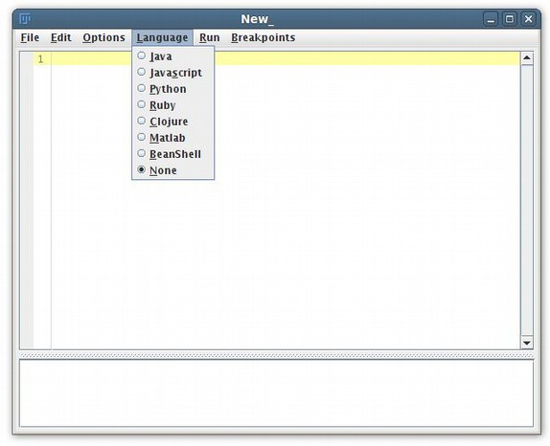
Script Editor:
beyond “Record”
Comments
Variables
Functions
String manipulation
Conditionals
Loops
http://imagej.net/Script_Editor

Slide 7
Macros: comments
// Comments allow you to put human-readable thoughts
// into your code.
// The goal of this “macro” is simply to teach you about comments!
// Comments help you to remember why you did something:
// Set the value to “2” because my boss said so!
value = 2; // Comments can be added to any line!
// Code can be disabled by commenting it out:
// x = y * 2;
http://imagej.net/Macros

Slide 8
Macros: variables (1/2)
intensity = 255;
a = exp(x * sin(y)) + atan(x * y – a);
title = “Hello, World!”;
text = “title”;
text = title;
http://imagej.net/Macros

Slide 9
Macros: variables (2/2)
// after this, y will have the same value as x
y = x;
// now, x will be assigned a new value, but y will stay the same
x = y * y – 2 * y + 3;
// the variable is assigned after the expression is evaluated
intensity = intensity * 2;
http://imagej.net/Macros

Slide 10
Macros: functions
print(“Hello, world!”);
// functions can return values
number = getNumber(“Type in a number!”);
// the “run” function is the most important one
run(“Duplicate...”, “title=New”);
run(“Duplicate...”, “title=[with spaces]”);
// Try Tools>Help on Macro Functions...
// then select a function name, such as “print” and try again
http://imagej.net/Macros

Slide 11
Macros: strings
number = 1;
// you can concatenate strings, and strings and numbers
text = “The number is “ + number;
// what happens when we run this?
run(“My plugin”, “does_not_work=number”);
// what's different with this line?
run(“My plugin”, “this_works=” + number);
http://imagej.net/Macros

Slide 12
Macros: conditionals
if (getBoolean(“Is Curtis going too fast?”)) {
hint = “Tell him!”;
} else {
hint = “Try to modify the code, play with it...”;
}
showMessage(hint);
http://imagej.net/Macros

Slide 13
Macros: loops
for (i = 1; i <= 10; i++) {
print(“Counter: ” + i);
}
while (getBoolean(“Are you sick of my questions yet?”)) {
print(“You know, I really have all day to keep asking...”);
}
http://imagej.net/Macros

Slide 14
Macros: tying it together
// this example makes a stack of blurred versions of the
// current slicewith a range of radii.
radius = getNumber(“Maximal radius?”);
title = “Blurred stack of “ + getTitle();
run(“Duplicate...”, “title=[” + title + “]”);
run(“Select All”);
run(“Copy”);
for (i = 1; i <= radius; i++) {
run(“Add Slice”);
run(“Paste”);
run(“Gaussian Blur...”, “radius=” + radius);
}

Slide 15
Further reading
Help from the community—ImageJ mailing list! ~2000 members:
http://imagej.net/Help
Scripting guide:
http://imagej.net/Scripting
Additional workshops and presentations:
http://imagej.net/Presentations

