Slide 1

Segmentation with Fiji
http://imagej.net/Presentations

Slide 2
What is Segmentation?
Traditionally:
  preprocessing + thresholding
Advanced techniques:
  active contours (mostly interactive)
  graph-based methods
  machine learning!
http://imagej.net/Segmentation

Slide 3
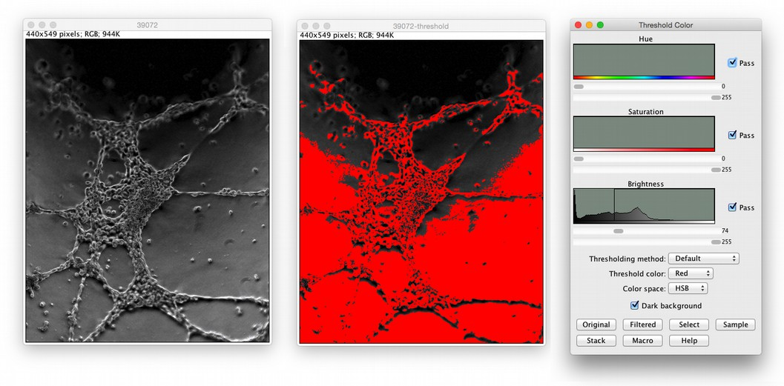
Basic Segmentation (1/2)
Apply a threshold
http://www.cellimagelibrary.org/images/39072

Slide 4
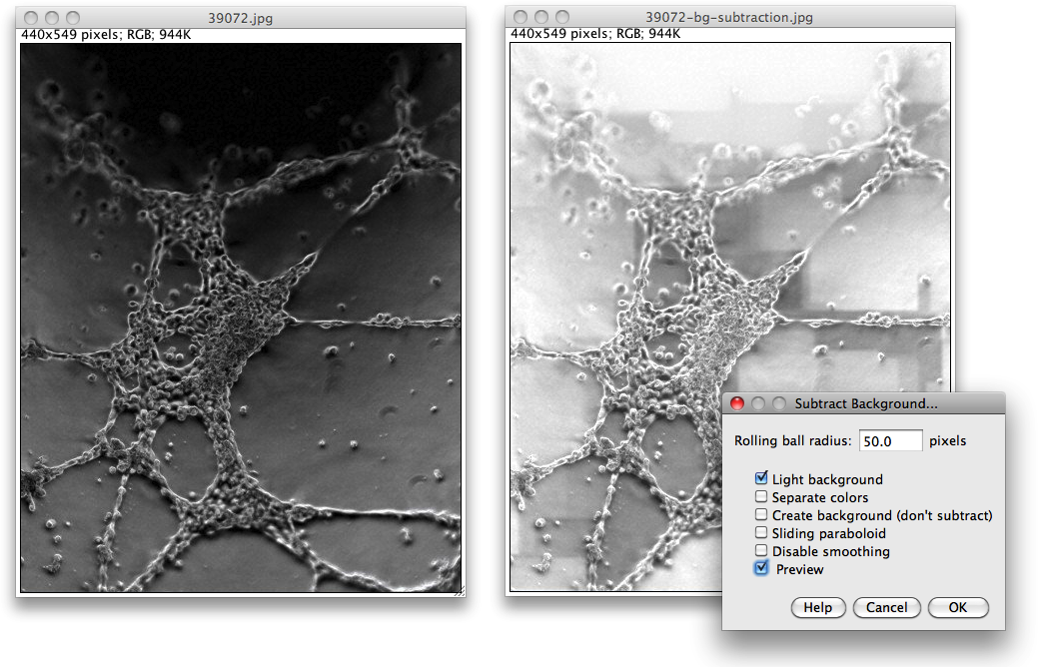
Basic Segmentation (2/2)
Subtract background
http://imagej.net/docs/menus/process.html#background

Slide 5
What's going wrong?
Uneven illumination
Subtract Background is too clever
JPEG artifacts!
How can we do better?
“wash out” details to obtain background
subtract background to fix illumination

Slide 6
Do It Yourself
Duplicate... image
Make 8-bit
Apply a Gaussian blur (large radius)
Image Calculator:
  subtract blurred image from original
Make result 8-bit again
… that was a lot of work.
Good thing there's a Macros workshop!

Slide 7
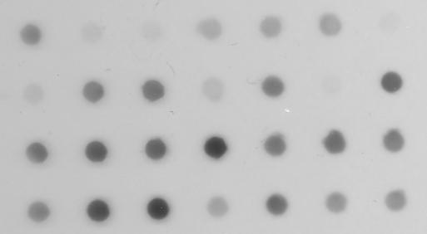
Preprocessing
File>Open Samples>Dot Blot (7K)

Slide 8
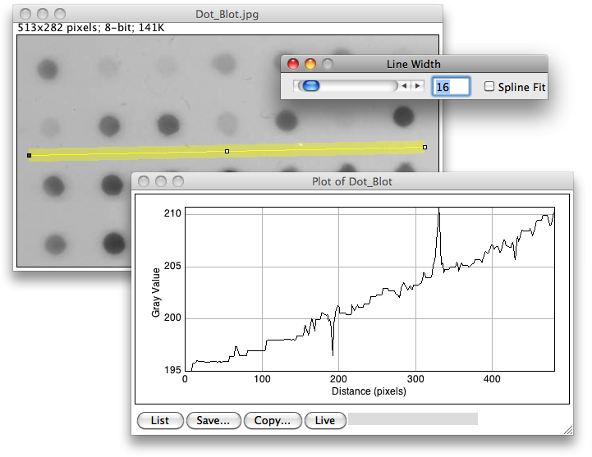
Why preprocessing?
Uneven illumination!

Slide 9
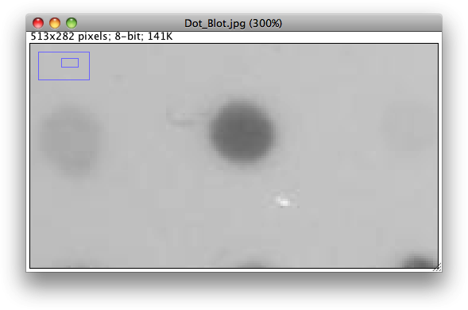
Why preprocessing?
Artifacts (smudges, scratches, JPEG)!

Slide 10
Preprocessing steps
Plan: preprocess the image to obtain a segmentation, then measure original
Median to remove scratches
Smooth
Subtract background (maximum filter)

Slide 11
Dot Blot preprocessing
run("Duplicate...", "title=median");
run("Median...", "radius=7");
run("32-bit");
run("Gaussian Blur...", "radius=2");
id1 = getImageID();
run("Duplicate...", "title=max");
run("Maximum...", "radius=20");
id2 = getImageID();
imageCalculator("Subtract create 32-bit", id1, id2);
run("8-bit");
setAutoThreshold("Triangle");

Slide 12
Further Preprocessing
Median
Gaussian
Bilateral filter or anisotropic diffusion
Background subtraction
Morphological operations with masks
Bandpass filters

Slide 13
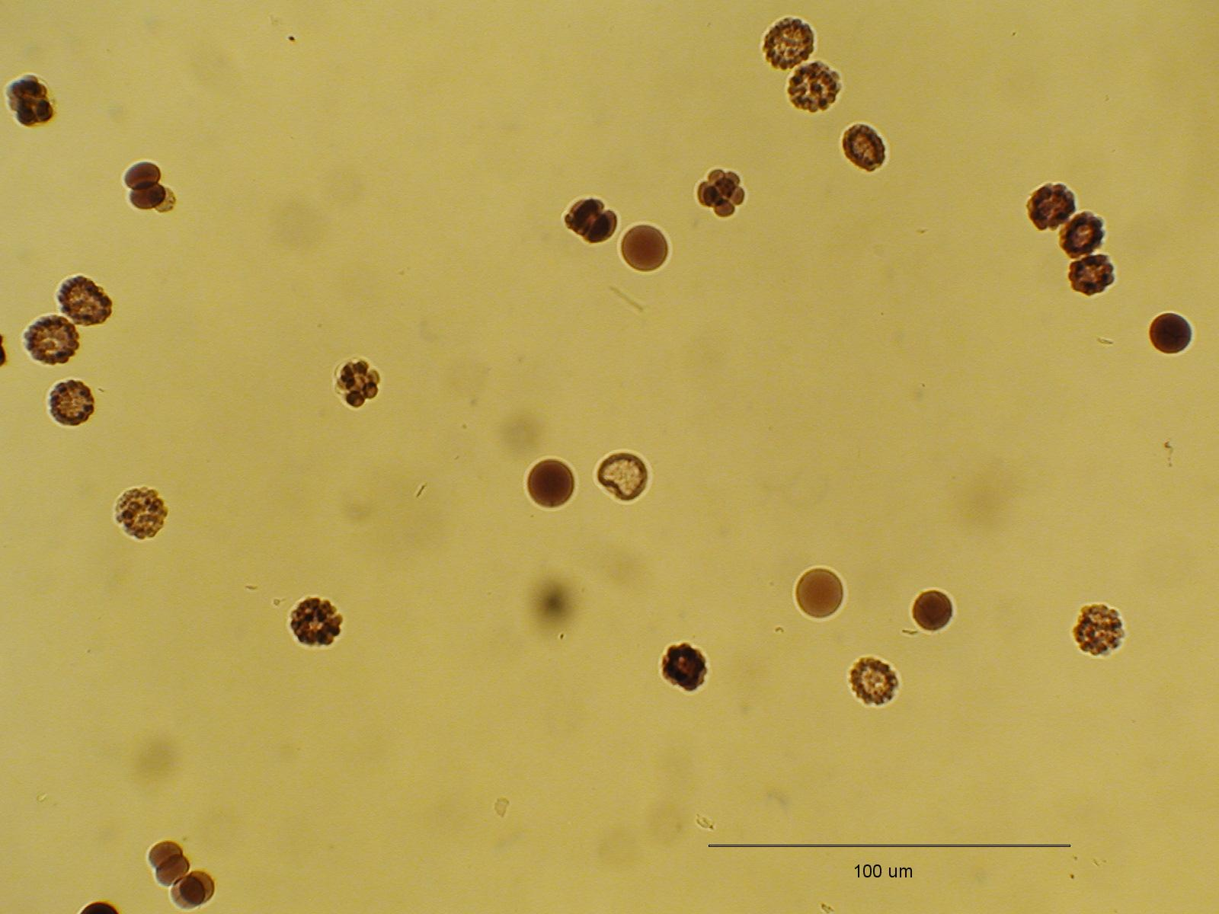
Real-world segmentation
File>Open Samples>Embryos (42K)

Slide 14
Real-world segmentation
Segment based on all channels: 8-bit
Or could use one channel: Split Channels
Threshold
Create Mask
Fill Holes
Watershed
Analyze Particles

Slide 15
Real-world segmentation
Challenges:
Color
Holes
Touching objects
Out-of-focus objects
Embedded scale bar

Slide 16
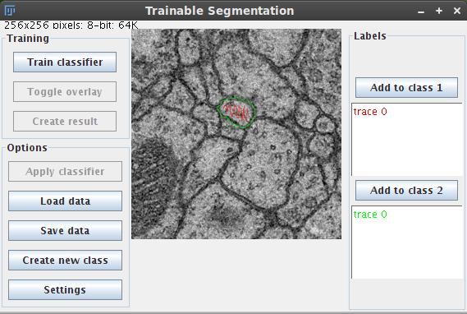
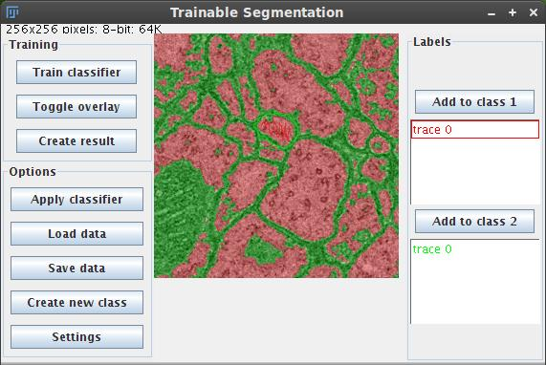
Trainable Segmentation
Automation through Machine Learning:
http://imagej.net/Trainable_Segmentation

Slide 17
Further reading
Help from the community—ImageJ mailing list! ~2000 members:
http://imagej.net/Help
Segmentation overview:
http://imagej.net/Segmentation
Scripting guide:
http://imagej.net/Scripting
Additional workshops and presentations:
http://imagej.net/Presentations

