Slide 1
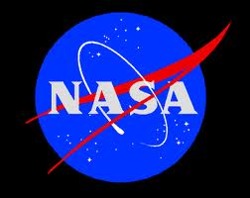
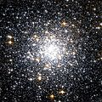
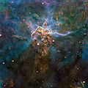

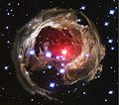


Slide 2
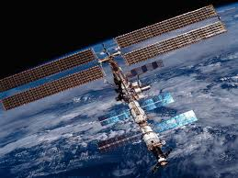

PRESENT ADMINISTRATOR OF NASA
On May 24, 2009, President Obama announced the nomination of Charles Bolden as NASA administrator, and Lori Garver as deputy administrator.
Charles F. Bolden, Jr.
(2009-present)

Slide 3
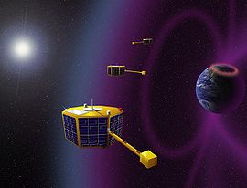
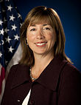
LORI GARVER
DEPUTY ADIMINISTRATOR

Slide 4


Slide 5
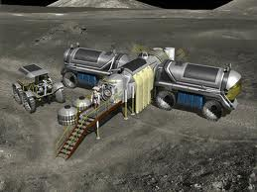
What is NASA
National Aeronautics and Space Administration
NASA is an executive branch agency of the United States government, responsible for the nation's civilian space program and aeronautics and aerospace research.

Slide 6
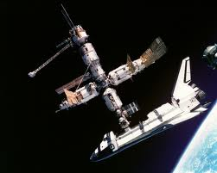
NASA
Formed | July 29, 1958 (1958-07-29) (53 years ago)
Preceding agency | NACA (1915-1958)^{[2]}
Jurisdiction | United States government
Headquarters | Washington, D.C. 38°52′59″N 77°0′59″W﻿ / ﻿38.88306°N 77.01639°W﻿ / 38.88306; -77.01639
Employees | 18,800+^{[3]}
Annual budget | US$17.6 billion (FY 2009)^{[4]} See also NASA Budget
Agency executives | Charles Bolden, administrator Lori Garver, deputy administrator

Slide 7
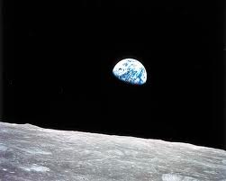
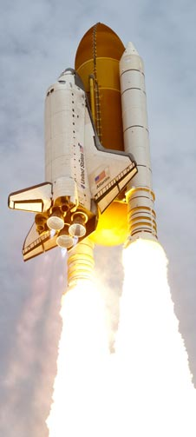
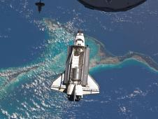
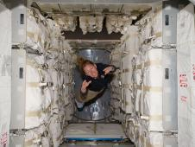
mission
1. STS-135
Mission name | STS-135
Space shuttle | Atlantis
Launch pad | 39A
Launch date | 8 July 2011 11:29:03 EDT (15:29 UTC)^{[1][2]}
Landing | 21 July 2011 05:57:54 EDT (09:57 UTC) at KSC^{[3]}
Mission duration | 12 days, 18 hours, 28 minutes, 50 seconds^{[3]}

Slide 8
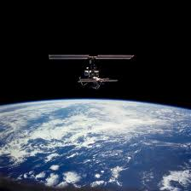
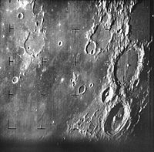
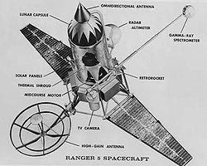
LUNAR MISSION
RANGER PROGRAM
The Ranger program was a series of unmanned space missions by the United States in the 1960s whose objective was to obtain the first close-up images of the surface of the Moon.
Ranger block spacecraft diagram
First image of the moon returned by a Ranger mission

Slide 9
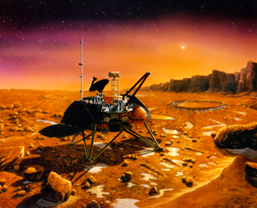
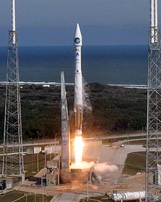
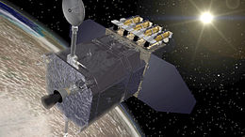
SUN MISSION
SOLAR DYNAMICS OBSERVATORY
DATE:2010-02-11
The Solar Dynamics Observatory (SDO) is a NASA mission which will observe the Sun for over five years.
The launch Thursday, 11 February 2010 15:23:00

Slide 10
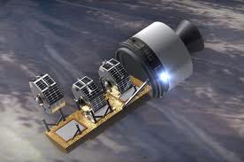
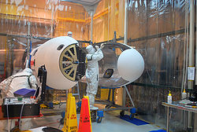
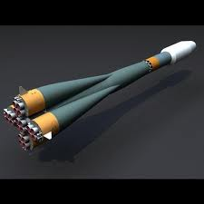
Space Technology 5
Space Technology 5 (ST5) of the NASA New Millennium program is a test of ten new technologies aboard a group of microsatellites
Launch date | 2006-03-22 14:03:45 UTC
ROCKET

Slide 11
LAUNCH OF SPACE CRAFT

Slide 12
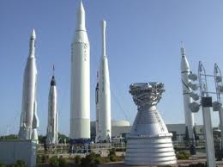
NASA PLANNED ACTIVITIES
NASA's ongoing investigations include in-depth surveys of Mars and Saturn and studies of the Earth and the Sun.
On December 4, 2006, NASA announced it was planning a permanent moon base
In September 2011, the Space Launch System, a planned launch vehicle was announced.

Slide 13
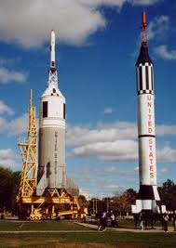
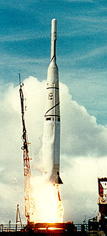
NASA UNMANNED MISSIONS
Explorer program (1958-2011)
The Explorer program continues and over more than five decades has launched 90+ missions into Space

Slide 14

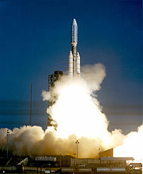
Voyager program (1977)
The Voyager program is a series of NASA unmanned space missions that consists of a pair of unmanned scientific probes, Voyager 1 and Voyager 2

Slide 15
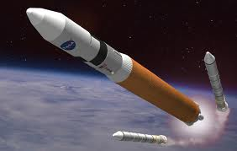
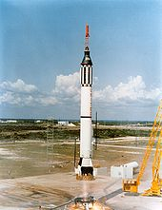
MANNED MISSIONS OF NASA
Project Mercury (1959-1963, manned missions from 1961)
Conducted under the pressure of the competition between the U.S. and the Soviet Union that existed during the Cold War, Project Mercury

Slide 16
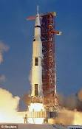
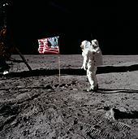
Apollo program (1961-1972, manned missions from 1968)
The Apollo program landed the first humans on Earth's Moon
Apollo 11 landed on the moon on July 20, 1969 with astronauts Neil Armstrong and Buzz Aldrin,

Slide 17
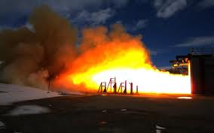
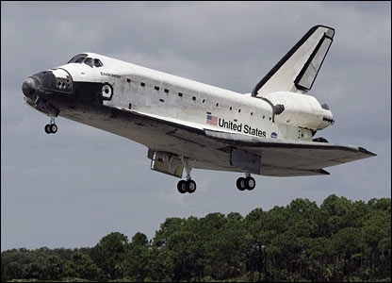
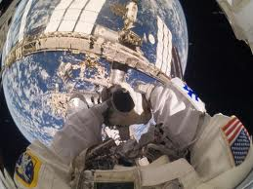
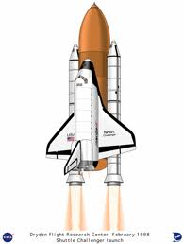
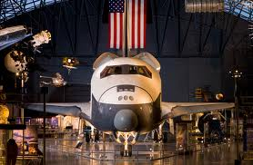
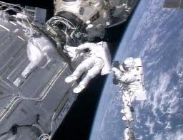

Slide 18


SPACE CRAFTS OF NASA
NACA Bell X-1, experimental rocket plane, 1947.
Jupiter C, used for Explorer 1, first space mission, 1958.

Slide 19
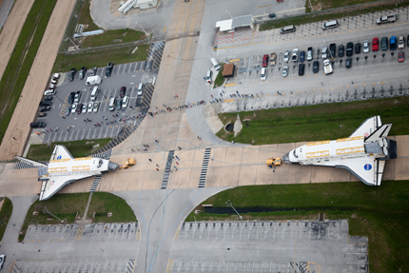

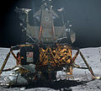

Saturn 5, used for Apollo[ and Skylab,[1969.
Lunar module, 1972.
Space Shuttle, first reusable spacecraft, 1981

Slide 20
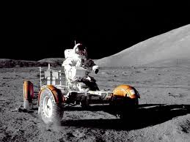
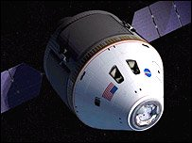
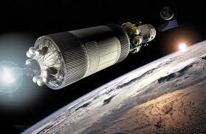
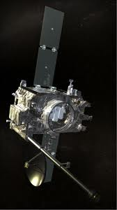
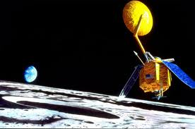

Slide 21
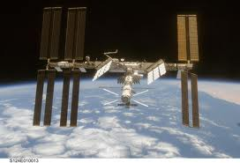
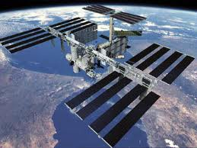
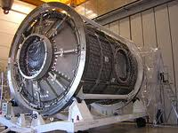
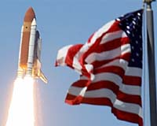
Space stations:-
FREEDOM

Slide 22
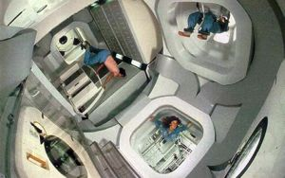
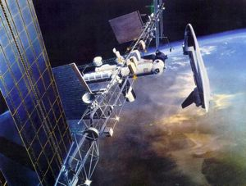
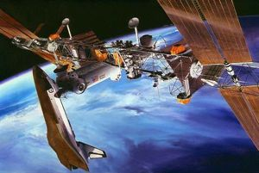


Slide 23
THANKYOU

