Slide 1

WILDLIFE TRIGGER
Bobcat shutter trigger on a Raspberry Pi — MobileNetV2 quantized to INT8, deployed in C++
2.27× faster on-device · 20.4 → 46.3 FPS · 3.5× smaller · accuracy-equivalent
Vadym (imagic9) · Efficient ML final project · SET University · 2026-07-20
github.com/imagic9/
efficient-ml-set

Slide 2
THE PRODUCT
Why Edge AI: the shutter must decide locally
📶
🔋
⚡
Offline
Battery / CPU-only
Real-time
No cloud, no signal in the field — the model runs on the device itself.
No GPU. A small INT8 model that sips power and fits on an SD card.
Keep up with a camera-trap burst — a decision every few tens of ms.
The core artifact is a CPU-only C++ inference engine that fires SHUTTER_TRIGGER only when a bobcat is present.

Slide 3
ASSIGNMENT MAPPING
The engineering question
How much on-device speedup can INT8 quantization + structured pruning buy for a MobileNetV2 wildlife classifier — and does it cost accuracy?
Model training & optimization
C++ inference implementation
PTQ · QAT · structured pruning, justified
ONNX Runtime CPU EP, parity-tested
Benchmarking & metrics
Results analysis & presentation
baseline vs optimized on the real Pi
what worked / what didn't / next
Answer: 2.27× faster, 3.5× smaller, no accuracy cost (better in-distribution).

Slide 4
DATA
CCT-20 · bobcat target · leakage controls
57,864
bobcat
0.5775
256×192
images · 16 classes
graded target (idx 3)
shortcut probe (≈0.50)
input · +31% real pixels
cis / trans split — same cameras vs new locations (the hard generalization test).
Leakage fingerprinted: 224 seqs / 270 imgs / 10 bobcat overlap → all decisions use cis_val_clean (3,214 imgs / 144 bobcat).
Empty supplement: 5,000 frames, location-disjoint, downsized ≤1024 px so resolution is not a shortcut for 'empty'.
Multi-label frames excluded from cross-entropy, kept for target-presence. Gate B passed 43/43.

Slide 5
BASELINE & DEPLOYMENT
MobileNetV2 baseline → C++ inference pipeline
ImageNet-pretrained MobileNetV2 (width 1.0), 16 outputs, input 256×192.
Effective-number weighted CE; two-phase head→full fine-tuning (seed 42).
Threshold calibrated on validation inside a 5% false-fire budget (§6.3).
Python only for training/export — inference is C++ + ONNX Runtime CPU EP.
JPEG
▼
decode
▼
letterbox
256×192
▼
ORT
CPU EP
▼
policy
(threshold)
▼
SHUTTER

Slide 6
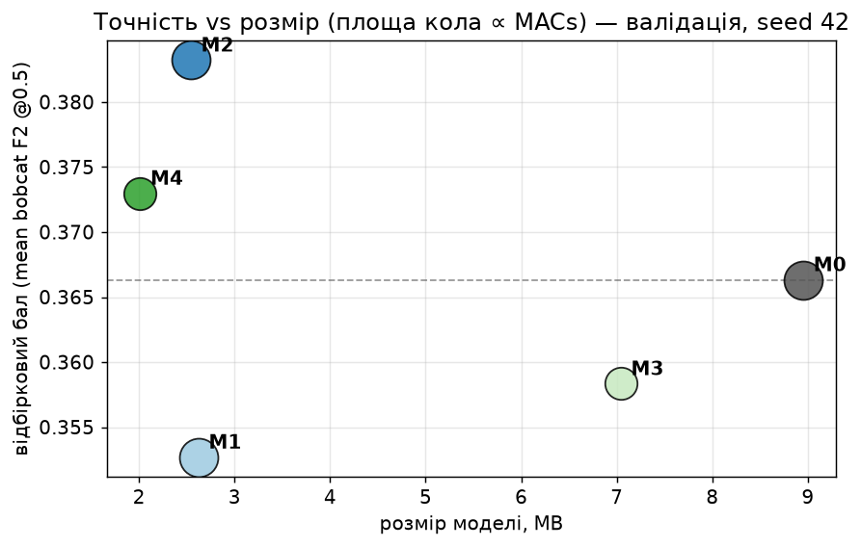
OPTIMIZATION LADDER
PTQ · QAT · structured pruning
Model | transform | score | MB | MACs
M0 | FP32 baseline | 0.3663 | 8.95 | 293M
M1 | INT8 PTQ | 0.3527 | 2.62 | 293M
M2 | INT8 QAT ✓final | 0.3832 | 2.54 | 293M
M3 | pruned FP32 | 0.3583 | 7.04 | 206M
M4 | pruned+QAT | 0.3730 | 2.01 | 206M
M1 (PTQ) — pre-registered negative: depthwise MobileNetV2 loses accuracy.
M2 (QAT) — most accurate; recovers the PTQ loss.
M3/M4 pruning — 30% fewer MACs (widths rounded to ×8 first).
Final = M2 by rule §8.4: a more complex stack must be more accurate to win — M4 isn't.

Slide 7
TRUST THE NUMBERS
Correctness & reproducibility before performance
✓
P1 preprocessing
✓
P2 · P3 · P4 parity
C++ ↔ Python golden tensors: 0.0 / 7e-7
C++ ORT = Python ORT; run-dataset confusion identical
✓
QEMU cortex-a76
✓
Pi ↔ gx10 parity
native vs emulated bit-identical (M0/M2/M4)
bit-identical on the CM5 — target equivalence
✓
Reproducibility
✓
Fail-closed preflight
F4 vs F5 within ±3.5%; seeds 17/42/73
refuses non-aarch64 / non-Ubuntu-24.04 / no asimddp
Every performance number below sits on a passed correctness gate.

Slide 8
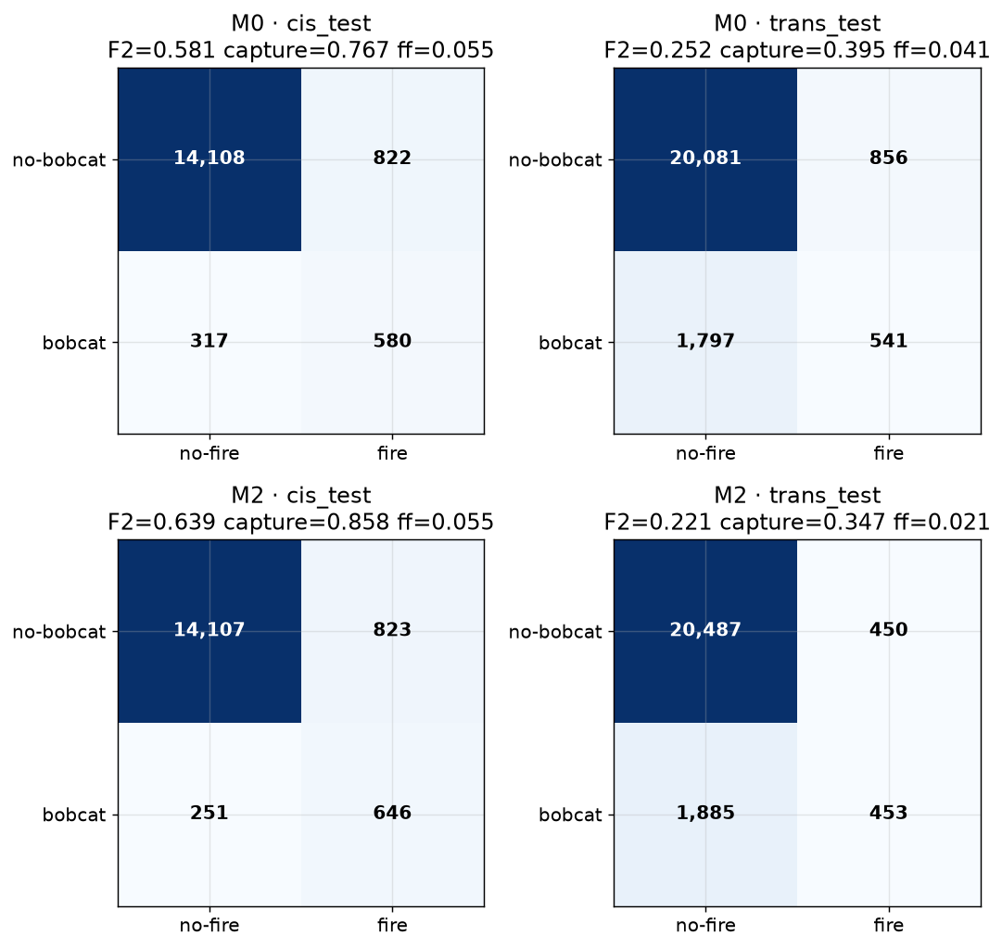
ACCURACY
At the bobcat operating point (frozen test, opened once)
 | cis-test F2 | capture | trans-test F2 | capture
M0 FP32 | 0.5812 | 0.767 | 0.2517 | 0.395
M2 QAT | 0.6387 | 0.858 | 0.2209 | 0.347
In-distribution (cis-test): M2 BEATS the FP32 baseline — captures 85.8% of bobcat visits vs 76.7%, at equal 5.5% false-fire.
New locations (trans-test): both drop to ~35–40% capture — the honest domain-shift limitation, reported not hidden.
Both stay recall_floor_infeasible: ships the best admissible threshold, never claims the 90% floor is met.

Slide 9
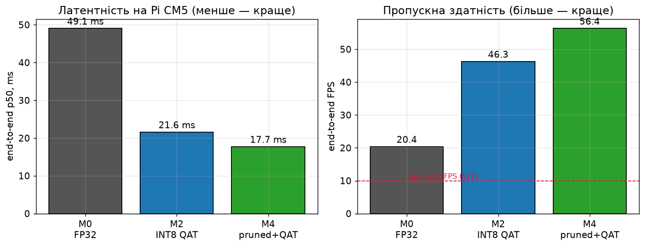
THE RESULT THAT COUNTS (DESIGN §12.4)
On-device: baseline vs optimized — real Raspberry Pi CM5
2.27×
20.4 → 46.3
3.5×
faster end-to-end (M0 → M2)
FPS (frozen, threads=1)
smaller: 8.95 → 2.54 MB
CM5 · Cortex-A76 @ 2.4 GHz · performance governor · no throttling · 3 reps ×≥1000 iters · Pi↔gx10 bit-identical

Slide 10
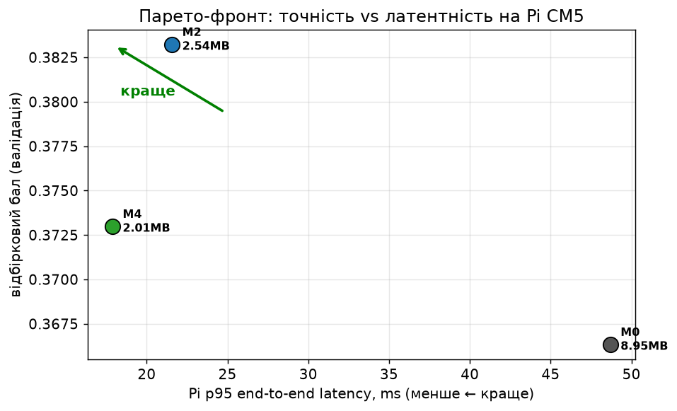
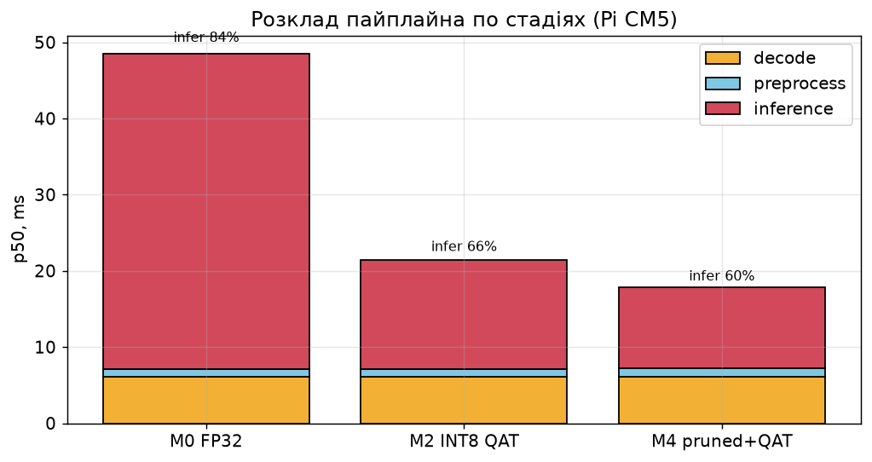
ANALYSIS
Pareto front & where the time goes
Inference is 85% of the FP32 pipeline and collapses 4× under INT8 — the bottleneck shifts to the fixed ~6 ms JPEG decode. On the 4-core A76 threads=3 is optimal — the opposite of the 20-core gx10.

Slide 11
CRITICAL EVALUATION
What worked · what didn't · limitations
What worked
What didn't
Limitations
INT8 QAT: 2.27× on-device, 3.5× smaller, no accuracy cost
C++/ORT parity exact — Pi↔gx10 bit-identical
QEMU rehearsal de-risked the one-shot rental
Threading on Pi: +1.25× (target-specific)
Trans-domain recall poor (~35–40% capture)
90% recall floor infeasible in the 5% budget
PTQ (M1) — pre-registered negative result
Pruning (M4) not more accurate → not selected
Remote Pi: no camera, no GPIO, no power meter
Shutter is an emulated JSON signal
CCT domain; weak on unseen sites
badger/deer/fox: null thresholds (no support)
Negatives are measured and reported — nothing is hidden (DESIGN §18 decision rules).

Slide 12
Result & next steps
2.27× faster · 46.3 FPS · 3.5× smaller · accuracy-equivalent on the real Raspberry Pi CM5
1
Close the decode bottleneck — inference no longer dominates — attack the ~6 ms JPEG decode
2
Improve OOD generalization — more locations, TTA, or crop-teacher KD (Phase S)
3
Physical integration — wire GPIO shutter + on-device power (Joules/decision)
github.com/imagic9/efficient-ml-set
Vadym (imagic9) · Efficient ML · SET University

