Slide 1
Exploring a ground based,
always observing
Askaryan-telescope
for gamma-ray-astronomy
Sebastian A. Mueller, MPI-Heidelberg, 2019 December

Slide 2
- Radio-emission in air-showers
- Previous research
- Proposing the Askaryan-telescope
- Simulating wave-mechanics
- Simulating radio-receivers
- Example events
- Outlook

Slide 3
Radio detection of cosmic ray air showers in the digital era
Tim Huegeª ªInstitut für Kernphysik, Karlsruher Institut für Technologie - Campus Nord, Postfach 3640, 76021 Karlsruhe, Germany
Radio-emission
Recommended as introduction.
Summarizes emission, simulation, and detection.
A cosmic-ray E > 10¹⁷eV point of view.

Slide 4
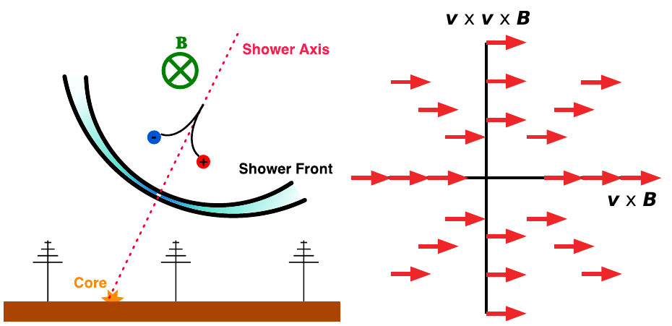
Radio-emission
Geomagnetic
- transverse currents
- strongest component
- only relevant for e⁺, e⁻
Radio detection of cosmic ray air showers in the digital era
Huege, Tim
Physics Reports, vol.620, p.1-52, 2016

Slide 5
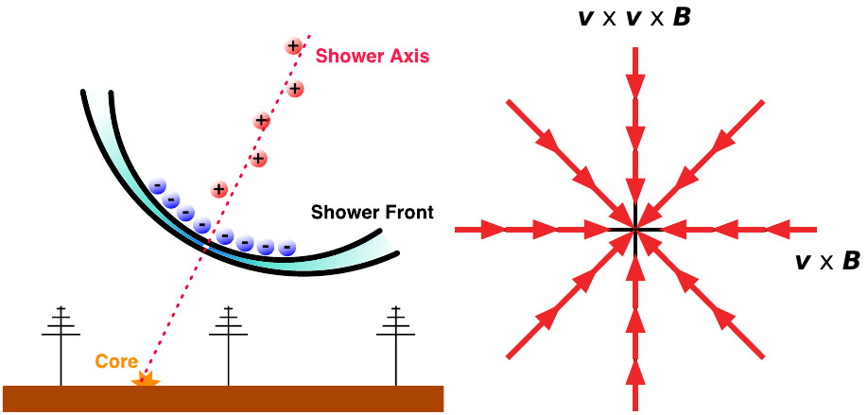
Radio-emission
Charge-excess
(Askaryan-effect)
Radio detection of cosmic ray air showers in the digital era
Huege, Tim
Physics Reports, vol.620, p.1-52, 2016

Slide 6
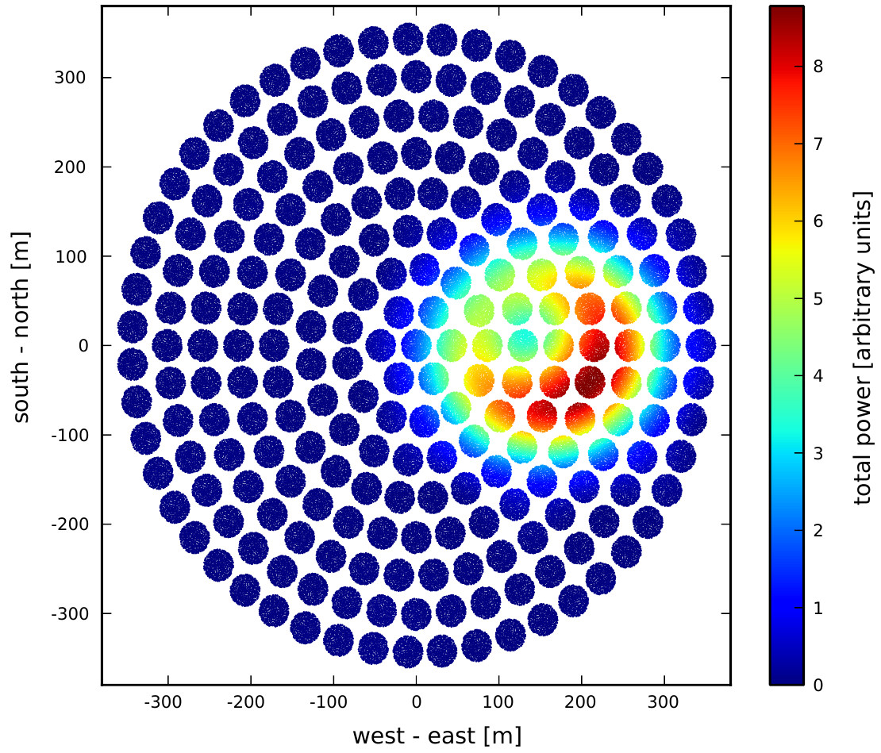
Radio-emission
Emission strongly beamed in forward direction,
similar geometry as Cherenkov-pool.
Figure shows simulation for Square-Kilometer-Array
Radio detection of cosmic ray air showers in the digital era
Huege, Tim
Physics Reports, vol.620, p.1-52, 2016

Slide 7
- Radio-emission in air-showers
- Previous research
- Proposing the Askaryan-telescope
- Simulating wave-mechanics
- Simulating radio-receivers
- Example events
- Outlook

Slide 8
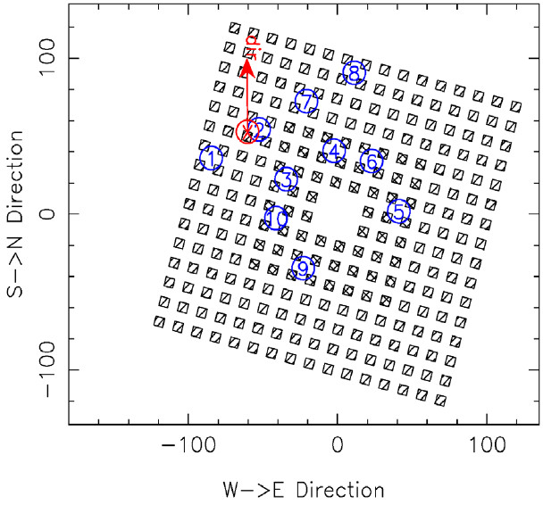
KASCADE, LOPES
air-shower’s core (reconstructed)
LOPES Antennas
Detectors for charged particles
Detection and imaging of atmospheric radio flashes from cosmic ray air showers
Falcke, H and Apel, WD and Badea, AF and Baehren, L and Bekk, K and Bercuci, A and Bertaina, M and Biermann, PL and Bluemer, J and Bozdog, H and others,
Nature, vol.435, num.7040, p.313, 2005
/ m

Slide 9
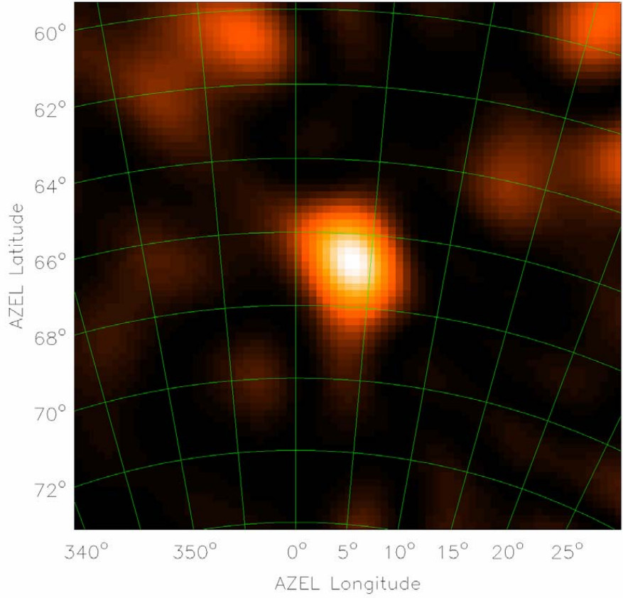
KASCADE, LOPES
“For each pixel in the map, we formed a beam in this direction integrated over 12.5 ns and show the resulting electric field intensity.”
Detection and imaging of atmospheric radio flashes from cosmic ray air showers
Falcke, H and Apel, WD and Badea, AF and Baehren, L and Bekk, K and Bercuci, A and Bertaina, M and Biermann, PL and Bluemer, J and Bozdog, H and others,
Nature, vol.435, num.7040, p.313, 2005

Slide 10
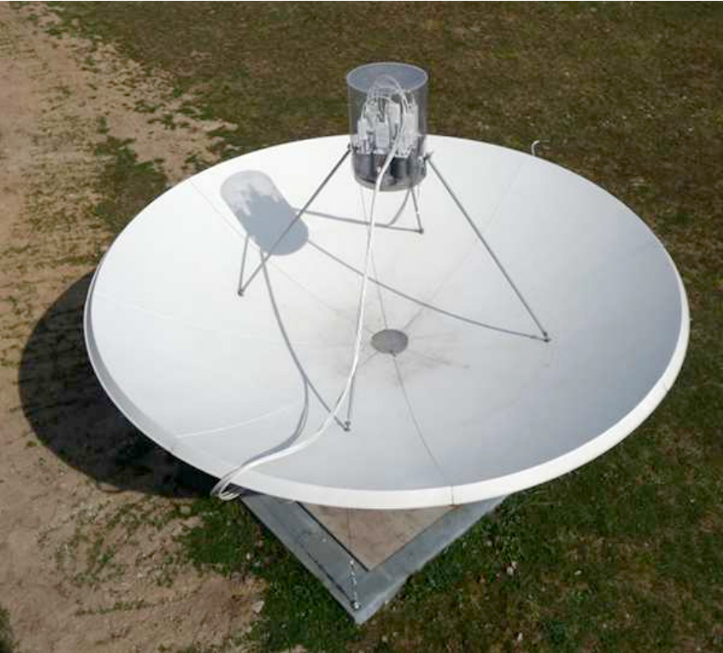
CROME
KASCADE
First experimental characterization of microwave emission from cosmic ray air showers
Smida, R and Werner, F and Engel, R and Arteaga-Velazquez, JC and Bekk, K and Bertaina, M and Bluemer, J and Bozdog, H and Brancus, IM and Chiavassa, A and others, 32nd ICRC Beijing, 2011

Slide 11
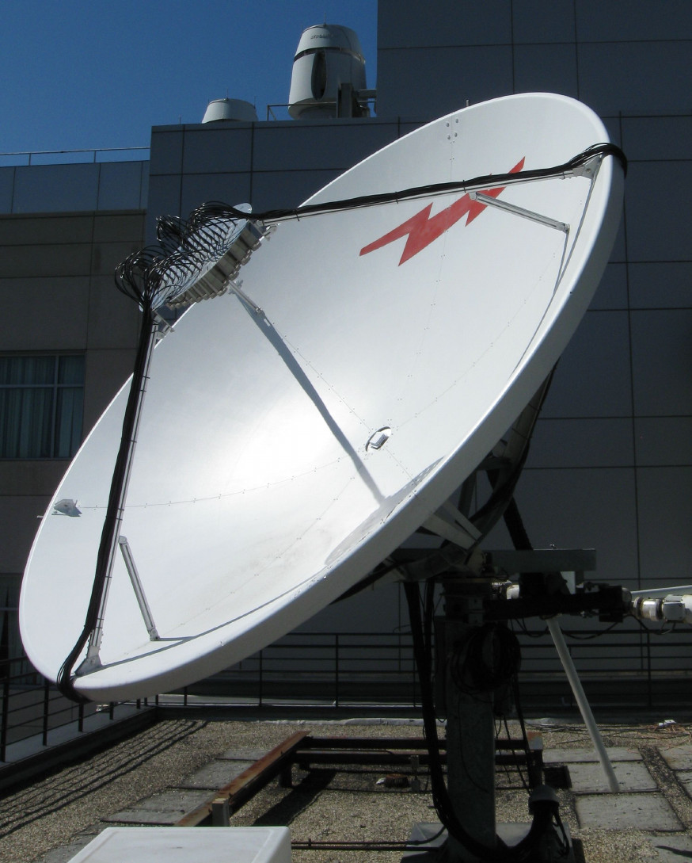
MIDAS
Chicago, 2013, for Pierre-Auger-Observatory
The MIDAS telescope for microwave detection of ultra-high energy cosmic rays
Alvarez-Muniz, J and Soares, E Amaral and Berlin, A and Bogdan, M and Bohacova, M and Bonifazi, C and Carvalho Jr, WR and de Mello Neto, JRT and San Luis, P Facal and Genat, JF and others
NIM-A vol.719, p.70-80, 2013

Slide 12
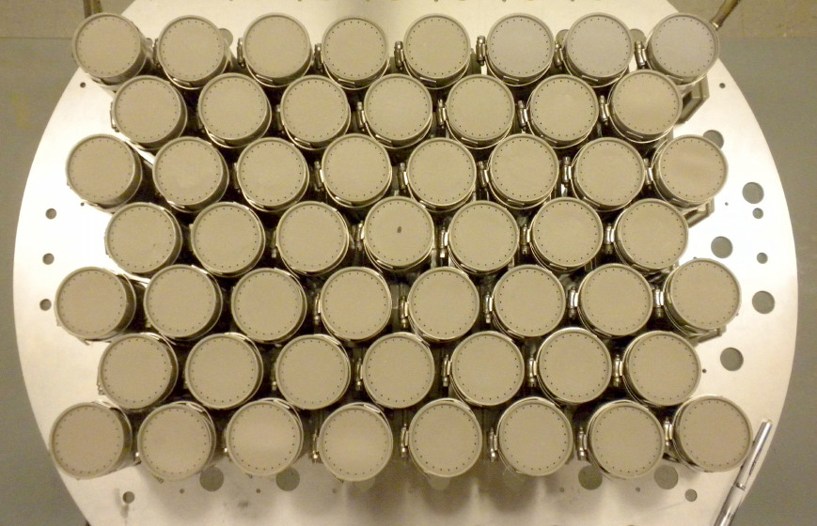
MIDAS
Chicago, 2013, for Pierre-Auger-Observatory
The MIDAS telescope for microwave detection of ultra-high energy cosmic rays
Alvarez-Muniz, J and Soares, E Amaral and Berlin, A and Bogdan, M and Bohacova, M and Bonifazi, C and Carvalho Jr, WR and de Mello Neto, JRT and San Luis, P Facal and Genat, JF and others
NIM-A vol.719, p.70-80, 2013

Slide 13
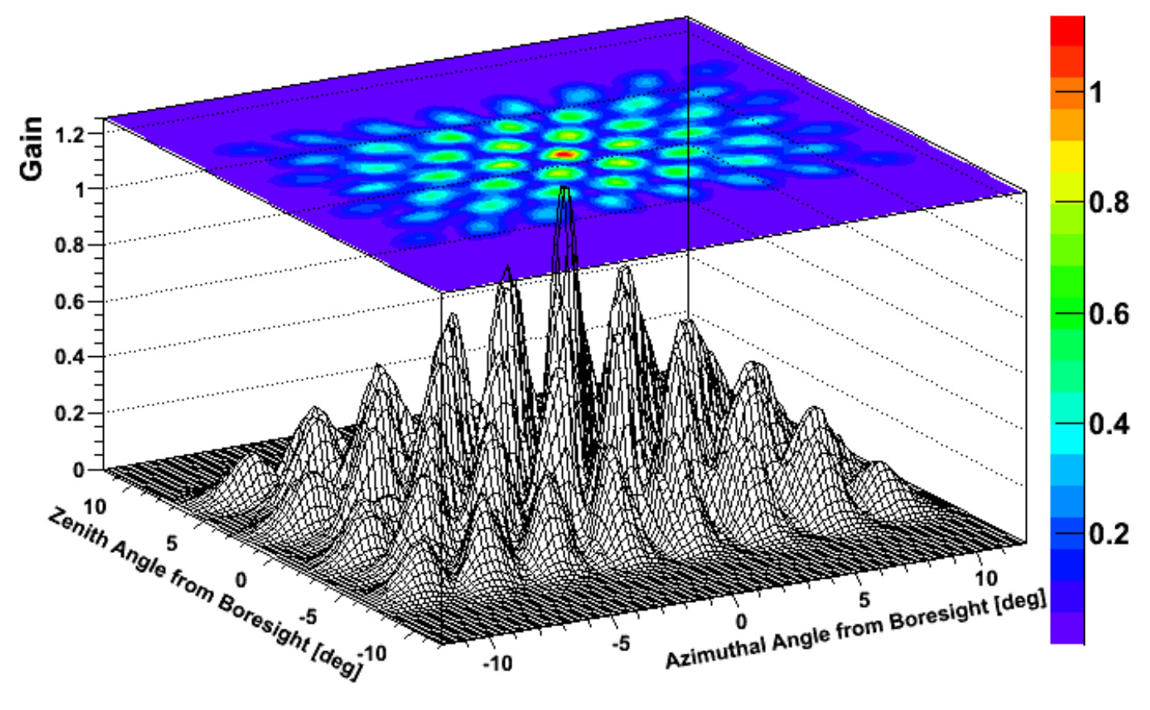
MIDAS
Chicago, 2013, for Pierre-Auger-Observatory
The MIDAS telescope for microwave detection of ultra-high energy cosmic rays
Alvarez-Muniz, J and Soares, E Amaral and Berlin, A and Bogdan, M and Bohacova, M and Bonifazi, C and Carvalho Jr, WR and de Mello Neto, JRT and San Luis, P Facal and Genat, JF and others
NIM-A vol.719, p.70-80, 2013

Slide 14
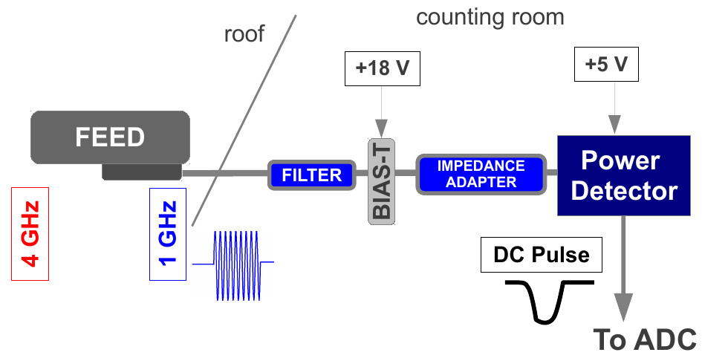
MIDAS
Chicago, 2013, for Pierre-Auger-Observatory
The MIDAS telescope for microwave detection of ultra-high energy cosmic rays
Alvarez-Muniz, J and Soares, E Amaral and Berlin, A and Bogdan, M and Bohacova, M and Bonifazi, C and Carvalho Jr, WR and de Mello Neto, JRT and San Luis, P Facal and Genat, JF and others
NIM-A vol.719, p.70-80, 2013

Slide 15
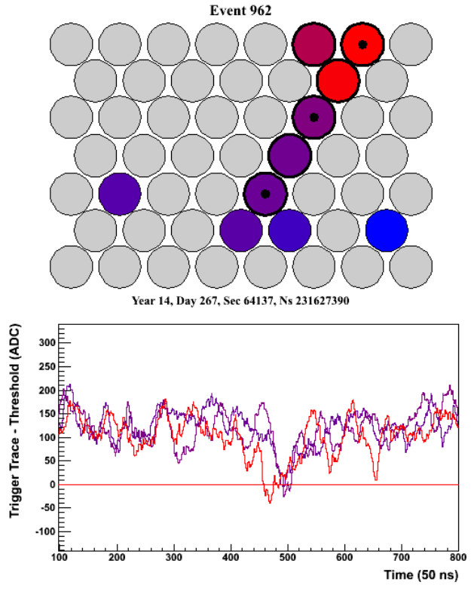
MIDAS
Chicago, 2013, for Pierre-Auger-Observatory
The MIDAS telescope for microwave detection of ultra-high energy cosmic rays
Alvarez-Muniz, J and Soares, E Amaral and Berlin, A and Bogdan, M and Bohacova, M and Bonifazi, C and Carvalho Jr, WR and de Mello Neto, JRT and San Luis, P Facal and Genat, JF and others
NIM-A vol.719, p.70-80, 2013

Slide 16
- Radio-emission in air-showers
- Previous research
- Proposing the Askaryan-telescope
- Simulating wave-mechanics
- Simulating radio-receivers
- Example events
- Outlook

