Slide 1
Data Assimilation of Sentinel-2 Observations: Preliminary results from EO-LDAS and Outlook
P.Lewis ⁽¹⁾ Gomez-Dans, J.⁽¹⁾, Kaminski, T.⁽²⁾; Settle, J.⁽³⁾, Quaife, T.⁽³⁾, Gobron, N.⁽⁴⁾, Styles, J.⁽⁵⁾, Berger, M. ⁽⁶⁾
⁽¹⁾ UCL and NCEO, ⁽²⁾ FastOpt, ⁽³⁾ University of Reading and NCEO ⁽⁴⁾ European Commission, DG Joint Research Centre ⁽⁵⁾ Assimila Ltd., ⁽⁶⁾ ESA ESRIN, Science Strategy, Coordination and Planning Office (EOP-SA),
+FSU Jena (field data)

Slide 2
EO-LDAS
ESA STSE project
prototype Earth Observation Data Assimilation System
Software soon to be released: python package
gain experience with using DA with EO data
Variational system
Includes interface to the canopy Radiative Transfer model: semi-discrete (Gobron et al.)
+ soil & leaf spectral
with associated adjoint code

Slide 3
The remote sensing problem
Context here: vegetation canopies
Infer vegetation properties from radiometry
E.g. LAI, chlorophyll, water
Test/drive models e.g. biogeochem. for C flux, crop models etc.
Historically
Vegetation indices
Data transforms to maximise sensitivity to target variable (e.g. LAI)
Empirical or model-based relationships
Model ‘inversion’
RT model predictions of measurements y as function of state x
LUT/ANN mapping of inverse function

Slide 4
Issues with inversion
Poor or no treatment of uncertainty
Problem mostly ill-conditioned
Not enough information to solve for all terms
E.g. RT model state:
Assume some terms ‘known’
Better to specify knowledge as explicit constraint
With associated uncertainty
LAI | Leaf inclination distribution | Leaf chlorophyll | Leaf water | Leaf dry matter | Soil brightness | Soil water

Slide 5
Bayes theorum
Combine probabilities
Gaussian

Slide 6
Combine prior and observation
Optimal (ML) estimate for x at max(exp(j))
So min(J)
Recognise J as ‘cost fn’

Slide 7
Combine prior and observation
For illustration, consider simplest case:
H(x)=I(x)
so y=x

Slide 8
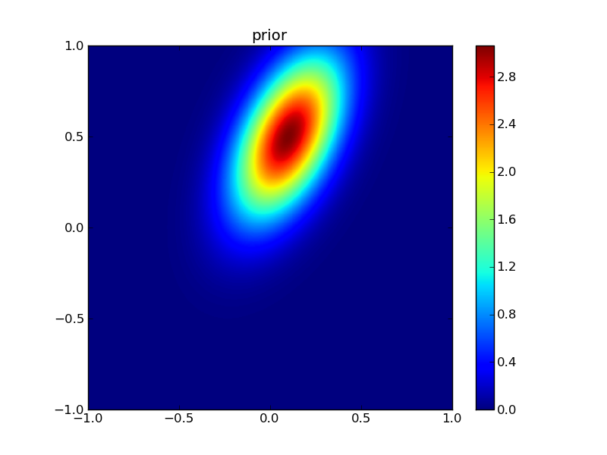
prior

Slide 9
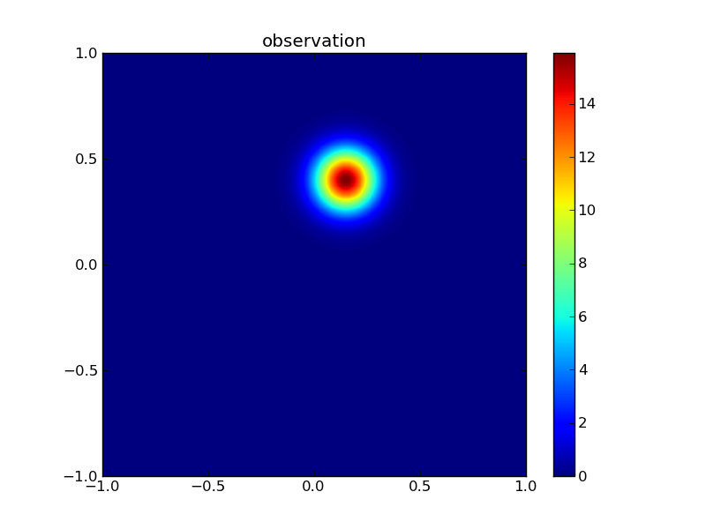
observation

Slide 10

posterior

Slide 11
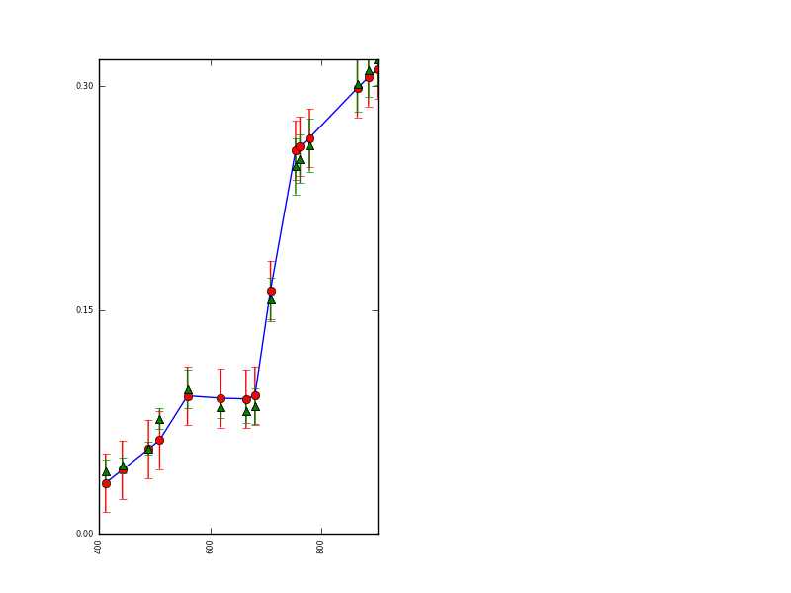
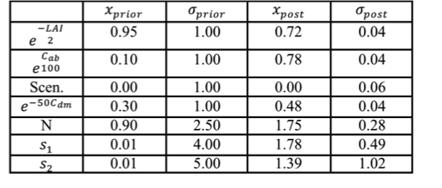
e.g. MERIS with weak prior
Prior conditions solution

Slide 12
0.4<=LAI<=0.9

Slide 13
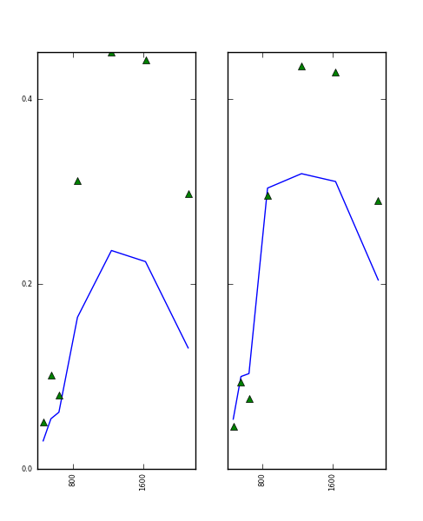
Predict MODIS from solution

Slide 14
Data Assimilation
Variational methods
Solve for minimum of (summed) J
Can solve large (10³⁺) state vector
Make use of Jacobian J’
So need adjoint code for efficiency
Uncertainty from error fn curvature (Hessian) J’’
Solve for all x at once
Easiest if assume Gaussian stats
Sequential methods
E.g. Kalman filter++

Slide 15
Elements of a DA system
State vector x
Observations y
Prior constraint
Process model Q(x)
Obs constraint with y=H(x)

Slide 16
Constraint models
Allows to integrate process model and observations
E.g. biogeochem model/crop model
Options:
Solve for initial conditions (strong constraint)
Solve for full state vector
With model uncertainty (weak constraint)
Issues:
Models for all elements that affect EO not available

Slide 17
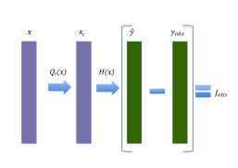
Strong constraint
e.g. meteo forecast

Slide 18
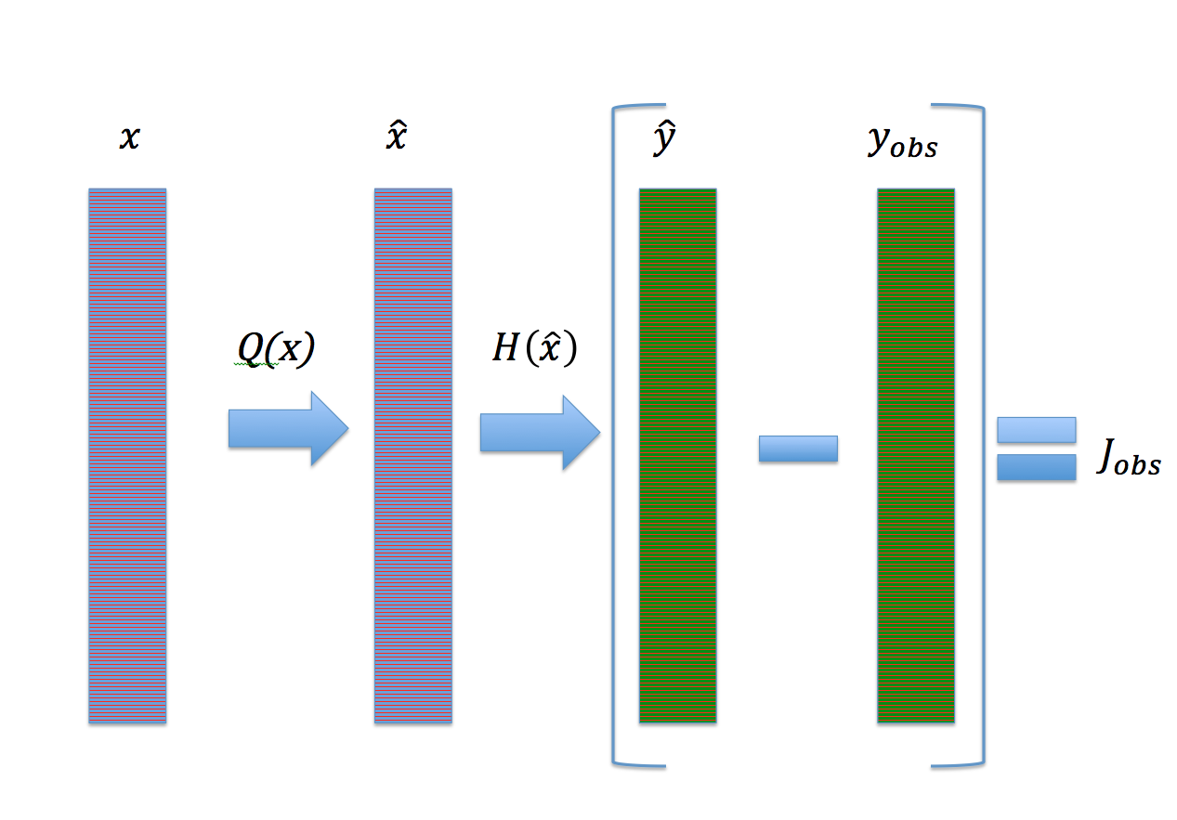
Weak constraint

Slide 19
Simplest Q model
Zero-order process model
x(t+1) = x(t)
E[x(t+1)-x(t)=0] = C_{model}
So Dx=0
1st O difference constraint
regularisation

Slide 20
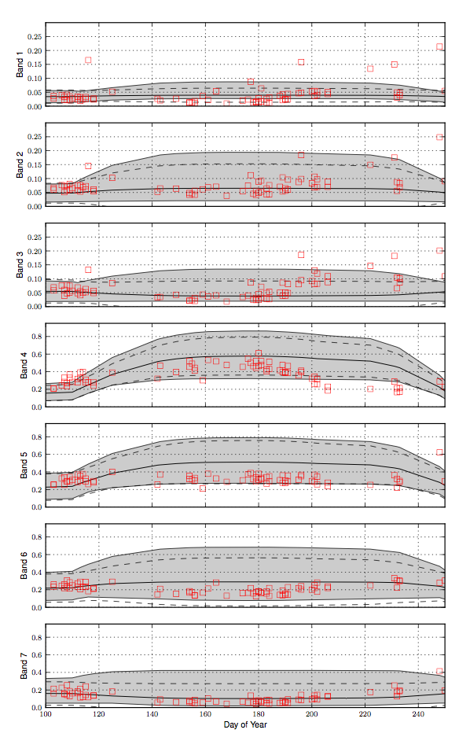
EO-LDAS
MODIS data
Wheat field, Gebesee

Slide 21
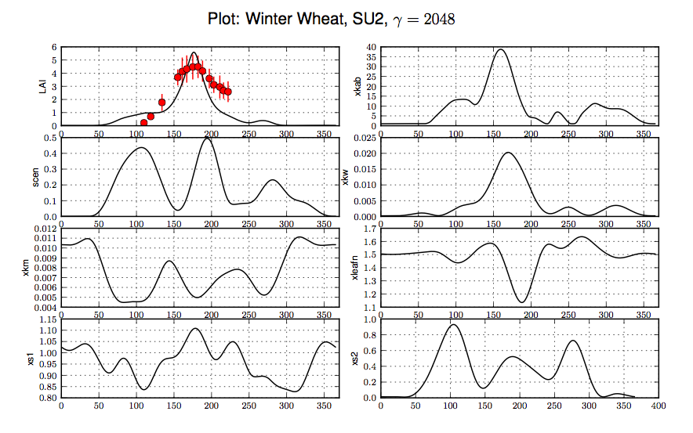

Slide 22
MODIS results
Slight over-smoothed
But viable LAI
But demonstrate ability to solve for all (8 here) vegetation state parameters
For each day of year = 8x365 ~= 3000
Using only simple regularisation model
2nd difference here

Slide 23
Sentinel-2 MSI
Synthetic experiment
See Lewis et al. (2012) RSE
2 scenarios
Full (5 day) coverage
Cloudy (50%) coverage
Assume temporal trajectories
Green lines in plots
Solve for vegetation state
For each sample day (loose prior only)
With prior + D1 & D2 regularisation models

Slide 24
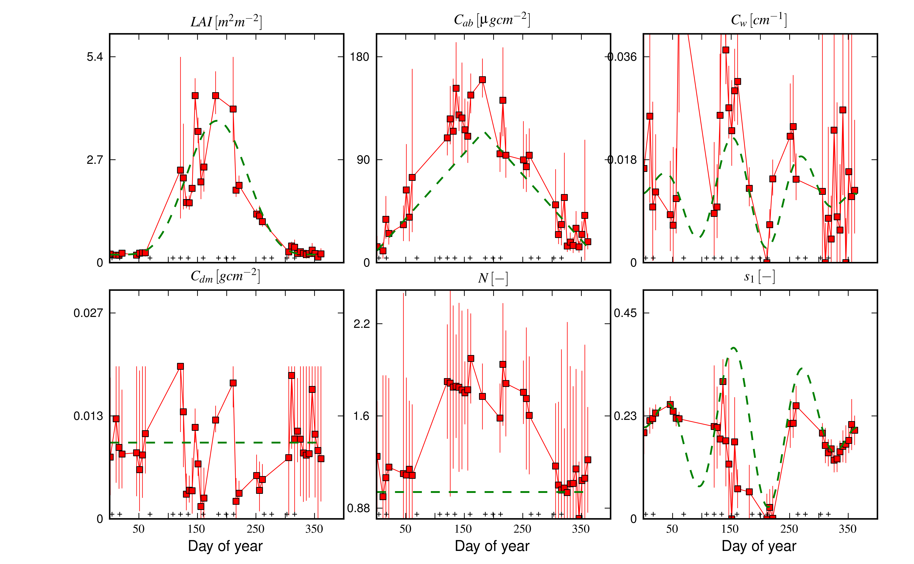
Sentinel-2 MSI: cloudy

Slide 25
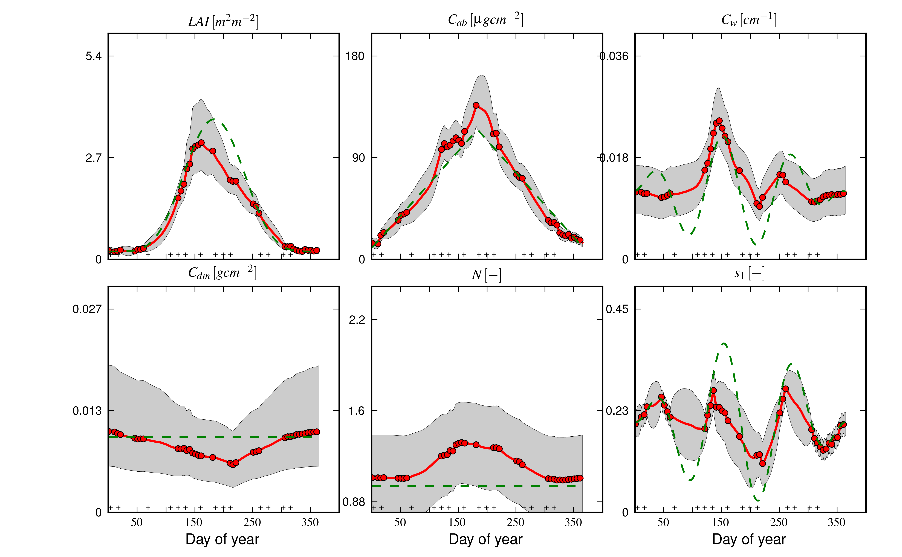
Sentinel-2 MSI: regularisation

Slide 26
Sentinel-2 MSI
Viable results for MSI with prior
But quite large uncertainties
DA with regularisation model
Reduce uncertainty by ~2 on average
Solve for all days
Speed bottleneck for full RT model
Replace by GP emulation models
Same for process models?

Slide 27
Outlook
DA framework appropriate way to estimate vegetation state from EO
Priors express certainty in expectations
Rather than simply assuming terms constant
Regularisation methods allow estimation of full state vector
If no other process model available
Or if purpose is to test process model
Framework can integrate any process models
E.g. biogeochem models for C flux estimation
E.g. crop growth
Framework can be applied to space as well as time
Route for multi-scale sensor integration

Slide 28
EO-LDAS
Project website
http://www.assimila.eu/eoldas/
Software tutorial
http://www2.geog.ucl.ac.uk/~plewis/eoldas
Software release soon
New ESA DA project
Integrate SVAT/vegetation dynamics models
More observation operators:
Passive microwave

Slide 29
Thank you

