Slide 5







o
Px
n
x
$$x^{′}$$
ｃ
$$x^{′}=o+t(x−o)$$
$$\left(o+t(x−o)−c\right)∙n=0$$
$$\left(x^{′}−c\right)∙\frac{T}{{\left\|T\right\|}^{2}}=\left(o−c\right)∙\frac{T}{{\left\|T\right\|}^{2}}+\frac{\left(c−o\right)∙n}{(x−o)∙n}(x−o)∙\frac{T}{{\left\|T\right\|}^{2}}$$
$$\left(x^{′}−c\right)∙n=0$$
$$t=\frac{\left(c−o\right)∙n}{(x−o)∙n}$$
$$(x^{′}−c)∙\frac{B}{{\left\|B\right\|}^{2}}=(o−c)∙\frac{B}{{\left\|B\right\|}^{2}}+\frac{\left(c−o\right)∙n}{(x−o)∙n}(x−o)∙\frac{B}{{\left\|B\right\|}^{2}}$$
$$x^{′}=o+\frac{\left(c−o\right)∙n}{(x−o)∙n}(x−o)$$

Slide 6







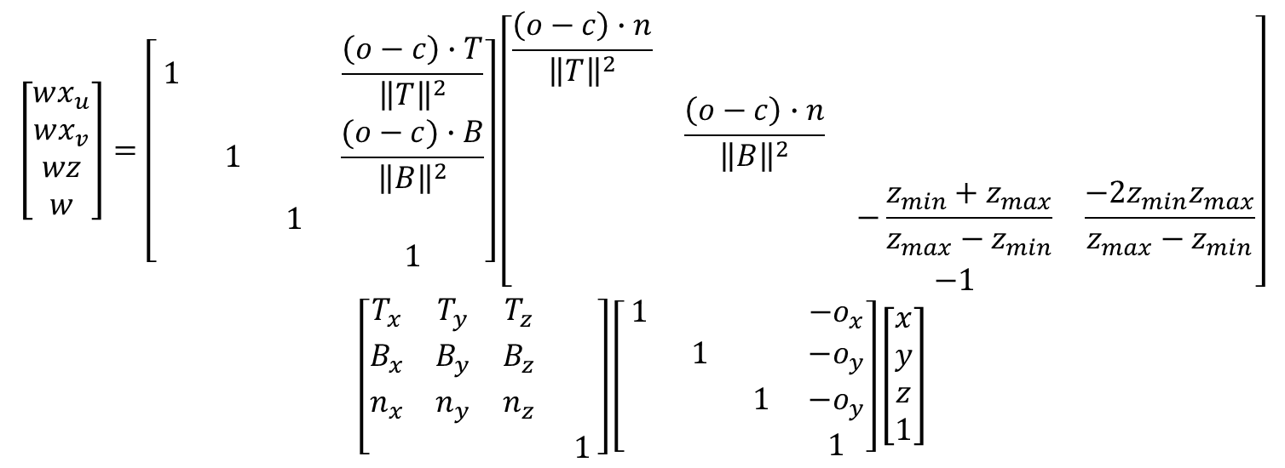



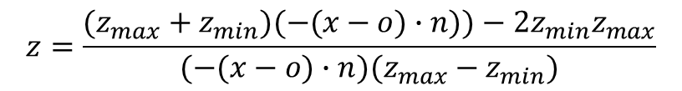
o
Px
n
$$x_{u}=\left(o−c\right)∙\frac{T}{{\left\|T\right\|}^{2}}+\frac{\left(c−o\right)∙n}{(x−o)∙n}(x−o)∙\frac{T}{{\left\|T\right\|}^{2}}$$
x
$$x_{v}=(o−c)∙\frac{B}{{\left\|B\right\|}^{2}}+\frac{\left(c−o\right)∙n}{(x−o)∙n}(x−o)∙\frac{B}{{\left\|B\right\|}^{2}}$$
ｃ
$$x^{′}$$
$$z=\frac{(z_{max}+z_{min})(−(x−o)∙n))−2{z_{min}z}_{max}}{(−(x−o)∙n)(z_{max}−z_{min})}$$
$$T$$
297mm
$$B$$
$$x_{u}=\frac{\left(o−c\right)∙T}{{\left\|T\right\|}^{2}}+{x′}_{u}$$
210mm
$$\left[\begin{matrix}wx_{u} \\ wx_{v} \\ wz \\ w\end{matrix}\right]=\left[\begin{matrix}1 & & & \frac{\left(o−c\right)∙T}{{\left\|T\right\|}^{2}} \\ & 1 & & \frac{(o−c)∙B}{{\left\|B\right\|}^{2}} \\ & & 1 & \\ & & & 1\end{matrix}\right]\left[\begin{matrix}\frac{\left(o−c\right)∙n}{{\left\|T\right\|}^{2}} & & & \\ & \frac{\left(o−c\right)∙n}{{\left\|B\right\|}^{2}} & & \\ & & −\frac{z_{min}+z_{max}}{z_{max}−z_{min}} & \frac{−2z_{min}z_{max}}{z_{max}−z_{min}} \\ & & −1 & \end{matrix}\right]$$
$$\left[\begin{matrix}T_{x} & T_{y} & T_{z} & \\ B_{x} & B_{y} & B_{z} & \\ n_{x} & n_{y} & n_{z} & \\ & & & 1\end{matrix}\right]\left[\begin{matrix}1 & & & −o_{x} \\ & 1 & & −o_{y} \\ & & 1 & −o_{y} \\ & & & 1\end{matrix}\right]\left[\begin{matrix}x \\ y \\ z \\ 1\end{matrix}\right]$$
$$x_{v}=\frac{(o−c)∙B}{{\left\|B\right\|}^{2}}+{x′}_{v}$$
$${x′}_{u}=\frac{\left(c−o\right)∙n}{{\left\|T\right\|}^{2}}\frac{d∙T}{d∙n}$$
$${x′}_{v}=\frac{\left(c−o\right)∙n}{{\left\|B\right\|}^{2}}\frac{d∙B}{d∙n}$$
$$d=x−o$$

Slide 7

射影行列を最後に持ってこなくてはならないので、平行移動の積をひっくり返す
$$\left[\begin{matrix}1 & & & t_{x} \\ & 1 & & t_{y} \\ & & 1 & \\ & & & 1\end{matrix}\right]\left[\begin{matrix}P_{00} & & & \\ & P_{11} & & \\ & & P_{22} & P_{23} \\ & & −1 & \end{matrix}\right]$$
$$=\left[\begin{matrix}P_{00} & & −t_{x} & \\ & P_{11} & −t_{y} & \\ & & P_{22} & P_{23} \\ & & −1 & \end{matrix}\right]$$
$$\left[\begin{matrix}P_{00} & & & \\ & P_{11} & & \\ & & P_{22} & P_{23} \\ & & −1 & \end{matrix}\right]\left[\begin{matrix}1 & & −t_{x}/P_{00} & \\ & 1 & −t_{y}/P_{11} & \\ & & 1 & \\ & & & 1\end{matrix}\right]$$

