Slide 1


SMART INDIA HACKATHON 2026
TITLE PAGE
Problem Statement ID – SIH26056
Problem Statement Title – Real-Time Airfare Price Indexing for Consumer Price Index (CPI) Augmentation
Team ID –
Theme – Smart Automation
PS Category – Software
Team Name – 404 Found

Slide 2

IDEA / APPROACH DETAILS
The Ministry of Statistics and Programme Implementation (MoSPI), via the National Statistical Office (NSO), measures and publishes India's monthly Consumer Price Index (CPI). This index dictates the country's inflation figures and heavily influences the Reserve Bank of India (RBI) when setting
benchmark interest (repo) rates.
CORE INFLATION BLINDSPOT
Extreme Price Elasticity
Outdated Manual Point-in time Sampling
NSO traditionally collected static monthly quotes from physical airline offices, missing the full advance-purchase curve and passenger volume distributions.
Noise & Outlier Pollution
Inter-Ministerial Silos
Downstream decision-makers (RBI Monetary Policy Committee, MoCA, DGCA) lack
real-time, verifiable, automated statistical data feeds.
A ticket bought 1 day before departure (T+1) can cost 300% to 500%
Flash sales, monsoon disruptions, and severe festival surges (Diwali/Chhath)
heavily distort raw average calculations without robust statistical filtering.
More than the exact same seat bought 30
days in advance (T+30).

Slide 3
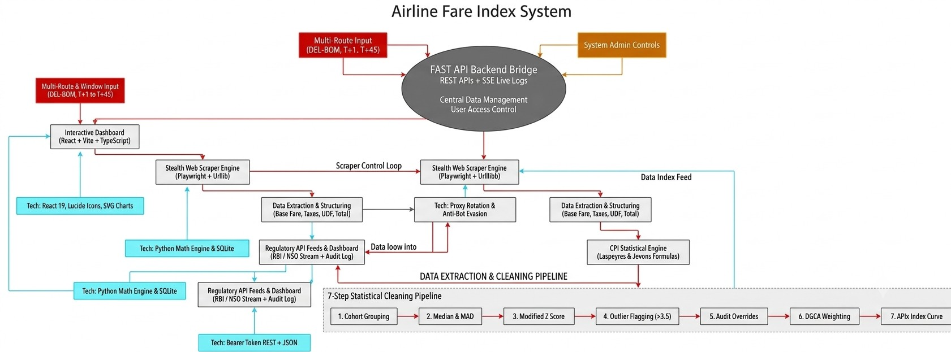
TECHNICAL APPROACH
Error 404
Backend: FastAPI (Python) on Port 3001 — REST API + SSE for real-time scraper log streaming; recalculates CPI after every scrape or override. Frontend: React + TypeScript + Vite — 5-module enterprise dashboard
Tech Stack
React 19 + TypeScript
Vite 8
FastAPI (Python) Playwright
with client-side dynamic index recalculation and interactive SVG charts. Scraping: 3-layer architecture — mock portal server, standard HTTP scraper (rate-limited, proxy/UA rotation), and Playwright stealth scraper with anti-detection patches.
Storage: SQLite (flights, index_history, overrides, settings) — auto-seeds 35+ days of historical data on startup.
SQLite
Server-Sent Events
PyTest
Lucide Icons
404 FOUND

Slide 4
FEASIBILITY AND VIABILITY
Error 404
Feasibility
Viability
Technical Feasibility
Proven Stack: Built with lightweight, high-performance tech (FastAPI, React 19, SQLite/Postgres).
Stealth Ingestion: Playwright headless scraping with proxy rotation bypasses bot blockers reliably.
Zero-Downtime Design: Includes a mock portal fallback engine for offline testing and 100% demo stability.
Economic Feasibility
Near-Zero Data Costs: Replaces expensive GDS API licenses (Amadeus/Sabre) with automated web extraction.
Massive Cost Savings: Eliminates manual survey field visits, cutting operational costs by
~90%.
Cloud-Ready: Lightweight containerized setup (Docker) deployable on NIC/MeghRaj government cloud.
Operational Feasibility
Zero Coding Needed: Statisticians tune CPI weights & toggle formulas via intuitive UI sliders. Human-in-the-Loop: Outlier Audit Hub lets officers review & override flagged anomalies with mandatory audit notes.
Plug-and-Play APIs: Delivers token-secured REST feeds directly to RBI & MoCA dashboards.
Legal & Ethical Feasibility
Strict Compliance: Adheres to robots.txt and rate-limiting (10 req/min) to avoid target server load.
Public Data Only: Scrapes only unauthenticated public fare quotes—zero PII or private data involved.
Long-Term Strategic Viability
Government Alignment: Perfectly aligns with the Digital India and Data-Driven Governance mandates by modernizing NSO's 60-year-old manual CPI collection method. Critical National Utility: Directly empowers the Reserve Bank of India (RBI) Monetary Policy Committee with high-frequency inflation data to set accurate national interest (repo) rates.
Financial & Resource Sustainability
Zero Recurring Licensing Fees: Avoids costly commercial aviation API subscriptions (Amadeus/IATA) by leveraging open-source stealth extraction.
Low Maintenance Overhead: Automated pipeline requires minimal technical intervention, allowing small NSO IT teams to manage national-scale deployment effortlessly.
Market & Institutional Adoption
High Inter-Ministerial Demand: Serves multiple government stakeholders simultaneously:
MoSPI / NSO: Official CPI inflation reporting.
MoCA & DGCA: Monitoring surge pricing during disasters or festival seasons.
CCI (Competition Commission): Detecting potential airline cartelization on duopoly routes.
Scalability & Extensibility
Nationwide Sector Expansion: Modular architecture seamlessly scales from 6 corridors to 1,500+ domestic routes, including subsidized UDAN regional flights.

Slide 5
IMPACT AND BENEFITS
Error 404
Impact on Stakeholders
Benefits
MoSPI / NSO: automated real-time airfare data replaces manual monthly surveys, improving CPI accuracy.
RBI Monetary Policy Committee: more precise transport-inflation input for repo-rate decisions affecting 1.4 billion people.
DGCA & MoCA: real-time fare visibility supports consumer-protection enforcement and fare-policy design.
Citizens: a more accurate inflation measure feeds into fairer interest rates on loans and deposits.
Structurally corrects a known blind spot in the CPI Services Basket (Transport & Communication sub-group).
Full advance-purchase yield curve (T+1 to T+45) instead of one static monthly quote. Robust outlier governance — legitimate surges are kept, genuine anomalies are excluded.
Complete audit-compliance trail builds institutional trust and transparency.
Secure REST API makes the index directly consumable by RBI/NSO systems, closing inter-ministerial data silos.

Slide 6
RESEARCH AND REFERENCES
Error 404
MoSPI — Consumer Price Index Methodology
Source: Ministry of Statistics & Programme Implementation — https://www.mospi.gov.in
IMF Consumer Price Index Manual (Jevons index guidance)
Source: International Monetary Fund — https://www.imf.org/en/Data/Statistics/cpi-manual
DGCA Domestic Air Traffic & Fare Data
Source: Directorate General of Civil Aviation — https://www.dgca.gov.in
RBI Monetary Policy Framework
Source: Reserve Bank of India — https://www.rbi.org.in
FastAPI Documentation
Backend framework reference — https://fastapi.tiangolo.com
Playwright Documentation
Browser automation / scraping reference — https://playwright.dev

