Slide 1




Low quality genotype data is not appropriate for family-based analyses
Mahdi Mir (UCLA & SSGAC) Alexander S. Young (UCLA & SSGAC) Oct 2024

Slide 2
Motivation
We are concerned that the low-quality imputed genotypes may not be suitable for family-based analyses.
FGWAS is designed to leverage Mendelian inheritance as a clean natural experiment to obtain unbiased estimates, but with imputation we may lose that.
Notes:
Our motivation is

Slide 3
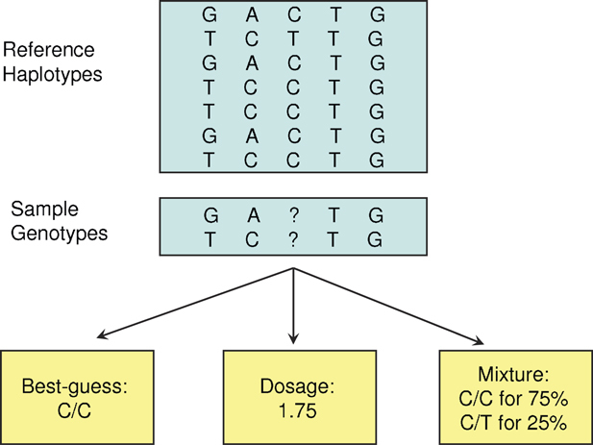
Imputation from a Reference Panel
Hard Call
Source: Zheng et al. (2011)

Slide 4
Reference Based vs Mendelian Imputation
Mendelian imputation, as implemented in SNIPAR (Young et al., Nature Genetics, 2022), differs entirely from reference-based imputation.
Reference-based imputation does not consider the relationships between individuals and performs the imputation for everyone separately.

Slide 5
Correlation Analysis in UK Biobank
UK BioBank Imputed Data
SNPs with MAF > 1%
Info Score (Imputation Quality) > 30%
70K SNPs
White British Subsample
19K Full Siblings Pairs
4K Parent-Offspring Pairs
Howe et.al (2022) Sib-GWAS used low-quality imputed SNPs (Info Score > 30%, Hard Calls).

Slide 6
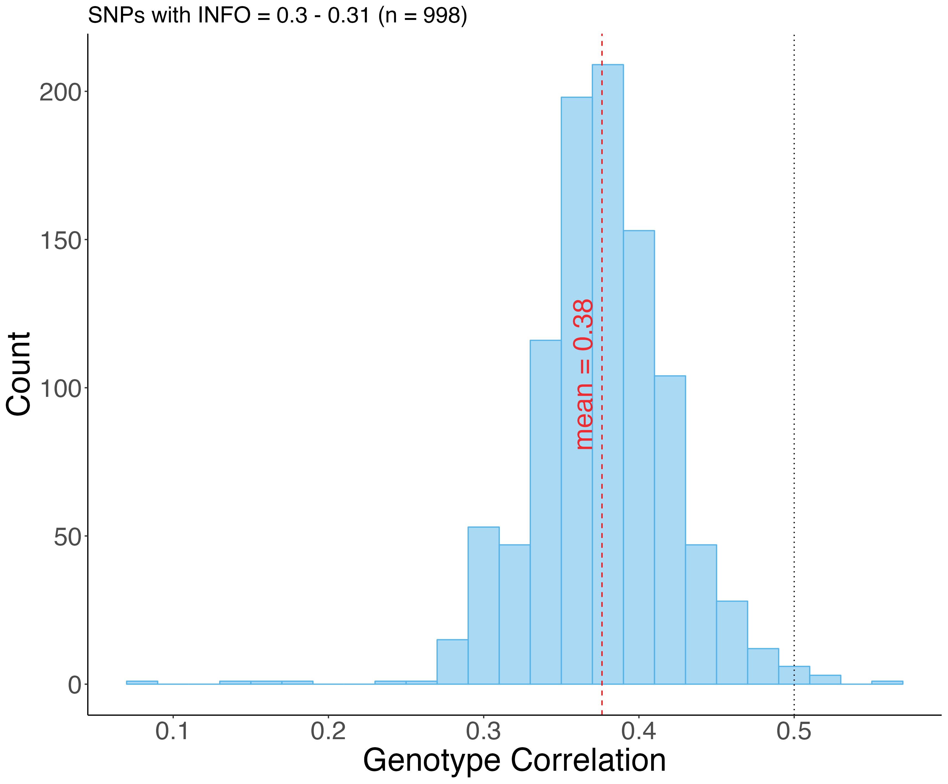
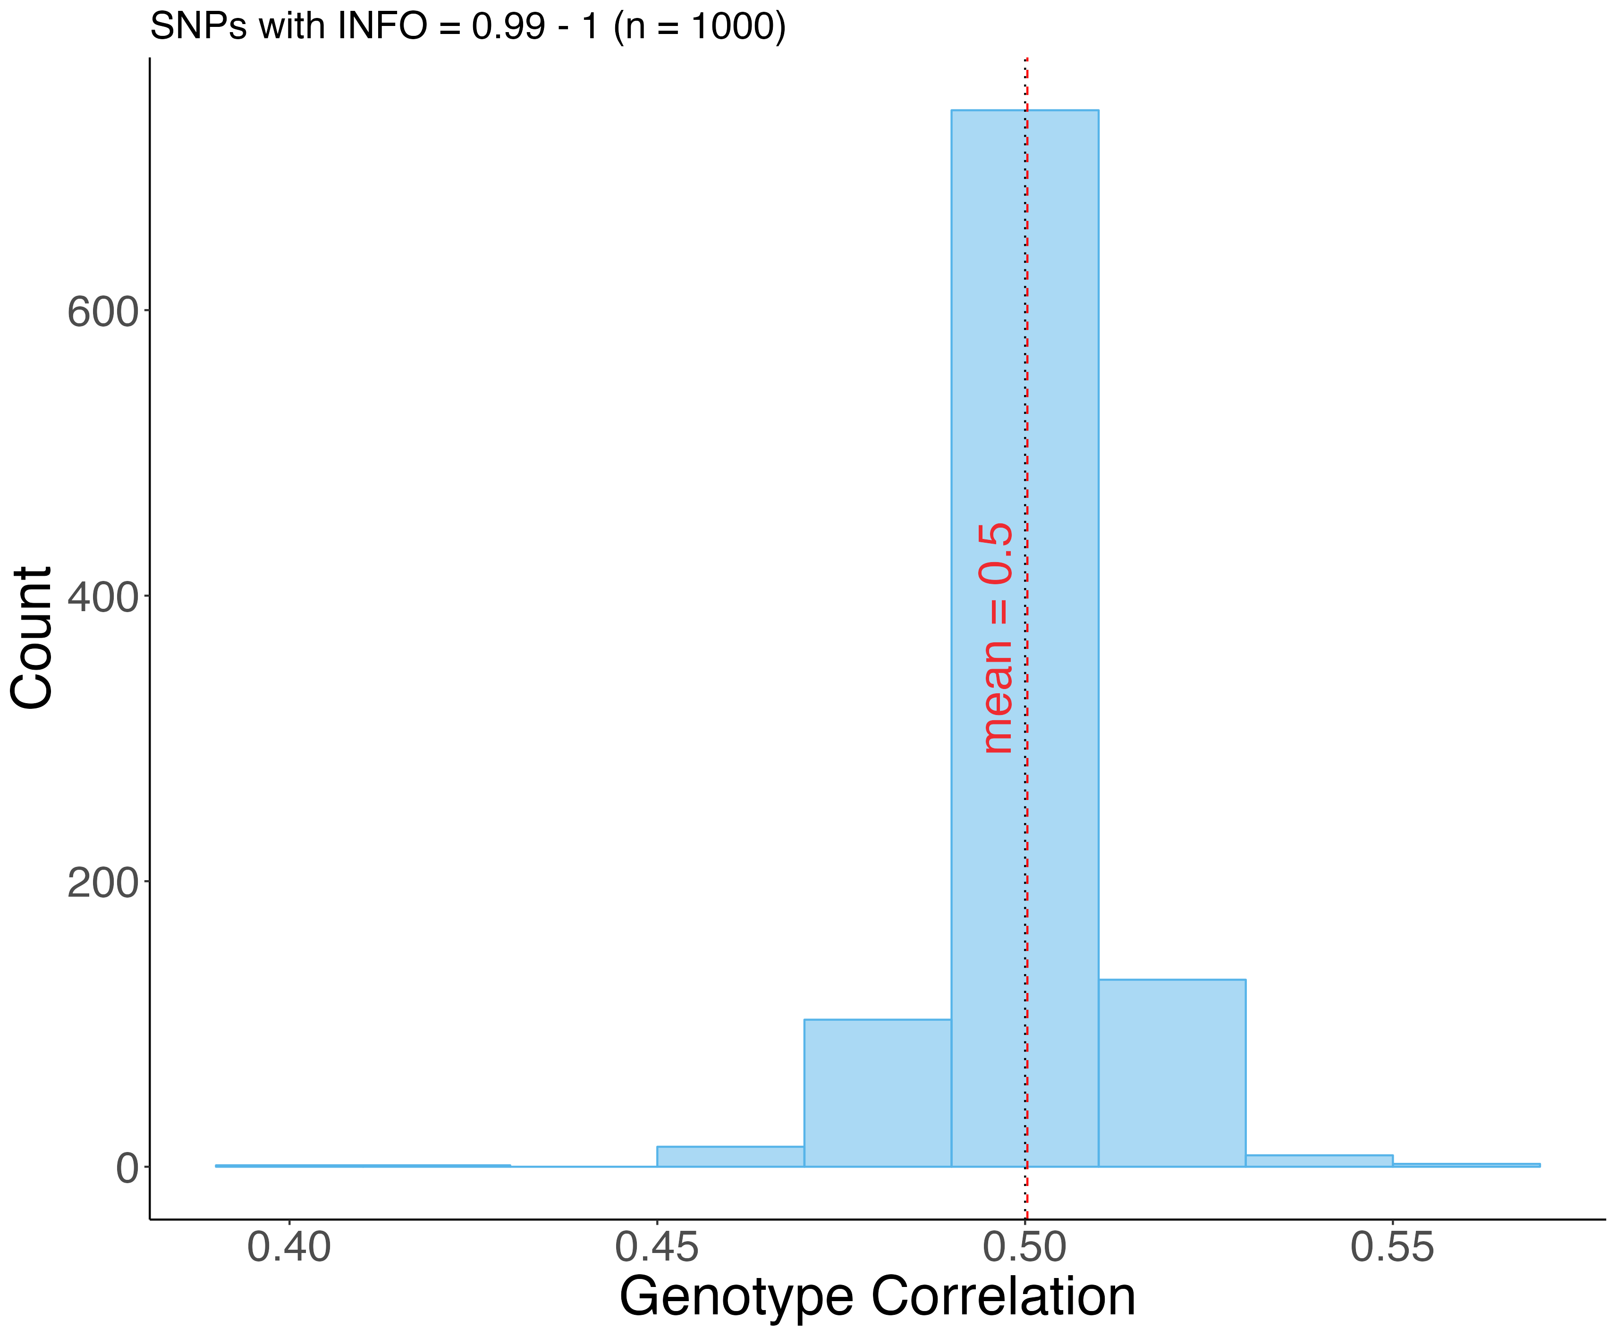
Correlations Distribution – Full Sibs
Low Quality Imputed
High Quality Imputed

Slide 7
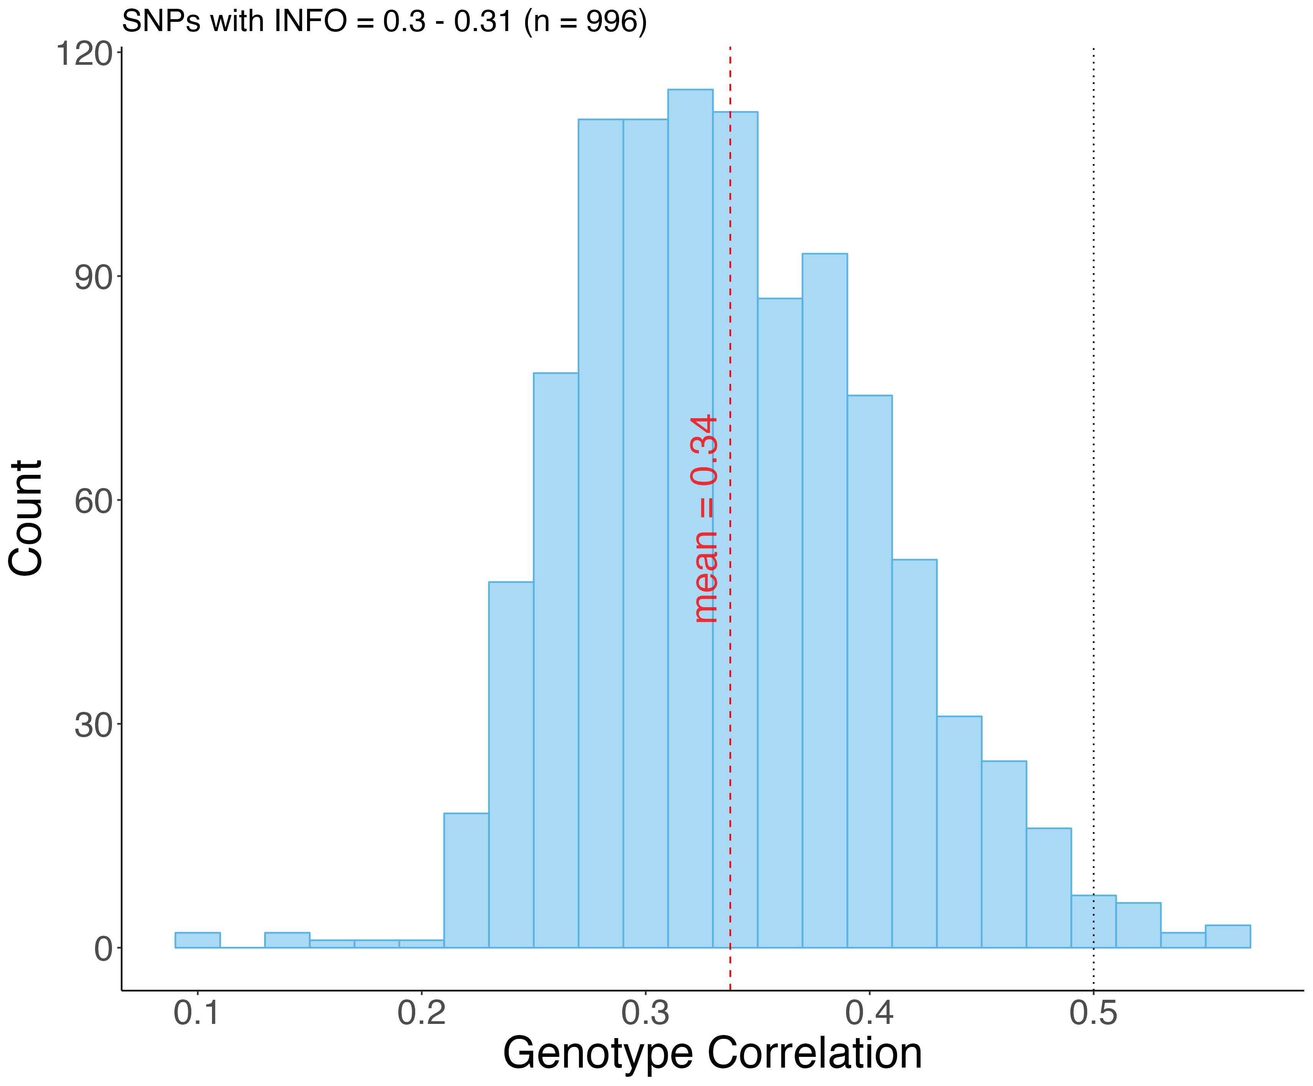
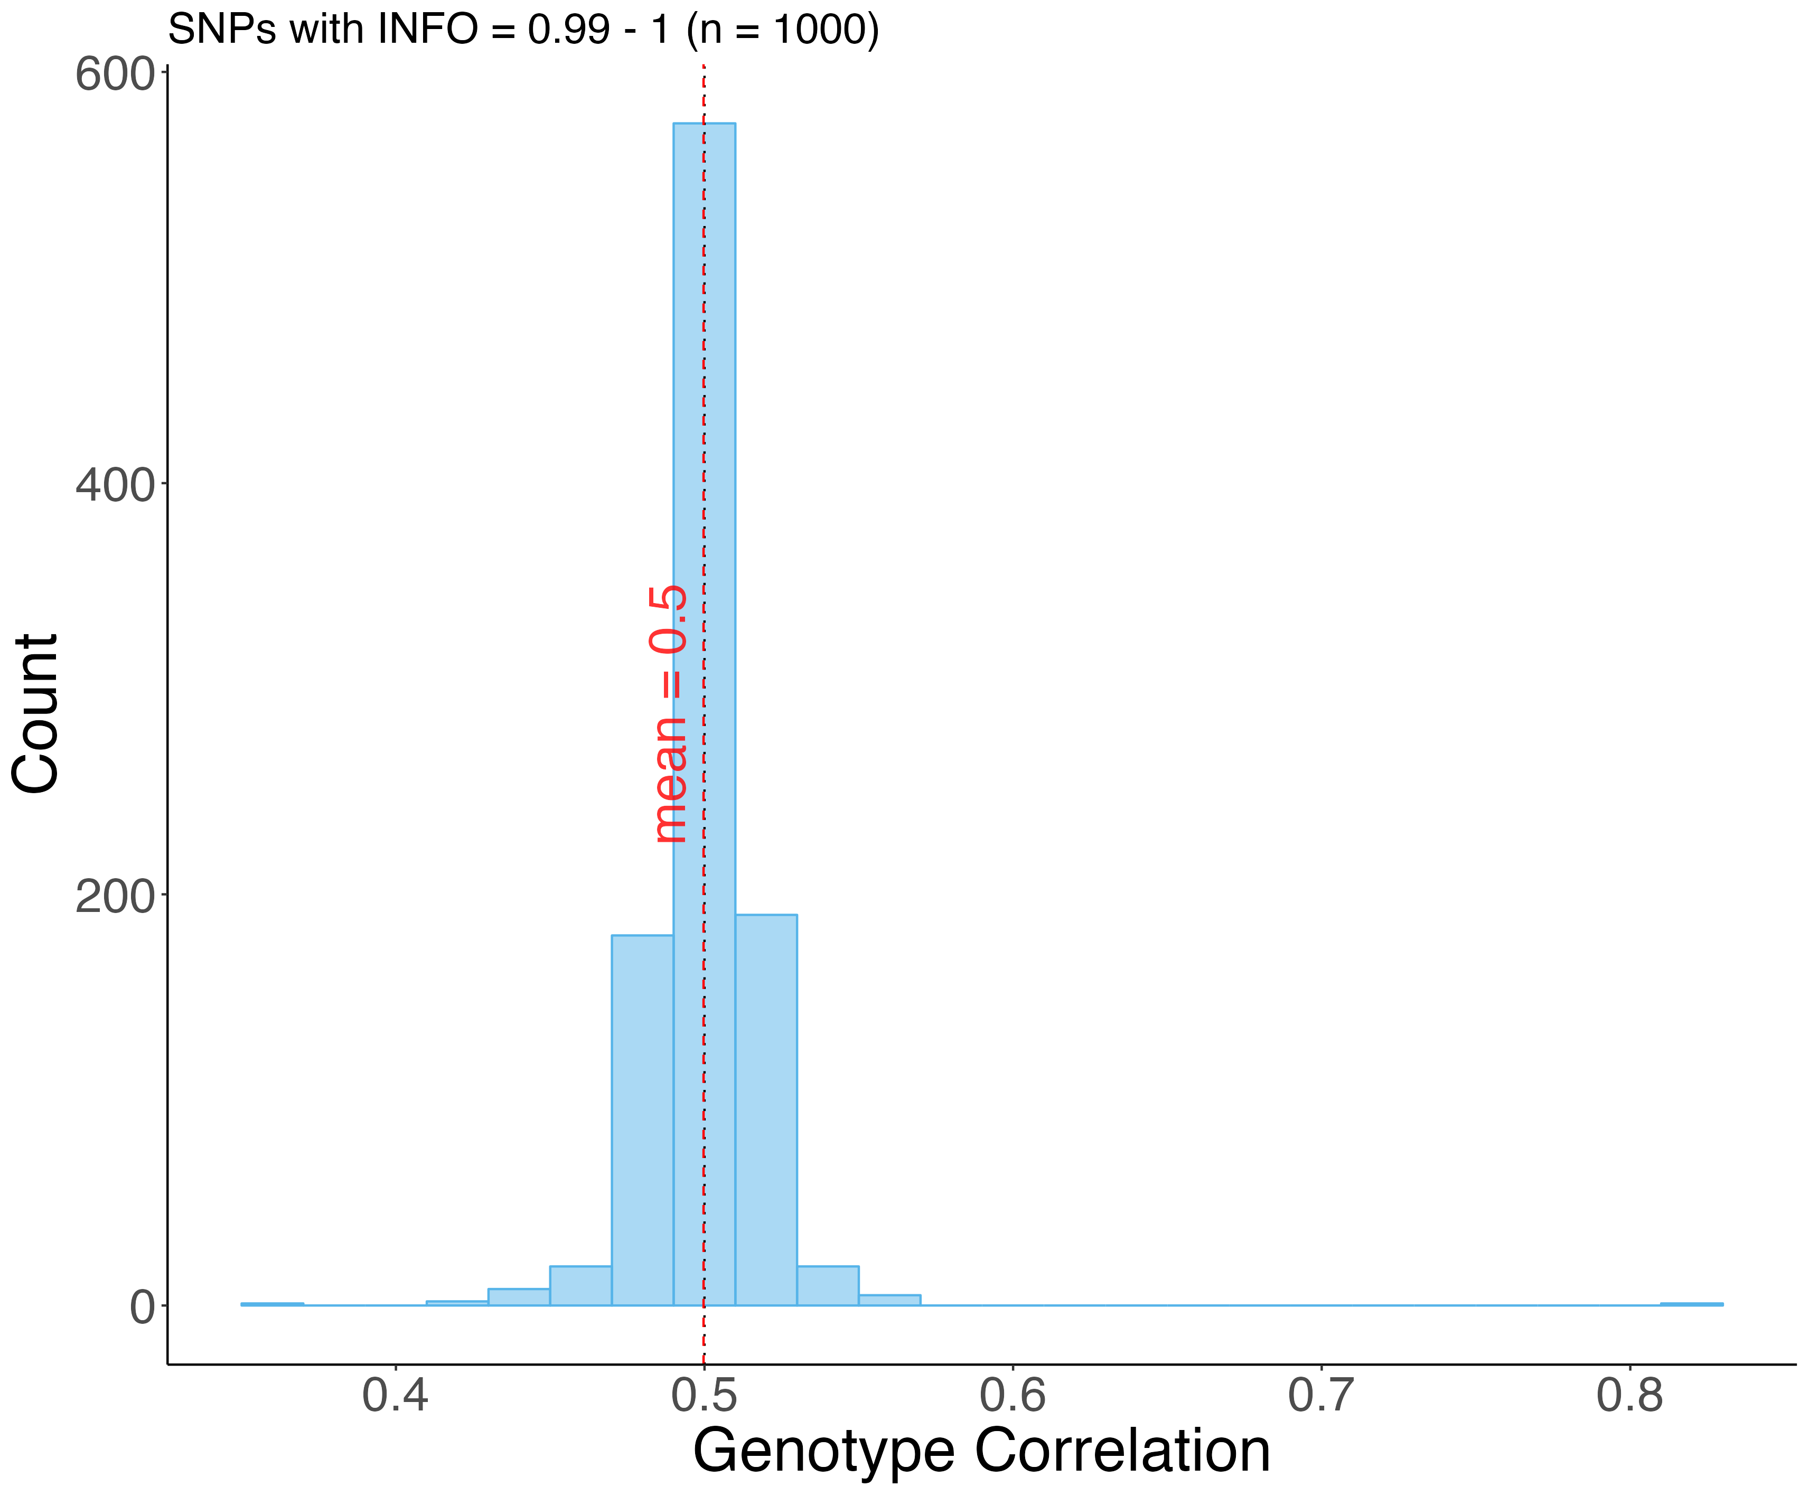
Correlations Distribution – Parent-Offspring
Low Quality Imputed
High Quality Imputed

Slide 8
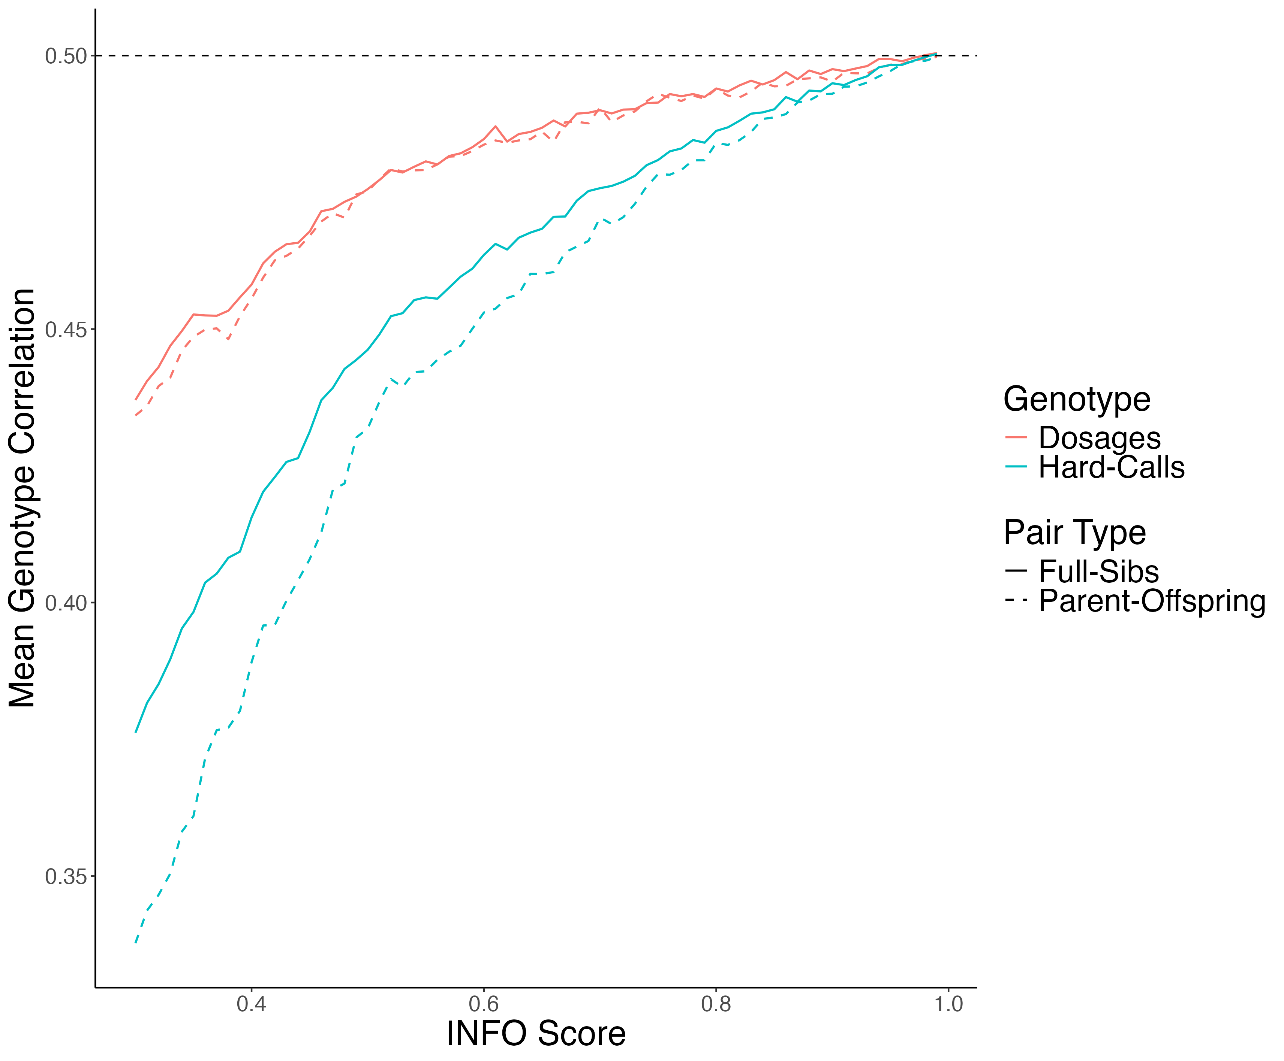
Mean Genotype Correlation

Slide 9

Correlation Analysis Conditional on IBD States
Quantitative genetics theory tells us the correlation between siblings’ genotypes depends on their IBD state.
IBD state records how many alleles they share by descent from their parents.
Suppose i and j are full siblings. Then in theory (under random-mating) we have:
$$\begin{matrix}Corr⁡\left(G_{i},G_{j}∣IBD=0\right)=0 \\ Corr⁡\left(G_{i},G_{j }| IBD=1\right)=0.5 \\ Corr⁡\left(G_{i},G_{j}∣IBD=2\right)=1\end{matrix}$$

Slide 10
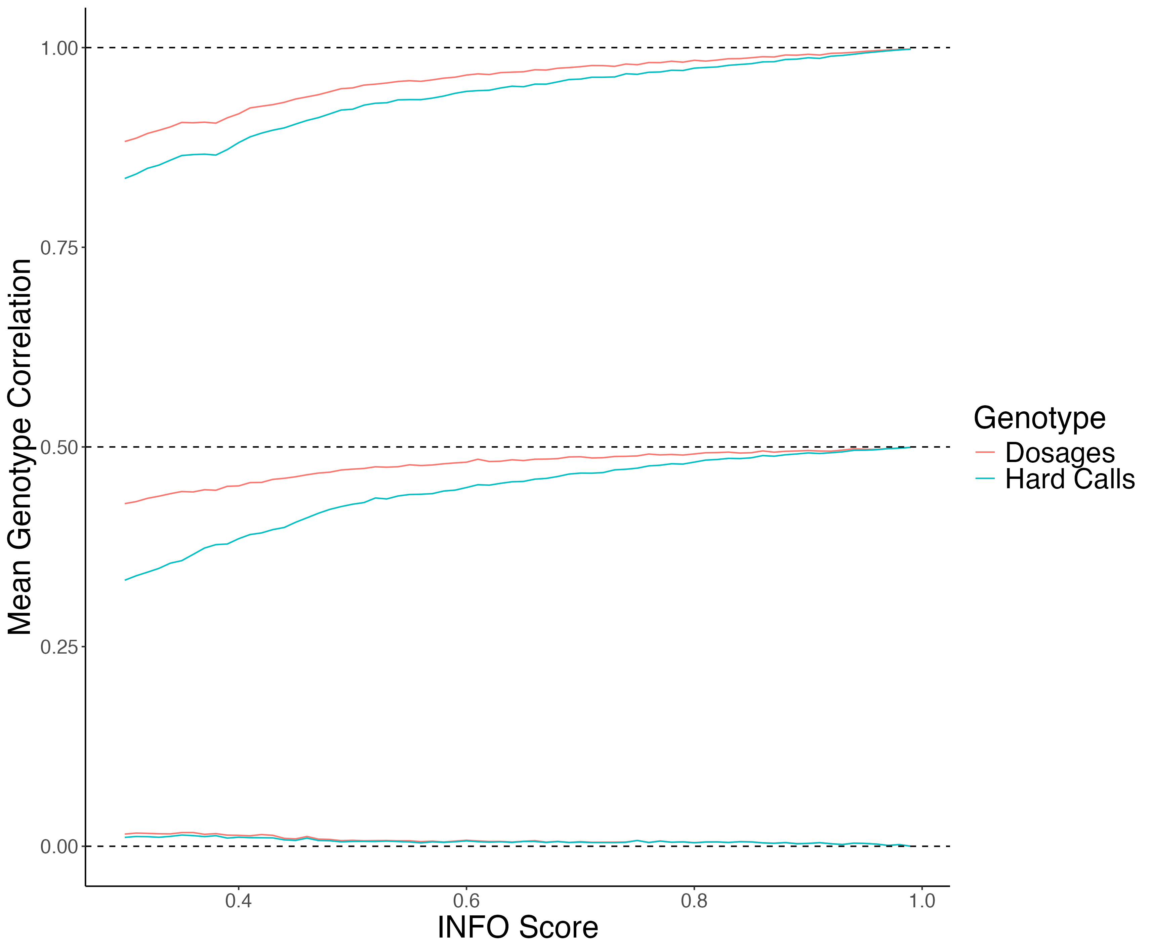
Mean Imputed Genotype Correlation Conditional on IBD State

Slide 11
Mean Imputed Genotype Correlation Conditional on IBD State
IBD = 2

Slide 12
Mean Imputed Genotype Correlation Conditional on IBD State
IBD = 1

Slide 13
Mean Imputed Genotype Correlation Conditional on IBD State
IBD = 0

Slide 14

Conclusion
Genotypes imputed from a reference panel do not preserve Mendelian laws except for the very highest quality imputed variants.
In practice with FGWAS, using imputed data, we can't ensure proper controls and unbiased estimates due to missing key data features.
Stringent quality control is required for family-based analyses using imputed genotype data.

Slide 15
Next Steps
We are working with WGS data to see the downstream effect of using low-quality imputed genotypes in FGWAS.
Also, we are interested in developing reference-based imputation methods that consider the relationships between individuals and Mendelian laws.

Slide 16
THANK YOU!

