Slide 1
Reliability of imputed genotype data for family-based analyses
Mahdi Mir, Alexander S. Young

Slide 2
Motivation
We are concerned that the low-quality imputed genotypes may not be suitable for family-based analyses.
FGWAS is designed to leverage Mendelian inheritance as a clean natural experiment to obtain unbiased estimates, but with imputation we may lose that.
Notes:
Our motivation is

Slide 3
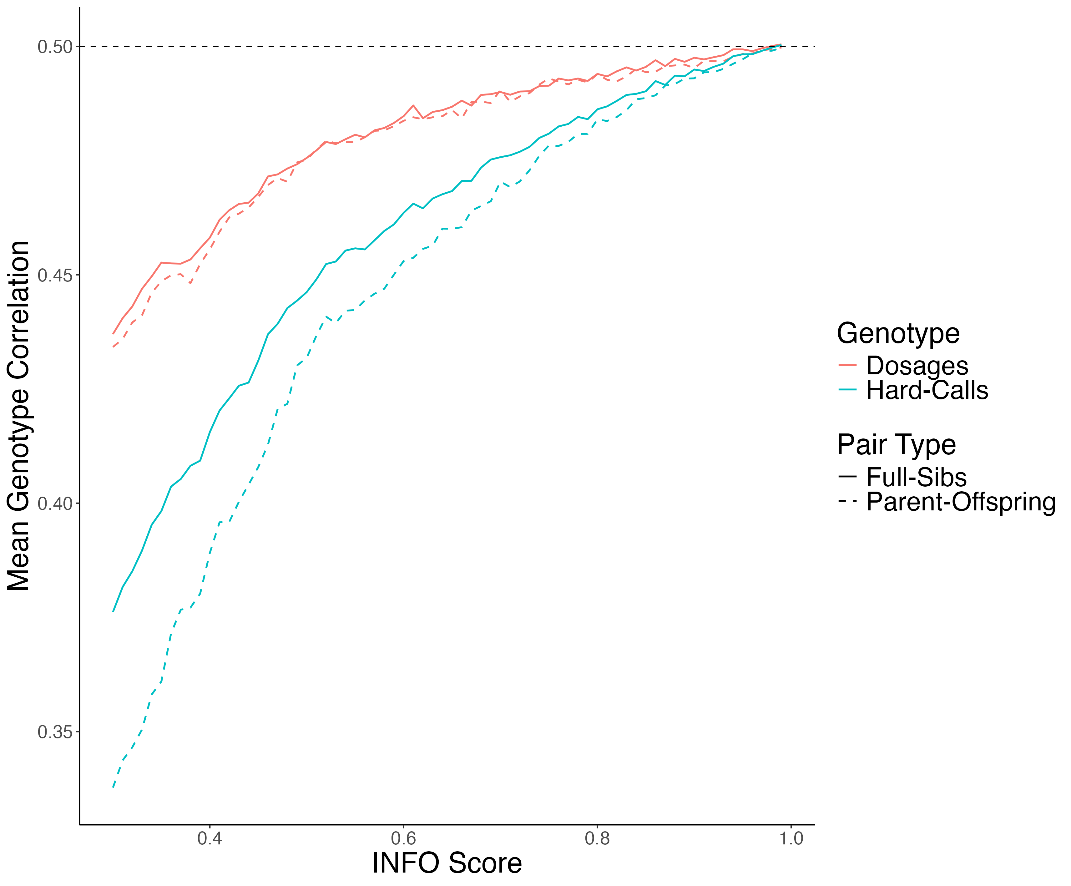
Mean Genotype Correlation

Slide 4

Sib Differences with Imputed Genotypes
For a sibling pair from family $i$, the model is:
$$\begin{matrix} & Y_{i1}=δg_{i1}+αg_{par(i)}+ϵ_{i1} \\ & Y_{i2}=δg_{i2}+αg_{par(i)}+ϵ_{i2}\end{matrix}$$

Slide 5
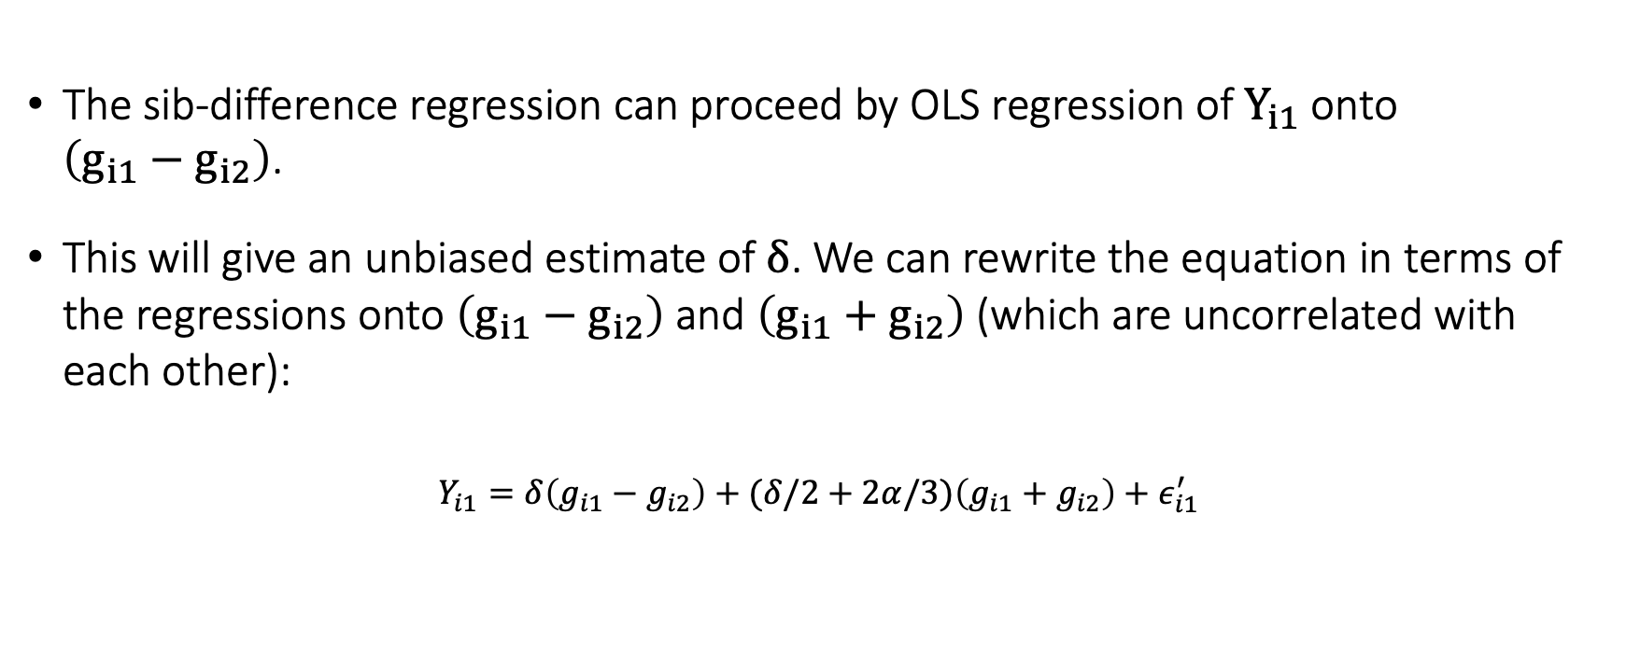
Sib Differences with Imputed Genotypes
The sib-difference regression can proceed by OLS regression of $Y_{i1}$ onto $\left(g_{i1}−g_{i2}\right)$.
This will give an unbiased estimate of $δ$. We can rewrite the equation in terms of the regressions onto $\left(g_{i1}−g_{i2}\right)$ and $\left(g_{i1}+g_{i2}\right)$ (which are uncorrelated with each other):
$$Y_{i1}=δ\left(g_{i1}−g_{i2}\right)+(δ/2+2α/3)\left(g_{i1}+g_{i2}\right)+ε_{i1}^{′}$$

Slide 6

Sib Differences with Imputed Genotypes
for some $ϵ_{i1}^{′}$ uncorrelated with $\left(g_{i1}−g_{i2}\right)$ and $\left(g_{i1}+g_{i2}\right)$. We can then ask what we would obtain if we instead performed regression onto the difference in imputed sibling genotypes:
$$\frac{Cov⁡\left(Y_{i1},{\overset{ˆ}{g}}_{i1}−{\overset{ˆ}{g}}_{i2}\right)}{Var⁡\left({\overset{ˆ}{g}}_{i1}−{\overset{ˆ}{g}}_{i2}\right)}=δ\frac{Cov⁡\left(g_{i1}−g_{i2},{\overset{ˆ}{g}}_{i1}−{\overset{ˆ}{g}}_{i2}\right)}{Var⁡\left({\overset{ˆ}{g}}_{i1}−{\overset{ˆ}{g}}_{i2}\right)}+(δ/2+2α/3)\frac{Cov⁡\left(g_{i1}+g_{i2},{\overset{ˆ}{g}}_{i1}−{\overset{ˆ}{g}}_{i2}\right)}{Var⁡\left({\overset{ˆ}{g}}_{i1}−{\overset{ˆ}{g}}_{i2}\right)}+\frac{Cov⁡\left(ε_{i1}^{′},{\overset{ˆ}{g}}_{i1}−{\overset{ˆ}{g}}_{i2}\right)}{Var⁡\left({\overset{ˆ}{g}}_{i1}−{\overset{ˆ}{g}}_{i2}\right)}$$

Slide 7
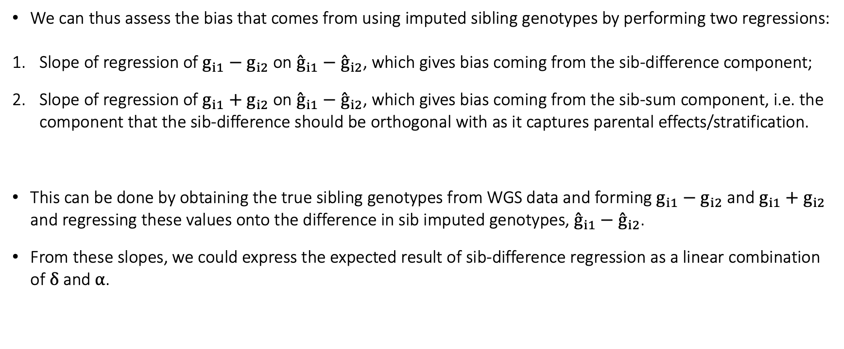
Sib Differences with Imputed Genotypes
We can thus assess the bias that comes from using imputed sibling genotypes by performing two regressions:
Slope of regression of $g_{i1}−g_{i2}$ on ${\overset{ˆ}{g}}_{i1}−{\overset{ˆ}{g}}_{i2}$, which gives bias coming from the sib-difference component;
Slope of regression of $g_{i1}+g_{i2}$ on ${\overset{ˆ}{g}}_{i1}−{\overset{ˆ}{g}}_{i2}$, which gives bias coming from the sib-sum component, i.e. the component that the sib-difference should be orthogonal with as it captures parental effects/stratification.
This can be done by obtaining the true sibling genotypes from WGS data and forming $g_{i1}−g_{i2}$ and $g_{i1}+g_{i2}$ and regressing these values onto the difference in sib imputed genotypes, ${\overset{ˆ}{g}}_{i1}−{\overset{ˆ}{g}}_{i2}$.
From these slopes, we could express the expected result of sib-difference regression as a linear combination of $δ$ and $α$.

Slide 8

Sib Differences with Imputed Genotypes
$g_{i1}−g_{i2}=a+b ({\overset{ˆ}{g}}_{i1}−{\overset{ˆ}{g}}_{i2})$ (Minus Models)
$g_{i1}+g_{i2}=a+b ({\overset{ˆ}{g}}_{i1}−{\overset{ˆ}{g}}_{i2})$ (Plus Models)

Slide 9
Sample
68 High Quality Imputed SNPs, mean INFO score = 96%
46 Low Quality Imputed SNPs, mean INFO score = 31%
19,052 White British Sibling Pairs from UKB
MAF > 1%
Only bi-allelic SNPs

Slide 10
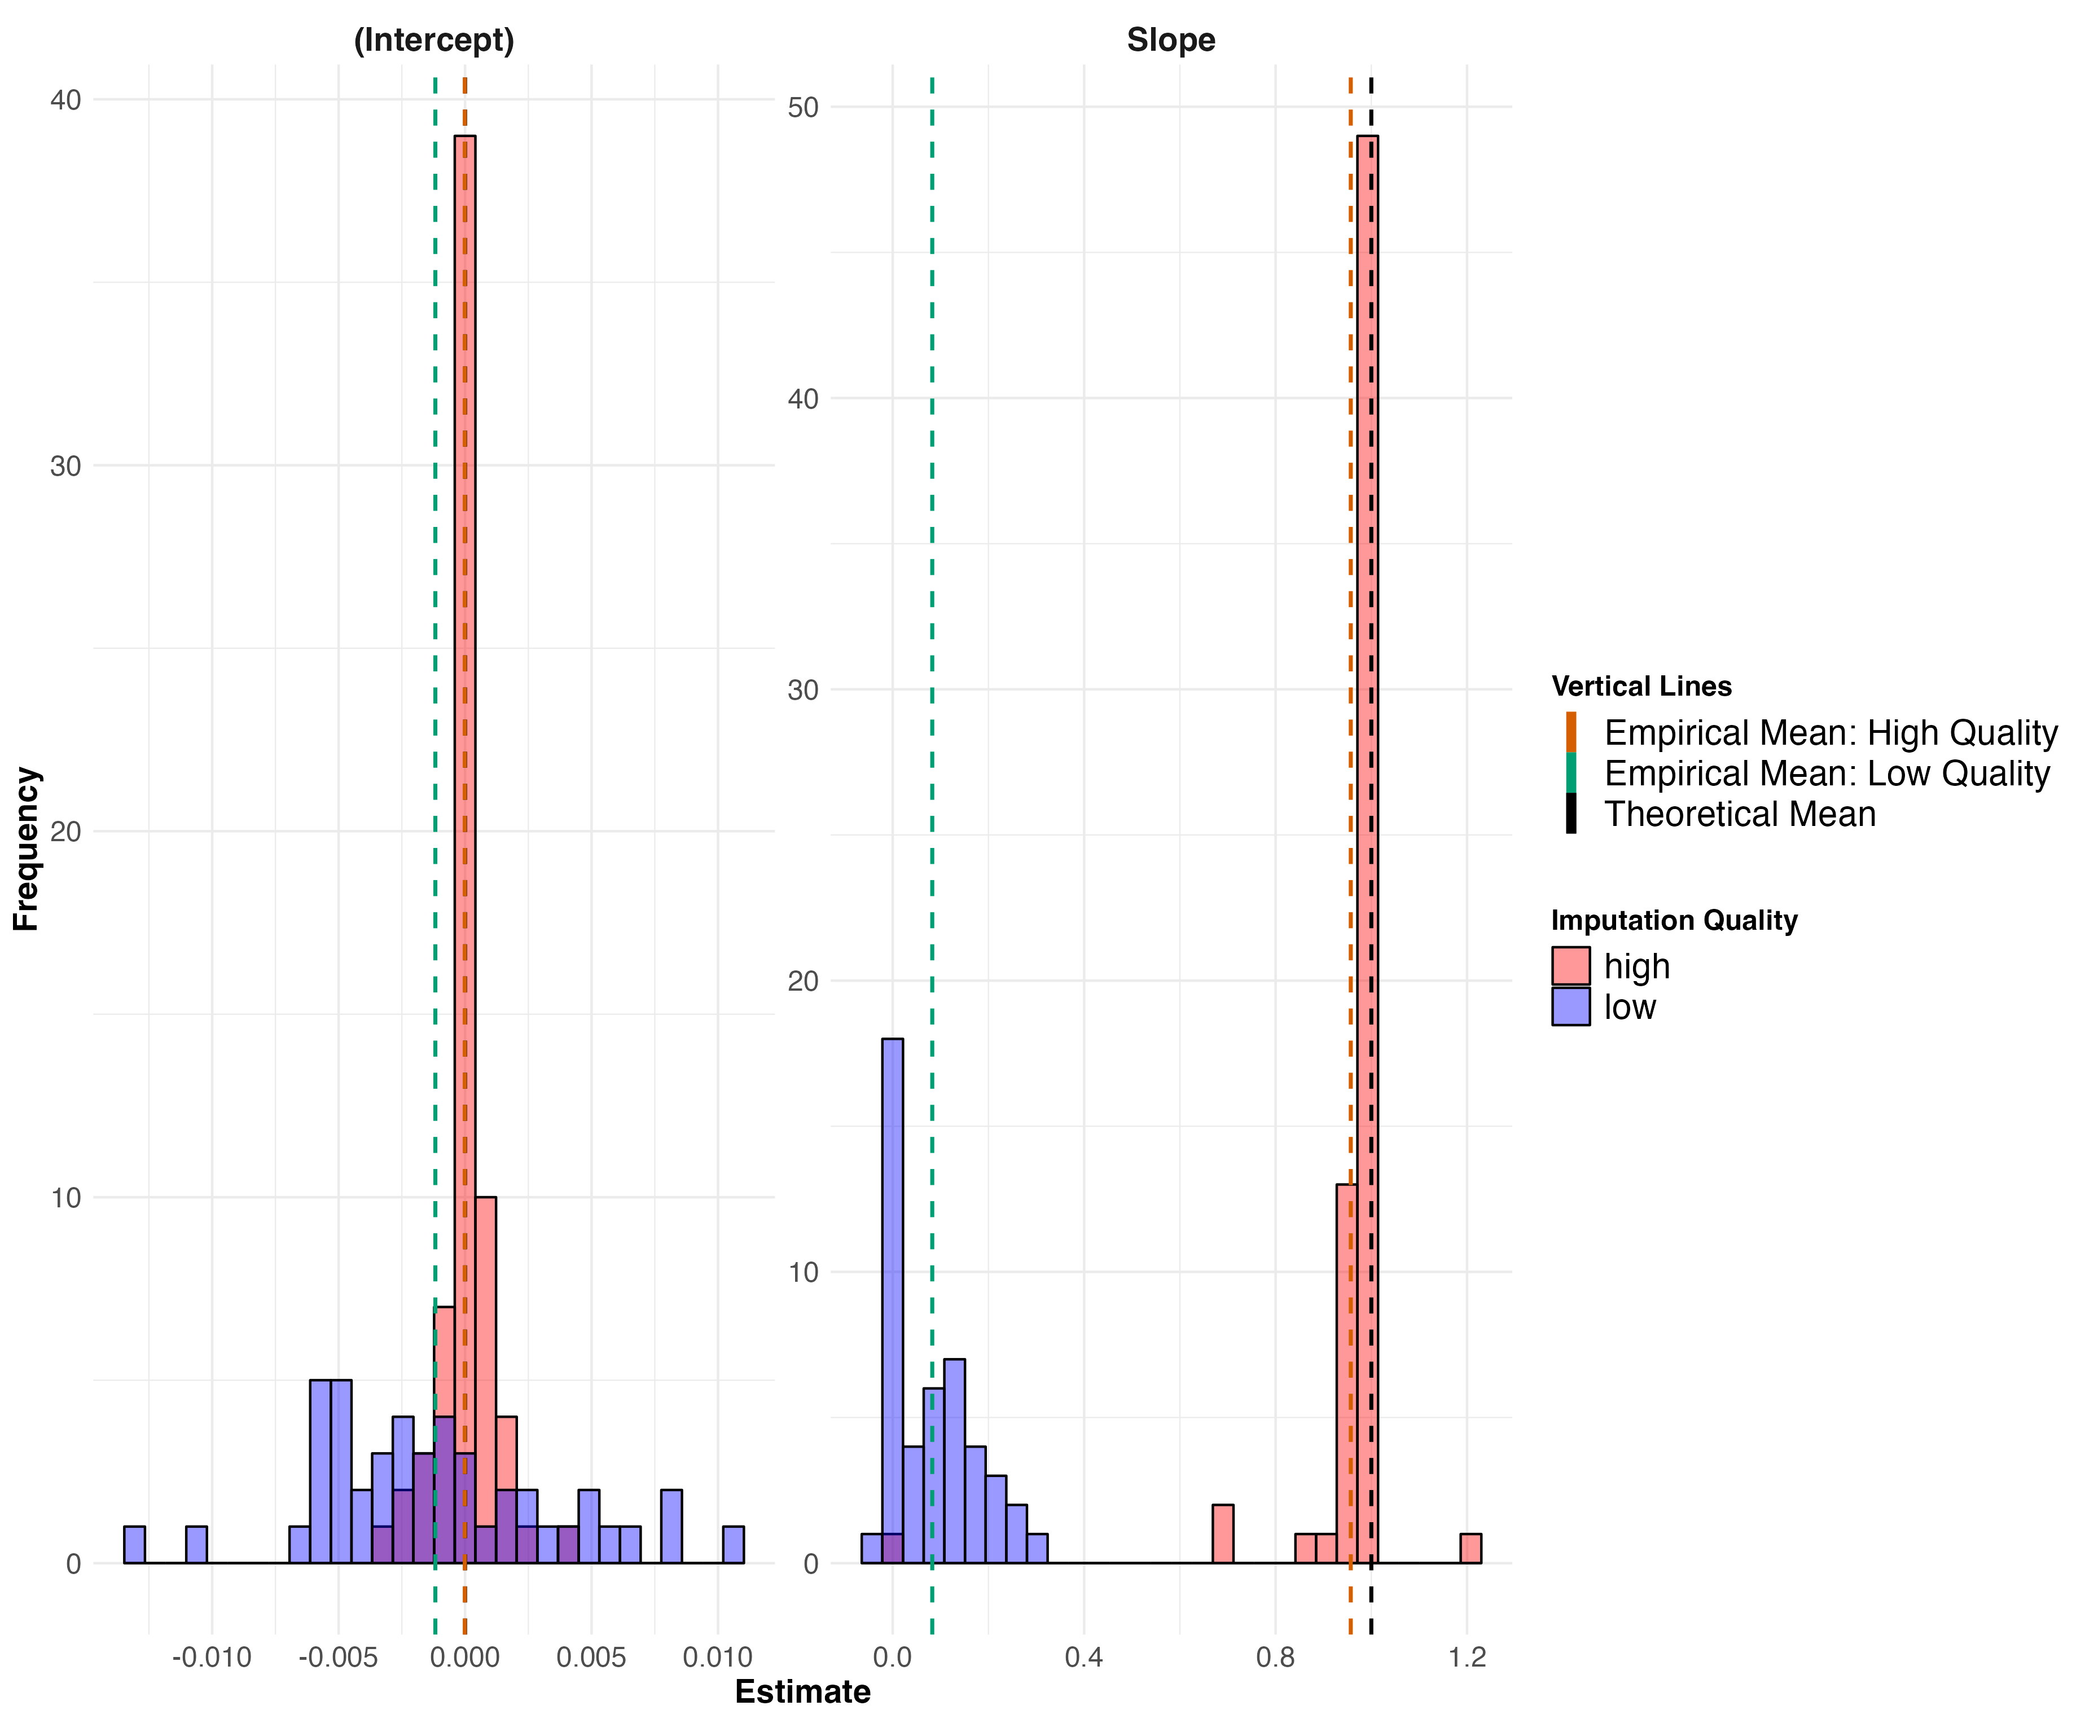
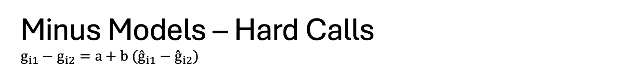
Minus Models – Hard Calls $$g_{i1}−g_{i2}=a+b ({\overset{ˆ}{g}}_{i1}−{\overset{ˆ}{g}}_{i2})$$

Slide 11
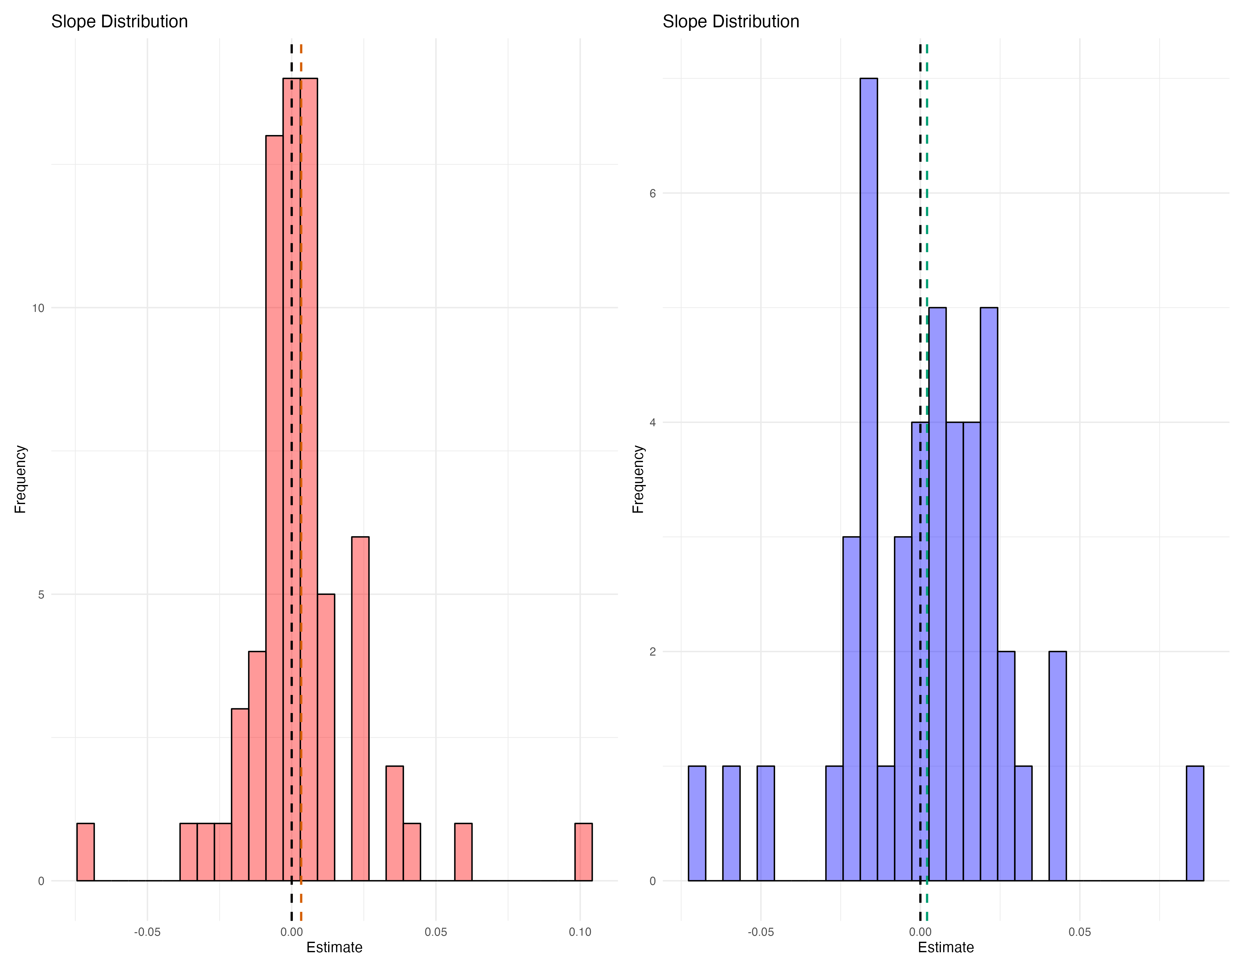
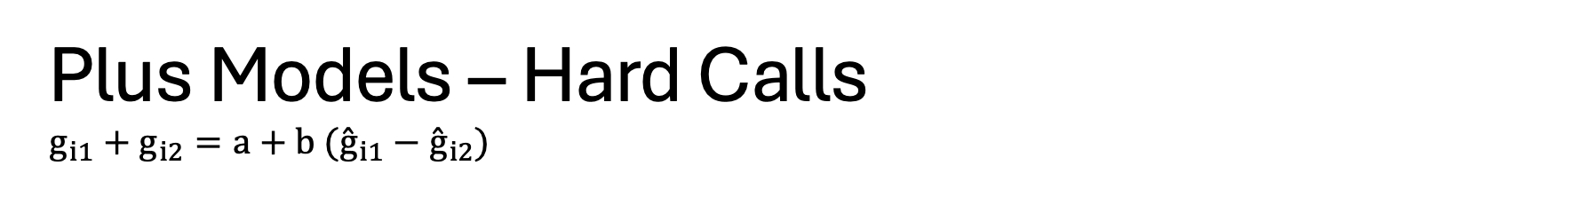
Plus Models – Hard Calls $$g_{i1}+g_{i2}=a+b ({\overset{ˆ}{g}}_{i1}−{\overset{ˆ}{g}}_{i2})$$

Slide 12
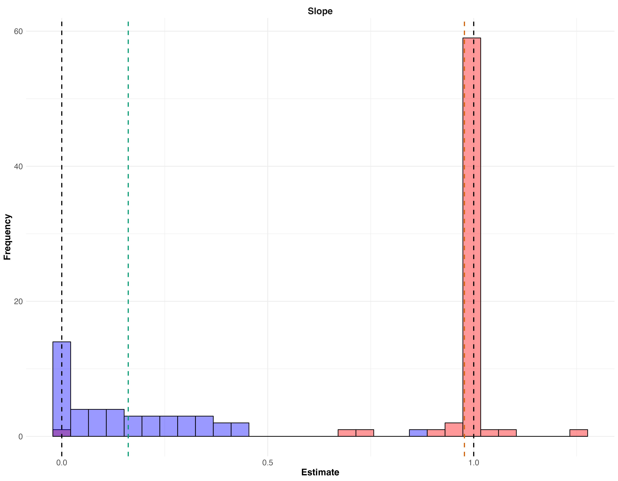
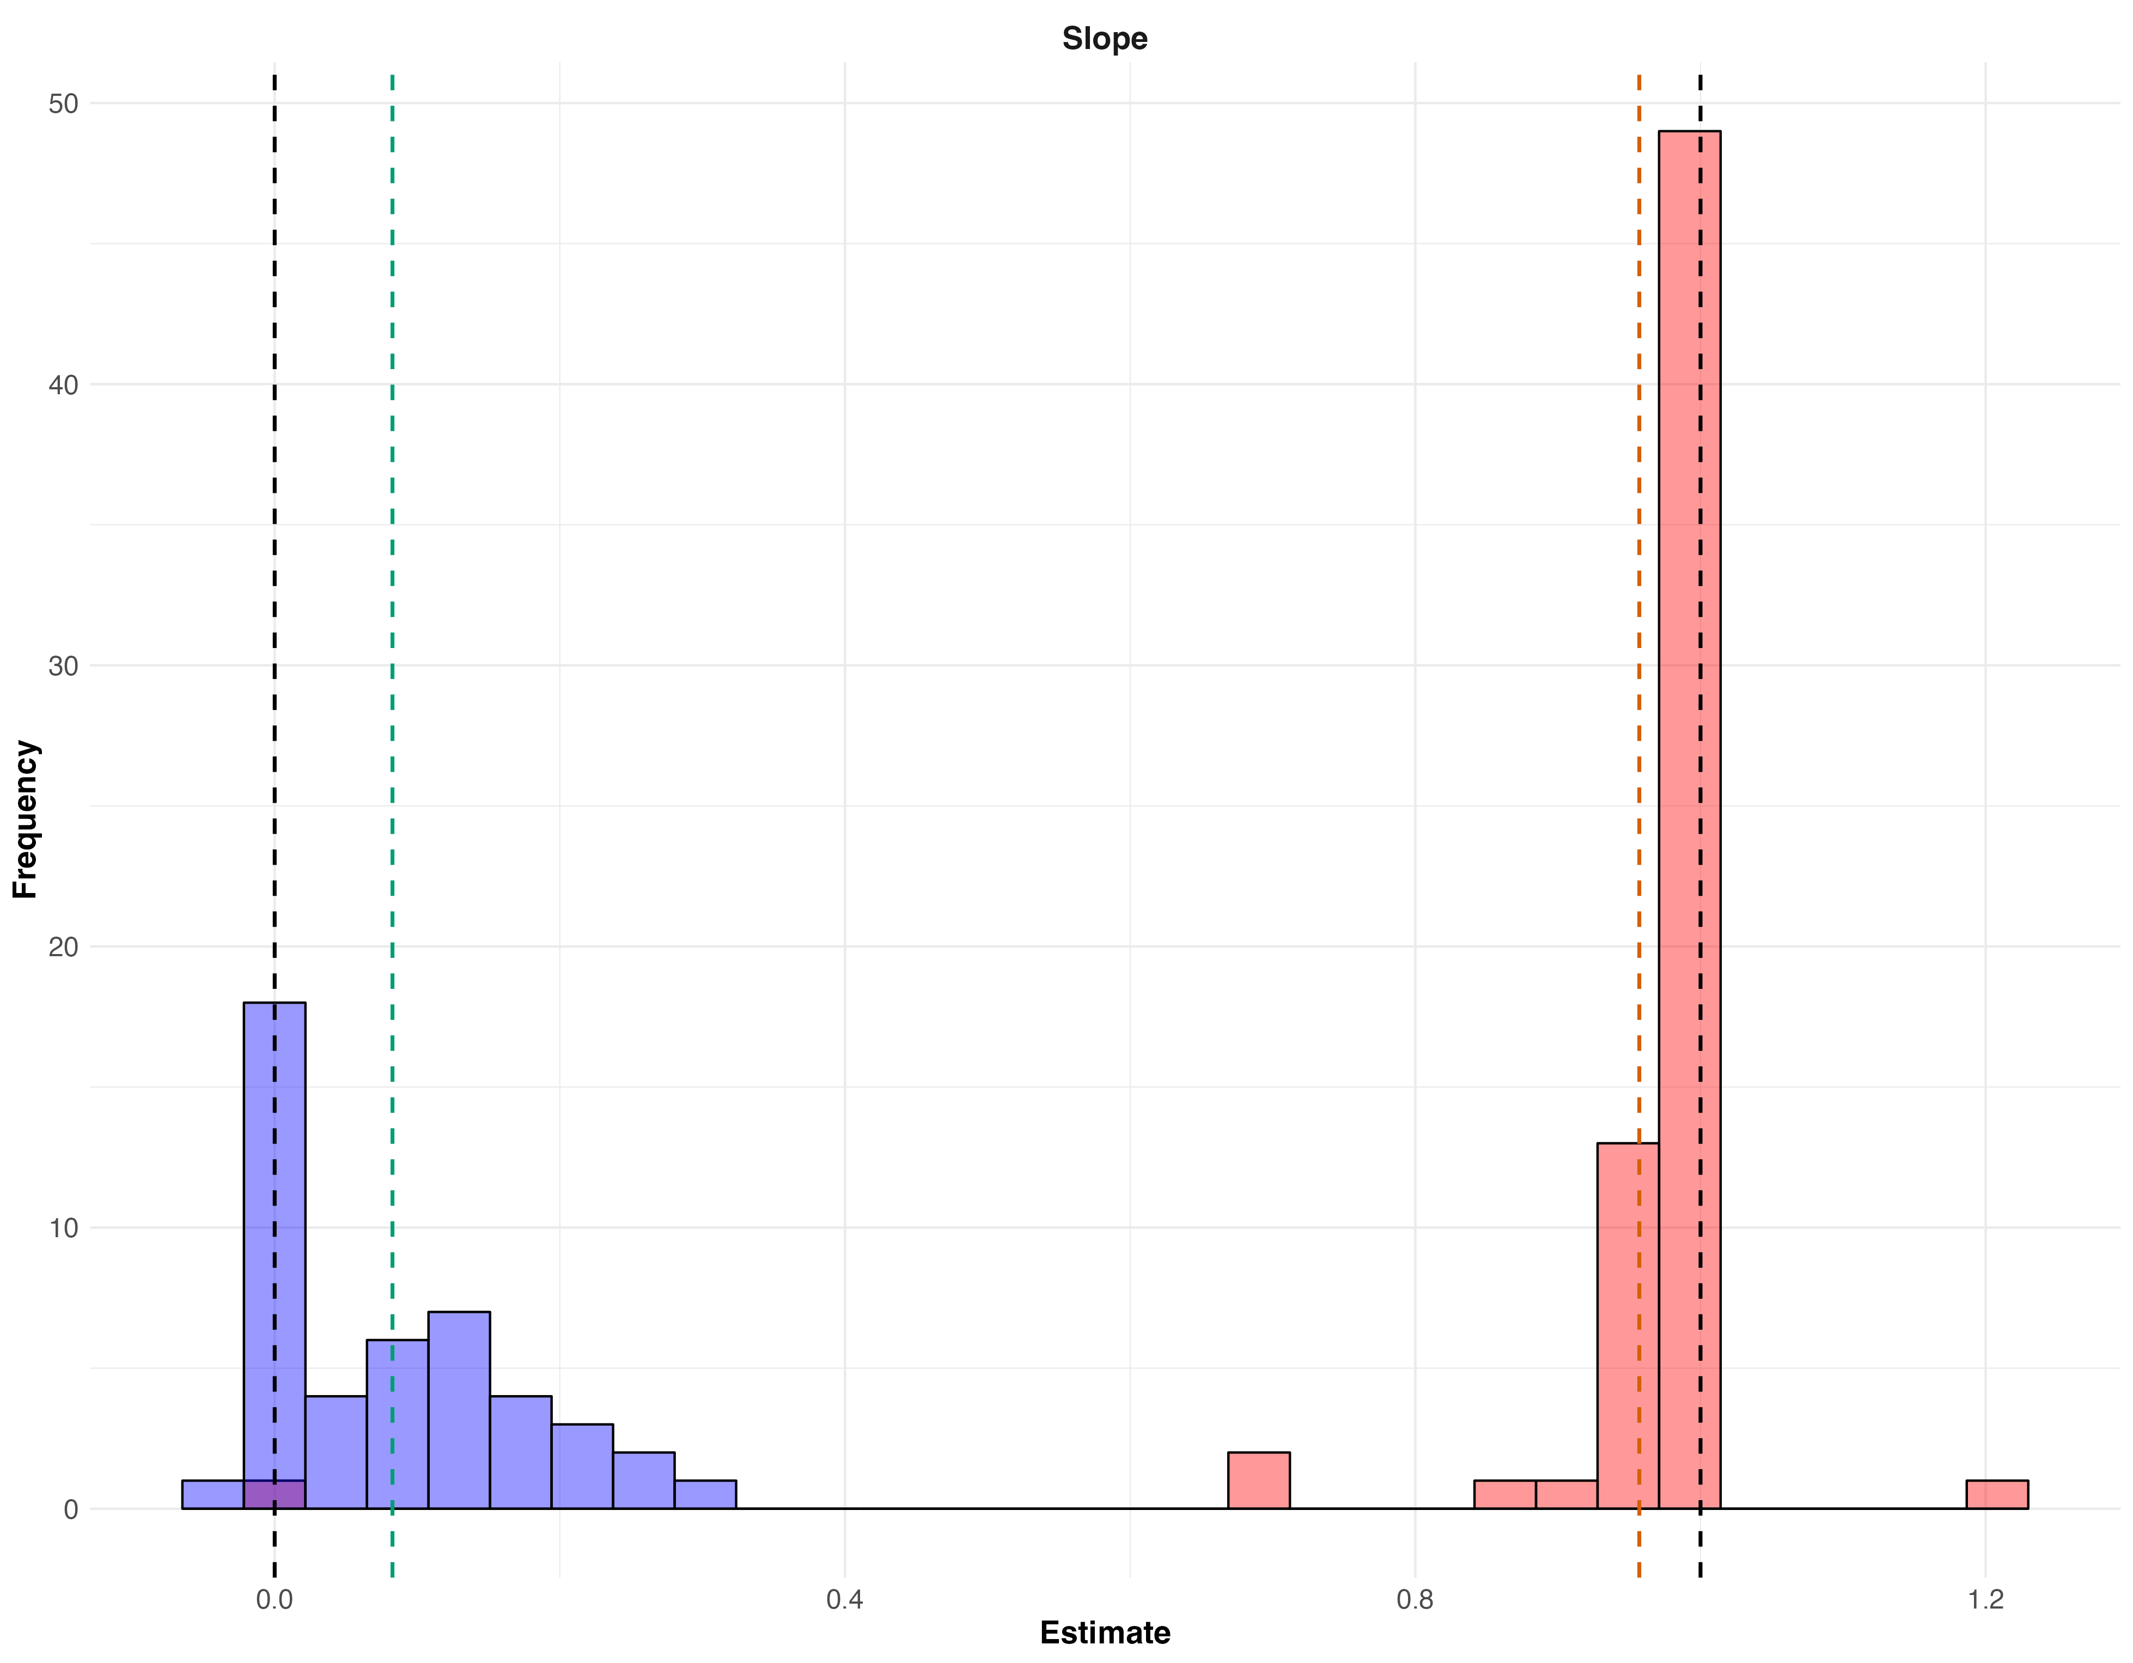
What if we use imputed dosages instead of hard-calls?
Minus Models, $g_{i1}−g_{i2}=a+b ({\overset{ˆ}{g}}_{i1}−{\overset{ˆ}{g}}_{i2})$
Dosages
Hard-Calls

Slide 13
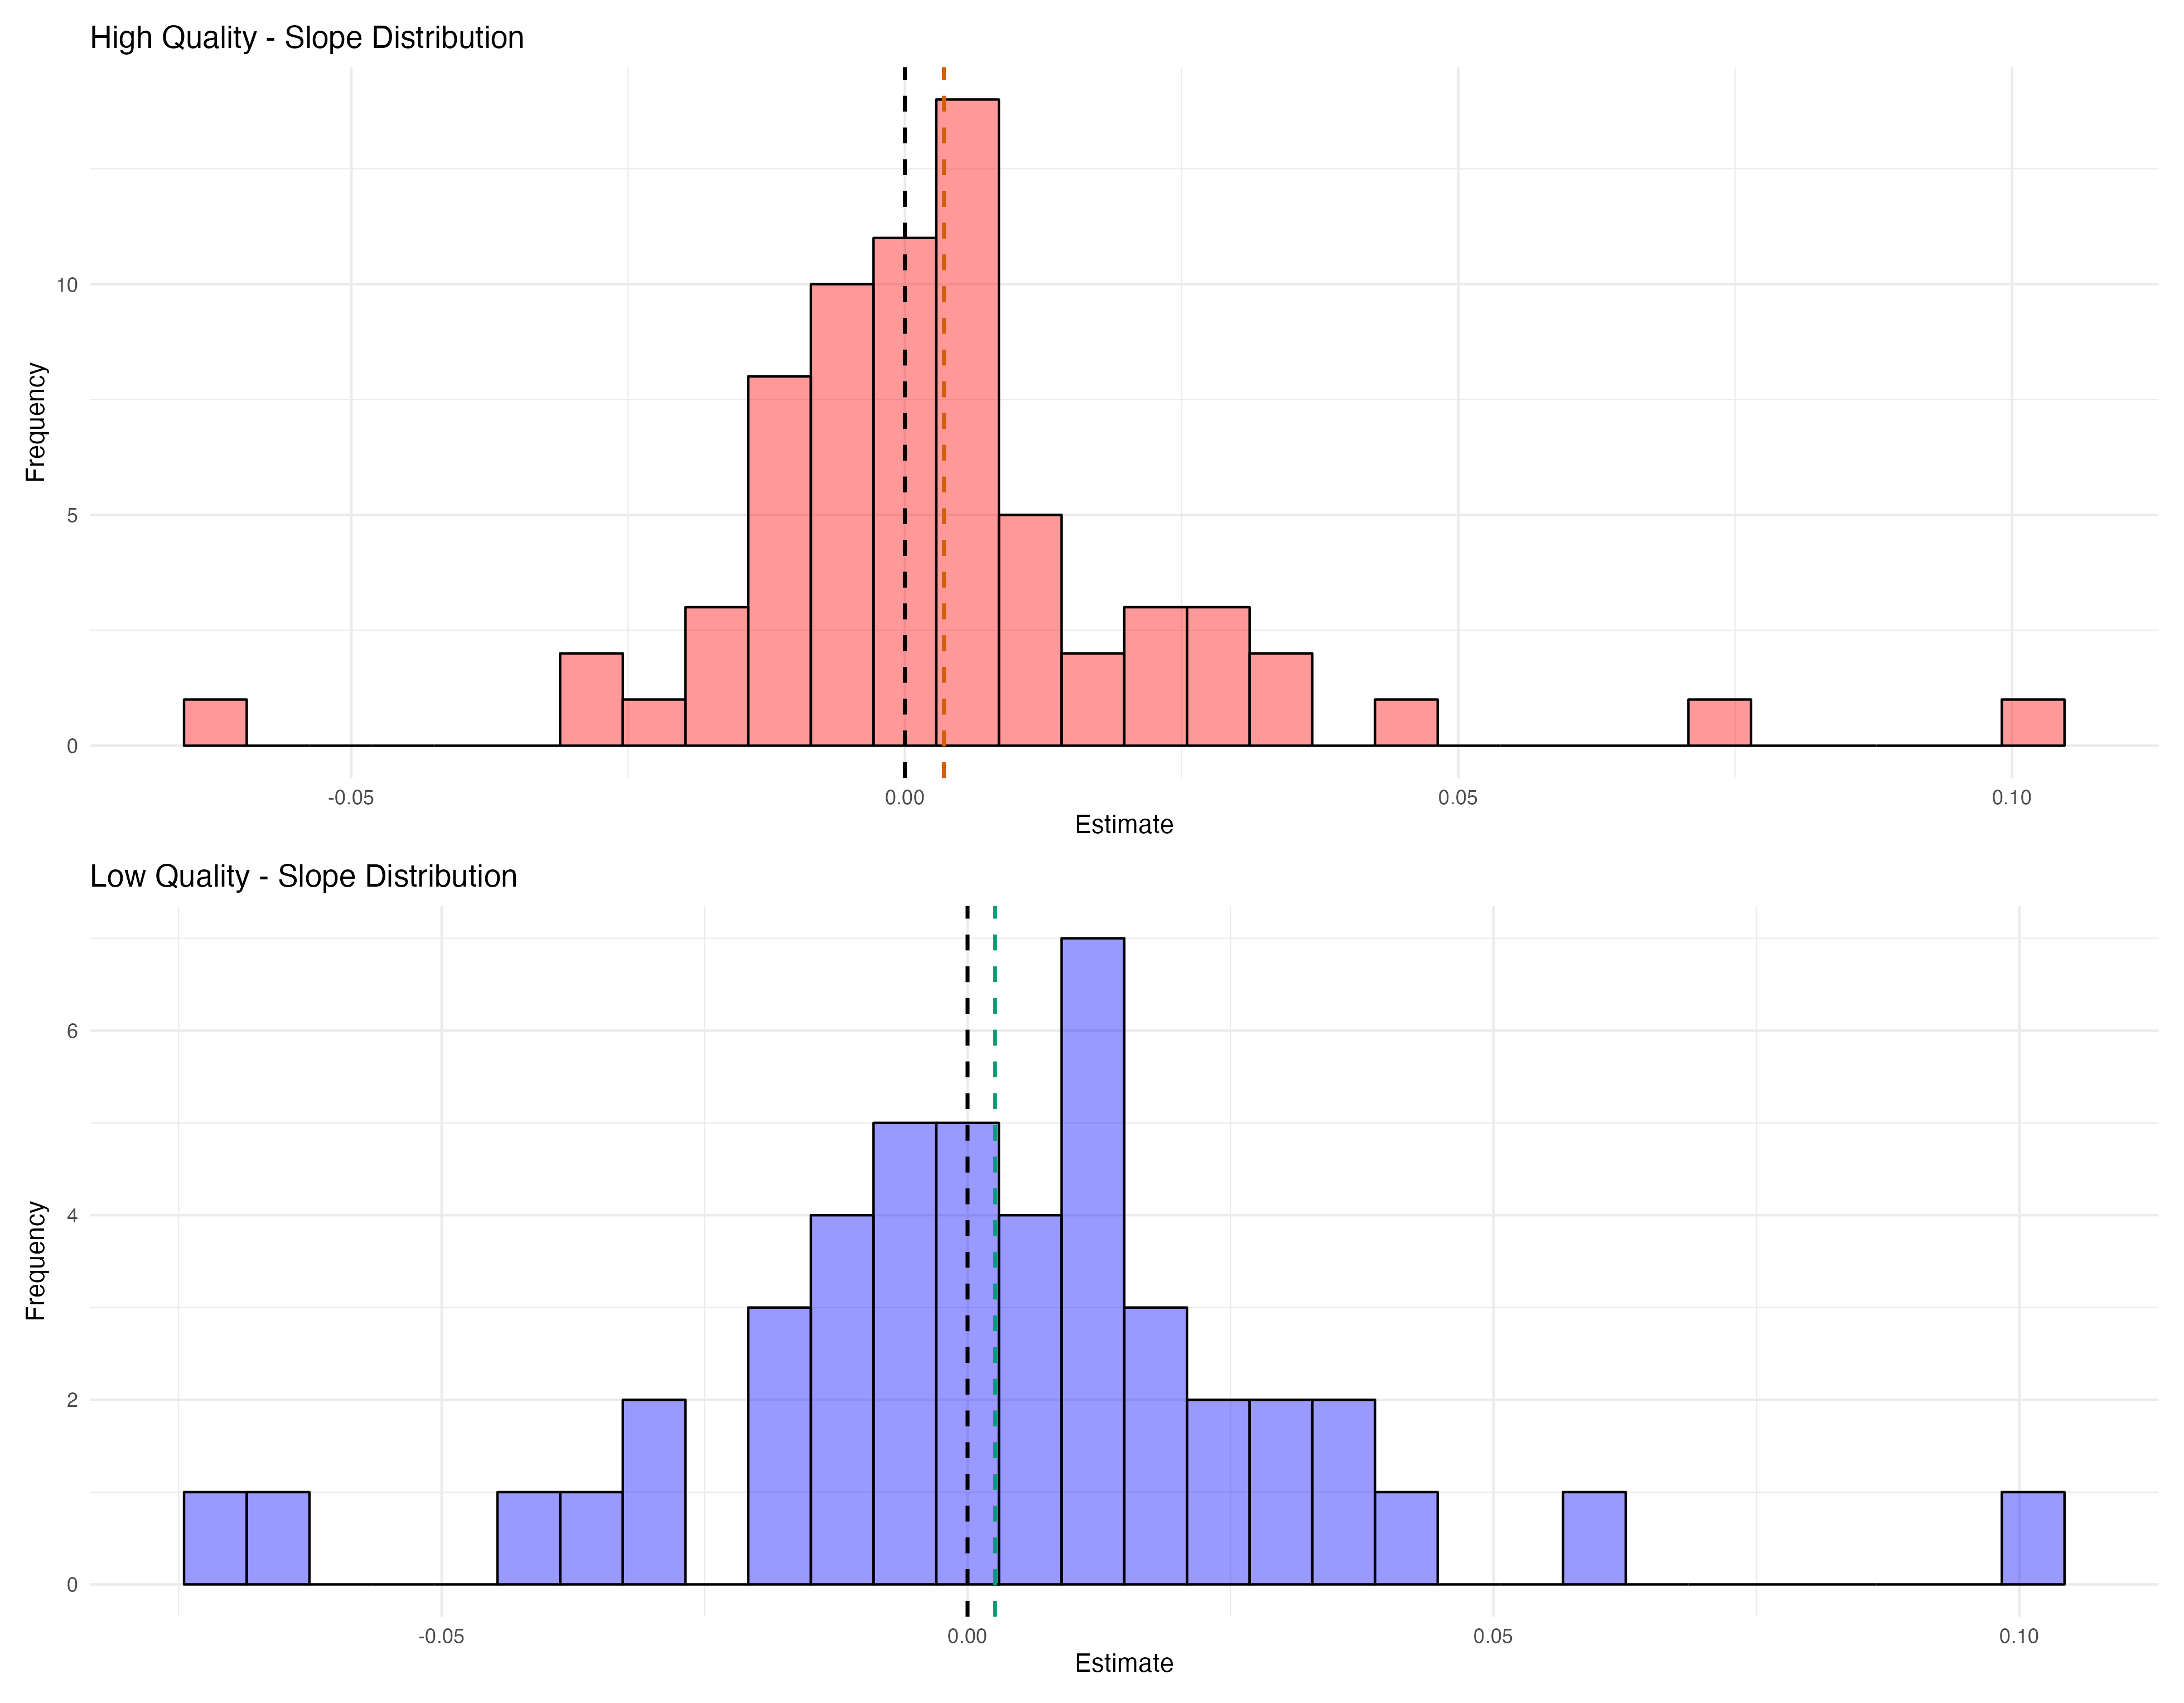
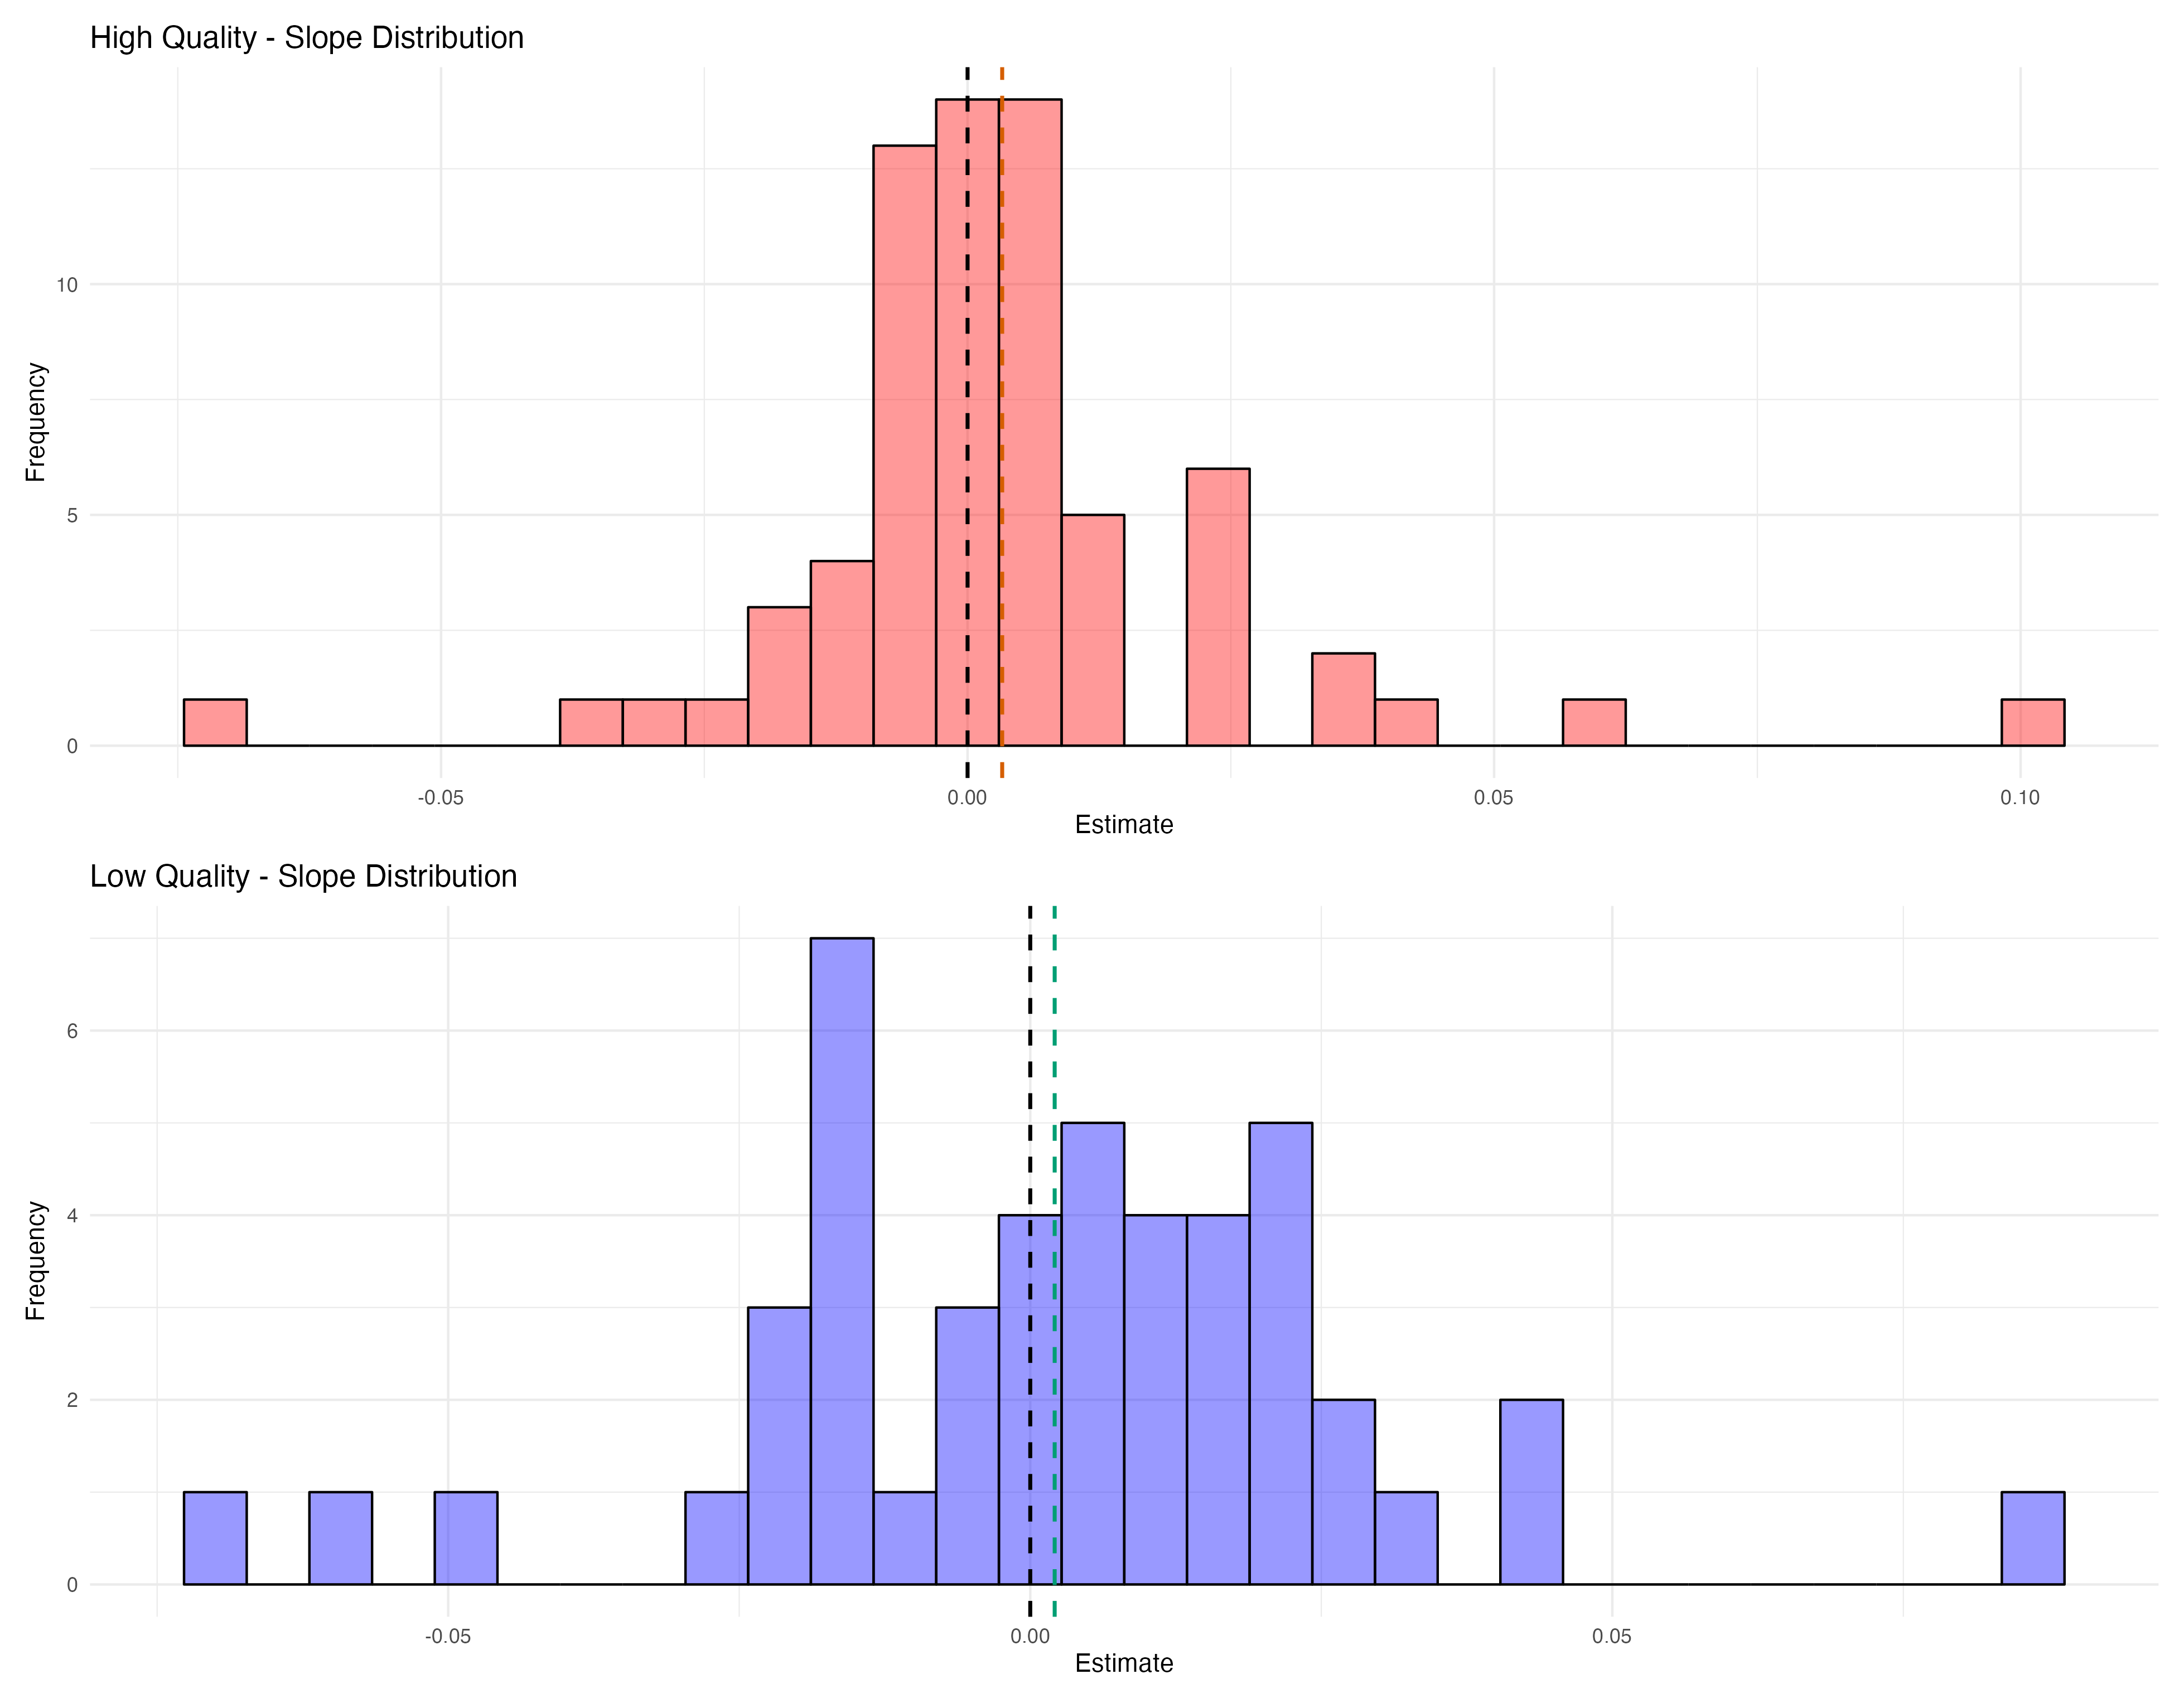
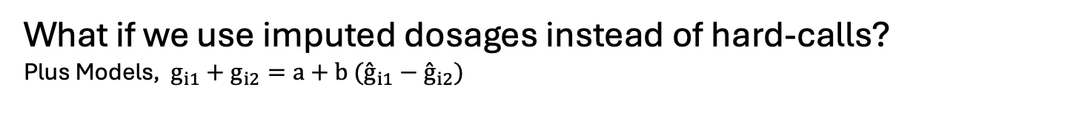
What if we use imputed dosages instead of hard-calls?
Plus Models, $g_{i1}+g_{i2}=a+b ({\overset{ˆ}{g}}_{i1}−{\overset{ˆ}{g}}_{i2})$
Dosages
Hard-Calls

Slide 14
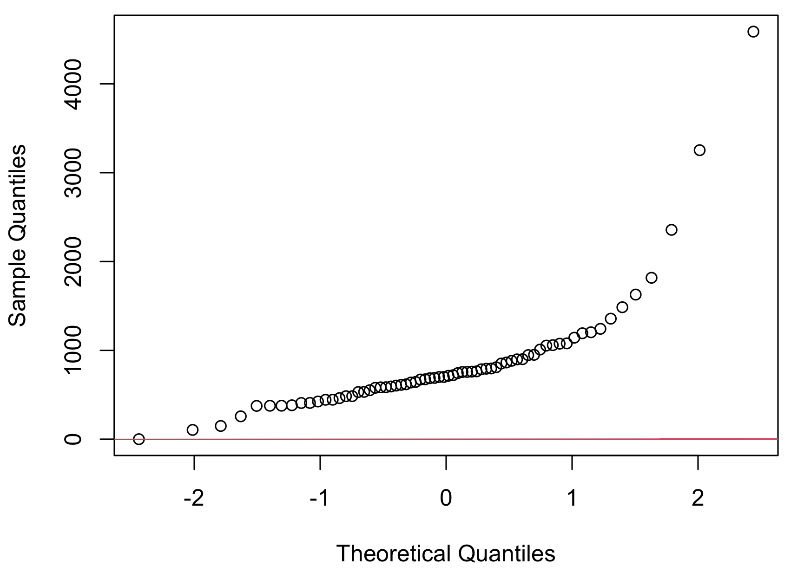
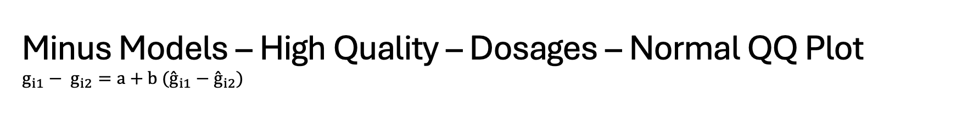
Minus Models – High Quality – Dosages – Normal QQ Plot $$g_{i1}− g_{i2}=a+b ({\overset{ˆ}{g}}_{i1}−{\overset{ˆ}{g}}_{i2})$$

Slide 15
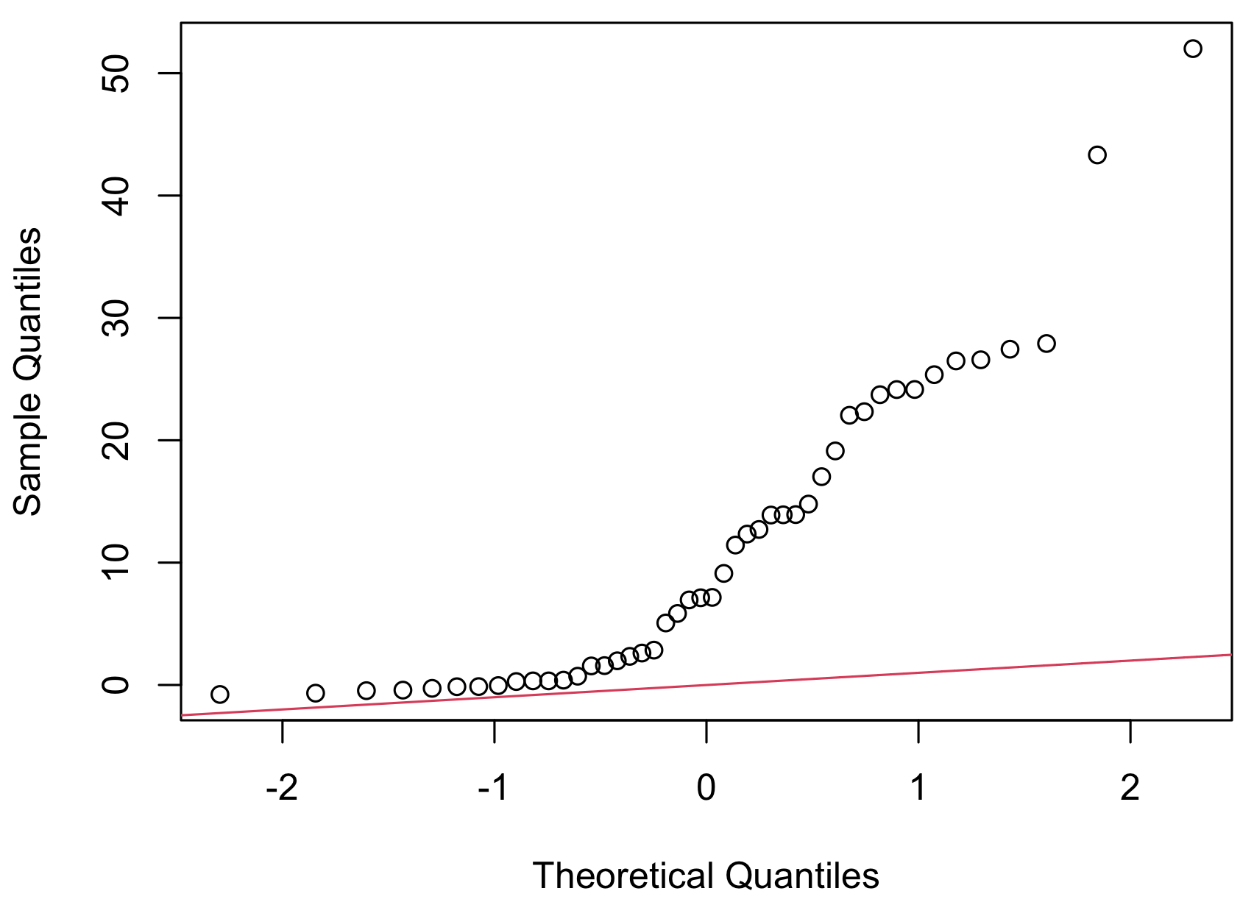
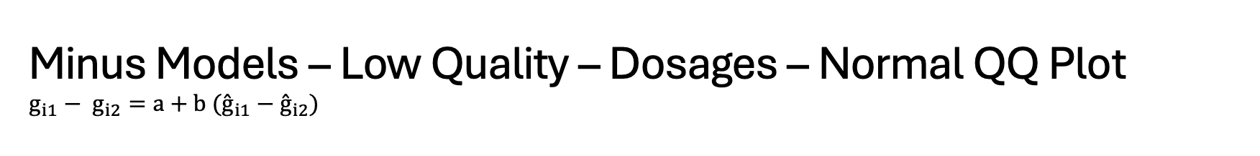
Minus Models – Low Quality – Dosages – Normal QQ Plot $$g_{i1}− g_{i2}=a+b ({\overset{ˆ}{g}}_{i1}−{\overset{ˆ}{g}}_{i2})$$

Slide 16
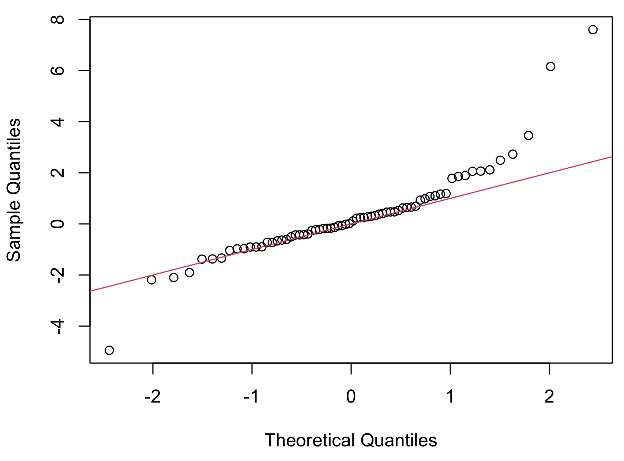
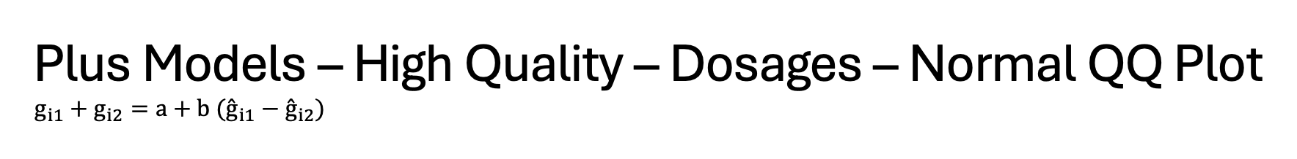
Plus Models – High Quality – Dosages – Normal QQ Plot $$g_{i1}+g_{i2}=a+b ({\overset{ˆ}{g}}_{i1}−{\overset{ˆ}{g}}_{i2})$$

Slide 17
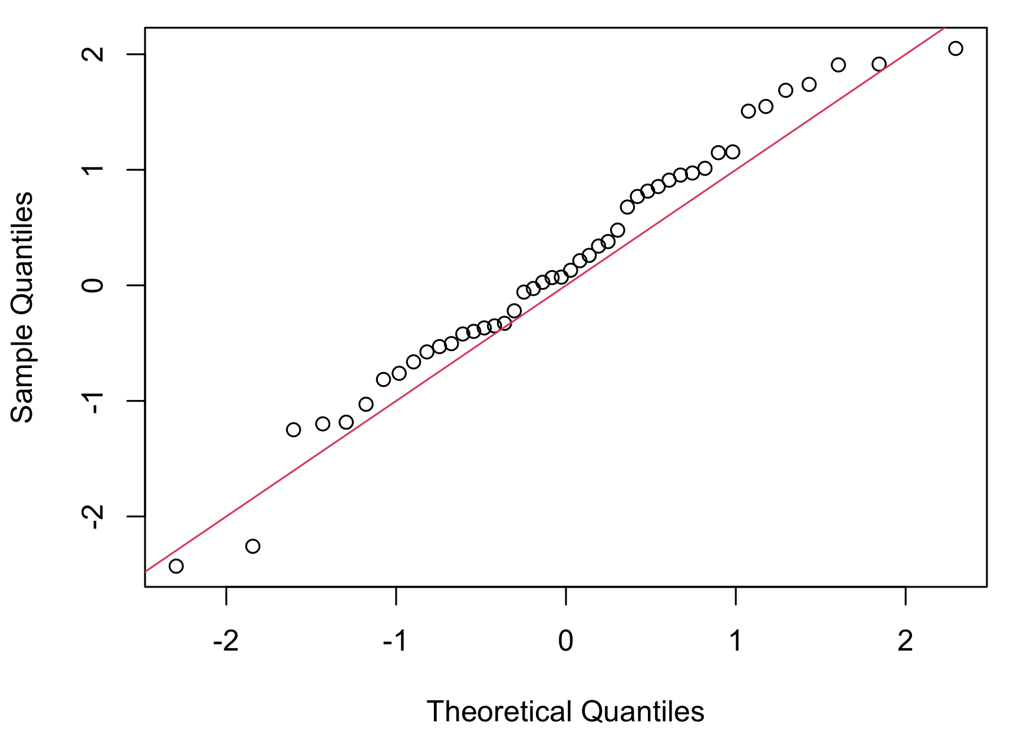
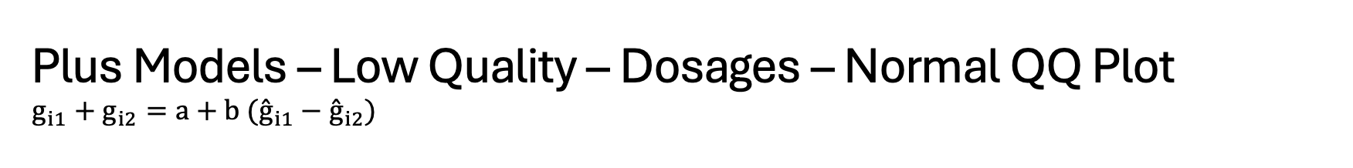
Plus Models – Low Quality – Dosages – Normal QQ Plot $$g_{i1}+g_{i2}=a+b ({\overset{ˆ}{g}}_{i1}−{\overset{ˆ}{g}}_{i2})$$

Slide 18
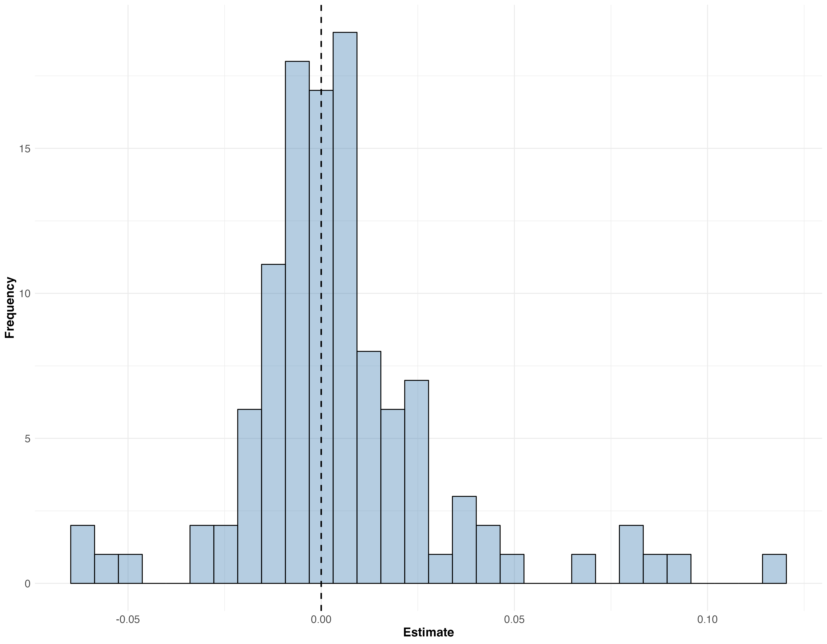
Slope Distribution of $(g1+g2) \sim (g1 −g2$) , WGS Data

Slide 19
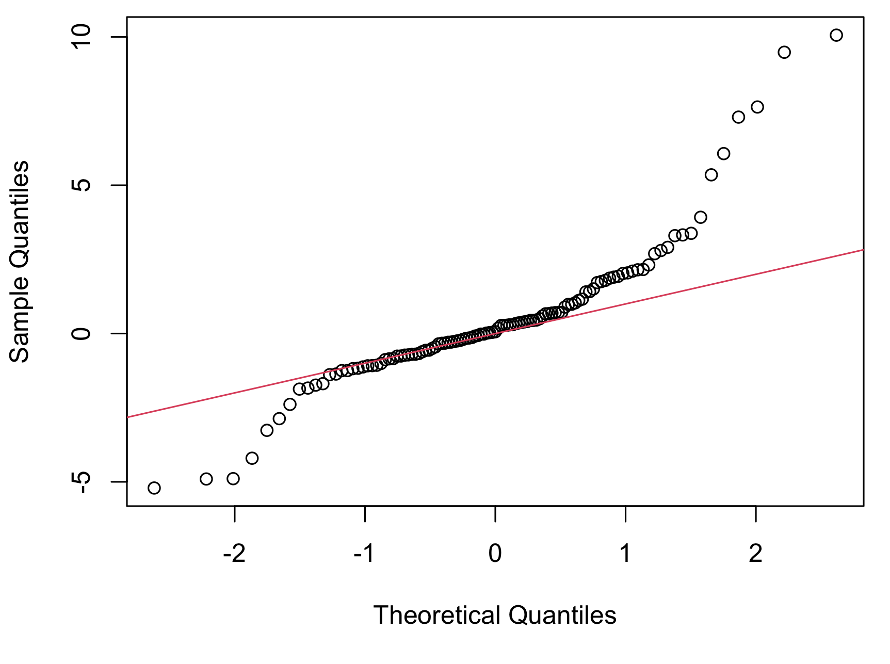
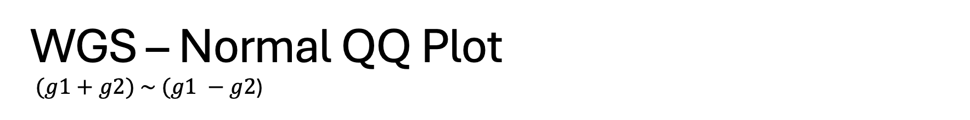
WGS – Normal QQ Plot $(g1+g2) \sim (g1 −g2$)

Slide 20
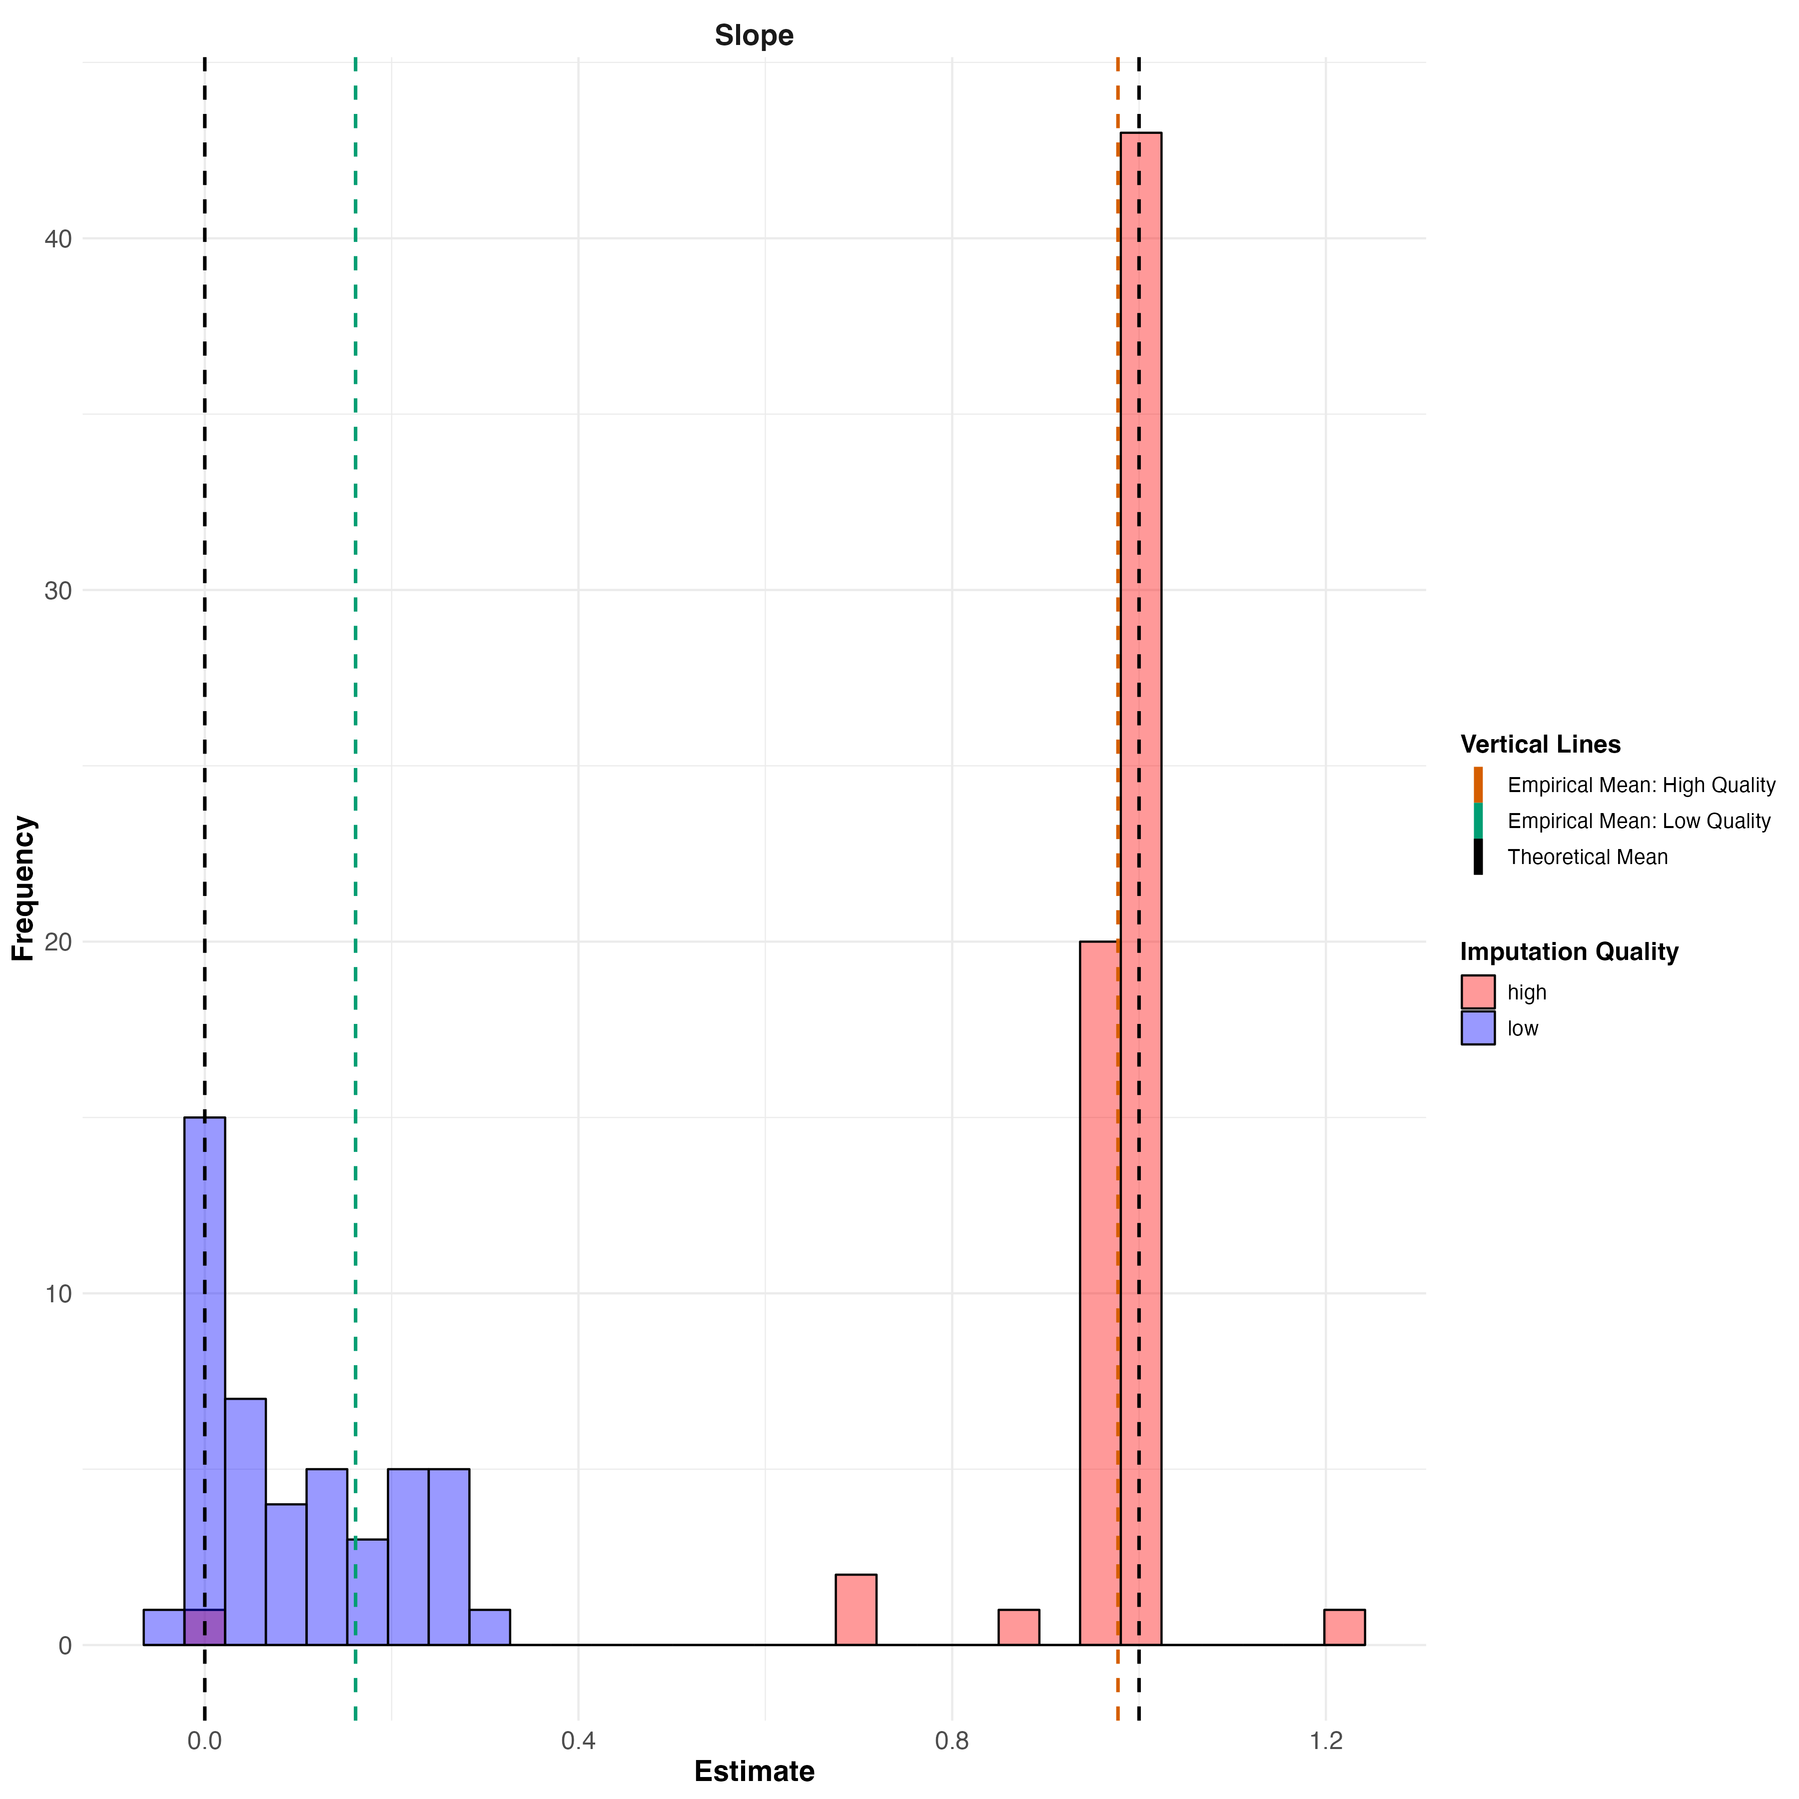
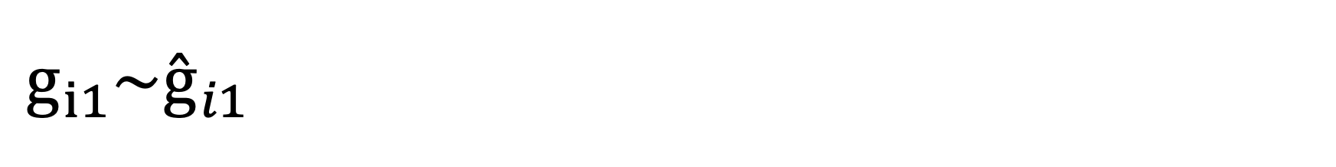
$$g_{i1}\sim {\overset{ˆ}{g}}_{i1}$$

Slide 21
INFO score vs R² between imputed and WGS data in UK Biobank.
INFO score is an unreliable metric of imputation quality in UK Biobank.

Slide 22
Next Steps
We are going to extend the analysis to a larger set of SNPs across a range of Info Scores.
We will do the parental imputation with Sniper using WGS data.

Slide 23
Thank You!

