Slide 1
Reliability of imputed genotype data for family-based analyses
Mahdi Mir, Alexander S. Young

Slide 2
Motivation
We are concerned that the low-quality imputed genotypes may not be suitable for family-based analyses.
FGWAS is designed to leverage Mendelian inheritance as a clean natural experiment to obtain unbiased estimates, but with imputation we may lose that.
Notes:
Our motivation is

Slide 3
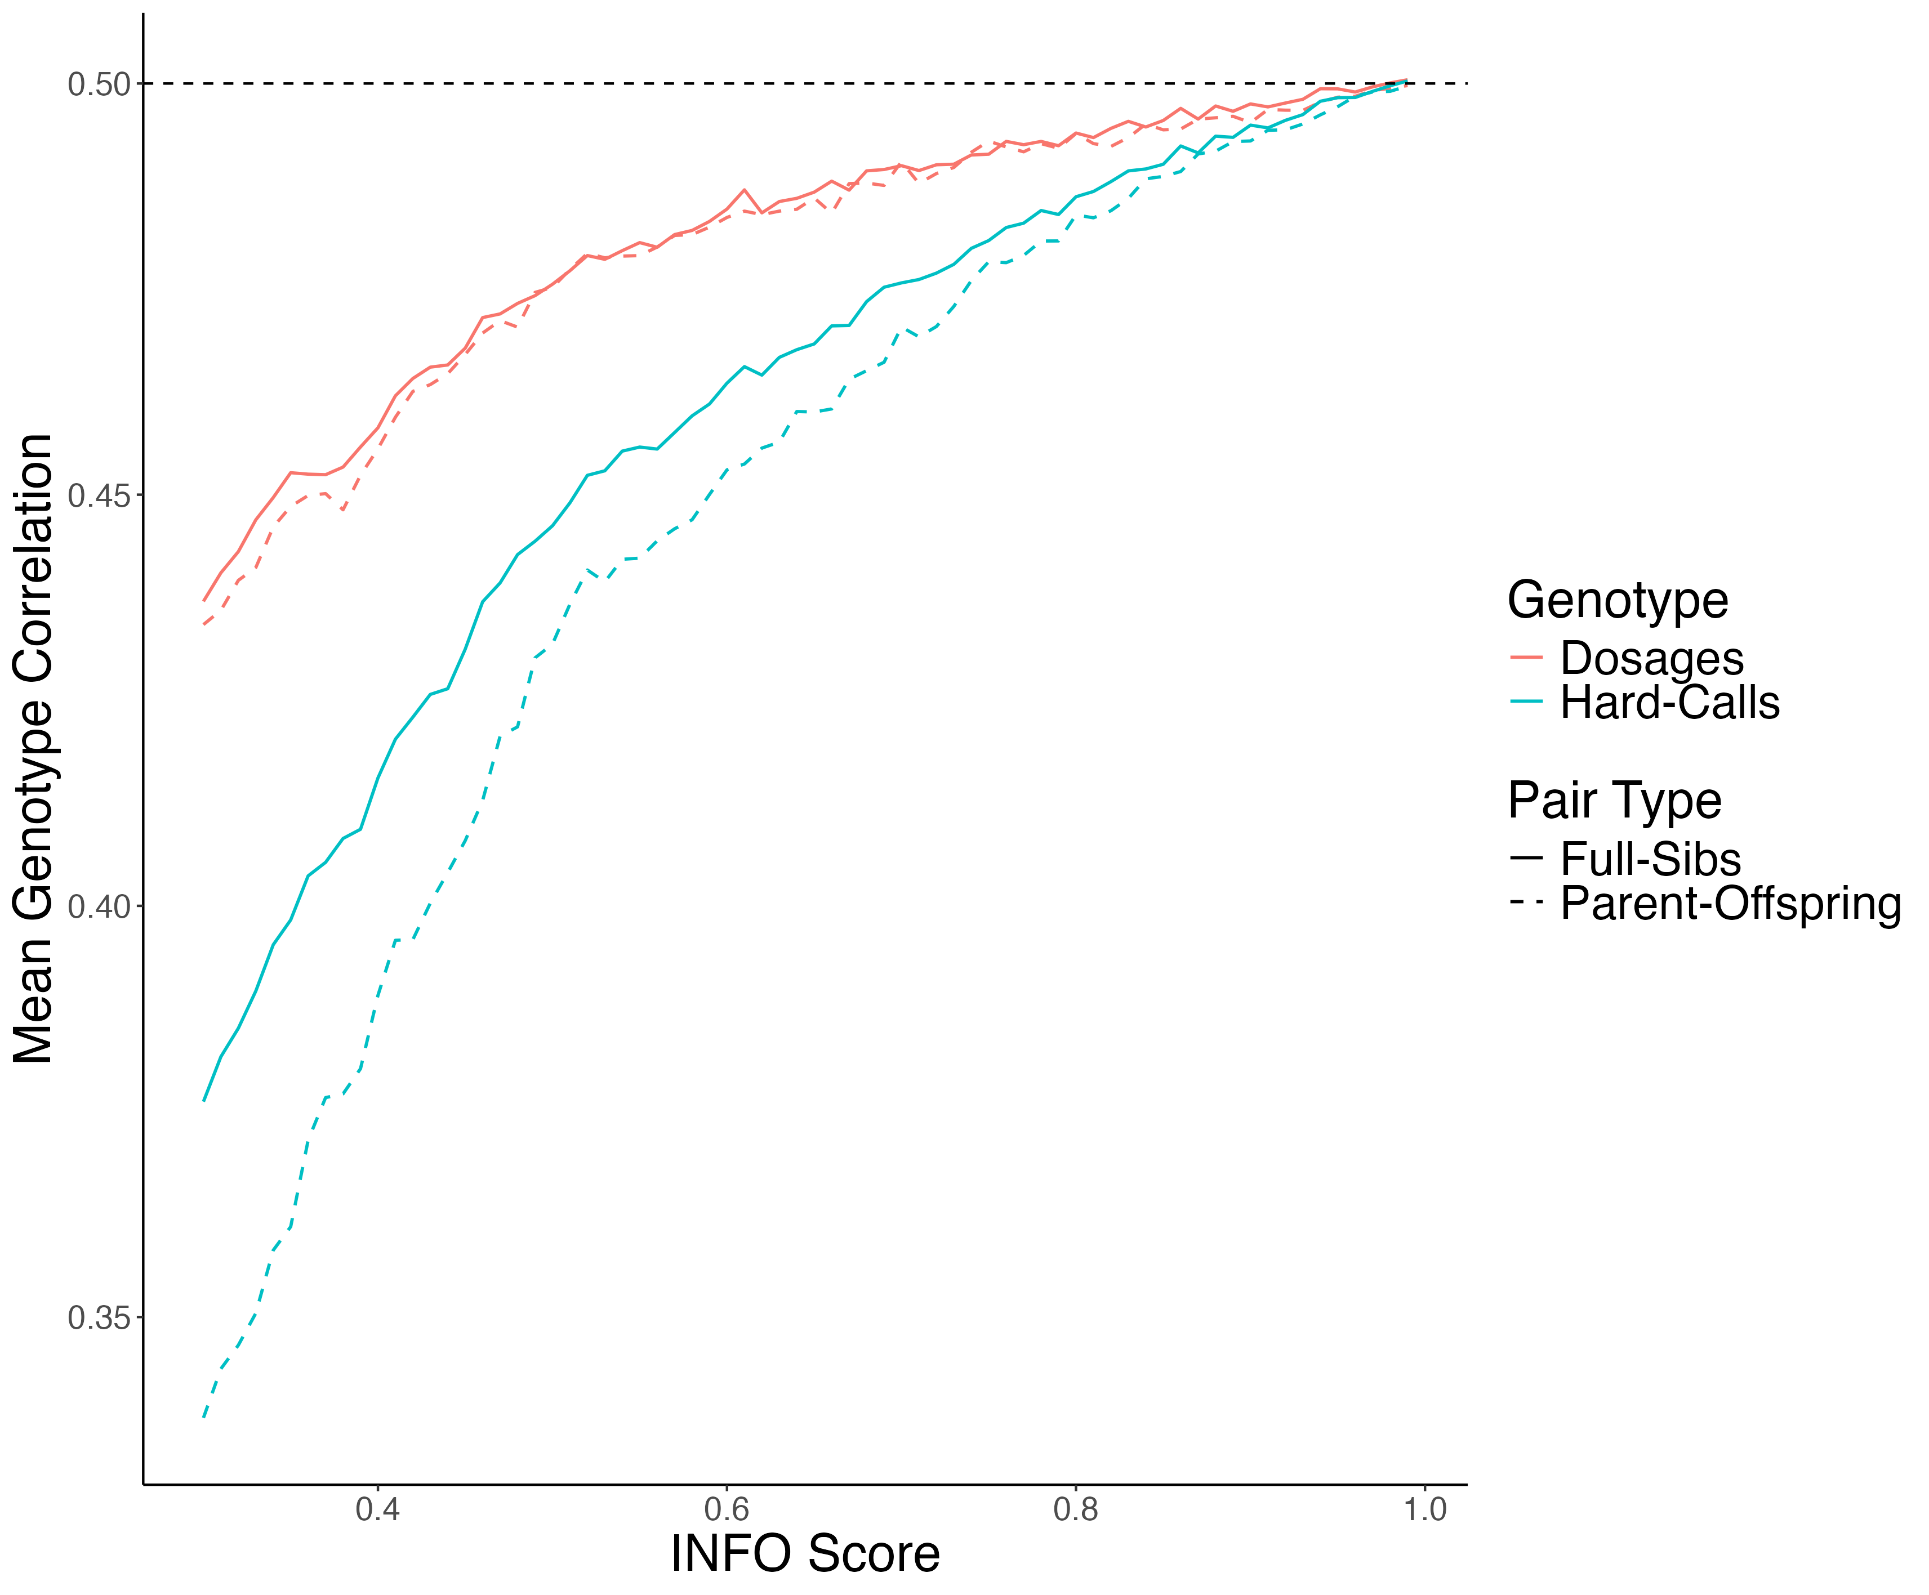
Mean Genotype Correlation

Slide 4

Sib Differences with Imputed Genotypes
For a sibling pair from family $i$, the model is:
$$\begin{matrix} & Y_{i1}=δg_{i1}+αg_{par(i)}+ϵ_{i1} \\ & Y_{i2}=δg_{i2}+αg_{par(i)}+ϵ_{i2}\end{matrix}$$

Slide 5
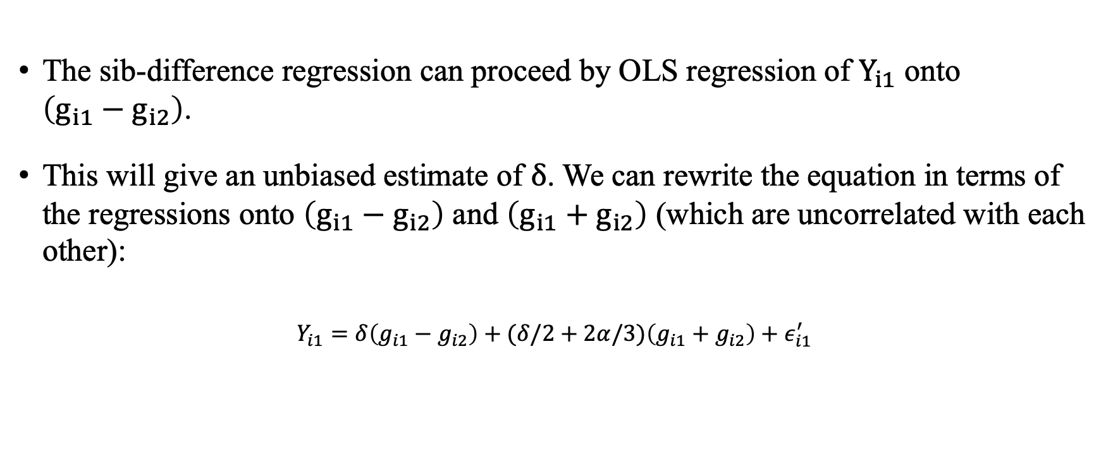
Sib Differences with Imputed Genotypes (cont’d)
The sib-difference regression can proceed by OLS regression of $Y_{i1}$ onto $\left(g_{i1}−g_{i2}\right)$.
This will give an unbiased estimate of $δ$. We can rewrite the equation in terms of the regressions onto $\left(g_{i1}−g_{i2}\right)$ and $\left(g_{i1}+g_{i2}\right)$ (which are uncorrelated with each other):
$$Y_{i1}=δ\left(g_{i1}−g_{i2}\right)+(δ/2+2α/3)\left(g_{i1}+g_{i2}\right)+ε_{i1}^{′}$$

Slide 6

Sib Differences with Imputed Genotypes (cont’d)
for some $ϵ_{i1}^{′}$ uncorrelated with $\left(g_{i1}−g_{i2}\right)$ and $\left(g_{i1}+g_{i2}\right)$. We can then ask what we would obtain if we instead performed regression onto the difference in imputed sibling genotypes:
$$\frac{Cov⁡\left(Y_{i1},{\overset{ˆ}{g}}_{i1}−{\overset{ˆ}{g}}_{i2}\right)}{Var⁡\left({\overset{ˆ}{g}}_{i1}−{\overset{ˆ}{g}}_{i2}\right)}=δ\frac{Cov⁡\left(g_{i1}−g_{i2},{\overset{ˆ}{g}}_{i1}−{\overset{ˆ}{g}}_{i2}\right)}{Var⁡\left({\overset{ˆ}{g}}_{i1}−{\overset{ˆ}{g}}_{i2}\right)}+(δ/2+2α/3)\frac{Cov⁡\left(g_{i1}+g_{i2},{\overset{ˆ}{g}}_{i1}−{\overset{ˆ}{g}}_{i2}\right)}{Var⁡\left({\overset{ˆ}{g}}_{i1}−{\overset{ˆ}{g}}_{i2}\right)}+\frac{Cov⁡\left(ε_{i1}^{′},{\overset{ˆ}{g}}_{i1}−{\overset{ˆ}{g}}_{i2}\right)}{Var⁡\left({\overset{ˆ}{g}}_{i1}−{\overset{ˆ}{g}}_{i2}\right)}$$

Slide 7
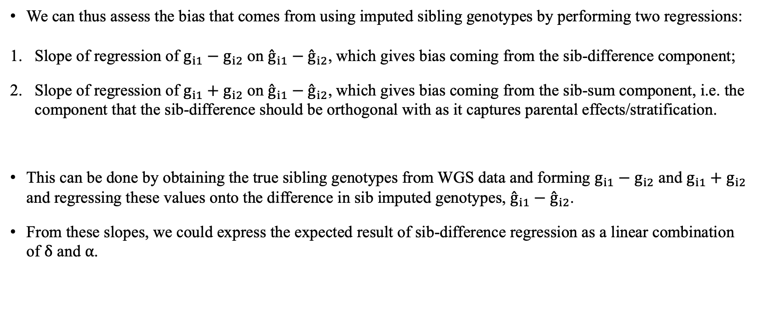
Sib Differences with Imputed Genotypes (cont’d)
We can thus assess the bias that comes from using imputed sibling genotypes by performing two regressions:
Slope of regression of $g_{i1}−g_{i2}$ on ${\overset{ˆ}{g}}_{i1}−{\overset{ˆ}{g}}_{i2}$, which gives bias coming from the sib-difference component;
Slope of regression of $g_{i1}+g_{i2}$ on ${\overset{ˆ}{g}}_{i1}−{\overset{ˆ}{g}}_{i2}$, which gives bias coming from the sib-sum component, i.e. the component that the sib-difference should be orthogonal with as it captures parental effects/stratification.
This can be done by obtaining the true sibling genotypes from WGS data and forming $g_{i1}−g_{i2}$ and $g_{i1}+g_{i2}$ and regressing these values onto the difference in sib imputed genotypes, ${\overset{ˆ}{g}}_{i1}−{\overset{ˆ}{g}}_{i2}$.
From these slopes, we could express the expected result of sib-difference regression as a linear combination of $δ$ and $α$.

Slide 8

Sib Differences with Imputed Genotypes (cont’d)
$g_{i1}−g_{i2}=a+b ({\overset{ˆ}{g}}_{i1}−{\overset{ˆ}{g}}_{i2})$ (Minus Models)
$g_{i1}+g_{i2}=a+b ({\overset{ˆ}{g}}_{i1}−{\overset{ˆ}{g}}_{i2})$ (Plus Models)

Slide 9
Sample
68 High Quality Imputed SNPs, mean INFO score = 96%
46 Low Quality Imputed SNPs, mean INFO score = 31%
19,052 White British Sibling Pairs from UKB
SNPs with MAF > 1%
Only bi-allelic SNPs

Slide 10
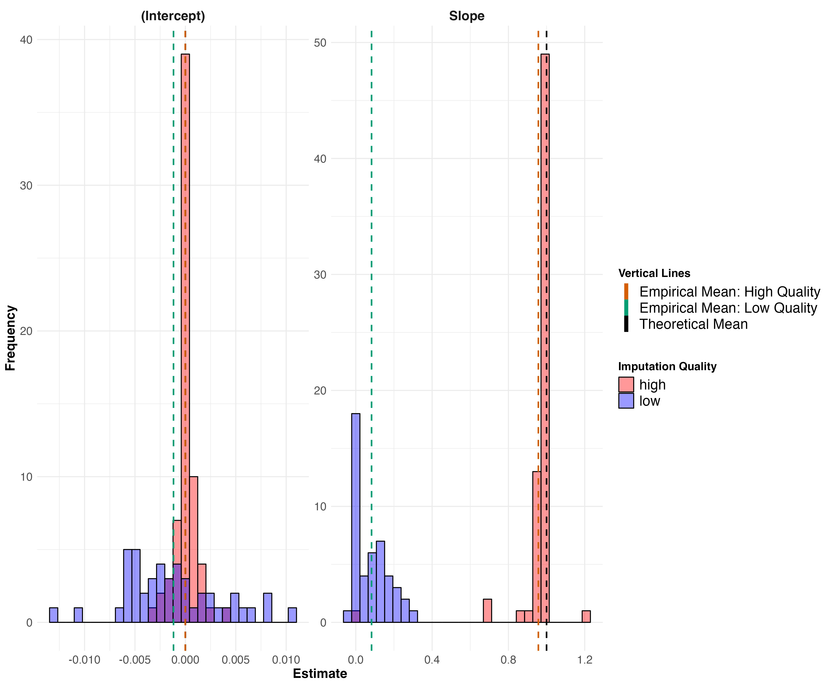
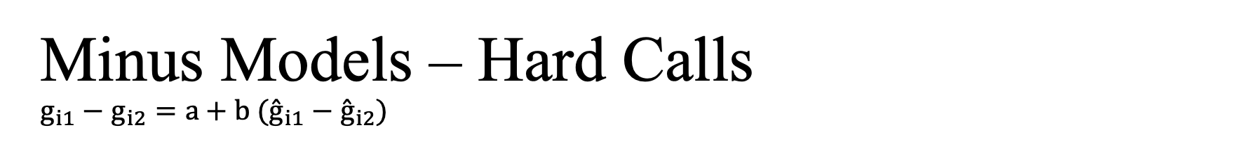
Minus Models – Hard Calls $$g_{i1}−g_{i2}=a+b ({\overset{ˆ}{g}}_{i1}−{\overset{ˆ}{g}}_{i2})$$

Slide 11
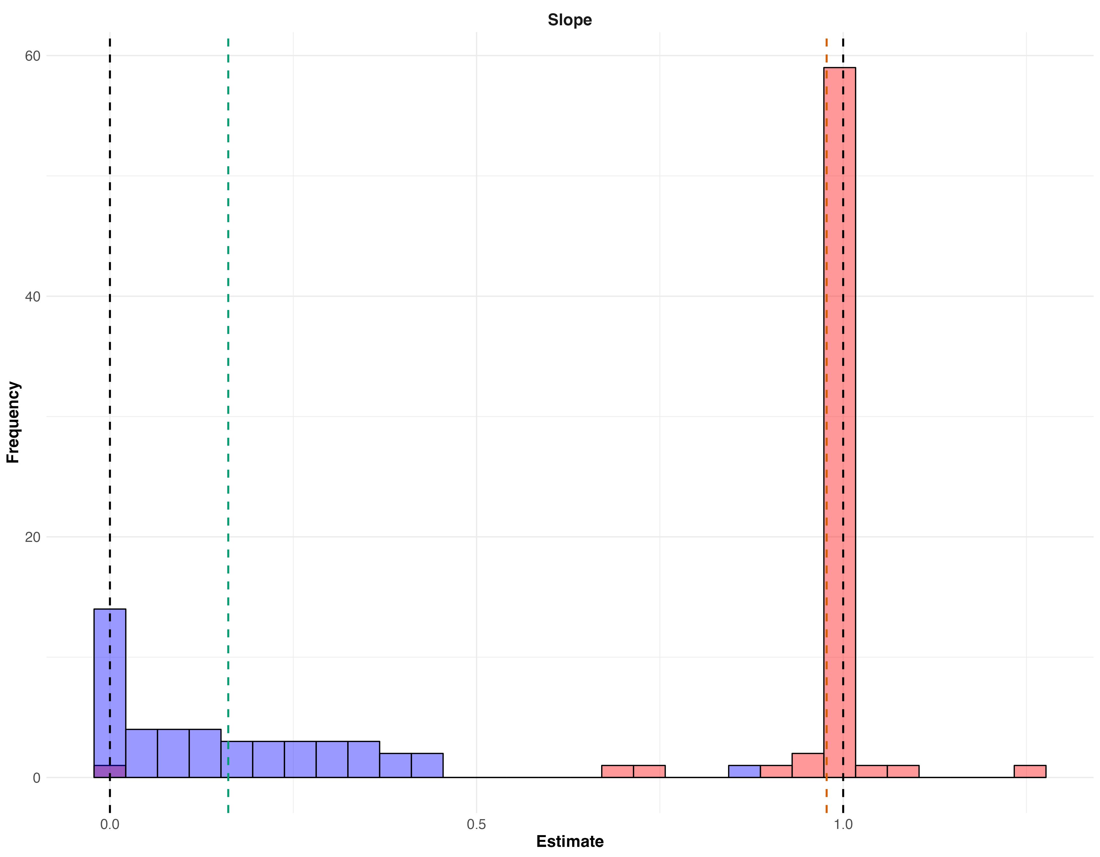
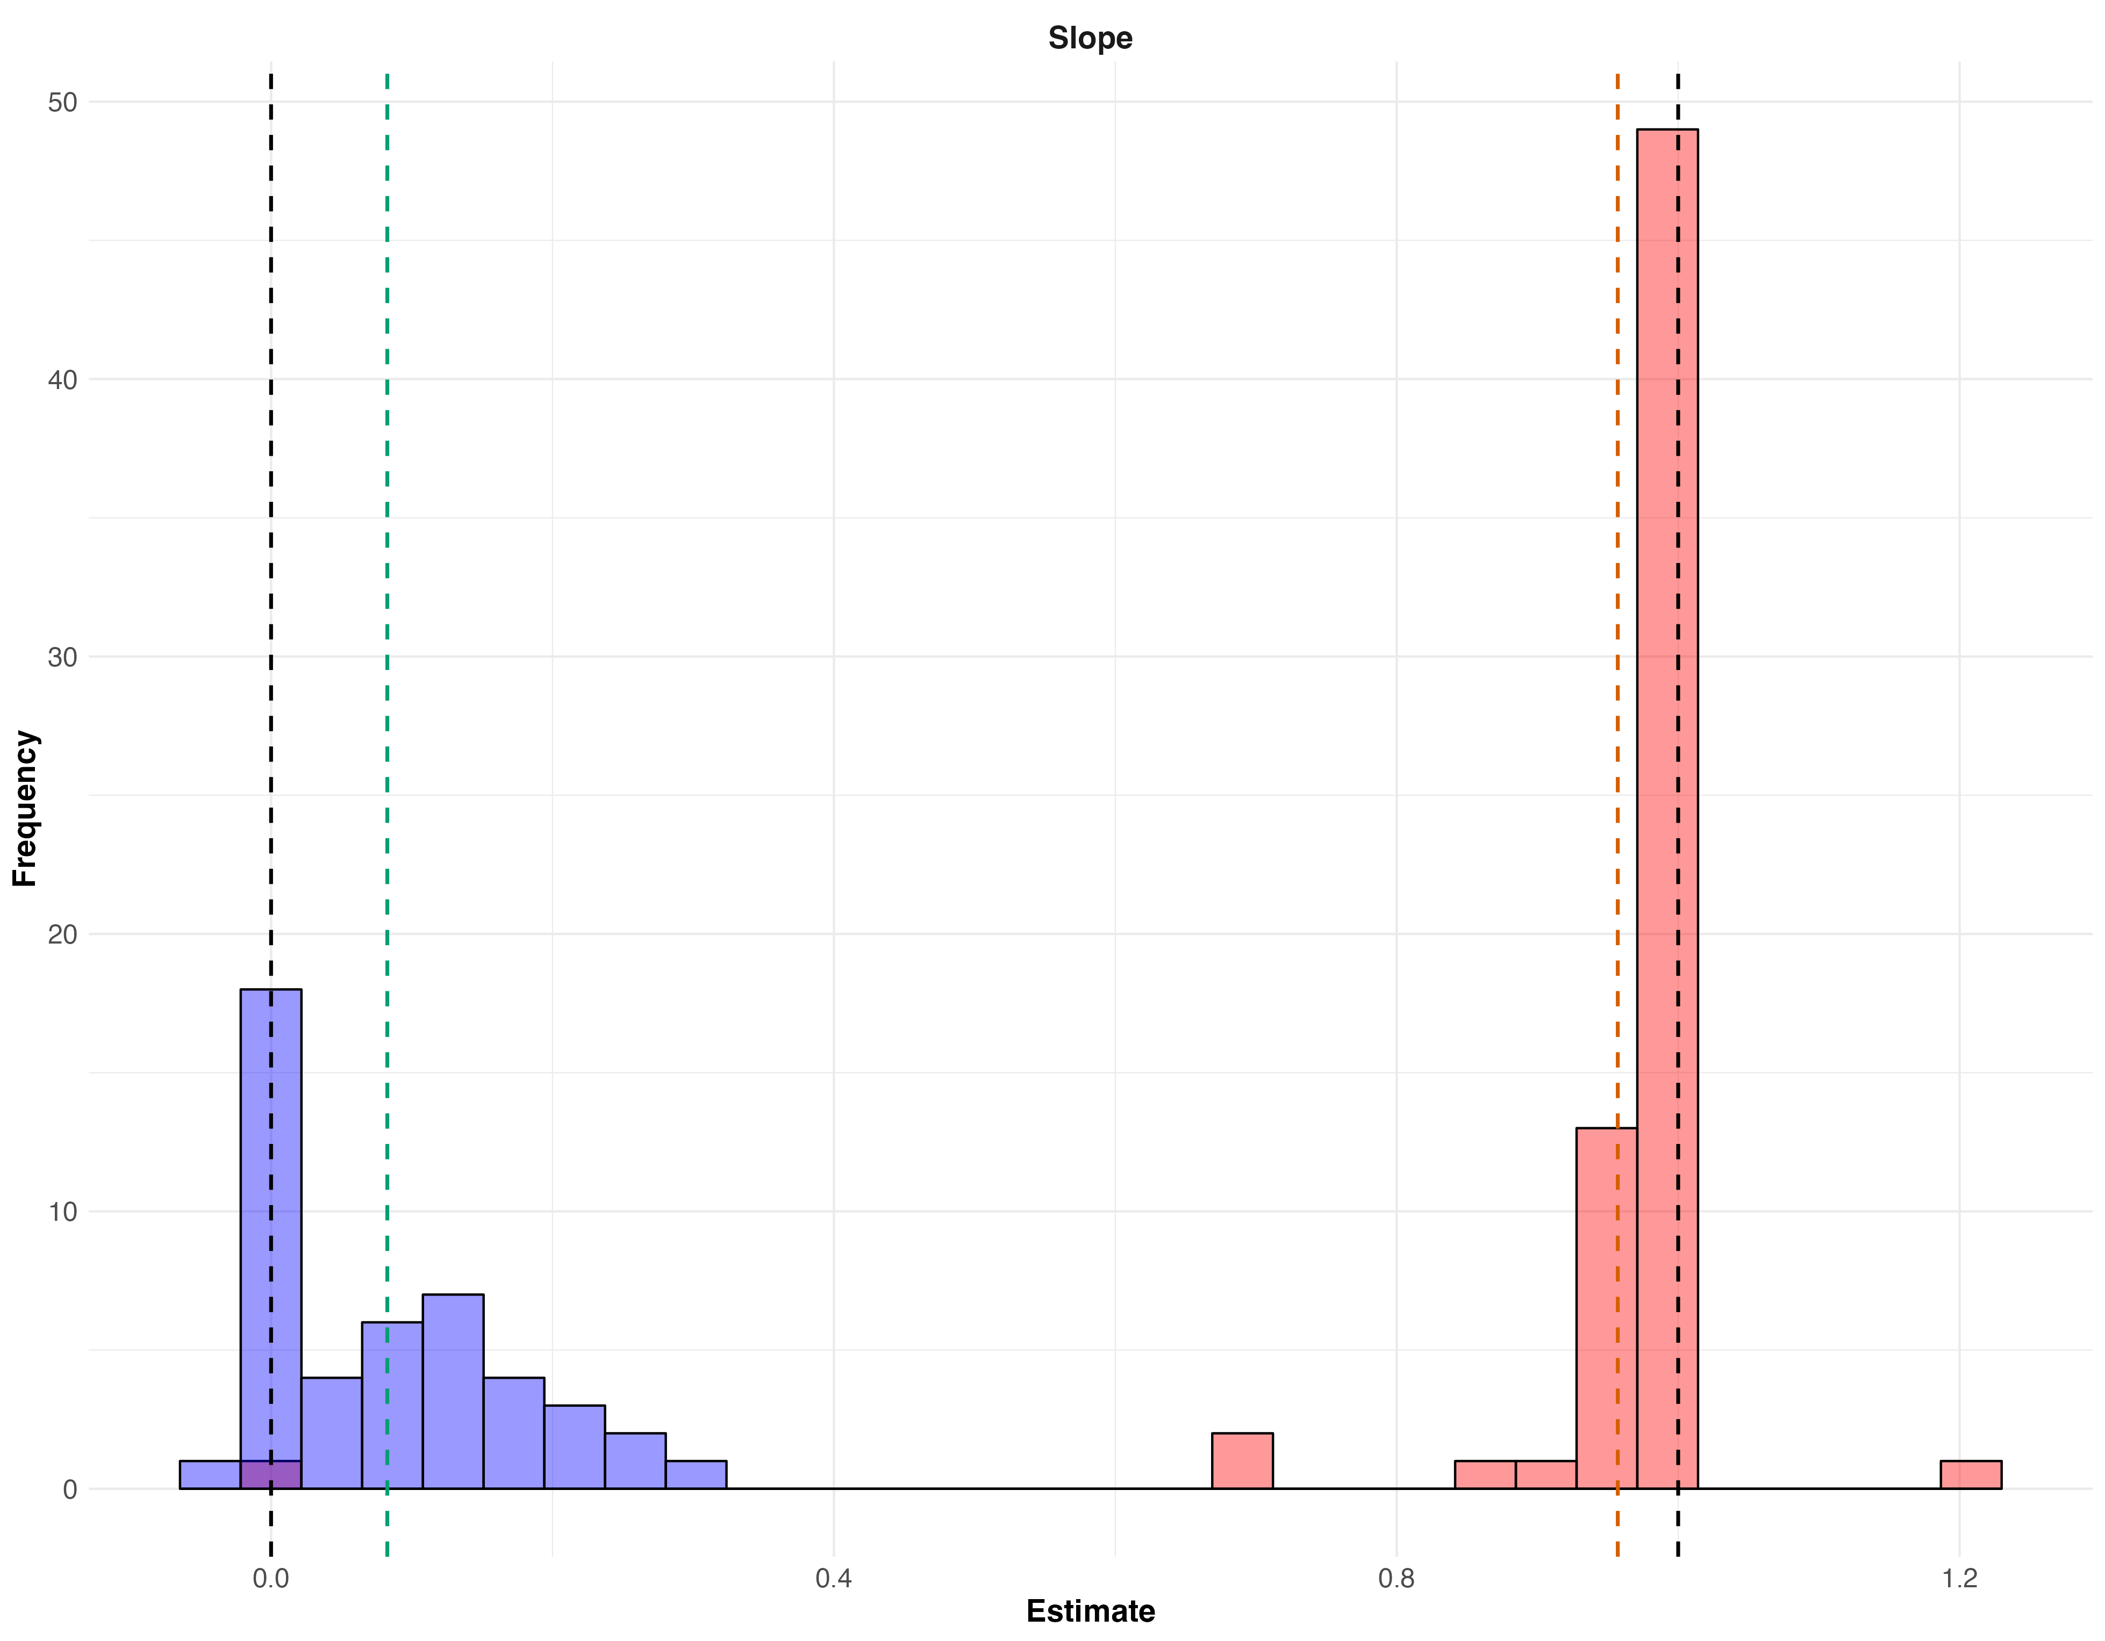
What if we use imputed dosages instead of hard-calls?
Minus Models, $g_{i1}−g_{i2}=a+b ({\overset{ˆ}{g}}_{i1}−{\overset{ˆ}{g}}_{i2})$
Dosages
Hard-Calls

Slide 12
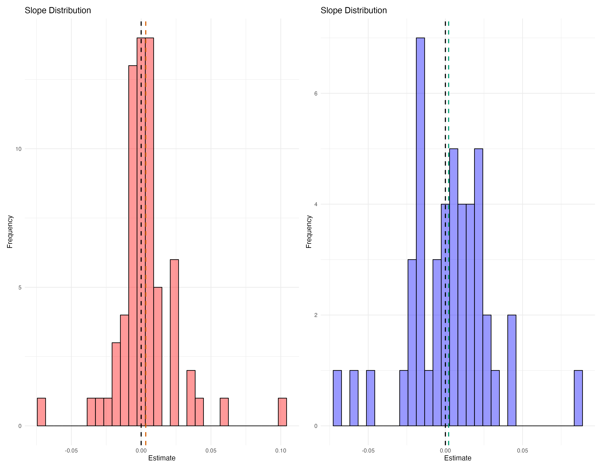
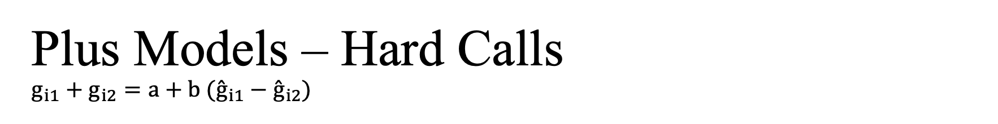
Plus Models – Hard Calls $$g_{i1}+g_{i2}=a+b ({\overset{ˆ}{g}}_{i1}−{\overset{ˆ}{g}}_{i2})$$

Slide 13
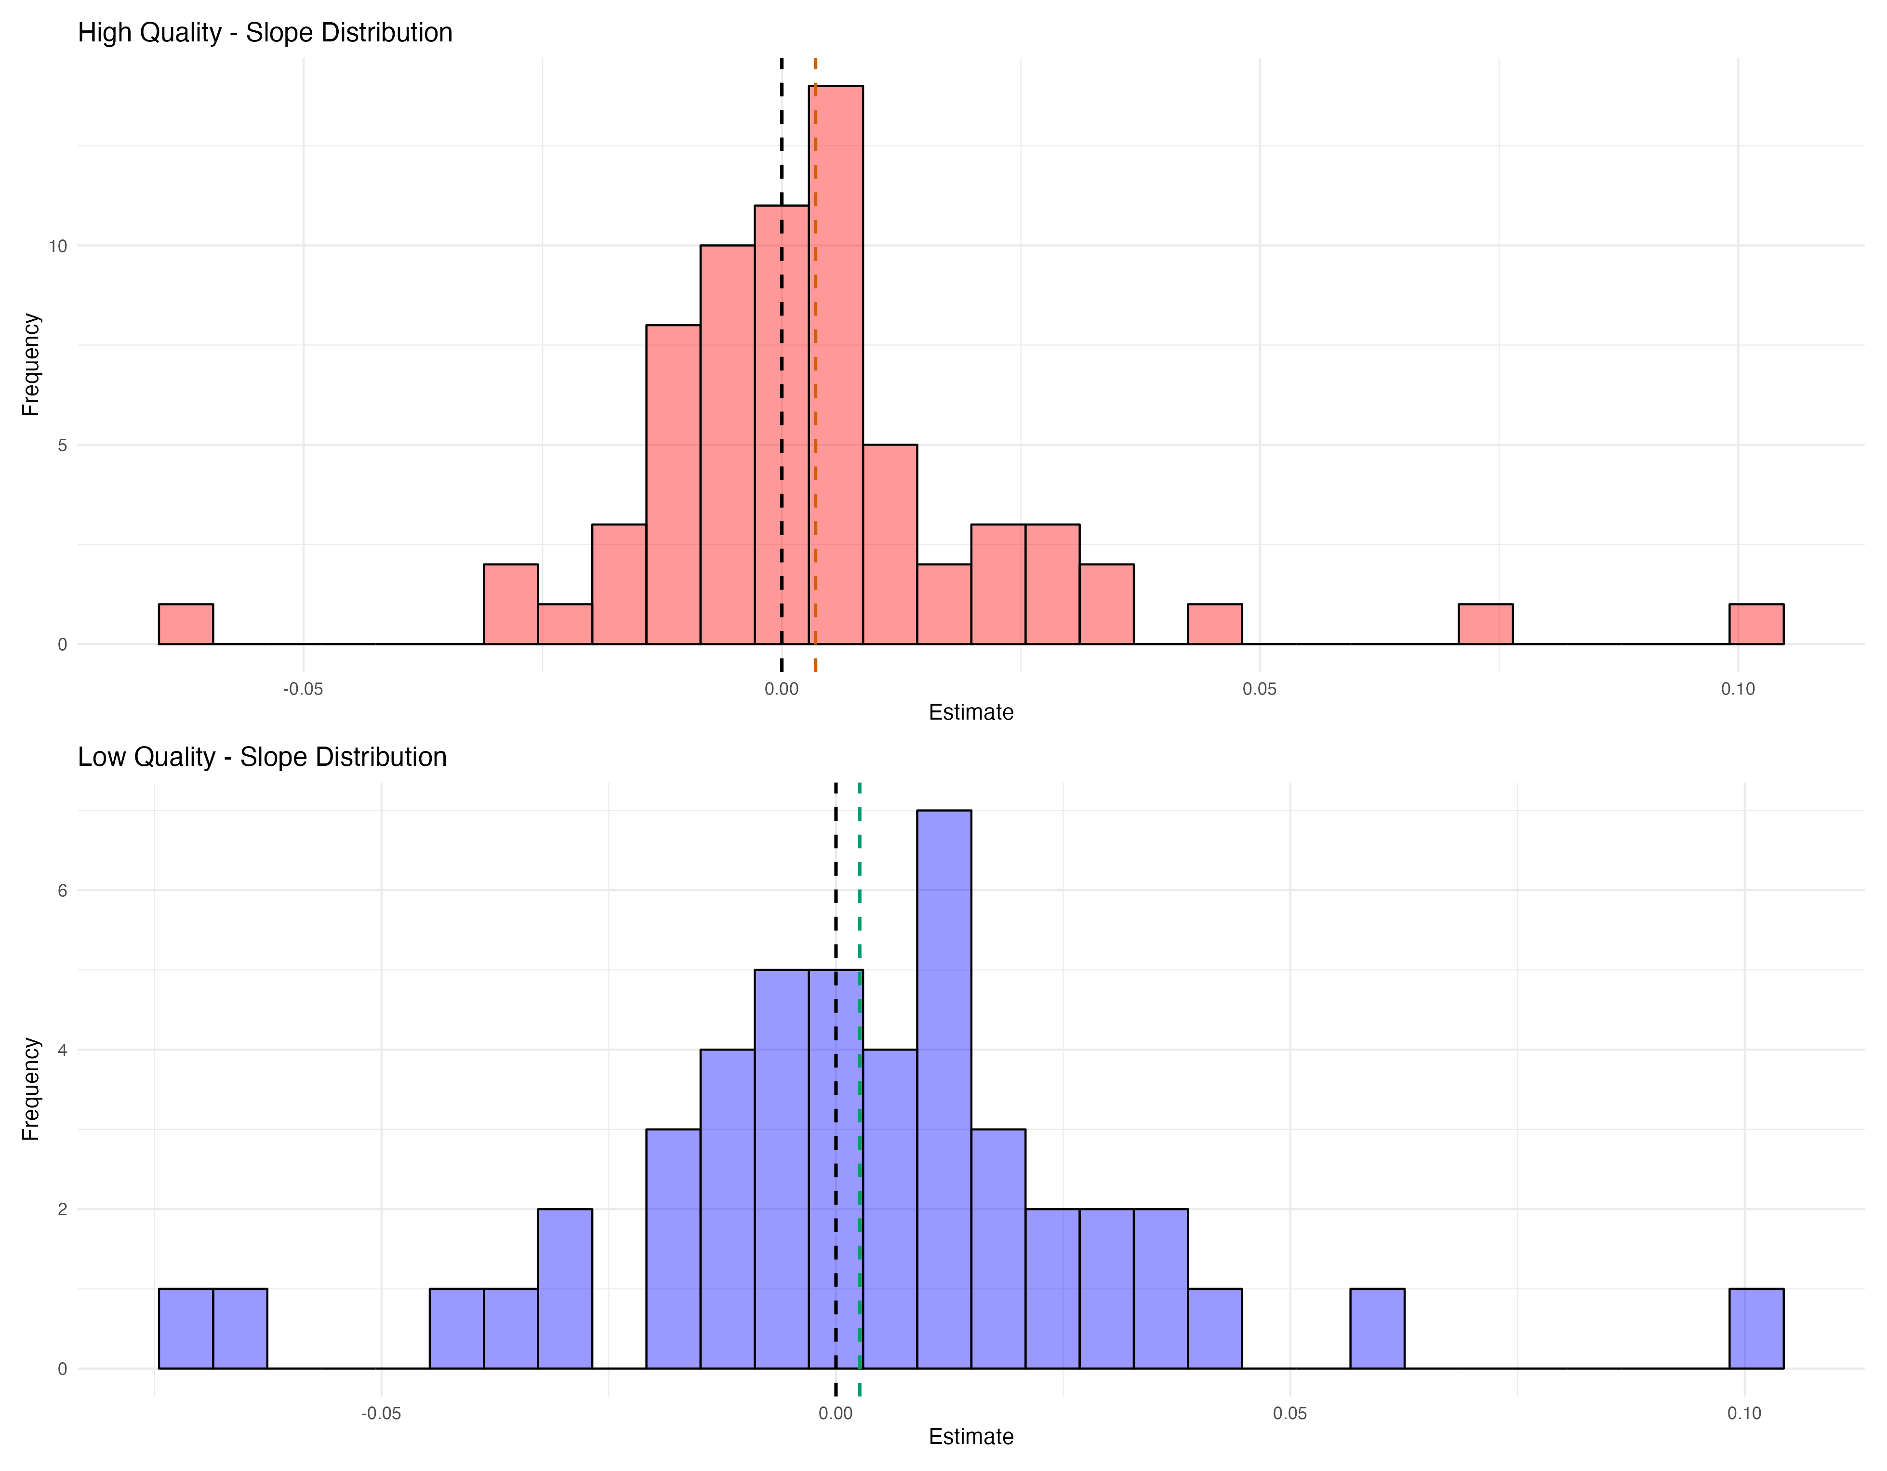
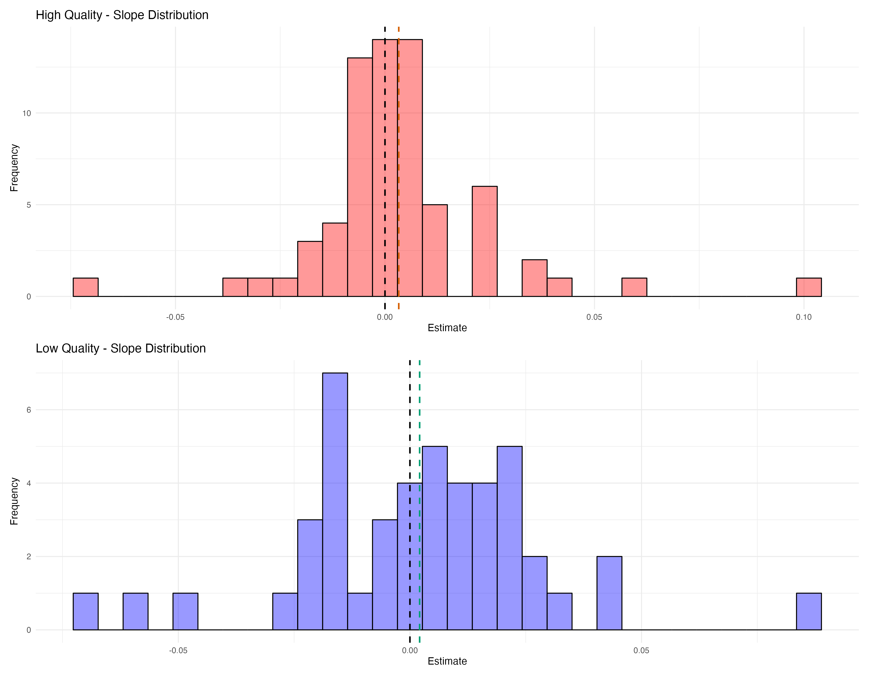
What if we use imputed dosages instead of hard-calls?
Plus Models, $g_{i1}+g_{i2}=a+b ({\overset{ˆ}{g}}_{i1}−{\overset{ˆ}{g}}_{i2})$
Dosages
Hard-Calls

Slide 14
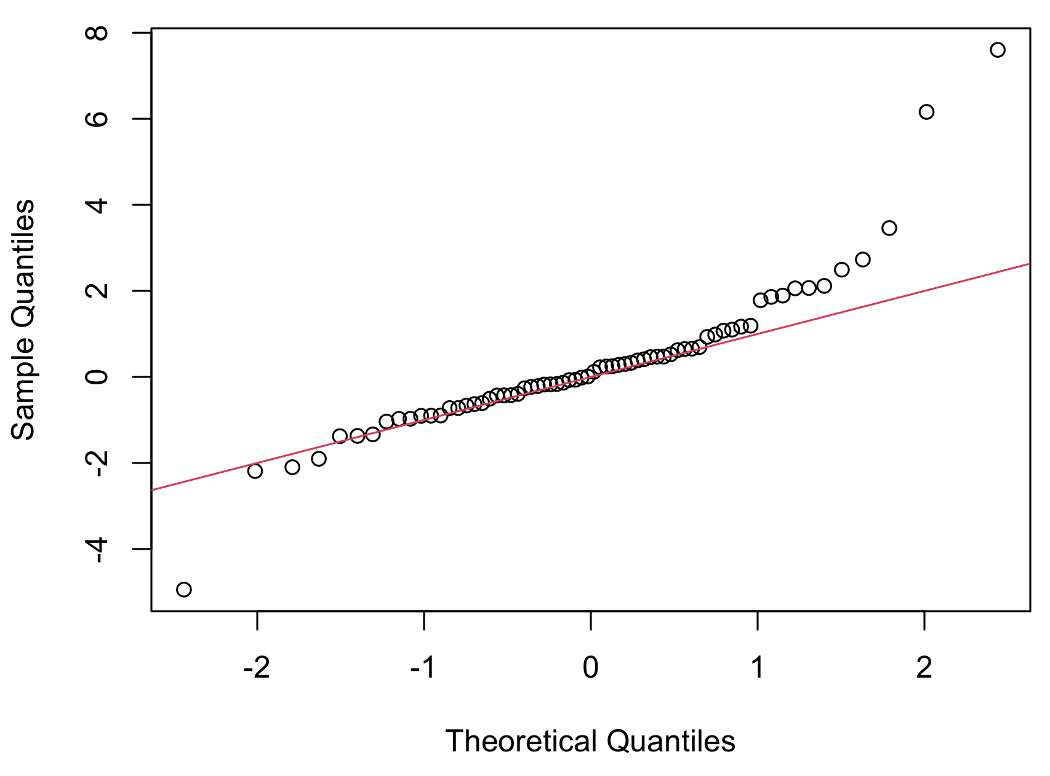
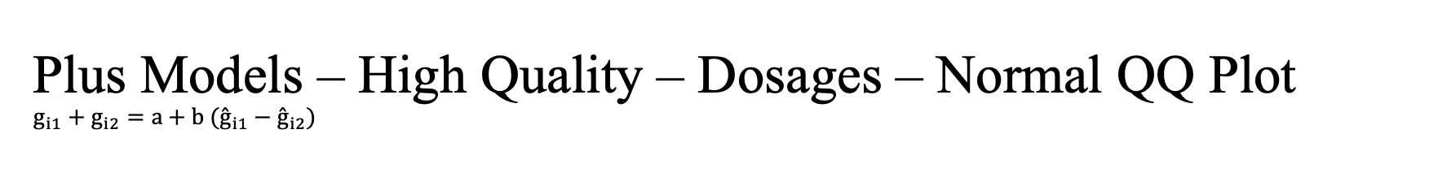
Plus Models – High Quality – Dosages – Normal QQ Plot $$g_{i1}+g_{i2}=a+b ({\overset{ˆ}{g}}_{i1}−{\overset{ˆ}{g}}_{i2})$$

Slide 15
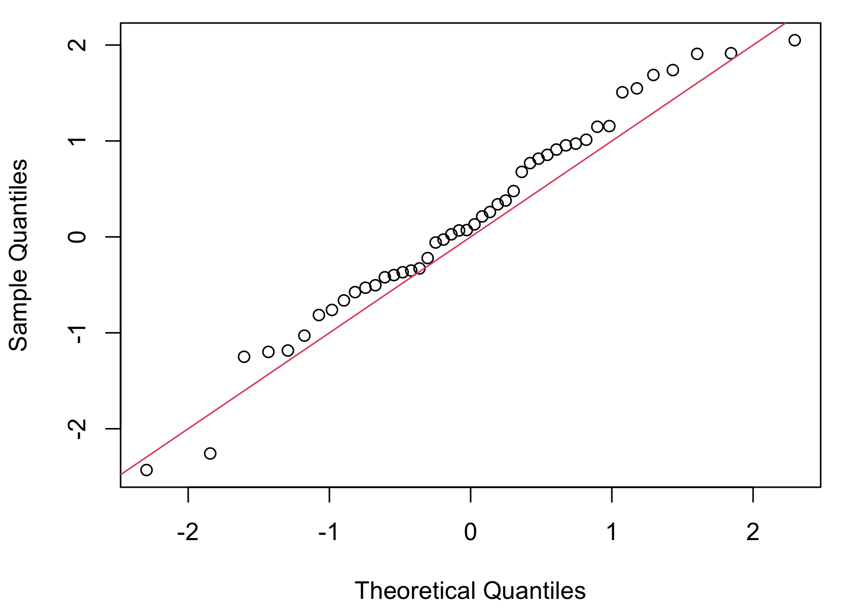
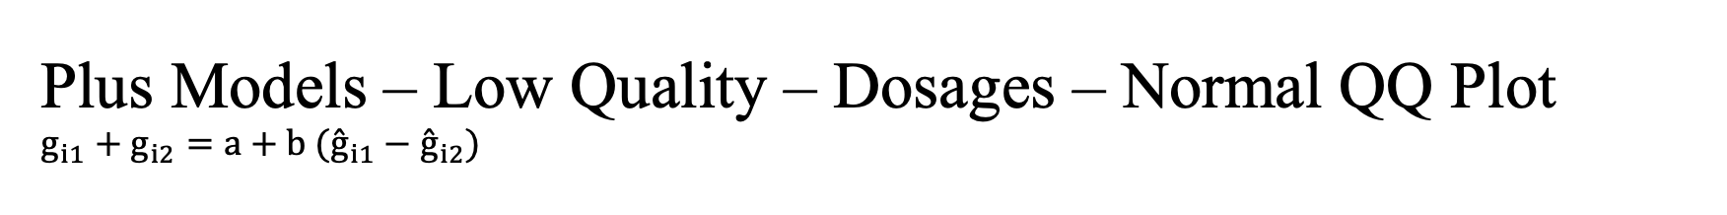
Plus Models – Low Quality – Dosages – Normal QQ Plot $$g_{i1}+g_{i2}=a+b ({\overset{ˆ}{g}}_{i1}−{\overset{ˆ}{g}}_{i2})$$

Slide 16
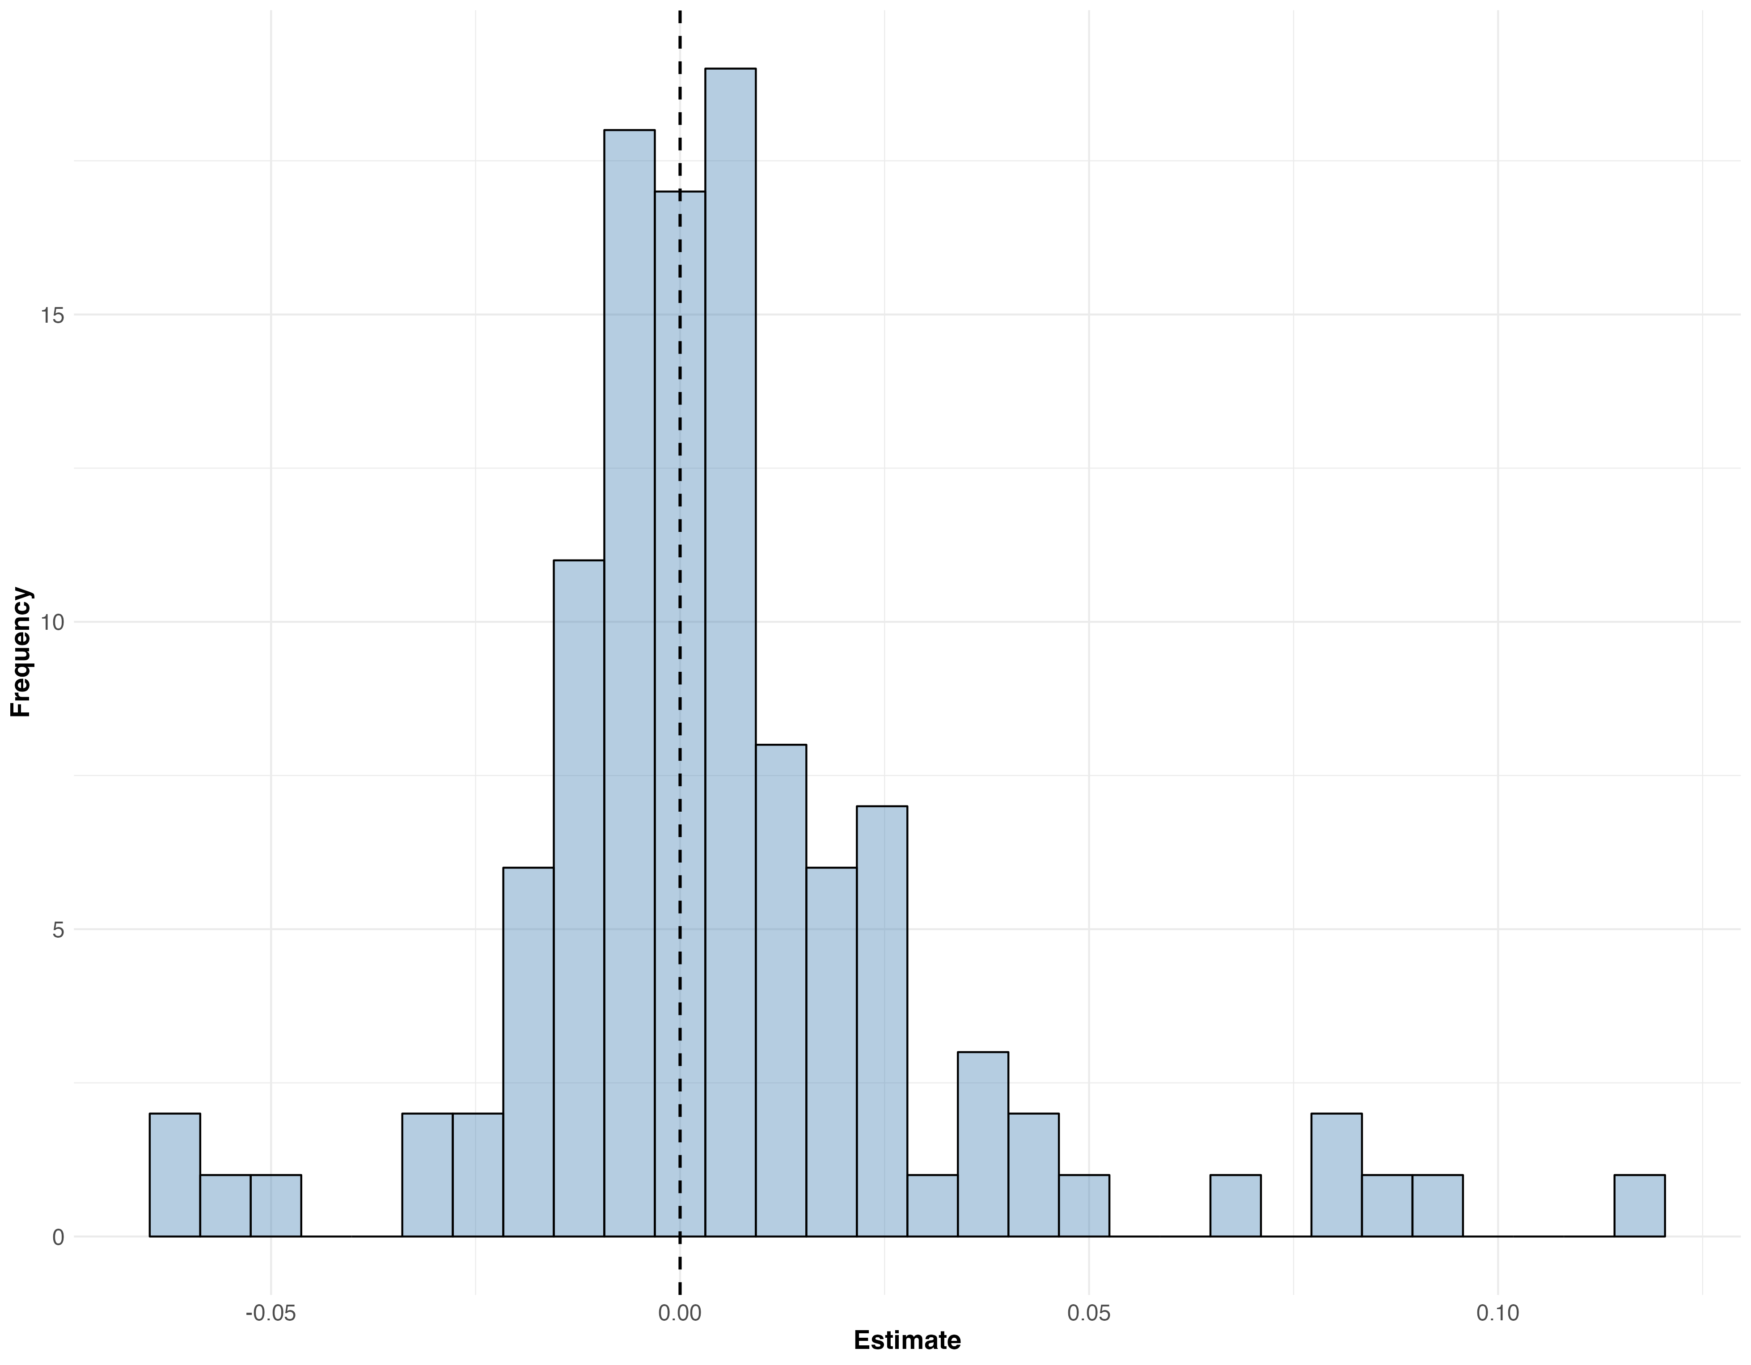
Slope Distribution of $(g1+g2) \sim (g1 −g2$) , WGS Data

Slide 17
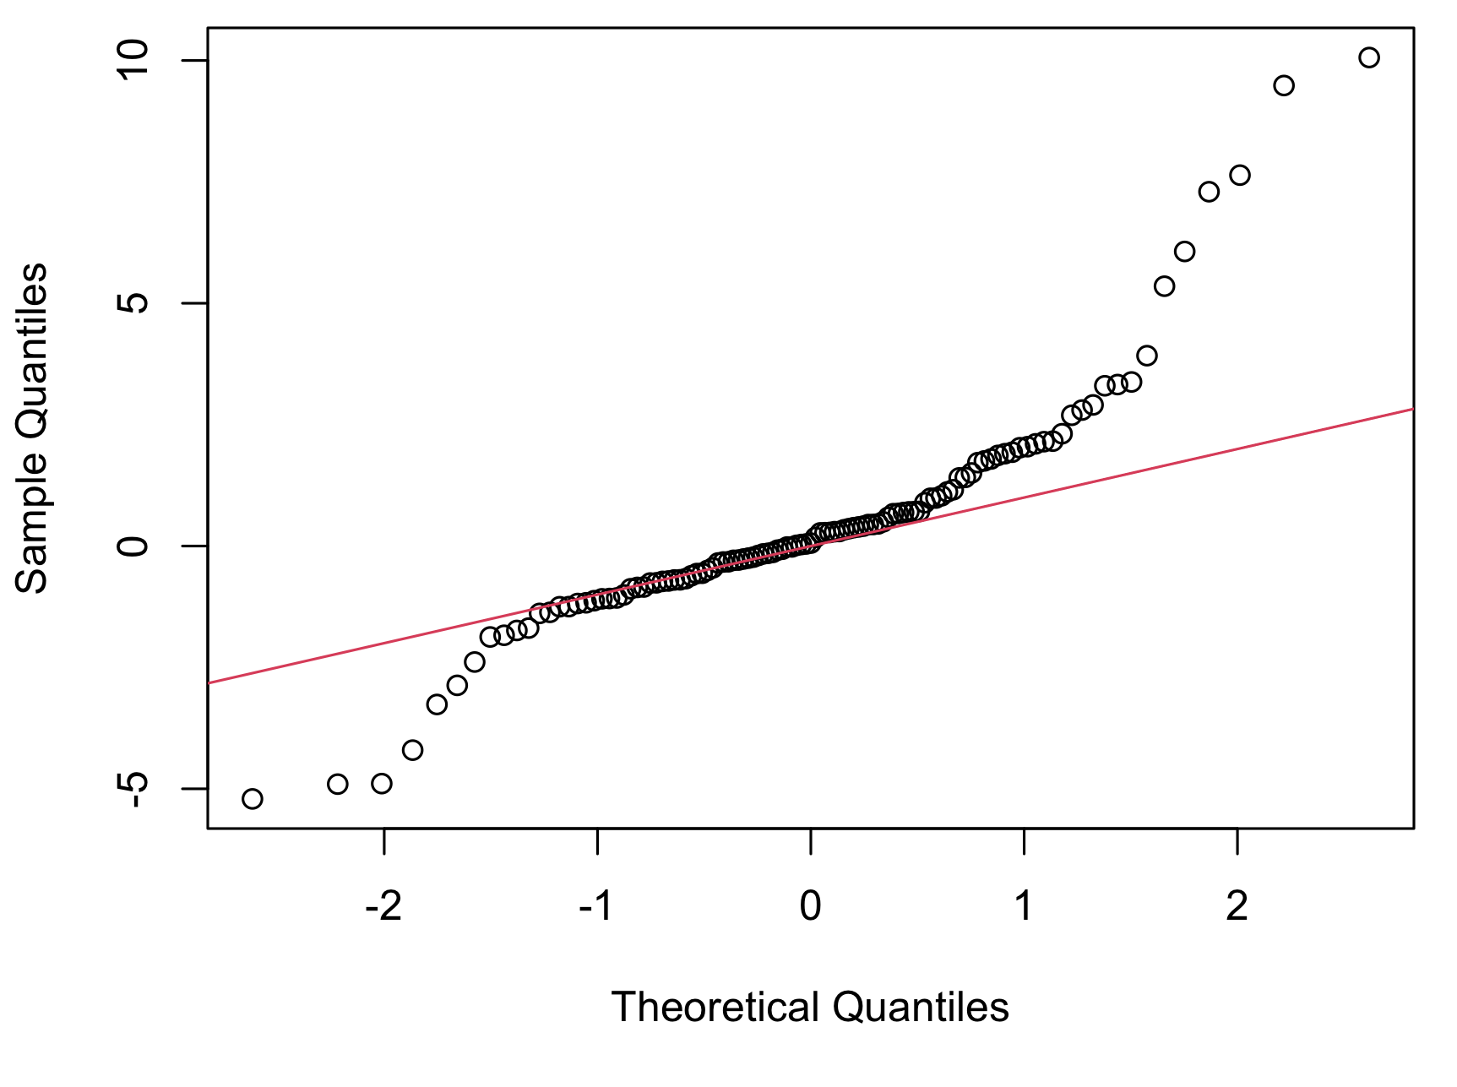
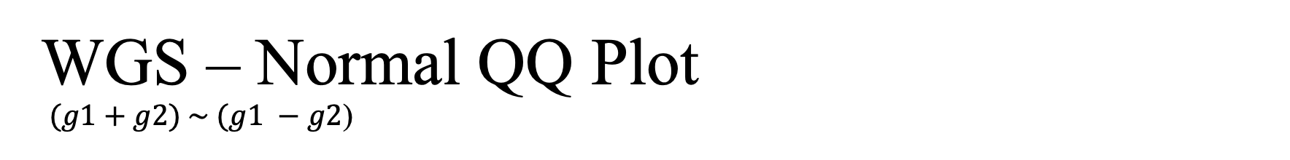
WGS – Normal QQ Plot $(g1+g2) \sim (g1 −g2$)

Slide 18
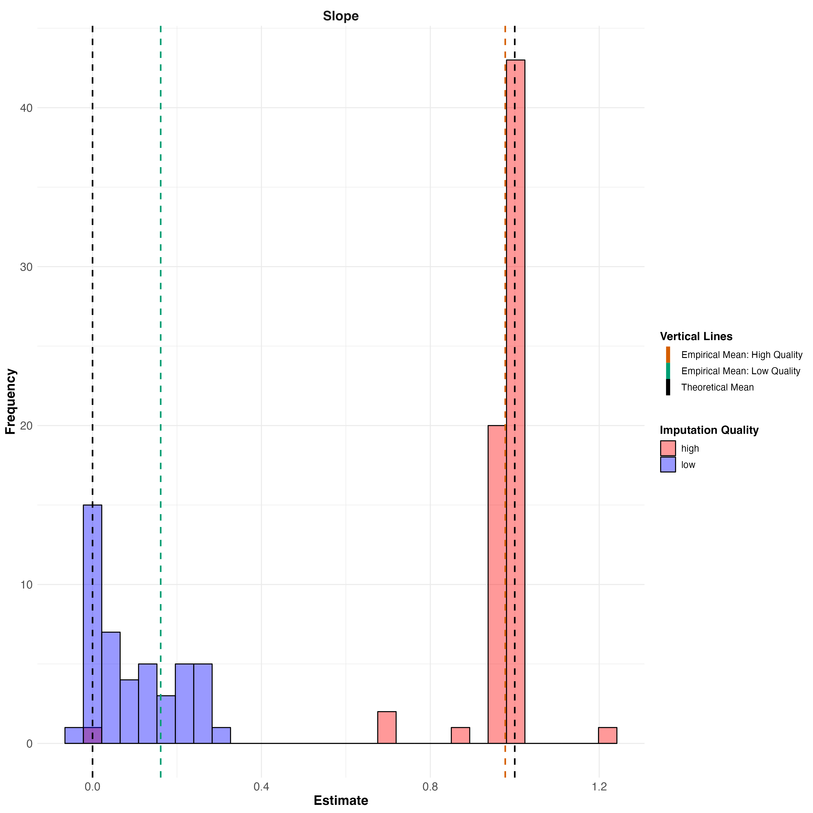
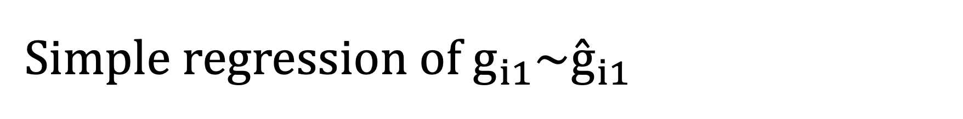
$${Simple regression of g}_{i1}\sim {\overset{ˆ}{g}}_{i1}$$

Slide 19
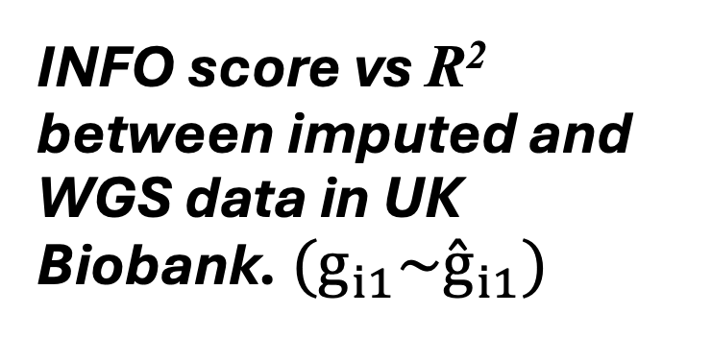
INFO score vs R² between imputed and WGS data in UK Biobank. ${(g}_{i1}\sim {\overset{ˆ}{g}}_{i1})$
INFO score is an unreliable metric of imputation quality in UK Biobank.

Slide 20
Next Steps
We are going to extend the analysis to a larger set of SNPs across a range of INCO scores to increase power.
We will do the parental imputation with Sniper using WGS data.

Slide 21
Thank You!

