Slide 1
Reliability of imputed genotype data for family-based analyses
Mahdi Mir, Alexander S. Young

Slide 2
Motivation
We are concerned that the low-quality imputed genotypes may not be suitable for family-based analyses.
FGWAS is designed to leverage Mendelian inheritance as a clean natural experiment to obtain unbiased estimates, but with imputation we may lose that.
Notes:
Our motivation is

Slide 3
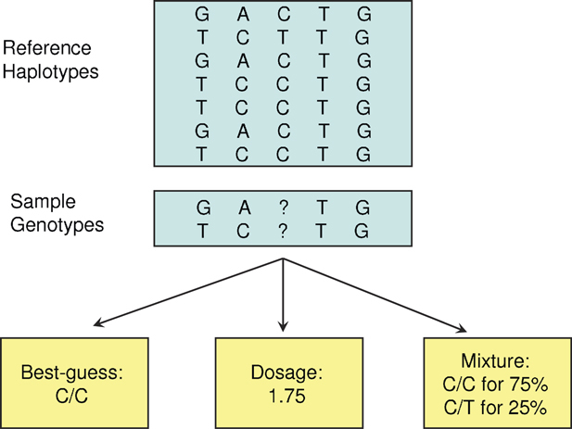
Imputation from a Reference Panel
Hard-Calls
Source: Zheng et al. (2011)

Slide 4
Reference Based vs Mendelian Imputation
Mendelian imputation, as implemented in SNIPAR (Young et al., Nature Genetics, 2022), differs entirely from reference-based imputation.
Reference-based imputation does not consider the relationships between individuals and performs the imputation for everyone separately.

Slide 5
Correlation Analysis in UK Biobank
UK BioBank Imputed Data
SNPs with MAF > 1%
Info Score (Imputation Quality) > 0.3
70K SNPs
White British Subsample
19K Full Siblings Pairs
4K Parent-Offspring Pairs
Howe et.al (2022) Sib-GWAS used low-quality imputed SNPs (Info Score > 30%, Hard Calls).

Slide 6
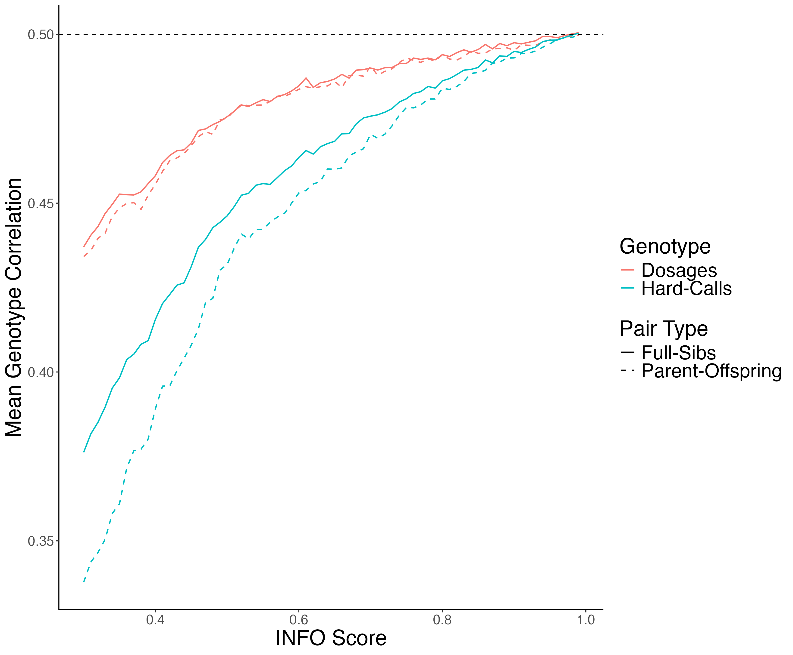
Mean Genotype Correlation

Slide 7
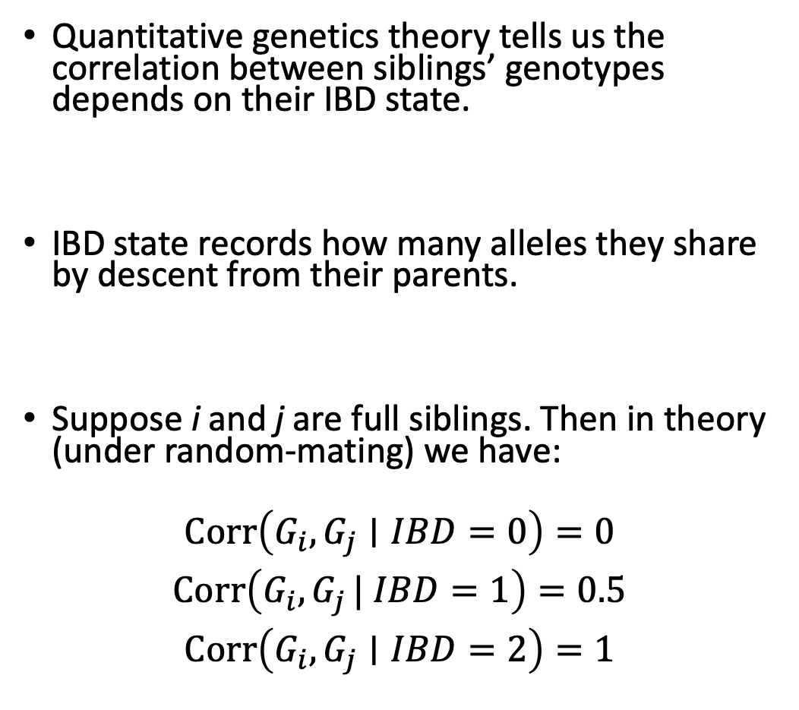
Correlation Analysis Conditional on IBD States
Quantitative genetics theory tells us the correlation between siblings’ genotypes depends on their IBD state.
IBD state records how many alleles they share by descent from their parents.
Suppose i and j are full siblings. Then in theory (under random-mating) we have:
$$\begin{matrix}Corr⁡\left(G_{i},G_{j}∣IBD=0\right)=0 \\ Corr⁡\left(G_{i},G_{j }| IBD=1\right)=0.5 \\ Corr⁡\left(G_{i},G_{j}∣IBD=2\right)=1\end{matrix}$$

Slide 8
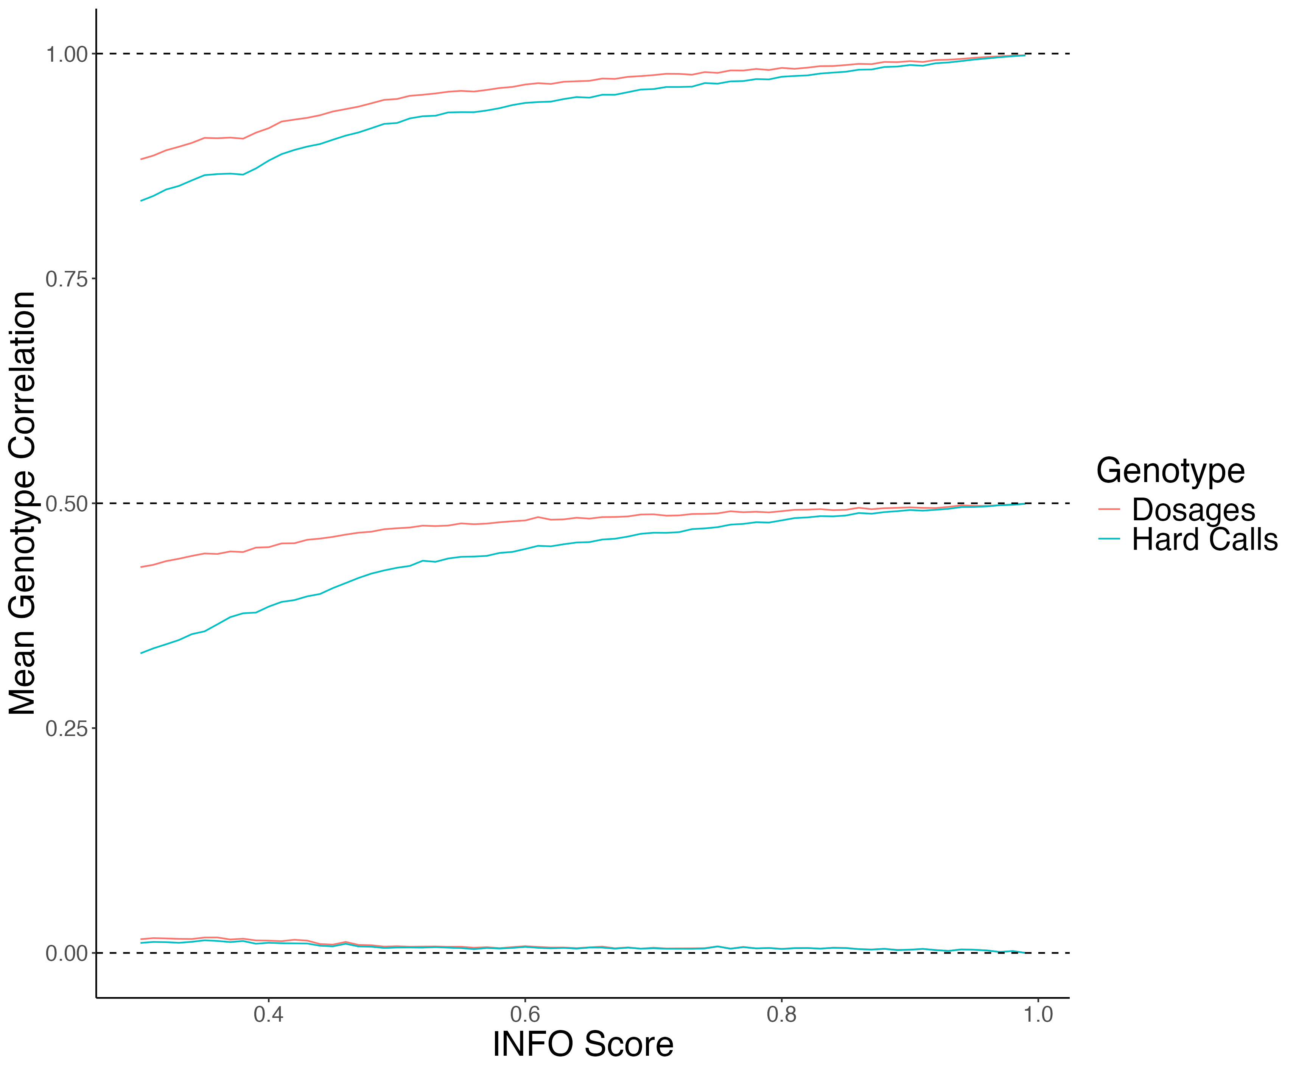
Mean Imputed Genotype Correlation Conditional on IBD State

Slide 9
UKB WGS Analysis
68 High Quality Imputed SNPs, mean INFO score = 96%
46 Low Quality Imputed SNPs, mean INFO score = 31%
19,052 White British Sibling Pairs from UKB
SNPs with MAF > 1%
Only bi-allelic SNPs

Slide 10
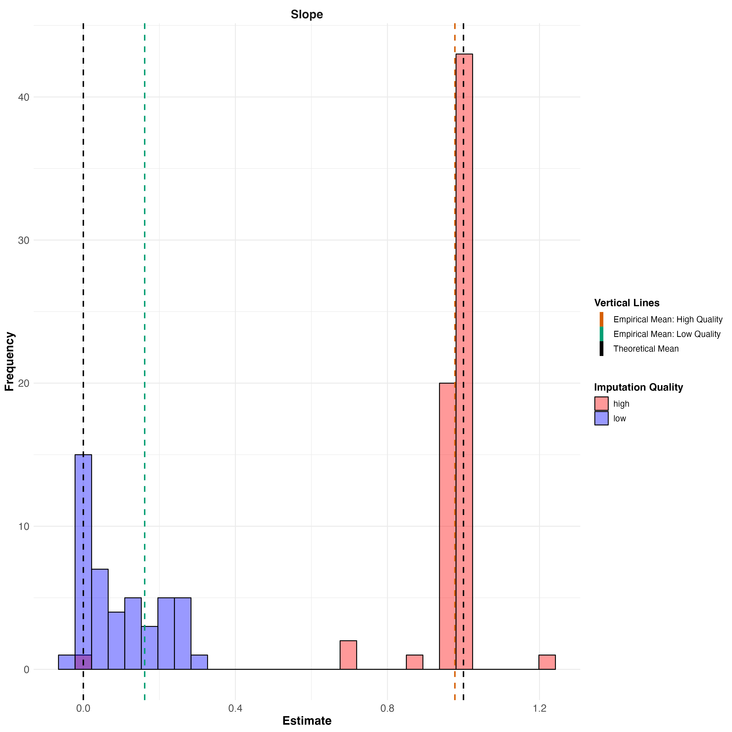
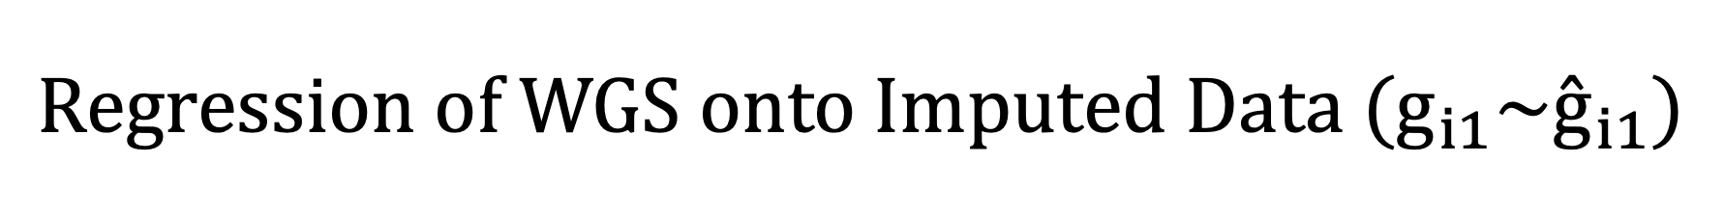
$${Regression of WGS onto Imputed Data (g}_{i1}\sim {\overset{ˆ}{g}}_{i1})$$

Slide 11
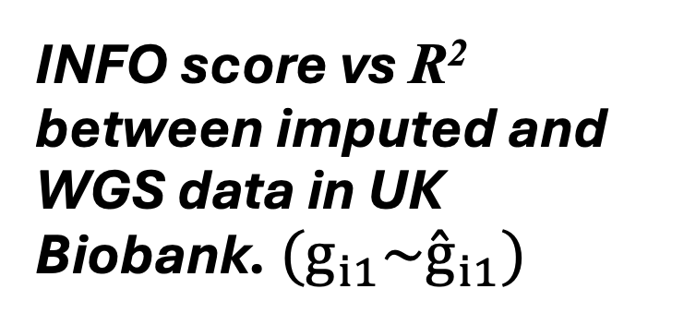
INFO score vs R² between imputed and WGS data in UK Biobank. ${(g}_{i1}\sim {\overset{ˆ}{g}}_{i1})$
INFO score is an unreliable metric of imputation quality in UK Biobank.

Slide 12
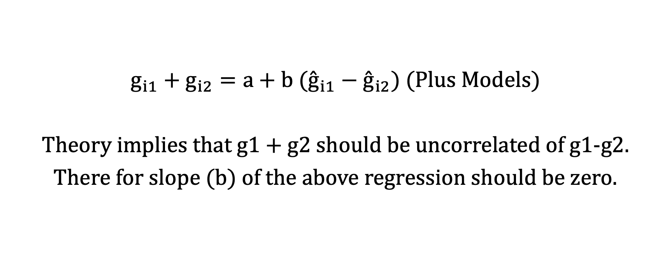
Sib Differences with Imputed Genotypes
$g_{i1}+g_{i2}=a+b ({\overset{ˆ}{g}}_{i1}−{\overset{ˆ}{g}}_{i2})$ (Plus Models)
Theory implies that g1 + g2 should be uncorrelated of g1-g2.
There for slope (b) of the above regression should be zero.

Slide 13
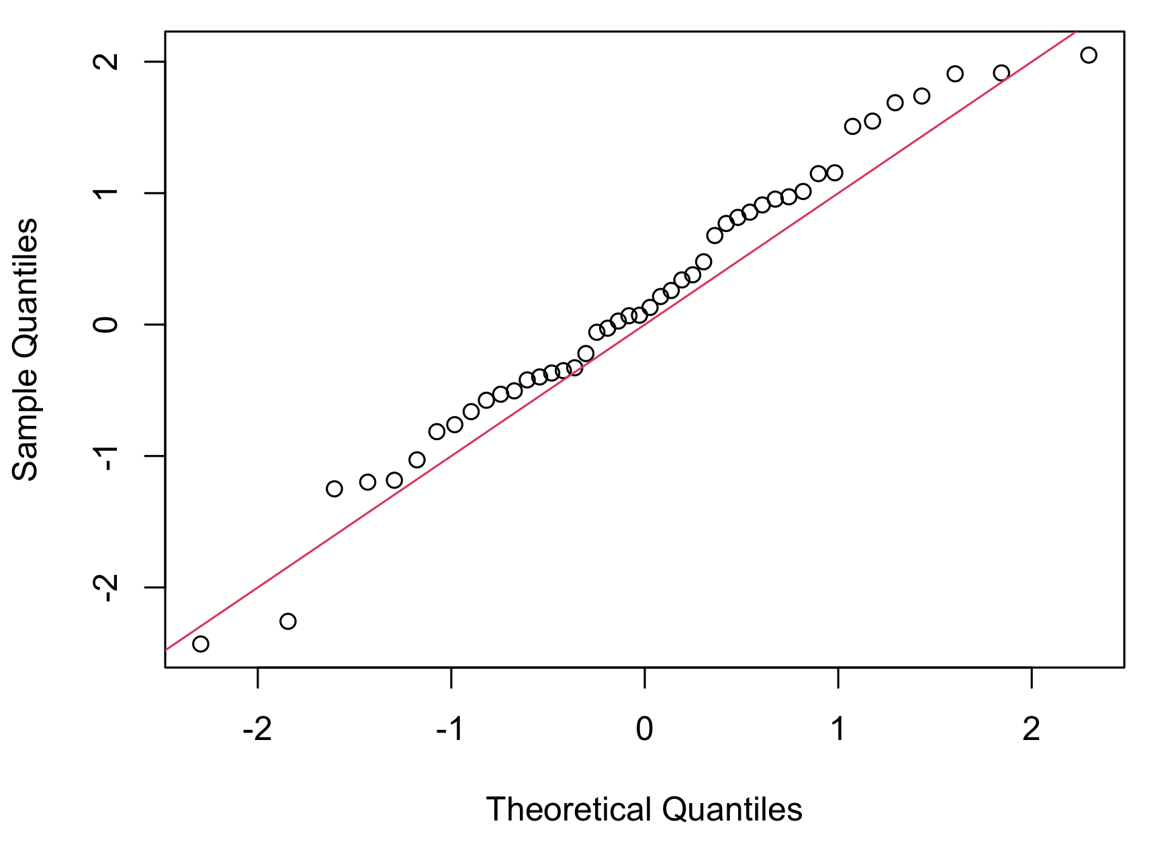
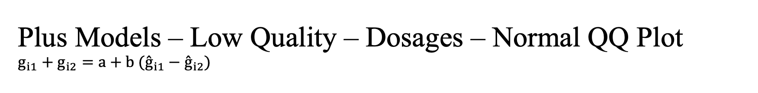
Plus Models – Low Quality – Dosages – Normal QQ Plot $$g_{i1}+g_{i2}=a+b ({\overset{ˆ}{g}}_{i1}−{\overset{ˆ}{g}}_{i2})$$

Slide 14
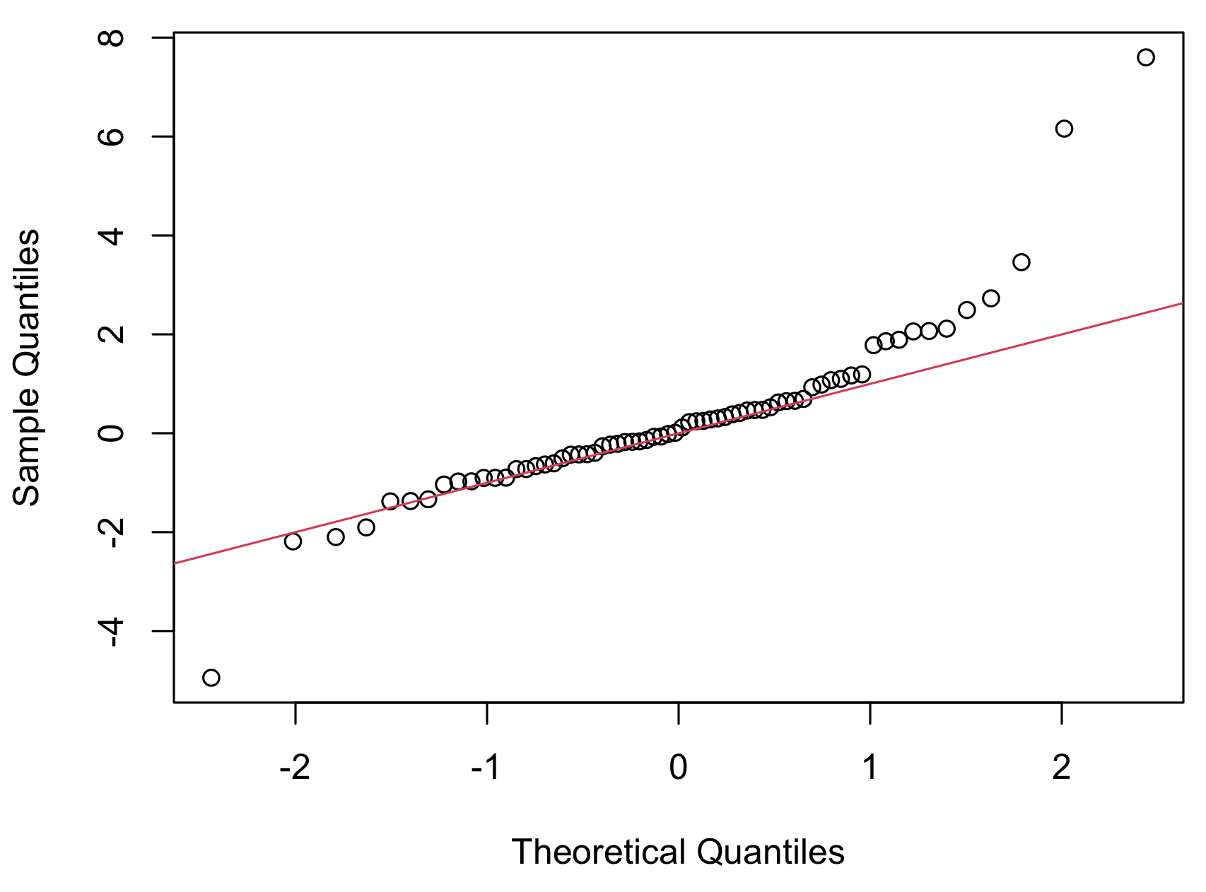
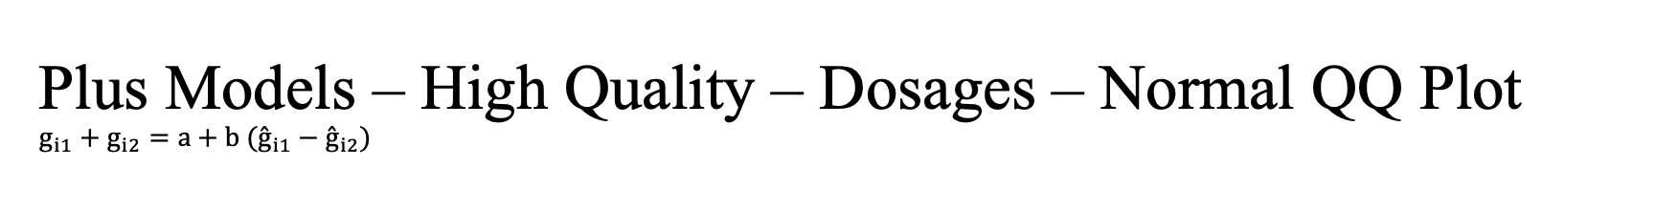
Plus Models – High Quality – Dosages – Normal QQ Plot $$g_{i1}+g_{i2}=a+b ({\overset{ˆ}{g}}_{i1}−{\overset{ˆ}{g}}_{i2})$$

Slide 15
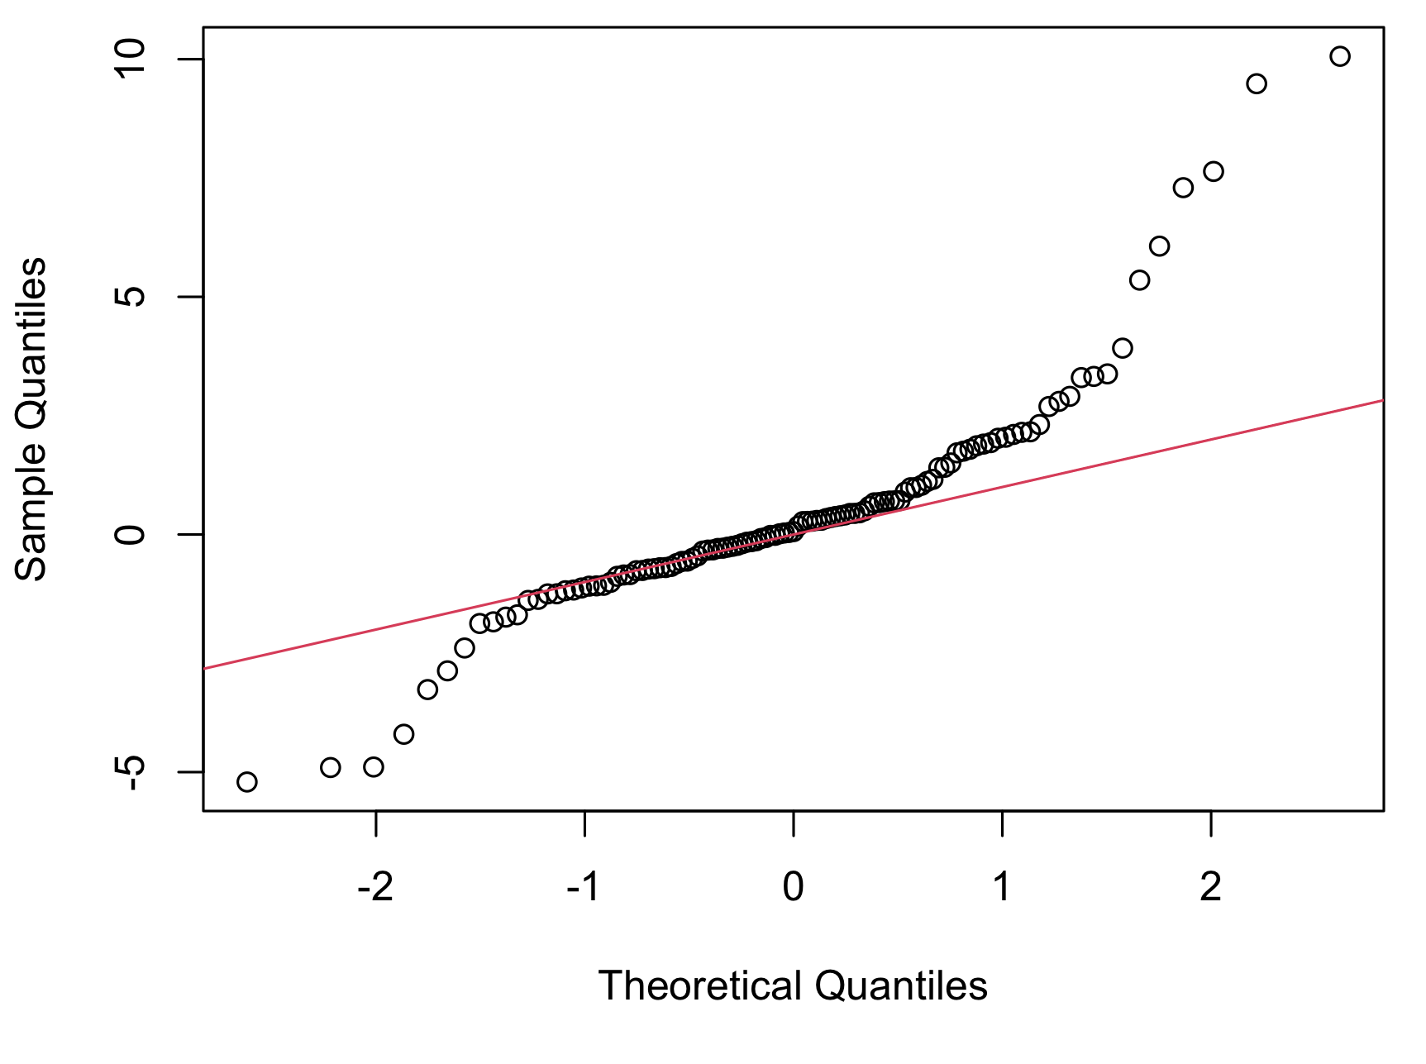
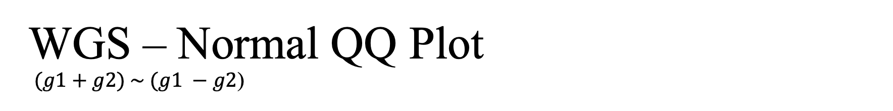
WGS – Normal QQ Plot $(g1+g2) \sim (g1 −g2$)

Slide 16
Using Genotyped Array Data
UKB Genotyped array data is the original data used for imputation and creation of imputed data.
Using 2000 SNPs, the results are broadly similar to what we obtained from the imputed and WGS data.

Slide 17

$(g1+g2) \sim (g1 −g2$)

Slide 18
Next Steps
We are going to extend the WGS analysis to a larger set of SNPs across a range of INFO scores to increase power.
We will do Family-GWAS using the WGS data and compare the results to imputed data.
We will do the parental imputation with Sniper using WGS data.

Slide 19
Thank You!

