Slide 1

Reliability of Imputed Genotype Data for Family-Based Analyses
Mahdi Mir, Tammy Tan, ­Patrick Turley, Daniel J. Benjamin, and Alexander Strudwick Young

Slide 2
Motivation
We are concerned that the low-quality imputed genotypes may not be suitable for family-based analyses.
Family- and Sib-GWAS is designed to leverage Mendelian inheritance as a clean natural experiment to obtain unbiased estimates, but with imputation we may lose that.
Notes:
Our motivation is

Slide 3
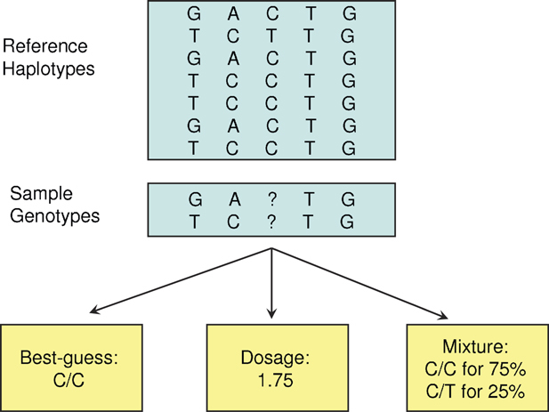
Imputation from a Reference Panel
HARD-CALLS
DOSAGES
Source: Zheng et al. (2011)

Slide 4
Reference Based vs Mendelian Imputation
Mendelian imputation, as implemented in SNIPAR (Young et al., Nature Genetics, 2022), differs entirely from reference-based imputation.
Reference-based imputation does not consider the relationships between individuals (or pedigree) and performs the imputation for everyone separately.

Slide 5
Correlation Analysis in UK Biobank
UKB Imputed Data
SNPs with MAF > 1%
INFO Score (Imputation Quality) > 0.3
70K SNPs
White British Subsample
~ 19K Full Siblings Pairs
~ 4K Parent-Offspring Pairs
Howe et.al (2022) Sib-GWAS used low-quality imputed SNPs (Info Score > 0.3, Hard Calls).

Slide 6

Correlation Analysis
Suppose i and j are full siblings or parent-offspring.
Then in theory (under random-mating):
$$\begin{matrix}Corr⁡\left(g_{i},g_{j}\right)=0.5 \\ \\ \end{matrix}$$

Slide 7
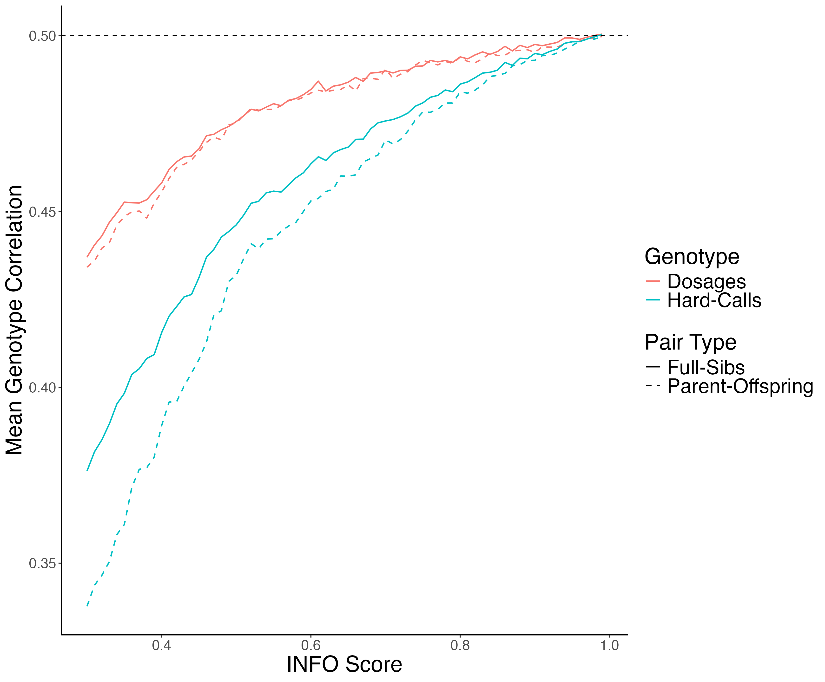
Mean Genotype Correlation

Slide 8

Correlation Analysis Conditional on IBD States
Quantitative genetics theory tells us the correlation between siblings’ genotypes depends on their IBD state.
IBD state records how many alleles they share by descent from their parents.
Suppose i and j are full siblings. Then in theory (under random-mating) we have:
$$\begin{matrix}Corr⁡\left(G_{i},G_{j}∣IBD=0\right)=0 \\ Corr⁡\left(G_{i},G_{j }| IBD=1\right)=0.5 \\ Corr⁡\left(G_{i},G_{j}∣IBD=2\right)=1\end{matrix}$$

Slide 9
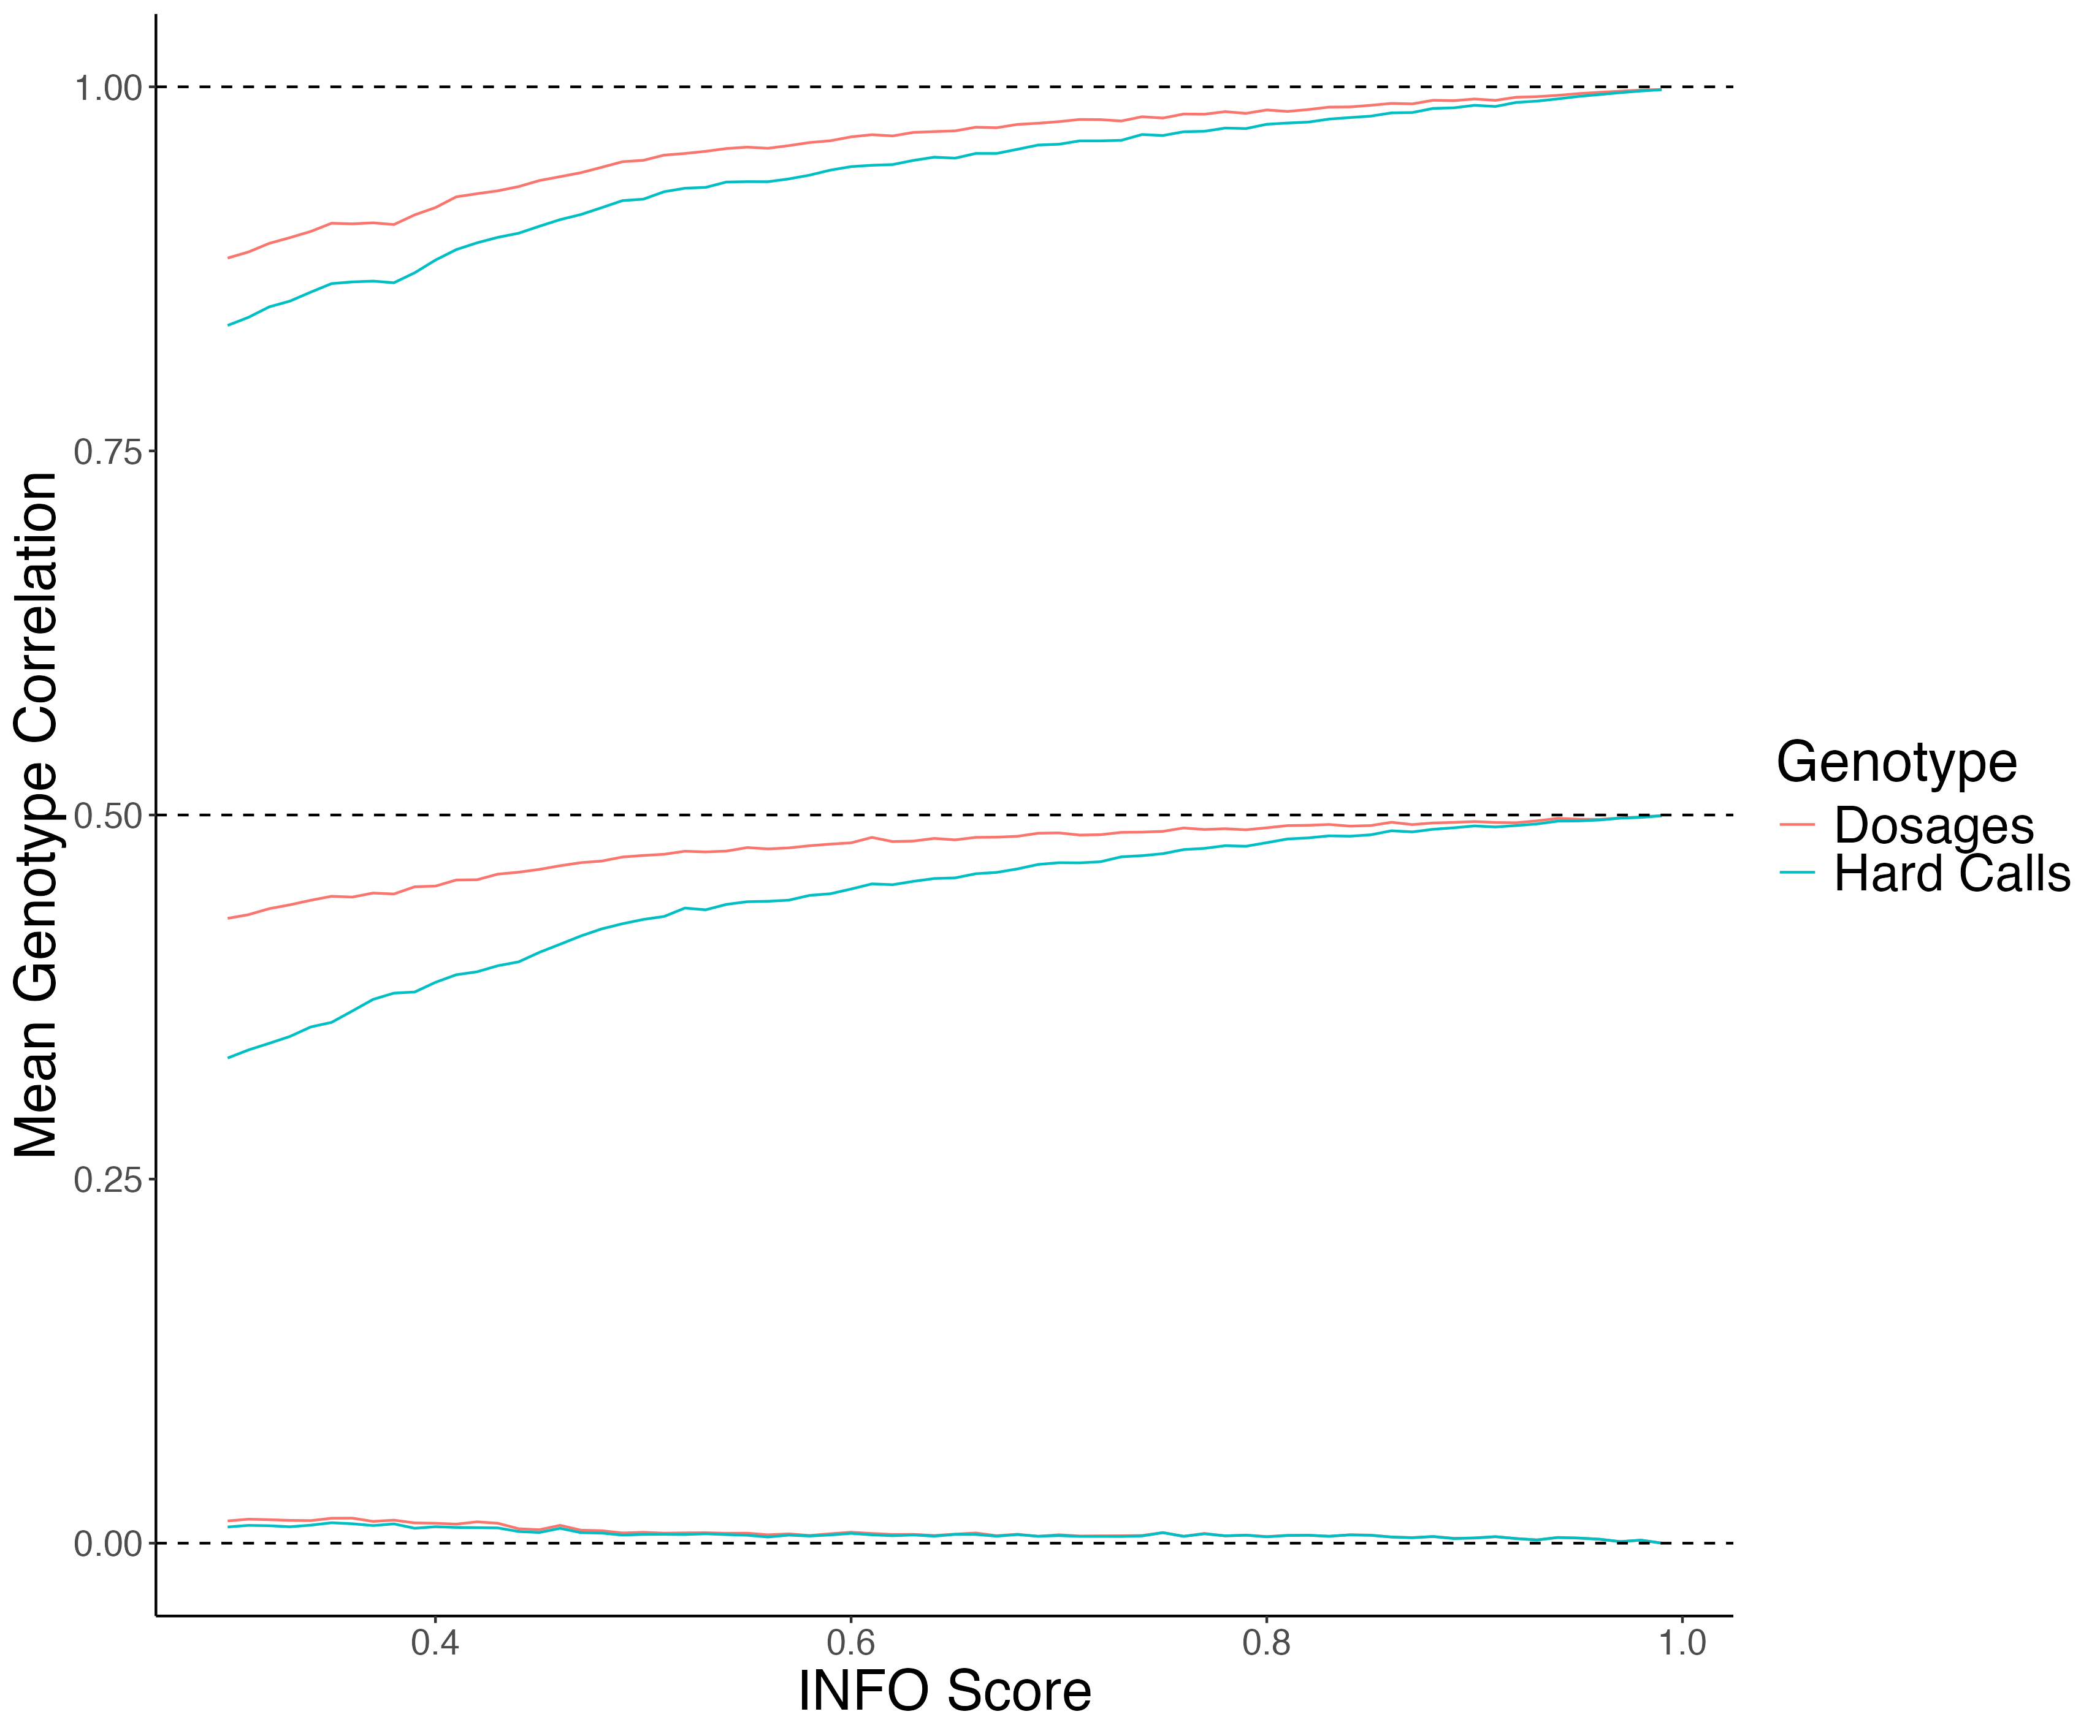
Mean Imputed Genotype Correlation Conditional on IBD State

Slide 10
Mean Imputed Genotype Correlation Conditional on IBD State
IBD = 2

Slide 11
Mean Imputed Genotype Correlation Conditional on IBD State
IBD = 1

Slide 12
Mean Imputed Genotype Correlation Conditional on IBD State
IBD = 0

Slide 13
UKB WGS Analysis
UKB WGS Data
68 High Quality Imputed SNPs, INFO Score in (0.92-0.99)
46 Low Quality Imputed SNPs, INFO Score in (0.30-0.32)
19,052 White British Sibling
SNPs with MAF > 1%

Slide 14
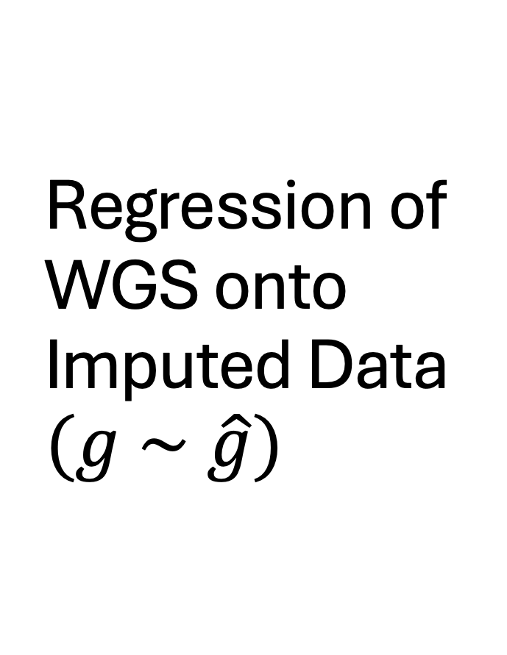
Regression of WGS onto Imputed Data $$(g \sim \hat{g})$$
If imputed data is good quality, then
We would expect all the slopes across all SNPs to be 1.

Slide 15
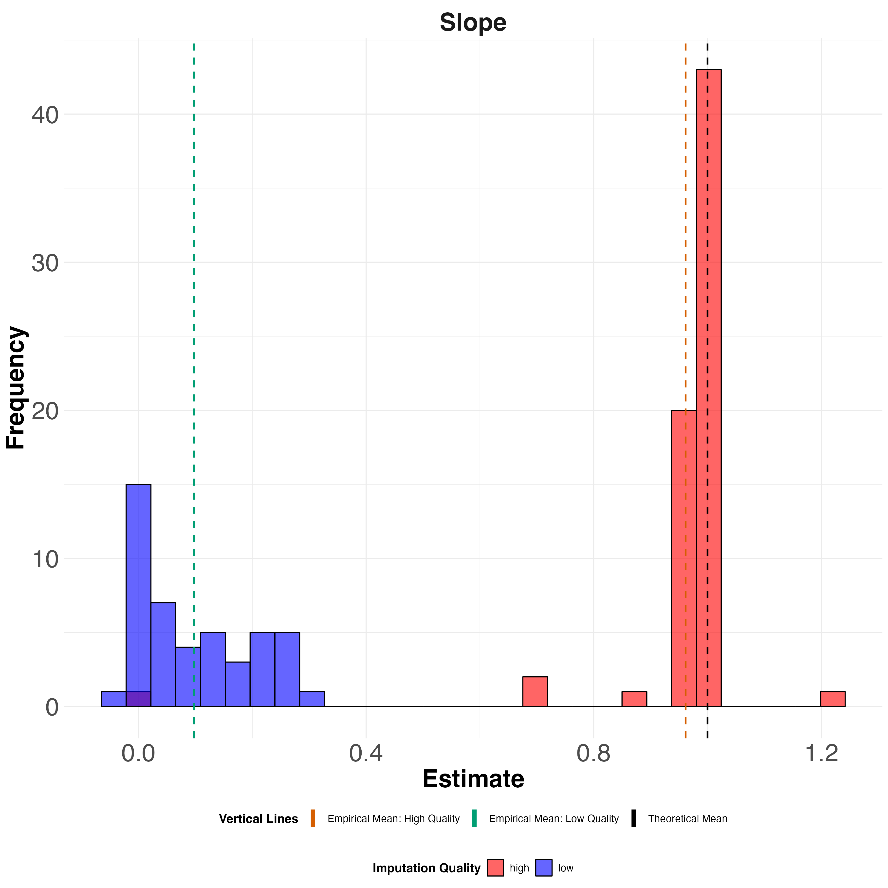
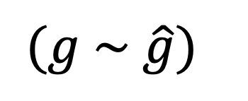
Regression of WGS onto Imputed Data
$$(g \sim \hat{g})$$
LOW Quality
HIGH Quality
1

Slide 16
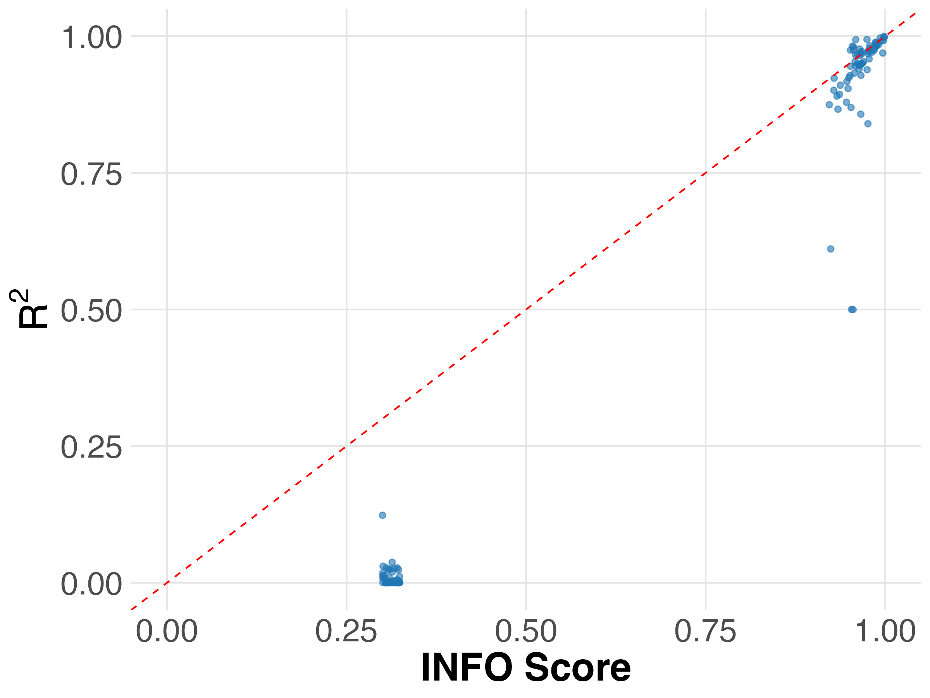

INFO Score vs R² Between WGS and Imputed data in UKB $${(g}_{i1}\sim {\overset{ˆ}{g}}_{i1})$$
INFO score is an unreliable metric of imputation quality in UKB Imputed data.

Slide 17

Sib-Sum, Sib-Difference Regression
Theory implies that (g1 + g2) should be uncorrelated of (g1 - g2).
Therefore, the slope ($β$) of the following regression should be zero.
${(g}_{i1}+g_{i2})=α+β ({\overset{ˆ}{g}}_{i1}−{\overset{ˆ}{g}}_{i2})$

Slide 18
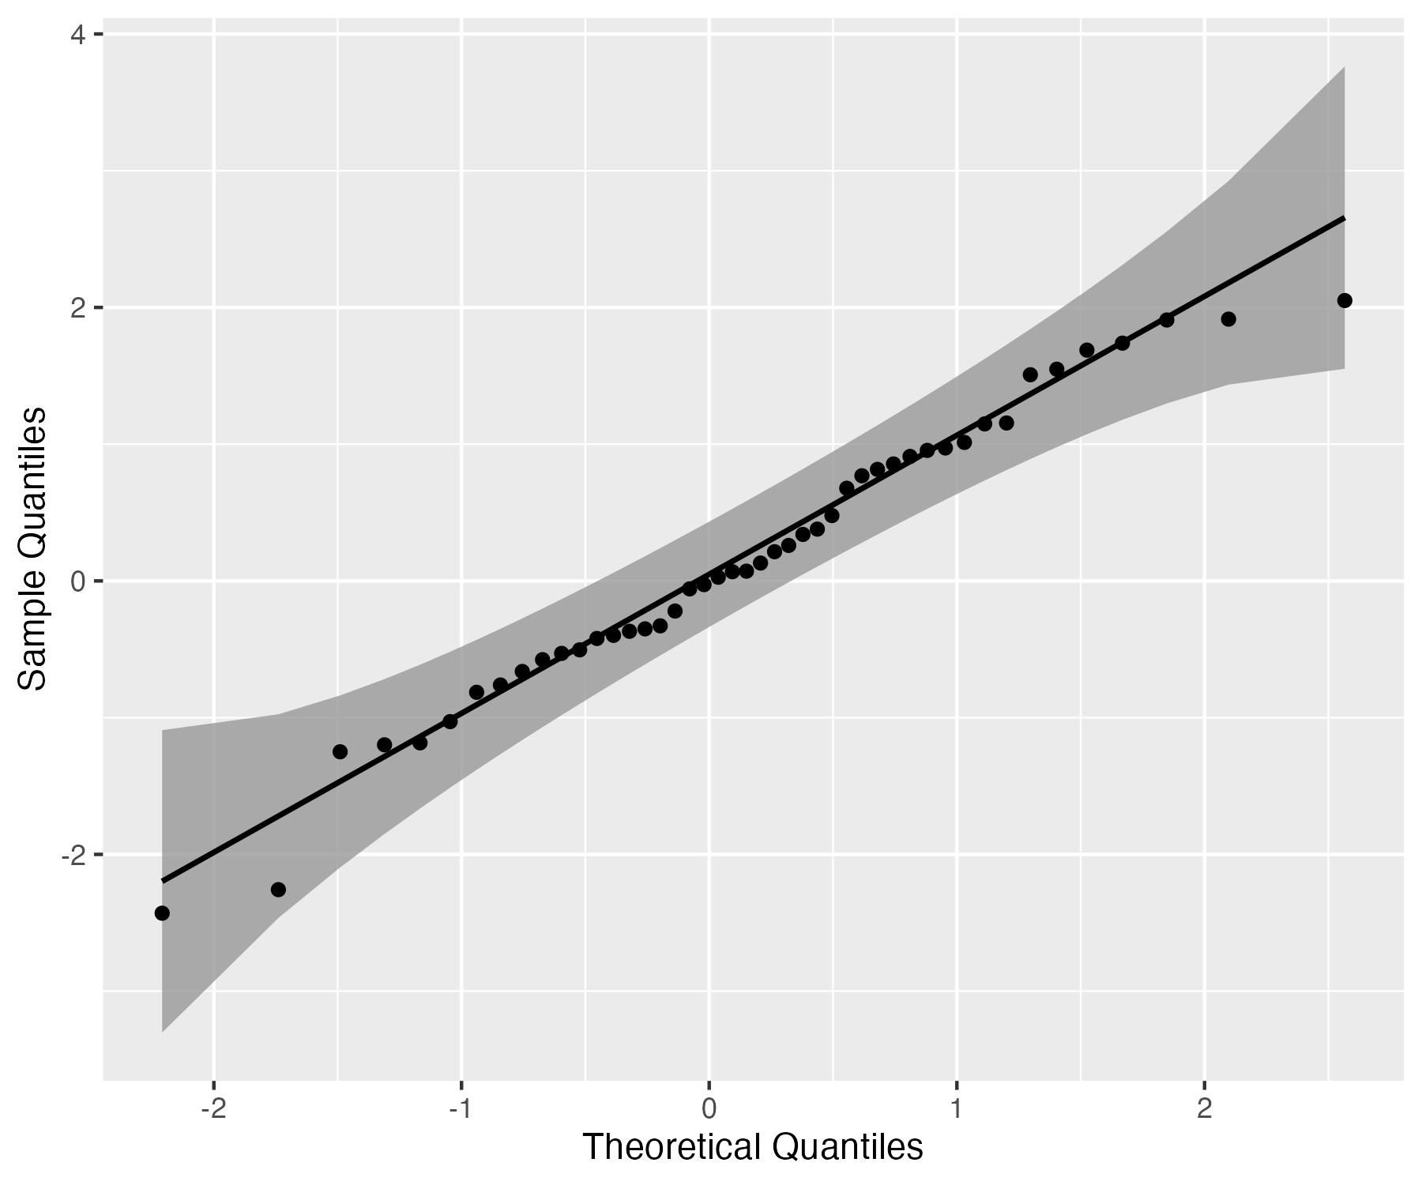
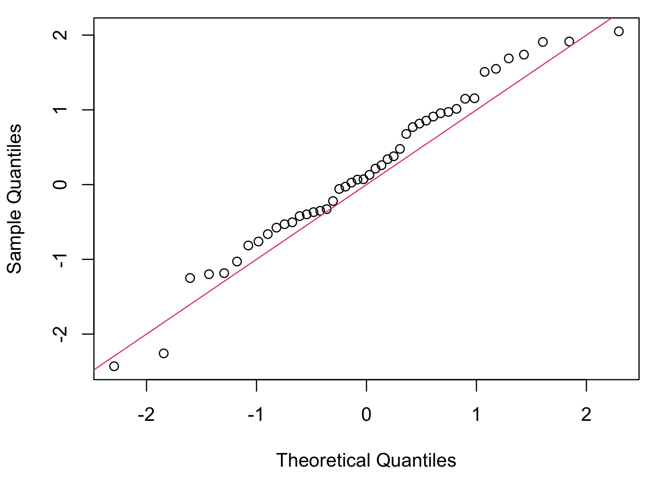
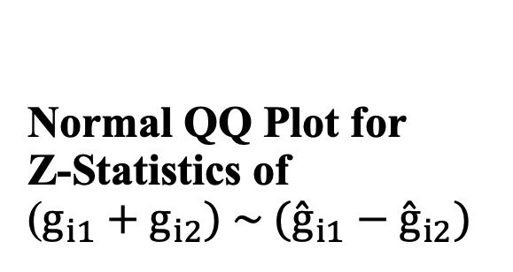
Normal QQ Plot for Z-Statistics of ($g_{i1}+g_{i2}) \sim ({\overset{ˆ}{g}}_{i1}−{\overset{ˆ}{g}}_{i2})$
Low Quality Group

Slide 19
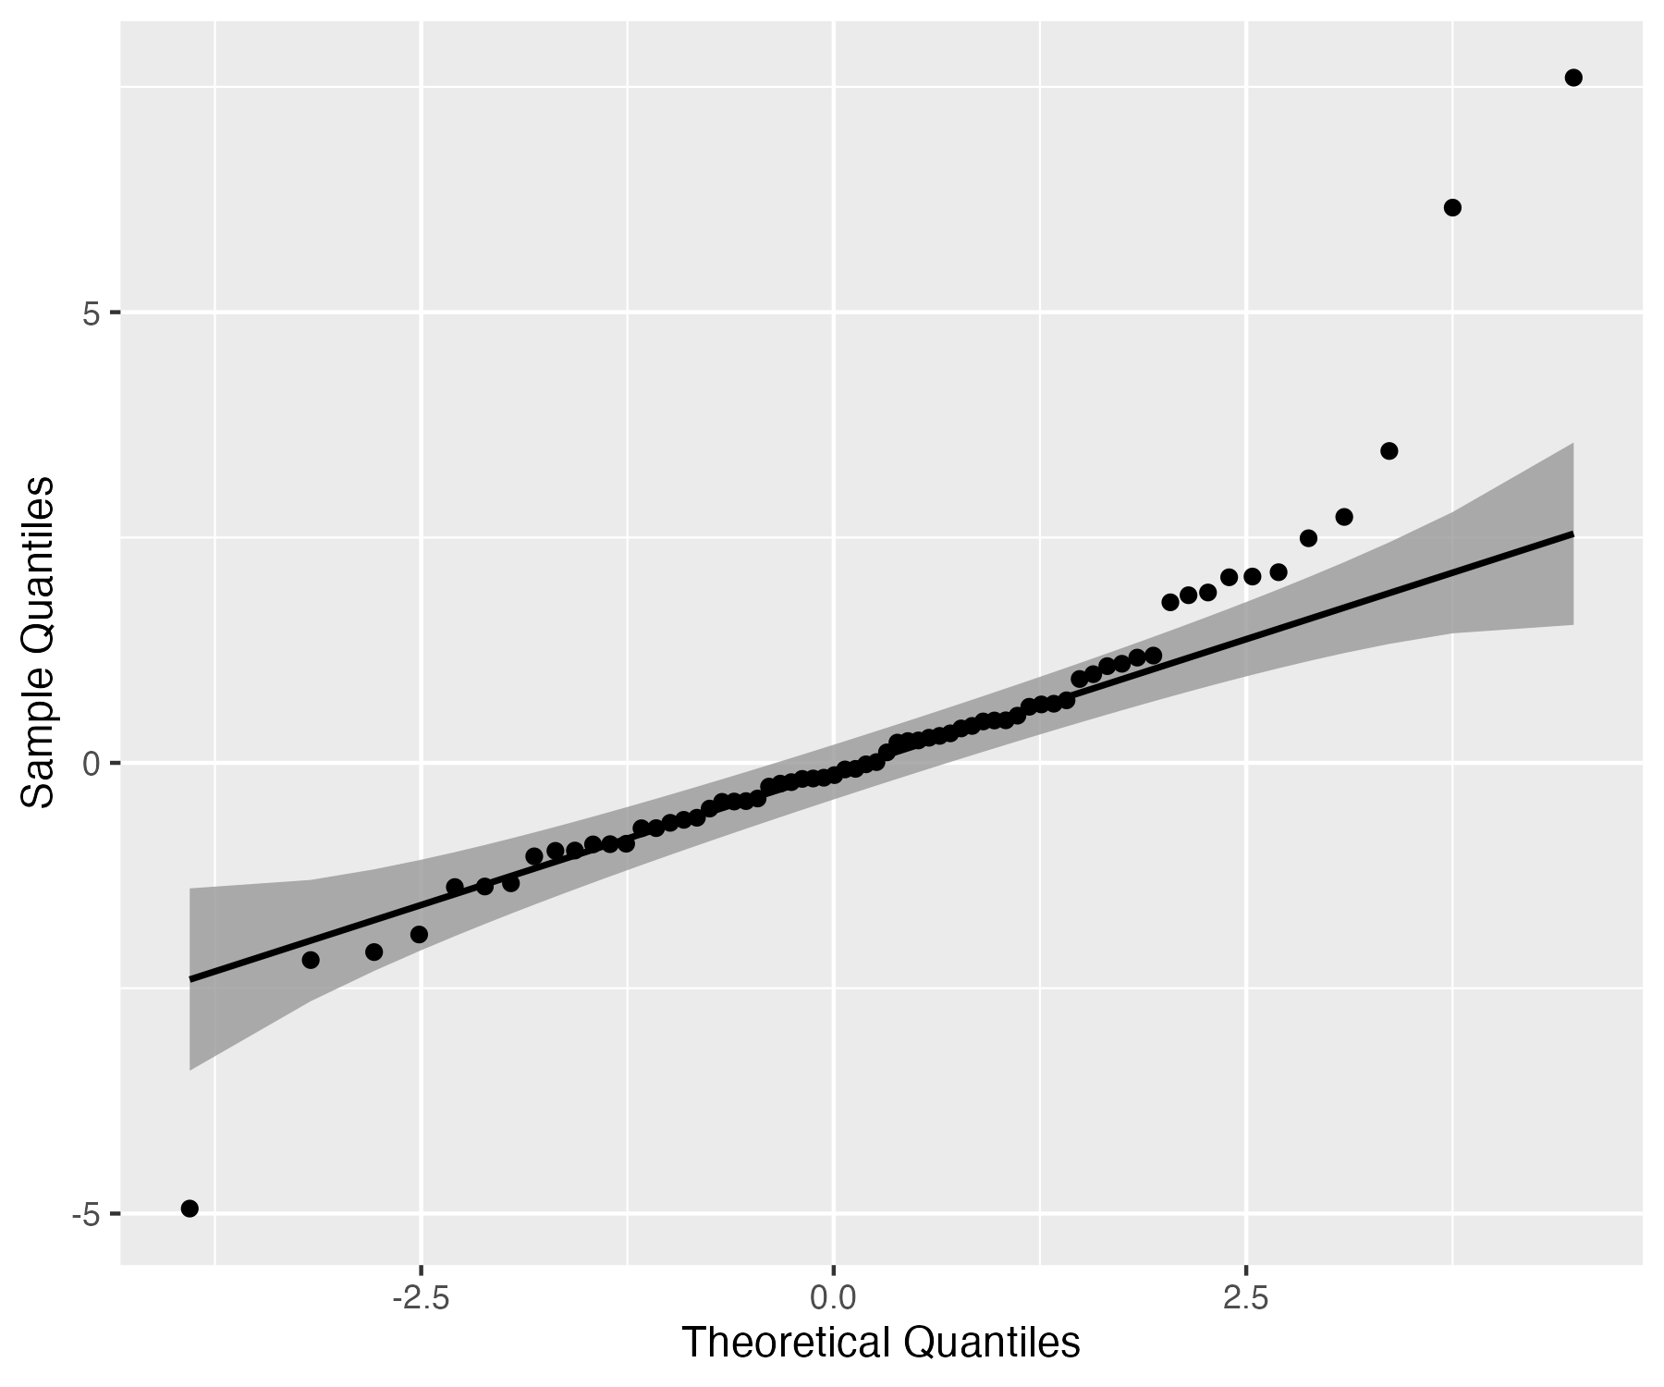
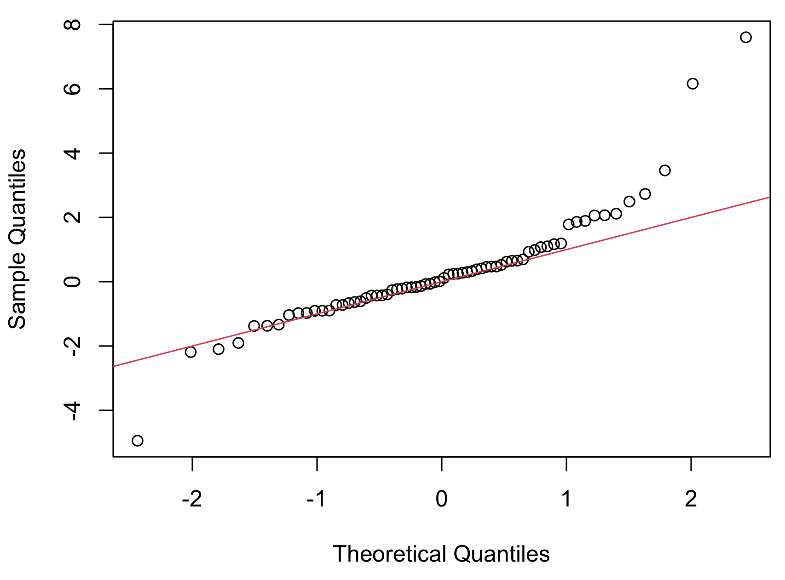
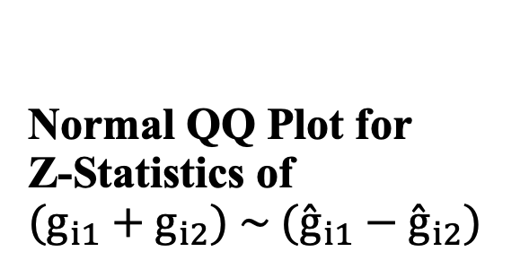
Normal QQ Plot for Z-Statistics of $$(g_{i1}+g_{i2}) \sim ({\overset{ˆ}{g}}_{i1}−{\overset{ˆ}{g}}_{i2})$$
High Quality Group

Slide 20
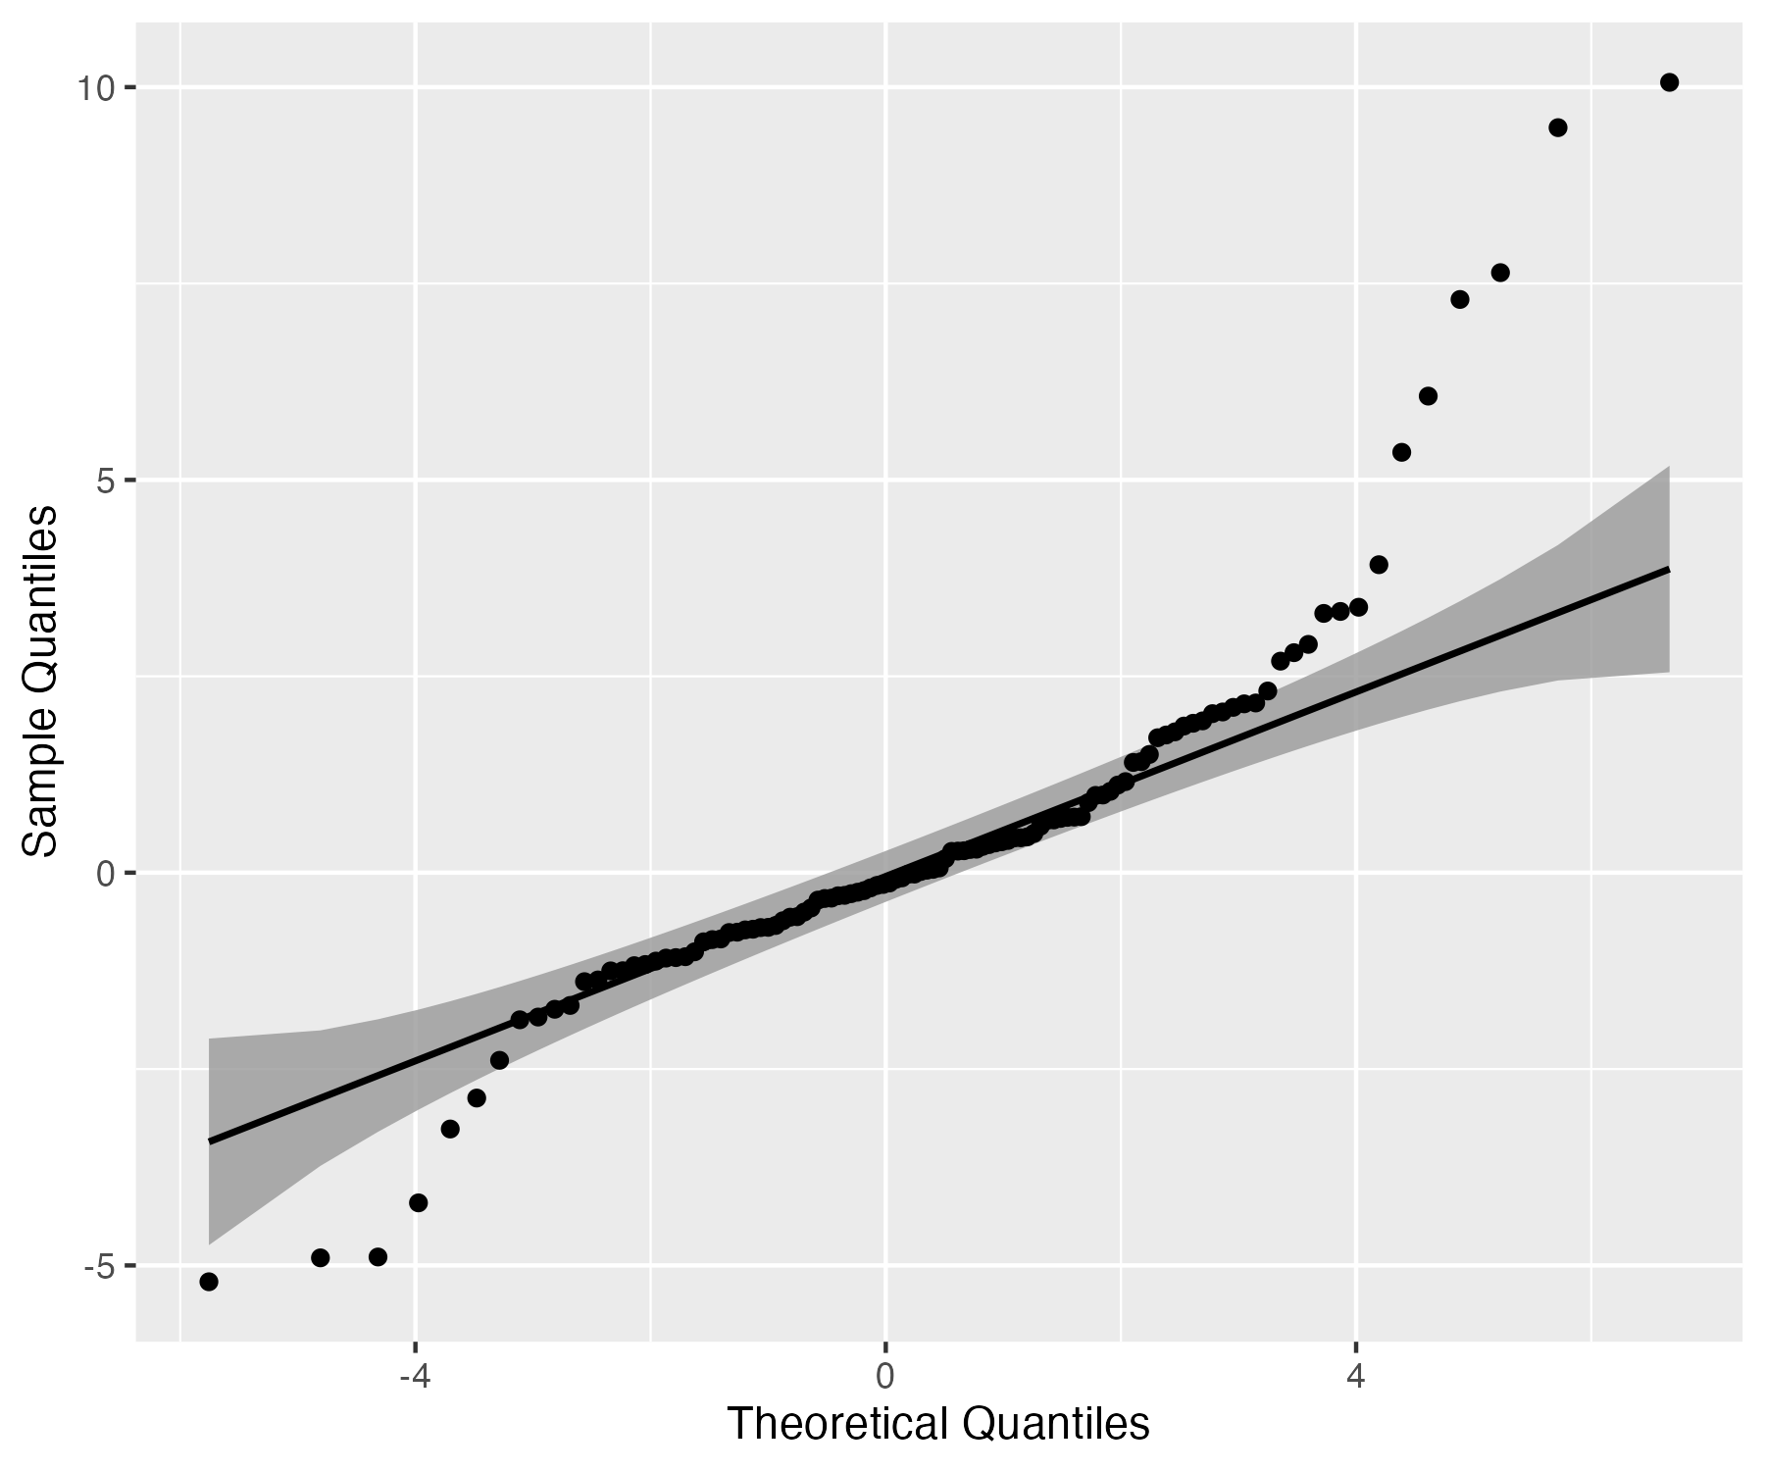

$$(g_{i1}+g_{i2}) \sim (g_{i1}−g_{i2})$$ Using Only WGS Data
Normal QQ Plot for Z-Statistics of

Slide 21
Using Array Data
The original data used for imputation.
Using 2000 SNPs, we got results that are broadly similar to what we obtained from the imputed and WGS data.

Slide 24
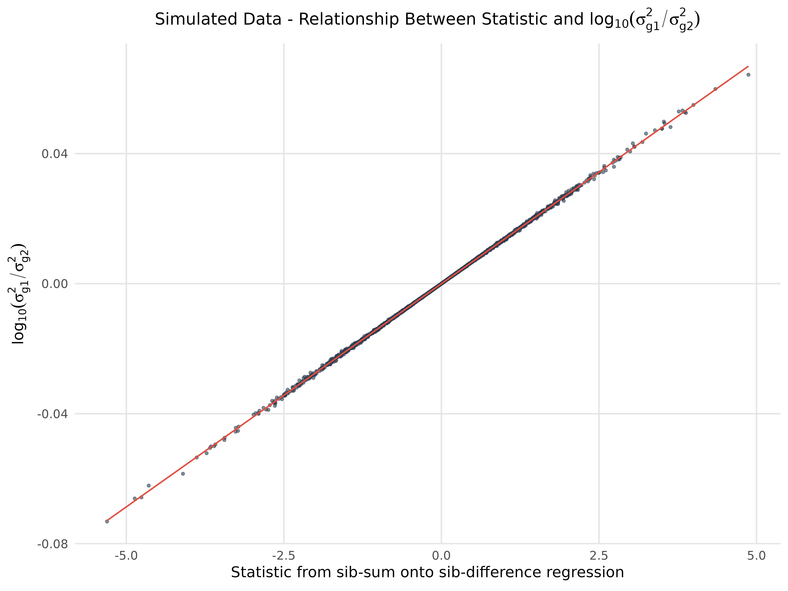

Slide 25
Conclusion
Genotypes imputed from a reference panel do not preserve Mendelian laws except for the very highest quality imputed variants.
In practice with family- and sib-GWAS , using imputed data, we can't ensure proper controls and unbiased estimates due to missing key data features.
Stringent quality control is required for family-based analyses using imputed genotype data.

Slide 26
Next Steps
We are going to extend the WGS analysis to a larger set of SNPs across a range of INFO scores.
We are working with WGS data to see the downstream effect of using low-quality imputed genotypes in FGWAS.
We will do Family GWAS using SNIPAR with WGS data.
We are interested in developing reference-based imputation methods that consider the relationships between individuals and Mendelian laws.

Slide 27
THANK YOU!

