Slide 1

Reliability of Imputed Genotype Data for Family-Based Analyses
Mahdi Mir, Tammy Tan, ­Patrick Turley, Daniel J. Benjamin, and Alexander Strudwick Young

Slide 2
Motivation
We are concerned that the low-quality imputed genotypes may not be suitable for family-based analyses.
Family- and Sib-GWAS is designed to leverage Mendelian inheritance as a clean natural experiment to obtain unbiased estimates, but with imputation we may lose that.
Notes:
We are concerned that imputed data especially low-quality imputed genotypes may not be suitable for family-based analyses. In fact, Family and sib-GWAS are designed to use Mendelian inheritance as a natural experiment to obtain unbiased estimates, but with imputation, especially low-quality imputation, we may lose this advantage.

Slide 3
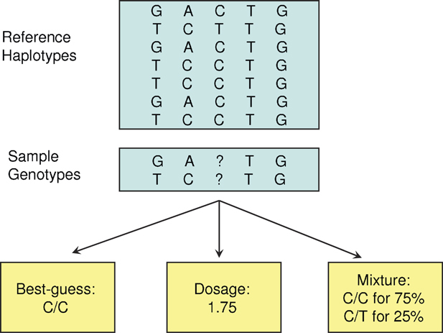
Imputation from a Reference Panel
HARD-CALLS
DOSAGES
Source: Zheng et al. (2011)
Notes:
Before going forward I want to remind you about the imputation from a reference panel and the difference between hard-calls and dosages genotypes, imputation from a reference panel is when we estimate genotypes at unobserved locations using a reference panel. Basically, the reference panel helps us figure out the probability of different genotypes at those spots. If we go with the genotype that has the highest probability, that’s called “hard calls.” And if we use the expected value of the genotypes instead, we call that “dosages.”

Slide 4
Reference Based vs Mendelian Imputation
Mendelian imputation, as implemented in SNIPAR (Young et al., Nature Genetics, 2022), differs entirely from reference-based imputation.
Reference-based imputation does not consider the relationships between individuals (or pedigree) and performs the imputation for everyone separately.
Notes:
One thing worth pointing out is that the reference-based imputation used in UKB data is completely different from the method used in Alex Young’s SNIPAR package. The UKB imputation doesn’t take relationships between individuals into account, and it performs the imputation separately for each person, that means we lose some valuable information from Mendelian inheritance that could have improved the imputation quality.

Slide 5
Correlation Analysis in UK Biobank
UKB Imputed Data
SNPs with MAF > 1%
INFO Score (Imputation Quality) > 0.3
70K SNPs
White British Subsample
~ 19K Full Siblings Pairs
~ 4K Parent-Offspring Pairs
Howe et.al (2022) Sib-GWAS used low-quality imputed SNPs (Info Score > 0.3, Hard Calls).
Notes:
For the analyses I’m about to present, we used 70K randomly selected SNPs with MAF greater than 1% from UKB imputed data. These SNPs have imputation quality (INFO Score) between 0.3 and 1. We used the White British subsample of the UKB, which consists of around19,000 full sibling pairs and 4,000 parent-offspring pairs.

Slide 6

Correlation Analysis
Suppose i and j are full siblings or parent-offspring.
Then in theory (under random-mating):
$$\begin{matrix}Corr⁡\left(g_{i},g_{j}\right)=0.5 \\ \\ \end{matrix}$$
Notes:
One way to assess the imputation quality is to look at siblings and parent-offspring pairs correlation in theory we should see a correlation of half between the genotypes of both sibling and parent-offspring pairs if the data quality is good then we should see this correlation in the data but if we don’t see that we then can have doubts about the imputed data and imputation quality and a natural question would be how much bias does come from the imputation quality?

Slide 7
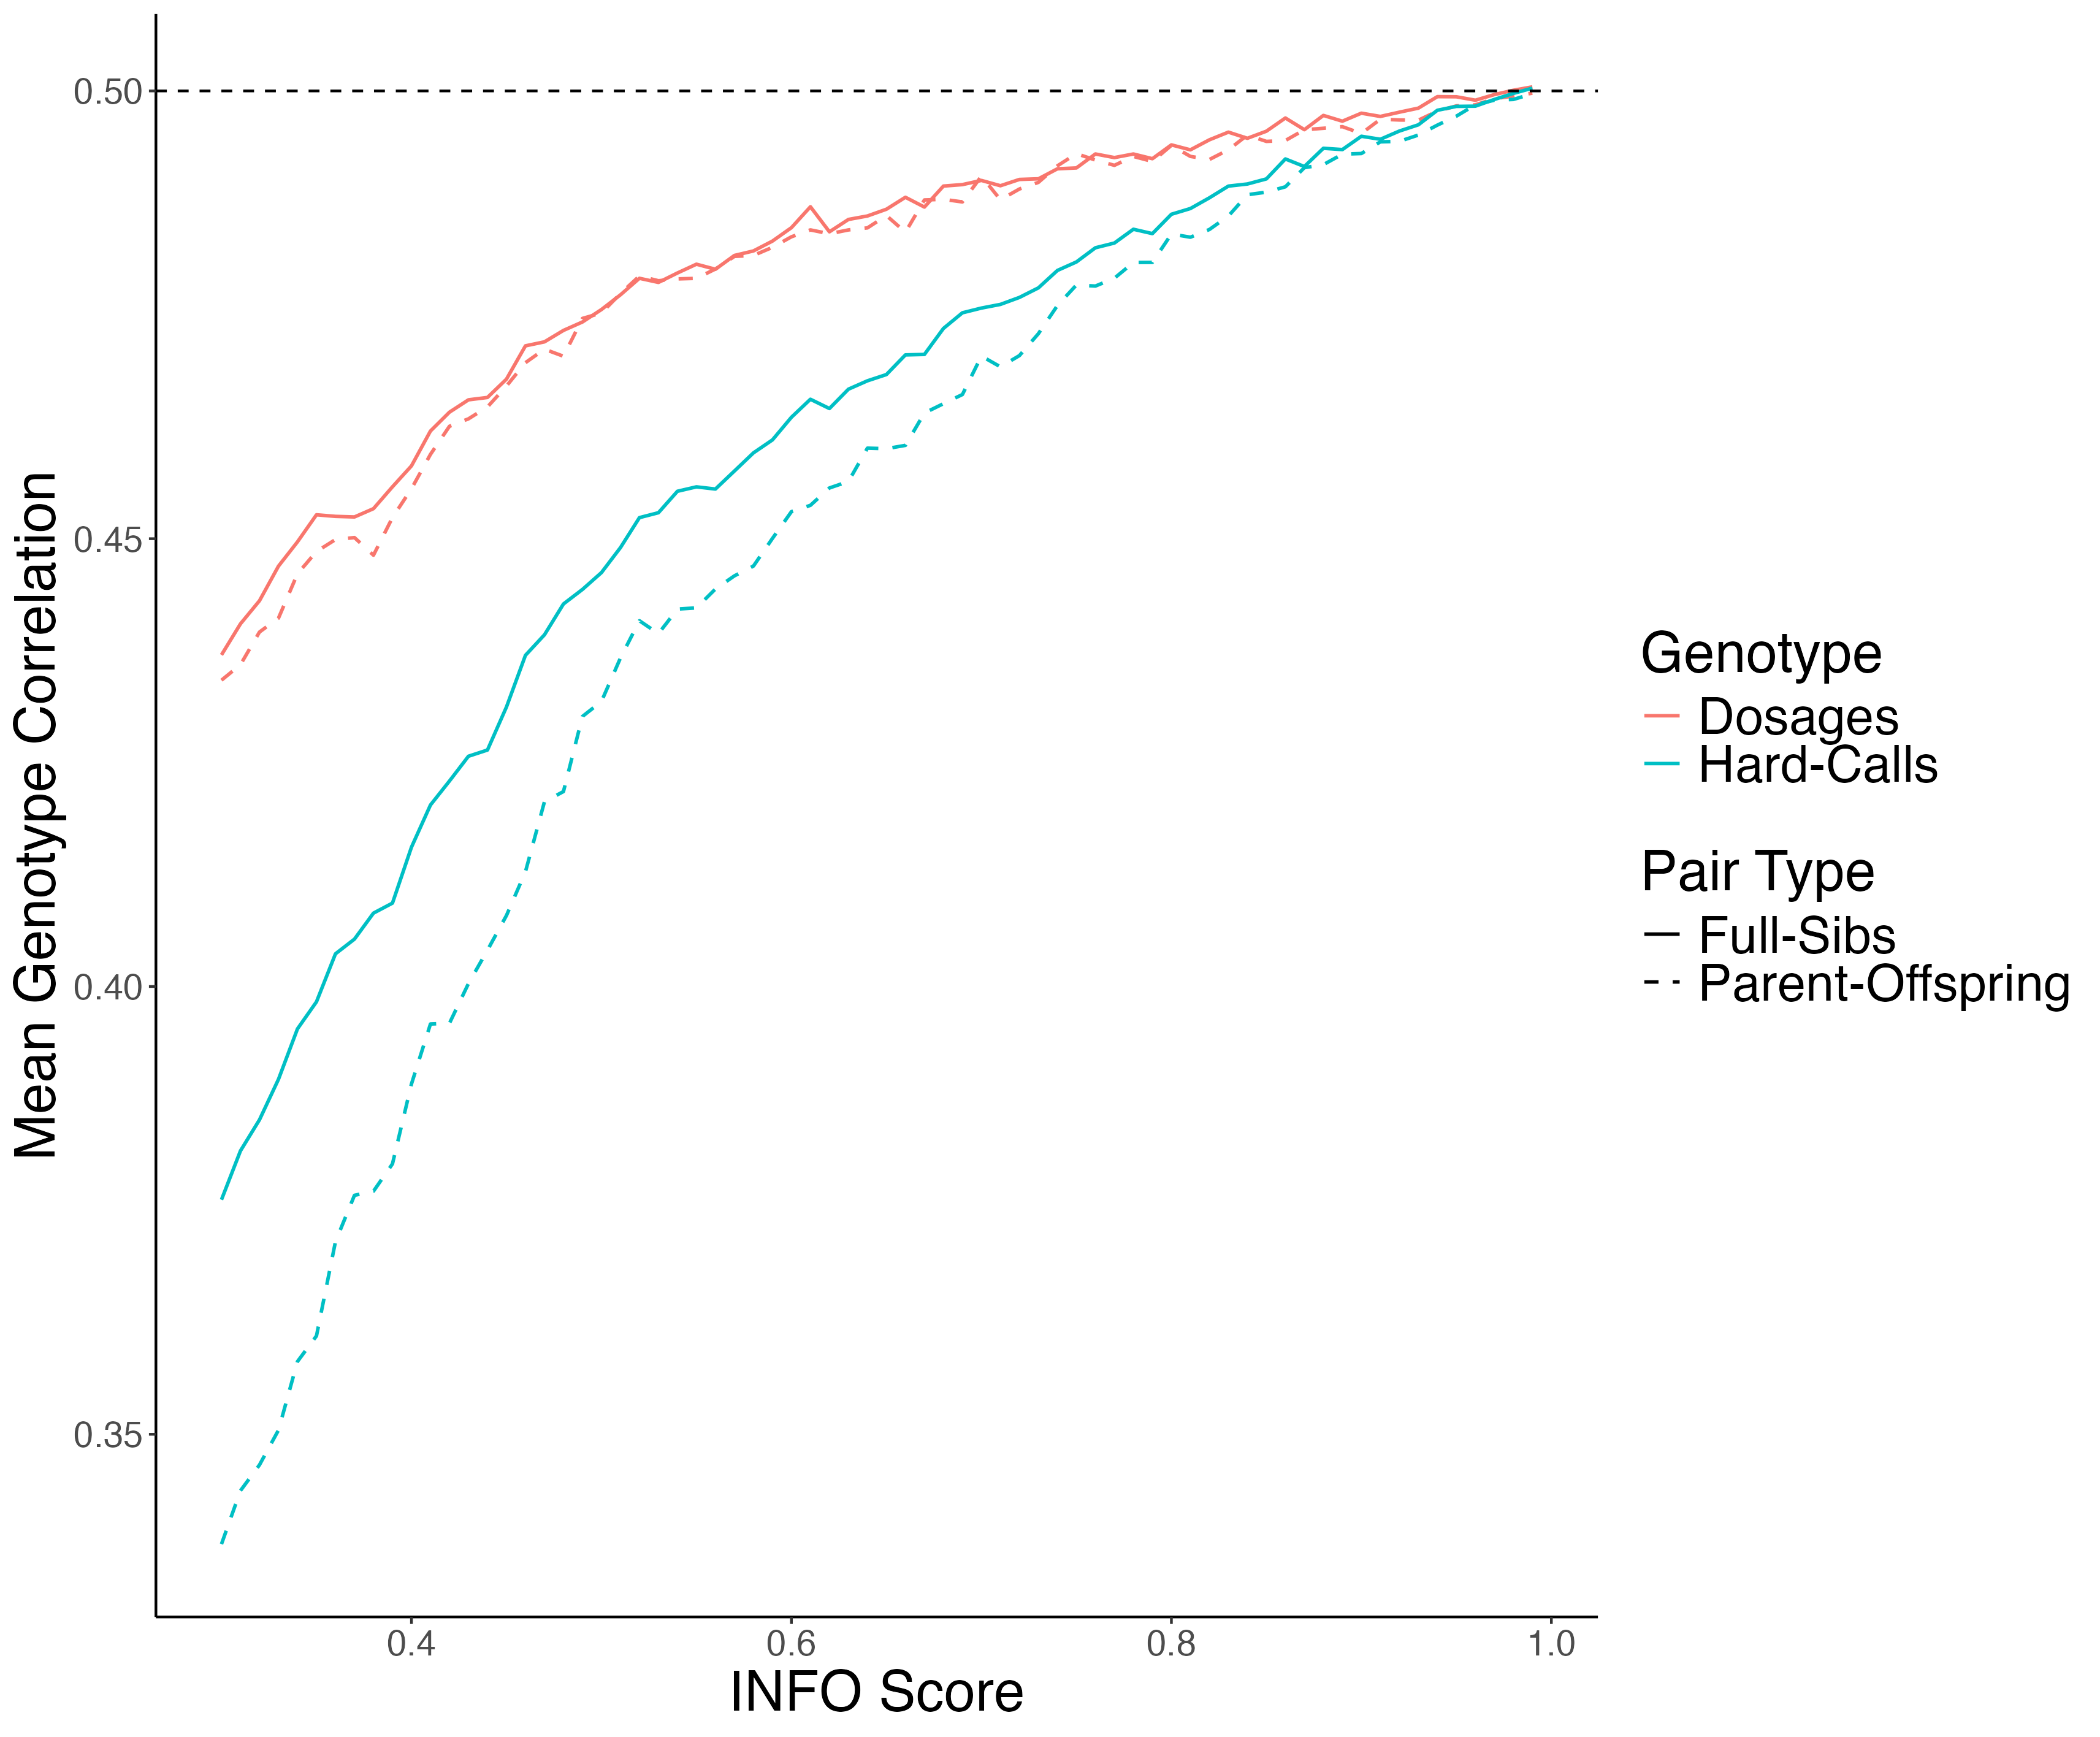
Mean Genotype Correlation
Notes:
we plotted the empirical correlation as a function of imputation quality or INFO score, we notice that for low-quality imputed SNPs, the correlation is well below 0.5 for both types of pairs, regardless of whether we’re looking at dosages or hard calls. Even for the highest-quality imputed SNPs, there are still deviations from the expected 0.5. This plot also highlights that the issue is more pronounced for parent-offspring pairs and for hard-calls compared to full sibling pairs and dosage genotypes.

Slide 8

Correlation Analysis Conditional on IBD States
Quantitative genetics theory tells us the correlation between siblings’ genotypes depends on their IBD state.
IBD state records how many alleles they share by descent from their parents.
Suppose i and j are full siblings. Then in theory (under random-mating) we have:
$$\begin{matrix}Corr⁡\left(G_{i},G_{j}∣IBD=0\right)=0 \\ Corr⁡\left(G_{i},G_{j }| IBD=1\right)=0.5 \\ Corr⁡\left(G_{i},G_{j}∣IBD=2\right)=1\end{matrix}$$
Notes:
Another way to test the quality of imputed data is by examining the correlation between siblings' genotypes, conditional on their IBD (Identity by Descent) states. IBD state shows how many alleles siblings share from their parents. If they share both alleles (IBD = 2), the genotype correlation at those locations should be 1. For locations with IBD = 1, the correlation should be 0.5, and for locations where no alleles are shared (IBD = 0), the correlation should be zero.

Slide 9
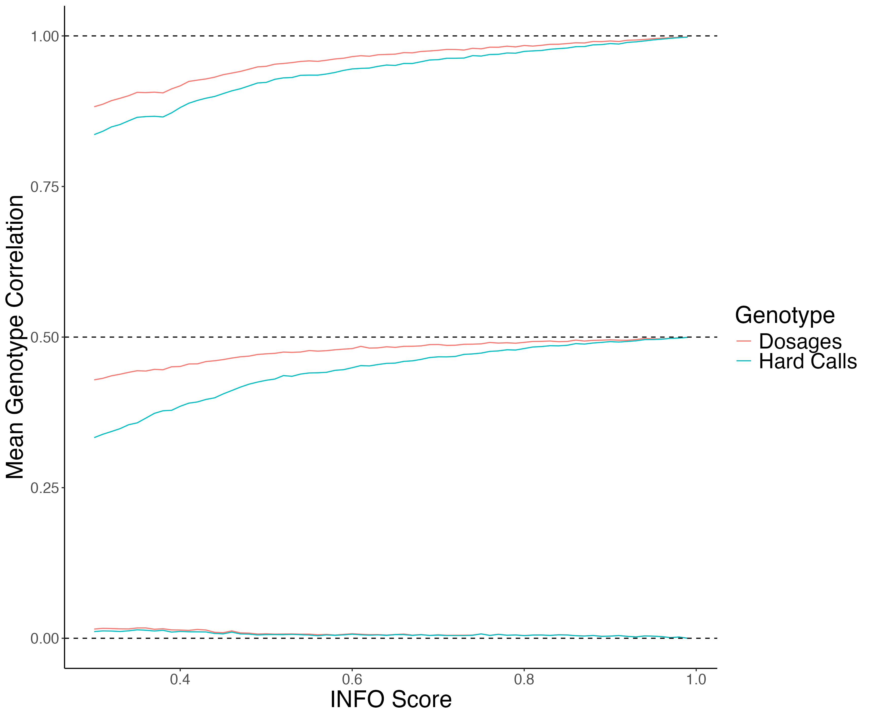
Mean Imputed Genotype Correlation Conditional on IBD State
Notes:
We plotted the mean correlation between siblings' genotypes—both for dosages and hard-calls—across different IBD states as a function of imputation quality.

Slide 10
Mean Imputed Genotype Correlation Conditional on IBD State
IBD = 2

Slide 11
Mean Imputed Genotype Correlation Conditional on IBD State
IBD = 1

Slide 12
Mean Imputed Genotype Correlation Conditional on IBD State
IBD = 0

Slide 13
UKB WGS Analysis
UKB WGS Data
68 High Quality Imputed SNPs, INFO Score in (0.92-0.99)
46 Low Quality Imputed SNPs, INFO Score in (0.30-0.32)
19,052 White British Sibling
SNPs with MAF > 1%
Notes:
After analyzing imputed data, we started using the newly available UKB Whole Genome Sequencing (WGS) data to compare it with the imputed data and understand what might have been missed during imputation. For the analyses I’m about to show, we used 68 high-quality SNPs 46 low-quality SNPs

Slide 14
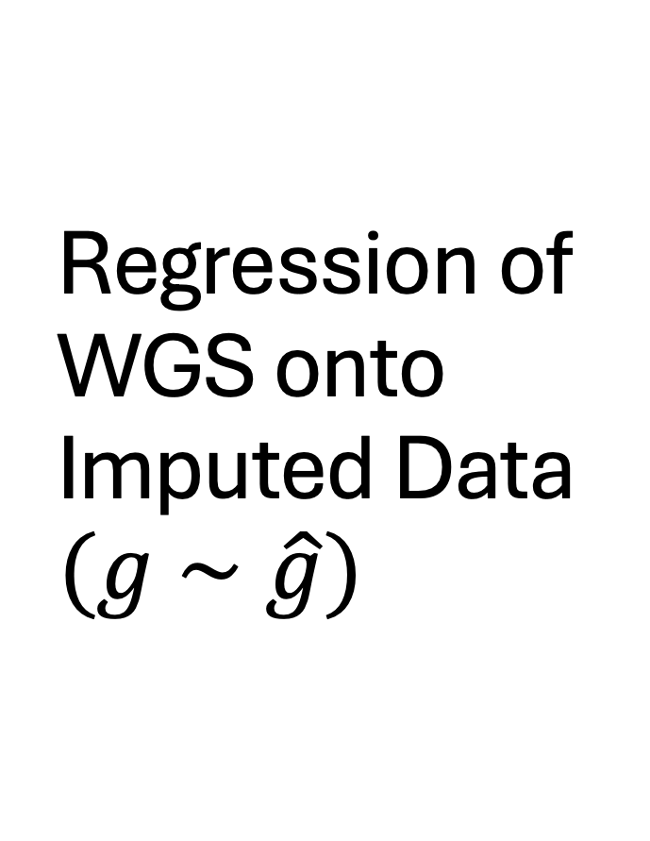
Regression of WGS onto Imputed Data $$(g \sim \hat{g})$$
If imputed data is good quality, then
We would expect all the slopes across all SNPs to be 1.
Notes:
What if we perform a simple regression of WGS data onto imputed data to see how well the imputed data was representing the actual data? We did this and separated the SNPs into high- and low-quality groups, represented by red and blue bars here and we plotted the distribution of resulted slopes.

Slide 15
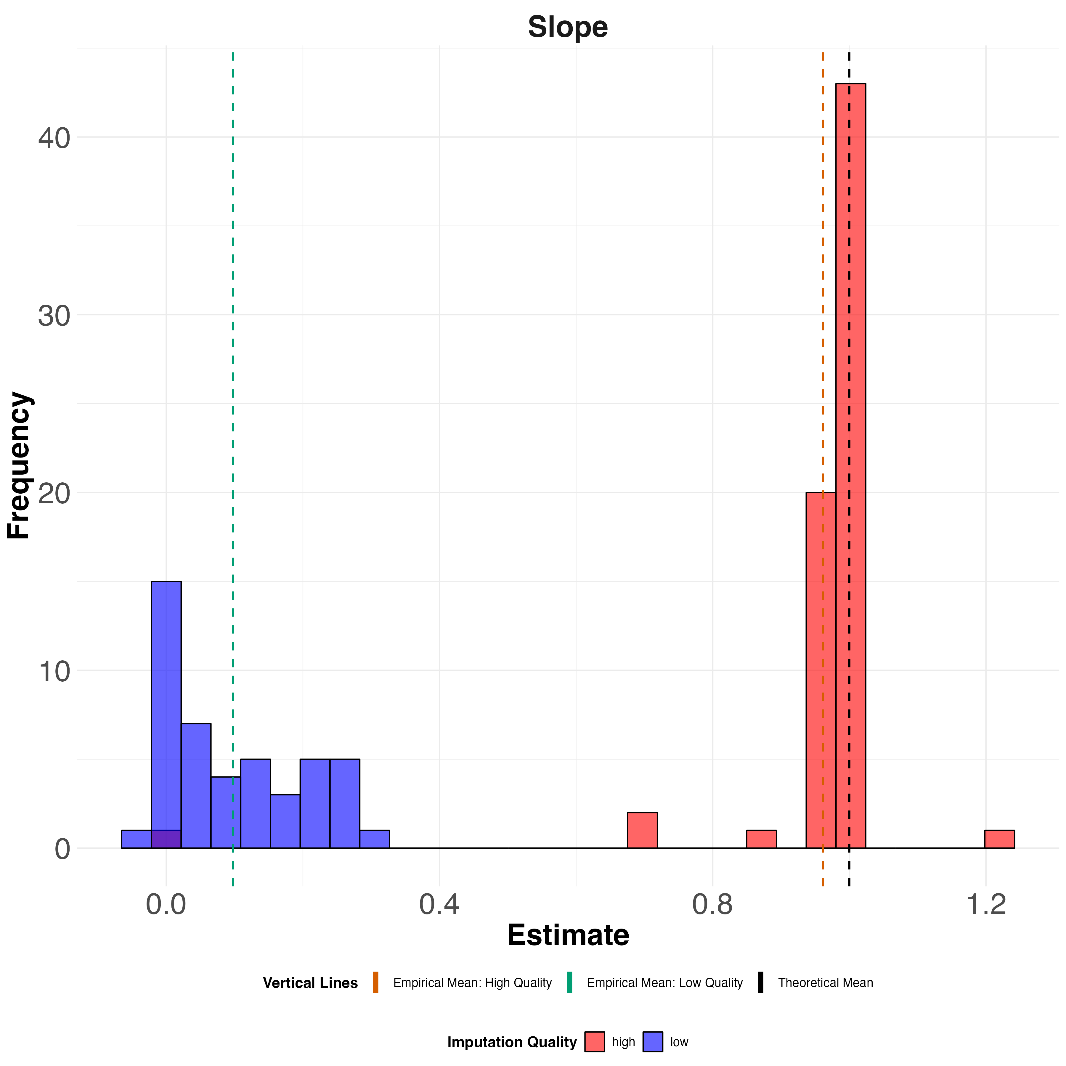
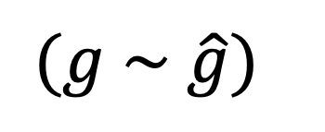
Regression of WGS onto Imputed Data
$$(g \sim \hat{g})$$
LOW Quality
HIGH Quality
1
Notes:
For the high-quality group (red), the distribution of slopes for different SNPs is mostly concentrated around 1 which is not bad. However, for the low-quality group (blue), the distribution is closer to zero, with a peak at zero, indicating that the quality imputed data is almost uncorrelated with real data and it is essentially just noise. Even for the very high-quality imputed data, where we’d expect a stronger correlation, there are still significant deviations from a slope of 1 in the distribution.

Slide 16

Regression of WGS onto Imputed Data $$(g \sim \hat{g})$$
Info Score is the $R^{2}$ from this simple regression.
So, if we plot $R^{2}$ vs Info Score all the dots should lie on the 45-degree line.
Notes:
We then examined the R² values from this regression. The INFO score is supposed to represent the R² of this simple regression and serve as a measure of imputation quality in the imputed data. Ideally, when we plot R² against the INFO score, all the points should lie along the 45-degree line

Slide 17
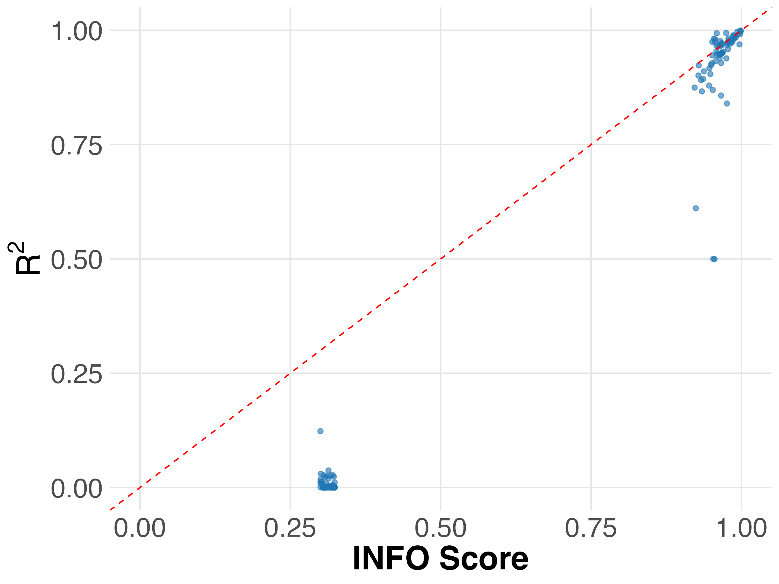

INFO Score vs R² Between WGS and Imputed data in UKB $${(g}_{i1}\sim {\overset{ˆ}{g}}_{i1})$$
INFO score is an unreliable metric of imputation quality in UKB Imputed data.
Notes:
However, what we observe is that for low-quality imputed data, the R² values are mostly zero, except for one point. For high-quality imputed data, while the R² values are closer, there are still noticeable deviations from the 45-degree line. So wan can safely say INFO score is an unreliable metric of imputation quality in UKB imputed data.

Slide 18

Sib-Sum, Sib-Difference Regression
Theory implies that (g1 + g2) should be uncorrelated of (g1 - g2).
Therefore, the slope ($β$) of the following regression should be zero.
${(g}_{i1}+g_{i2})=α+β ({\overset{ˆ}{g}}_{i1}−{\overset{ˆ}{g}}_{i2})$
Notes:
We conducted another analysis combining WGS and imputed data. In theory, the sibling sum genotypes should be uncorrelated with the sibling difference genotypes. So, we performed a regression with the sibling sum from the WGS data as the dependent variable and the sibling difference from the imputed data as the independent variable. Ideally, we’d expect to see a slope of zero because, theoretically, these two variables should have no correlation.

Slide 19
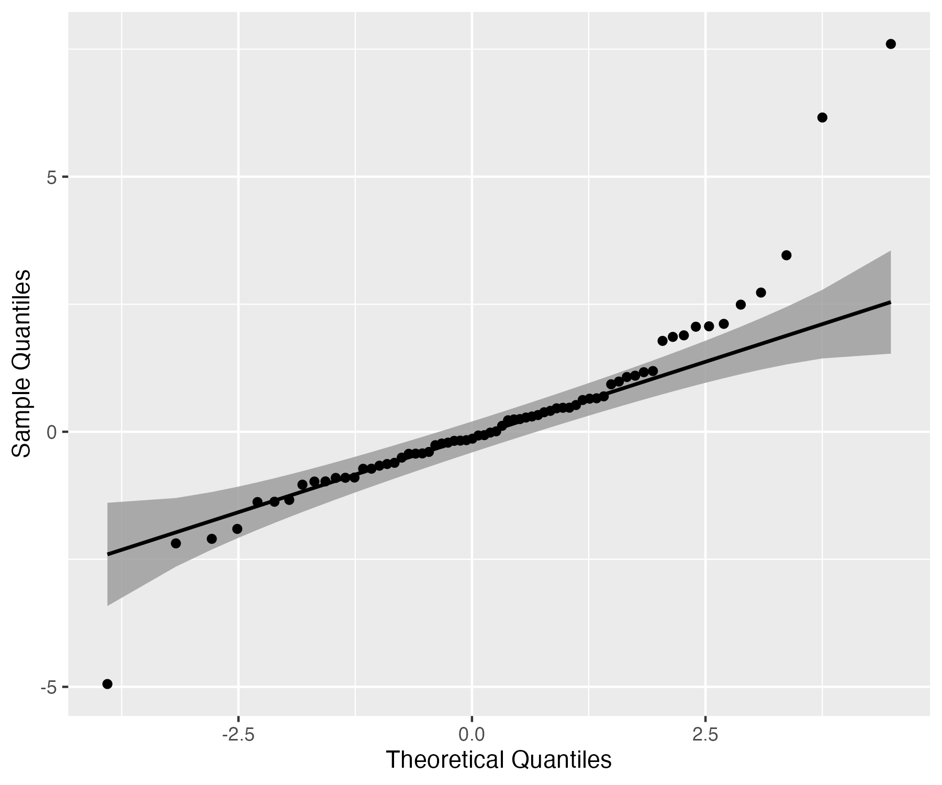
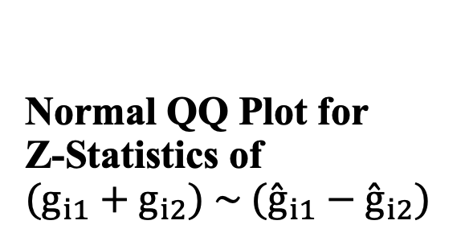
Normal QQ Plot for Z-Statistics of $$(g_{i1}+g_{i2}) \sim ({\overset{ˆ}{g}}_{i1}−{\overset{ˆ}{g}}_{i2})$$
High Quality Imputed Group
Notes:
We plotted the qq plot for zstatistics of this regression, under the null hypothesis which is having slope of zero here the distribution of zstatistics shold be normal and the points in the qq plot should lie on the 45 degree line high quality imputed data. For the high quality group we have less problems but we still see asymmetric deviation from the line.

Slide 20
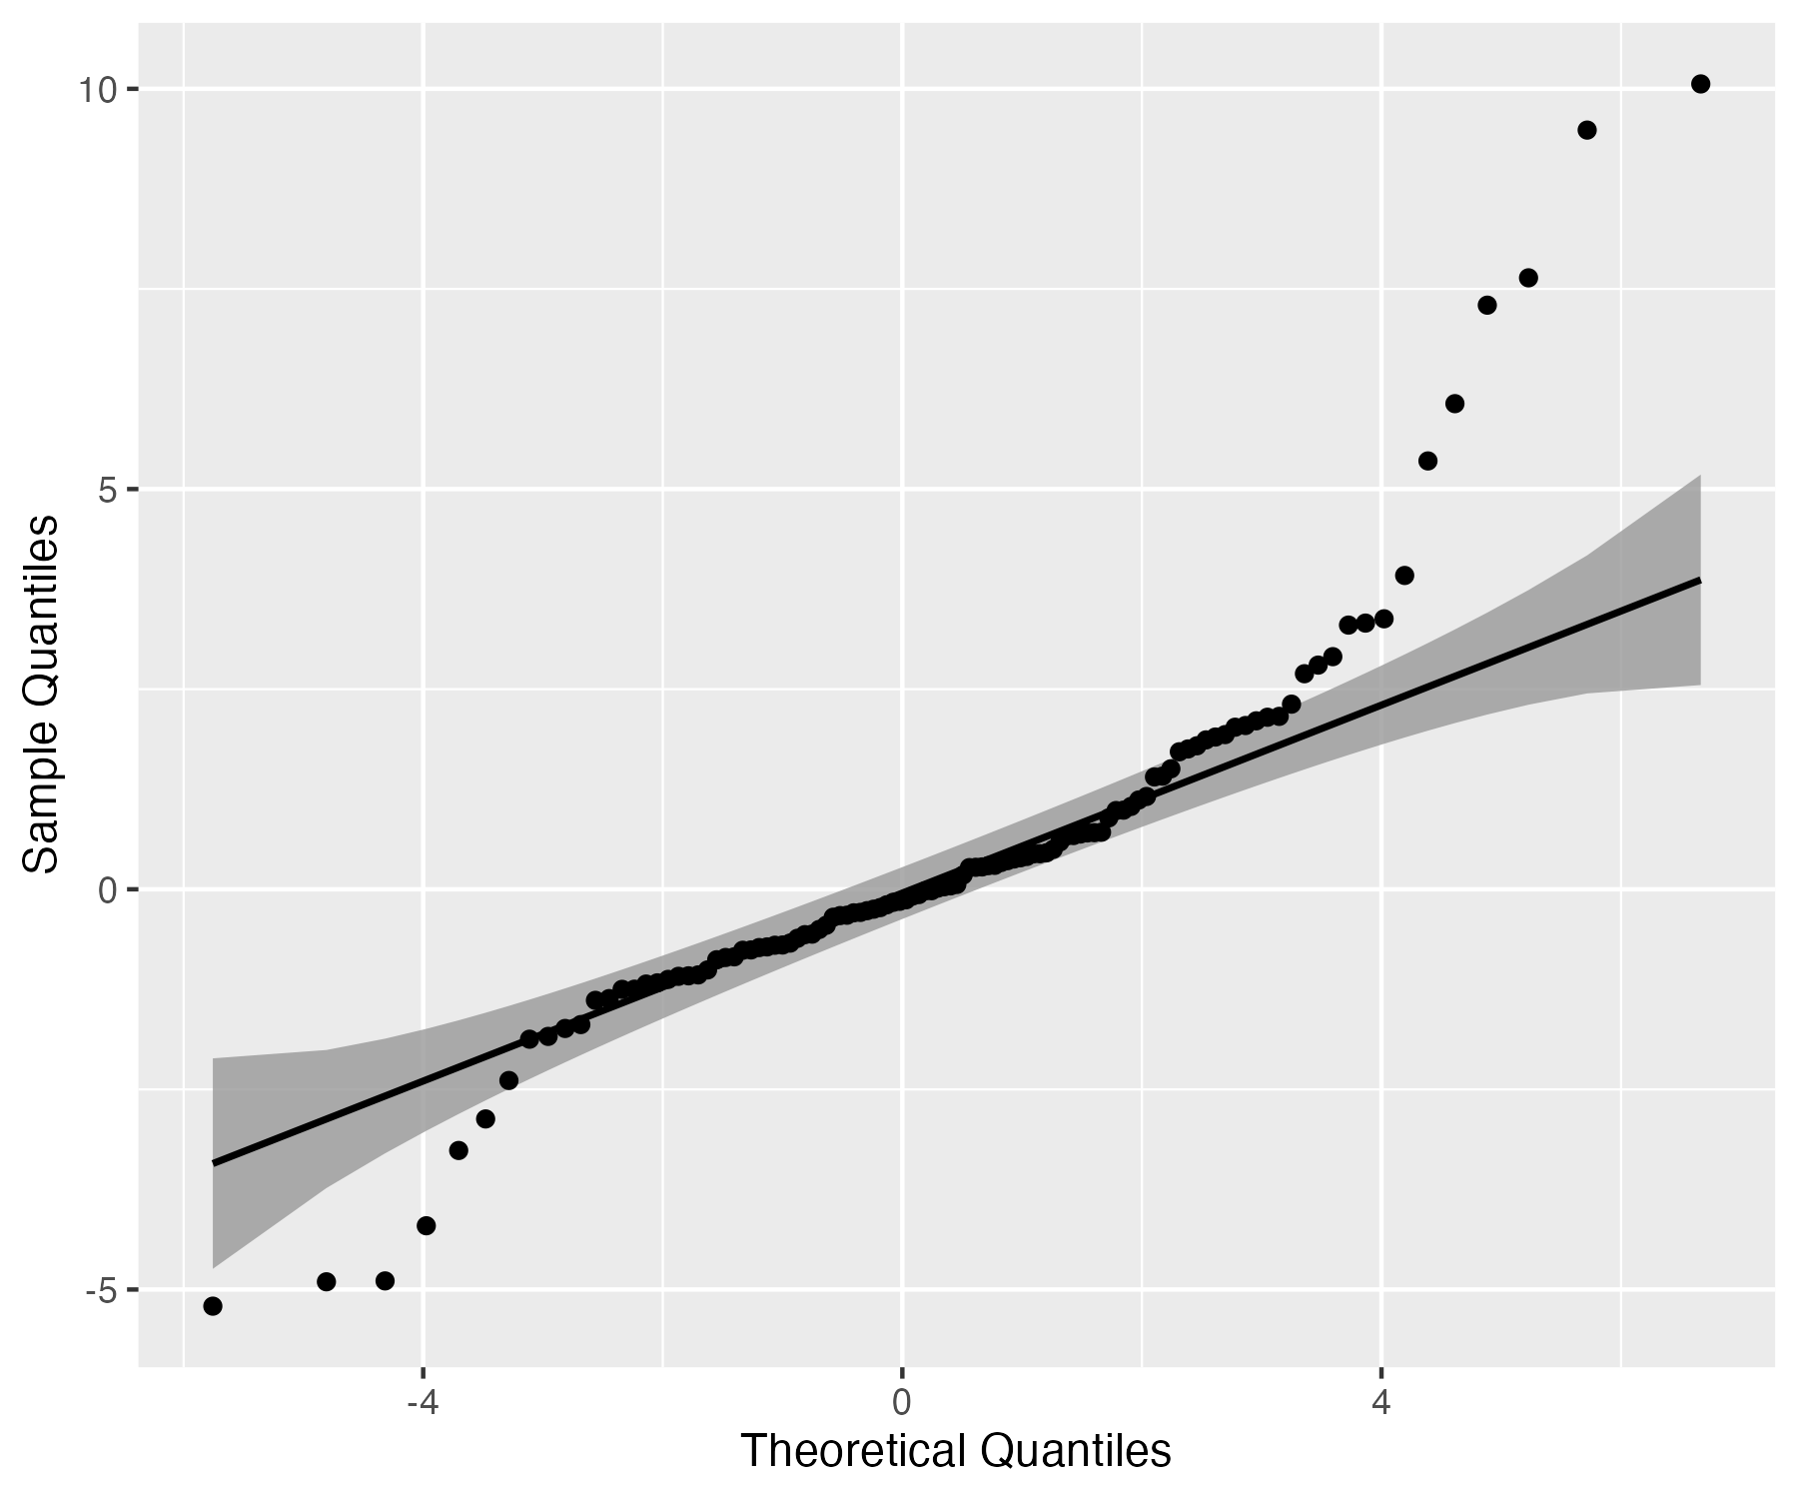

$$(g_{i1}+g_{i2}) \sim (g_{i1}−g_{i2})$$ Using Only WGS Data
Normal QQ Plot for Z-Statistics of
Notes:
What if we use only WGS data in this regression? We Plotted the same normal Q-Q plot for the slope, we still observe issues with data quality. We expect fewer quality issues in WGS data compared to imputed data, but some problems still persist.

Slide 21
Using Array Data
The original data used for imputation.
Using 2000 SNPs, we got results that are broadly similar to what we obtained from the imputed and WGS data.
Notes:
We also used array data and did the same analyses we did on imputed and WGS data using 2000 SNPs for that and we got similar results to what we obtained from the imputed and WGS data.

Slide 22
Conclusion
Genotypes imputed from a reference panel do not preserve Mendelian laws except for the very highest quality imputed variants.
In practice with family- and sib-GWAS , using imputed data, we can't ensure proper controls and unbiased estimates due to missing key data features.
Stringent quality control is required for family-based analyses using imputed genotype data.

Slide 23
Next Steps
We are going to extend the WGS analysis to a larger set of SNPs across a range of INFO scores.
We are working with WGS data to see the downstream effect of using low-quality imputed genotypes in FGWAS.
We will do Family GWAS using SNIPAR with WGS data.
We are interested in developing reference-based imputation methods that consider the relationships between individuals and Mendelian laws.

Slide 24
THANK YOU!

