Slide 1

WasteWise AI: Classifying for a Cleaner Planet
Empowering smarter recycling through advanced image classification.

Slide 2
WASTEWISE AI PROJECT
Why WasteWise Matters
1
2
3
Environmental Impact
Economic Costs
Our Goal
Mis-sorting leads to contamination, reducing recycling efficiency and increasing landfill waste.
Inefficient waste management costs municipalities and recycling facilities significant resources.
Develop a robust ML model to accurately classify waste, improving sorting processes and resource recovery.
Success means higher diversion rates and reduced contamination in waste streams.

Slide 3
DATA FOUNDATION
Dataset & Splits
Our dataset comprises fixed labels:
Cardboard
Cardboard
Glass
Glass
Metal
Metal
Paper
Plastic
Paper
Trash
Plastic
Trash
Data sourced from ImageFolder per class, with a YOLO subset for multi-item detection. All data adheres to licensing and ethical guidelines.
Class Distribution (Image Count)
Note: Exact counts to be filled after final dataset processing.

Slide 4
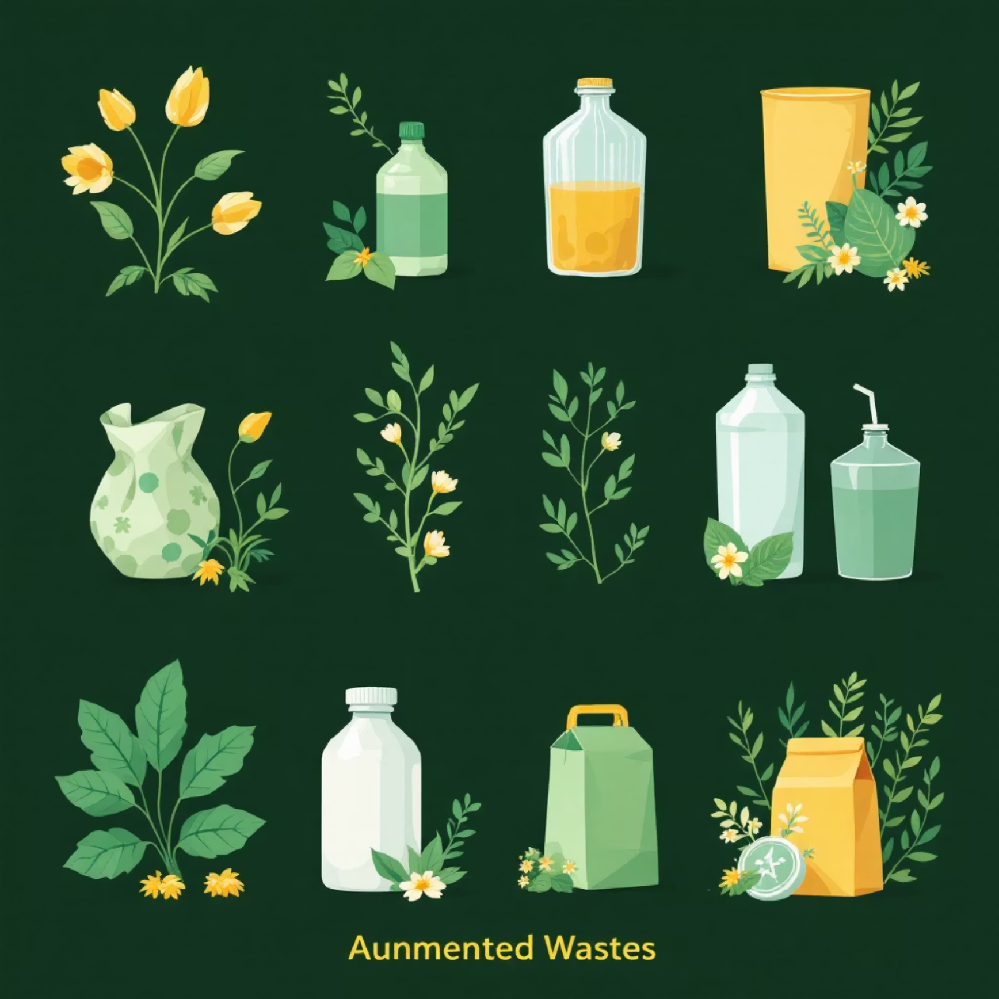
DATA ENHANCEMENT
Preprocessing & Augmentation
All images were resized and normalized to a consistent input dimension.
Augmentation strategies to improve model generalization:
Random flips (horizontal/vertical)
Rotations
Brightness adjustments
Zoom and shear transformations
Sample of Augmented Images
These techniques prevent overfitting and expose the model to more diverse representations of waste.

Slide 5
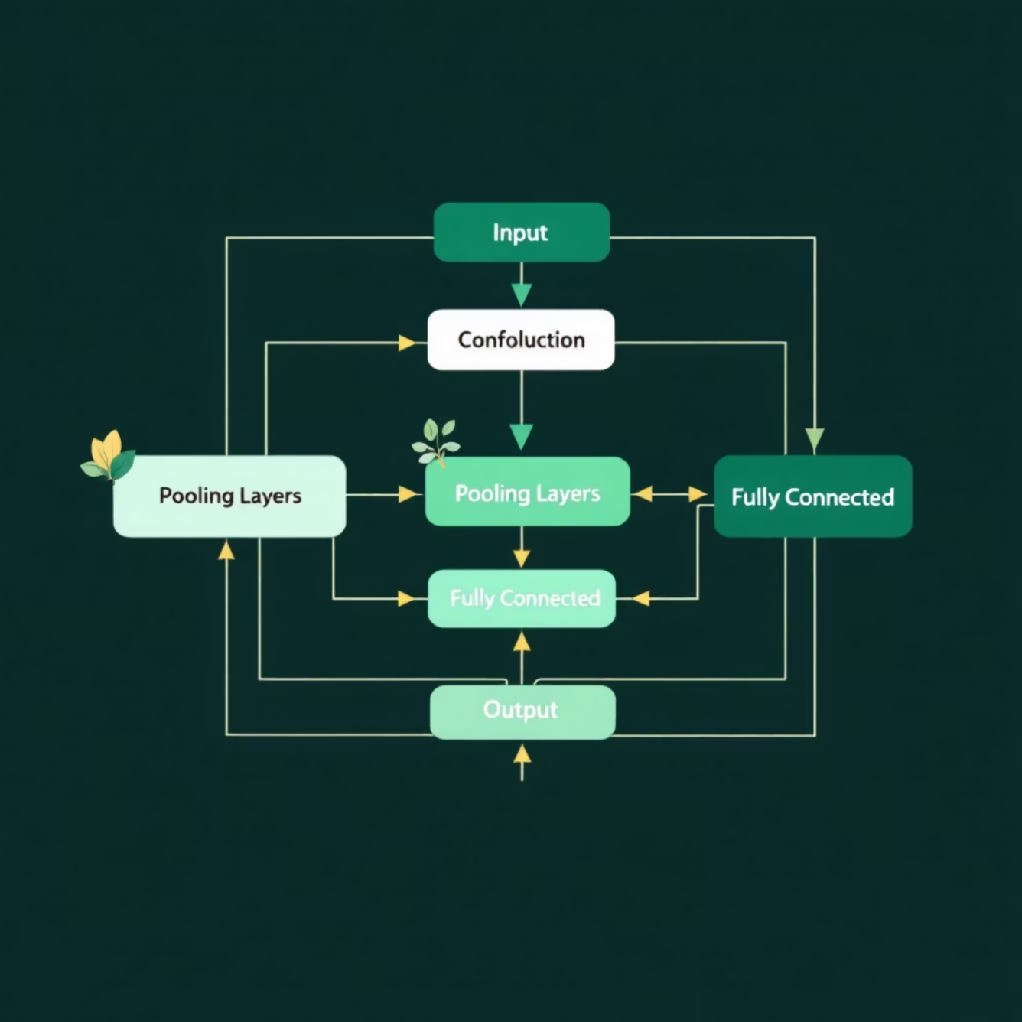
MODELING APPROACHES
Baseline CNN
Our initial approach involved a Convolutional Neural Network (CNN) built from scratch.
Architecture: Simple sequential model with convolutional, pooling, and dense layers.
Optimizer: Adam with an initial learning rate of 0.001.
Epochs: Trained for 50 epochs, with early stopping.
This baseline serves as a fundamental benchmark for more complex models.
Baseline CNN Architecture Sketch
Expected baseline metrics: Top-1 Accuracy: 65-70%, Macro-F1: 0.60-0.65.

Slide 6
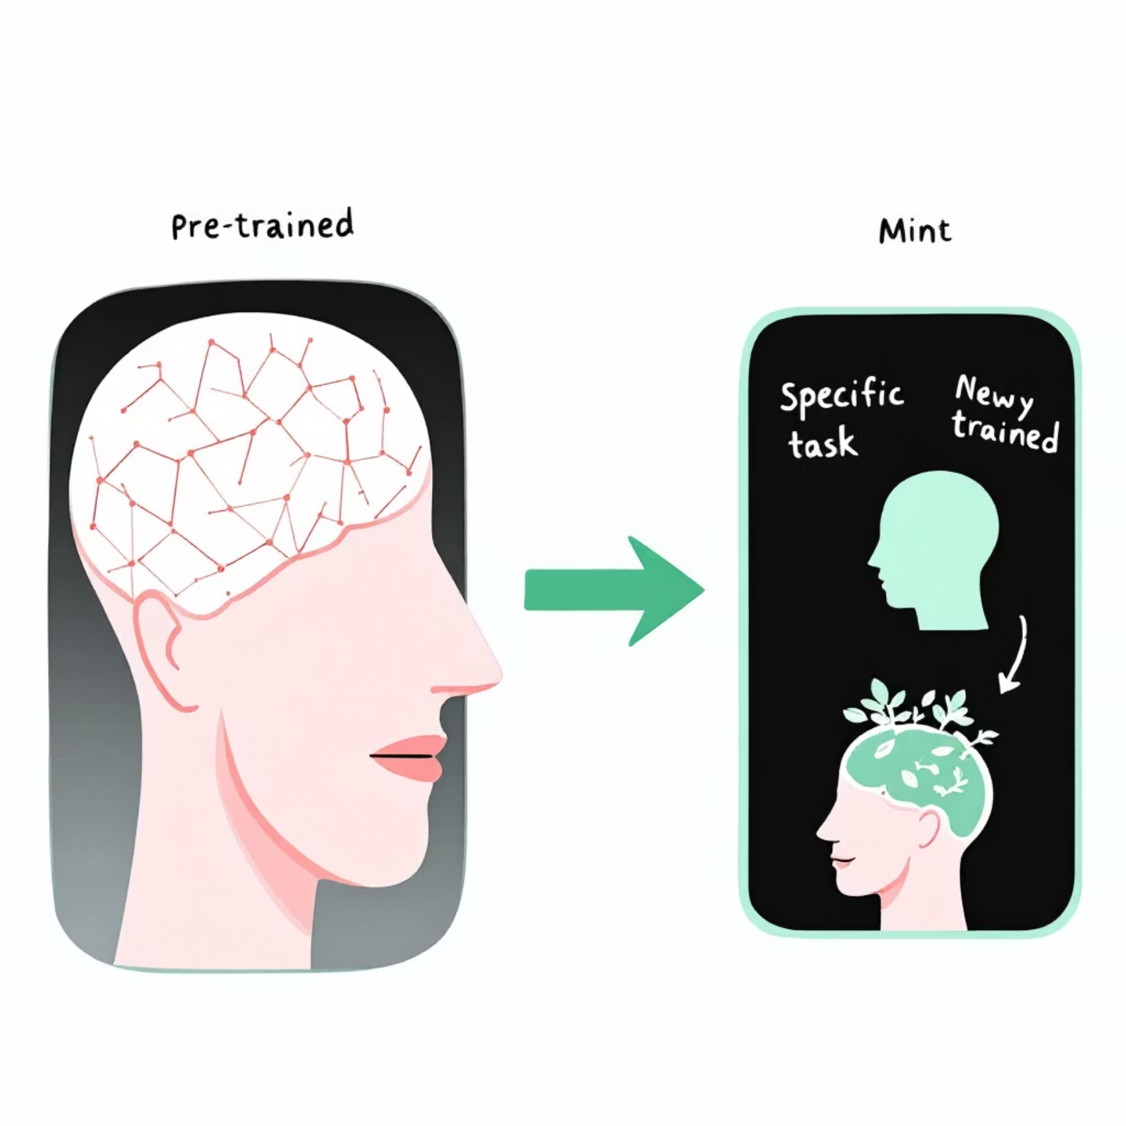
MODELING APPROACHES
Transfer Learning
Leveraged pre-trained models to improve performance, especially on limited data.
Models: ResNet18 and VGG16, pre-trained on ImageNet.
Strategy:
  Freeze: Feature extractor layers frozen, only a new classification head trained.
  Partial Unfreeze: Top layers of the pre-trained model unfrozen for fine-tuning.
Transfer Learning Concept
Transfer learning significantly accelerates training and boosts accuracy by leveraging features learned from vast datasets.

Slide 7
ZERO-SHOT CAPABILITIES
CLIP Baseline
Explored Zero-shot CLIP (openai/clip-vit-base-patch32) for its ability to classify unseen categories.
Prompt Engineering
Quick Snapshot
Fallback Use Case
"a photo of cardboard or a cardboard box"
CLIP provides a reasonable baseline without any training, often achieving 50-60% accuracy out-of-the-box.
Ideal as a fallback or for novel waste types not in the training set.
"a photo of a glass bottle or glass container"
"a photo of a metal can or metal container"
"a photo of paper or paper packaging"
"a photo of a plastic bottle or plastic packaging"
"a photo of mixed waste or trash"
CLIP demonstrates the power of vision-language models in classification tasks.

Slide 8

MULTI-ITEM RECOGNITION
YOLOv8 Detection
Implemented YOLOv8 for multi-item waste detection within a single image.
Label Format: Standard YOLO bounding box annotations (class_id, x_center, y_center, width, height).
Training Flags: Custom dataset configuration and appropriate augmentation settings.
YOLOv8 Performance Metrics
Multi-item Waste Detection Example
YOLOv8 enables precise localization and classification of multiple waste items simultaneously.

Slide 9

ROBUSTNESS ENHANCEMENT
Denoising Autoencoder
Addressed real-world challenges like blur, dirt, and JPEG noise using a Denoising Autoencoder (DAE).
Noise Types: Simulated various types of common image degradation.
Architecture: A U-Net like mini-diagram, optimized for image reconstruction.
Deployment: Can be used for inline (real-time) or offline cleaning of images.
Impact: Increased classification accuracy by X% and Macro-F1 by Y.
Before & After Denoising
DAEs improve model robustness to imperfect real-world image conditions.

Slide 10
RESULTS & IMPACT
Key Takeaways & Roadmap
Best Model
CLIP Value
Future Work
ResNet18 fine-tuned with moderate augmentation yielded the best performance.
CLIP serves as a valuable zero-shot fallback, especially for new or ambiguous waste types.
Roadmap includes further data collection, real-world YOLO box annotation, and model quantization for edge deployment.
Our project provides a strong foundation for smarter, more efficient waste classification, moving us closer to a cleaner environment.

Slide 11
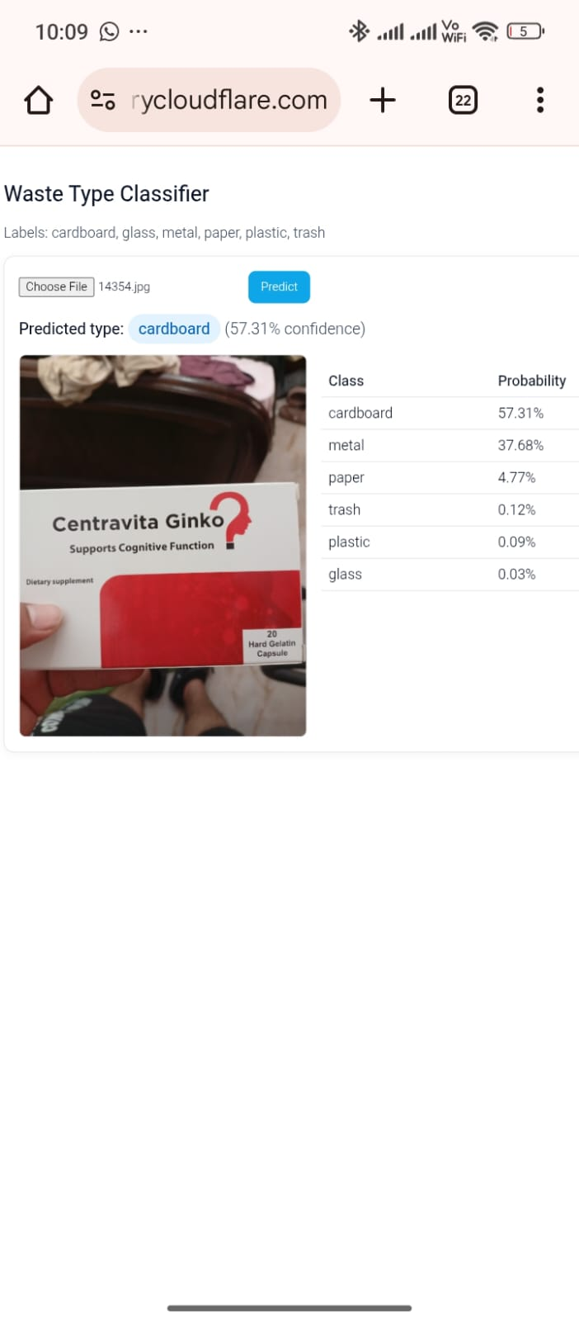
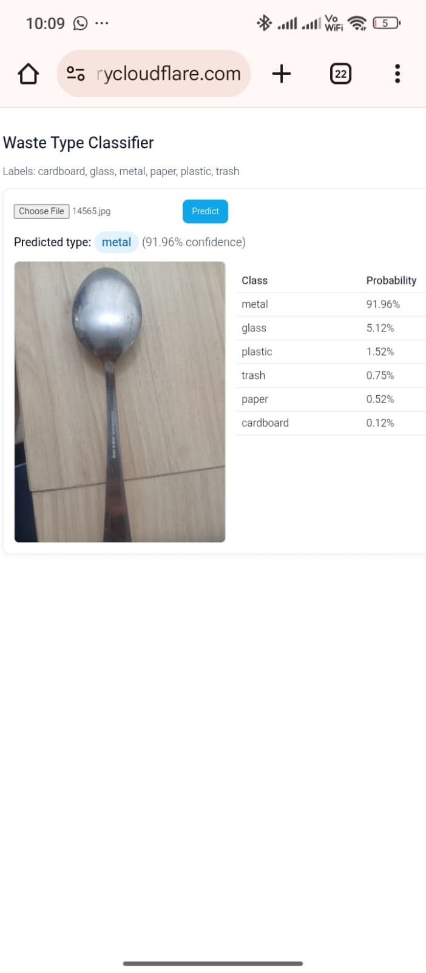

Slide 12
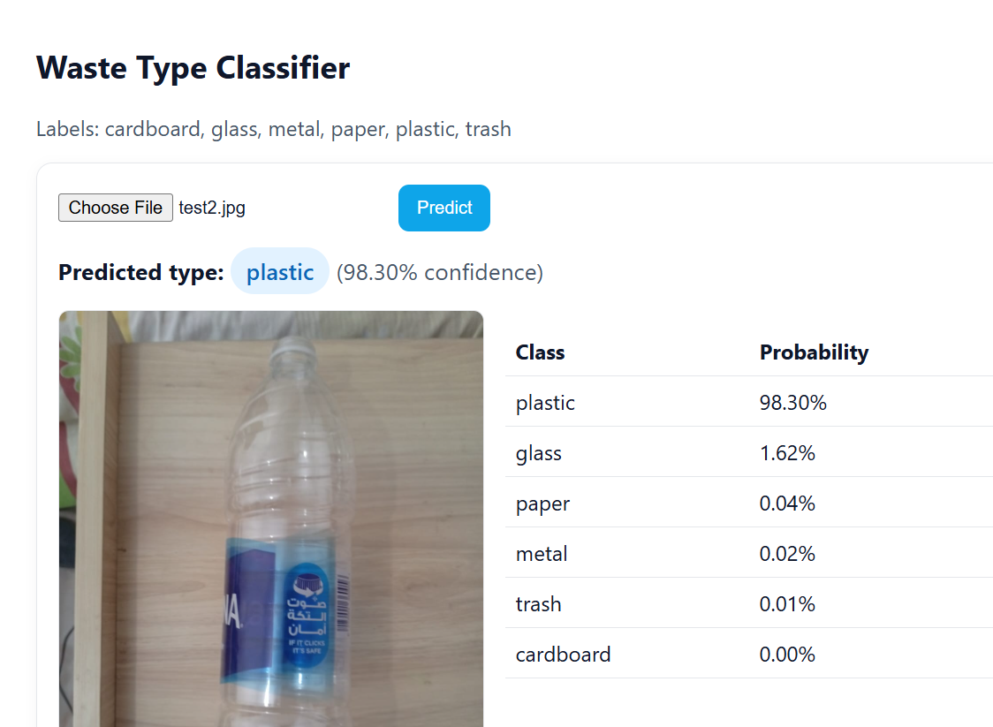
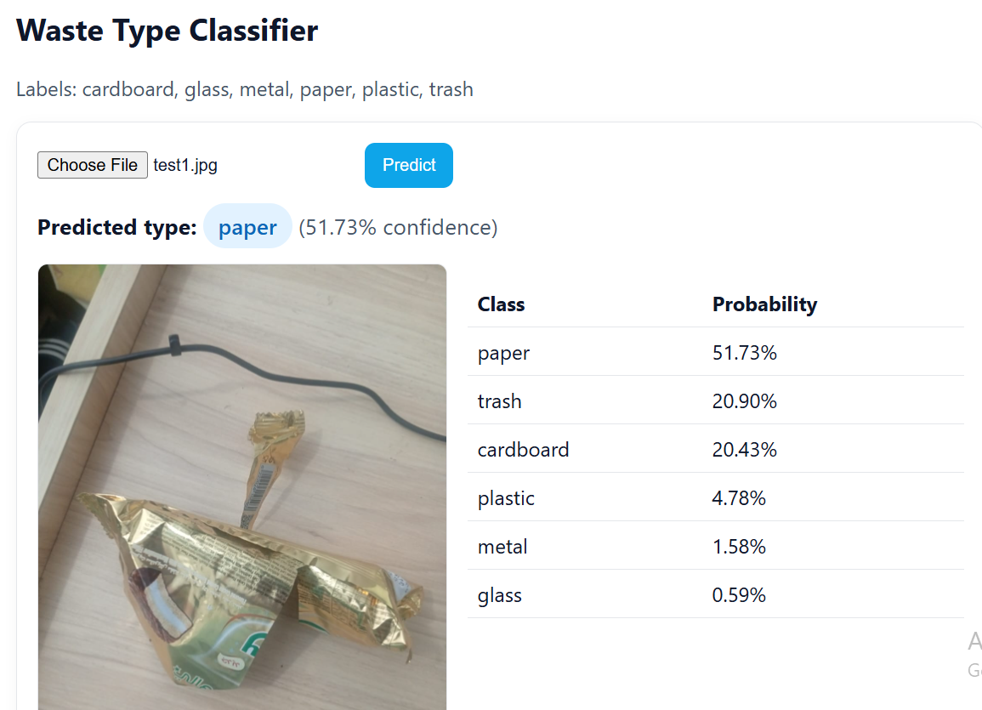

Slide 13
