Slide 1

Tic Tac Toe
With genetic algorithms

Slide 2
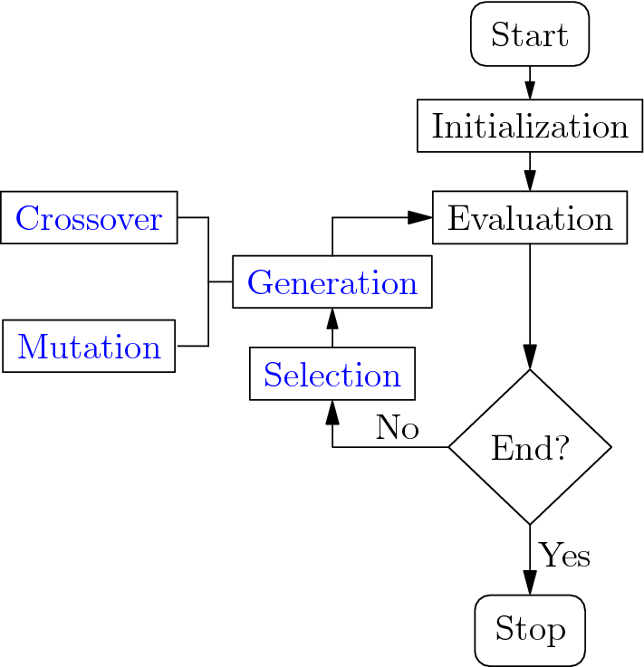
Overview: Introduction to Genetic Algorithms
What are Genetic Algorithms (GAs)?
A search and optimization technique inspired by natural selection and evolution.
Mimics biological processes like selection, crossover, and mutation to solve complex problems.
Why Use GAs?
Efficiently explores a large solution space.
Learns and improves strategies over iterations.

Slide 3
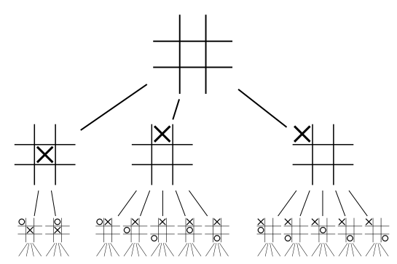
Overview: Tic Tac Toe Game
Basic Rules: Two players: "X" and "O". Players take turns marking empty squares on a 3x3 grid. The first to align three marks in a row, column, or diagonal wins. A draw occurs if all squares are filled without a winner.
Connection Between GAs and Tic Tac Toe :Use GAs to train an AI to play Tic Tac Toe. Optimize the AI’s strategy over time through evolutionary techniques.

Slide 4
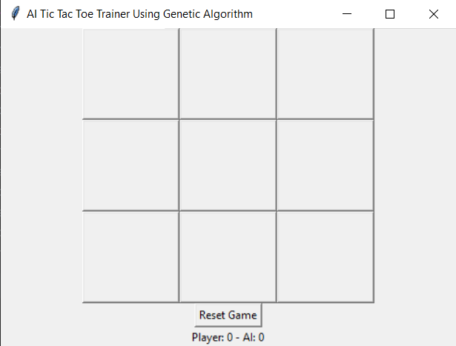
System Design: Tkinter UI
Game Interface Design: The game interface is built using the Tkinter library for GUI development.
Buttons: Represent each cell in the 3x3 grid, dynamically created using a loop.
Score Display: A label shows the current score for the Player and AI.
Reset Button: Allows restarting the game with a single click.

Slide 5
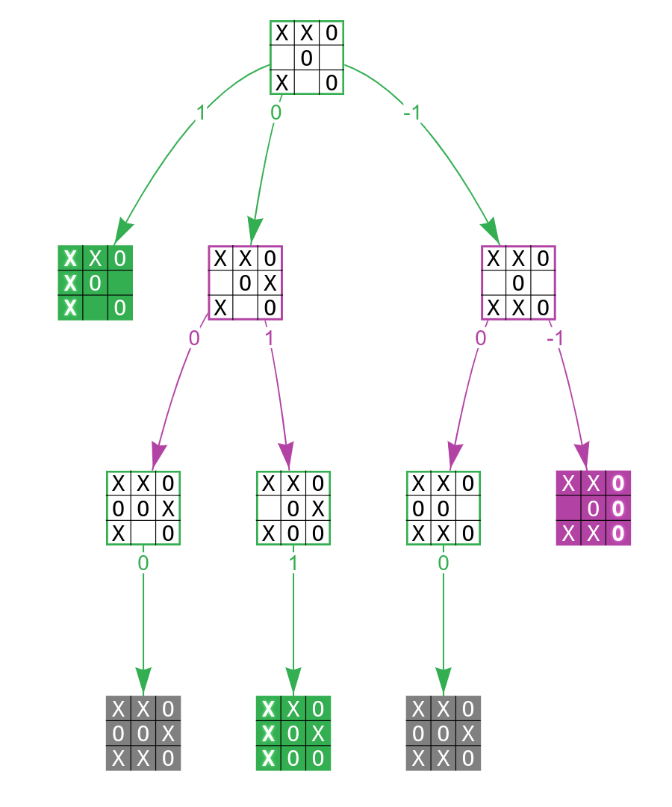
System Design: Game Flow
Initialization: Game begins with an empty 3x3 board, and buttons are enabled. Player starts by default, unless the AI is configured to go first.
Player Turn: Player clicks a button to make a move. The move is validated, marked as "X," and checked for a win using check_winner.
AI Turn: AI uses the Genetic Algorithm strategy to make a move: Considers blocking, winning, or strategic positions like the center or corners. Updates the board and checks for a win.
Game End: Displays results via a popup message (e.g., "Player Wins!" or "It's a Draw!"). Scores are updated, and fitness for the AI is adjusted. New game starts automatically.

Slide 6
Algorithm & Learning Process: Genetic Algorithm
Population Initialization: A population of AI strategies is created as random binary arrays, representing potential moves in the game. Each individual corresponds to a unique strategy.
Fitness Evaluation: Fitness scores are calculated based on performance: +10 for an AI win, -10 for a loss, 0 for a draw.
Crossover: Combines two parent strategies to create a new child strategy: A random crossover point determines how genes from parents are merged.
Mutation: Introduces random changes to genes in the offspring to ensure diversity: A mutation rate (e.g., 10%) controls the probability of change.

Slide 7
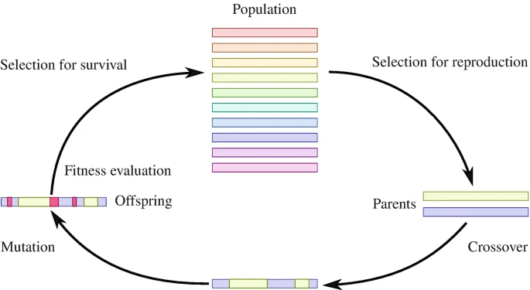
Algorithm & Learning Process: AI's Learning Process
Performance-Driven Evolution: After each game, the fitness scores guide which strategies are retained and evolved. Top-performing strategies are prioritized for creating the next generation.
Adapting to Challenges: Over successive generations, the AI learns effective tactics: Blocking the player’s winning moves. Prioritizing winning positions.
Continuous Improvement: Each generation becomes progressively stronger as strategies are refined. The AI aims to maximize its fitness score while minimizing losses.

Slide 8
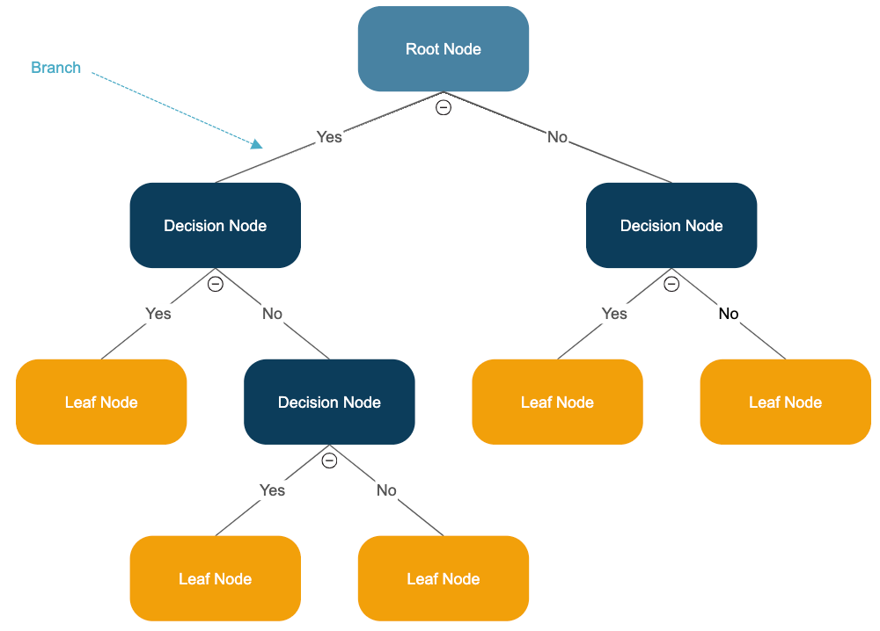
Challenges: Handling Different Player Strategies
Adaptability of the AI: The AI must counter diverse player tactics, from aggressive to defensive strategies. Requires effective prioritization of moves, like blocking threats or securing winning positions.
Edge Cases: Ensuring the AI handles uncommon or unpredictable moves without failure.

Slide 9
Challenges: Fine-Tuning Fitness
Fitness Function Design: Balancing rewards for wins and penalties for losses or suboptimal moves. Avoiding overfitting to specific scenarios, ensuring broad applicability.
Learning Speed: Ensuring the fitness function promotes meaningful learning without overcomplicating strategy selection.
Mutation and Crossover Parameters: Fine-tuning mutation rates and crossover mechanisms to maintain diversity while improving performance.

Slide 10
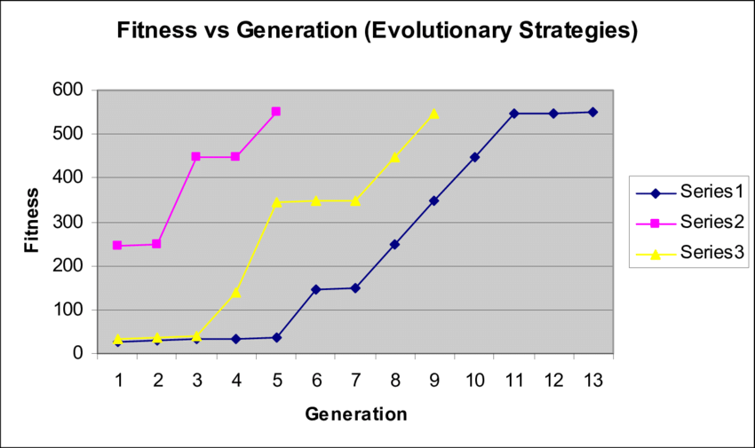
Results & Findings: AI Improvement and Player Experience
Performance Over Generations: Initial generations rely on random strategies with low success rates. Over time, the AI evolves to prioritize: Blocking winning moves, Securing optimal positions (center, corners). Observation: Consistent improvement in fitness scores as generations progress.
Smarter Gameplay: The AI becomes increasingly competitive, learning to anticipate player moves and counter effectively.
Enhanced Challenge: The AI evolves to pose a greater challenge to players. Matches become more engaging due to dynamic and adaptive AI responses.

Slide 11
Future Work: Optimization and Additional Features
Refining Fitness Evaluation: Explore advanced metrics to assess strategy effectiveness. Incorporate penalties for suboptimal moves or unnecessary risks.
Algorithm Efficiency: Improve the speed of population evolution for quicker AI learning cycles.
Difficulty Levels: Design varying difficulty settings: Beginner: Early-generation AI strategies, Expert: Fully evolved AI for a challenging match.
Multi-Game Learning: Enable the AI to retain knowledge across multiple sessions for continuous improvement.

Slide 12

Thank you

