Slide 1
Advanced Study on Man-Machine Real World Interaction
実世界コミュニケーション特論
Michita Imai
今井 倫太

Slide 2
Topics
Systems dealing with real world interaction
Communication mechanisms from person’s viewpoint
  Psychological aspect
How to develop a system dealing the psychological aspect of the interaction or dynamics of human-machine interaction
  Computation model and strategy

Slide 3
Contents of Lecture
Systems dealing with real world interaction
  1.Multi-modal Interface and Attention Mechanism
Communication mechanisms from person’s viewpoint
  2.Joint Attention and Communication Robot
  3.Relationship in Communication
  4.Embodied Intelligence
Computational model and strategy
  5.Synergetics and Two Phase Model
  6.Qualia Communication
  7.Indefinite observation model

Slide 4
Evaluation
Three reports
  Communication Robot (May)
  Two phase model (June)
  Indefinite interaction (July or August)??

Slide 5
Web site
http://www.ayu.ics.keio.ac.jp/~michita/realworld

Slide 6
Feature of Real World
Open world
  Infinite entities
  Uncertainty about the world

Slide 7
Contrast between two worlds
Real world
  Vast numbers of entities regardless of a systems
  Uncertainty: someone or something may induce an event anytime.
Virtual world
  Given entities in developing a system
  Almost events are predictable.
  Only user’s behavior is un predictable.

Slide 8
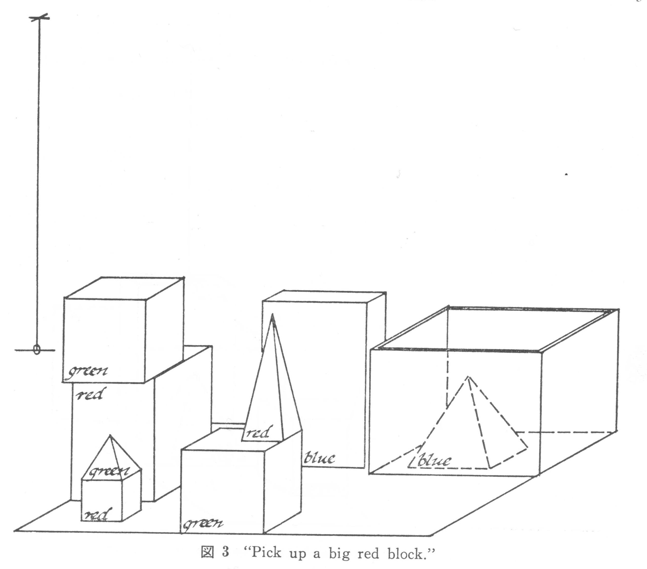
SHRDLU
Dialogue system on a virtual world (block world)

Slide 9
Overview of SHRDLU
Subroutine call
Monitor
Answer
Input
Grammar
Semantics
Mover
Blocks
Semantic
features
Data
Programmar
Dictionary
Planner

Slide 10
Overview of SHRDLU
Monitor
  Main routine which calls main routines: Input, Grammar, Semantics, and Answer.
Monitor
Input
Answer
Grammar
Semantics
Mover
Blocks
Programmar
Semantic
features
Data
Dictionary
Planner

Slide 11
Overview of SHRDLU
Input
  This routine obtains text string typed in English and carries out morphological analysis.
    running -> run + ing
Monitor
Input
Answer
Grammar
Semantics
Mover
Blocks
Programmar
Semantic
features
Data
Dictionary
Planner

Slide 12
Overview of SHRDLU
Grammar
  This routine analyzes the input texts with grammatical information and generates a parse tree.
Monitor
Input
Answer
Grammar
Semantics
Mover
Blocks
Programmar
Semantic
features
Data
Dictionary
Planner

Slide 13
Overview of SHRDLU
Semantics
  This routine interprets the input texts cooperating with Grammar and infers an appropriate meaning with Planner.
Monitor
Input
Answer
Grammar
Semantics
Mover
Blocks
Programmar
Semantic
features
Data
Dictionary
Planner

Slide 14
Overview of SHRDLU
Answer
  This routine controls the responses of SHRDLU by generating a natural language expression and storing conversation contexts.
Monitor
Input
Answer
Grammar
Semantics
Mover
Blocks
Programmar
Semantic
features
Data
Dictionary
Planner

Slide 15
Overview of SHRDLU
Programmar
  This routine is a set of parser programs executed by Grammar. The programs produces a parse tree.
Monitor
Input
Answer
Grammar
Semantics
Mover
Blocks
Programmar
Semantic
features
Data
Dictionary
Planner

Slide 16
Overview of SHRDLU
Dictionary
  This routine has the definitions of words used by Input, Grammar, and Semantics.
Monitor
Input
Answer
Grammar
Semantics
Mover
Blocks
Programmar
Semantic
features
Data
Dictionary
Planner

Slide 17
Overview of SHRDLU
Semantics features
  This routine has the feature lists of the block world. This features are used to categorize items in the block world and the action of the robot. Ex. “in”
  -how many blocks
  are in the box?
  -The red block in
  the tall stack
Monitor
Input
Answer
Grammar
Semantics
Mover
Blocks
Programmar
Semantic
features
Data
Dictionary
Planner

Slide 18
Overview of SHRDLU
Blocks
  This routine is the knowledge of the block world. Physical constraints.
Monitor
Input
Answer
Grammar
Semantics
Mover
Blocks
Programmar
Semantic
features
Data
Dictionary
Planner

Slide 19
Overview of SHRDLU
Mover
  This routine shows the block world and the robot on a computer display.
Monitor
Input
Answer
Grammar
Semantics
Mover
Blocks
Programmar
Semantic
features
Data
Dictionary
Planner

Slide 20
Overview of SHRDLU
Planner
  This routine infers relations between the items in the block world to generate information for parsing texts and to confirm the statement of the text.
Monitor
Input
Answer
Grammar
Semantics
Mover
Blocks
Programmar
Semantic
features
Data
Dictionary
Planner

Slide 21
Overview of SHRDLU
Data
  This routine keeps information about a current state of the world.
Monitor
Input
Answer
Grammar
Semantics
Mover
Blocks
Programmar
Semantic
features
Data
Dictionary
Planner

Slide 22
Overview of SHRDLU
Current situation: Knowledge of the world.
Context : Knowledge of the conversation
Grammar: Lexical Knowledge
Semantics: Knowledge of physical constraints

Slide 23
Overview of SHRDLU
Recognition skills of the robot
  It is able to identify the size, figure, color, and position of the items in the block world.
The feature of the virtual world.

Slide 24
Example with Current Situation
pick up a big red block.
  OK

Slide 25
Example with Block world knowledge
find a block which is taller than the one you are holding and put it into the box.
  But “IT,” I ASSUME YOU MEAN THE BLOCK WHICH IS TALLER THAN THE ONE I AM HOLDING. OK

Slide 26
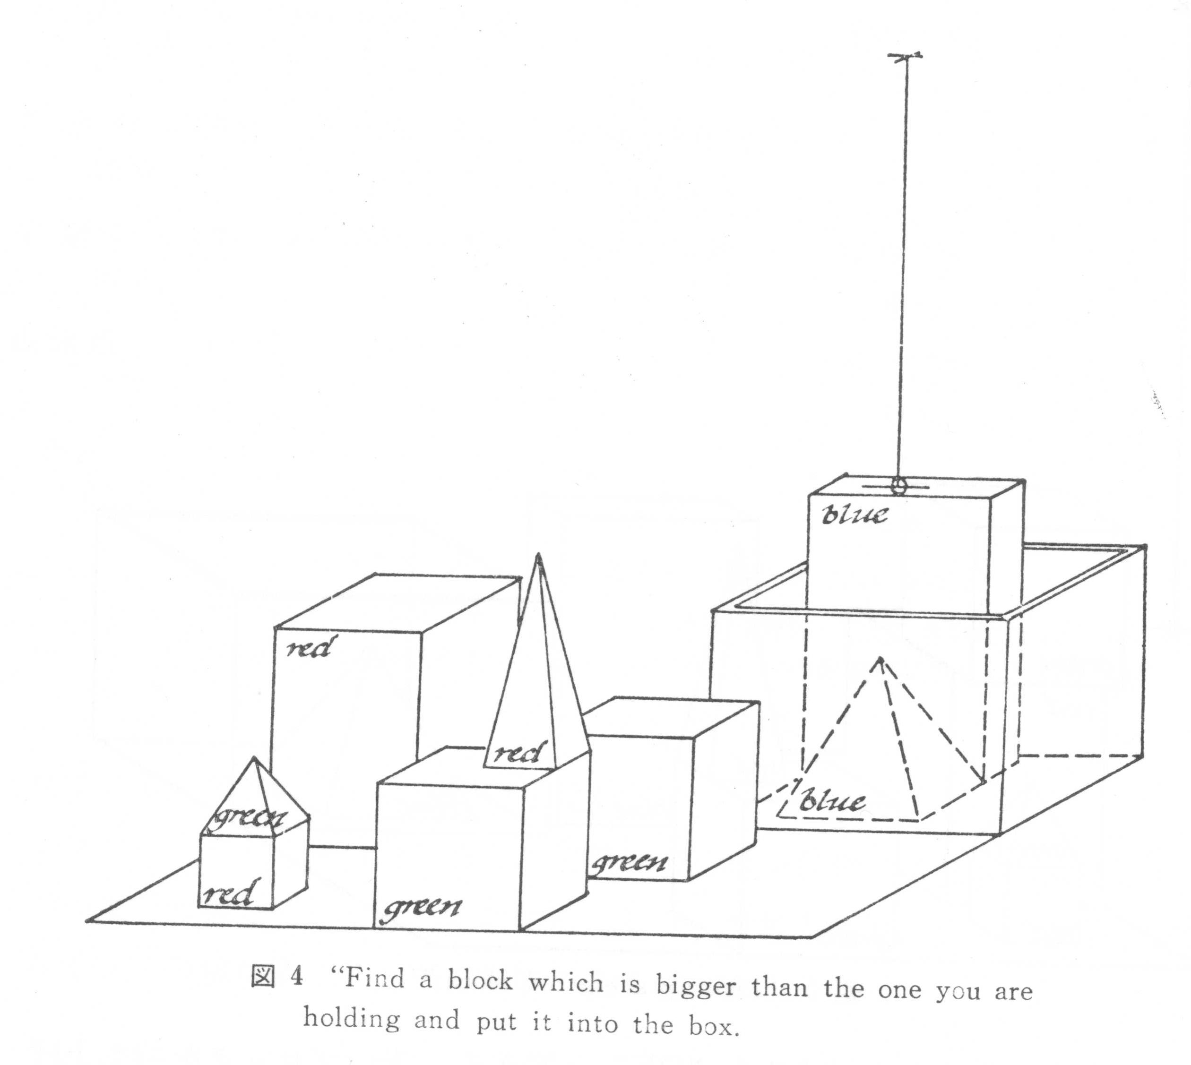
Example with Current Situation
find a block which is taller than the one you are holding and put it into the box.
  But “IT,” I ASSUME YOU MEAN THE BLOCK WHICH IS TALLER THAN THE ONE I AM HOLDING. OK

Slide 27
Example with Context
What does the box contains?
  THE BLUE PYRAMID AND THE BLUE BLOCK.
What is the pyramid supported by?
  THE BOX

Slide 28
Example with Lexical knowledge
How many blocks are not in the box?
  FOUR OF THEM.
Is at least one of them narrower than the one which I told you to pick up?
  YES, THE RED CUBE

Slide 29
Example with Knowledge of Physical Constraints
Can the table pick up blocks?
  NO
Can a pyramid be supported by a block?
  YES

Slide 30
For real world application
There are vast (infinite) number of items or events in the real world.
Some of them relates to the meaning of conversation. All items are not used.
The items are already selected in the virtual world.
A system must selects the items related to communication or interaction in real world.

Slide 31
Intelligent Robot

Slide 32
Ecological Approach

