Slide 1
Design of Physically Grounded Communication System
実世界コミュニケーション特論
Michita Imai
今井 倫太

Slide 2
Requirements of a robot in Real World
Process of sensor input and behavior generation
Multiple Goals
Multiple Sensors
Robustness
Additivity

Slide 3
Multiple Goals
There are several goals simultaneously
  EX.
    A robot tries to reach a certain place while avoiding local obstacles.
    It tries to reach a certain place in minimal time while conserving power reserves.
  The relative importance of goals will be context dependent.

Slide 4
Multiple Sensors
Many sensors
  CCD cameras, encoders on steering and drive mechanism, infrared beacon detectors, an internal navigation system, laser rangefinders, sonic sensors, GPS, and etc.
The robot must make decisions under the conditions.
  No direct analytic mapping from sensor values to desired physical quantities
  They overlap in the physical quantities they measure.
  Inconsistent readings
    normal error
    errors based on use outside its domain of applicability
    No analytic characterization of the domain of applicability

Slide 5
Robustness
Sensors fail: when some sensors fail, the robot should be able to adapt and cope by relying on those still functional.
Dynamic environment: when the environment changes drastically, it should be able to still achieve some sensible behaviors.
Hardware fail: when there are faults in parts of its processors...

Slide 6
Additivity
Hardware requirement
  When more sensors and capabilities are added, it needs more processing power.

Slide 7
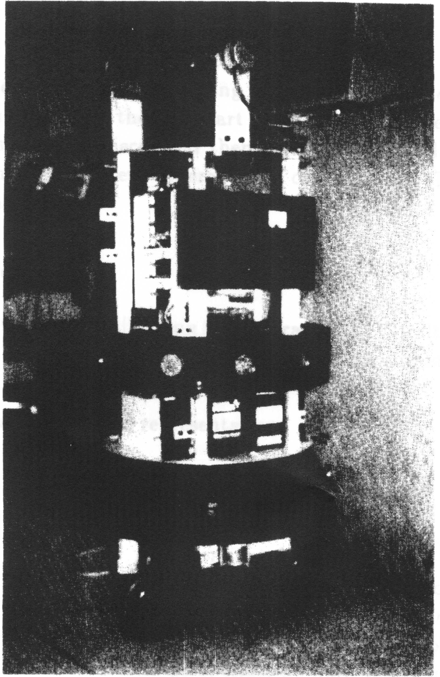

Robot
Mobile robot
Sensors
  a ring of twelve sonar
  pan tilt camera

Slide 8
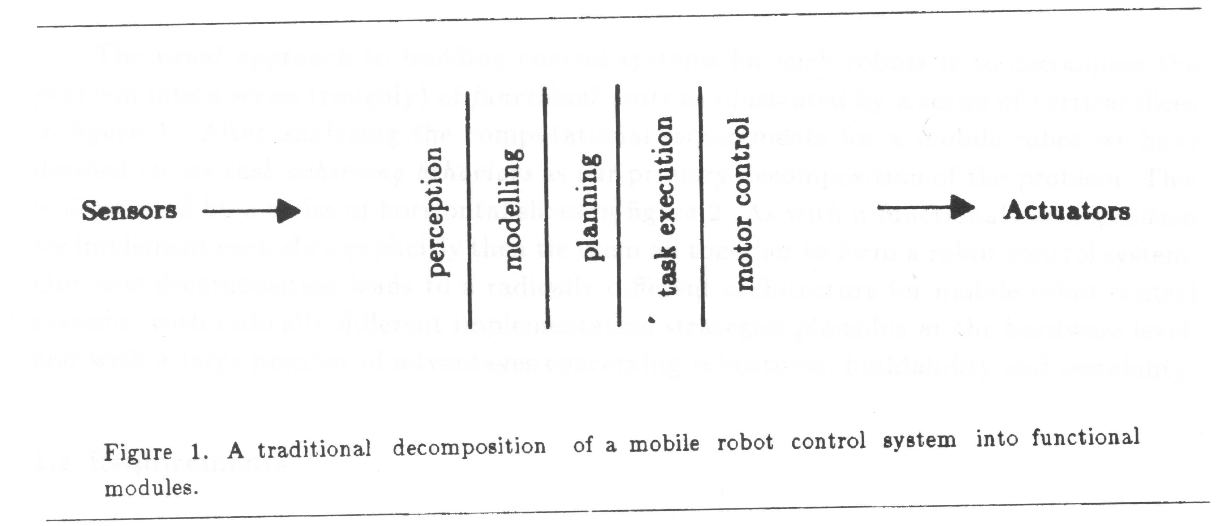
Typical design of robot
Horizontal decomposition with vertical slices
  A traditional decomposition of a robot control system into functional modules
    Sensing, Mapping sensor data into a world representation, Planning, Task execution, Motor control

Slide 9
Typical design of robot
A designer must consider the overall performance of a robot.
Difficulty of modification

Slide 10
Dynamic Environment
Disadvantage of the traditional decomposition is that the robot cannot react the changes in an environment immediately.

Slide 11
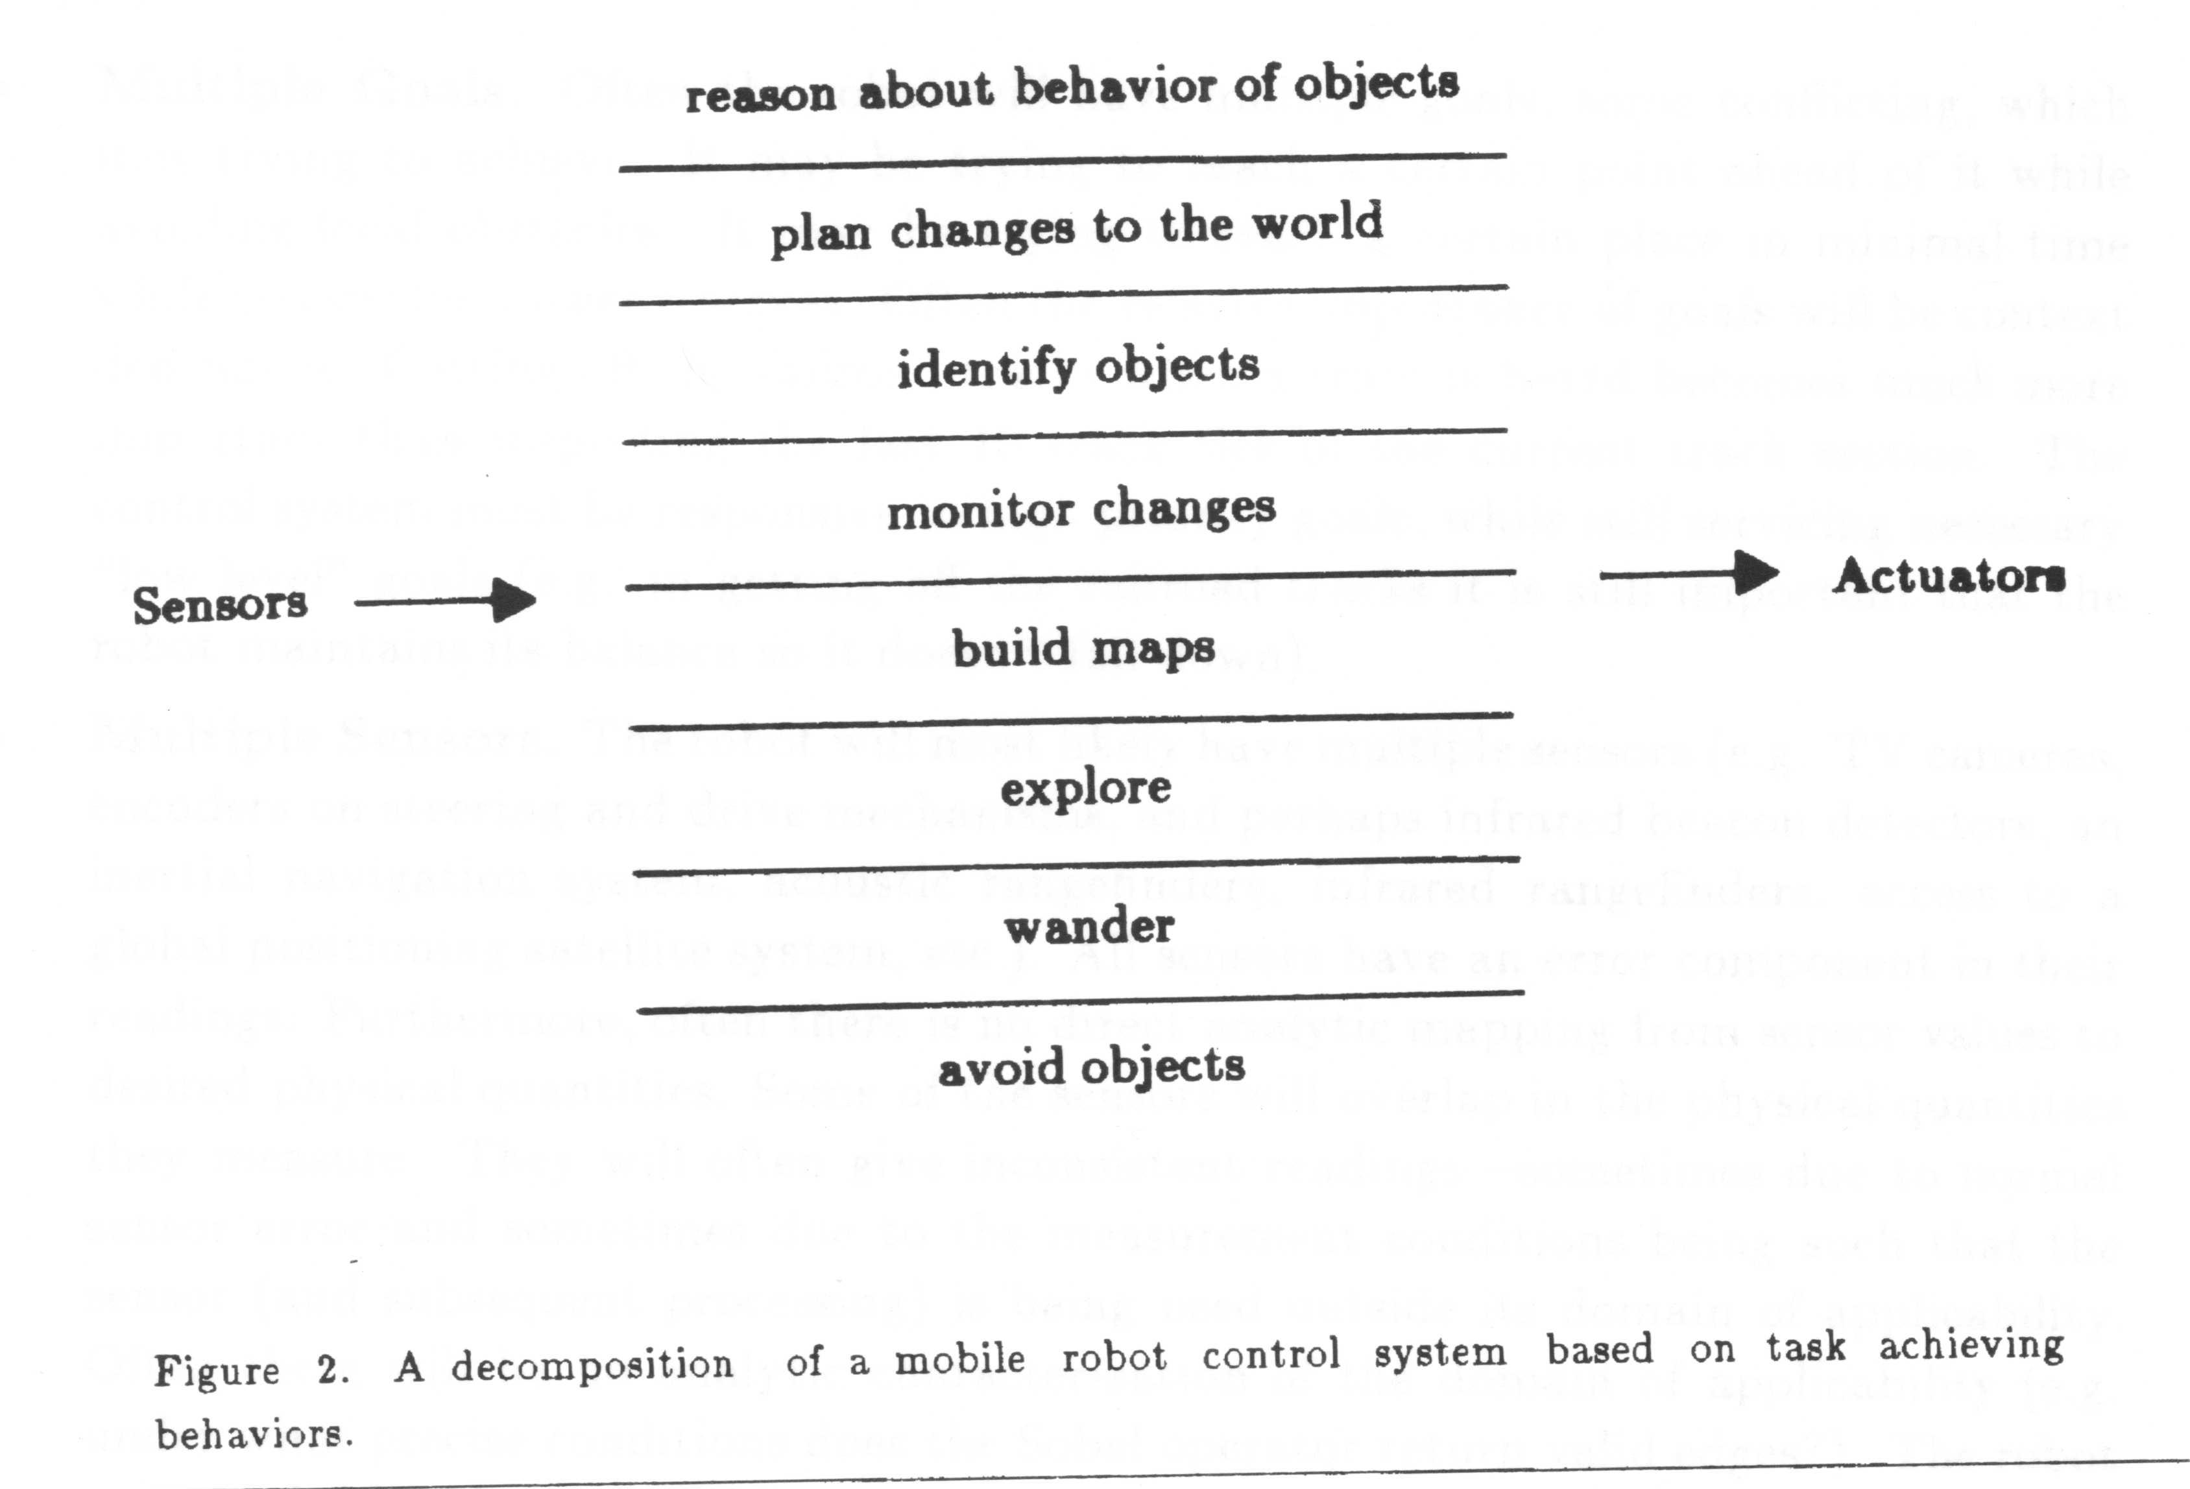
Subsumption Architecture (SSA)
A decomposition of a control system based on achieving behaviors

Slide 12
Subsumption Architecture (SSA)
Complex behaviors are the reflection of a complex environment.
  The complex behaviors of traditional systems come from the internal computations.
Easy to react the changes in an environment immediately

Slide 13
SSA design
Decomposing the problem vertically
Rather than the slice based on internal workings of the solution, SSA slices the problem on the basis of desired external manifestations of the robot control system.
A SSA designer is able to do the design modules differently to other groups.

Slide 14
Levels of competence
Level 0: Avoid contact with objects
Level1: Wander aimlessly around without hitting things
Level 2: Explore the world by seeing places in the distance which look reachable and heading for them.
Level 3: Build a map of the environment and plan routes from one place to another.
Level 4: Notice changes in the static environment.
Level 5: Reason about the world in terms of identifiable objects and perform tasks related to certain objects.
Level 6: Formulate and execute plans which involve changing the state of the world in some desirable way.
Level 7: Reason about the behavior of objects in the world and modify plans accordingly.

Slide 15
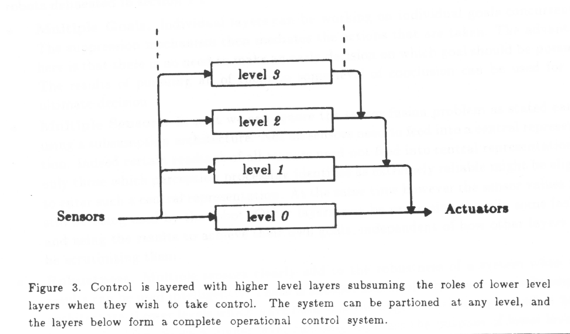
Level of competence

Slide 16
Design process of Layers of control
Building layers of a control system corresponding to each level of competence
Easy to add a new layer to an existing set to achieve a new behavior

Slide 17
Development of level 0
Starting by building a complete robot system which achieving level 0 competence.
  Never alter level 0 after it is debugged thoroughly

Slide 18
Development of level 1
Next building level 1
  Examining data from level 0
  Permitted to inject data into the internal interface of level 0 suppressing the normal data flow in level 0.
The achievement of level 1 competence with the aid of level 0
Level 0 continues to run unaware of the layer above it which sometimes interferes with its data paths.

Slide 19
Development of higher levels
The same process is repeated for the higher levels.
In the scheme of the development, the robot is able to run as soon as we have built the first layer.
Additional layers can be added later
The initial working system need never be changed.

Slide 20
Components for SSA
Internal structure of modules
Communication structure between modules

Slide 21
Internal Structure of Modules
Each module is a finite state machine.
  Lisp data structure
  Four state types
    Output: An output message is sent to line.
    Side effect: One of the module’s variables is set to a new value.
    Conditional dispatch: A predicate on the module’s variables and input buffers is computed. Depending on the outcome, one of two subsequent states is entered. Branch.
    Event dispatch: A sequence of pairs of conditions and states to branch to are monitored until one of the event is true. The event are in combinations of arrivals of messages on input lines and expiration of time delays.

Slide 22
Example of avoid module
(defmodule avoid
  :inputs (force heading)
  :outputs (command)
  :instance-vars (resultforce)
  :states
    ((nil (event-dispatch (and force heading) plan))
    (plan (setf resultforce (select-direction force heading)) go)
    (go (conditional-dispatch (significant-force-p resultforce 1.0)
    start
    nil))
    (start (output command (follow-force resultforce))
    nil)))

Slide 23
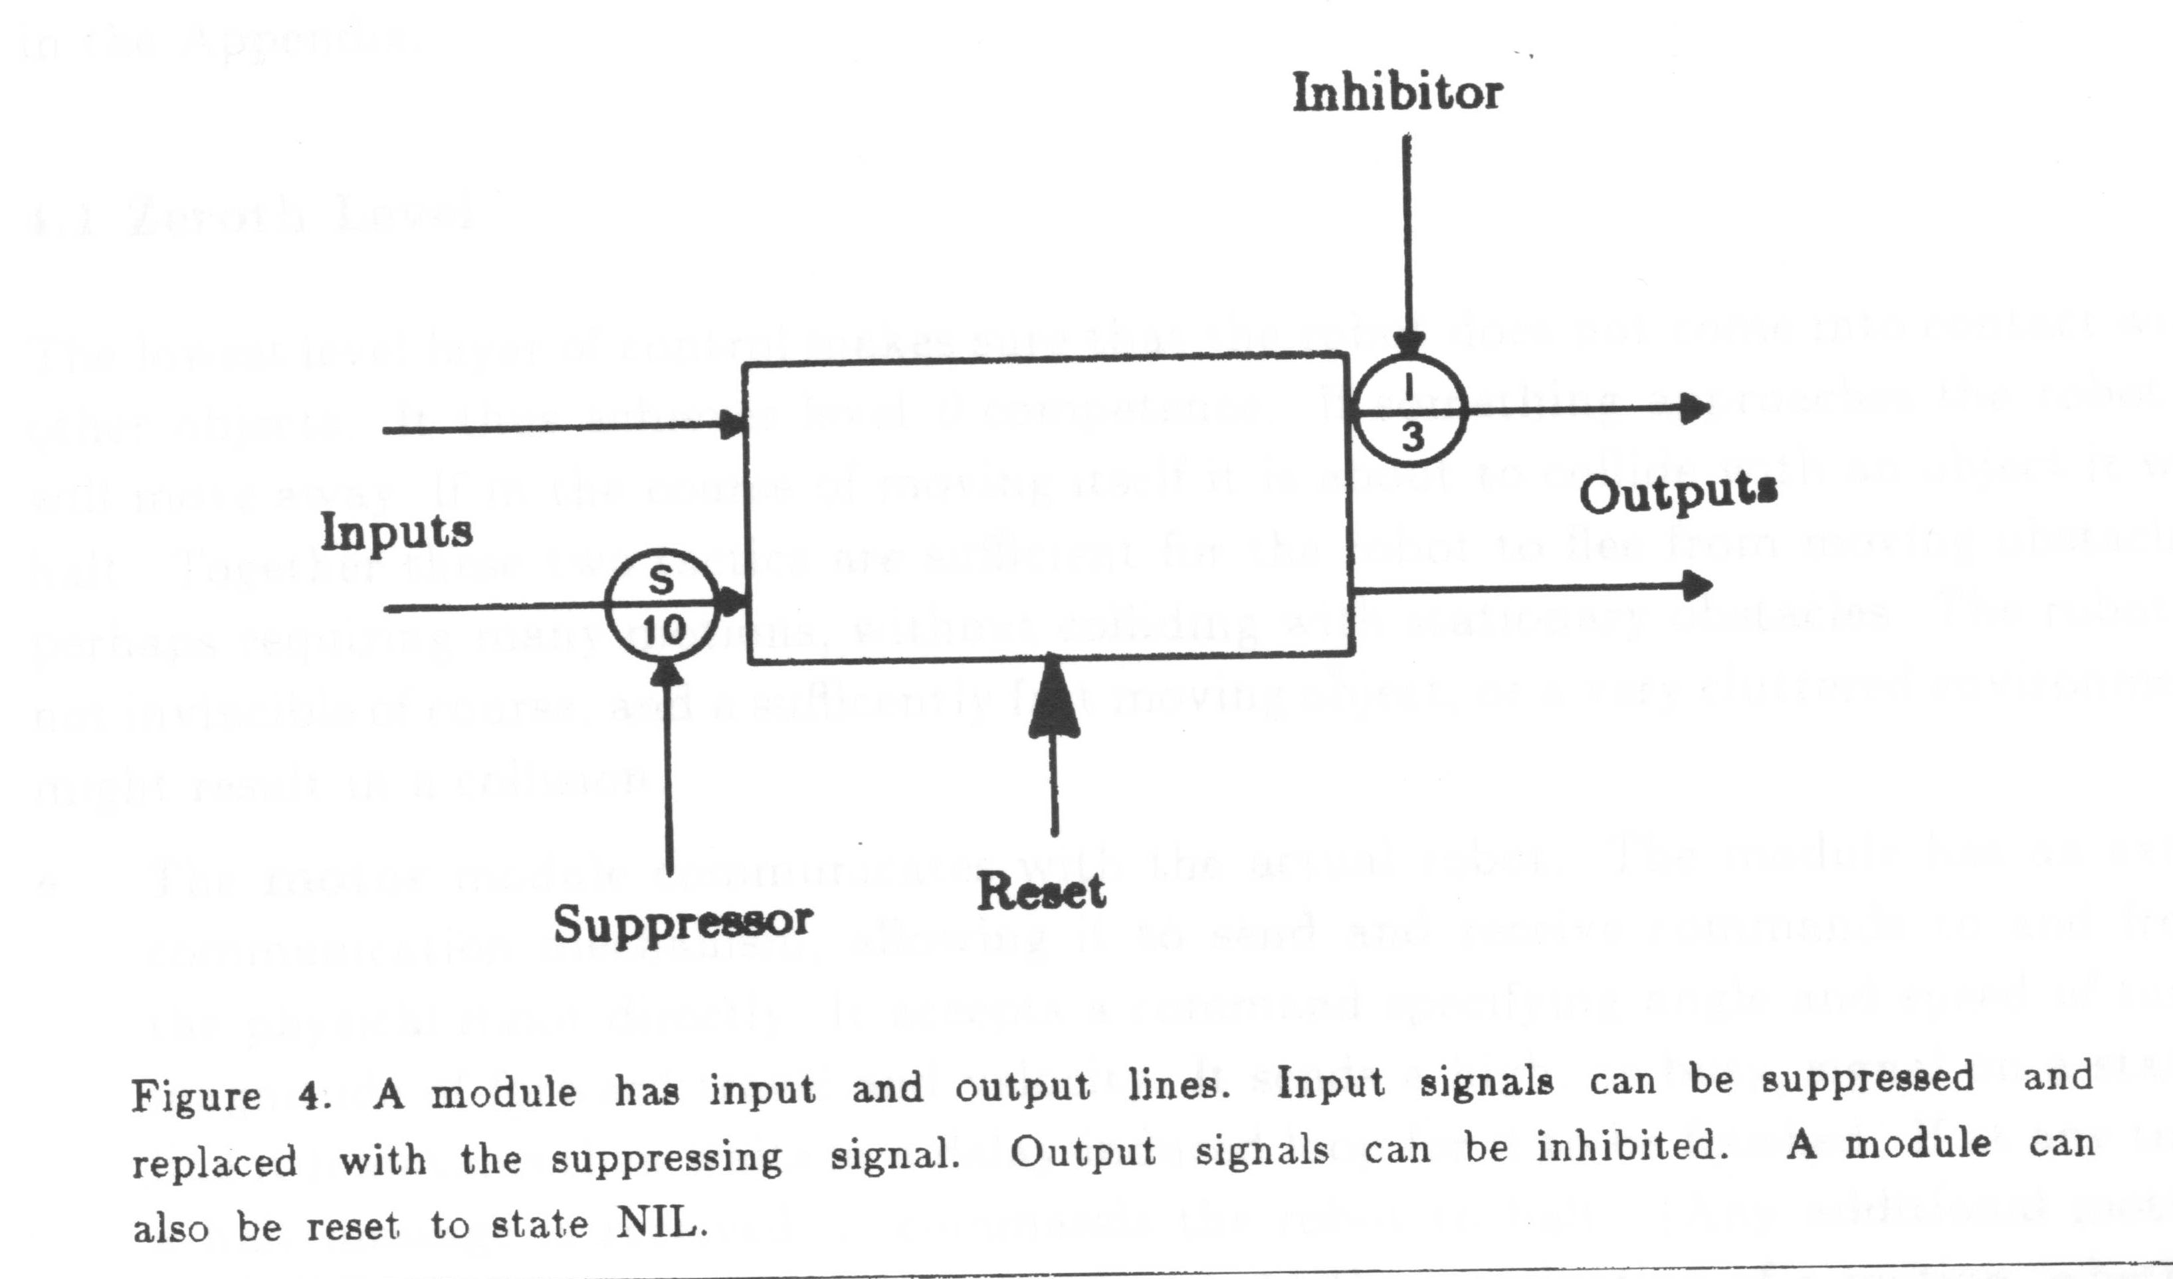
Communication between modules
Output may be inhibited.
Input may be suppressed.
(defwire (feelforce force) (runaway force) (avoid force))
(defwire (avoid command) ((suppress (motor command) 1.5)))

Slide 24
Robot control system intance
level 0: prevent a robot from contact with an object.
level 1: wander avoiding obstacles.
level 2: generate a path to reach a certain place.

Slide 25
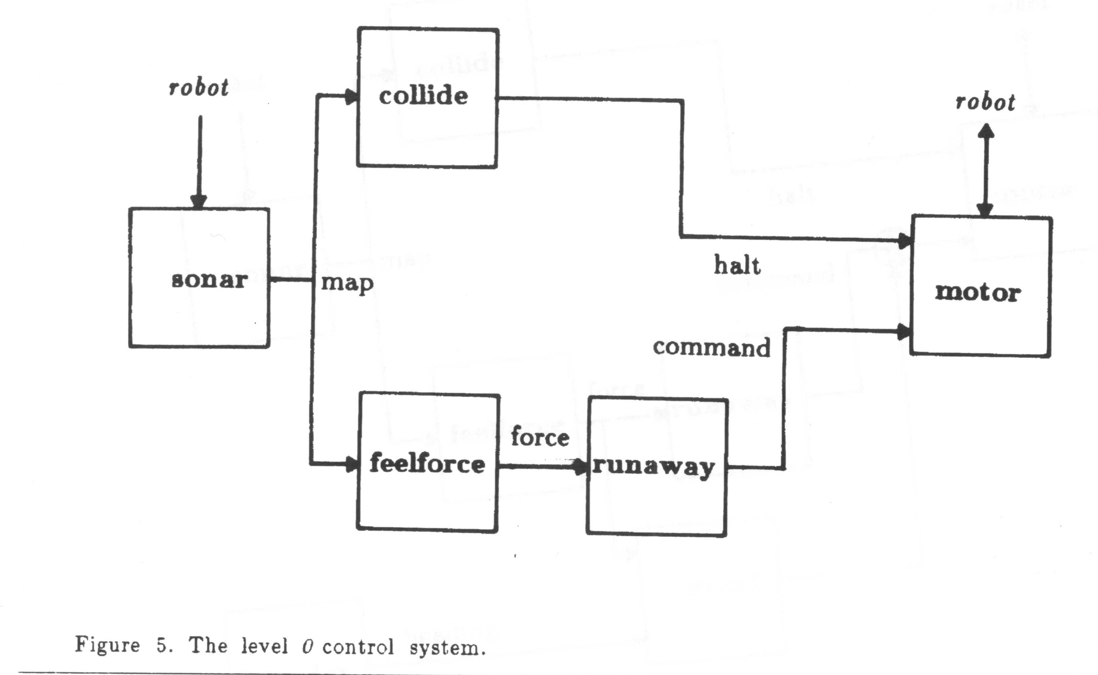
Instance of level 0

Slide 26
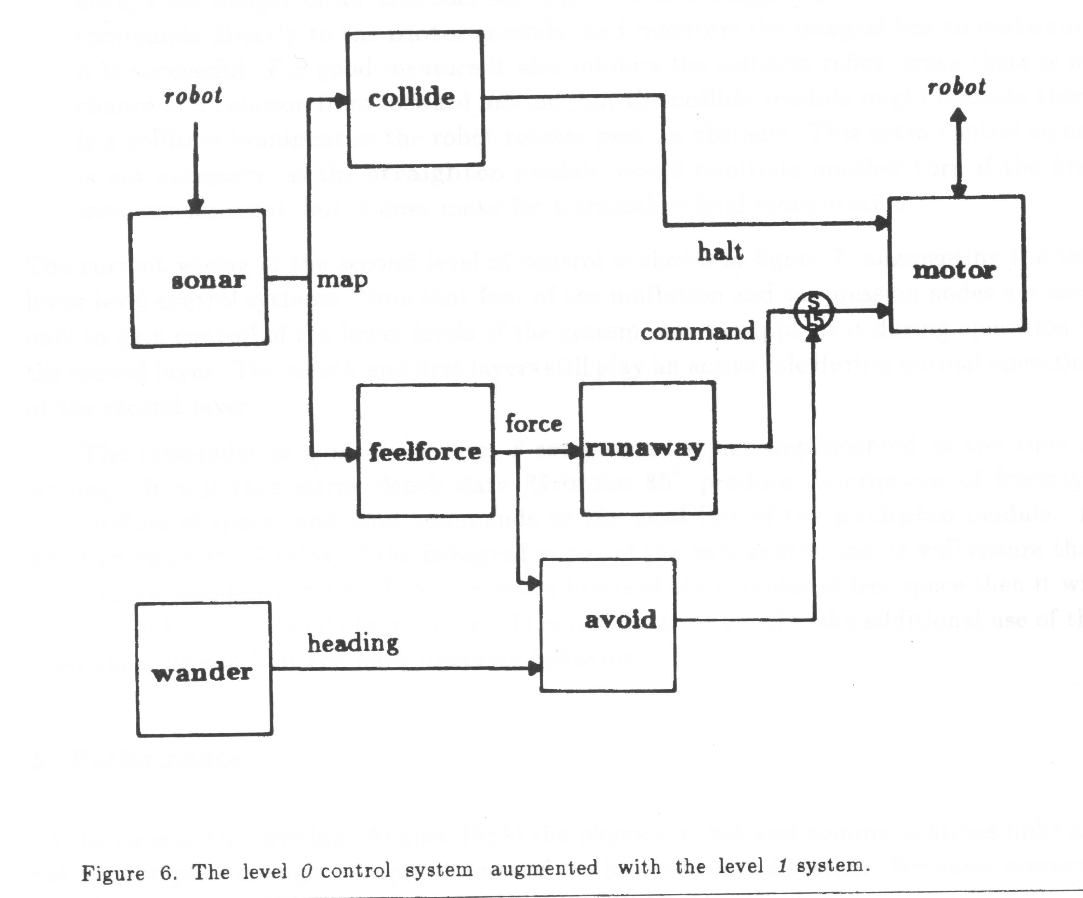
Instance of level 1

Slide 27
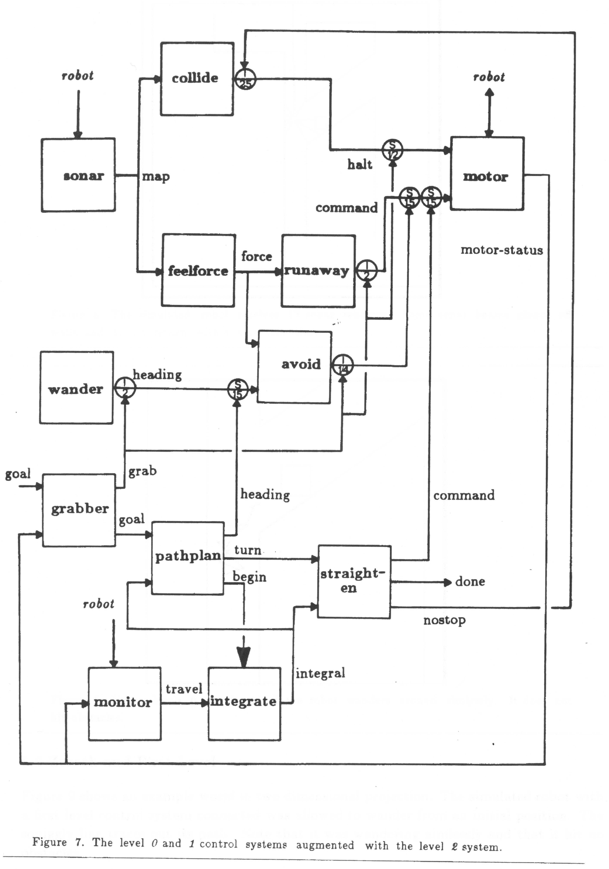
instance of level 2

Slide 28
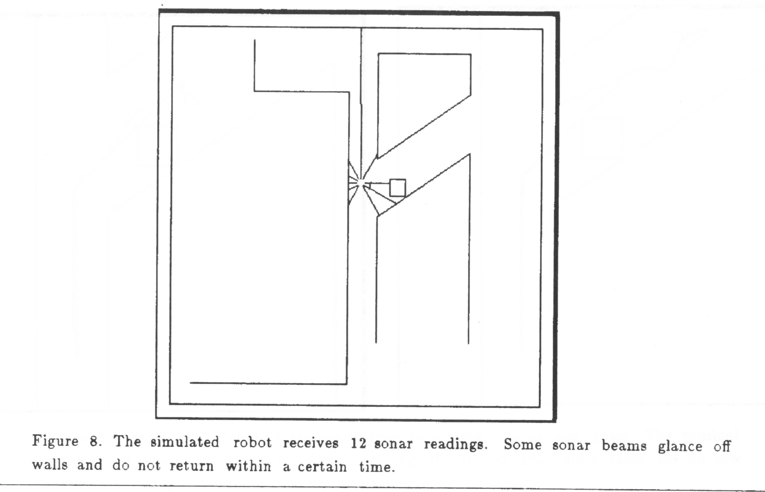
Simulation of SSA
Sonar data

Slide 29
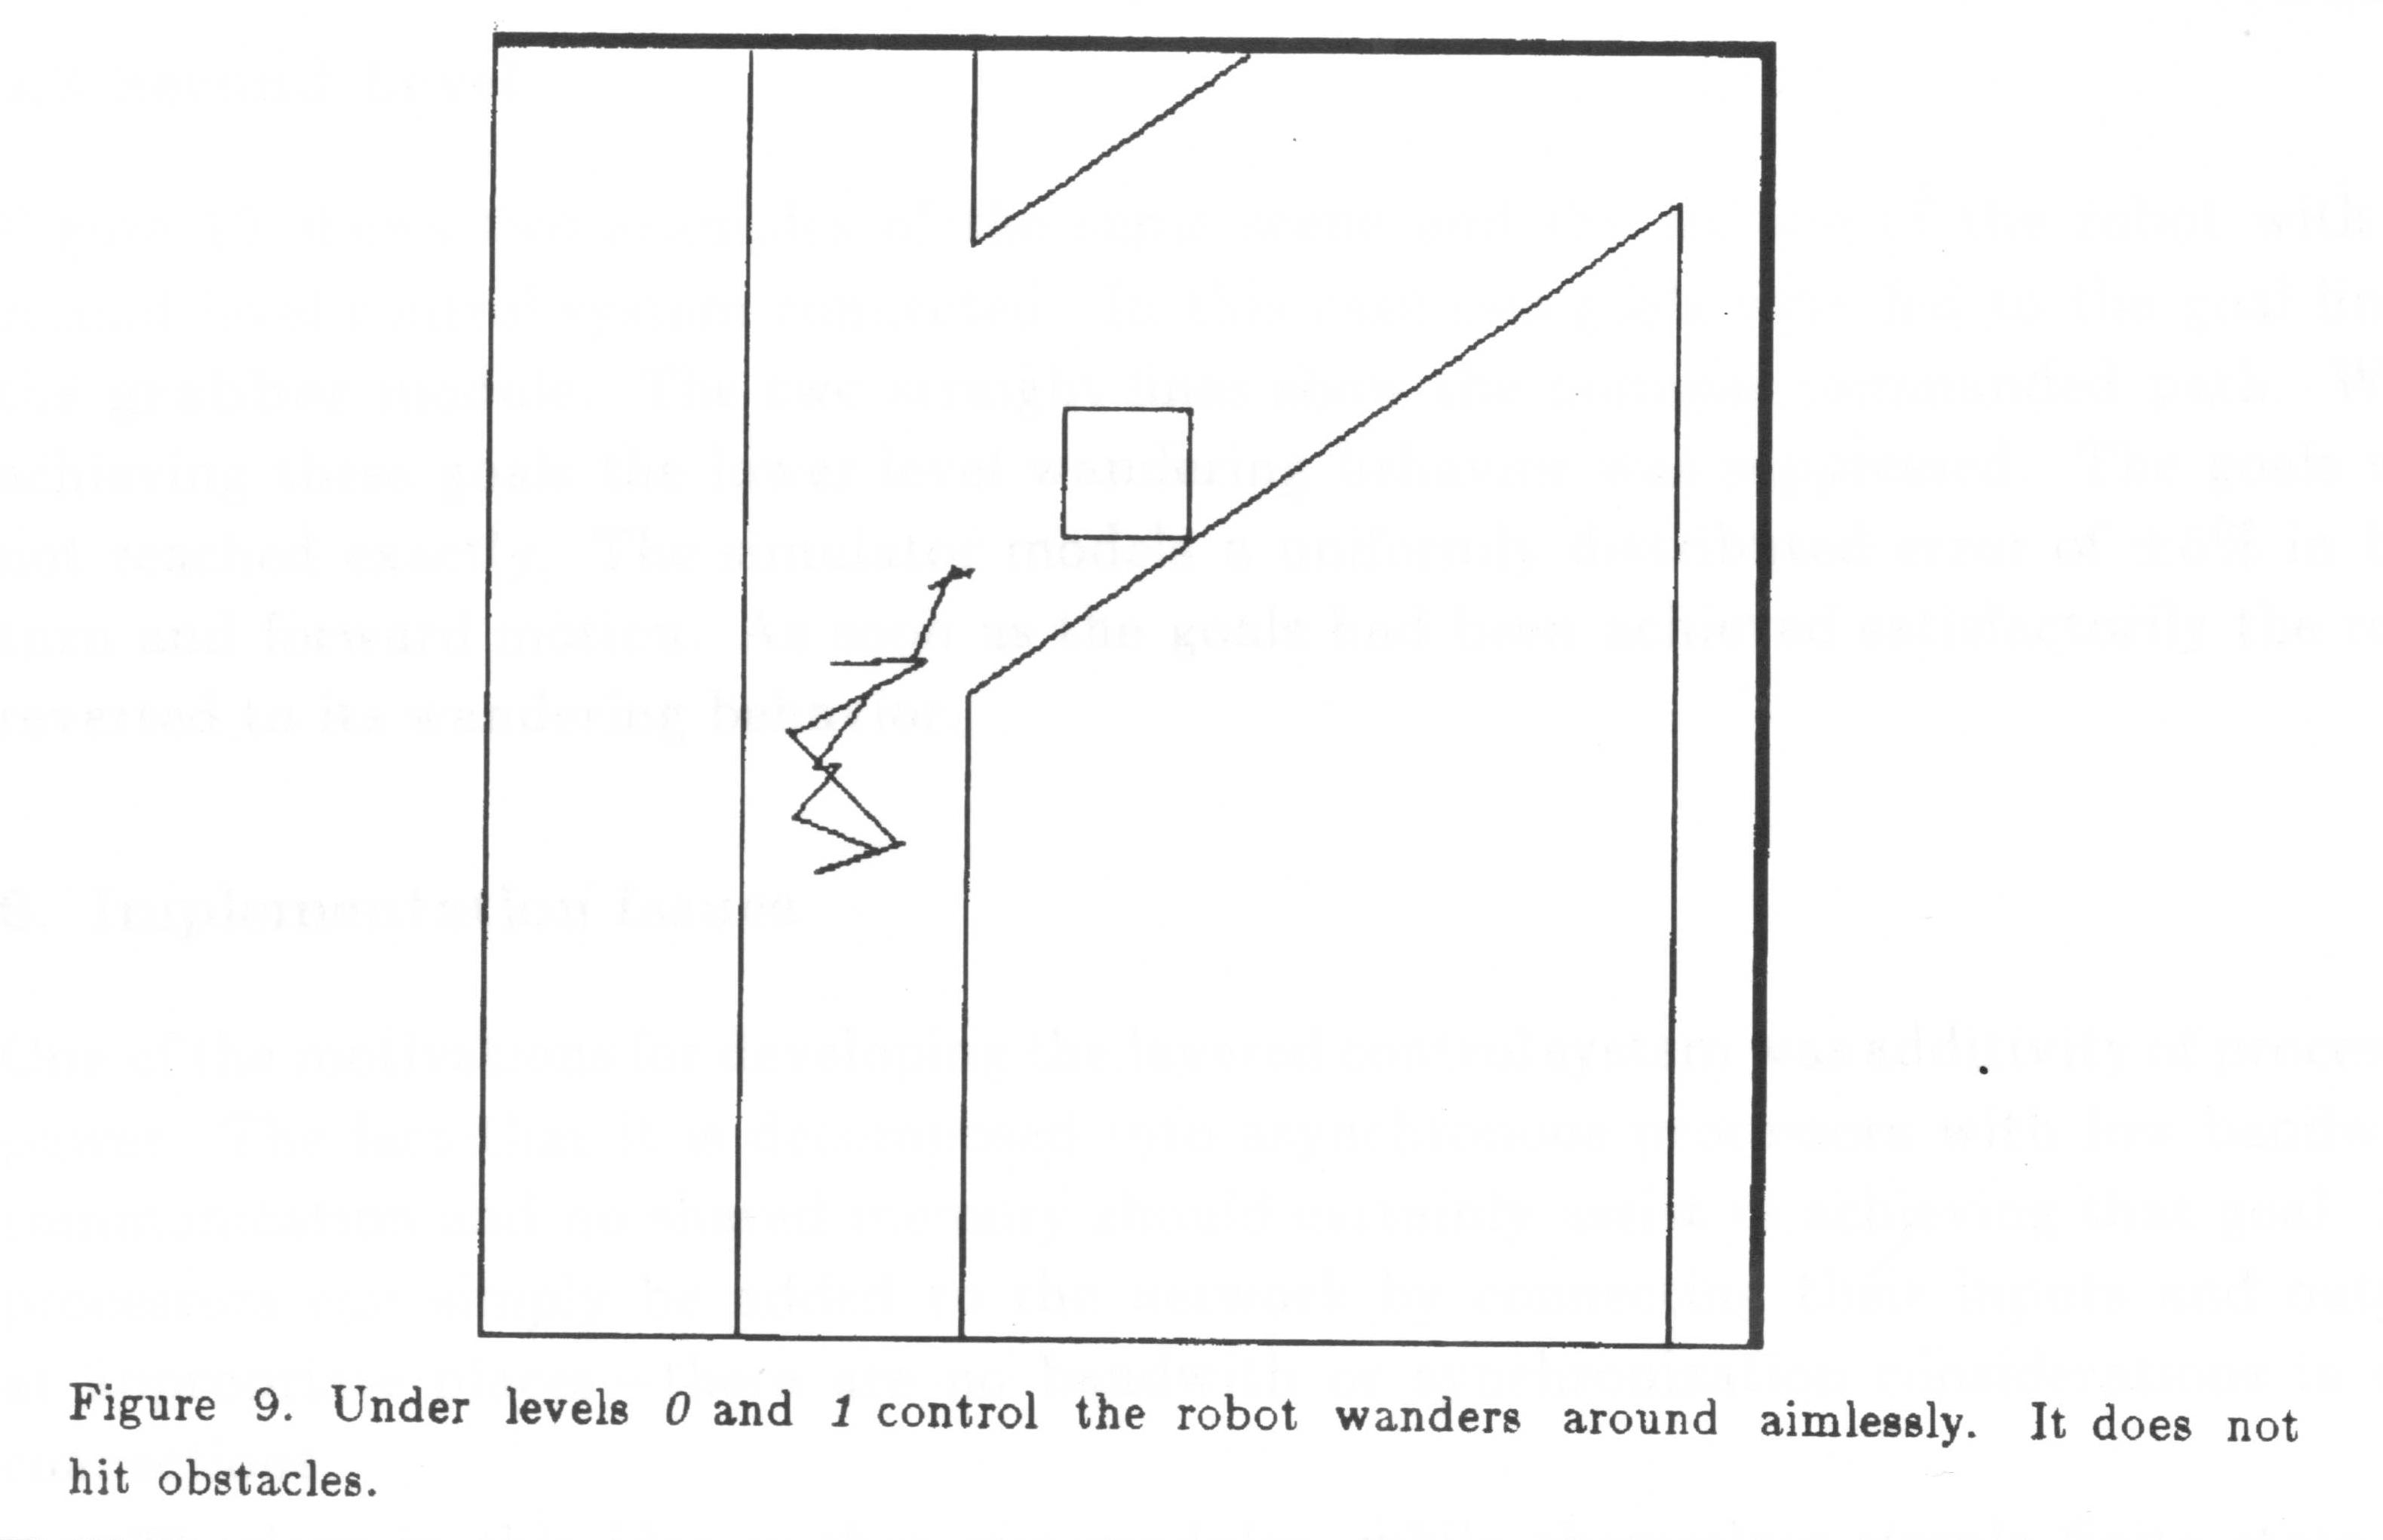
Simulation of level 1

Slide 30
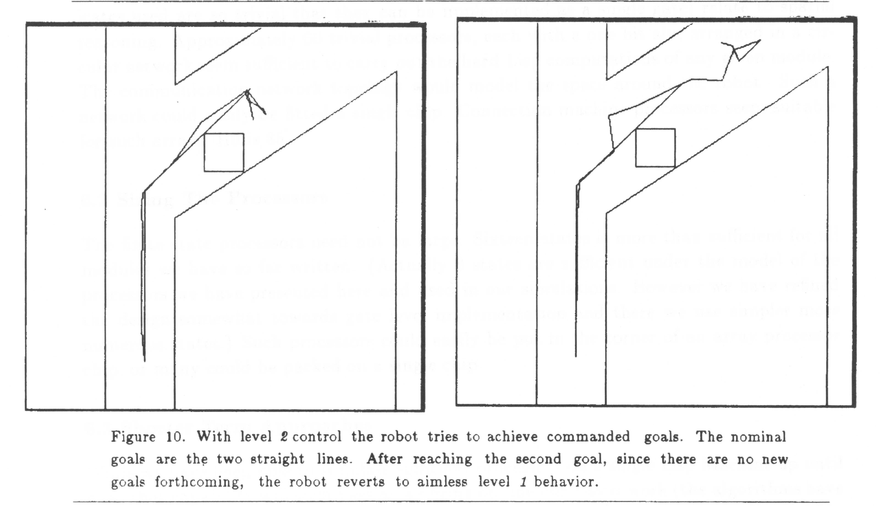
Simulation of level 2
After tracing the given path, level 1 controls the robot.

Slide 31
Tackle of the problems by SSA
Multiple Goals
  Individual layers works on individual goals concurrently.
  The suppression mechanism between layers mediates the action selection.
  The advantage is that there is no need to make an early decision which goal should be pursued.
Multiple Sensors
  SSA can ignore the sensor fusion problem.
  Not all sensors need to feed into a central representation.
    Only those which perception processing identifies as extremely reliable might be eligible to enter it.
  At the same time, other layers may be processing them to achieve their own goals independent of how other layers use them.

Slide 32
Tackle of the problems by SSA
Robustness
  The use of multiple senesors
  Lower levels have been well debugged and continue to run independent of higher layers.
    Since the lower level continues to produce outputs if the higher layers cannot produce results in a timely fashion.
Additivity
  Easy to spread the layers over many loosely coupled processors.
  Each layers can be implemented on its own processor.
  Communications between them require fairly low bandwidth.

Slide 33
Advantage of Layers design
The designers are free to use different decomposition for different sensor-set task-set pairs.
The processors send messages over connecting wires.
  There is no handshaking or acknowledgement of messages.
  There is no other communication path. Ex. Shared memory.
The processors run completely asynchronously monitoring input wire and sending messages on output wires.
There is no central control.
  All processors are created equal.
Higher level layers subsume the role of lower levels.
  Inputs to modules can be suppressed and outputs can be inhibited by wires terminating form other modules.

Slide 34
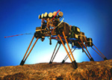
Robot with SSA

Slide 35
SSA for Communication
Elaborate answer
Reactive answer
Nodding

Slide 36
Dialogue System with Robot

Slide 37
Situation

Slide 38
Attention Mechanism

Slide 39
Sonja

