Slide 1
Design of Physically Grounded Communication System
実世界コミュニケーション特論
Michita Imai
今井 倫太

Slide 2
Linta-I
Dialogue system for a real world robot
  Sensor Information

Slide 3
Dialogue in Real World
Person’s utterance is generated referring to a current situation or context.
They omits an obvious information from their utterances.
  Close!
  A robot must use real world information to interpret it.

Slide 4
Linta-I
Linta-I tries to interpret user’s command which has incomplete expression, with sensor information.

Slide 5
Ambiguity in Dialogue System
Recognized
text
Structure
of text
Semantics
of text
Verbal
command
Speech
Recognition
Parsing
Interpretation
Situation and Context

Slide 6
Ambiguity in Dialogue System
Verbal
command
Recognized
text
Structure
of text
Semantics
of text
Ambiguity at Speech Recognition
Ambiguity at Parsing
Ambiguity at Interpretation
Speech
Recognition
Parsing
Interpretation
Situation and Context

Slide 7
Example of Interaction
U: Go forwad!
R: Should I go forward?
U: Yes.
R: I see. I proceed.
U: Stop!
R: Yes. I will stop.

Slide 8
Example of Interaction
U: Go!
R: Which direction should I go?
U: Right!
R: I cannot proceed to right.

Slide 9
Example of Interaction
U: Go forward!
R: I see. I proceed.
U: Wrong!
R: What is wrong?
U:Proceeding.
R:Yes. I will stop.

Slide 10
Example of Interaction
U: Go forward!
R: I see. I proceed.
U: Wrong!
R: Do you mention that proceeding is wrong?
U: Yes.
R. I see. I will stop.

Slide 11
Example of Interaction
U: Go forward!
R: I see. I proceed.
U: Wrong!
R. I see. I will stop.

Slide 12
Structure of Linta-I
Speech
Recognition
Natural Language Processing
Action Generation
Words
Words
Response
message
Main Program
Sensor data
Robot state
Command
Response
message
US sensors
Speech
Synthesis
Robot

Slide 13
Natural Language Processing
DCG (Definite Clause Grammars)
Case Frame
Ex. Go forward!
  [proceed, [agent [robot]], [goal, [forward]], [source, X], [adv, Y]]

Slide 14
Interpretation
DB
Speech recognition
Verbal
command
Real World
Parsing
Sensor
information
Context
Current
robot
action
Case frame
Condition 1
Condition 2
Robot action
Response utterance

Slide 15
Knowledge
Robot action
  Go forward
  Turn right
  Turn left
  Go Backward
  Stop
Object

Slide 16
Knowledge Frame
attribute
  safety
  distance
  robot_action
attribute | value
safety | danger warning normal safety
distance | 0 - 250 cm
robot_action | running no_running

Slide 17
Sensor Information
safety
normal
warning
danger
15cm
100cm
200cm

Slide 18
Example of interpretation
[proceed, [agent, [robot]], [direction, [front]], [adv]]
action: go_forwad
speak: [ok]
I see. I proceed.
front_sensor_output
state_of_robot

Slide 19
Constraints on decision
Wrong!
  [reject, [object A]]
Go forward!
  [proceed, [agent, [robot]], [direction, [front]], [adv]]

Slide 20
Response utterance
[where]
  Where should I go?
[yes_no, [proceed, X]]
  Do I go toward X?
[yes_no, [subject, X]]
  Do you mention X?
[what_object, X]
  What is X?

Slide 21
Linta-I

Slide 22
Situation and Attitude
Theory of meaning of situated expression
  Jon Barwise and John Perry, 1983
  The meaning changes according to a current situation.
Relation between verbal expression and situations.

Slide 23
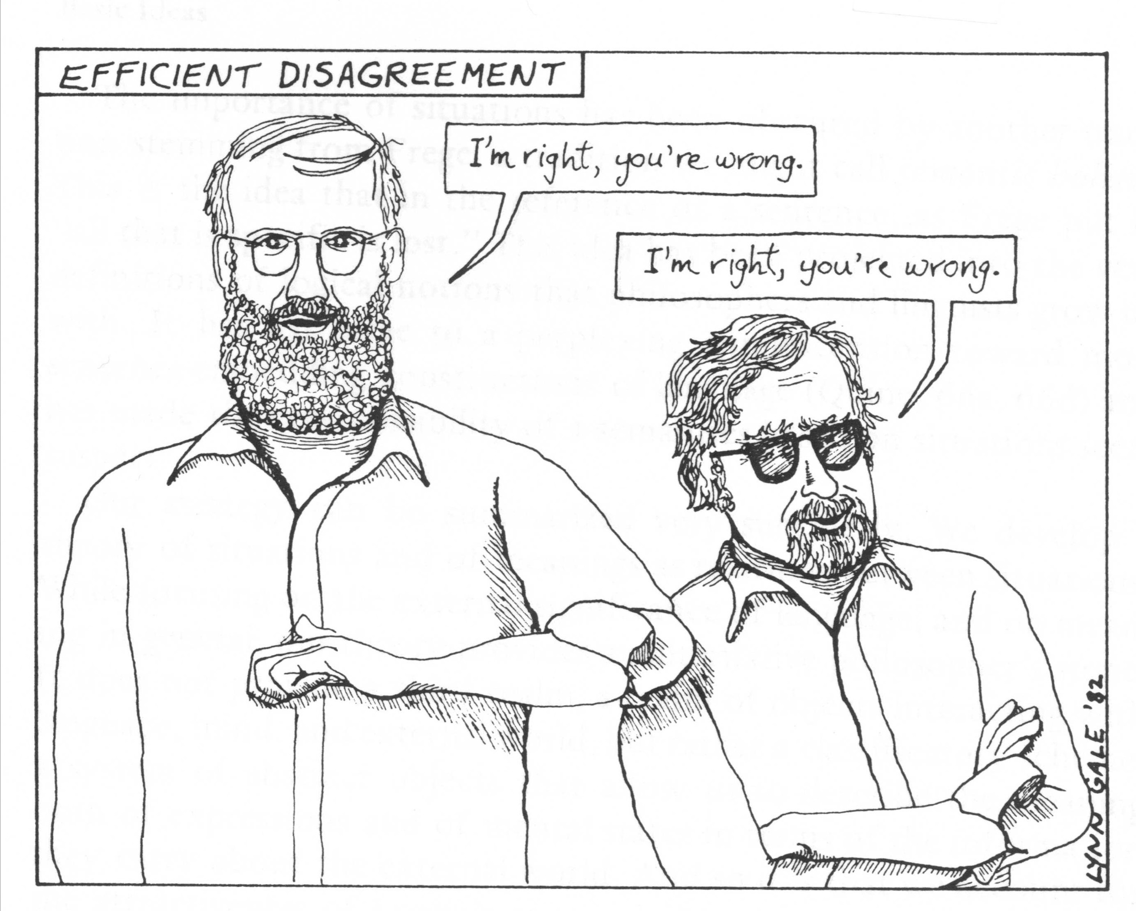
Situated Expression
I’m right, you’re wrong.

Slide 24
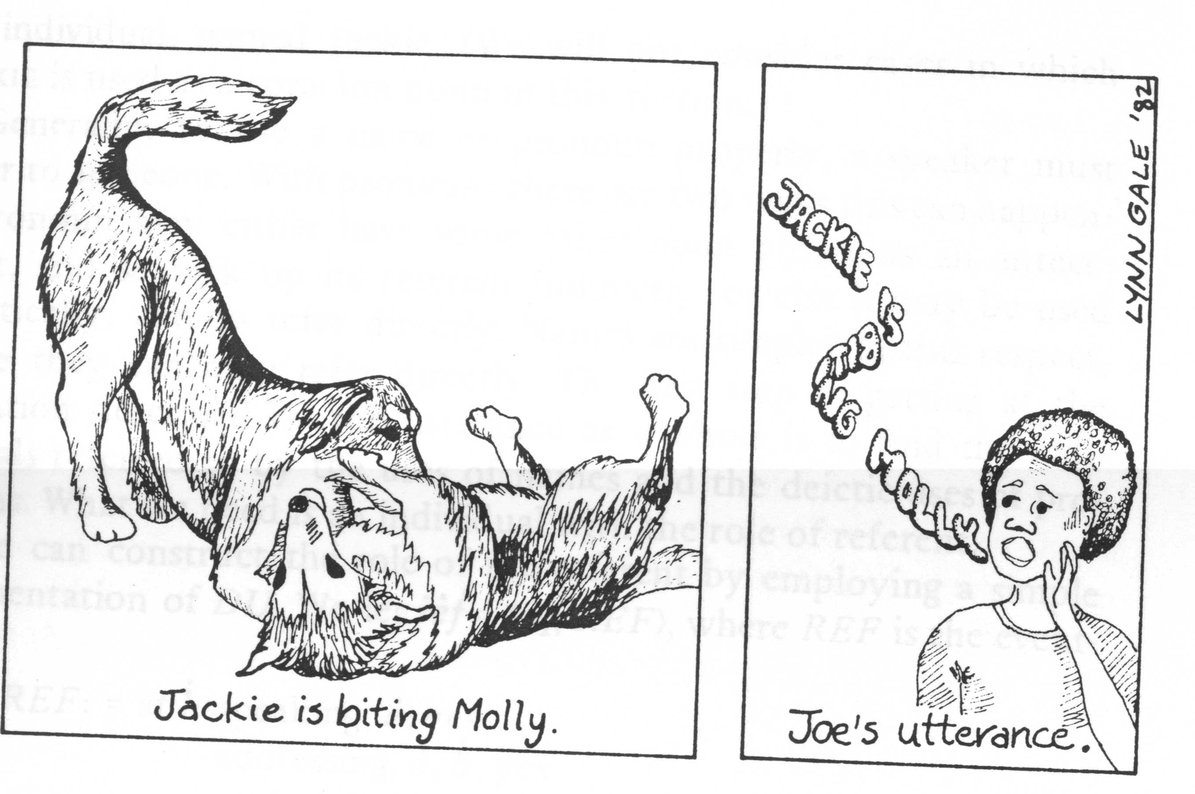
Situated Expression
Jackie is biting Molly.

Slide 25
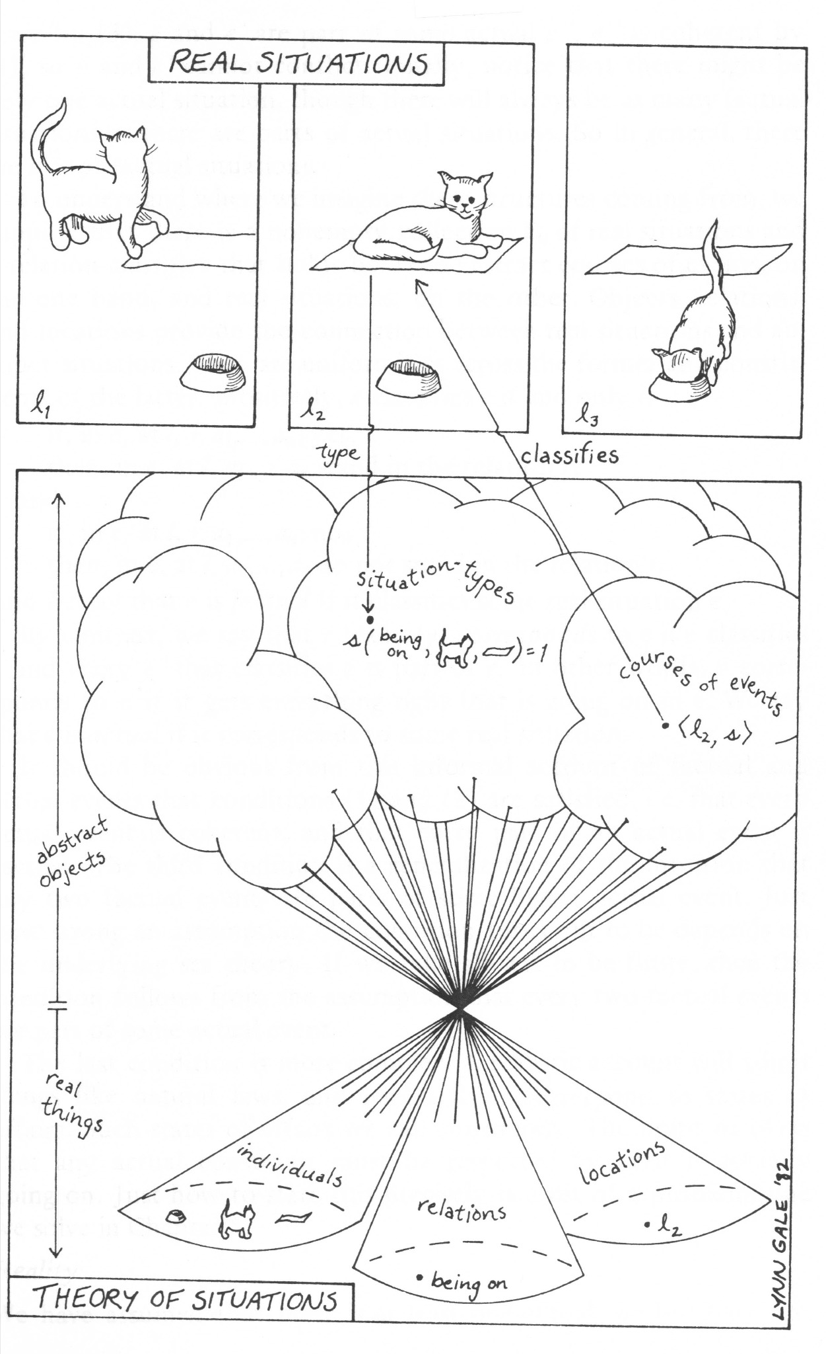
Relation between Physical event and Logical from

Slide 26
Logical From
u[[I AM SITTING]]e
  u denotes a discourse situation; who is speaking, when and where, what words are being uttered, and to whom.
  e denotes a recognized/described situation; what events occur and where.
  in u: at l: speaks, a; yes
  in e: at l: sits, a; yes

Slide 27
Logical Form
u[[I AM SITTING]]e
  in u:
  at l: speaks, a; yes
  referring-to,Miss a,
  I,a;yes
in e:
at l: sits, a; yes
I am sitting.
Miss a

Slide 28
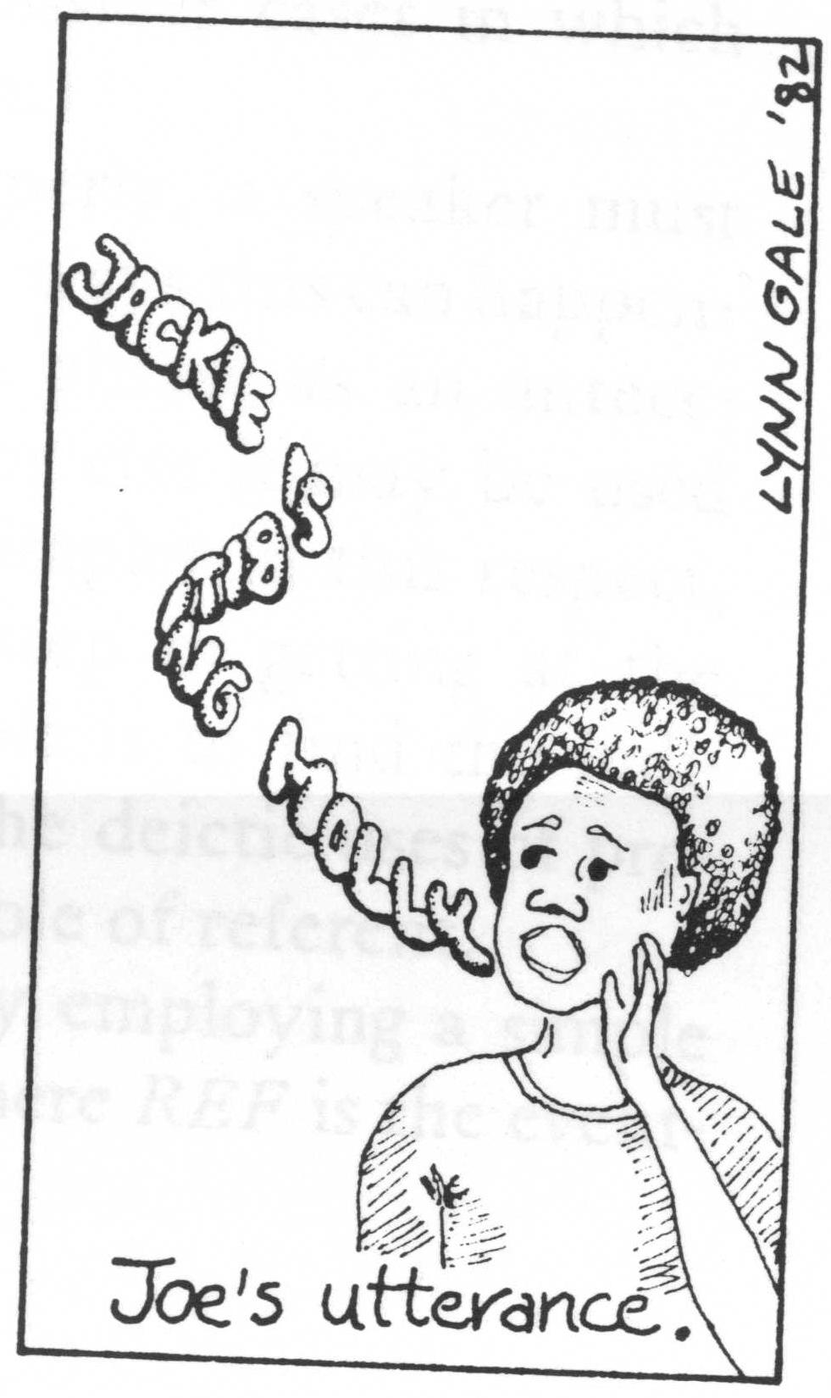
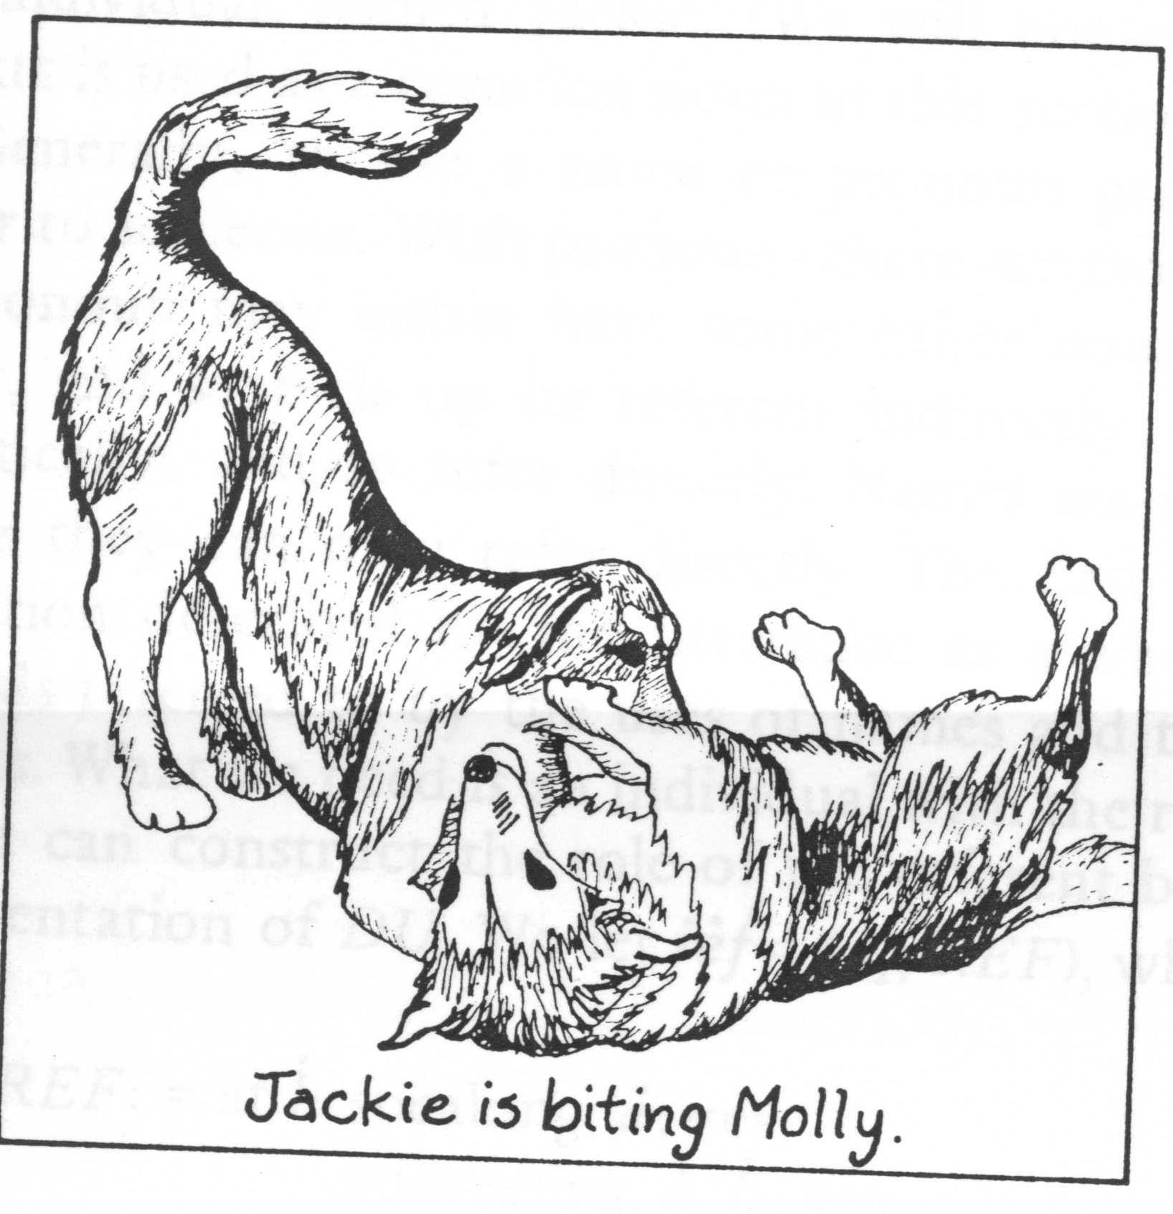
Logical Form
Jackie is Jonny’s dog.
Molly is Joe’s dog.
at l1
at l2
at l1:
speaking, Joe; yes
addressing, Joe, Jonny; yes
referring-to, Joe, JACKIE, Jackie;yes
referring-to, Joe, MOLLY, Molly;yes
at l2:
biting, Jackie,
Molly, yes
u[[Jackie is biting Molly]]e

Slide 29
Logical Form
Jackie is Jonny’s dog.
Molly is unfamiliar to Joe.
at l1
at l2
at l1:
speaking, Joe; yes
addressing, Joe, Jonny; yes
referring-to, Joe, JACKIE, Jackie;yes
referring-to, Joe, MOLLY, b;yes
at l2:
biting, Jackie,
b, yes
u[[Jackie is biting Molly]]e

Slide 30
Logical Form
Mr. A
right
Mr. B
wrong
at l1:
speaking, A; yes
addressing, A, B; yes
referring-to, A, I, A;yes
referring-to, A, YOU, B;yes
at l1:
right,A;yes
wrong,B;yes
u[[I am right. You are wrong.]]e

Slide 31
Logical Form
Mr. A
wrong
Mr. B
right
at l1:
speaking, B; yes
addressing, B, A; yes
referring-to, B, I, B;yes
referring-to, B, YOU, A;yes
at l1:
right,B;yes
wrong,A;yes
u[[I am right. You are wrong.]]e

Slide 32
Application for Actual System
how to recognize a situation
how to select relevant information
  the selected information forms a discourse situation.
Robot must recognize relevant situation from sensor data.

Slide 33
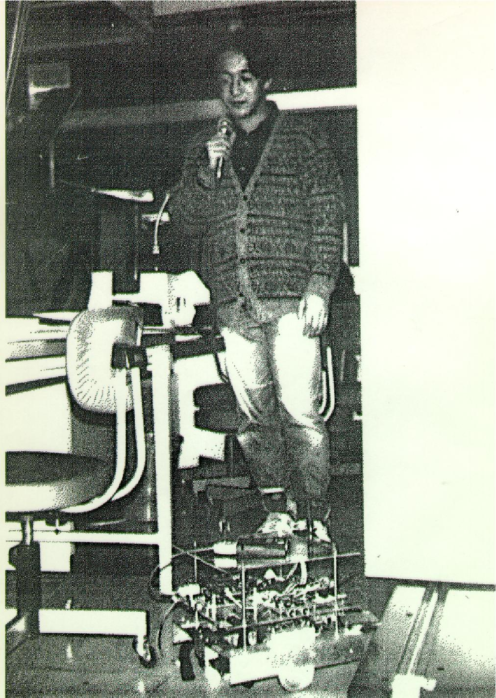
Application for Actual System
Wrong!
at l1:
speaking, Michita; yes
addressing, Michita, Linta; yes
at l2:
wrong, a; yes
u[[wrong!]]e

Slide 34
Application for Actual System
Wrong!
at l1:
speaking, Michita; yes
addressing, Michita, Linta; yes
referring-to, Michita,,obstacle;yes
referring-to,Michita,,proceeding;yes
at l2:
wrong, proceeding;
yes
u[[wrong!]]e

Slide 35
Application for Actual System
Wrong!
at l1:
speaking, Michita; yes
addressing, Michita, Linta; yes
referring-to, Michita,,obstacle;yes
referring-to,Michita,,proceeding;yes
at l2:
wrong, proceeding;
yes
Selection of relevant
information
u[[wrong!]]e

Slide 36
Attention Mechanism
Attention Mechanism
  To select sensor data to recognize current situation
Strategy of the selection
  Context
  Action

Slide 37
Attention Mechanism
Dialogue system Linta-II with Attention Mechanism
Attention mechanism selects sensor information relevant to current human robot interaction
  Top-down attention: selects sensor data related to a current robot action or planner
  Bottom-up attention: selects sensor data in response to an event around a robot.
Decrease of the use of constraints
Easy to design the system

Slide 38
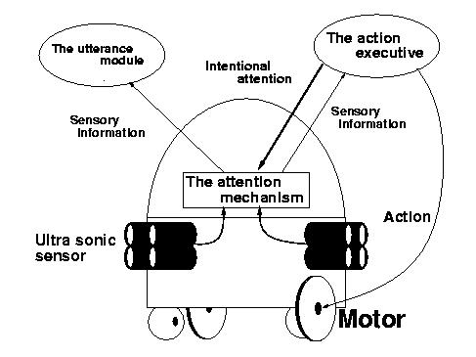
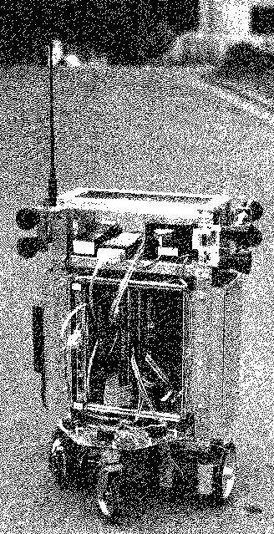
Linta-II

Slide 39
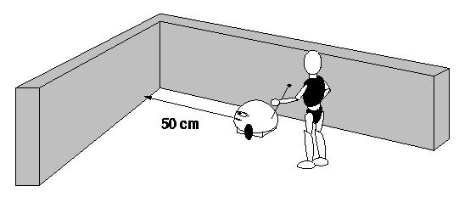
Utterance Example
Ex. 1.a User: “What’s next?”
ASPIRE: “We cannot proceed toward front direction soon.”
Ex. 1.b User: “What’s next?”
ASPIRE: “We can turn left.”
Ex. ASPIRE: “I’m surprised!”

Slide 40
Utterance Example
Ex. 1.a User: “What’s next?”
ASPIRE: “We cannot proceed toward front direction soon.”
Ex. 1.b User: “What’s next?”
ASPIRE: “We can turn left.”
Ex. ASPIRE: “I’m surprised!”
Top-down attention
by a robot’s action
Top-down attention
by a planner
Bottom-up attention
by a change in an environment

Slide 41
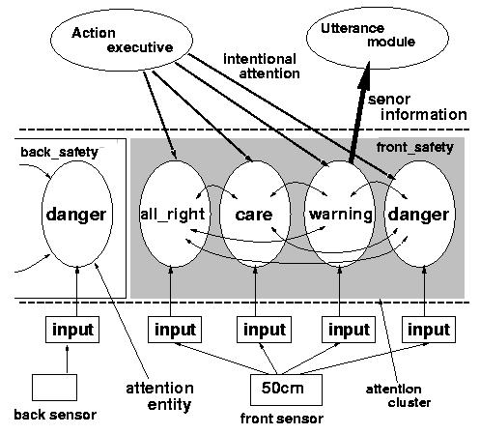
Attention Mechanism

Slide 42
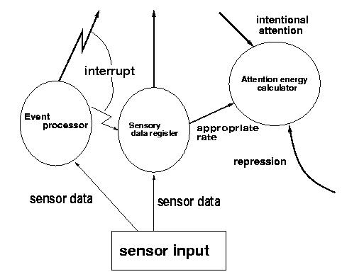
Attention Entities

Slide 43
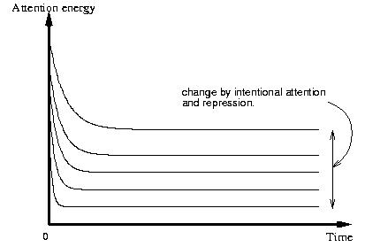
Attention Energy

Slide 44
Attention Mechanism

Slide 45
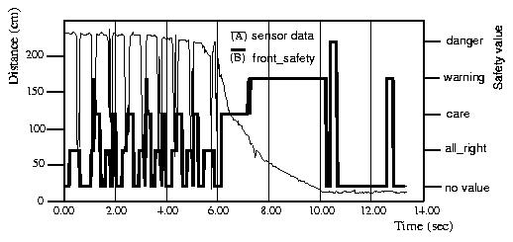
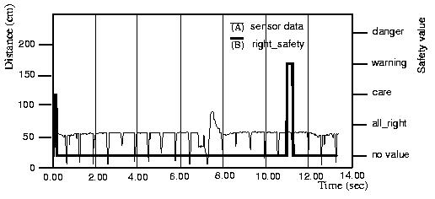
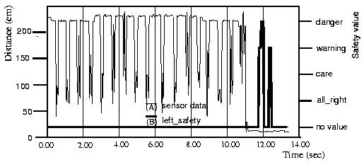
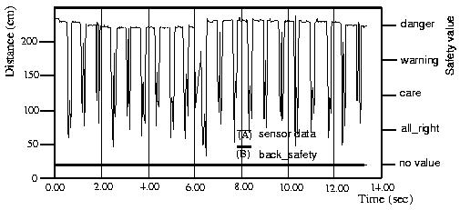
Example
Top-down attention
from front moving
Top-down attention
from planner
F
R
“We cannot proceed toward front
direction soon.”
“We can turn left.”
Bottom-up attention
L
B
“I’m surprised!”

Slide 46
Conclusion of Linta-II
Linta-II employs attention mechanism to obtain a situation for utterance generation.
Attention mechanism: Top-down attention and Bottom-up attention
A system designer can develop a dialogue system and an action system independently. These are connected through the attention mechanism.
Problem
  Robot obtain the situation selfishly.

Slide 47
Sonja

