Slide 1
Design of Physically Grounded Communication System
実世界コミュニケーション特論
Michita Imai
今井 倫太

Slide 2
Joint Attention
Development of an infant
  Interaction between a mother and her baby
  Studies on autism children (自閉症児)
Mind-reading

Slide 3
Study on gaze interaction
Infant’s joint attention process
The relationship between a gaze and
  Environment feature
  Geographical feature
  Mental 3D map

Slide 4
EDD and SAM
EDD: Eye Direction Detector
  Detects someone directs gaze to me.
SAM: Shared Attention Mechanism
  Detects the establishment of joint attention.

Slide 5
EDD
Dyadic representation (二項表象）
  [agent -relation- self] , bidrectional
    [mother -look-at- me], [I -look-at- mother]
  [agent -relation- proposition], one way
    [mother -look-at- bus]
  [agent1 -relation- agent2], bidirectional
    [mother -look-at- father], [father -look-at- mother]
  [self -relation- proposition], one way
    [I -look-at- house]

Slide 6
EDD
What does someone look at?
  Identify where is an enemy.
Insufficient for joint attention

Slide 7
SAM
Triadic representation (三項表象)
  Identify whether the other pays attention to the same thing.
  Only EDD cannot recognize the affair.

Slide 8
SAM
Triadic representation (三項表象)
  Nest structure
    [self -relation- (other -relation- proposition)]
      bidirectional
      [I -look-at- (mom -look-at- bus)]
      [mom -look-at- (I -look-at- bus)]
    [self -relation- (other1 -relation- other2)]
      bidirectional
      [I -look-at- (mom -look-at- dad)]
      [I -look-at- (dad -look-at- mom)]
      [mom -look-at- (I -look-at- dad)]
      [mom -look-at- (dad -look-at- me)], etc...

Slide 9
SAM
Complex structure of triadic representation
  [self -relation- (other -relation- (self -relation- proposition)]
  [other -relation- (self -relation- (other -relation- proposition)]
  [self -relation- (other -relation- (self -relation- (other -relation- .....))]

Slide 10
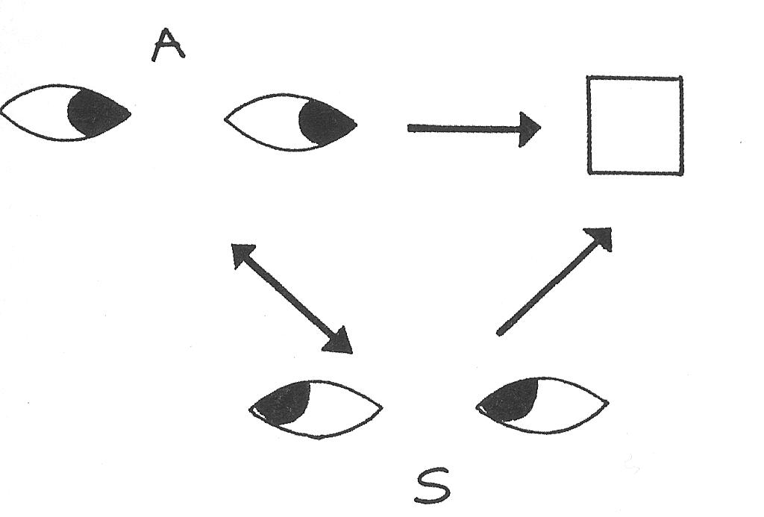
SAM
2D representation of triadic representation

Slide 11
SAM
Gaze direction
EDD
Dyadic representation
SAM
Triadic representation

Slide 12
SAM
Introduce a view point to consider other’s intention or goal in the triadic representation.
  Infer other’s intention or motivation form other’s gaze direction.
Base of ToMM (Theory of Mind Mechanism)

Slide 13
SAM
An infant watched eyes to confirm someone’s intention.
  9th-18th month infants
  Eye-contact: An experimenter hide a thing intentionally when their hand reaches it.
  No eye-contact: otherwise.
Watching eyes is clue to infer intention.

Slide 14
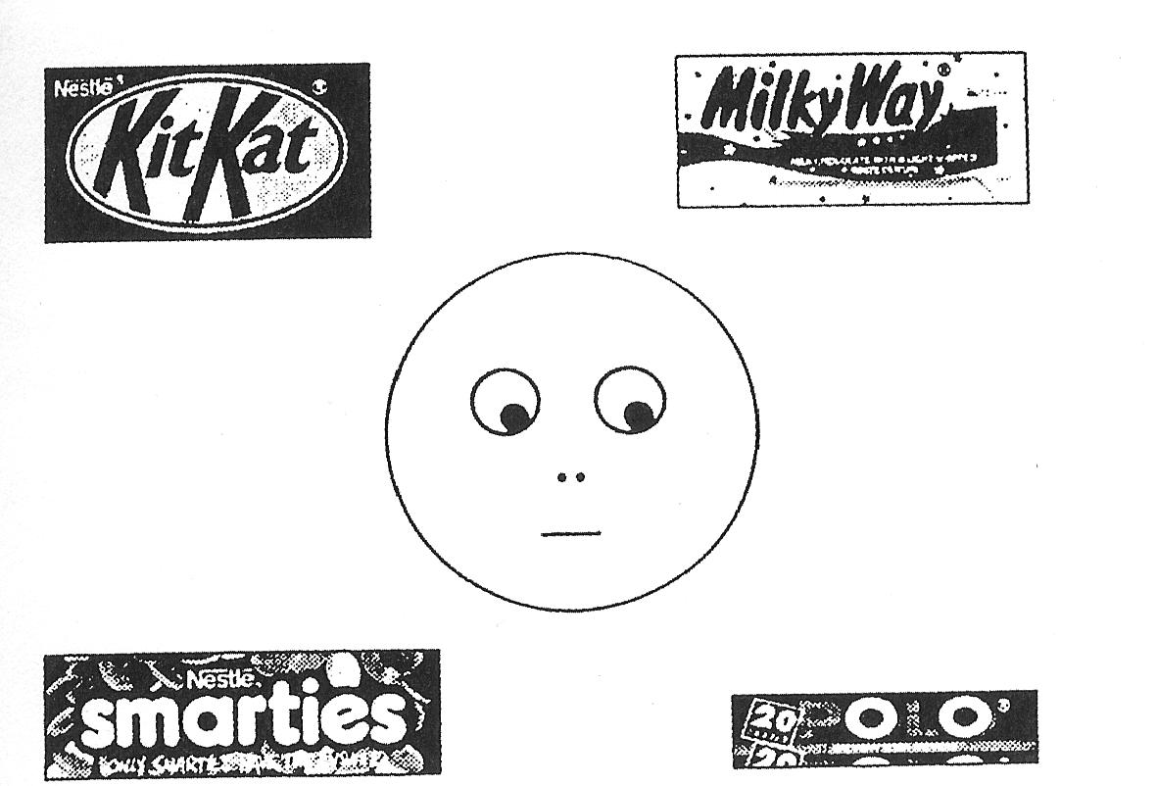
SAM
3--4 years old kids

Slide 15
SAM
What sweet does Charlie get?
What does Charlie want?
What does Charlie mention?

Slide 16
SAM
EDD -> SAM -> ToMM
  Evidence of the relation comes form studies on autism.

Slide 17
Joint attention and autism
Autism kids have EDD but do not have SAM.
  They recognize that someone is looking at them.
  They cannot behave based on joint attention.
They can handle dyadic representation, and
cannot deal with triadic representation.
They cannot read other’s mind or intention.

Slide 18
Joint attention and autism
Autism kids do not carry out eye-contact.
They are not good at find out an item where someone directs his/her gaze.
Lack of SAM.

Slide 19
Joint Attention with Robot
User: “Wrong!”

Slide 20
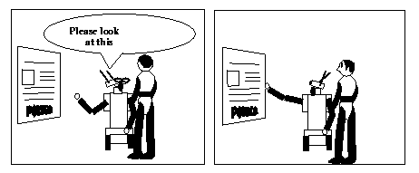
Joint Attention with Robot
Joint attention
Eye-contact
Robot’s intention

Slide 21
Joint Attention with Robot
Human
Intention
Joint Attention
Real World
Robot
Intention

Slide 22
Joint Attention on Social Interaction
Understanding others as intentional agents
  Base of initial stage of SAM development

Slide 23
Joint Attention on Social Interaction
Gaze
EDD
Others have
Intention.
SAM
Others may pay attention to
something intentionally and
ignore the others.
A climber watches a mountain.
A hiker watches a mountain.
Joint Attention
Understanding
others.

Slide 24
Joint Attention on Social Interaction
Understanding others
  Kids understand others in terms of intention.
  Kids understand that the others have intentions and they may differ from kids’ intention.
  Kids understand that the other have intentions and they may differ from actual facts.

Slide 25
Infant’s Joint Attention
9th month, 18th month, 24th month
Joint Attention
  is not a geographical phenomenon when two persons directs their gaze to a same thing simultaneously
  but is a social phenomenon where they are aware that they focus on the same thing.

Slide 26
Infant’s Joint Attention
There is a possibility that infants is not aware that an adult directs attention.
9th month infants cannot have joint attention.
  Infants look at the same thing that an adult watches simultaneously by chance.
  Infants look at a situation where the adult looks at the thing.
  Gaze alternation: Infants direct their attention toward the two interesting things (the adult and the thing) by turns.

Slide 27
Infant’s Joint Attention
18th month infants’ joint attention skill
  Learning by mimicking adult’s behaviors
  Intentional communication
Understanding the others as intentional existence

Slide 28
Infant’s Joint Attention
Evidence of the skill
  Directing their attention to an adult and a target by turns spontaneously without adult’s prompt
  Ex. An infant follows an adult’s gaze direction spontaneously, identifies the target, and returns to the adult immediately to confirm that the adult’s attention still remains there.

Slide 29
Infant’s Joint Attention
Behaviors based on joint attention
  If an adult bent and pushed the power button with their head, an infant mimicked the behavior.
Inferring an adult’s intention based on the joint attention
  Intention to turn on the light.

Slide 30
Infant’s Joint Attention
Behaviors related to intention
  When an infant tells an adult their intention,
  the infant carries out spontaneous gaze alternation expecting adult’s intentional responses while generating pointing behaviors.
  Significant fact: the infant gazes at the adult’s eyes instead of the adult’s hand which carries out the desired response.

Slide 31
Infant’s Joint Attention
12th--18th month infants
  behave recognizing a adult’s attention and intention and understanding a difference between their intention.

Slide 32
Infant’s Joint Attention
12th--18th month infants
 | 9th month | 12th month
Following attention Following gaze Sharing interaction | Directed gaze following Passive sharing | Spontaneous gaze following Confirming sharing
Following action Social reference Learning by mimicking | Just mimicking | mimicking based on other’s intention
Directs other’s attention |  | pointing behavior and gaze alternation

Slide 33
Infant’s Joint Attention
People develop joint attention in generating an verbal directive (言語的指示).
  “I intend that you intend to interact with X.”
  The intention is directed to you, not to X.
24th month infants understand others as intentional agent.
  Learning a new word by finding an attention target.
  Using a language to draw the other’s attention.

Slide 34
Infant’s Joint Attention
24th month infants notice that others’ intentions are different from them.
  Learning a new word based on the attention target that an adult pay attention to, even though the infants direct their attention to a different thing.

Slide 35
Infant’s Joint Attention
Pragmatics (語用論)
  Topic(話題) - Predicative(叙述)
It’s fun.

Slide 36
Infant’s Joint Attention
Pragmatics
  Topic - Predicative is develop according to the acquisition of a joint attention skill.
month | communication skill | topic | predicative
0-6th | primary intersubjectivity
6-12th | secondary intersubjectivity | nonverbal
12-18th | first word | verbal
18-24th | first sentence | nonverbal | verbal
24th- | conversation | verbal | verbal

Slide 37
The Effect of ToMM
A robot request a human to do a task.
  Joint Attention
  Mind reading
  The development of relationship

Slide 38
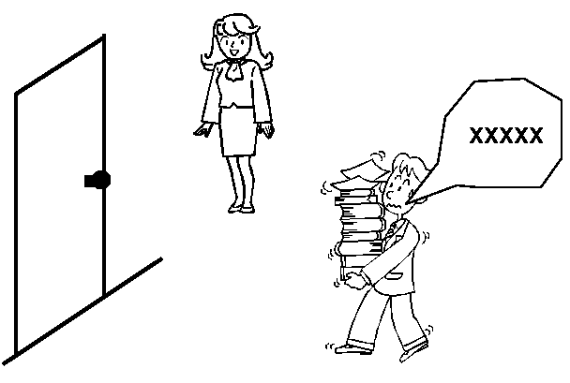
The Effect of ToMM

Slide 39
The Effect of ToMM
Xxxx....

Slide 40
Hypothesis
By reading a robot’s mind, a human can estimate the robot’s intention with ease, and, moreover, the person can even understand the robot’s unclear utterances made by synthesized speech sounds.

Slide 41
Model of Utterance Understanding based on ToMM
UUM
UUM
Utterance
ToMM
ToMM
SAM
SAM
Gaze and Gestures
interaction
EDD
EDD
ID
ID
MUUToMM
MUUToMM

Slide 42
Model of Utterance Understanding based on ToMM
UUM
ToMM
SAM
EDD
ID
MUUToMM

Slide 43
Robot System
Lack of appearance enhancing ID and SAM
  human does not regard robots as autonomous beings with intention
Agent mediated communication interface

Slide 44
Agent Migration
CG character as an autonomous being
Agent migration gives the robot relationship with the human.

Slide 45
Understanding a Robot’s Utterances
Utterance
UUM
Voice
generator
ToMM
SAM
EDD
ID
MUUToMM
Robot System

Slide 46
Understanding a Robot’s Utterances
Utterance
UUM
Voice
generator
ToMM
Agent
migration
SAM
Relationship
EDD
Autonomous
Agent
ID
Interaction
MUUToMM
Robot System

Slide 47
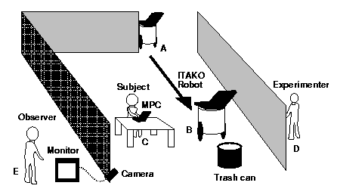
Experiment

Slide 48
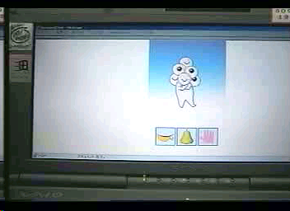
Experiment

Slide 49
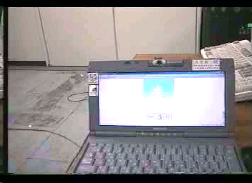
Experiment

Slide 50
Experimental Condition
The agent migrates on the robot when the robot generates an utterance
The agent does not migrate.
The experimenter observes responses of the subjects.

Slide 51
Hypothesis and Prediction
By reading a robot’s mind, a human can estimate the robot’s intention with ease, and, moreover, the person can even understand the robot’s unclear utterances made by synthesized speech sounds.

Slide 52
Hypothesis and Prediction
The subjects will regard the robot as an autonomous entity with intention (ID, EDD).
The subjects will first look at the robot and then turn their eyes to the trash can (SAM).
The subjects will be able to estimate the robot’s intention with ease, and this will facilitate their understanding of the robot’s utterance (ToMM, UUM).

Slide 53
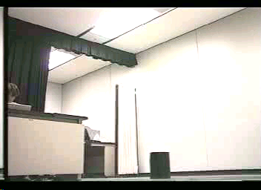
Experimental scene
When the agent migrated on the robot,

Slide 54
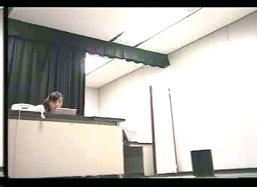
Experimental scene
When the agent did not migrate on the robot,

Slide 55
Experimental Outcome
With agent migration
Utterance Understanding 8/10 persons
Moving the trash can 8/10 persons
Without agent miguration
3/10 persons
1/10 persons

Slide 56
Experimental Outcome
The subjects regarded the robot as an autonomous entity with intention (ID, EDD).
The subjects first looked at the robot and then turned their eyes to the trash can (SAM).
The subjects estimated the robot’s intention with ease, and this facilitated their understanding of the robot’s utterance (ToMM, UUM).

