Slide 1
Design of Physically Grounded Communication System
実世界コミュニケーション特論
Michita Imai
今井 倫太

Slide 2
The effect of eye-contact
Experiment on Agent Migration Mechanism
  Significance of Mind reading
EDD -> SAM -> ToMM
Eye-contact
  Confirmation of the other’s intension

Slide 3
Gaze drawing
Experiment to confirm the effect of eye-contact on human-robot interaction
  The effect on person’s utterance interpretation when a humanoid robot generates an utterance referring to a physical world object.
Linta-III with Joint Attention Mechanism

Slide 4
Utterance Referring to Physical World Object
Please remove this.
(KORE WO DOKETE KUDASAI)
ask(R,P,move(P,O)),
f(this)=O,
f(hearer)=P.
a demonstrative pronoun

Slide 5
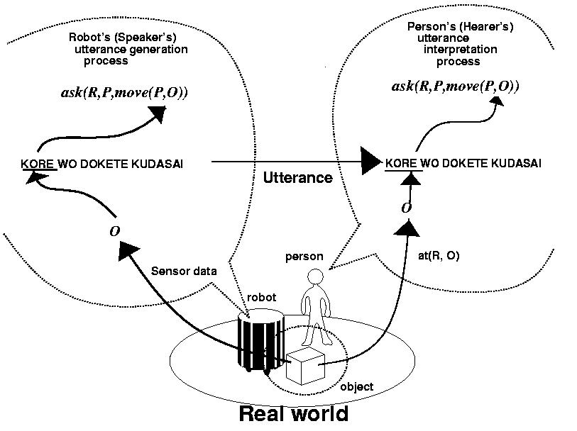
The Process of Utterance Interpretation
Please move
this.
Please move this.

Slide 6
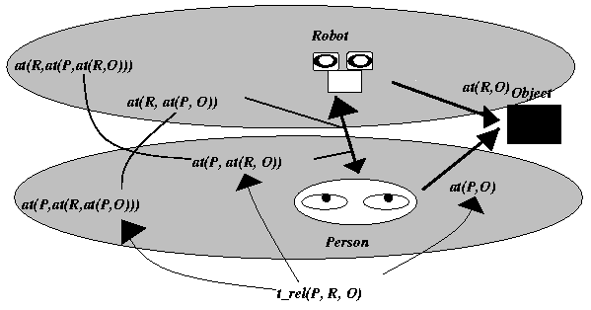
Triadic Relation

Slide 7
Triadic Relation
Robot: t_rel(R,P,O) ←at(R,O),
at(R,at(P,O))
at(R,at(P,at(R,O)))
Person: t_rel(P,R,O) ←at(P,O),
at(P,at(R,O))
at(P,at(R,at(P,O)))

Slide 8
Triadic Relation
Robot: t_rel(R,P,O) ←at(R,O),
at(R,at(P,O))
at(R,at(P,at(R,O)))
Attention Mechanism
EDD

Slide 9
Triadic Relation
Robot: t_rel(R,P,O) at(R,O).
Attention Mechanism
EDD
Obtaining Real World Information
with Attention Mechanism
The selection of sensor information
with voluntary attention and reactive
attention

Slide 10
Triadic Relation
Robot: at(R,O)
Person: t_rel(P,R,O)←at(P,O),
at(P,at(R,O))
at(P,at(R,at(P,O)))
Drawing person’s attention to
at(R,O).

Slide 11
Triadic Relation
t_rel(P,R,O)←at(P,O),
at(P,at(R,O))
at(P,at(R,at(P,O)))
It is sufficient for human-robot interaction to give only person joint attention.

Slide 12
Triadic Relation
Obtaining Real World Information
with Attention Mechanism
The selection of sensor information
with voluntary attention and reactive
attention
Drawing Person’s Attention

Slide 13
Attention Expression
Drawing person’s attention with robot’s gaze motion and hand gestures
  Gaze motion
  Hand gestures

Slide 14
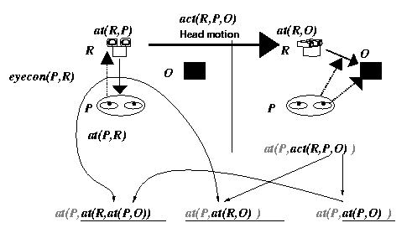
Triadic Relation by Gaze Motion
Eye-contact
Attention Expression

Slide 15
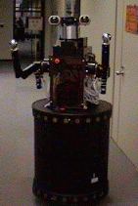
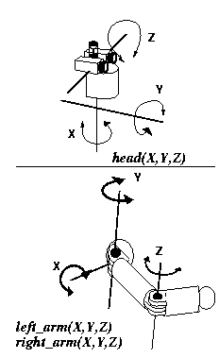
Everyday Robot

Slide 16
Attention Expression Mechanism
Attention Mechanism + Attention Expression

Slide 17
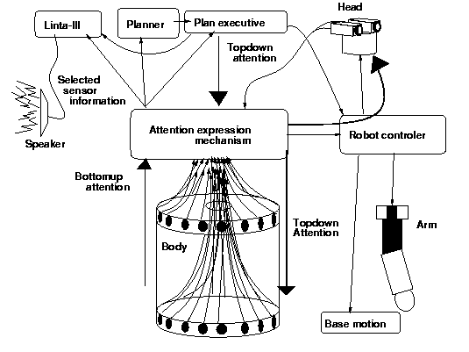
Everyday Robot and Linta-III

Slide 18
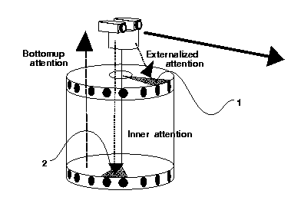
Attention Expression

Slide 19
Attention Exression

Slide 20
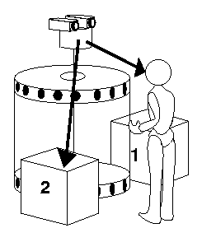
Experiment
An experiment confirms the effect of gaze motion (eye-contact and attention expression) on the construction of joint attention.
Please move this.
Condition１ Eye-contact＋Attention Expression
Condition２ Eye-contact
Condition３ Attention Expression toward
the box２

Slide 21
Experiment
Thirty subjects
They were given an instruction.
  Please obey a robot utterance.
Please move this.
Condition１ Eye-contact＋Attention Expression
Condition２ Eye-contact
Condition３ Attention Expression toward
the box 2

Slide 22
Experimental Outcome
Condition 1: Eye-contact and Attention Expression

Slide 23
Experimental Outcome
Condition２: eye-contact

Slide 24
Experimental Outcome
Condition３: Attention Expression

Slide 25
Experimental Outcome
Condition１
Condition２
Condition３
Eye-contact and Attention Expression encourage the development of joint attention.
9/１０persons moved
at the correct object.
The ９ persons determined
the target of “This” according
to the head motion
2/１０persons
3/１０ persons
Only ２ persons refers
to the head motion.

Slide 26
Pointing Behavior
The study of infants joint attention indicates that gaze detection is significant to construct joint attention.
The effect of pointing behavior with or without eye-contact.

Slide 27
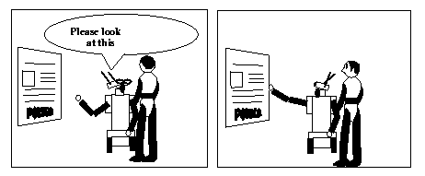
Example Interaction
Joint attention toward the poster
It’s fun.

Slide 28
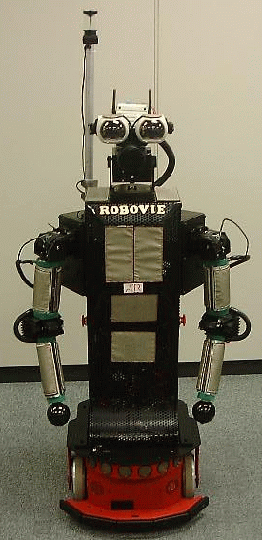
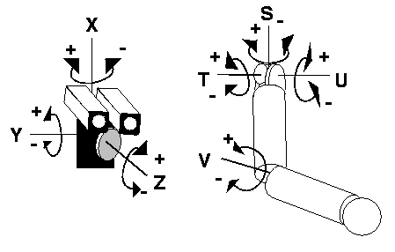
Communication Robot Robovie

Slide 29
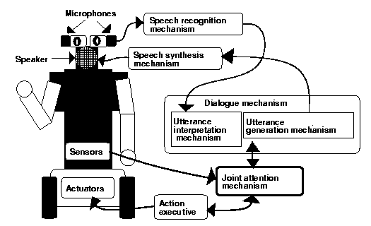
Communication Robot Robovie with Joint Attention Mechanism

Slide 30
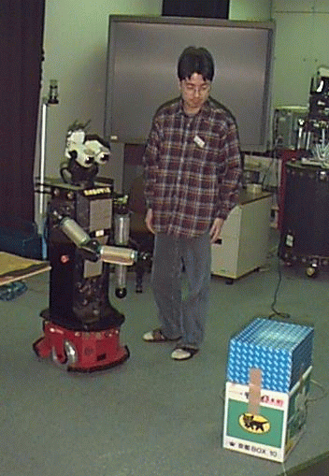
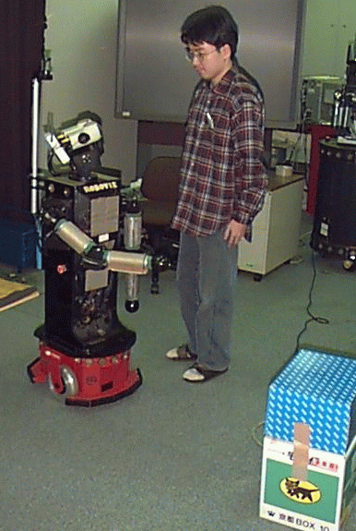
Pointing Behavior with Joint Attention Mechanism
Attention
Expression
Eye-contact

Slide 31
Eye-contact and Attention Expression on Robovie

Slide 32
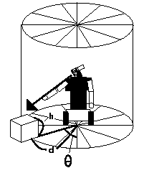
Attention Coordinate

Slide 33
Experiment
Confirm the effect of eye-contact and attention Expression on a pointing behavior.
  Condition１ Pointing behavior with eye-contact and attention expression
  Condition２ Pointing behavior without them

Slide 34
Experiment
Twenty subjects
  Condition１ Pointing behavior with eye-contact and attention expression
  Condition２ Pointing behavior without them
They were given an instruction.
  Please obey a robot’s utterance.

Slide 35
Experimental Outcome
Condition1: with eye-contact and
attention Expression
Condition2: without them

Slide 36
Experimental Outcome
Condition1: with eye-contact and attention Expression

Slide 37
Experimental Outcome
Condition2: without them

Slide 38
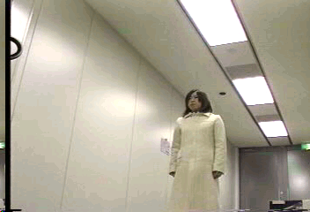
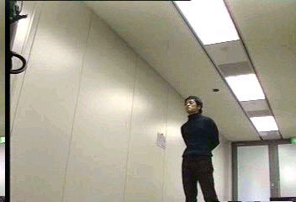
Experimental Outcome
Condition1: with eye-contact and
attention Expression
All subject (10 persons) looked
at the poster.
condition2: without them
Only one person (10 persons)
looked at it.
The other 9 looked at the hand.

Slide 39
Utterance Generation based on Joint Attention
Robot oriented interaction
  Lower recognition skill of a robot
  The use of higher recognition skill and intelligence of a human.
When generating utterance
  The robot selects relevant sensor information.
  The robot draws persons attention.

Slide 40
Robot Oriented Interaction
Generating utterances
  Depending on the degree of ease to notice robot’s attention expression
    Everyday Robot
  Depending on the stage of the joint attention process
    Robovie

Slide 41
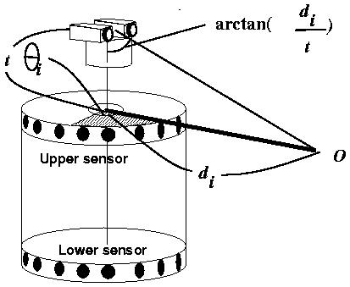
The Degree of Attention Expression

Slide 42
The Degree of Attention Expression
t_val(P,R,O)=(at_val(R,P),at_val(R,O))

Slide 43
The Degree of Attention Expression
i denotes a person or a object.

Slide 44
The Degree of Attention Expression
When all 4 conditions
are satisfied,
  c
three conditions
  p
Less than one condition
  u

Slide 45
The Degree of Attention Expression
The location of a person
A object’s location
t_val(P,R,O)=(at_val(R,P),at_val(R,O))
=(c,p)

Slide 46
Utterance Generation depending on the degree
Omit a word expressing obvious event in a physical world
  Construct joint attention
  Check the degree of the of the attention

Slide 47
Utterance Generation depending on the degree
Omit a word expressing obvious event in a physical world
  A robot directs its attention to physical world event O spontaneously with attention mechanism.
  A planner determines O must be mentioned and generates intentional attention from the planner.
  Planner generates utterance content.
    p1(R,P,p2(P,O)),f(R)=R,f(P)=p,f(O)=O
  Eye-contact and Attention Expression to O
  Checking the degree of the attention expression
  Generating an utterance based on the degree

Slide 48
Checking the degree
t_val(P,R,O)≠(-,u), (u,-)
  An utterance is generated.
t_val(P,R,O) | O
(c,c) | Demonstrative pronoun
(c,p) | Direct expression with ajectives
(p,c) | Direct expression
(p,p) | Direct expression with ajectives
(u,-),(-,u)

Slide 49
Example Interaction
Finding out an object
Having intention for a person to remove it
  ask(R,P,move(P,O))
Eye-contact and Attention Expression
Degree t_val(P,R,O)=(c,c)
Demonstrative pronouns: f(this)=O
“Please move this.”

Slide 50
Example Interaction
Finding out an object
Having intention for a person to remove it
  ask(R,P,move(P,O))
Eye-contact and Attention Expression
Degree t_val(P,R,O)=(p,c)
Demonstrative pronouns: f(obstacle)=O
“Please move the obstacle.”

Slide 51
Example Interaction
Finding out an object
Having intention for a person to remove it
  ask(R,P,move(P,O))
Eye-contact and Attention Expression
Degree t_val(P,R,O)=(p,p)
Demonstrative pronouns: f(front object)=O
“Please move the object in front of me.”

Slide 52
The Stage of Joint Attention Process
Generate an utterance depending
on the stage.
Sensor information
  f denotes p, o, e, r
  person, object, poster, Robovie
  A person directs his/her attention to a.

Slide 53
The Stage of Joint Attention Process
Development of joint attention
  A person and a poster
  Eye-contact: the person may notice a robot.
  Attention expression toward the poster

Slide 54
Utterance Generation Rule
utterance content, attention → altered utterance content
v(-,f) → v(r,-)
v(-,f),p[-,-] → Hello, v(-,f)
v(-,f) ,p[-,(r,-)] → v(-,f)
v(-,f) ,p[-,(r,f)] → v(-,dp)/v(-,-)

Slide 55
Utterance Generation Rule
v(-,f) → v(r,-)
v(-,f),p[-,-] → Hello, v(-,f)
v(-,f) ,p[-,(r,-)] → v(-,f)
v(-,f) ,p[-,(r,f)] → v(-,dp)/v(-,-)
When a robot is stuck by an obstacle,
move(p,o)

Slide 56
Utterance Generation Rule
v(-,f) → v(r,-)
v(-,f),p[-,-] → Hello, v(-,f)
v(-,f) ,p[-,(r,-)] → v(-,f)
v(-,f) ,p[-,(r,f)] → v(-,dp)/v(-,-)
When there is no person,
move(p,o)

Slide 57
Utterance Generation Rule
v(-,f) → v(r,-)
v(-,f),p[-,-] → Hello, v(-,f)
v(-,f) ,p[-,(r,-)] → v(-,f)
v(-,f) ,p[-,(r,f)] → v(-,dp)/v(-,-)
When there is no person,
“I cannot proceed!”

Slide 58
Utterance Generation Rule
v(-,f) → v(r,-)
v(-,f),p[-,-] → Hello, v(-,f)
v(-,f) ,p[-,(r,-)] → v(-,f)
v(-,f) ,p[-,(r,f)] → v(-,dp)/v(-,-)
When there is a person but he/she does not have a relation with the robot,
look(p,o),p[-,-]

Slide 59
Utterance Generation Rule
v(-,f) → v(r,-)
v(-,f),p[-,-] → Hello, v(-,f)
v(-,f) ,p[-,(r,-)] → v(-,f)
v(-,f) ,p[-,(r,f)] → v(-,dp)/v(-,-)
When there is a person but he/she does not have a relation with the robot,
look(p,o),p[-,-]→Hello, look(p,e)
“Hello, please look at the poster!”

Slide 60
Utterance Generation Rule
v(-,f) → v(r,-)
v(-,f),p[-,-] → Hello, v(-,f)
v(-,f) ,p[-,(r,-)] → v(-,f)
v(-,f) ,p[-,(r,f)] → v(-,dp)/v(-,-)
When eye-contact with a person is achieved,
look(p,o),p[-,(r,-)]

Slide 61
Utterance Generation Rule
v(-,f) → v(r,-)
v(-,f),p[-,-] → Hello, v(-,f)
v(-,f) ,p[-,(r,-)] → v(-,f)
v(-,f) ,p[-,(r,f)] → v(-,dp)/v(-,-)
When eye-contact with a person is achieved,
look(p,e),p[-,(r,-)]→look(p,e)
“Please look at the poster!”

Slide 62
Utterance Generation Rule
v(-,f) → v(r,-)
v(-,f),p[-,-] → Hello, v(-,f)
v(-,f) ,p[-,(r,-)] → v(-,f)
v(-,f) ,p[-,(r,f)] → v(-,dp)/v(-,-)
When joint attention are achieved,
is-a(p,e),p[-,(r,e)]

Slide 63
Utterance Generation Rule
v(-,f) → v(r,-)
v(-,f),p[-,-] → Hello, v(-,f)
v(-,f) ,p[-,(r,-)] → v(-,f)
v(-,f) ,p[-,(r,f)] → v(-,dp)/v(-,-)
When joint attention are achieved,
is-a(p,e),p[-,(r,e)]→is-a(p,e)
“It is fun!”

