Slide 1
Design of Physically Grounded Communication System
実世界コミュニケーション特論
Michita Imai
今井 倫太

Slide 2
Synergetics
Biological inspired system
Deal with complex world
Adaptation to environments
Natural process from choatic behavior to ordered behavior
  Micro-interaction generates ordered behavior at the macro-interaction

Slide 3
Natural Process
Thermodynamics
  toward disordered situation
  air,ink in water, smoke distribution
  Never turn back to the initial condition in the natural processes

Slide 4
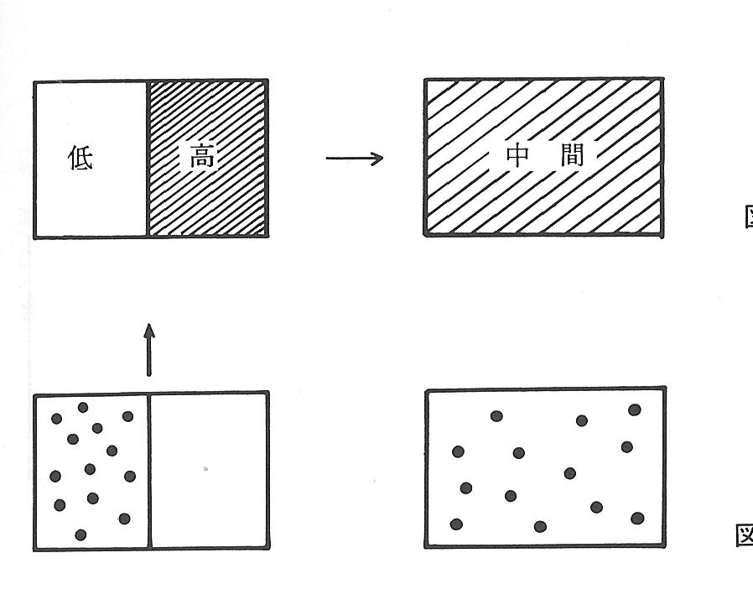
Natural Process
Irreversible process: air temperature
Low
temp.
High
temp.
Medium
temp.

Slide 5
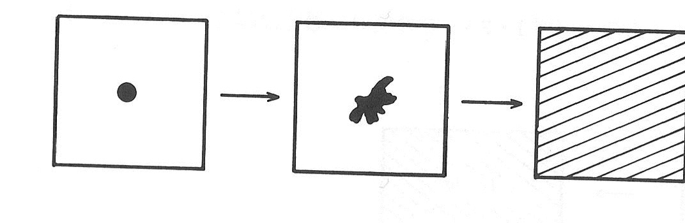
Natural Process
Irreversible process: ink in water

Slide 6
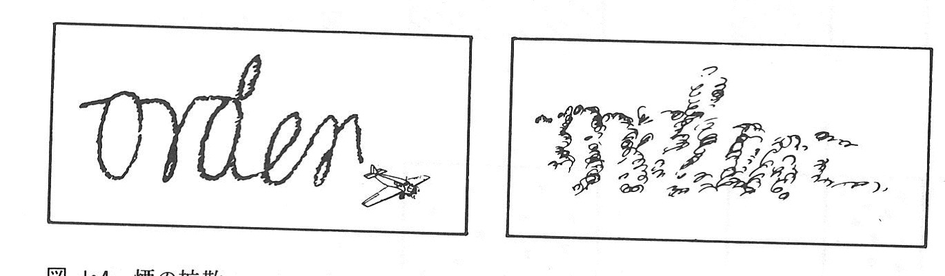
Natural Process
Irreversible process: smoke distribution

Slide 7
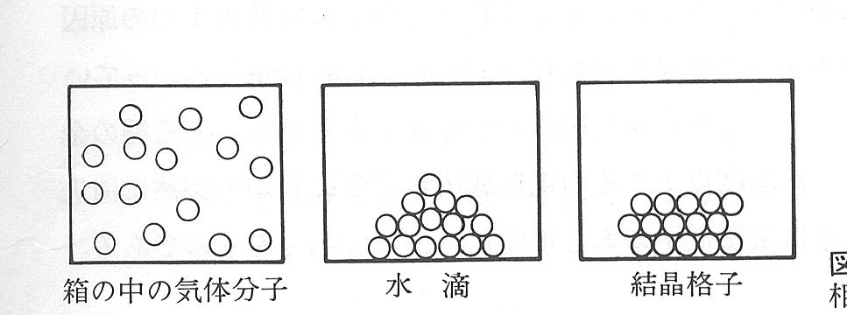
Natural Process
From disordered situation to ordered situation
Phase transition
  Steam:Gas Water:Liquid Ice:Solid

Slide 8
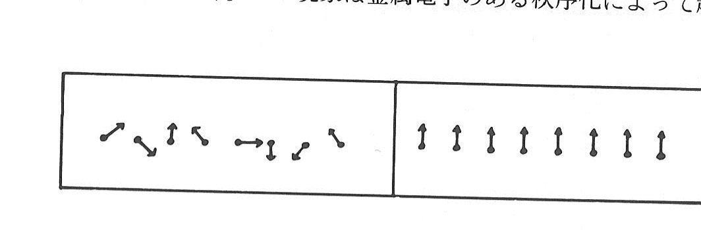
Natural Process
Phase transition
  Magnetic substance

Slide 9
Natural Process
Generation of ordered situation with the phase transition
Engine can strengthen one degree of freedom with energy from vast number of degree of freedom.

Slide 10
Natural Process
Example of the engine
  A human gives a constraint to reduce the degree of freedom with a piston and cylinder.
  The phenomena are far from thermal equilibrium(熱的平衡).
    The piston is pushed when the state of gas changes toward the equilibrium.

Slide 11
Natural Process
Engine is an artificial system.
Biological system has self-organize mechanism.
Are there any natural system which generates ordered behaviors which are far form the thermal equilibrium.

Slide 12
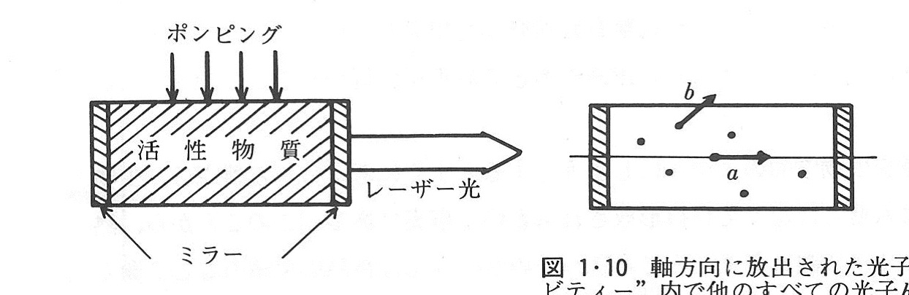
Natural Process
Laser
  Energy larger than a threshold
  Although the energy activates each substance in a random manner, the substances starts to generates lays towards same direction.
  The degree of freedom decreases.
energy
laser lay
mirror

Slide 13
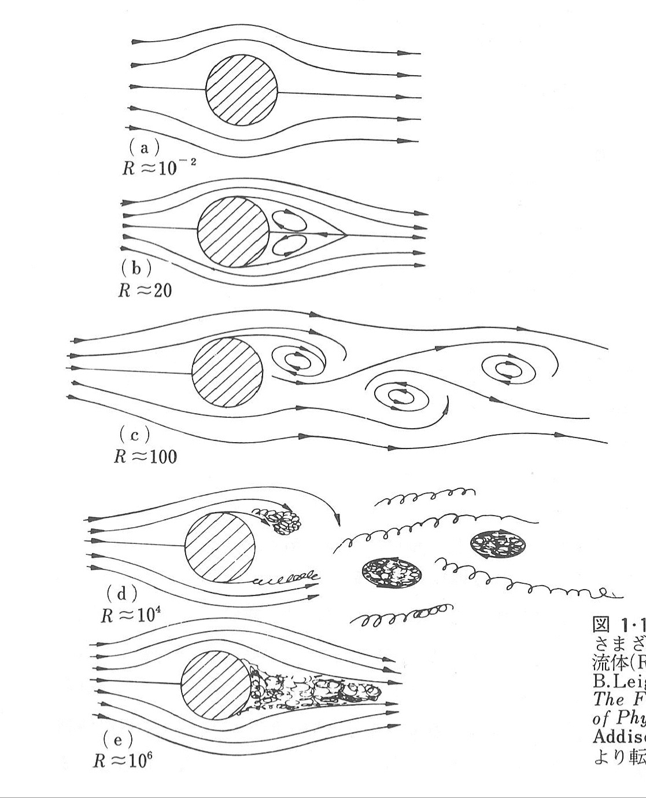
Natural Process
Fluid dynamics

Slide 14
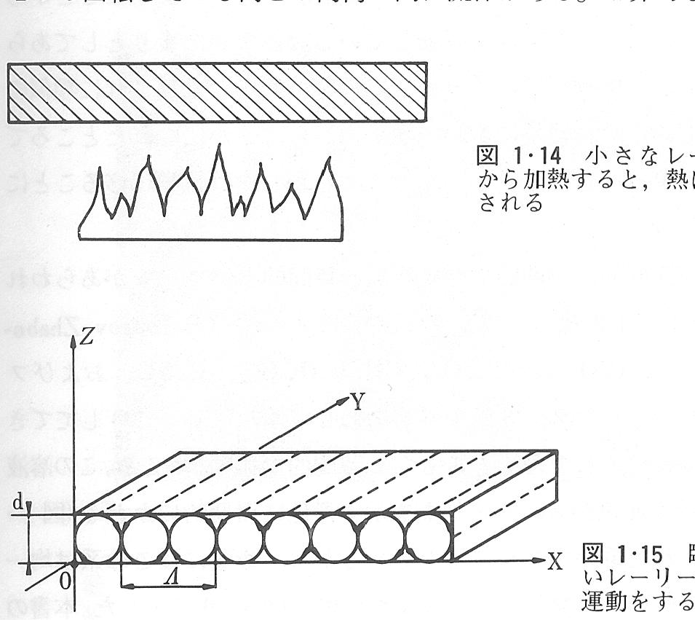
Natural Process
Fluid dynamics
  Benard convection

Slide 15
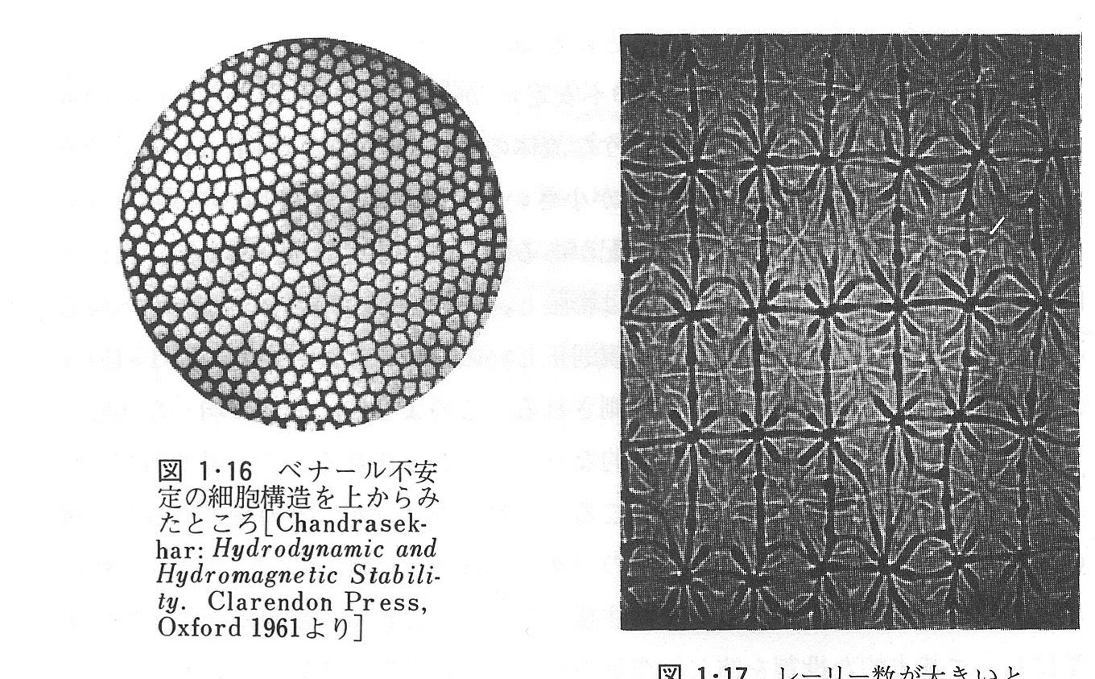
Natural Process
Fluid dynamics
  Benard convection

Slide 16
What is an Ordered Behavior
Order parameter
  dominates behaviors of all entities and organizes ordered activities.
  A few order parameter explains macro order which consists of vast number of entities.

Slide 17
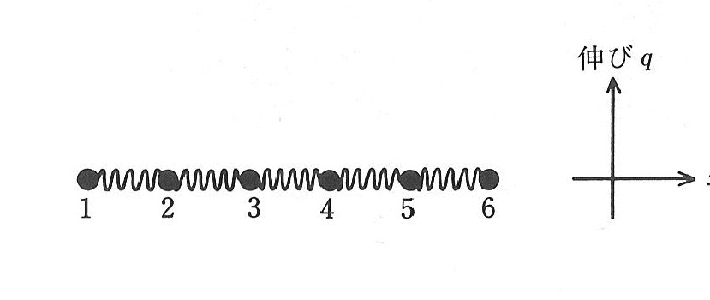
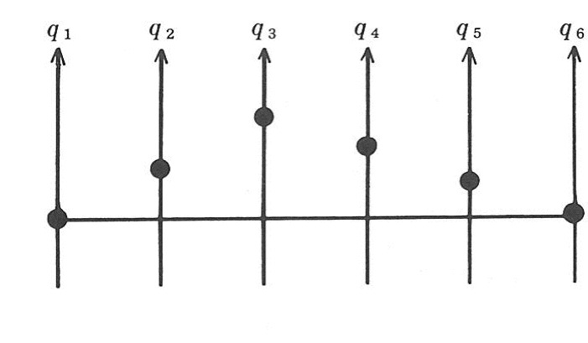
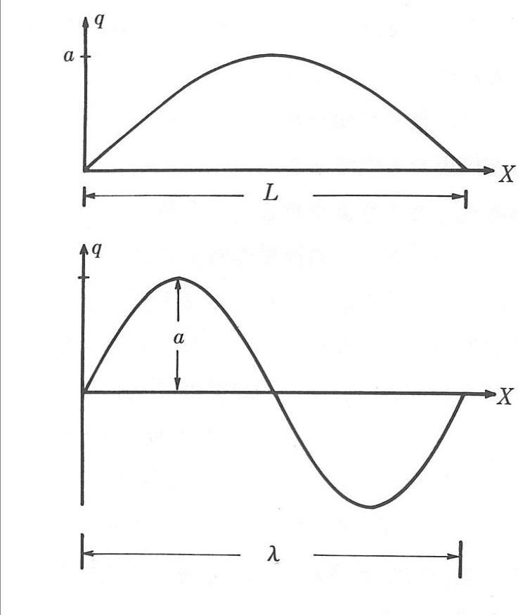
Macro Order among Micro-Interaction
Example of spring
Micro-interaction
  Dynamics between entities. F= -kx
Macro Order
  Need different expression from the micro-interaction.
  ξsin(2πx/λ)
  ξ: an amplitude λ: an wavelength

Slide 18
Macro Ordered Behaviro
Synergetics
  Ordered behaviors appear even though energy is given to the system in a random manner.
Order parameter
  One mode appears throughout conflict between several modes.
  A coexistence situation emerges with mutual stabilization.

Slide 19
Toward Synergetics
Deterministic dynamics
Probable dynamics
Mixture of them
Synergetics

Slide 20
Deterministic dynamics
Equation of motion
m; weight, v: velocity, F: force
Friction effect:
  γ:friction coefficient
v
m
F

Slide 21
Deterministic dynamics
Force from spring
Use of derivative
Equation of motion

Slide 22
Deterministic dynamics
Overdamped motion:
  Synergetics phenomena are expressed with it.
Change time rate:

Slide 23
Deterministic dynamics
Example of
  q is a density of molecule Q
  Q is generated by a chemical reaction between a and b. k is a speed of the reaction.
  Autocatalytic reaction (自己促進反応)
  q is the number of bacteria.
  The equation expresses the increase or the decrease of them.

Slide 24
Deterministic dynamics
Potential field of the equation
  Energy needed for the dynamics or workload.
  [Work] = [Force] X [degree of movement]
  Local workload:
  Workload:
  Potential field:

Slide 25
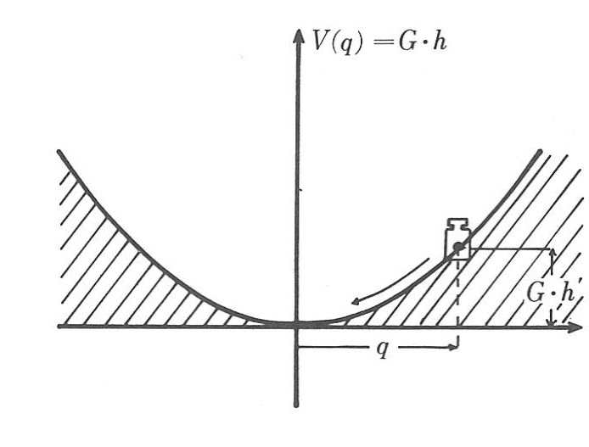
Deterministic dynamics
Potential field of the equation
Stable point q=0
The system behavior proceeds to q =0.

Slide 26
Deterministic dynamics
Example of motion equation which is basis of self-organization.
  Motion equation :
  Potential field:

Slide 27
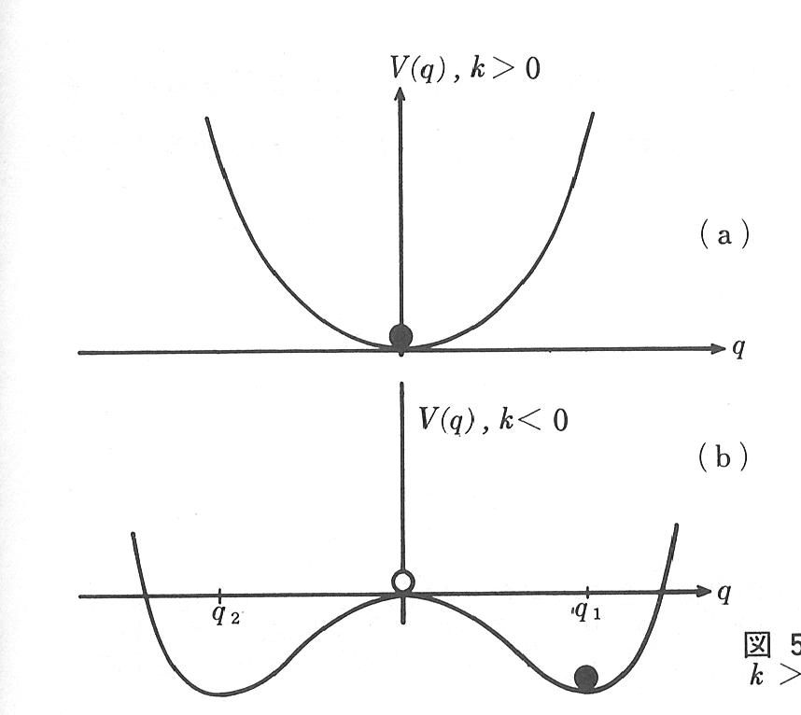
Deterministic dynamics
Potential field

Slide 28
Deterministic dynamics
Break down of symmetry
  The basis of self-organization
Symmetrical equation about q, -q

Slide 29
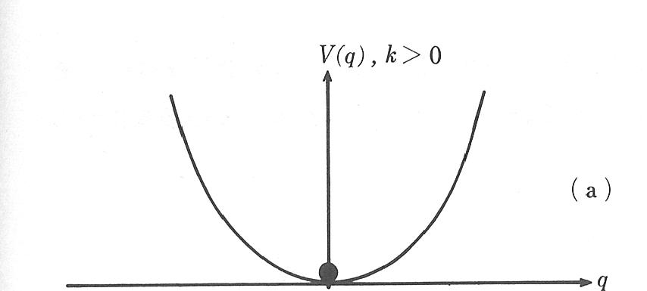
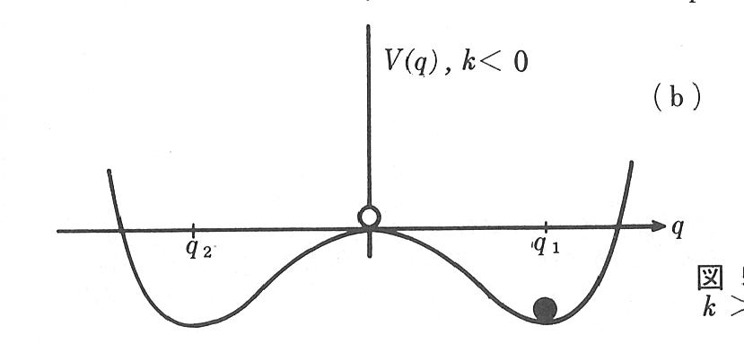
Deterministic dynamics
Symmetry breaking instability
  k>0→k=0→k<0
Bifurcation
  System selects one of stable points throughout bifurcation.
  The effect of probable behavior on the selection
unstable point
stable point
stable point

Slide 30
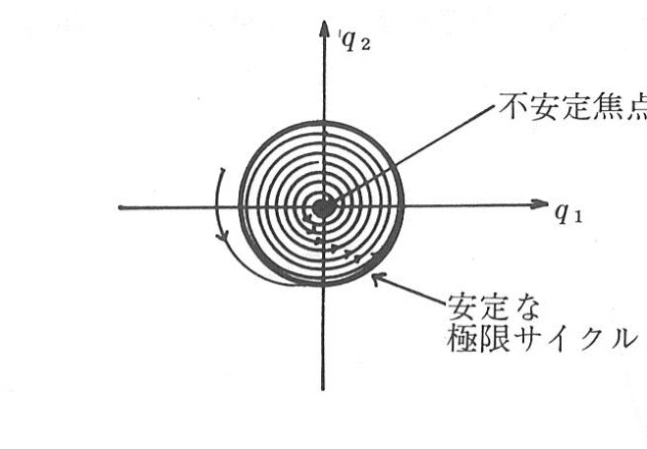
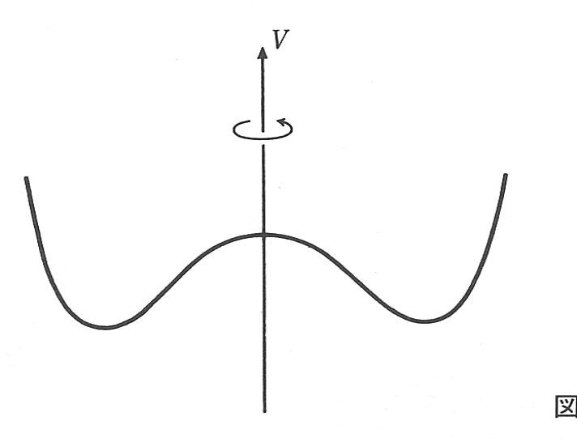
Deterministic dynamics
2D potential field by rotating it.
  limit cycle
unstable point
stable
limit cycle

Slide 31
Deterministic dynamics
2D potential field by rotating it.
  limit cycle
  motion equation
unstable point
stable
limit cycle

Slide 32
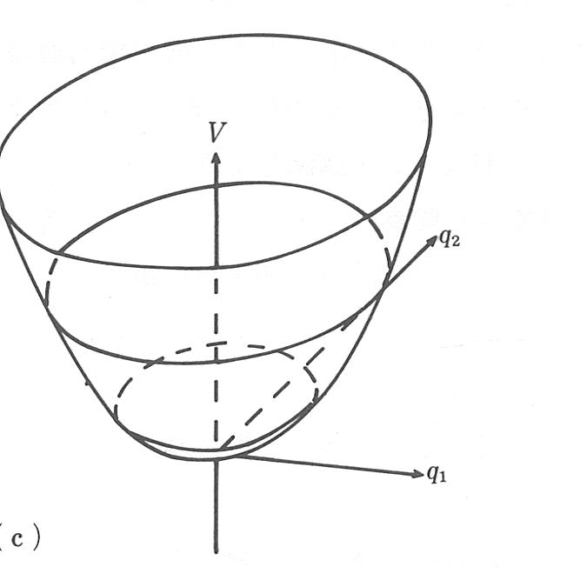
Deterministic dynamics
2D potential field by rotating it.
  bifurcation
Unstable point
Stable point
Stable limit cycle
unstable point
stable
limit cycle

Slide 33
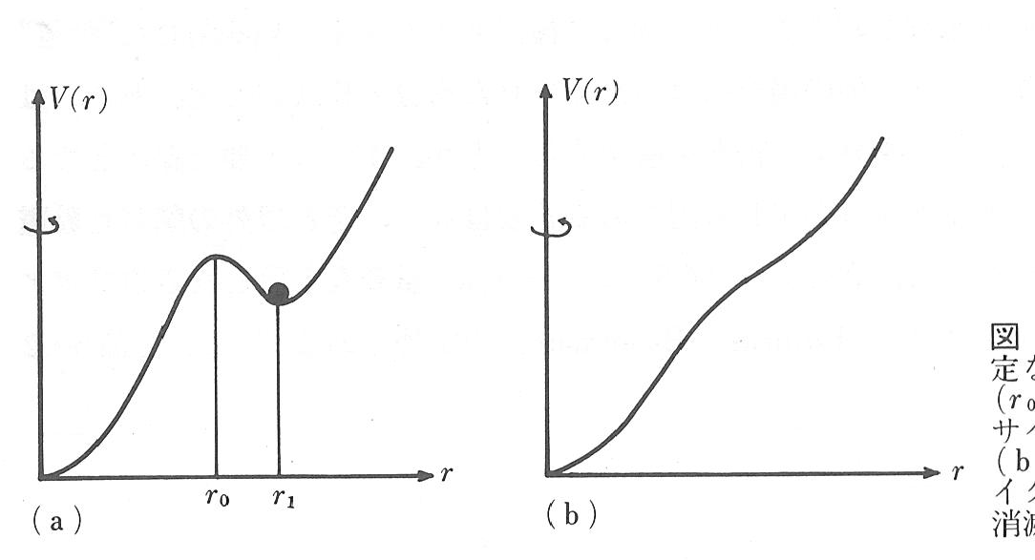
Deterministic dynamics
Soft mode and hard mode
Unstable limit cycle
No limit cycle
Stable limit cycle
Soft self-excitation
Hard excitation
unstable point
stable
limit cycle

Slide 34
Deterministic dynamics
Gives a system its behavior with the potential field.
Emerged behaviors sometimes depends on nondeterministic process like the effect of probability.

Slide 35
Self-organization

Slide 36
Dual Dynamics Model

Slide 37
Physarum Plasmodium

Slide 38
Dual Dynamics Model

