Slide 1
Design of Physically Grounded Communication System
実世界コミュニケーション特論
Michita Imai
今井 倫太

Slide 2
Toward Synergetics
Deterministic dynamics
Probable dynamics
Mixture of them
Synergetics

Slide 3
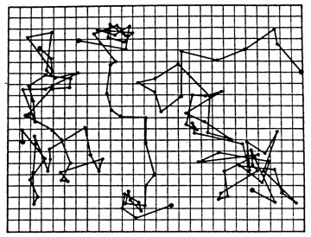
Probable dynamics
Brownian movement
  Example of probable dynamics

Slide 4
Model of Brownian Movement
  Position
    s times right movements in n times trials
  Continuous position x = a(s-(n-s)) = a(2s-n)
  Continuous time t = nτ

Slide 5
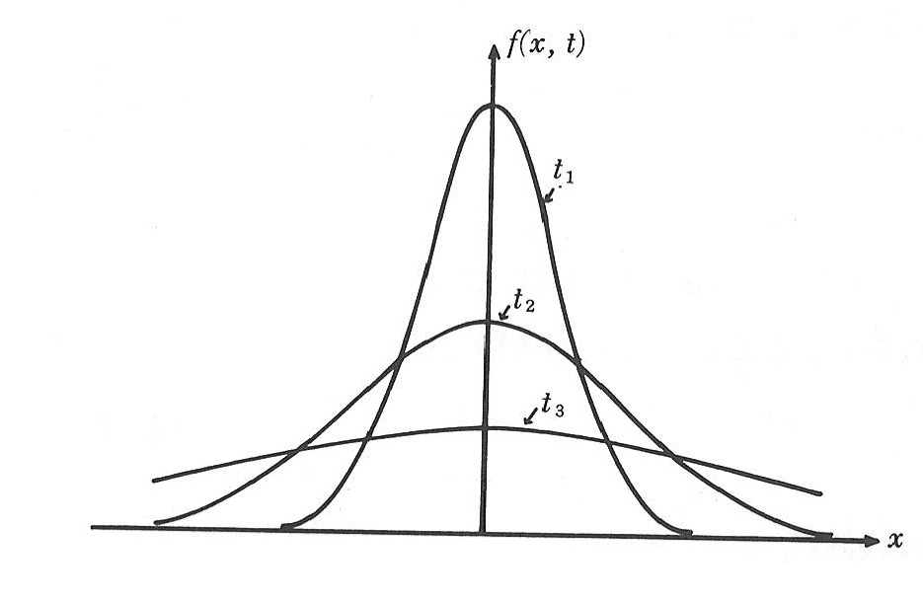
Model of Brownian Movement
  Probability density from P
  D is a diffusion coefficient

Slide 6
Model of Brownian Movement
One way Brownian movement
  Right movement p=1, left p=0
  s = n
vt

Slide 7
Master Equation
Equation for random walk
  Probability of position m after n+1 times
  w expresses probabilities of the movement
  Brownian movement
  General condition
m-1
m
m+1

Slide 8
Master Equation

Slide 9
Master Equation
Diffusion equation
Consider ε near m

Slide 10
Master Equation
Taylor series expansion about ε

Slide 11
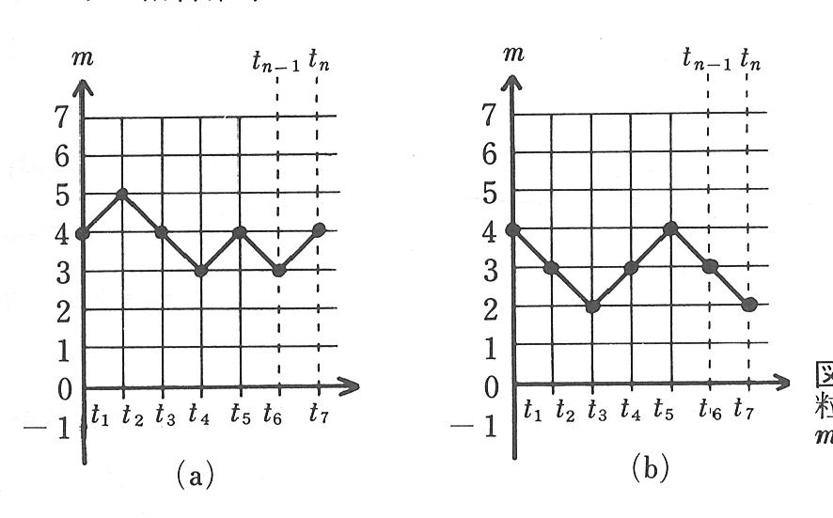
Master Equation
= [inward speed] - [outward speed]

Slide 12
Stationary Solution
Principle of detailed balance
Stationary solution P(m) exist satisfying .

Slide 13
Probable Dynamics
There are two boxes B1 and B2 which include N balls totally.
  The probability that B1 includes n1 balls.
  This stationary solution comes from the following condition:

Slide 14
Probable Dynamics
If N is enough large, n1=1/2.
There is subtle movements according to

Slide 15
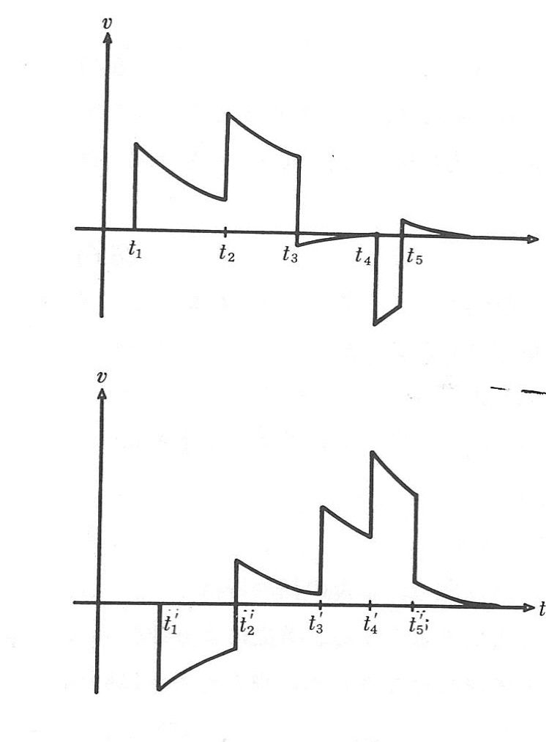
Deterministic and Probable Dynamics
Motion equation of football

Slide 16
Deterministic and Probable Dynamics
Basic motion equation
Consider F
  Friction
  Force by kicking

Slide 17
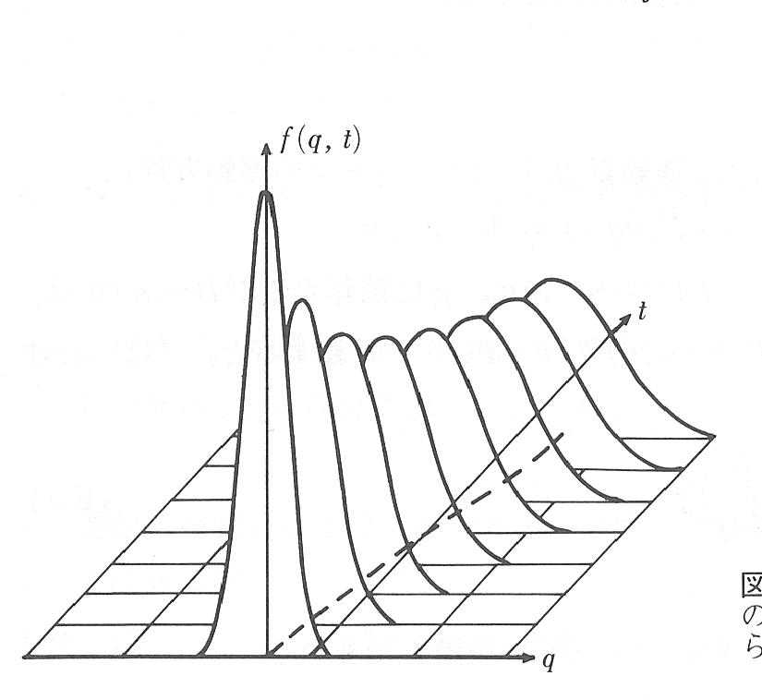
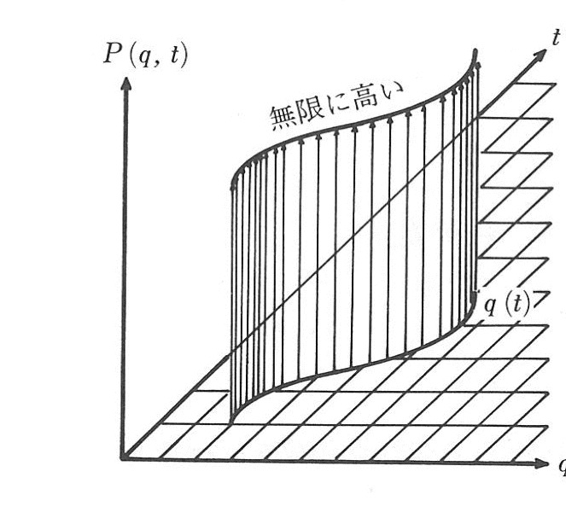
Deterministic and Probable Dynamics

Slide 18
Synergetics
Organization
  All entities are arranged and behave according to a given command.
Self-organization
  All entity are arranged without any commands but throughout mutual-interaction.

Slide 19
Organization
Order-response
If there is not force/command, q=0.
If the force/command is cut off, q=0.
  Damping coefficient γ
  A solution by method of variation of constants

Slide 20
Organization
q expresses a response to F(t) and also depends on forces/commands given formerly.
For organization, taking account on the system which depends on F(t).

Slide 21
Organization
For organization, taking account on the system which depends on F(t).
Condition:
  The time constant of the system (1/γ）must be much smaller than that of the command/force(1/δ).

Slide 22
Organization
Adiabatic approximation(断熱近似)
Because of the difference of the time constants, the system behaves as if it does not change in contrast to the change of forces/commands.

Slide 23
Organization
Multi-entity system

Slide 24
Self-organization
A force/command comes from a part of a system.
Example: two entities interact each other.

Slide 25
Self-organization
Adiabatic approximation

Slide 26
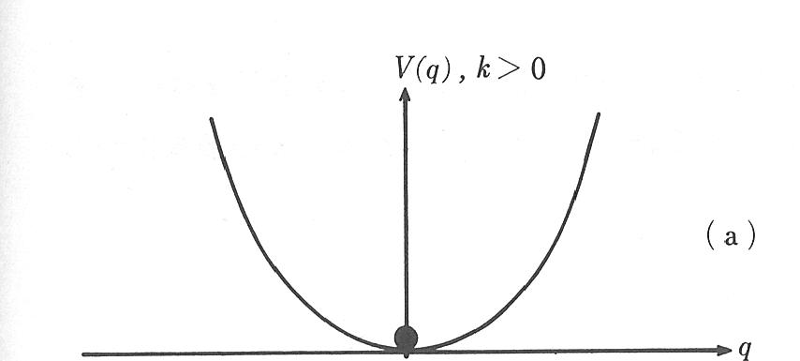
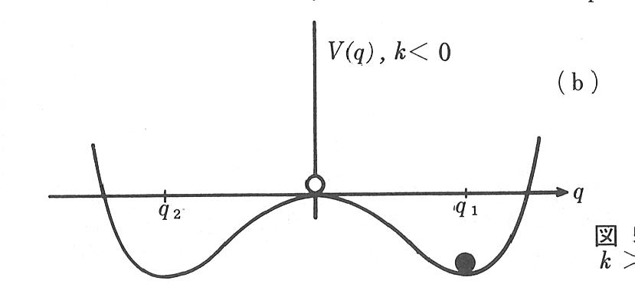
Self-organization
is called as an order parameter.

Slide 27
Self-organization
An stable parameter dominates unstable parameters.
Multi-entities model

Slide 28
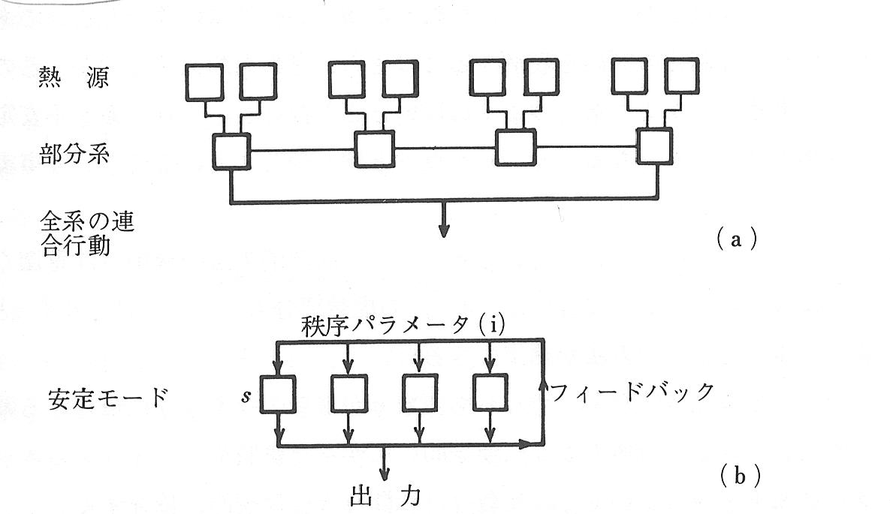
Self-organization
Heat
Each entity
Total output
Order parameters
Stable mode
Feedback loop
Output

Slide 29
Self-organization
The potential field emerges depending on the order parameter. The figure is determined by the internal structure of the system.
The effect of dissipative movement
  Searching global minimum
  Selecting one’s behavior

Slide 30
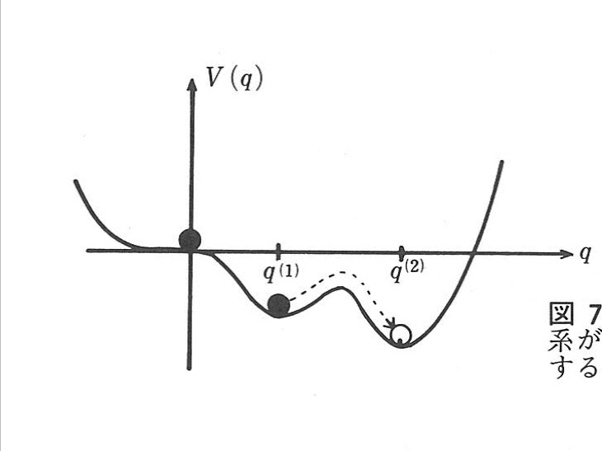
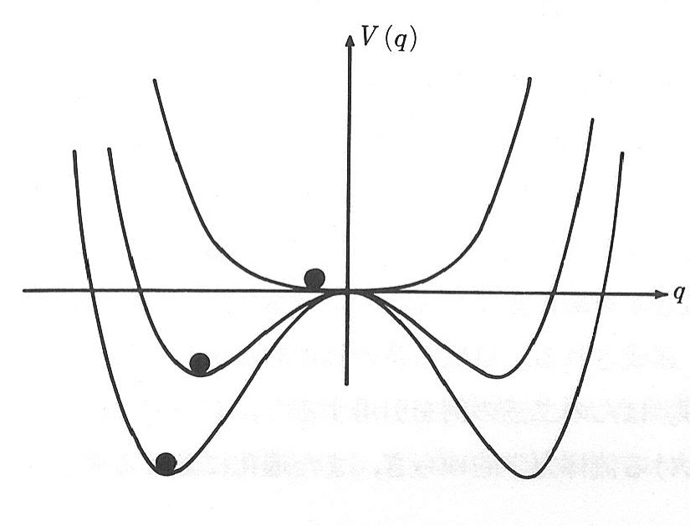
Self-organization
Searching global minimum
Selecting behavior

Slide 31
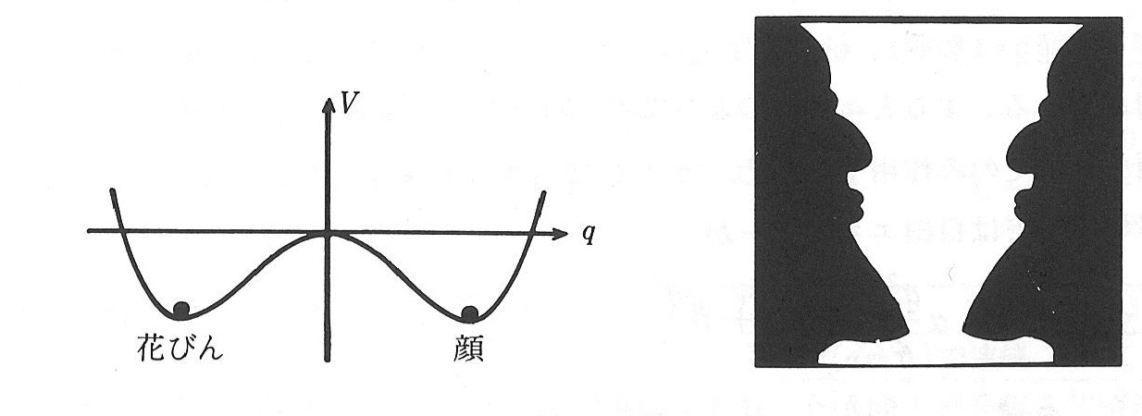
Catastrophe
Vase
Face

Slide 32
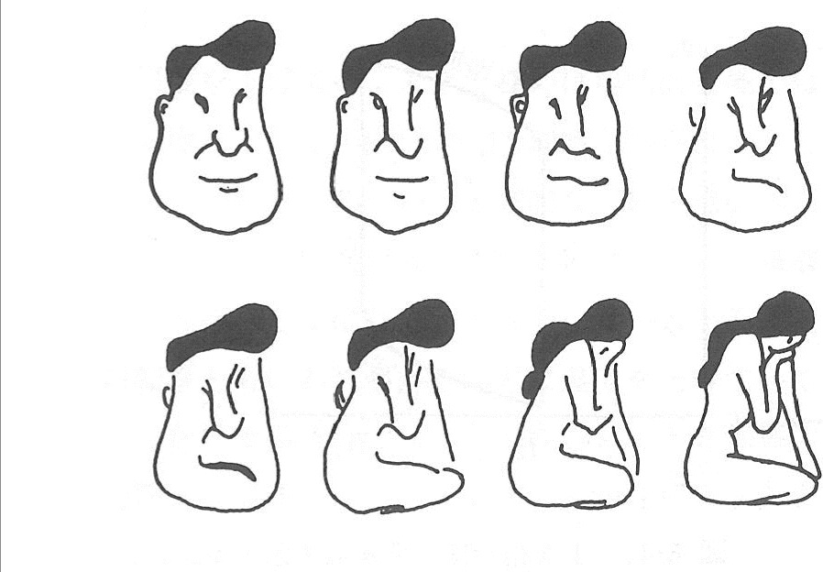
Catastrophe

Slide 33
Dual Dynamics Model

Slide 34
Physarum Plasmodium

Slide 35
Dual Dynamics Model

