Slide 1
Design of Physically Grounded Communication System
実世界コミュニケーション特論
Michita Imai
今井 倫太

Slide 2
Dual Dynamics Model
Model of behavior generation
  Describing the behavior form the viewpoint of the system.
  Causality(因果性): the relation of cause and effect
  Simultaneity(同時性): physical interaction
Synergetics

Slide 3
Dual Dynamics Model
Consider behavior from your viewpoint
  Simultaneity: current body movement or utterance generation of you and others
  Causality: your response to the others’ behavior and the other’s response to your behavior
  The causality is comprehended with an observation after the interaction.

Slide 4
Locality of Interaction
If you see all information in all of the world,
  You can select your behavior based on current state of the world rationally.
In actual real world, you can see only a part of the world.
  There is the locality of a cognition.
  You must generate your behaviors under the partial information.

Slide 5
Simultaneity as A part of the world
Behavior based on partial information indicates that you are a part of dynamics.
  You cannot be separate from others.
  You affects others and others affect you.
Meeting situation
  You regret your remark after the meeting.
  In the meeting, your behavior cannot separate from others.

Slide 6
Causality and Simultaneity
Important to deal wit Causality and Simultaneity
Simultaneity
  Locality of information
  Dynamics between entities
Causality
  Important for prediction in the dynamics
  It cannot comprehend the dynamics completely.
  It is obtained from the past event.
Self-organized behavior emerges from them.

Slide 7
Causality and Simultaneity
Example of meeting
  You annoyed somebody with an utterance.
  Not intending to annoy him.
  Simultaneity of behaviors
After the meeting
  Analyzing the interaction.
  Understanding the causality
  You will make up mind to use the understanding.
  Causality of behaviors

Slide 8
Causality and Simultaneity
Simultaneity
Causality
Causality

Slide 9
Causality and Simultaneity
Simultaneity
Causality
Causality

Slide 10
Causality and Simultaneity
From previous observation of partial information.
Another function may emerge from now.
1, 2, 3, 4, 5, 6, □

Slide 11
Causality and Simultaneity
Many-to-one function
One-to-many function and impossible to describe them

Slide 12
Causality and Simultaneity
From previous observation of partial information.
When we are involved by interaction and divide it into causal relations after the interaction, there are other factor outside the world interpretation by the causal relations.
Another function may emerge from now.

Slide 13
Causality and Simultaneity
Humans prefer causality in spite of simultaneity.
Attributed to a human body.
  Cause and effect
  Recognition by eyes and an effect by a hand
Physarum Plasmodium(粘菌)
  Preferring simultaneity

Slide 14
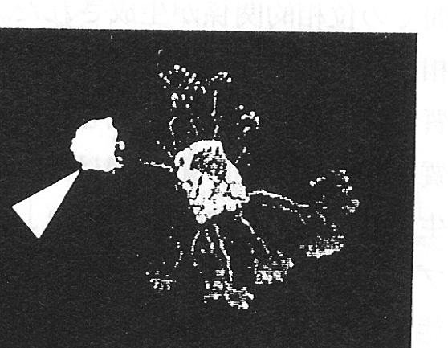
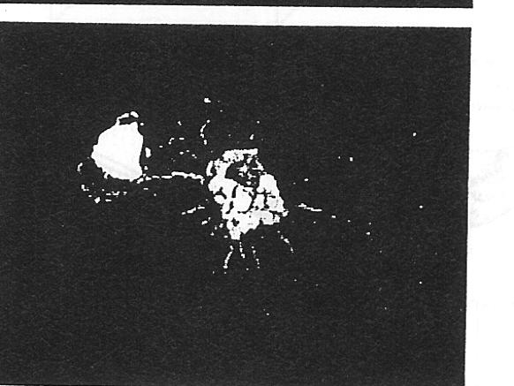
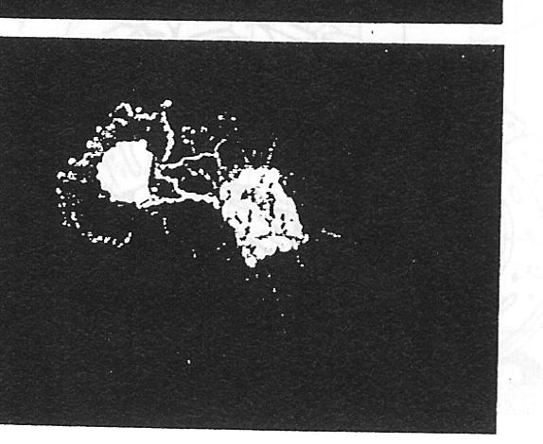
Physarum Plasmodium
Flexible figure to move
No central neural processor
The figure and interaction determine the movement.

Slide 15
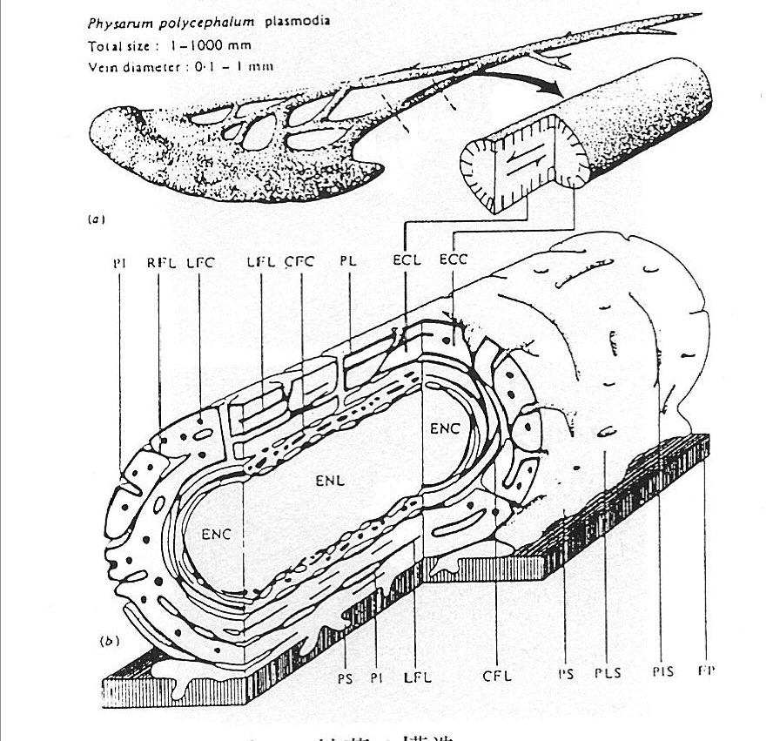
Physarum Plasmodium
Gel and Sol
  Figure made of Gel
  Network of Sol substance
Sol generates coherent movement between cells.
The movement determines the Physarum figure.
The figure affects the sol coherent movement.

Slide 16
Physarum Plasmodium
Simultaneity: the sol coherent movement
Causality: the Physarum figure
  Head and tail
  Moving direction

Slide 17
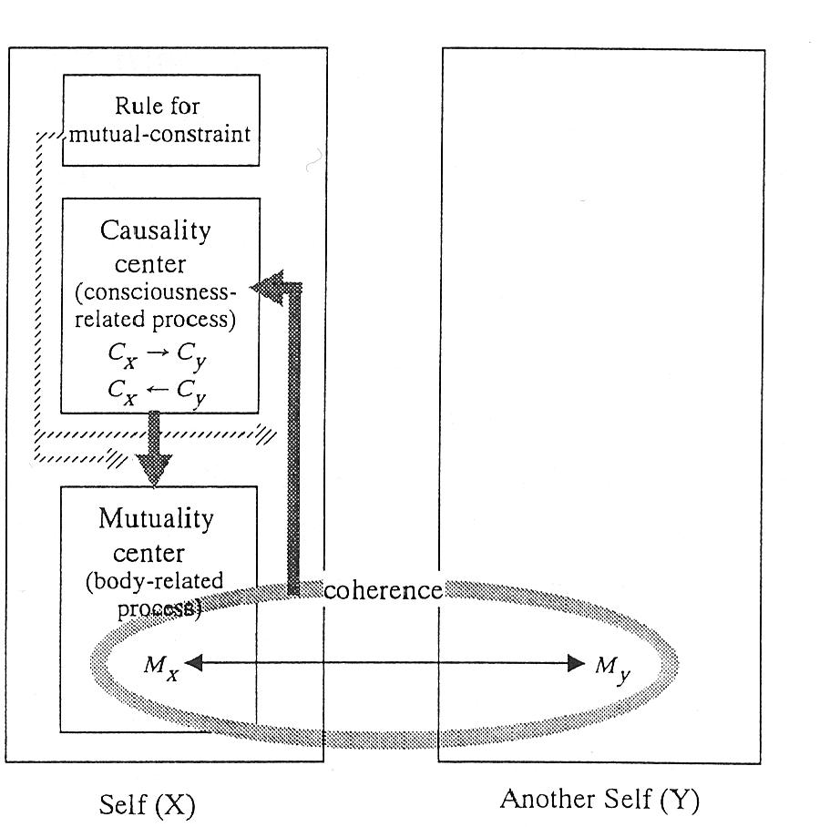
Dual Dynamics Model

Slide 18
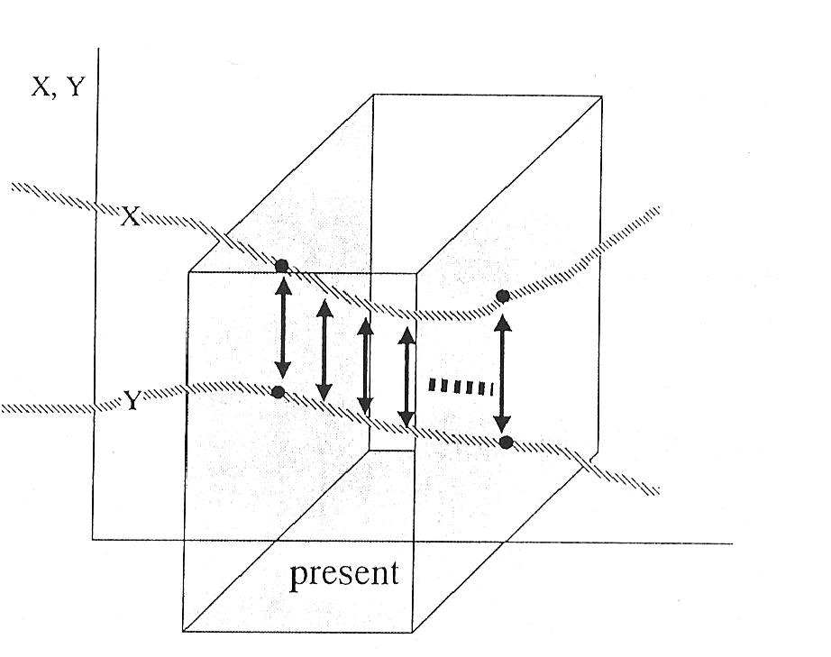
Dual Dynamics Model
Simultaneity

Slide 19
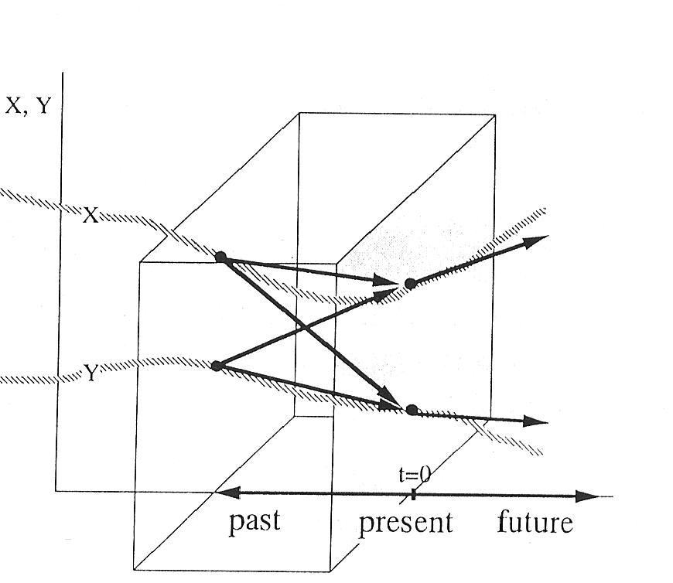
Dual Dynamics Model
Causality

Slide 20
Dual Dynamics Model

Slide 21
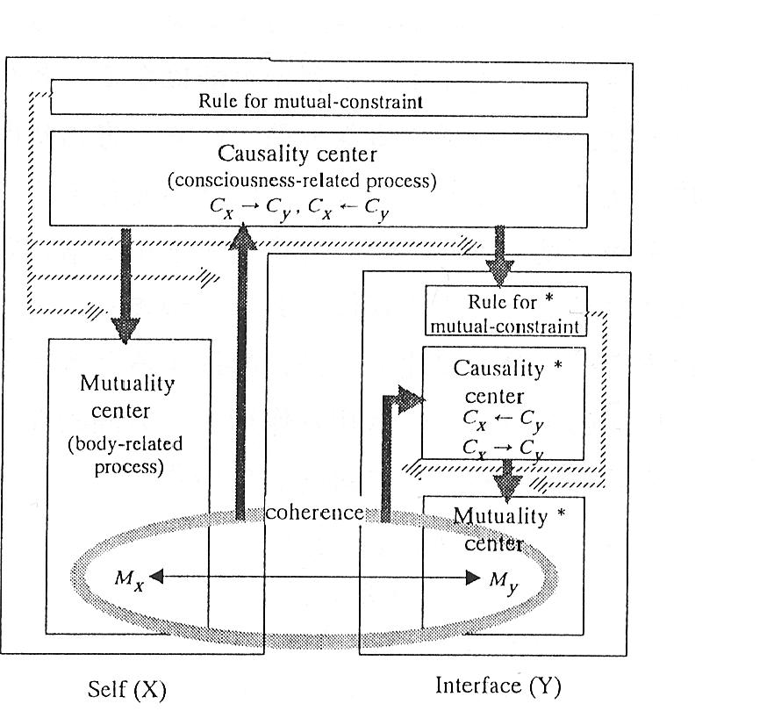
Interface with Dual Dynamics Model

Slide 22
Interface with Dual Dynamics Model
entrainment frequency
(引き込み振動数)
angular speed

Slide 23
Interface with Dual Dynamics Model
To observe causalities: stopping one of entities behavior.
  Adiabatic approximation(断熱近似)<- Synergetics
Causality form X to Y

Slide 24
Interface with Dual Dynamics Model
Causality form X to Y
Causality form Y to X

Slide 25
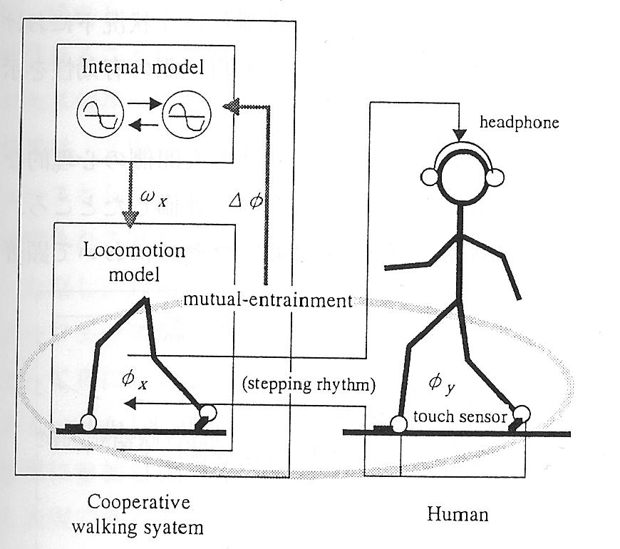
Walking Assistant Robot
Virtual Robot

Slide 26
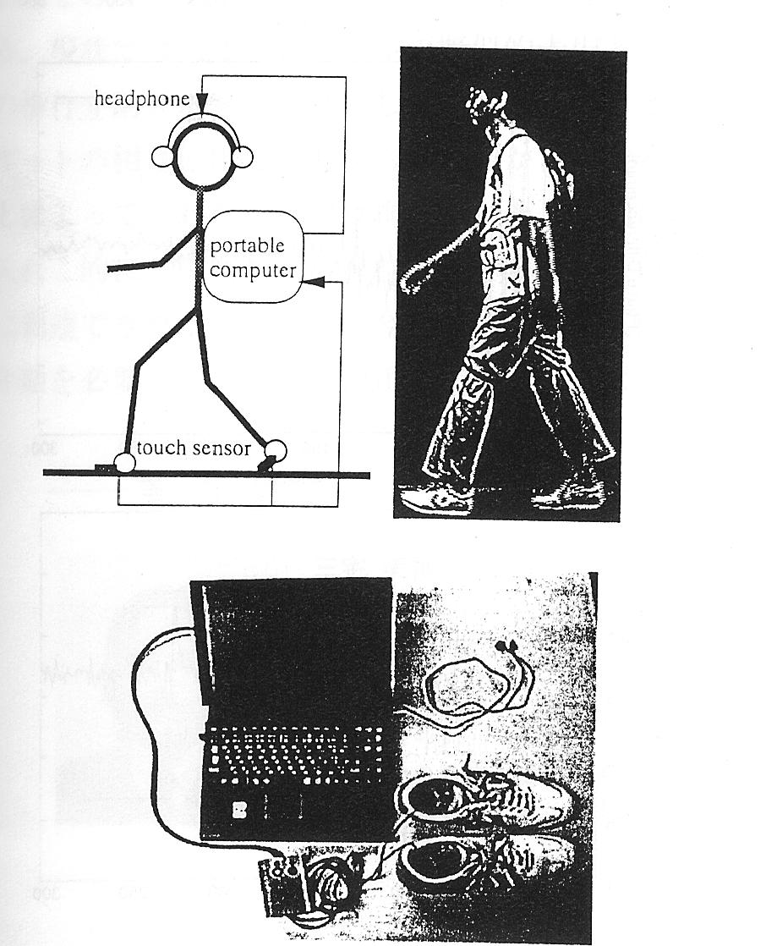
Walking Assistant Robot

Slide 27
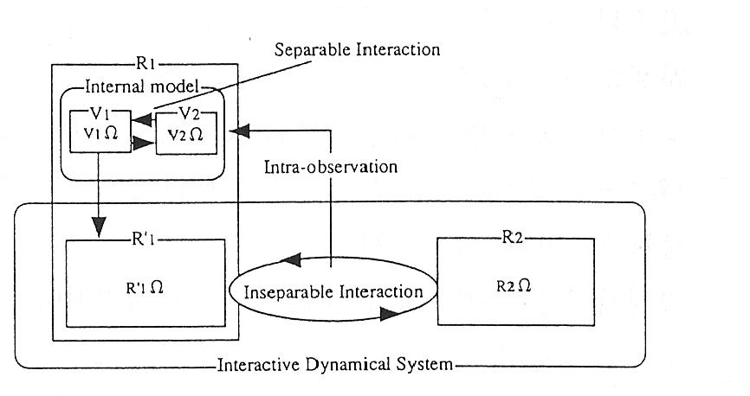
Walking Assistant Robot

Slide 28
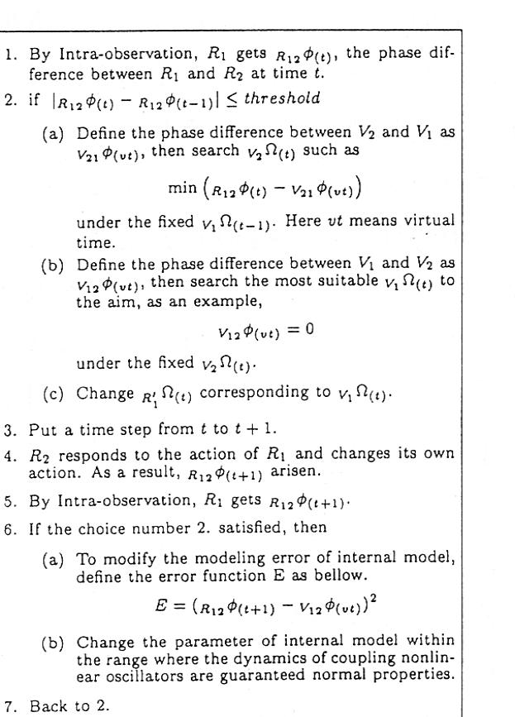
Walking Assistant Robot
Estimating person’s frequency
with Adiabatic approximation
Determining robot’s frequency
with Adiabatic approximation
Change models

Slide 29
Walking Assistant Robot

Slide 30
Walking Assistant Robot

Slide 31
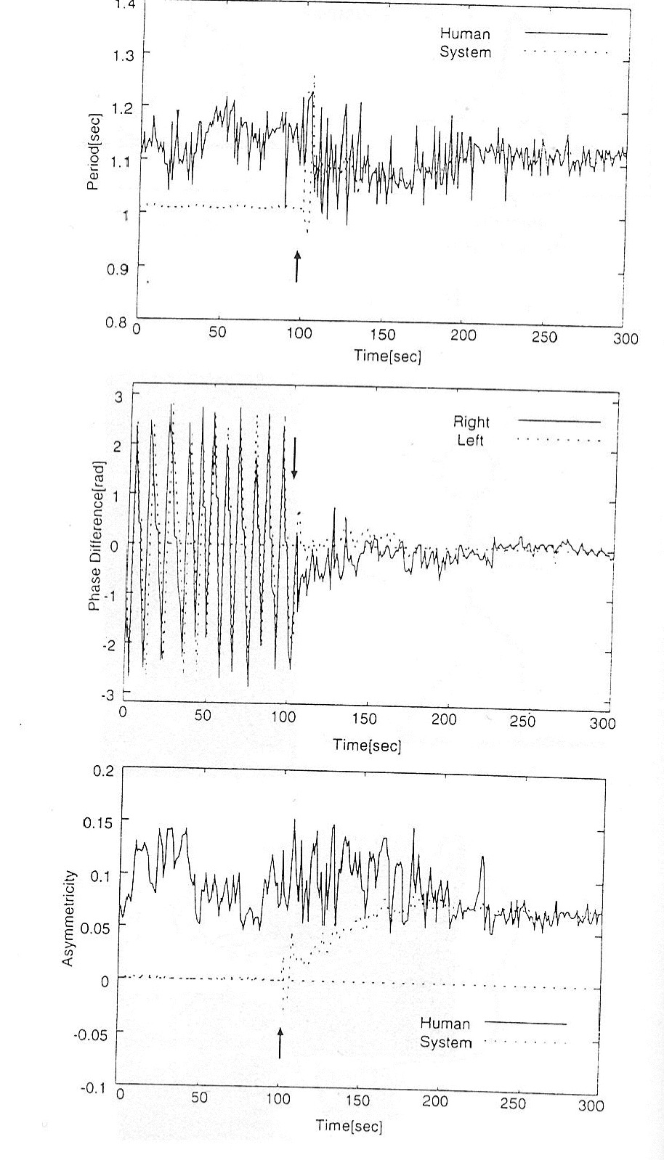
Walking Assistant Robot

