Slide 1
Design of Physically Grounded Communication System
実世界コミュニケーション特論
Michita Imai
今井 倫太

Slide 2
Media Equation
Humans treat a computer as a human.
Psychological experiment
  Byron Reeves and Clifford Nass
Media
  Videos, voices, computer applications, autonomous agents

Slide 3
Media Equation
Human’s social response in a communication
Humans also responds to media/a computer socially.
Social design is also important for human-robot interaction.

Slide 4
Media Equation
Example of Media Equation
Humans consider that actors/actresses in a movie have minds.
  They are images on films.
  They assume a mind on the images.
  Anthropomorphic ability (擬人化能力）

Slide 5
Politeness
Humans interact with a computer politely.
Experiment: the computer admires itself.
Knowledge
Quiz
Answer
Self-admiration

Slide 6
Politeness
Questionnaire
  Are the computer/software’s knowledge useful for you?
A computer asks humans the questions.
Another computer asks humans the questions.

Slide 7
Politeness
Knowledge
Quiz
Answer
Self-admiration
Questionnaire
Questionnaire

Slide 8
Politeness
If a person treat computers socially,
  he/she flatters it and gives good answer.
  he/she tell the other PC the truth about it.
Bad/moderate
evaluation
Questionnaire
Questionnaire
Good evaluation

Slide 9
Politeness
Does the social evaluation actually occur?
  Computers do not have emotion.
  Computers do not have any personalities.
Bad/moderate
evaluation
Questionnaire
Questionnaire
Good evaluation

Slide 10
Experiment
Test subjects (被験者) are given 20 sorts of knowledge about today’s American affairs.
  30 % of 10 years old American kiss at the first date.
They select a response to it.
  “I know it well.”“I almost know it.”“I do not know it.”
The computer gives bets of knowledge about it depending on the response.(Actually, the same response)

Slide 11
Experiment
The computer gives quizzes to him/her.
It tells which is right and which is wrong.
It admire itself.
  “I think that I’ve done best jobs.”

Slide 12
Experiment
Evaluation with adjective
  Correct, analytical, useful, fair, friendly, considerable
Evaluation
Questionnaire
Questionnaire
Evaluation

Slide 13
Experiment
Humans’ social response
Bad/moderate
evaluation
Questionnaire
Questionnaire
Good evaluation

Slide 14
Specialist
There are many social factor in Media Equation.
Specialist: significant factor for human robot interaction

Slide 15
Specialist
What is a specialist?
  He/she has proper knowledge.
  He/she can make an appropriate comments on his/her field.

Slide 16
Specialist
How does people identify the specialist?
  Label
  They do not confirm the label.
It is easy to interact with others referring the label.
The confirmation requires much more cost than the interaction.

Slide 17

Specialist for Media
Label for Media
News & Entertainment TV
News TV
Entertainment TV

Slide 18
Specialist for Media
Experiment: same contents
News & Entertainment TV
News TV
Entertainment TV

Slide 19
Specialist for Media
Evaluation
  News: quality of NEWS, appropriateness, significance, usefulness, enjoyment, seriousness
  Entertainment: quality, appropriateness, enjoyment, degree of relaxation

Slide 20
Specialist for Media
Test subjects regarded NEWS on News TV as more reliable.
They regarded entertainment contents on Entertainment TV as higher quality.
News & Entertainment TV
News TV
Entertainment TV

Slide 21
Specialist for Media
Factor of the label
If the subjects are asked the factor of the contents’ reliablility directly, they would not select the label factor.
News & Entertainment TV
News TV
Entertainment TV

Slide 22
Social Interaction
What a person identifies for Media has a significant effect on interaction with it.
Social relationship between a person and a machine

Slide 23
Social Interaction for a computer system
Capping game software (しりとりソフト）
  A person input a word to it.
  It outputs a word which starts the last Japanese character of the input word.
  It treats only noun.
  It rejects a word which finishes Japanese character N.

Slide 24
Social Interaction for a computer system
24 test subjects (SFC students)
Experimental condition
  H: “You play the network capping game with a person.”
  C: “You play the software.”
  E: “This is an experiment.”
  N: “This is just a game.”
HE,CE,HN,CN

Slide 25
Social Interaction for a computer system
Results:
E
60min.
N
H
C

Slide 26
Social Interaction for a computer system
HN and CN used the same software.
Persons’ identification of the software (a human or software) affects the interaction.
Significance of social relationship

Slide 27
Social Interaction for a robot
Difficulty of social interaction with a robot.
Psychological experiments

Slide 28
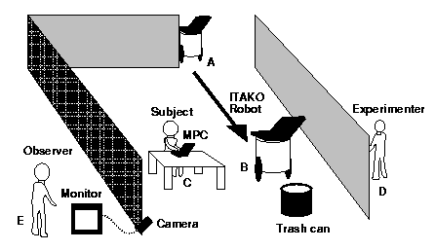
Social Interaction for a robot
Difficulty of social interaction with a robot.
Psychological experiments

Slide 29
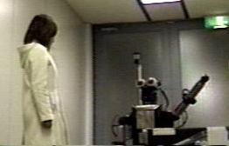
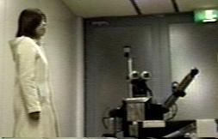
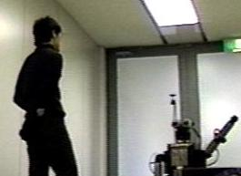
Social Interaction for a robot
Difficulty of social interaction with a robot.
Psychological experiments

Slide 30
Social Interaction for a robot
Experimental results
  Computers can interact with humans
  Humans behave socially toward the computers.
  Robot must starts to establish relationship for interaction.

Slide 31
Social Interaction for a robot
Embodied interaction
  Eye-contact and gestures
  Dual dynamics model
  Gesture synchronization

