Slide 1
Design of Physically Grounded Communication System
実世界指向コミュニケーション特論
Michita Imai
今井 倫太

Slide 2
1.1 Topics
Systems dealing with real world interaction
Communication mechanisms from person’s viewpoint
  Psychological aspect
How to develop a system dealing the psychological aspect of the interaction or dynamics of human-machine interaction
  Computation model and strategy

Slide 3
1.2 Target of This Lecture
For designing a system interacting with people
  Communication Robot
  Intelligent Room
  Multimodal-Interface
  All intelligent human-interface

Slide 4
1.3 Contents of Lecture
Design of Communication System
Recognition
Selection
Action
Design
System
Control Theory(制御理論）

Slide 5
1.3 Contents of Lecture
Design of Communication System
System Structure
・Vertical System
・Horizontal System
Recognition
Selection
Action
Design
Contents (human-factor)
・Sociality of System (社会性)
・Joint Attention (共同注意)
・Theory of Mind (心の理論)
Effect of Contents
・Ecological Approach
(生態学的アプローチ)
System
Control Theory(制御理論）

Slide 6
1.3 Contents of Lecture
Vertical System: Systems in virtual world:
  SHRDLU
Horizontal System:
  Subsumption Architecture for Robustness of Robot
  Systems dealing with real world interaction
Jointa Attention:
  Multi-modal Interface, Attention Mechanism, Joint Attention on Communication Robots
Theory of Mind Model
Sociality of System:
  Infant Robot and Social Agent
Ecological Approach

Slide 7
Evaluation
Two reports
  Communication Robot (May)
  Design of Real World System II (July)

Slide 8
Web site
http://www.ayu.ics.keio.ac.jp/~michita/realworld2006

Slide 9
1.4 Feature of Real World
Events occur regardless of systems’ behaviors
  Predictable event vs. Unpredictable event
Unpredictability of human’s behavior
  Difficulty to make model
    Difference among individuals
  Effect of psychological state
  Absence of attention toward system

Slide 10
1.5 Contrast between Real World and Virtual World
Real world
  Infinite numbers of entities exist regardless of systems.
  Uncertainty: someone or something may induce an event anytime.
Virtual world
  Entities are given when developing a system.
  Almost events are predictable.
  Only user’s behavior is unpredictable.

Slide 11
1.6 Example Problems of Real World
Fault in planned actions
Insect behavior for dynamic world
Reference to an object in a conversation
Mind-reading in a conversation
The effect of Sociality
Immersion (没入) in interaction
Difficulty to deal with physical objects
Ecological Approach

Slide 12
1.6.1 Example Problems of Real World
Fault in planned actions
  Planner software generates a sequence toward a goal state prior to the execution.
  Generated plan cannot be used under dynamic world.
  Planner is used to generate intermediate plan.

Slide 13
1.6. 2 Example Problems of Real World
Insect behavior such as ants
  Vast behaviors are selected in response to environmental events.
  Easy to adapt to dynamic environment
  Swarm intelligence (群知能）emerges.
  It cannot select actions intentionally.
  Model based control mechanism required to enable the intelligence to behave intentionally.
  Intentional behavior is important for communication.

Slide 14
1.6. 3 Example Problems of Real World
Reference can be achieved under cooperation between a speaker and a hearer.
Person’s attention
Joint attention
Difficult for the system to identify targets.

Slide 15
1.6. 4 Example Problems of Real World
Mind-reading in communication
Human’s action and utterance include hidden intention to take the action or to give the utterance.
Human does not always read other’s mind.
What trigger these phenomena?

Slide 16
1.6.5 Example Problems of Real World
Sociality must be also considered to develop an interactive system.
How to give a robot social appearance?

Slide 17
1.6.6 Example Problems of Real World
Immersion in interaction
  Mind-reading
  Joint Attention
What factor makes a person immerse him/herself in interaction?

Slide 18
1.6.7 Example Problems of Real World
The state of physical object is obscure from system’s viewpoint.
  Ownership of objects
    Easy to identify ownership of files in a computer system
    Difficult to identify it in real world
  Person’s intention toward objects

Slide 19
1.6.8 Example Problems of Real World
Ecological Approach
  When you drive a car backward,
  Relationship between movement and recognition
No formal way to implement the approach

Slide 20
1.6.9 Example Problems of Real World
The some of the problems are not solved.
They are important for the design of the system in real world.

Slide 21
2 Intelligent system in virtual world
System dealing with toy world
  Extension of thought experiment
  Static world
  Lack of effect of time
  Sufficient to solve a problem logically
  Interaction depends on discrete turn-taking.
  It cannot deal with dynamic changes.

Slide 22
2 Vertical System
R. Brooks named it.
Each module is executed in response to the execution results of former module.
The output is determined through all modules.

Slide 23
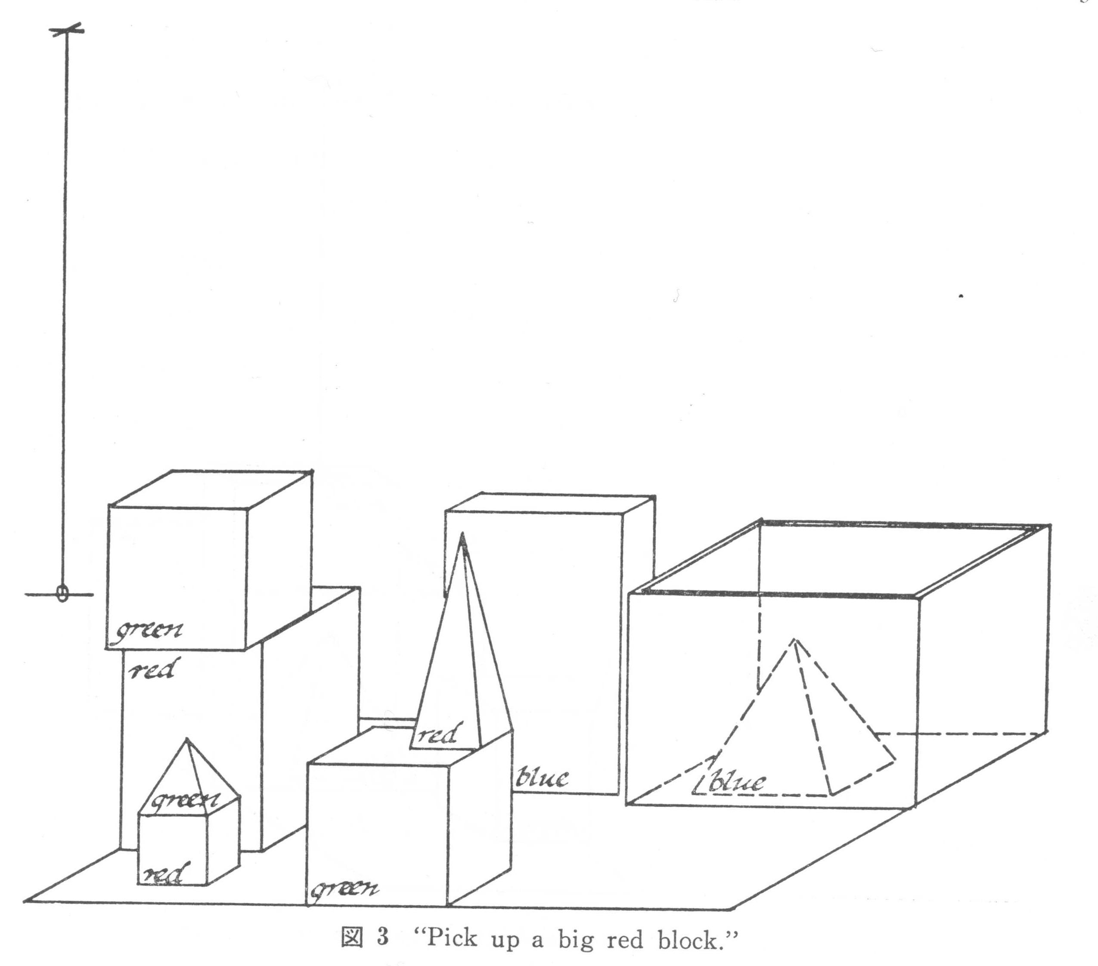
2.1 SHRDLU
1968, T. Winograd developed it.
Dialogue system on a virtual world (block world)

Slide 24
2.2 Overview of SHRDLU
Subroutine call
Monitor
Answer
Input
Grammar
Semantics
Mover
Blocks
Semantic
features
Data
Programmar
Dictionary
Planner

Slide 25
2.2 Overview of SHRDLU
Monitor
  Main routine which calls main routines: Input, Grammar, Semantics, and Answer.
Monitor
Input
Answer
Grammar
Semantics
Mover
Blocks
Programmar
Semantic
features
Data
Dictionary
Planner

Slide 26
2.2 Overview of SHRDLU
Input
  This routine obtains text string typed in English and carries out morphological analysis.
    running -> run + ing
Monitor
Input
Answer
Grammar
Semantics
Mover
Blocks
Programmar
Semantic
features
Data
Dictionary
Planner

Slide 27
2.2 Overview of SHRDLU
Grammar
  This routine analyzes the input texts with grammatical information and generates a parse tree.
Monitor
Input
Answer
Grammar
Semantics
Mover
Blocks
Programmar
Semantic
features
Data
Dictionary
Planner

Slide 28
2.2 Overview of SHRDLU
Semantics
  This routine interprets the input texts cooperating with Grammar and infers an appropriate meaning with Planner.
Monitor
Input
Answer
Grammar
Semantics
Mover
Blocks
Programmar
Semantic
features
Data
Dictionary
Planner

Slide 29
2.2 Overview of SHRDLU
Answer
  This routine controls the responses of SHRDLU by generating a natural language expression and storing conversation contexts.
Monitor
Input
Answer
Grammar
Semantics
Mover
Blocks
Programmar
Semantic
features
Data
Dictionary
Planner

Slide 30
2.2 Overview of SHRDLU
Programmar
  This routine is a set of parser programs executed by Grammar. The programs produce a parse tree.
Monitor
Input
Answer
Grammar
Semantics
Mover
Blocks
Programmar
Semantic
features
Data
Dictionary
Planner

Slide 31
2.2 Overview of SHRDLU
Dictionary
  This routine has the definitions of words used by Input, Grammar, and Semantics.
Monitor
Input
Answer
Grammar
Semantics
Mover
Blocks
Programmar
Semantic
features
Data
Dictionary
Planner

Slide 32
2.2 Overview of SHRDLU
Semantics features
  This routine has the feature lists of the block world. The features are used to categorize items in the block world and the action of the robot. Ex. Preposition “in”
  -how many blocks
  are in the box?
  -The red block in
  the tall stack
Monitor
Input
Answer
Grammar
Semantics
Mover
Blocks
Programmar
Semantic
features
Data
Dictionary
Planner

Slide 33
2.2 Overview of SHRDLU
Blocks
  This routine is the knowledge of the block world. Physical constraints.
Monitor
Input
Answer
Grammar
Semantics
Mover
Blocks
Programmar
Semantic
features
Data
Dictionary
Planner

Slide 34
2.2 Overview of SHRDLU
Mover
  This routine shows the block world and the robot on a computer display.
Monitor
Input
Answer
Grammar
Semantics
Mover
Blocks
Programmar
Semantic
features
Data
Dictionary
Planner

Slide 35
2.2 Overview of SHRDLU
Planner
  This routine infers relations between the items in the block world to generate information for parsing texts and to confirm the statement of the text.
Monitor
Input
Answer
Grammar
Semantics
Mover
Blocks
Programmar
Semantic
features
Data
Dictionary
Planner

Slide 36
2.2 Overview of SHRDLU
Data
  This routine keeps information about a current state of the world.
Monitor
Input
Answer
Grammar
Semantics
Mover
Blocks
Programmar
Semantic
features
Data
Dictionary
Planner

Slide 37
2.2 Overview of SHRDLU
Current situation: Knowledge of the world.
Context : Knowledge of the conversation
Grammar: Lexical Knowledge
Semantics: Knowledge of physical constraints

Slide 38
2.2 Overview of SHRDLU
Recognition skills of the robot
  It is able to identify the size, figure, color, and position of the items in the block world.
  The feature of the virtual world: it is easy for a system to obtain the information in the virtual world.

Slide 39
2.5 Example with Current Situation
pick up a big red block.
  OK
B4
B7
B6
B3
B8
B2
B1
B5

Slide 40
2.5 Example with Block world knowledge
find a block which is taller than the one you are holding and put it into the box.
  But “IT,” I ASSUME YOU MEAN THE BLOCK WHICH IS TALLER THAN THE ONE I AM HOLDING. OK

Slide 41
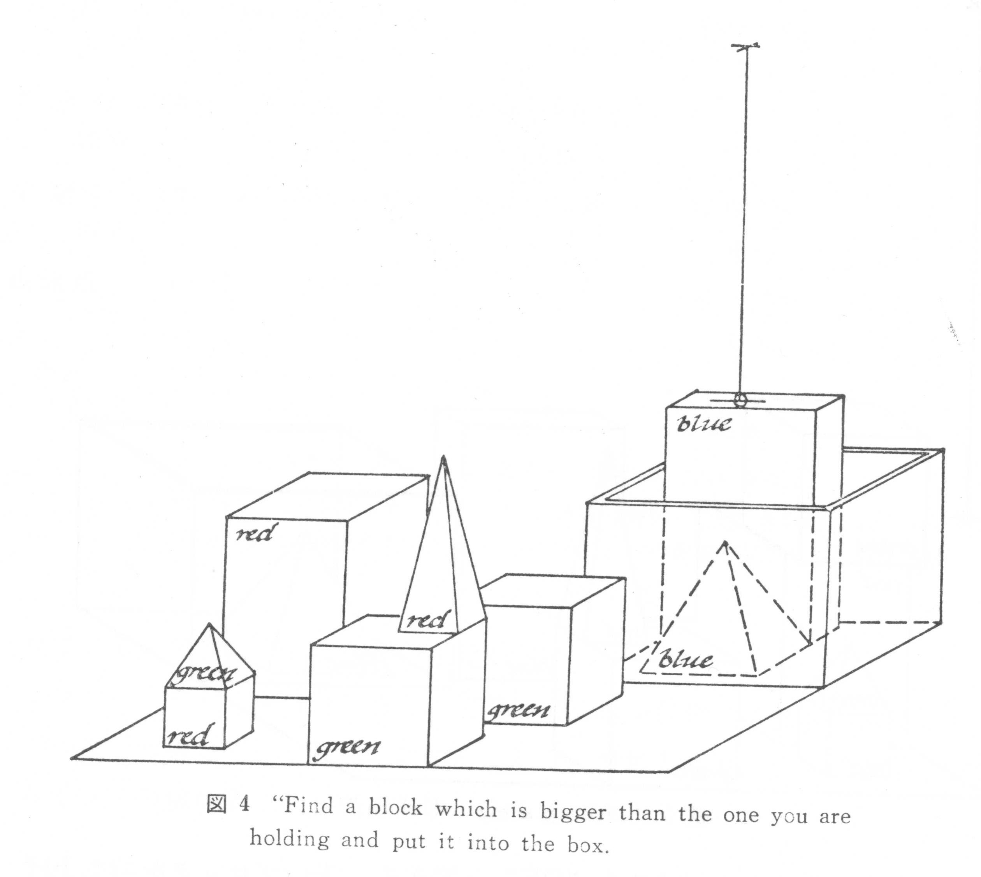
2.5 Example with Current Situation
find a block which is taller than the one you are holding and put it into the box.
  But “IT,” I ASSUME YOU MEAN THE BLOCK WHICH IS TALLER THAN THE ONE I AM HOLDING. OK

Slide 42
2.5 Example with Context
What does the box contains?
  THE BLUE PYRAMID AND THE BLUE BLOCK.
What is the pyramid supported by?
  THE BOX

Slide 43
2.5 Example with Lexical knowledge
How many blocks are not in the box?
  FOUR OF THEM.
Is at least one of them narrower than the one which I told you to pick up?
  YES, THE RED CUBE

Slide 44
2.5 Example with Knowledge of Physical Constraints
Can the table pick up blocks?
  NO
Can a pyramid be supported by a block?
  YES

Slide 45
2.6 Toward real world application
There are vast (infinite) numbers of items or events in the real world.
A part of them relates to the meaning of conversation. All items are not used.
The items are already selected in the virtual world.
A system must selects the items related to communication or interaction in real world.

Slide 46
Intelligent Robot

Slide 47
Ecological Approach

