Slide 1
Personal Robotics Workspace
Mahisorn Wongphati
PhD Student
Anzai-Imai Lab, Keio University
Notes:
Prof Manuela Veloso Prof Brian Scassellati Prof Ted Conway Prof Patricia Foland

Slide 2
Theme
A robotics workspace in home/office setting
Interact with single or small group of people
Close, proximate interaction
Has an interactive interface

Slide 3
System Ideas
A workspace with robotics arm
A workspace with sensors that can detect both human and robot movement
A workspace with interactive interfaces
Hardware
Software

Slide 4
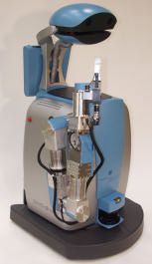
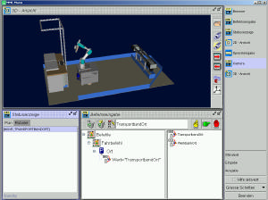
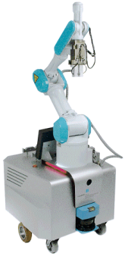
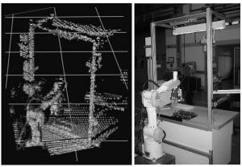
Anthropomorphic Robot Assistants – Giving the Human a Helping Hand
Notes:
2002

Slide 5
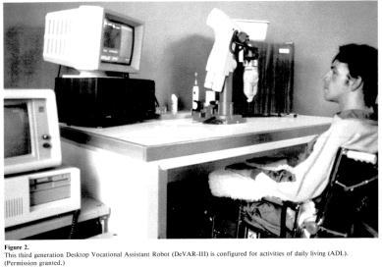
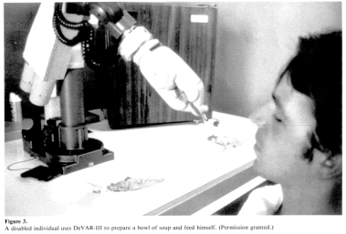
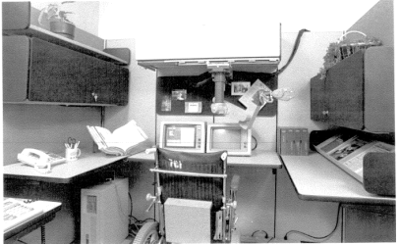
Clinical evaluation of a desktop robotic assistant
Notes:
1989

Slide 6
Research Question
What kind of help that people need in product assembly task?
Indicator
Timing
How to sense/detect user intension during the assembly task?
Can we create “it knows what I think” interaction in specific situation?
Notes:
Mostly predefine

Slide 7
Indicator
When will user need help?
We will focus on nonverbal movement
Body movement
Hand movement
Face movement
Eye movement

Slide 8
Timing
From specific movements to a point that user needs help
An acceptable delay for helper hands

Slide 9
How to sense/detect intension?
A combination of Indicator and Timing
Pattern and rules for interaction prediction
Additional tools
Artificial gesture
User gives system a specific gesture for particular task
Interactive user interface
Overlay projector
Touch table

Slide 10
“It knows what I think”
Can we predict the need of help using all available sensors and information?
Product assembly guide line
Indicator and Timing

